Slide 1
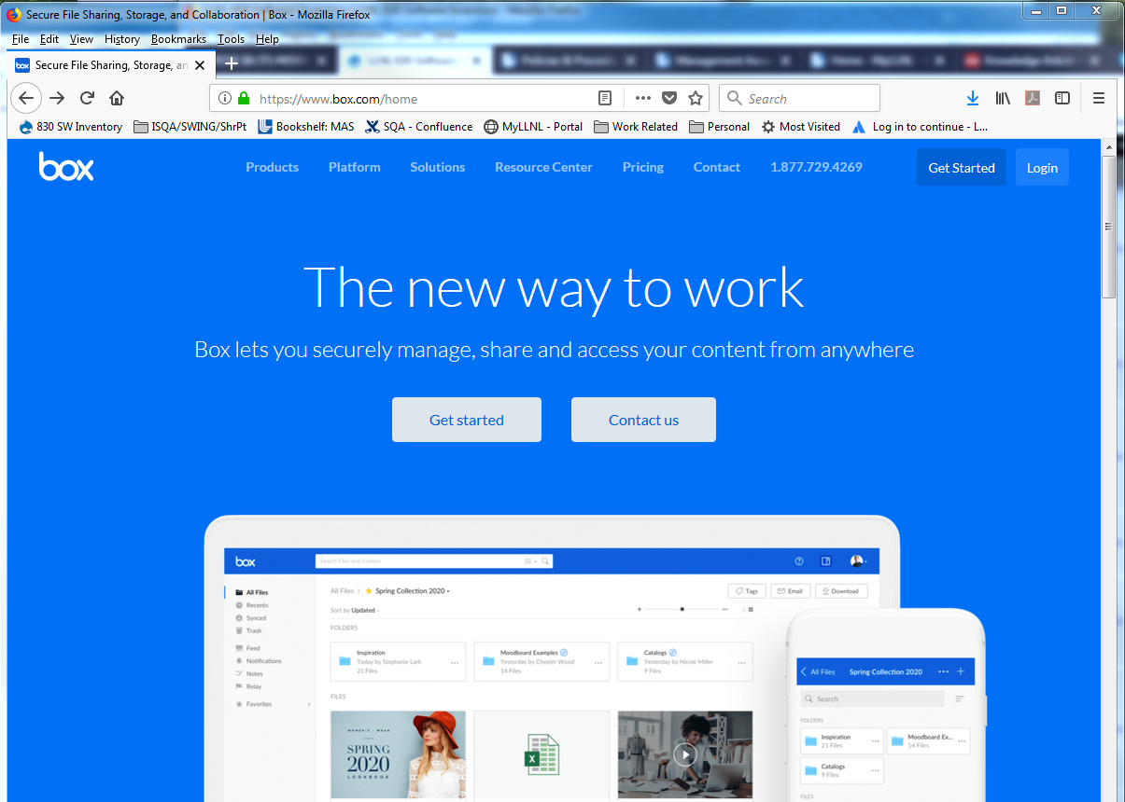
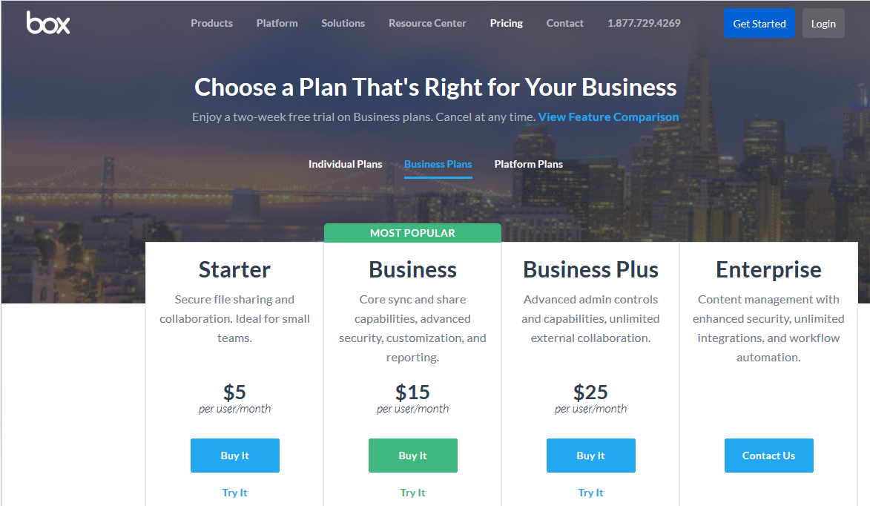
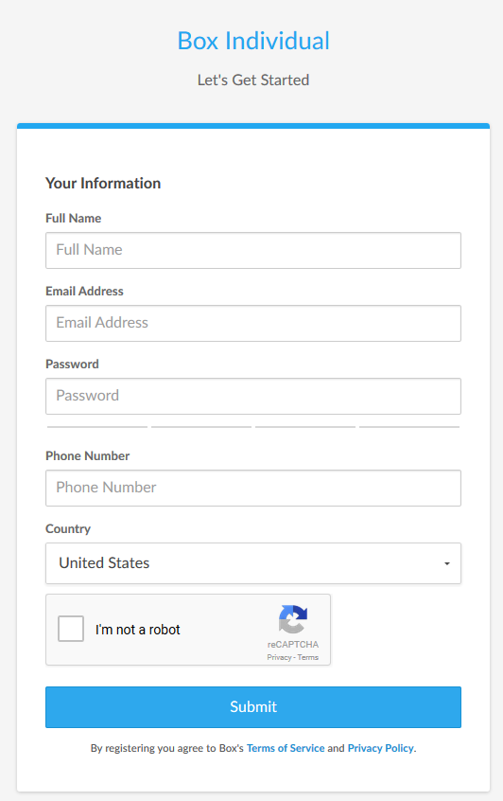
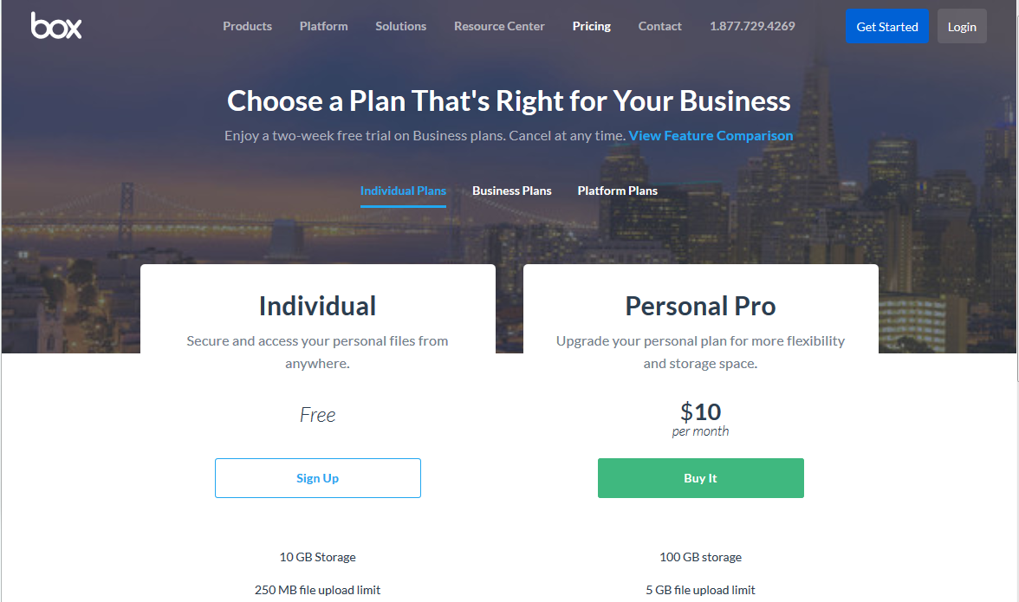
Create your BOX account in 6 Steps
1
1
Go to URL: https://www.box.com/home
Click on the “Get Started” button
Select “Individual Plans”
2
3
5
Complete the form
Send your user ID/email to:
cschultz@anl.gov *
4
6
* You may need to ask your IT group to grant you special access through
your site’s firewall to Box

Slide 2
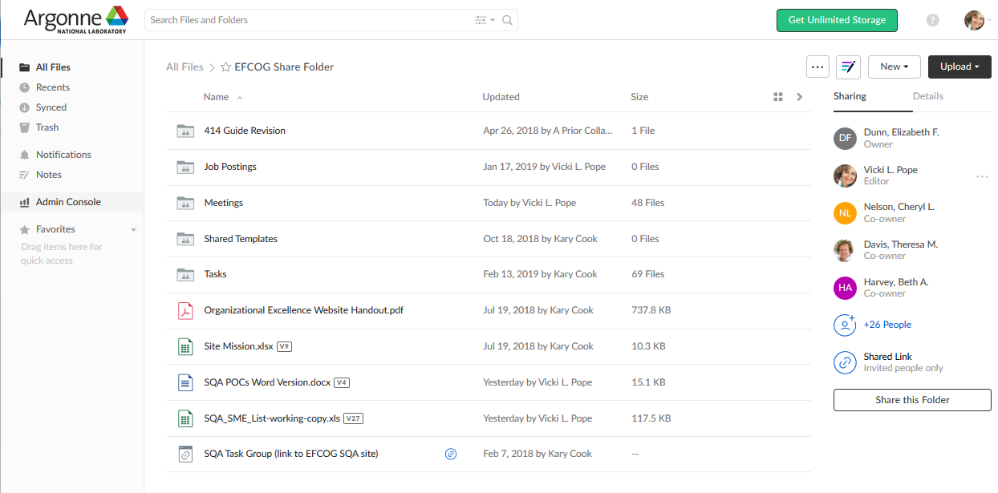
Click on the EFCOG Share Folder once you’ve logged in (box.com)
New Folders
SQA POC Listing
Links
Job Postings (LLNL)
Spring 2019
Draft Agenda
Word Version
Updates Needed
Add phone numbers
sqa Box Account Main page
2

