Slide 1
Covid 19: Lessons Learned / return to work
Honeywell Real Estate & Facilities
VP; James O’reilly

Slide 2
Global Honeywell RE Portfolio at a Glance
871
SITES
51.4M
SF
75+
COUNTRIES

Slide 3
Increased cleaning of high touch areas
Providing hand sanitizer and cleaning supplies throughout the facilities
Requiring face coverings when moving throughout the facilities or meeting face-to-face
Established engineering and administrative protocols to practice social distancing
Defined process for break/lunch times to ensure social distancing and enable
general cleaning
Shared training, resources and tips on mental health and well-being

Slide 4
Enabled expanded telecommuting
Daily temperature screenings for anyone entering a facility
Restricted site visits and business travel
Implemented signage and barriers to enforce one-way travel, social distancing and room capacity
Implemented procedures for suspected or confirmed COVID-19 cases
Providing personal protective
equipment

Slide 5
Facility & Ops Readiness – EMEA example
Personal hygiene is of utmost importance and must be continued post reopening the offices and facilities by all staff and visitors.
Display the following personal hygiene standards in prominent areas in the office/ facility including the washroom areas/ pantry/ cafeteria.
Wash Hands Frequently: use soap and water (min. 20 seconds) and use an alcohol-based hand sanitizer.
Practice Respiratory Hygiene: when coughing or sneezing cover your mouth and nose with a tissue or flexed elbow. Discard the tissue in a closed bin and clean your hands.
Maintain Social Distance: maintain at least 1.5-metre distance between you and others who are coughing, sneezing or have fever. Following local government advice on the recommend social distance as it can differ by country and whether inside a building or outside in public areas.
Avoid Touching Eyes, Nose & Mouth: if you touch a contaminated surface this could transfer the virus from the surface to your hands.
Fever/ Cough/ Difficulty Breathing: If you have these symptoms see a Doctor. Inform your line manager / HR / QHSE.

Slide 6
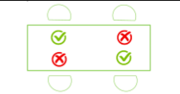
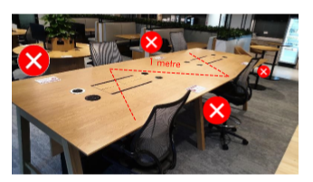
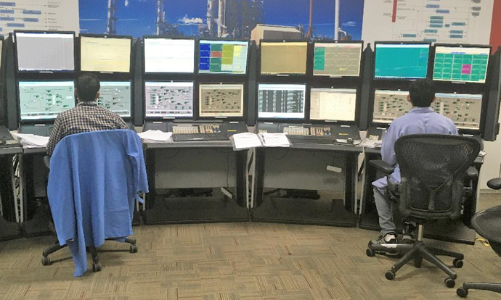
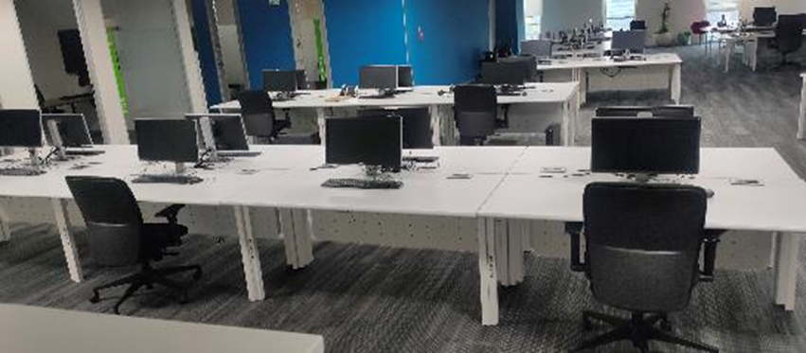
Social Distancing – EMEA Example
Office Space
When initially returning to the workplace we will introduce social distancing measures, with the aim to reduce physical contact and prevent transmission of COVID 19, should a case occur in the workplace.
Reduce the number of seats/ desks and meeting rooms to allow for social distance of at least 1.5 meters
Maintain social distancing in offices, production sites and labs - Sitting one seat away from each other in office spaces and meeting rooms – See Space Plan Examples on next slides
Consider suspending hot seating for fixed desk arrangements
Encourage employees to continue to WFH, wherever possible

Slide 7
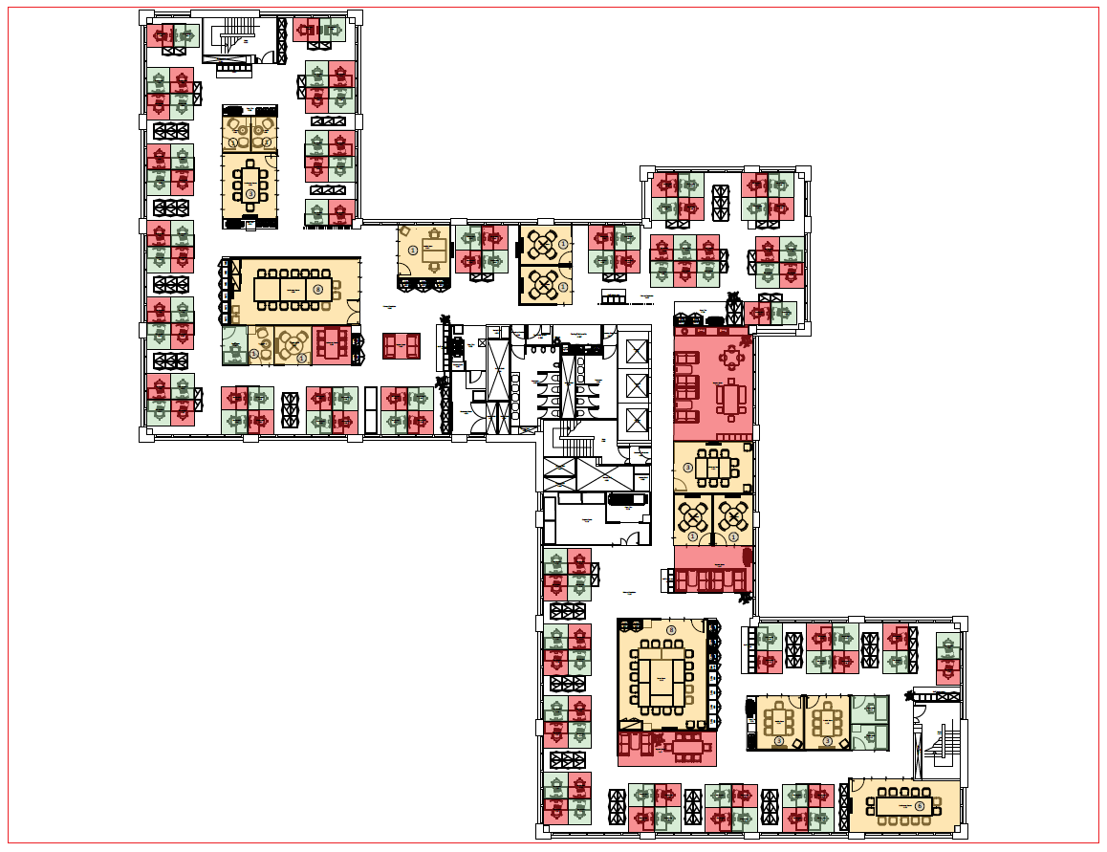
Return to work – EMEA Example
Space Type | Original Capacity | Covid 19 Capacity
Desk | 96 | 59
Meeting Room | 84 | 46
Do Not Use
Reduced Capacity
Available
Capacity Reduce by 38%

Slide 8
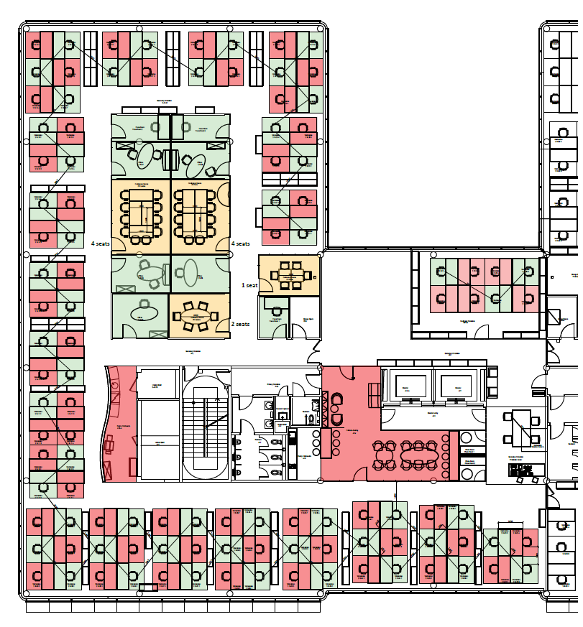
Return to work – emea example
Space Type | Original Capacity | Covid 19 Capacity
Desk | 111 | 56
Meeting Room | 35 | 14
Do Not Use
Reduced Capacity
Available
Capacity Reduce by 49%

Slide 9
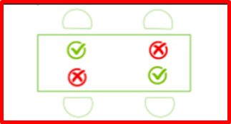
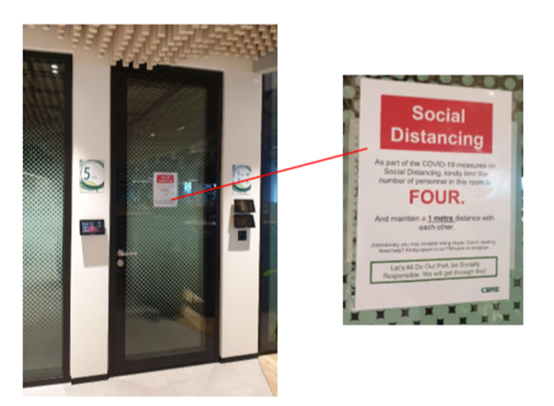
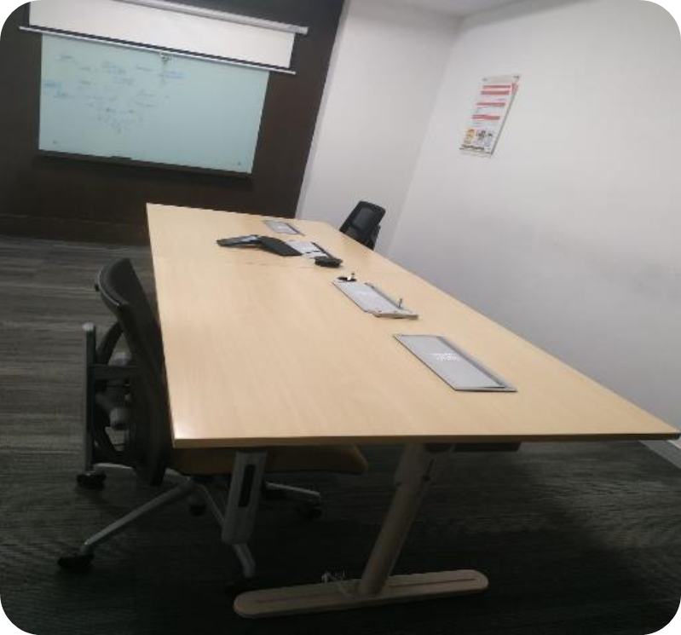
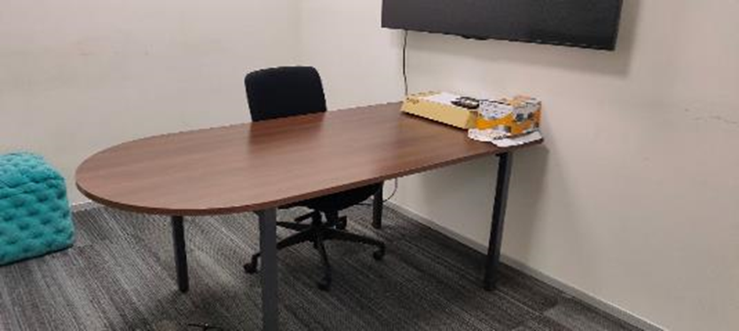
Meeting rooms – EMEA Example
Meeting Rooms
Social distancing can be achieved by reducing the number of chairs and capacity.
Update posters and / or meeting room booking systems to indicate the new room capacity

Slide 10
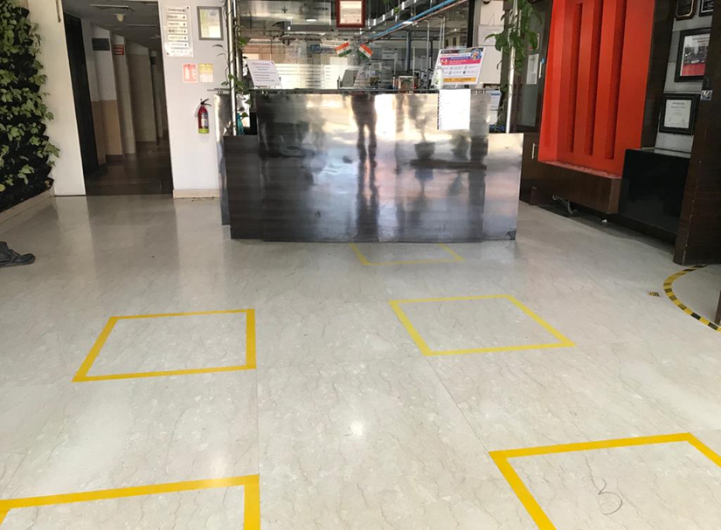
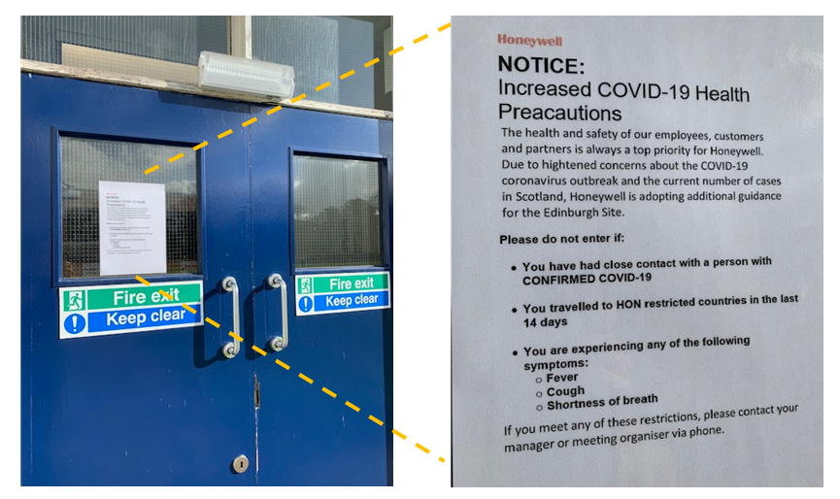
Reception & visitors – EMEA Example
No Visitors policy – place signage on all entrance doors
Social distancing markers at the Reception, goods in and other entrances – place markers on floor at regulatory distance
Continue frequent cleaning and disinfectant of high touch points such as door handles, manual release buttons to continue
Place hand sanitizer at the entrance/ reception desk, available for passing and entering visitors and employees.
Employee communications on all building entrance doors
No Parcels to be accepted at Reception, if goods in available
If no separate goods in - special delivery zone will be set where couriers will leave parcels without contact with goods in
No personal deliveries to minimalize couriers visits to site

Slide 11
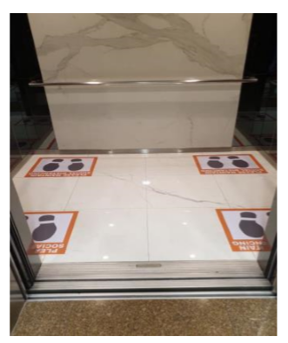
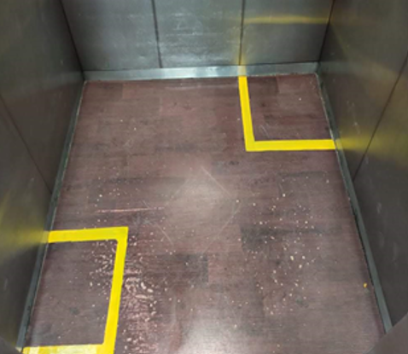
Vertical transportation - EMEA Example
Lifts & Staircases
Reducing the maximum capacity of people entering the elevator/ lift cabin – use floor markers in lift
Space markings on the elevator / lift floor.
Display elevator / lift etiquette posters in all lifts
A dedicated lift attendant may be deployed to operate the lift
Usage of staircases is encouraged to decongest lifts, ensuring employee maintains social distancing when in staircase

Slide 12
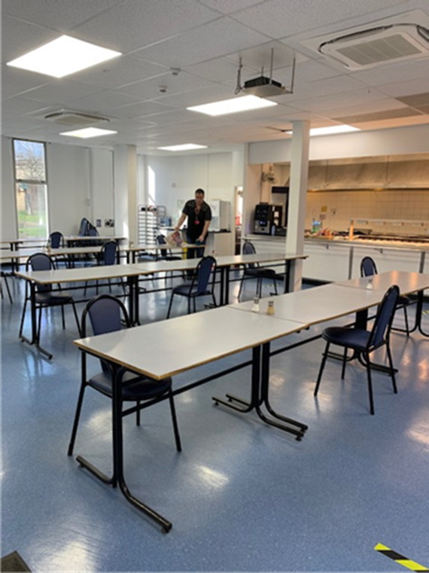
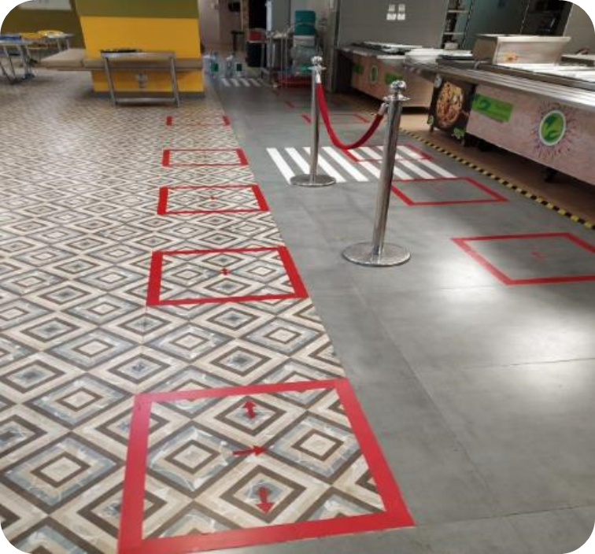
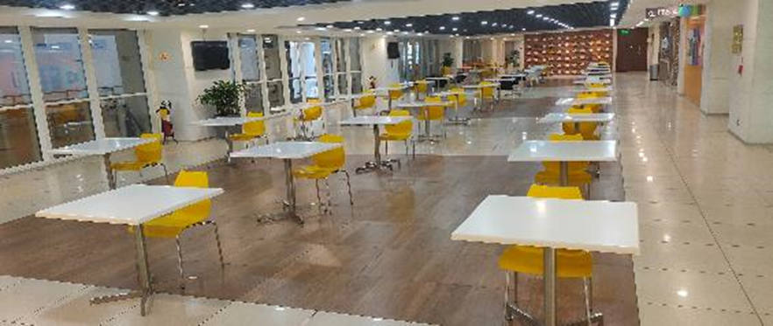
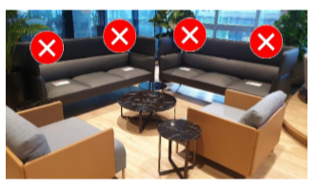
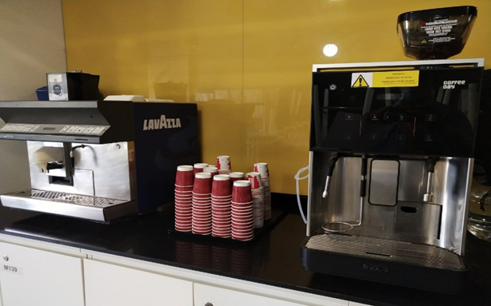
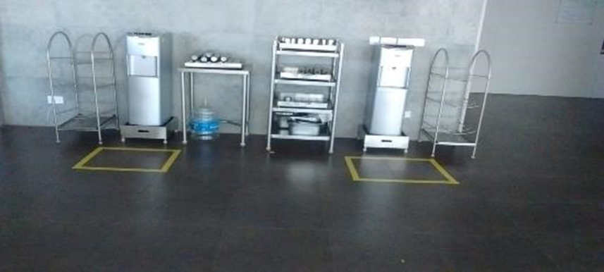
Café and Breakout - EMEA Example

Slide 13
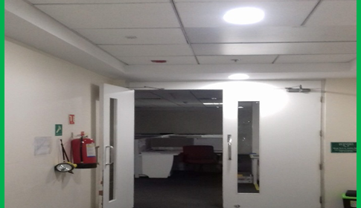
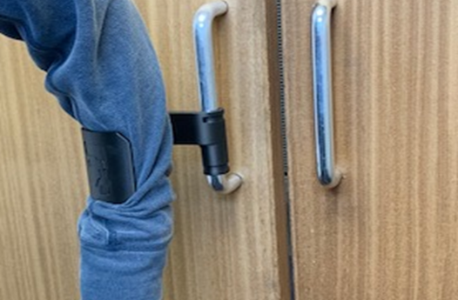
Egress prep – EMEA Example
Internal Doors
Non-essential doors to be kept open to minimize contacts, wherever safe to do so, and no impact on HVAC
Introduce non hand door openers, if possible

Slide 14
Prepare to gradually re-enter Focus on these key areas to create a successful re-entry plan
Promote the health and wellness of your employees and visitors
Ensure your buildings are safe, resilient, and ready
Create and monitor effective guidelines and adjustments to your space
How can you adjust and communicate expectations around new behaviors
that will increase safety, security, productivity and wellness?
How can you confirm that buildings and spaces are safe to re-enter and understand what operational changes you can make to adjust and drive adherence to new protocols?
How can you adjust spaces while balancing health, safety and financial implications?
13

Slide 15
Thank you For your attention

