Slide 1
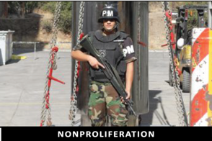
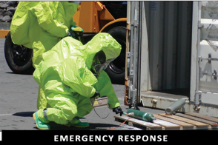
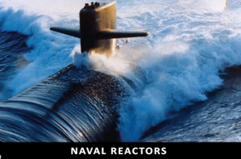
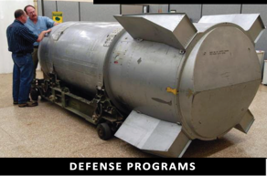
Office of Safety, Infrastructure, and Operations
COVID-19 Lessons Learned For
Enduring Organizational Improvement
Safe Operations, Effective Infrastructure Enterprise Services
ENABLING MULTIPLE PROGRAMS

Slide 2
Context
NNSA has made significant progress adopting lessons learned since the start of the pandemic.
We have also validated and strengthened our governance and management system.
It will remain crucial to prioritize our work (e.g., PMEFs & MEFs) and develop creative solutions where we are we most vulnerable.
We will need to stay diligent as people start to become more comfortable and less focused on social distancing, masks and other controls – both at work and at home.

Slide 3
Framework
We need to understand, analyze, mitigate, respond to and manage our risks.
Many groups such as EFCOG, EA, and others are working on lessons learned from this pandemic.
The goal is to improve our response going forward and to improve our response in the future when faced with a new situation that threatens our mission.
We in the NNSA are also trying to address some insights into long-term, steady-state, dare I say “normal” operations.
We call this our “COVID-19 Lessons Learned for Enduring Organizational Improvement.”

Slide 4
Team of Teams Approach
This initiative involves a team approach focused on the following four areas:
Mission
People
Infrastructure, and
Governance & Management
As an integrated team, we need to take what we’ve learned from the natural experiment of COVID and forecast where we want to go as one NNSA.

Slide 5
Key Considerations
Key considerations for the teams:
Mission threats such as supply chain and loss of productive work time
Consistent accounting for COVID impacts across all programs
Personnel Protective Equipment (PPE)
Telework
Online training
Space
Information Technology
Oversight and Trust

Slide 6
Path Forward
We expect cross-cutting issues.
We will use existing organizational structures – such as the Operations and Efficiencies Board – to work through the issues.
We will bring together senior leaders within the nuclear security enterprise to deliver the most cost-effective, timely, safe, secure, and measurable mission results.
As we continue to execute and adapt, we will need to continue to monitor our operational posture daily.
We will need to continue to partner to ensure workforce protection and mission delivery, while balancing the importance of safety and security.

