Slide 1
Efcog Contractor assurance Working Group (CAWG) Update
August 10, 2016
Patricia M. Allen, Chair
Darlene Murdoch, Vice Chair

Slide 2
Contractor Assurance Benchmarking Efforts
The overall task is to develop a tool to gauge the maturity of Contractor Assurance programs
The April 2016 CAWG meeting focused on DOE Order 226.1 requirements and presentations from multiple Sites/Projects/Laboratories Contractor Program

Slide 3
DOE Order 226.1B Requirements for CAS
The CAS must, at a minimum, include the following elements:
A method for validating the effectiveness
Self-assessment and feedback and improvement activities
An issues management system
Process for determining causal factors and corrective actions, conduct effectiveness reviews, and communicate issues/trends
Contracting Officer communications
Lessons learned programs
Metrics and targets
CAS description approved by DOE
CAS data readily available to DOE

Slide 4
Summary of Benchmarking Review
A total of eight contractors were benchmarked, and all contractors had the core elements of DOE Order implemented. Several best practices were identified:
Self-assessments
Feedback and lessons learned
Issues management
Performance evaluation
Management oversight/review boards
Contract governance processes
Involvement with corporate parents, third party reviews, etc.

Slide 5
CAS Survey
Survey was completed in July 2016
Twenty projects/facilities responded
Data is being compiled and analyzed, and will be reviewed at the Fall EFCOG meeting
A total of 66 questions were included. An example of survey questions on the assessment process:
Describe how self-assessments are selected.
Is the assessment planning process risk based?
Are criteria used to identify risk informed assessments?
Does the assessment program cover “potentially high consequence activities”?
Is the quality of assessments evaluated?

Slide 6
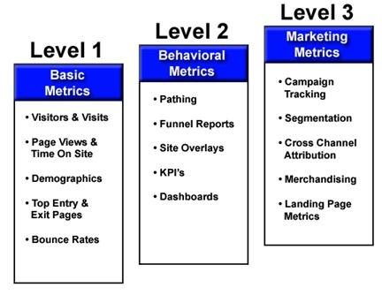
Maturity Evaluation Tool
The survey results will be the foundation for the development of the CAS Maturity tool. The survey requested specific information on which to support building the model. The tool will assist Contractors in evaluating the maturity of their Contractor Assurance programs and to share best practices across the DOE Complex.

Slide 7
Example of Maturity Evaluation Tool for Self-Assessments
The criteria start with basic elements required by DOE Order 226.1B, and continue through criteria expected for a mature self-assessment program. The survey responses will support the description of the varying levels.
A self-assessment process is in place.
The self-assessment process is risk based.
All levels of management participate in the self-assessment program.
The quality of self-assessments is evaluated (graded).
The effectiveness of the self-assessment program is monitored through review of contractor performance to ensure continuous improvement.
Increasing maturity level

Slide 8
Summary
The goal is to develop a tool to assist Contractors in evaluating the maturity of their Contractor Assurance programs and to share CAS best practices across the DOE Complex.
The survey has been completed and initial analysis is undeway. Results of the survey will be reviewed and discussed at the FAll EFCOG meeting as input to the maturity tool.
A CAS Maturity Evaluation Tool will be developed during FY17.

