Slide 1
CAS Implementation Idaho Operations Office
Robert Boston
Deputy Manager Operations Support/
Chief Operating Officer
Idaho Operations Office
November 16, 2016

Slide 2
Introduction
Description of the Idaho Site and the Idaho National Laboratory
Time line for CAS implementation
Improvement and hiccups alone the way
INL CAS description
Expectations for Federal Staff
Expectations for the Contractor
How NE-ID incorporates CAS into oversight
How NE-ID documents (CAS) oversight

Slide 3
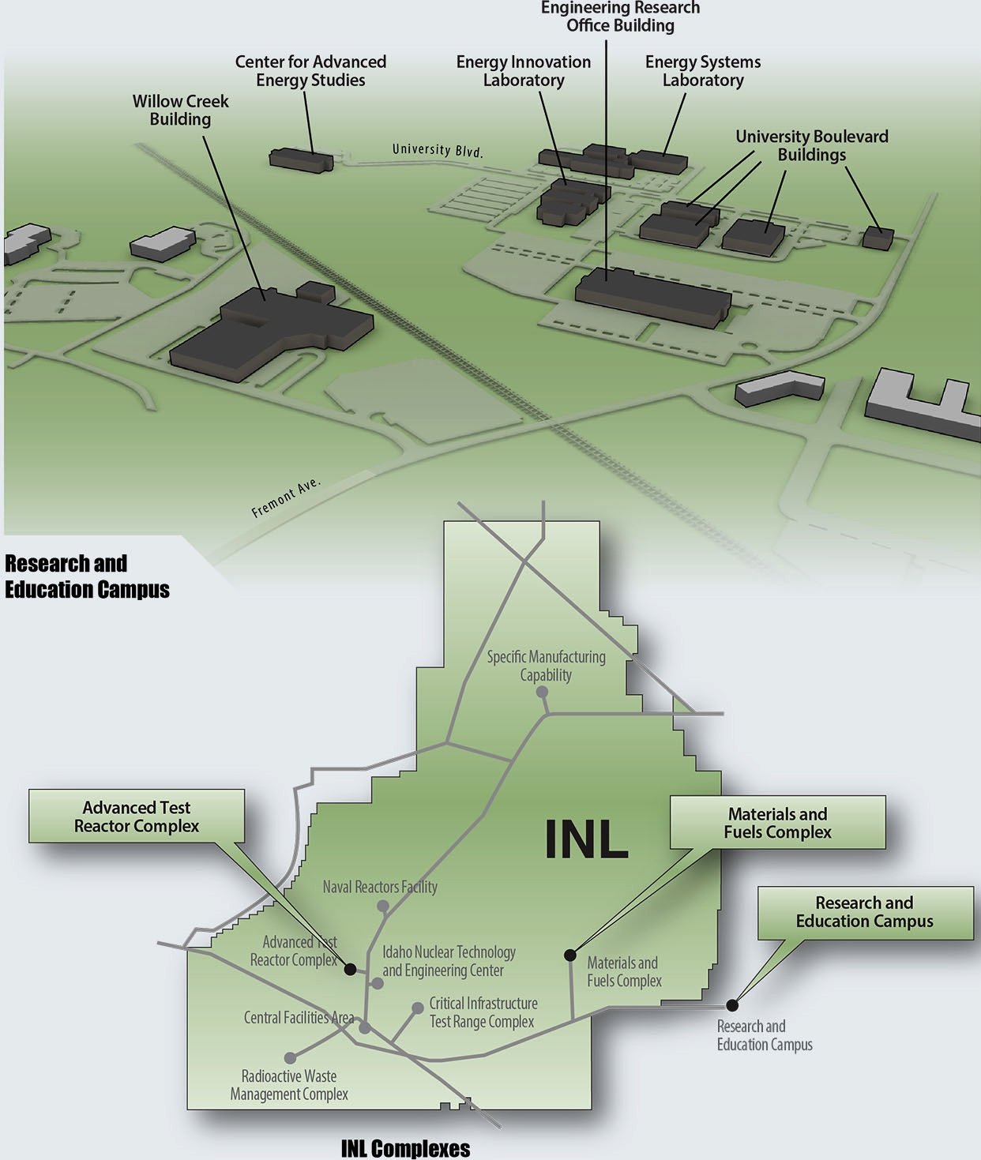
Idaho National Laboratory
890 square miles
Site ~ 50 miles west of Idaho Falls
26 non-nuclear buildings on the Idaho Falls Campus
199 non-nuclear buildings at the Site
Advanced Test Reactor (HC-1)
13 HC2 Facilities
4 HC3 Facilities
40 LTHC3 Radiological Facilities
3

Slide 4
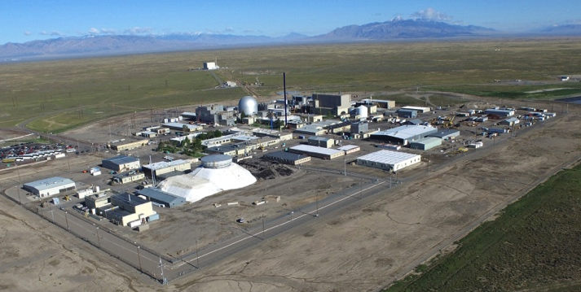
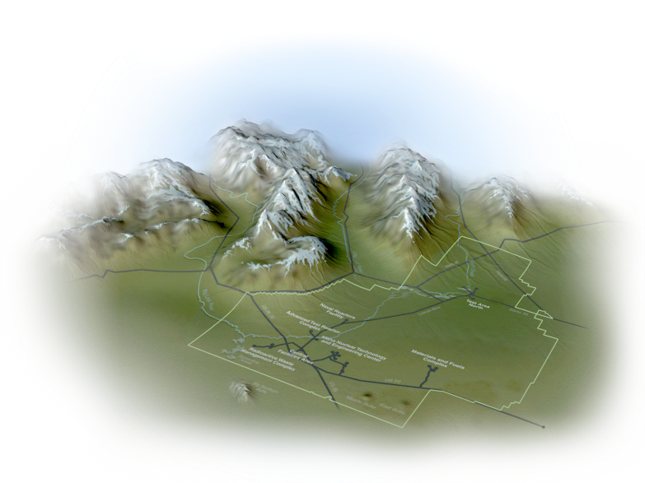
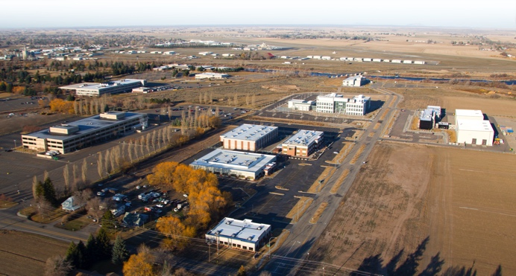
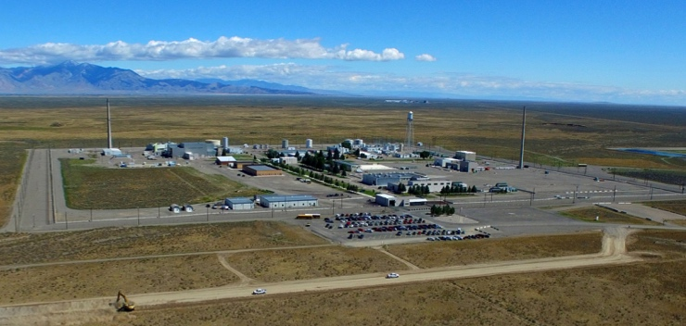
Idaho National Laboratory
Materials and Fuels Complex
Research and Education Campus
Advanced Test Reactor Complex
4
Notes:
The Idaho Site is located on Bureau of Land Management land. The Office of Nuclear Energy is the landlord for the Idaho Site and is responsible to the environmental permitting and cultural resources of the Site.
This presentation is in regards to the Idaho National Laboratory. The INL is the Office of Nuclear Energy contractor, Battelle Energy Alliance for the Idaho Site.
There are EM contractors on Site. My oversight responsibility is limited to environmental permitting, so this presentation will be focused on the INL.
Discuss the Site areas shown

Slide 5
Time Line of Development
2007-2009
2009-2010
2010-2012
2012-2013
2013-2015
Benchmark of NRC, INPO, other sites DOE P&O 226.1A | Independent review of Pilot Oversight Model | INL adopts new approach to issues management | CAS maturity Goals Established Benchmark of other labs Continuing maturity of issues management as foundational | CAS Road to Excellence: LabWay, MRM process, Management Observations, OPEX Share, Assessments, Risk Registers
Pilot Oversight Model Monthly Assessment Reporting (MAR) is transactional CAS not effective | Adopted high-volume / low threshold issues management PEMP incentivizes step change in CAS CAS metrics established & maintained by DOE | MAR evolves to Monthly Evaluation Reports (MER) CAS metrics maintained by Contractor | MER evolves to Quarterly Evaluation Report (QER) Metrics and issues management maturity better inform management and oversight Adopted SC PEMP model | QER dashboard implemented, includes cross cut area for evaluating CAS performance

Slide 6
Idaho Operations Office Evolution
2005 – INL Consolidation of INEEL & ANL-W, Start of new contract
Transactional oversight via Monthly Assessment Report
Contractor fixes DOE found issues
2007 – Red Phosphorus Event
2012/2013 – ZPPR Pu Event and MFC work shutdown
Battelle Community Practice Review
CAS evaluated in the incentive fee
2013 – Molten Salt Event
CAS fully implemented in the R&D community
Notes:
Initial consolidation of INEEL and ANL-W combined two very different cultures.
Red Phosphorus event revealed weaknesses on R&D self-oversight but the CAP was limited to the event only and not the INL
Molten Salt Event – The casual factors were similar to the Red Phosphorus event. The INL expanded the scope of the CAP to all non-nuclear R&D activities

Slide 7
Idaho Operations Office Evolution
Present
Quarterly Evaluation Report
CAS evaluated in Performance Evaluation & Measurement Plan
Verbal discussions:
NE-ID Office Manager
Senior Leadership Team
Central Facilities Area Arc Flash Event
Notes:
QER
•Objective –determined by comparison to defined objective criteria, and uninfluenced by emotion, or personal prejudice.
•Risk-informed - elements of risk to safe performance are considered along with other factors (such as engineering judgment, conservative safety margins and redundancy) to better focus management attention on issues commensurate with their importance to health and safety.
•Understandable - the process and its results are clear and concise, and provides a trend of performance ratings over the established reporting period.
•Repeatable - more than one individual can follow the same defined process and arrive at the same conclusion in a consistent manner.
•Open - Informs and involves DOE Management and the contractors in the process.
•Effective - the reports are high quality, efficient, timely, and realistic, to enable the safe and conduct of hazardous operations.

Slide 8
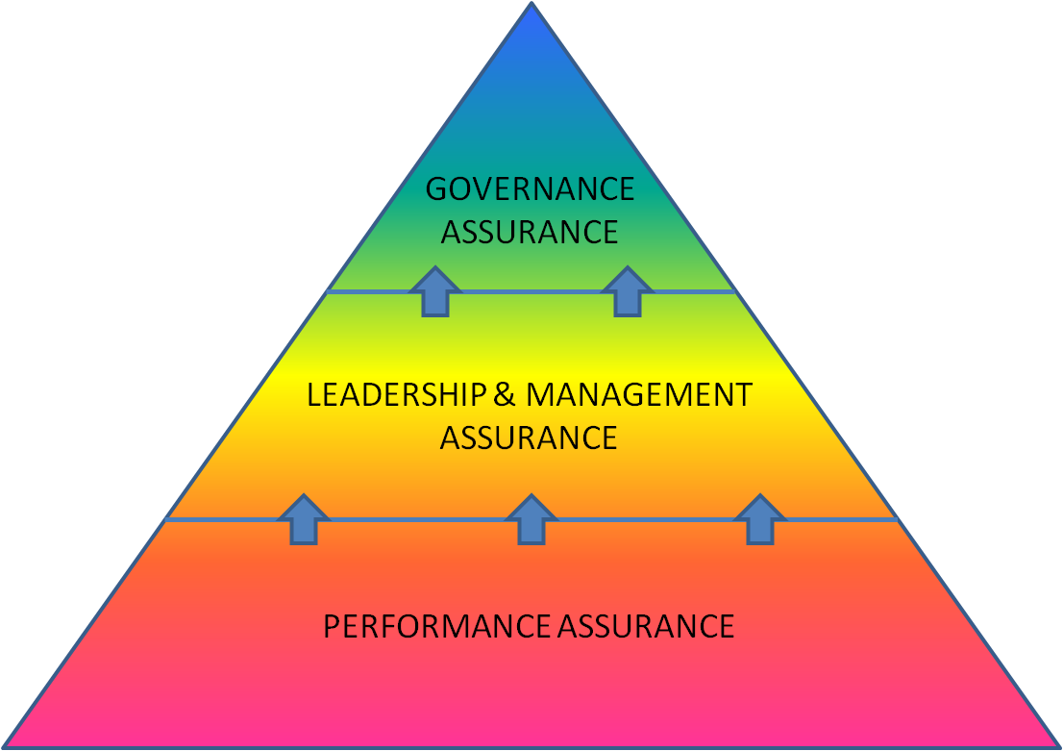
INL’s CAS
Battelle Committees & Board of Managers:
Institutional risk boundaries and strategy
INL LMT and Councils:
System effectiveness and organizational and system‑level learning
INL Employees and Line Management:
Transactional performance monitoring and improvement, task‑level learning
Notes:
The bottom level of the oversight triangle is foundational Without employee and first line supervisor involvement , CAS will not work.
Concerns need to be flowed up the Leadership Management Team for both awareness and for risk management determination (limited resources have to be applied effectively and a enterprise perspective is provided at this level. Also, INL wide safety management programs may need LMT support for Lab-wide adjustment.
The Corporate leadership must be engaged to provide the highest level of independent assessment of the Enterprise’s performance.
At all levels DOE is kept informed of issues, corrective actions and risk determinations.

Slide 9
INL CAS: How it Works
Senior Management Review Meeting: Continuous Performance Improvement
Risks: Mitigate Monitor Accept Avoid
Management Review Meetings: Evaluate Performance, Identify Risks, Take Actions
3
Behavior Awareness tied to events and Source of Process/Equipment Problems
Tier III: Incorporate Broader Perspectives and Operating Experience
Independent
Assessment
Lessons
Learned
External Events
2
Peer to Peer, Management Observation Program - Alignment to Standards/Fundamentals/Behaviors
Tier II: Focus Understanding and Improvement Areas
Issues Management as Core Business: Detect, Understand, Fix, Trend, Prevent
Self-Assessments
Work-Place Observations
1
Tier I:
Foundational
Performance Data/Metrics: Refine/Trend/Analyze
Oversight
Managers
Employees
Engaged in the Field: Find, Document, and Fix Problems
Notes:
All mission and support groups have most of these CAS elements: Still maturing, some groups do elements better
How the INL is unique:
This graphic - Element interfaces, their purpose (behaviors or programs), and relative impact (All important but not equal)
Issues management as core business and central to all elements
The management review meeting process is where it all comes together: data evaluated, decisions made, risks documented
CAS tools used for both compliance and mission: Enterprise risk framework - Strategic, Operations, Financial, and Compliance
The software (LabWay-DevonWay) makes it all easy, integrated, and efficient – key to leveraging CAS beyond compliance

Slide 10
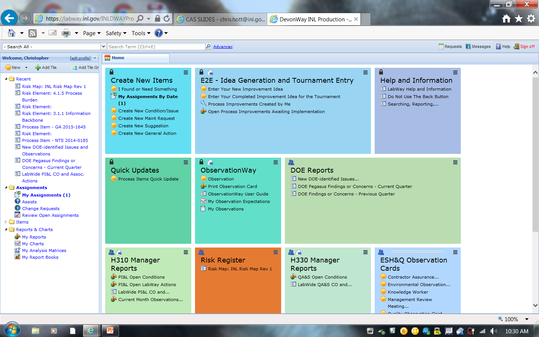
Issues Management is Foundational
High volume/Low Threshold provides low-level trending and key culture component
Requires a graded approach – 80/20
Message to staff: If you want to see something fixed, put it in LabWay
Management accountable for timely/proper responses – Not a black hole
Data trended by directorate and across directorates (management systems)
Significance categories include mission impact criteria
Research community embraced tools as a way to remove mission barriers
LabWay connects issues, events, observations, assessments, risks, and actions
Notes:
80/20 focus is important

Slide 11
Expectations of Federal Staff
Knowledgeable of the contract
Regulate to the Contract requirements
Communicate issue/concerns verbally to the Contractor
Track/trend Deviations of Minor Significance (DOMS)
Communicate status to HQ (Programs, EA, AU)
Reach out to Technically Qualified subject matter experts
Notes:
All Federal Staff are provided 16 hours on the specifics of the INL Contract.

Slide 12
DOE Expectations of Contractor Staff
Find/fix problems and communicate the find/fix to DOE
Management in the field
Document Management Observations
Tracking and trending
Take actions on the results
Communicate to DOE at all levels (working level to senior management)

Slide 13
How Does NE-ID Incorporate CAS Into Oversight?
NE’s ESH&Q expertise is located in Idaho
Start with the INL approved CAS description
Independently evaluates INL performance and risks using CAS metrics and results
Evaluates Contractor Management Observation Program
Emphasizes “boots on the ground” observations
Worker/supervisor level involvement
Self-evaluation and issues documentation/resolution

Slide 14
NE-ID Oversight of CAS
NE-ID attends MRMs and SMRM
Evaluation of quality and value of INL metrics, and INL progress towards meeting appropriate metric targets
Availability of INL CAS related information and products to NE-ID
Communication between INL Senior Leadership, BEA Board and Committees, and NE-ID Management
NE-ID staff shadow selected INL self and independent assessments to evaluate effectiveness/adequacy
Communicate with NE-HQ during scheduled weekly meetings

Slide 15
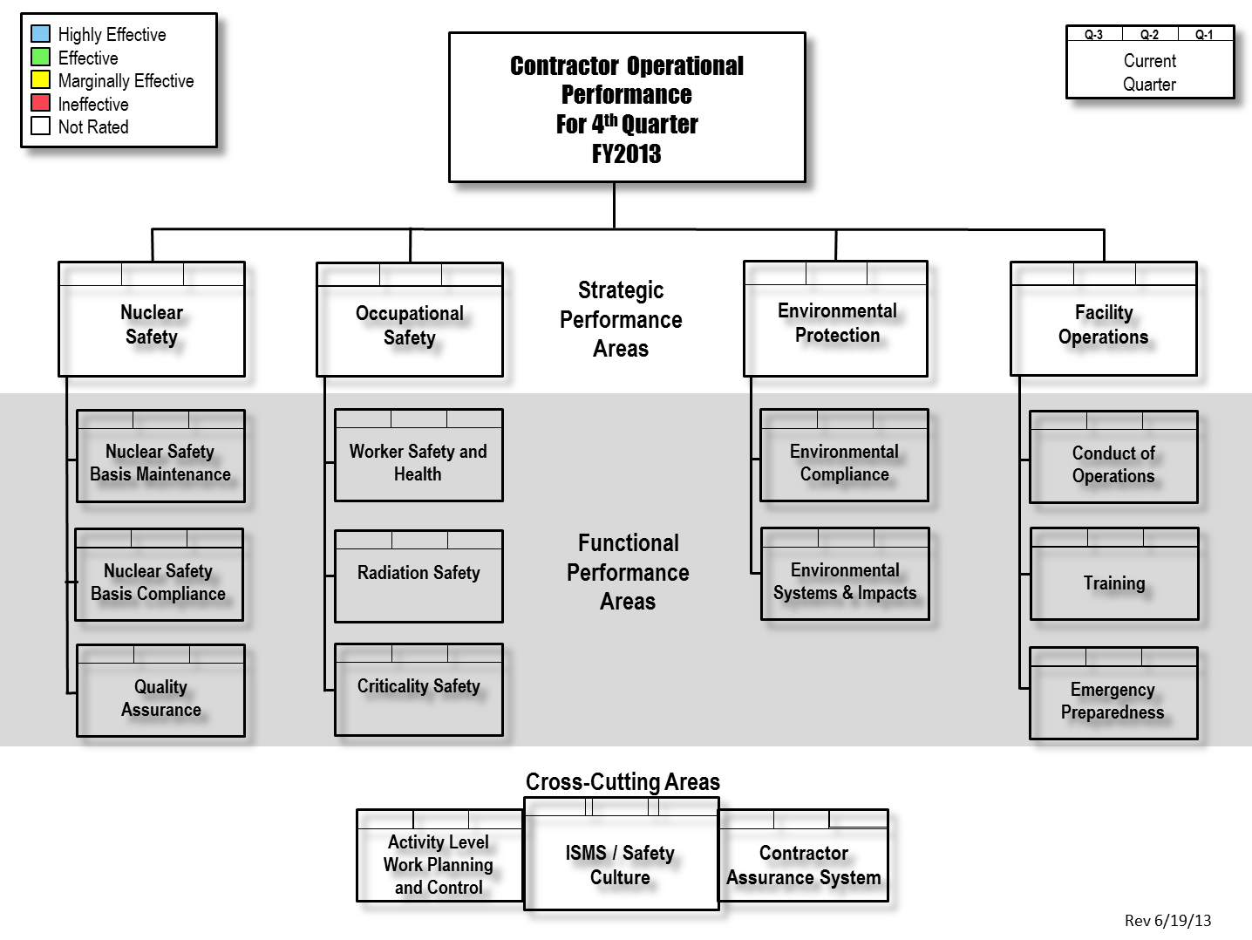
Documenting Federal Oversight
INL CAS Performance Reported in Quarterly Evaluation Report
Functional and strategic performance area evaluation includes CAS performance information
Adjustments in oversight are evaluated quarterly (or immediately for emergent issues) based on field awareness and CAS evaluation
Resources are shifted as needed to cover higher risk activities or areas with identified performance issues. Since NE-ID safety SMEs are local, implementation of NE oversight policy is developed locally
Notes:
Plagiarized from the NRC Reactor Oversight Process stoplight chart
Functional Area owners have specific grading criteria
Strategic Areas are a roll up of the Functional Areas.
Cross cutting Areas are provided input from the Functional Areas and also have specific criteria.
QER meeting is a multi-hour meeting with peers challenging each other on the results (murder board) (red, yellow, green, blue)

Slide 16
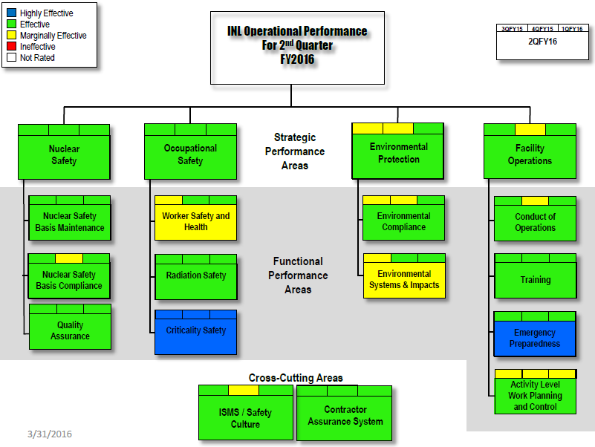
Documenting Oversight Federal Oversight
Notes:
This slide and the next is to emphasis how the CAS Oversight and the QER tool has modified contractor behavior.
Critiera:
Metrics
Events
DOE assessments
DOE Ops Awareness
CAS Elements
Self-assessments
Independent-assessments
Issue Management

Slide 17
What do we do with oversight results?
Idaho Operations Office Manager provided a quarterly report
Health of the Contractor ESH&Q programs
Current near term issues
Adjustments in oversight are evaluated quarterly (or immediately for emergent issues) based on field awareness and CAS evaluation
Resources are shifted as needed to cover higher risk activities or areas with identified performance issues.
Verbal discussion with Contractor management
Nothing in the report should be a surprise at this point
Operational awareness discussions with CTA/CNS, NE-HQ
Notes:
Group physiological response to an event:
1. Fear. Immediately after an event fear permeates the crew, supervision, management and their families. Fear of damaging the good standing of the crew, fear of disciplinary action, fear of retribution, fear of being fired. 2. Learning. Assessment, analysis, review, observations - what went wrong, how to fix it. What are our corrective actions. 3. Acceptance. Ok we have to follow the new processes, procedures, and protocols. Ok, I'm drinking the cool aid. 4. Confidence. We can do this. We get this. We've got this. 5. Pride. The ultimate goal in responding to an event. Proud in our new way of executing work. Proud in what we have become. Not just drinking the cool-aid, but selling it. Look at us, come observe us in the field. We are one of the best in the business and leading the way.
DOE Response to an event if CAS is working, it’s hard but wait for the contractor to act. If Contractor actions are aggressive and comprehensive, depending on the severity of the event, CPOF or enforcement action may or may not be necessary. If the severity is such that Federal action is necessary, a functioning CAS and appropriate Contractor response may limit contract or Enforcement action.

Slide 18
DOE Working Group Policy Statement
A mature CAS relies on the people and the relationships between the contractor personnel, the federal program office and the on-site federal staff.
The principles of trust, accountability, integrity and respect, along with frequent and open communication, must be the foundations upon which our mission is performed.
DOE line management will assure contract compliance by monitoring …. and providing timely feedback to the contractor on matters deserving attention.
The contractor's assurance systems must be transparent and the contractor must continue to pursue mission excellence.

Slide 19
