Slide 1
EFCOG Recent Accomplishments
Cost Savings: Issued the “Return to Service Impacts for Non-DOE Owned Transport Conveyance” Report. When DOE uses the output of this report as policy, it will potentially save several million dollars per year.

Slide 2
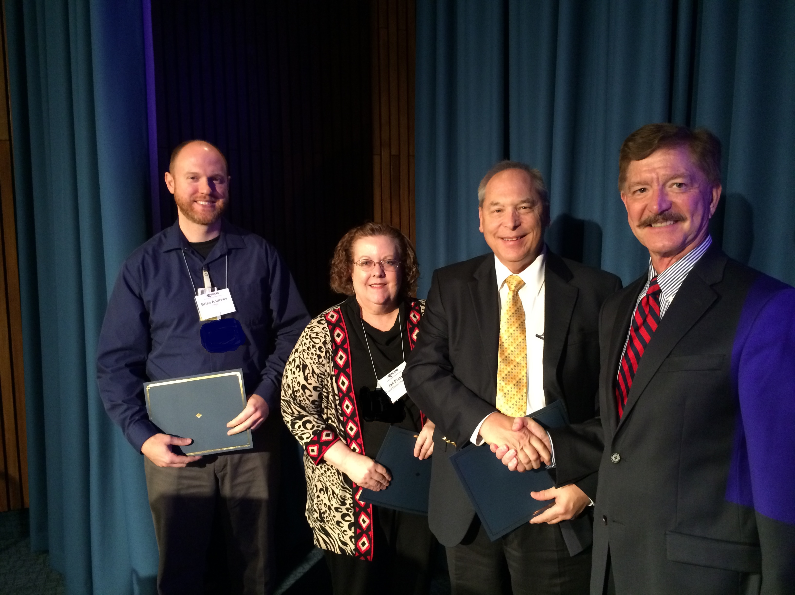
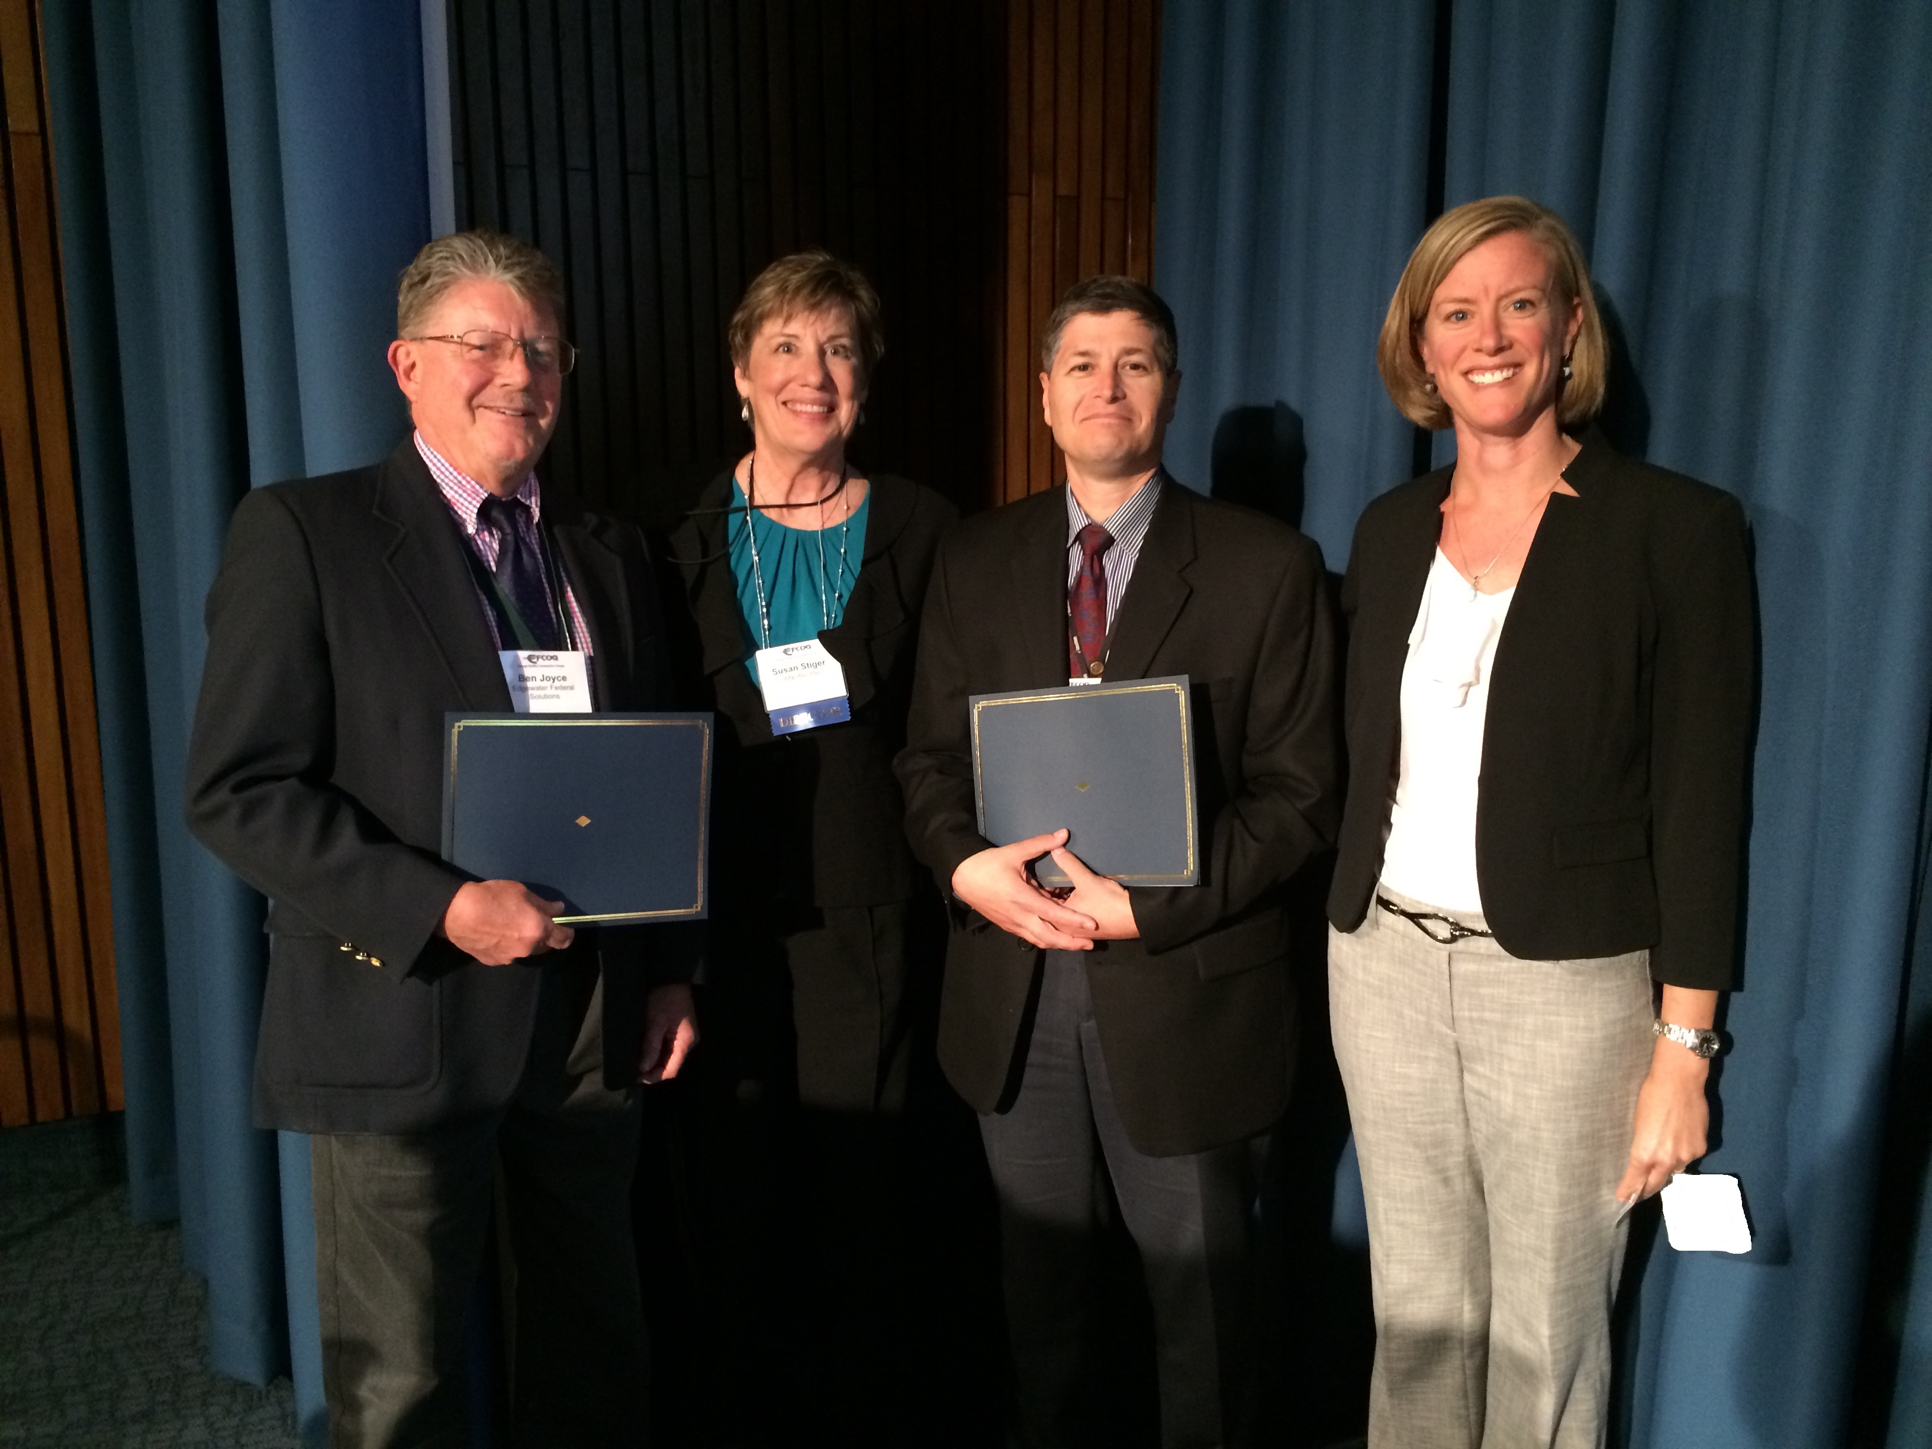
Recent EFCOG Award recipients

Slide 3
EFCOG Recent Accomplishments
Best Practices: Provided DOE Order 435.1 training (development and implementation) at LANL and HQ as a result of the WIPP incident. Provided SME assistance during the LANL follow up assessment.
Coordination: Established an NNSA Corporate Partnering group with corporate executives from NNSA prime contractors that mirrors the EM partnering process to proactively and cooperatively find and fix problems at a senior level.

Slide 4
Welcome New Members
Arcadis US, Inc.
Fire & Pump Service Group
Four Rivers Nuclear Partnership
Mission Support and Test Services
N3B
PAE Inc.

Slide 5
EFCOG Recent Accomplishments
Stakeholders: Deepened the EFCOG dialogue with the communities that host DOE sites, including jointly convening a successful National Cleanup Workshop with the Energy Communities Alliance
Effective Implementation: Consolidated from prime contractors the financial and programmatic impacts on the DOE Order 851 amendments which was issued in January 2018. As a result, DOE provided additional information to contractors and DOE field offices on options to be in full compliance by January 2019. EFCOG and DOE are coordinating closely on implementation.

Slide 6
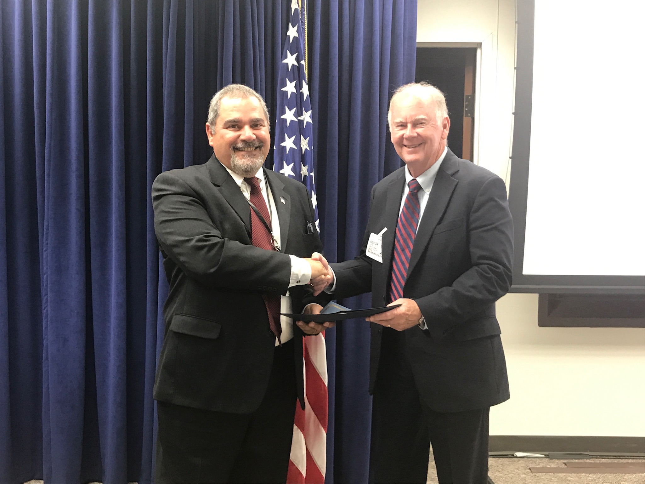
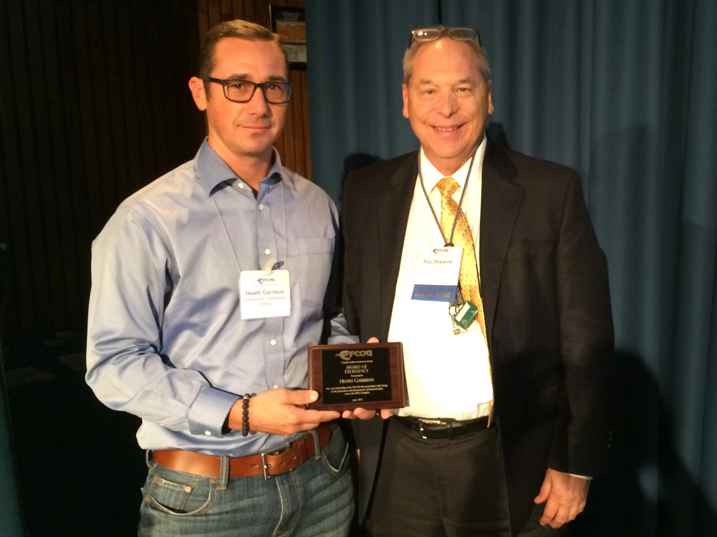
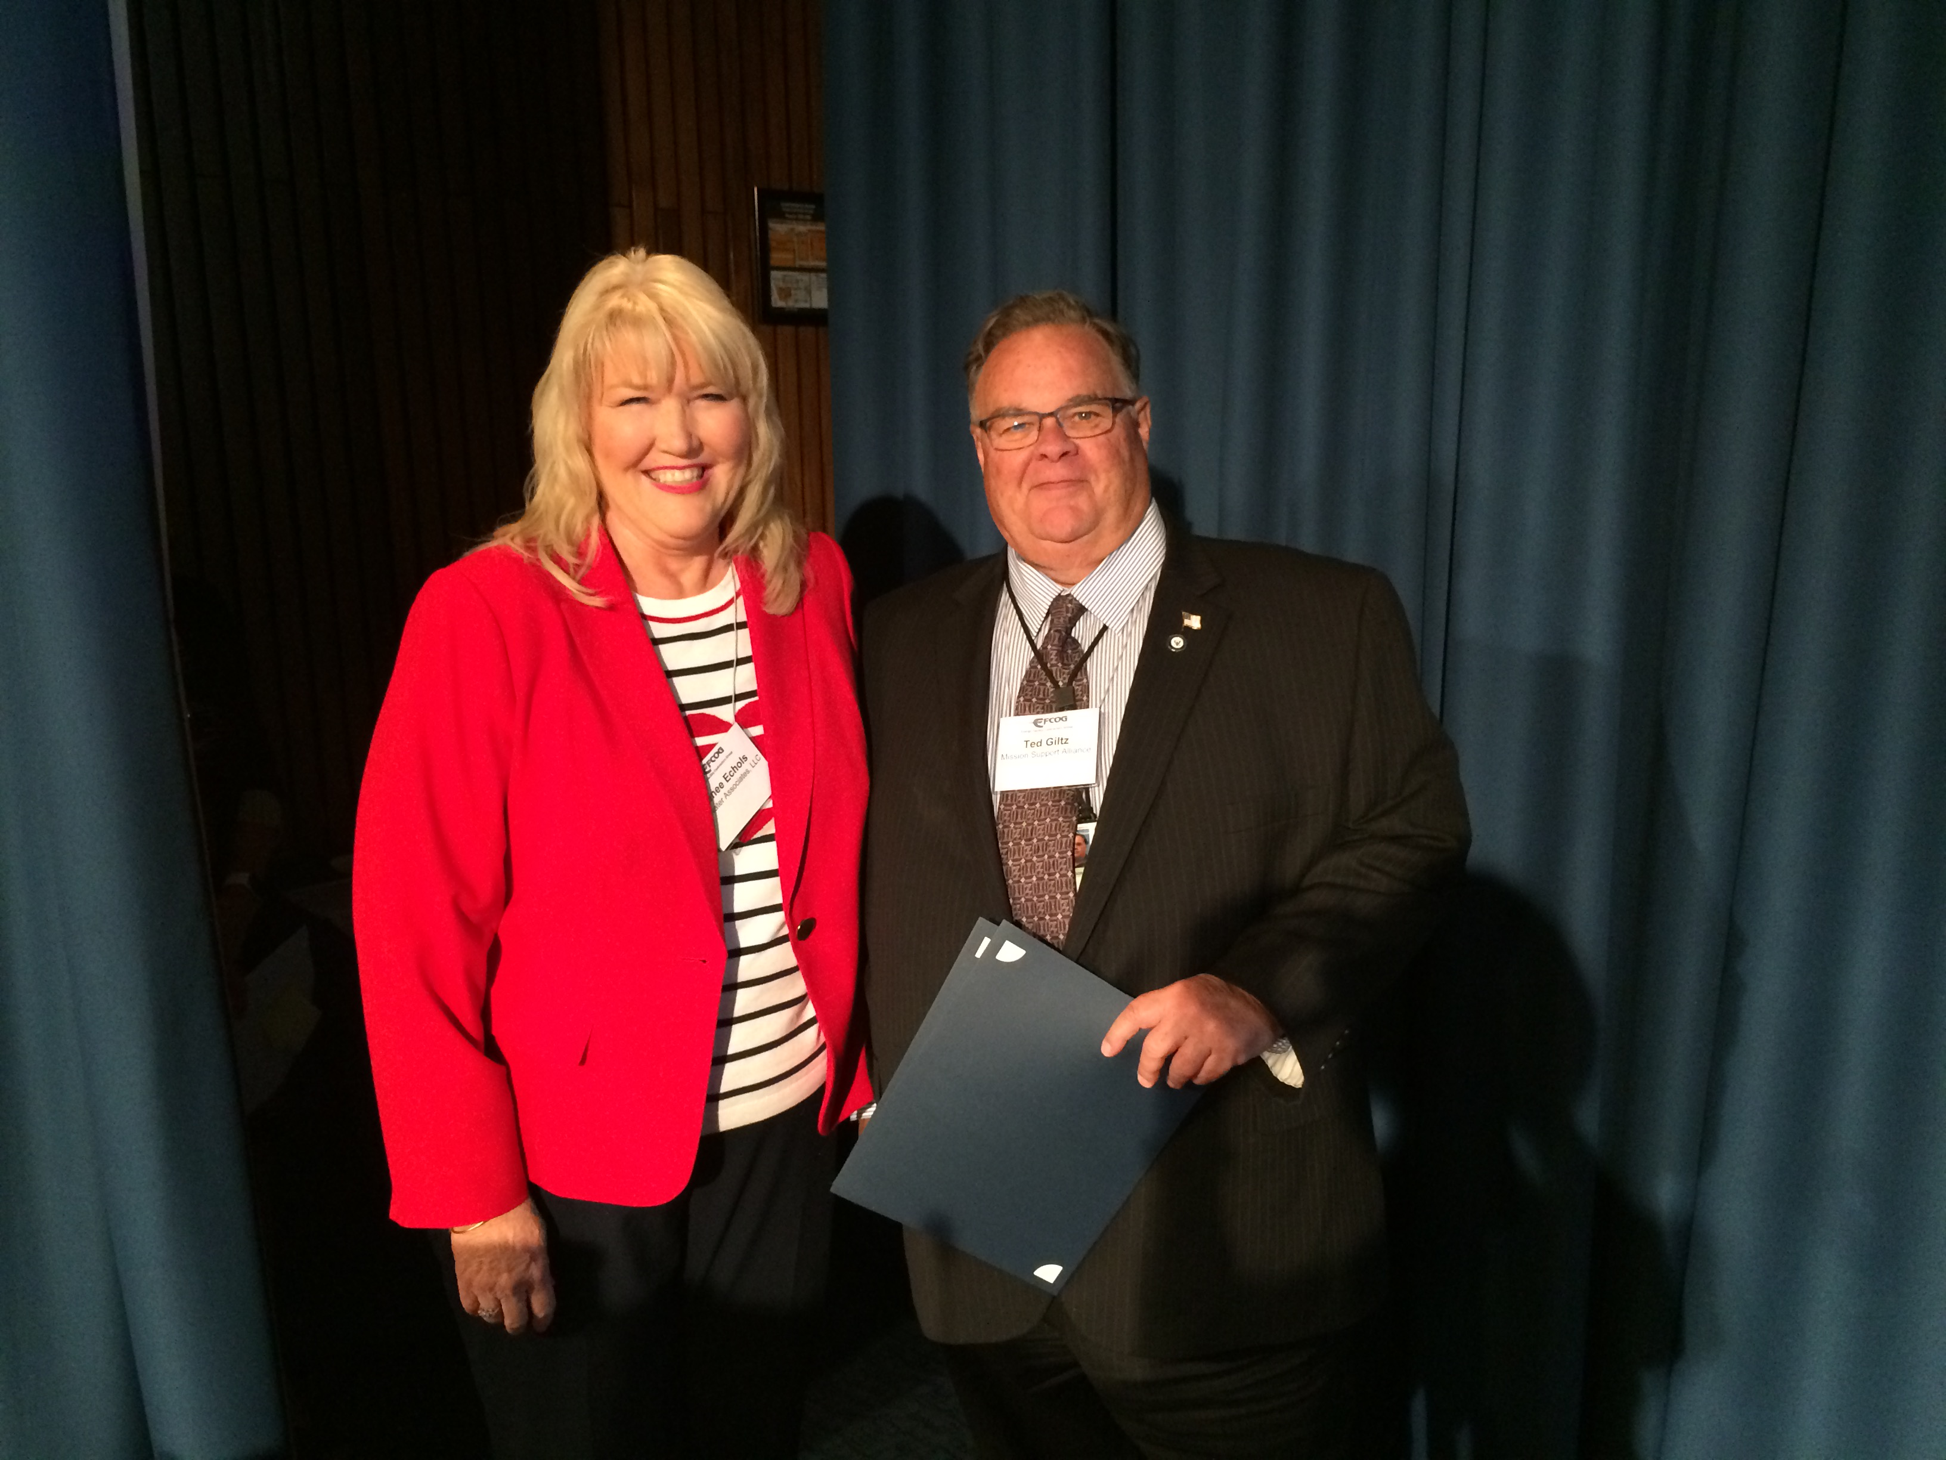
Recent EFCOG Award recipients

Slide 7
EFCOG Recent Accomplishments
Established an improved dialogue with the DOE-EM Field Office Managers for discussion of key issues such as contractor assurance, the revision of the DOE project management order, and acquisition planning, and DOE Order 851.
Re-established the EM Corporate Partnering group made up of corporate executives from all EM prime contractors, which is chaired and staffed by EFCOG, with EM-1. Topics include complex-wide operational, acquisition and strategic issues with EM management.
Launched a new EFCOG website to better highlight the important work of the Working Groups and to more easily share lessons learned.

Slide 8
EFCOG Recent Accomplishments
At the request of the DOE Deputy Secretary, EFCOG has made a number of important and cost-saving regulatory reform recommendations. EFCOG is continuing to work with the DOE sponsors to transfer ownership to DOE staff for implementation.
Provided a senior contractor panel as part of the annual DOE Safety Culture Improvement Panel Meeting.
As a follow up action to the joint EFCOG/DOE Contractor Assurance Effectiveness Initiative, EFCOG developed assessment lines of inquiry and posted them on the EFCOG website.

Slide 9
2018 National Cleanup Workshop
Hilton Alexandria Mark Center
Alexandria, VA
September 11-13, 2018
www.cleanupworkshop.com

Slide 10
EFCOG Recent Accomplishments
In ongoing activities on the Master Approved Supplier List (MASL), EFCOG worked to implement recommendations made in the original team report that allowed DOE to close their QA focus area related to MASL.
Continued to support DOE on the EVMSIH and the EVMS Roadside Assist visits. The EFCOG project delivery team assisted in facilitating discussions between HQ and the field to implement the EVMSIH and EFCOG is now identifying SMEs to support project peer reviews.
Work continued within the Startup and Commissioning Task Team with the expectation of having a draft guide available for review by June 2018.

Slide 11
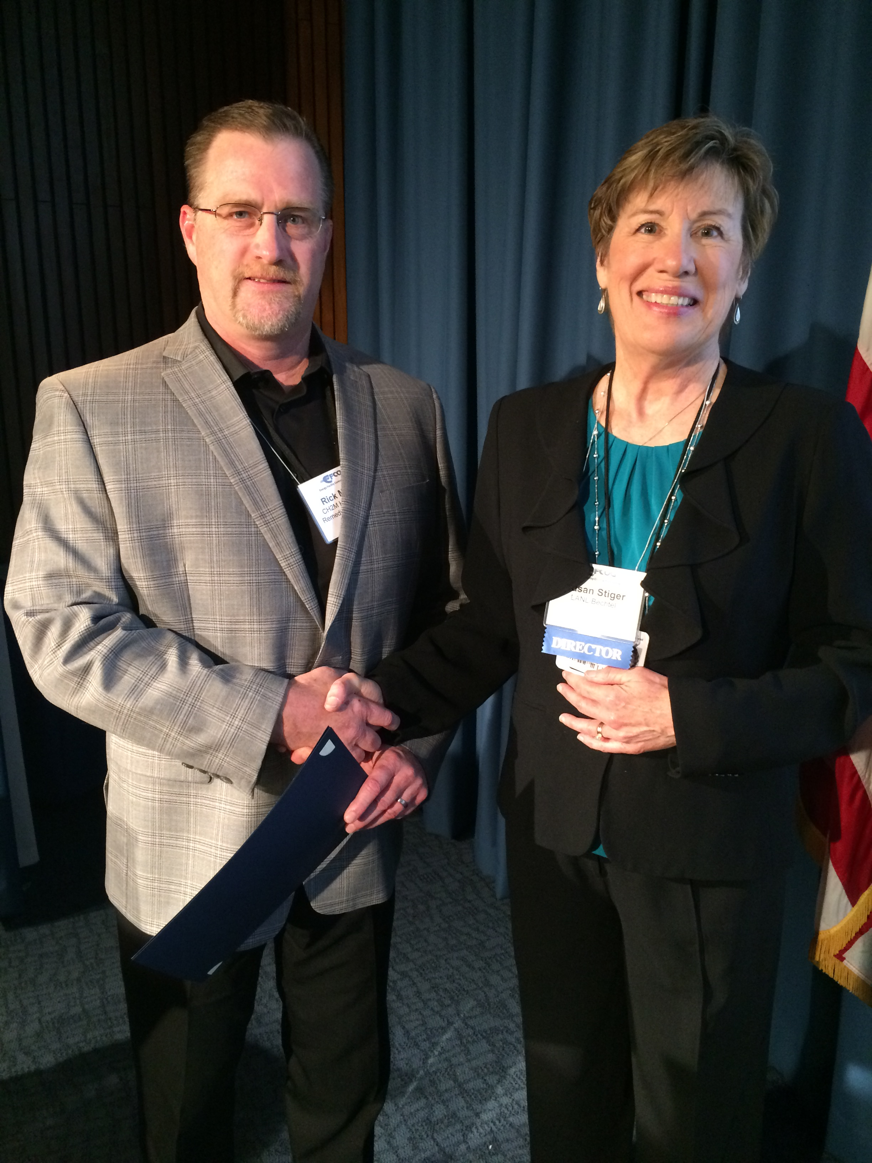
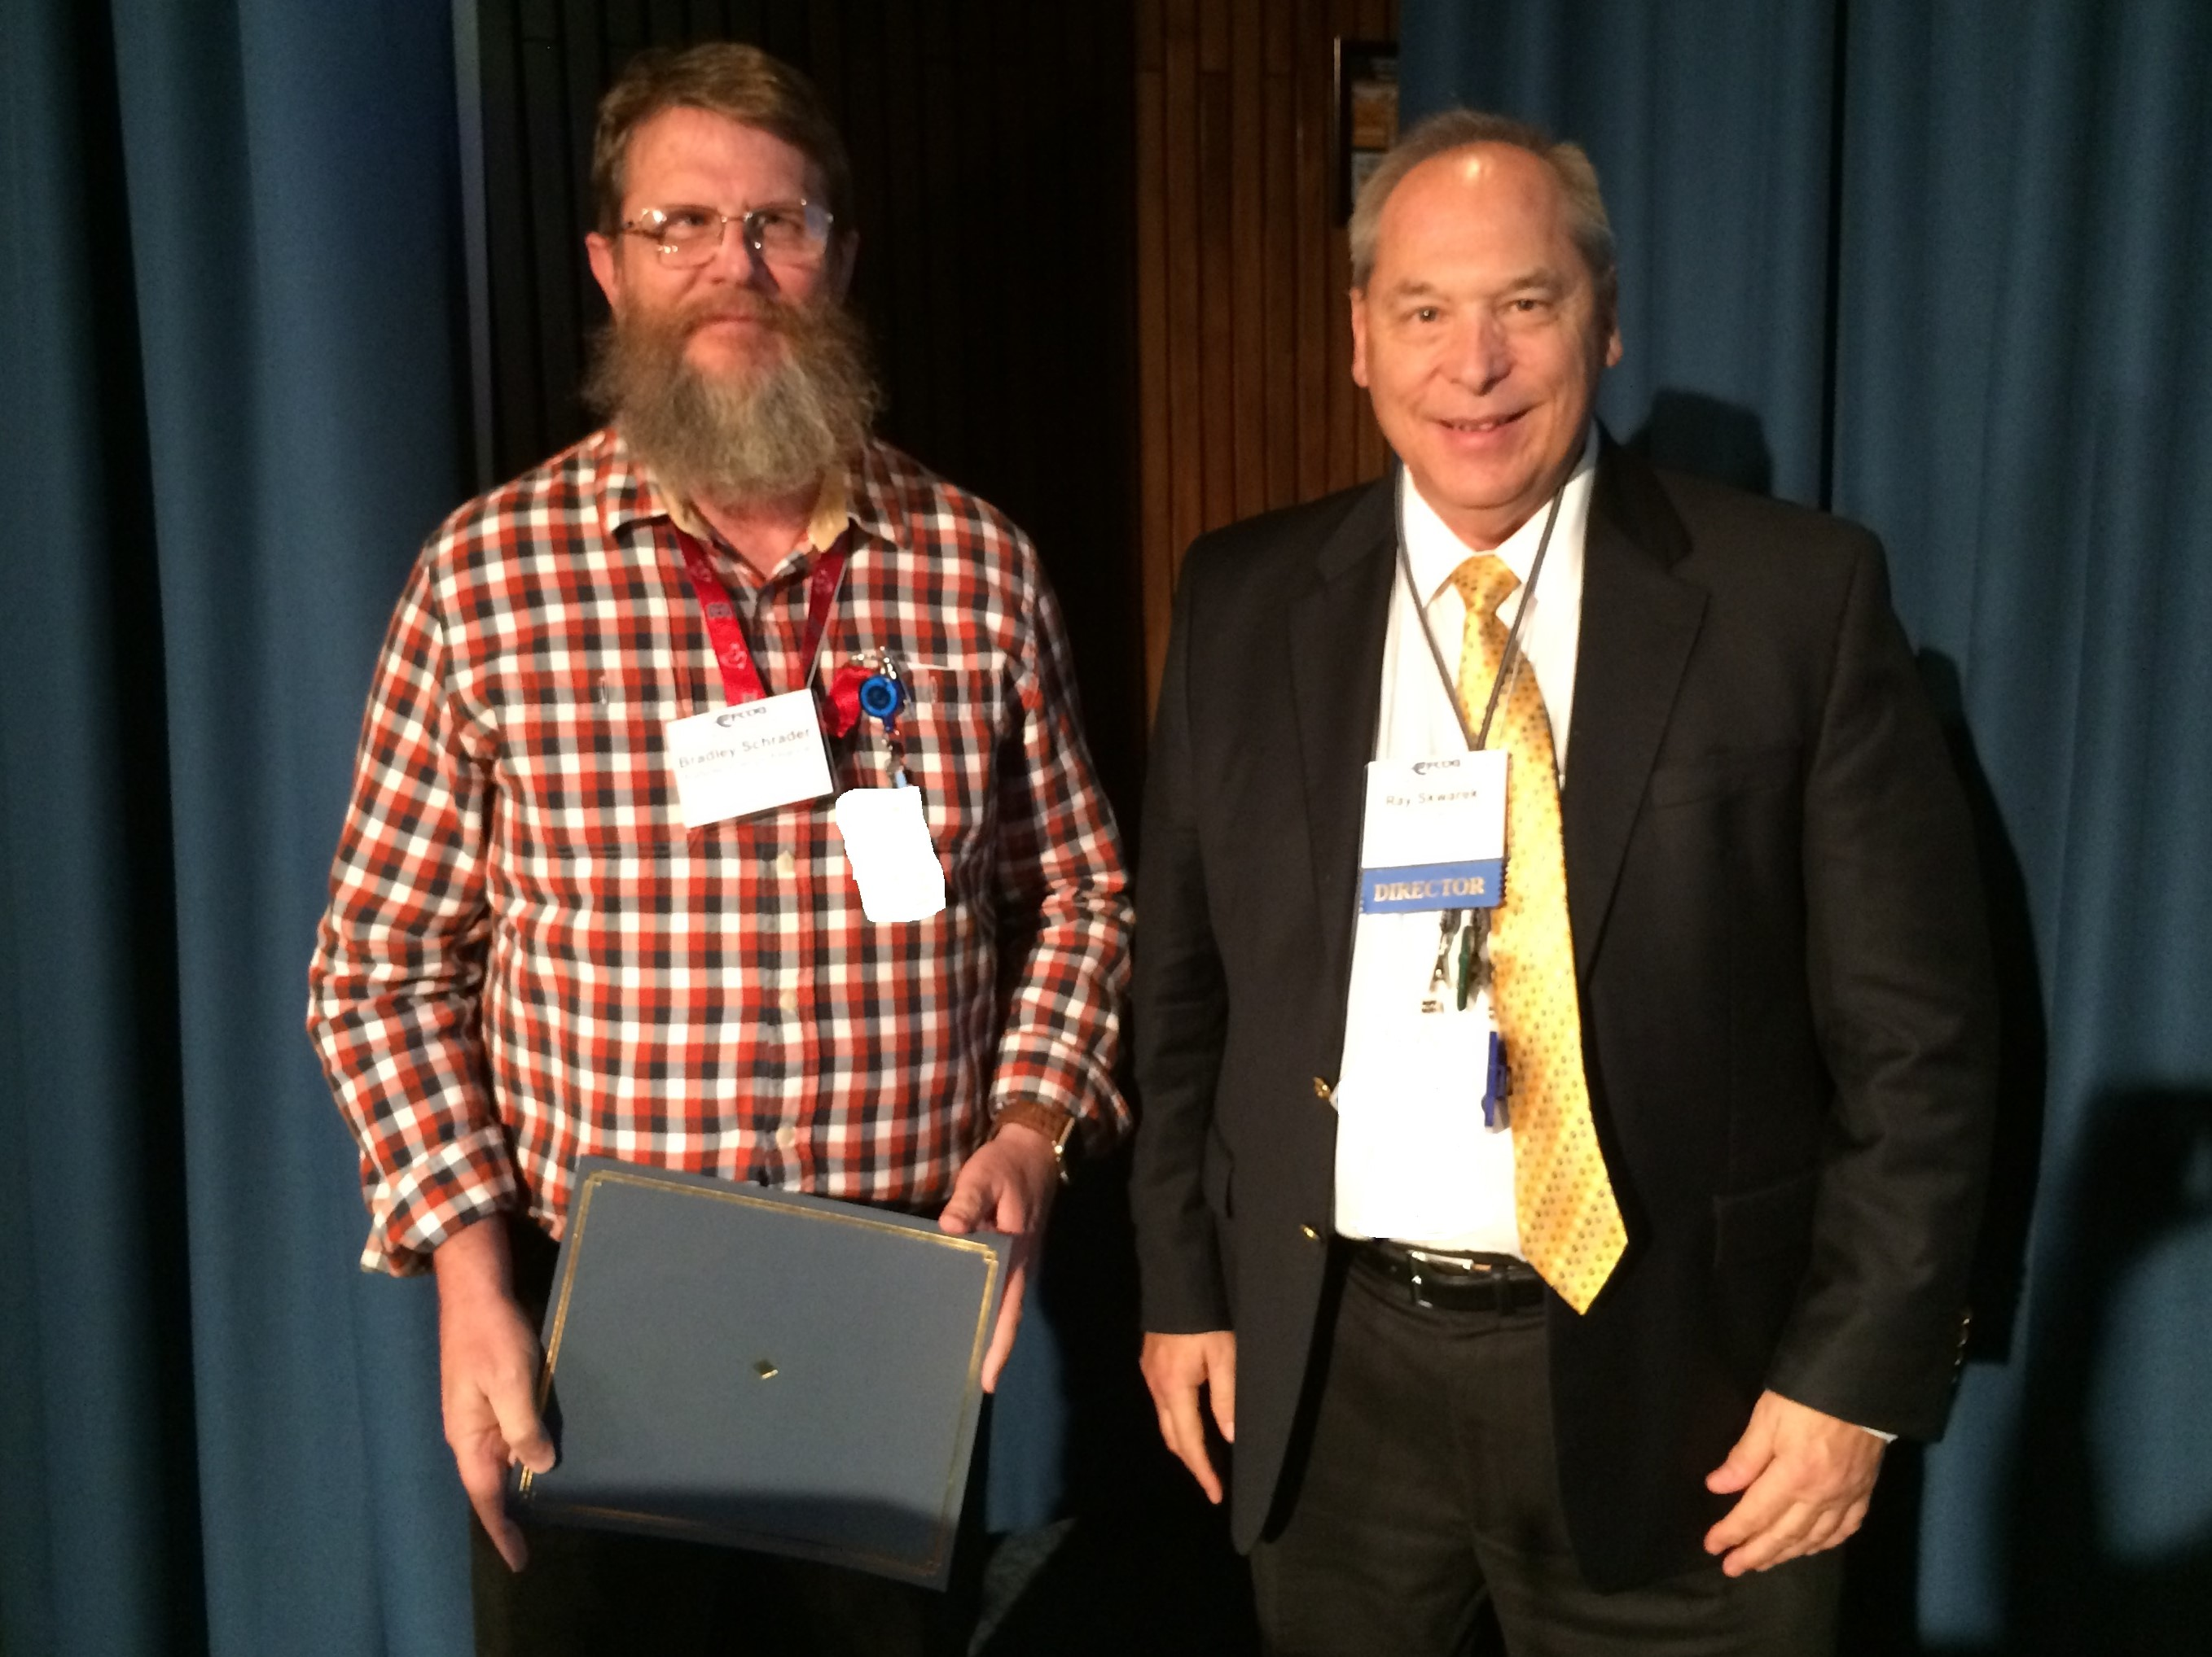
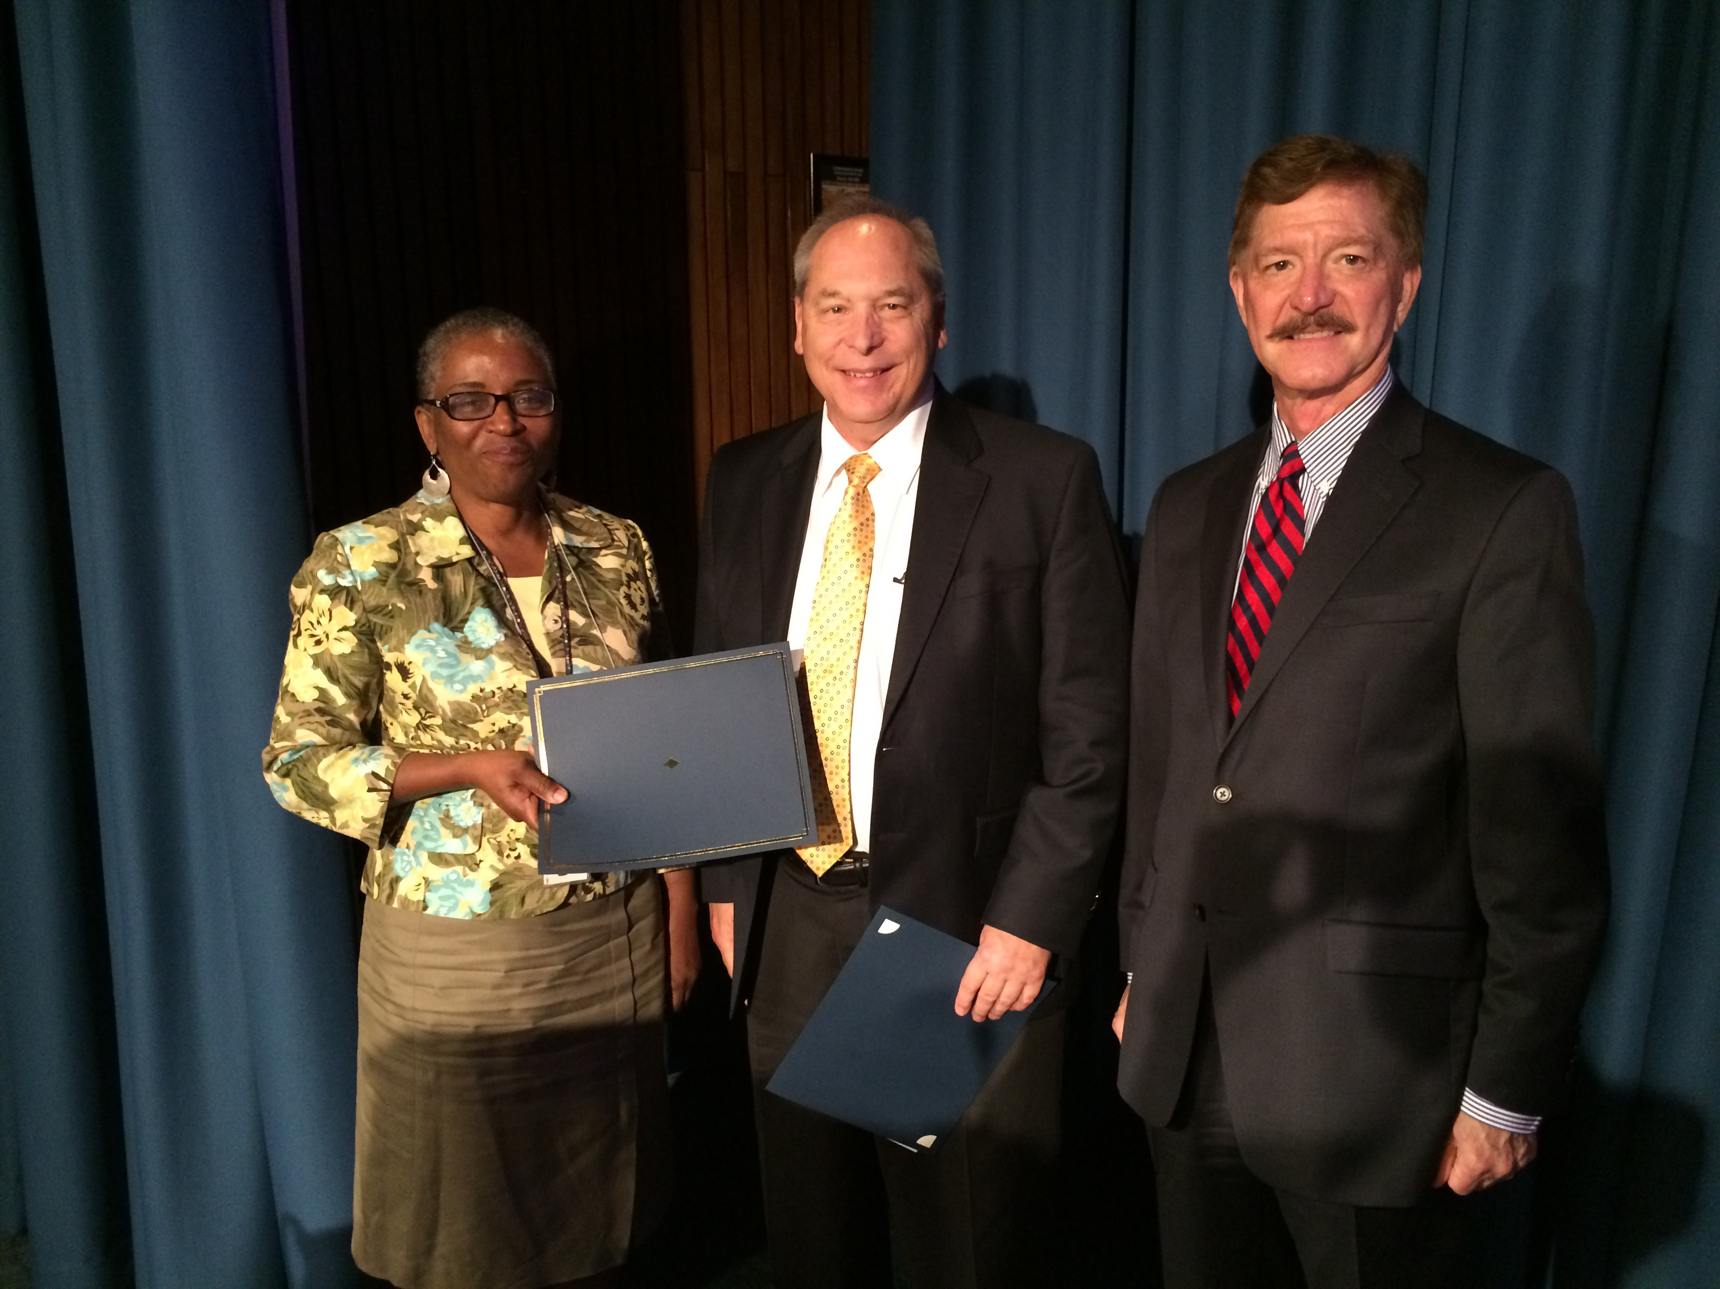
Recent EFCOG Award recipients

Slide 12
EFCOG Recent Accomplishments
Developed a gap analysis on compliance with the GAO’s 12-step cost estimating guide.
Began task groups within the Project Management Working Group on risk management, cost estimating, and start-up and commissioning to address key project issues that may impact cost and schedule.
Supported the draft revision of DOE Order 426.2 (Training) by providing SME review.

Slide 13
Congratulations to the 2018 EFCOG Annual Award recipients! A full list of award recipients will be on the website shortly.
www.efcog.org

Slide 14
Welcome New Members
Arcadis US, Inc.
Fire & Pump Service Group
Four Rivers Nuclear Partnership
Mission Support and Test Services
N3B
PAE Inc.

Slide 15
EFCOG Recent Accomplishments
Continued development of the Training Reciprocity Program. This program has the potential to significantly reduce costs due to time lost in taking the same course work multiple times and multiple sites.
Supported the revision to DOE Order 435.1 (Waste Management) by providing SME review. Waste Management Working Group has significantly contributed to sections of the Order, especially in the WIR determinations.
Completed several safety guides and conducted workshops in safety functional areas including electrical safety, laser training, nuclear and facility safety, and fire protection. Safety Working Group continues to be an integrator on safety functional areas and relied on heavily by DOE

