Slide 1
NNSA Office of Safety, Infrastructure, and Operations Transforming Safety Oversight Kelli Markham, PhD 06/06/2018

Slide 2
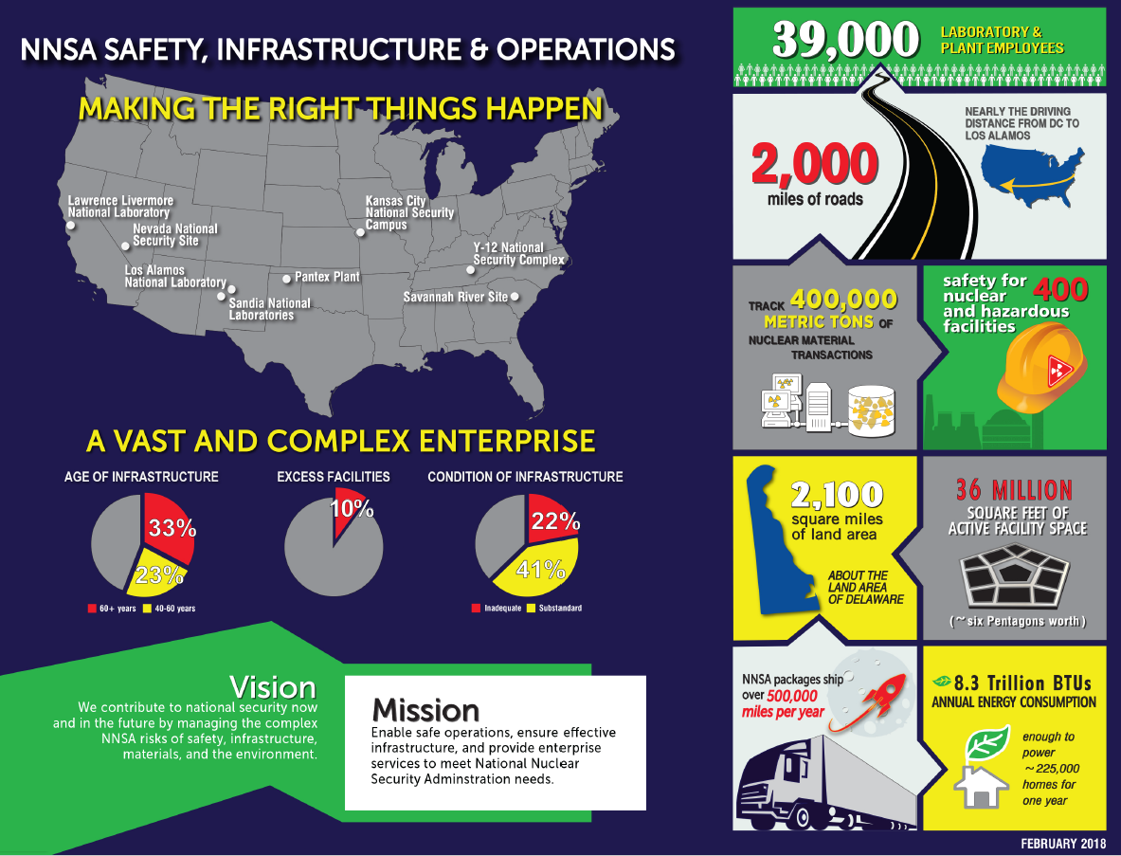
The NA-50 Mission

Slide 3
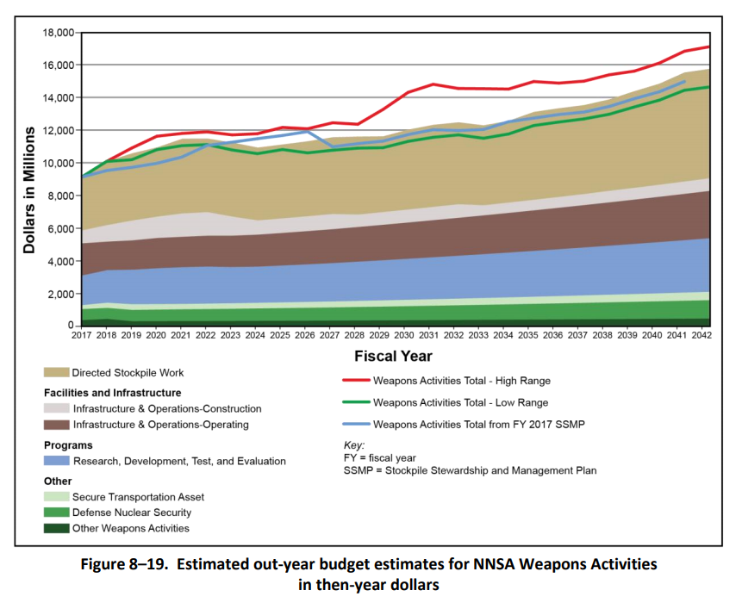
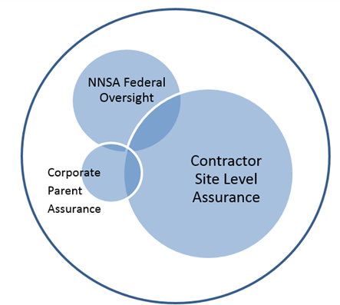
Background
The Enterprise needs are changing:
Workload is increasing
Federal staffing will remain constant
NNSA Management and Governance is under scrutiny
NNSA Governance is transforming to a new model of “One NNSA”
NNSA’s New Oversight Model
NNSA’s Upcoming Workload
Notes:
http://www.napawash.org/2017/1937-report-1-on-tracking-and-assessing-governance-and-management-reform-in-the-nuclear-security-enterprise.html
(Link to the National Academy of Public Administration March 2017 Report)

Slide 4
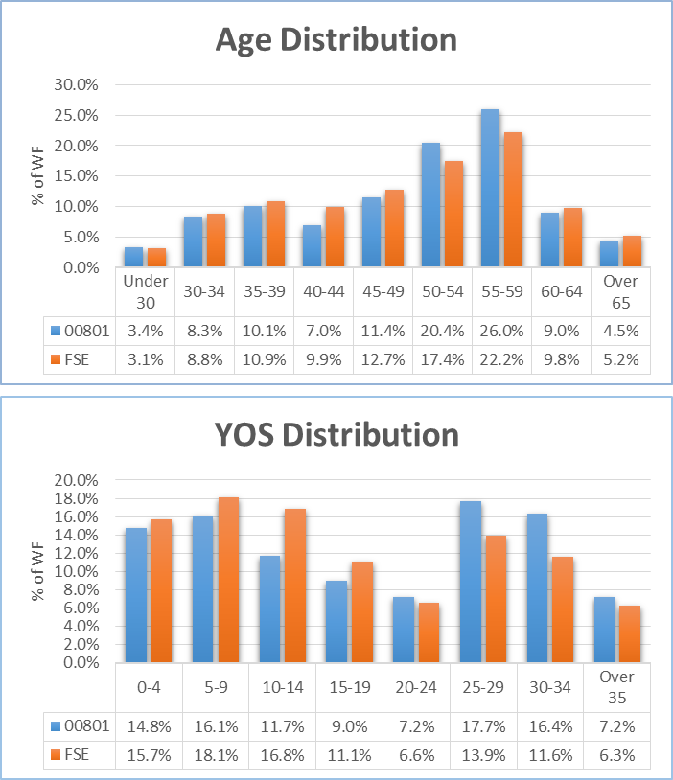
The Burning Platform

Slide 5
Background
Consistent with NNSA’s Implementation Plan for Governance and Management
We must do oversight smarter, more efficiently, and more effectively with the same set of resources
With our aging workforce, we must move from an expert based qualitative system to a more systematic, risk-based approach in our oversight
We must apply lessons learned from industry and modernize our operating practices in how we structure our oversight with both the contractor and Federal organizations
Modernizing our approach to safety oversight
Notes:
http://www.napawash.org/2017/1937-report-1-on-tracking-and-assessing-governance-and-management-reform-in-the-nuclear-security-enterprise.html
(Link to the National Academy of Public Administration March 2017 Report)

Slide 6
Two Safety Pilots
In response to the changing needs of NNSA, NA-50 has chartered two pilots to transform our approach to safety oversight. Both pilots aim to improve efficiency, and establish an integrated approach to safety management:
Safety Basis Pilot
Maximizing shared human resources for safety basis review teams
Standardizing best practices for safety basis
Safety Oversight Pilot
Improving information flow from Field SMEs to Senior Management
Exploring modern IT capabilities for consolidated data management
Notes:
This pilot is a response for our need to change.

Slide 7
Pilot Goals
Choose a scalable models for initial roll-outs
Use modern data sharing techniques
Coordinate resources between Field Offices, Program Offices, and Functional Offices for an integrated approach to safety management.

Slide 8
Scoping the Pilots
Problem Statement
Current State
Target Design
Execution Plan
Goal Statement
Problem Statement: NNSA Safety Oversight is performed at varying levels of maturity with a multitude of static, lagging, and uncoordinated data sources that limit data analysis and decision makers’ ability to manage risks.
Goal Statement: Develop a process for converting available data into useful information for decision makers to understand, communicate, and leverage resources to manage risks.

Slide 9
Current State and Target Design
Current State
Target Design
Human resource intensive
Static, paper driven processes
Governance oversight model at varying levels of maturity
Limited quick response to changes and new information
Existing data sources are lagging and focused on negative trends
Limited leveraging of existing data to inform decision makers
Focused resource management
Dynamic, data driven processes
Standardized integrated approach to oversight and analysis
Agile, oversight model optimizing workforce across the enterprise
Awareness of all work performance
Risk informed oversight decision making

Slide 10
Why should you care about these pilots?

Slide 11
Proof of Concept

Slide 12
Proof of Concept

Slide 13
Proof of Concept

Slide 14
Proof of Concept

Slide 15
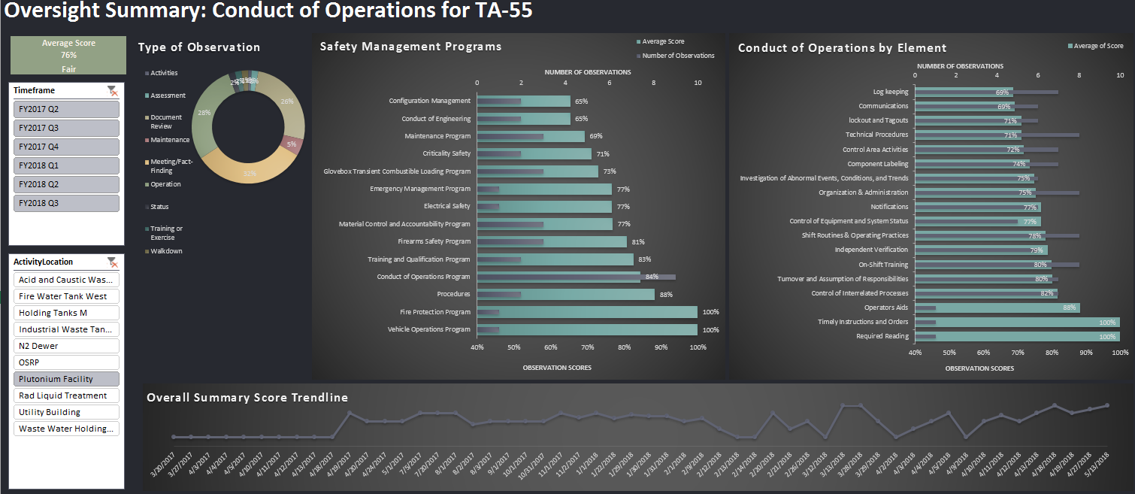
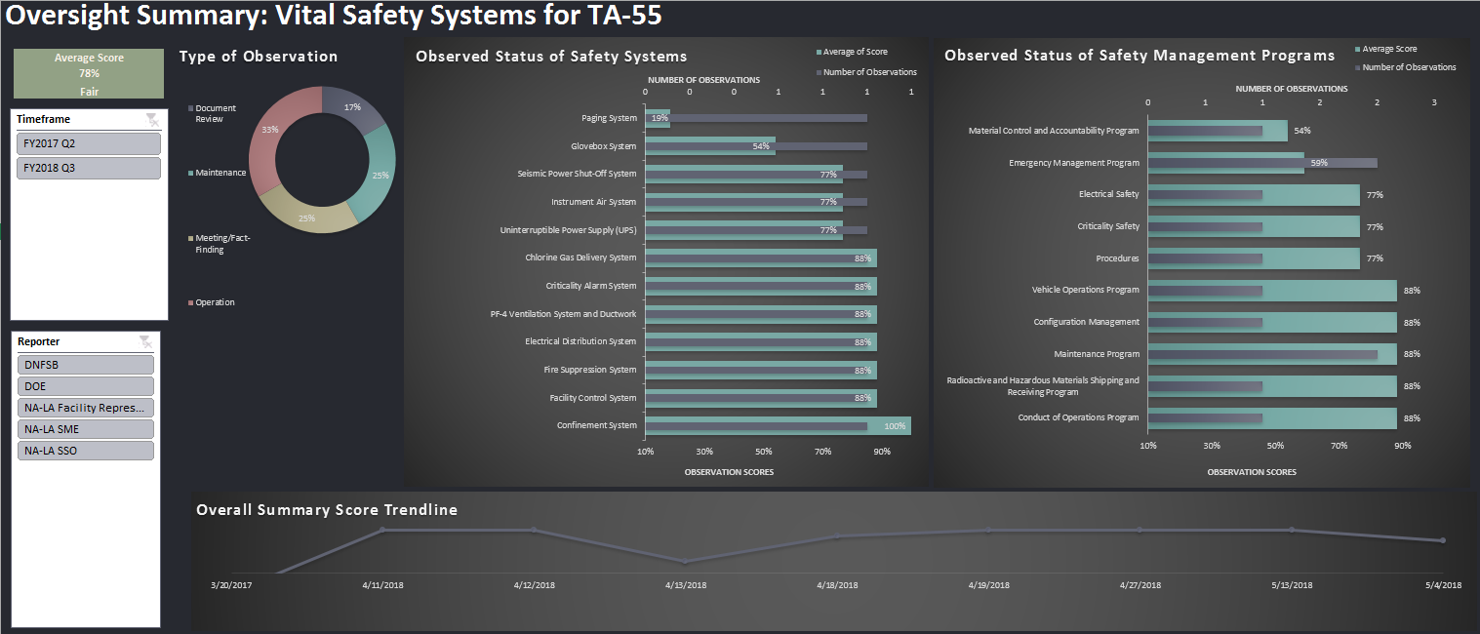
Concept Dashboards
These two concept dashboards convert oversight observation logs into interactive dashboards, slicing the data by any desired pivot:
Type of oversight
Con-Ops elements
Safety management programs
Vital safety systems

Slide 16
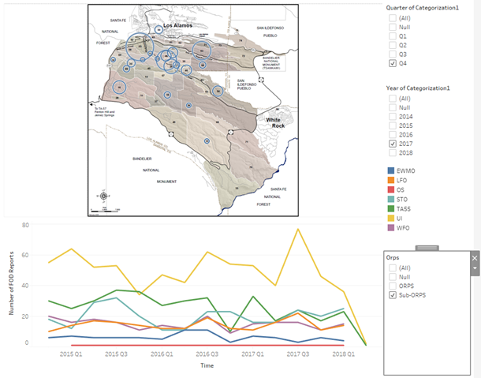
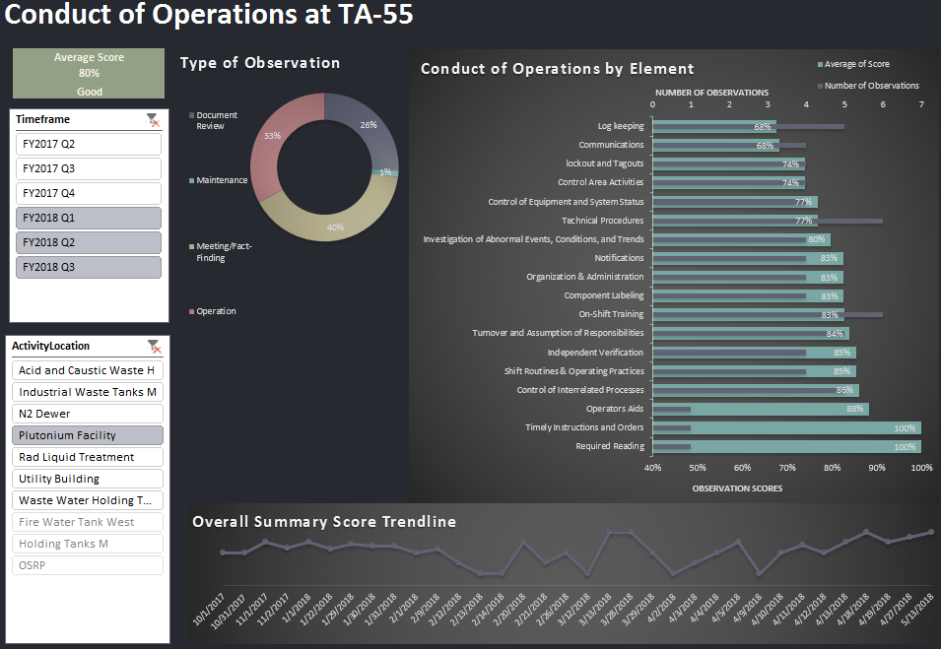
Multiple Visual Dashboards
Create visualizations and dashboards customized to the decision maker:
A view of Los Alamos from 20,000 feet, or
A detailed look into a specific SMP within a single facility
1) Site-Wide Display of Recent Events
2) Conduct of Operations at TA-55

Slide 17
Why should you care about these pilots?
NNSA will be using this data to inform decision making.

Slide 18
Points of Contact
Kelli Markham, Executive Champion
Kelli.Markham@nnsa.doe.gov
301-903-9252
James Goss, Safety Basis Pilot Team Lead
James.goss@nnsa.doe.gov
865-574-4335
Conrad Valencia, Safety Oversight Pilot Team Lead
conrad.valencia@nnsa.doe.gov
505-845-4776

