Slide 1
Cyber Requirements and Risks FY2022 EFCOG Annual Meeting
Bridgitte Mase Boston Government Services, LLC
CSWG Working Group Chair
June, 2022

Slide 2
Main Topics
1. Common Cyber Challenges
2. Securing the Supply Chain
3. FITARA Score Card
4. Executive Order 14028
5. Understanding Zero Trust
6. Risk Reduction Basics

Slide 3
Common Cyber Challenges
Controlling Access
4.6 billion active Internet users (in 1990 there were less than 1 million)
Technology improvements have increased speed capabilities – more data
Hacking tools are readily available and free
Everything is “internet-enabled” even when it is not needed
Technology Spending
Only 2.3% of technology dollars are spent on security
Lack of Visibility
Executives need to understand their cyber landscape and current risk profile
Visibility is limited at best
Legacy Technology
Unstructured data, obsolete technology, inadequately protected systems
Ransomware
Damage exceeded $20B in 2020
Cost of data loss due to cybercrime estimated at $2.5T in 2021
Insider Threat
34% of data breaches involve insiders
Discovery and Recovery Times are Unacceptable
Average breach is unknown for 7 months or longer
Increasing number of requirements without the resources to implement

Slide 4
Cybersecurity Threats in the Supply Chain
Counterfeiters inserting counterfeit products into the Supply Chain
Insiders causing intellectual property loss, or system destruction
Foreign Intelligence Services used to gain information or to interrupt/take over mission operations (malicious code insertion, modification of functionality)
Terrorists seeking to penetrate or disrupt the supply chain to implant unwanted functionality for information gathering, or disable systems/cause destruction
Industrial Espionage/Cyber Criminals seeking ways to penetrate supply chain to gather information or disable/cause destruction
Inability to obtain technology in the time required to support critical mission operations

Slide 5
Supply Chain Providers
System Integrators
Suppliers
Manufacturers
External Service Providers, including Managed Service Providers

Slide 6
Supply Chain Considerations
Technology Products (equipment/hardware, software) - used throughout the organization to support all business and mission functions
Some externally owned and/or managed
If other organizations are not coordinating with IT/Cyber, there is potential for severe cybersecurity concerns
Services
Service providers will need some type of access to perform services, which must be understood, documented, and managed
Roles and responsibilities need to be understood, documented, and managed (MOU or ISA, depending on specific needs)
Contractors
Contractors should follow the same or more restrictive policies and procedures as employees
Access needs to be controlled for contractors just like employees

Slide 7
Intent of FITARA
The Federal Information Technology Acquisition Reform Act (FITARA)
CIO authority enhancements
Enhanced transparency and improved risk management in IT investments
Portfolio reviews
Data Center Optimization Initiative (DCOI)
Maximize federal strategic sourcing initiative
Includes all programs that use IT, not just IT Programs or Line items

Slide 8
FITARA Score Card Areas
CIO Authority Enhancements – How well are IT investments incrementally implemented
Transparency & Risk Management - Tracks the degree of risk in major IT investments.
Networx Transition – Tracks telecom contract transition to the Enterprise Infrastructure Solutions (EIS) contracts (required before May 2023).
Portfolio Review – Grades IT portfolios in ability to increase efficiency, and reduce waste and duplication.
Federal Data Center Optimization Initiative - 50% of grade = agency met or exceeded planned savings goal. 50% based on performance metrics in: energy metering, power usage effectiveness, virtualization, server utilization, and facility utilization.
Modernizing Government Technology Act (MGT) - Use of working capital funds (WCFs) to support IT modernization and security to facilitate the CIO being in charge of capital IT decision making.
Cyber (Federal Information Security Modernization Act (FISMA)) - Tracks ability to continuously monitor their networks using tools to mitigate and remediate cyber threats.

Slide 9
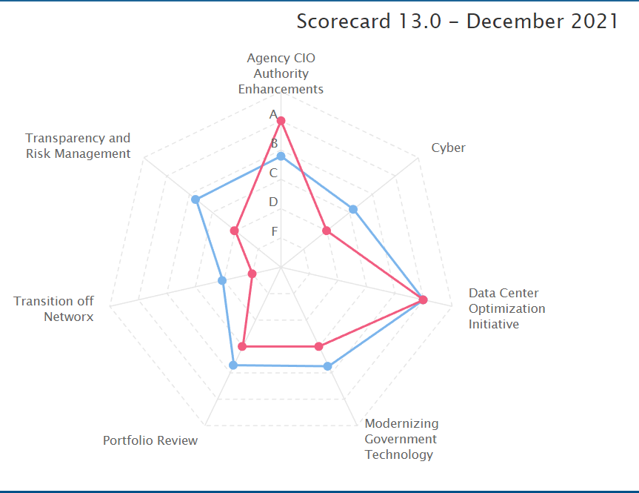
2021 FITARA Scores
Gov Average – Blue Lines
DOE – Red Lines

Slide 10
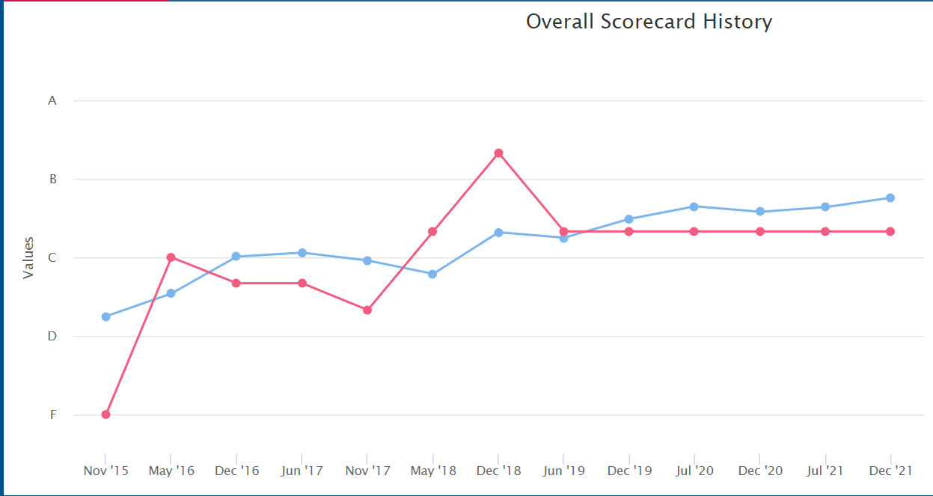
FITARA Overall Score History
Gov Average – Blue Lines
DOE – Red Lines

Slide 11
Improving the Score
Ensure sites meet deadlines listed in Plans of Actions and Milestones (POA&Ms)
Ensure that any assessment findings are promptly addressed – No Repeat Findings
Stay informed of current risks, changing requirements
Be vigilant and review data call metrics
Communicate and ask for help early
Eliminate legacy technologies

Slide 12
Executive Order 14028
1. Remove Barriers to Threat Information Sharing
Requires IT Service Providers to share breach, threat, and intel
2. Modernize and Implement Stronger Cybersecurity Standards.
Uses secure cloud services and a zero-trust architecture.
Mandates deployment of multifactor authentication and encryption.
3. Improve Software Supply Chain Security.
Implements baseline security standards for software
Creates a pilot program that marks software as secure or not
Leverages purchasing power to demand security by design
4. Establish a Cybersecurity Safety Review Board
Reviews post-incident investigations and recommendations
5. Create Incident Response Playbook
6. Improve and Standardize Detection of Cybersecurity Incidents
7. Improve Investigative and Remediation Capabilities
Creates cybersecurity event log requirements

Slide 13
Understanding Zero Trust
Principles:
Trust is never automatically granted
Access in continually evaluated
Common Implementation Methods
Enhanced Identity Governance
Micro-Segmentation
Network Infrastructure and Software Defined Perimeters
What do you need to know?
Requires all sites to rearchitect access control and authentication processes
Expensive and time consuming
Requires a FULL understanding of all systems, applications, users, and both business & operational processes

Slide 14
Risk Reduction Basics
Basic Cyber Hygiene
Comprehensive, on-demand system inventory
Vulnerability Scanning and Patch Management
Security Monitoring
Strong Incident Response Capabilities
Culture of Cybersecurity Awareness & Vigilance
Strong, Comprehensive Encryption
Secure the Supply Chain
Build in Cyber Resilience
Anticipate and Prepare for Attacks
Promptly Recover from Attacks
Adapt to Adverse Conditions, Stresses, and Compromises

