Slide 1



Supply Chain Initiative
Glovebox Subcommittee
June 21, 2022

Slide 2
  Charter
    Identify Supply Chain Challenges / Pit Production
    Provide Recommendations to NNSA
  Team
    Mark Edelson – Sponsor, NNSA-APM
    Co-Chairs – Scott Gustafson, Merrick / Bill Stephens, Omega
    Matthew Nuckols, SMSI; Tony Wampler, Merrick
    Dean Shipley, Honeywell
  Approach
    Understand Extent of Challenge (Supply vs Demand)
    Survey DOE/NNSA sites and supplier base
    Apply feedback from industry
    Provide creative solutions – Think Big!
Glovebox Subcommittee
Charter
2

Slide 3
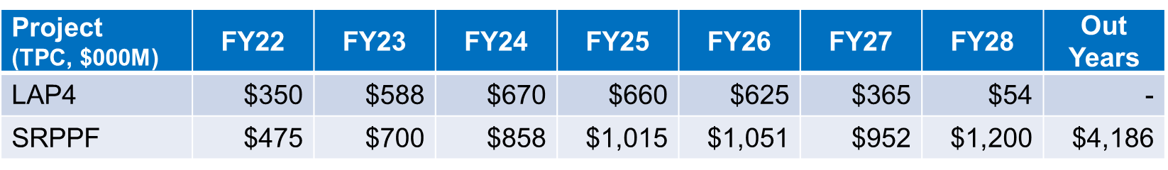
  Historically large demand from Nuclear Security Enterprise
  Demand will exceed supply. Driven by:
    Mission for production (W87-1)
    Legal requirement for pit production
  Opportunity to influence industrial base
  Cross-site competition and market response if not managed
  Industrial supply
    Rather small, but highly talented industrial base
    Inconsistent demand over decades => Fragmented supply
    Mix of both small, boutique fabricators and large fabricators
Glovebox Subcommittee
Scene Setter
3

Slide 4
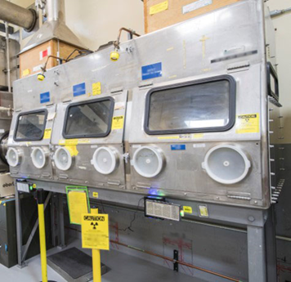
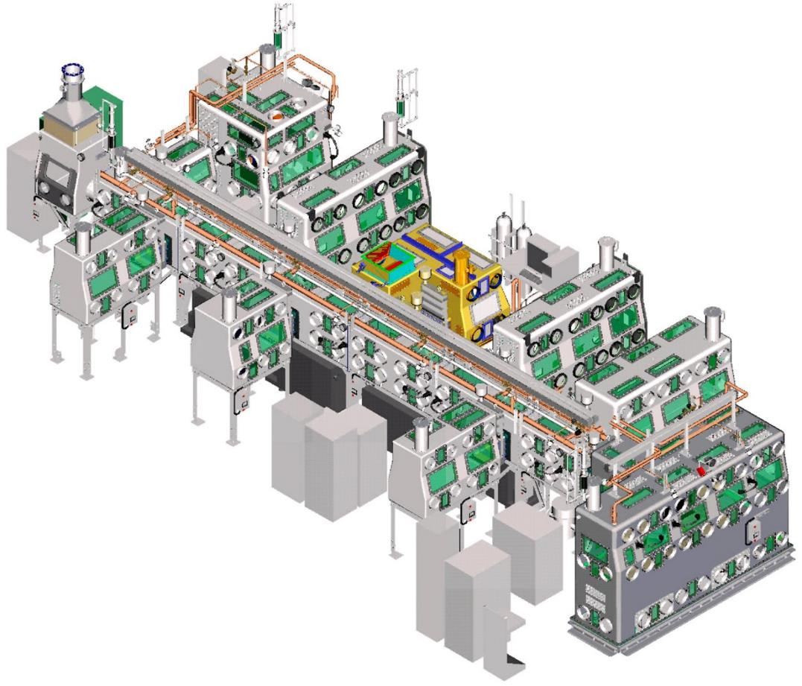
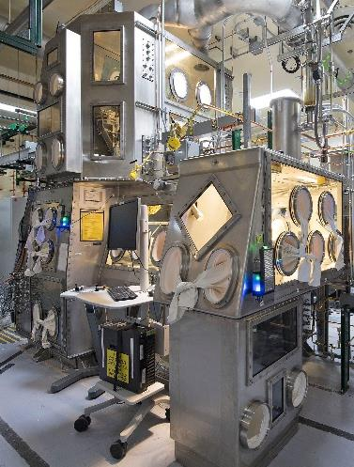
  Glovebox Attributes
    Highly complex, regulated and labor intensive
    Limited opportunity for automated fab techniques
    Integration with equipment
    Not all gloveboxes are the same
Glovebox Subcommittee
Scene Setter - Gloveboxes
4

Slide 5
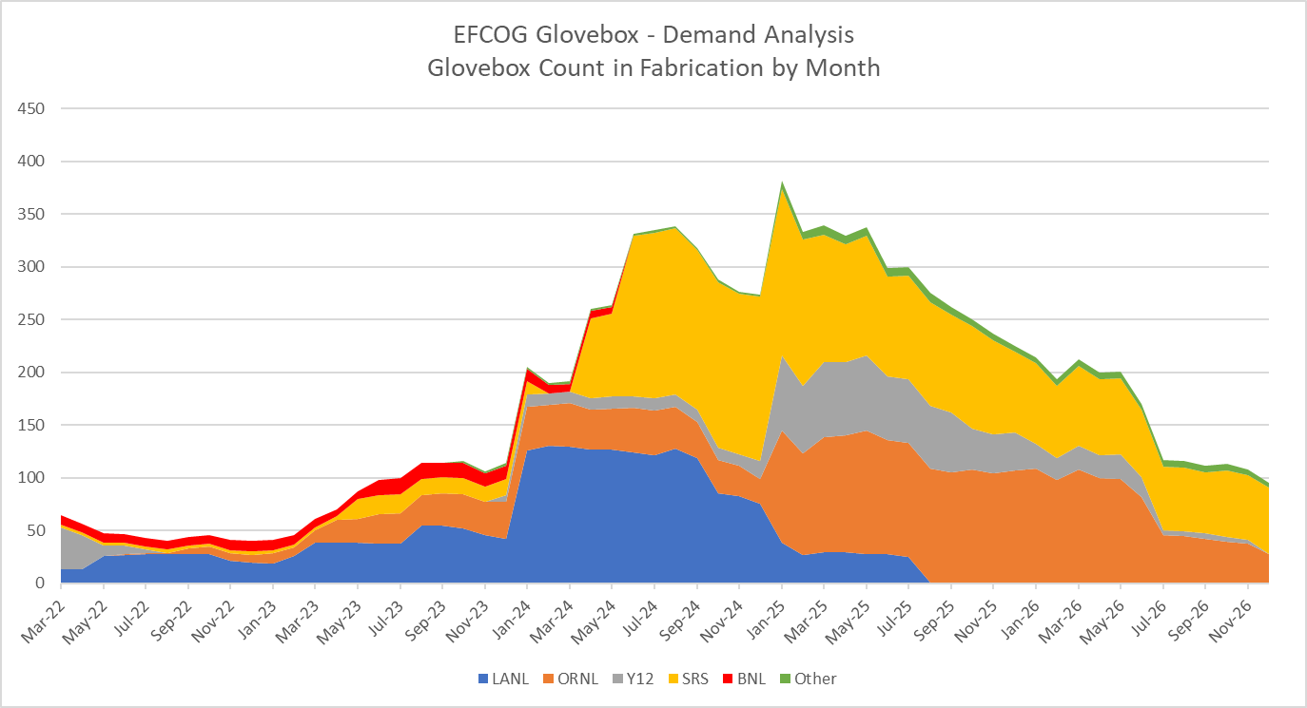
Demand Forecast
Major Drivers
Project | Site | # of GBs
LAP4 | LANL | 52
CMRR | LANL | 42
SRPPF | SRS | 371
LPF | Y-12 | 58
ISED | ORNL | 143
MIRP | BNL | 10
LANL 10 Pit Per Year Milestone
LANL 30 Pit Per Year Milestone
Historic Capacity
5

Slide 6
  Supply Base Attributes
    Survey to 18 suppliers, with 15 responses
    4 to 6 suppliers with historically larger capacity / experience
    Average 18 years of GB experience
    Average of 25 skilled glovebox fabricators each
    3 with > 50% of revenue from GBs; most < 20%
    Several with ASME NQA-1 Programs
    Limited engineering and design capacity (shop drawings)
    Average capacity highly variable by supplier
    Self-reported capacity ~200 to 300 GBs / year (Optimistic?)
Glovebox Subcommittee
Supply Base
6

Slide 7
  Constraints
    Labor supply is largest constraint
    Equipment and space not primary limitation
    Material supply presents some limitations
  Efficiencies
    Standardize design to greatest extent practical
    Repeatability of design features (windows, gloveports, etc.)
    Use of American Glovebox Society standards
    Standardize contracting terms
    Standardize quality assurance / control requirements
Glovebox Subcommittee
Constraints &
Efficiencies
7

Slide 8
  Acquisition Opportunities
    Motivate suppliers to expand
    IDIQs with early payments tied to training / materials
    Competitive or sole-source task awards
    Central IDIQs for material procurements / GFE
  Expand Capacity
    Expand existing suppliers
    Identify new (RFI) - Unlikely
    Provide $ to onboard trades, prior to fabrication
    Ensure designs are mature (minimize change)
    Minimize downtime (hold points) / on-site liaisons
    Automate where feasible (e.g. welding, cutting, etc.)
    Standardize quality assurance / control requirements
Glovebox Subcommittee
Recommendations
8

Slide 9
  Streamline Demand
    NNSA must prioritize or the market will
    Flatten the curve / maximize just-in-time delivery
    Coordination amongst DOE/NNSA sites and M&Os
  Industry Engagement
    NNSA RFI released June 1 – complements EFCOG work
    Industry day at AGS conference
    Transparency on demand and designs / COMMUNICATE!
    Team with valued, proven suppliers
    Act on supplier feedback
  Other Opportunities
    Defense Production Act Title III Funding
    Grants, Purchase Commitments, Loans, Loan Guarantees
Glovebox Subcommittee
Recommendations
9

Slide 10
  Publish Subcommittee Report – June 30
  Collaborate with NNSA
    Review NNSA RFI responses – June 30
    Identify highest potential opportunities
    Support / consult NNSA on implementation
    Identify new EFCOG subcommittee members as needed
  Timing is Critical
    Procurements from LANL starting now.
    Peak in 2024 / Ramp up time needed.
Glovebox Subcommittee
Path Forward
10

