Slide 1
Tailoring of 413 for Low Risk Conventional Construction Projects
Frank Sheppard
June 21, 2022

Slide 2
Low Risk Projects
Formed a task group to identify criteria to define the category of low risk projects
Utilize data and approaches which were being utilized by NNSA for Pilot Projects
Identify those areas (earned value, critical decisions, approval authority) that should be tailored for low risk projects

Slide 3
NNSA Pilot Projects

Slide 4
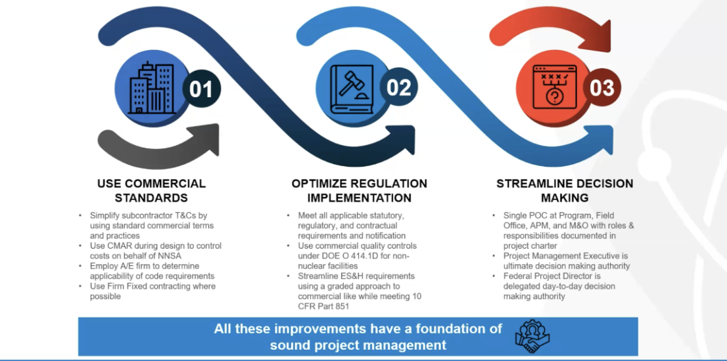
Approach to Pilot Implementation

Slide 5
Discussions with NA-50
During discussions with NA-50, NA-50 identified that it was developing an approach for low risk conventional construction projects
Task Force began supporting and supplying information and approaches to support the NNSA initiative
Approach was approved by the Administrator and a meeting with S-2 is being pursued
Approach included low risk capital construction projects with a Total Project Cost up to $100M

Slide 6
Next Steps
Continue to support NNSA with additional information, criteria, as well as definition of what projects would fit into this category of low risk capital construction projects
Support Implementation

