Slide 1
Training Working Group FY2023 EFCOG Annual Meeting
Amy Loevy, BNL (incoming)
Shayne Eyre, Battelle/INL (outgoing)
Working Group Chair
June 21, 2023

Slide 2
Training Working Group
Chair: Amy Loevy, BNL (incoming); Shayne Eyre, INL (outgoing)
Vice-Chair: David Yakonich, NNSS
Secretary: Melissa Walker, LANL
DOE Liaison: Gabriel Pugh, National Training Center
EFCOG Sponsoring Director: Kelly Beierschmitt, LANL
Course Efficiency Subgroup
Chair: Fallon Holloway, Hanford
Vice Chair: Ted Giltz, NTC/NIEHS
Training Collaboration Subgroup
Chair: David Yakonich, NNSS (acting)
Vice Chair: Eric Meakins, CPC

Slide 3
TWG Participation
The Training Working Group has broad participation with the right people and representation from across the DOE complex. Monthly learning opportunities regularly have 75+ people attending.
Participants are especially engaged during monthly sessions and annual working session.
Reaching beyond single reps from each site (i.e., manager). Now engaging all levels and positions within training
Subgroup leadership recently changed – have strong, committed leadership with right skillsets and active participation
Annual meeting in March 2023 had largest attendance at 254 (75 in person, 28 hybrid, and 151 virtual)
Building new task teams with enthusiastic start

Slide 4
Training Working Group Strategic Initiatives
Training Collaboration Subgroup
Best practice sharing, skill building, network development
Strategic communications venue key to building strong community – helps engage people in other TWG efforts
Course Efficiency Subgroup
Common course and resource development and accessibility
Reciprocity, shared course delivery, standard core

Slide 5
Training Working Group Task Teams
Assisting DOE in developing and implementing training regulatory improvements
Key in aggregating sites feedback and upcoming implementation of DOE O 426.2
Training Regulation Development Support
Workforce Development
Diversity, Equity, Inclusion, and Accessibility in Learning
Learning Technology
Develop best practices on relations between business, local schools, etc.
Launched March 2023 with strong engagement
Three focus areas: before hire, during employment, after transition
Building partnership with Safety/Operations Working Group
Develop best practices in how training can support diversity, equity, and inclusion.
Launched March 2023
Develop best practices in use of learning technology, such as VR/AR, content delivery
Launched March 2023 with strong engagement

Slide 6
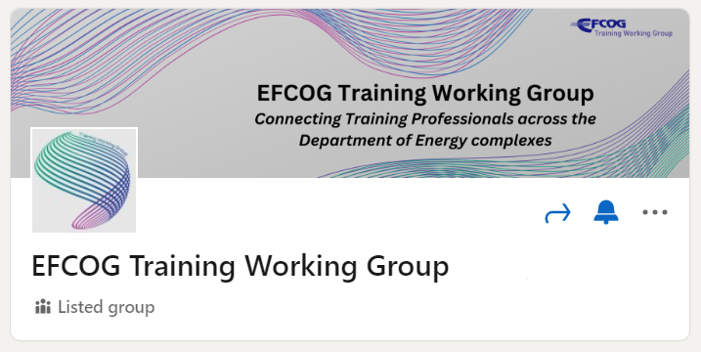
FY23 Key Achievements
Held successful Annual Meeting March 2023
Continued to host Monthly Learning Opportunities
Some topics include microlearning, immersive onboarding, mentoring, “How to Handle Brain Drain”
Building a stronger network of training-related personnel
JLON project has made headway with agreement between NV, Sandia, LANL and LLNL, reducing duplication of common on-boarding training and implementing a means to share training records to reduce manual input of training information.
Increased awareness and use of NTC Reciprocity - New contractors (UCOR, WTP and LLNL) submitted their RW courses for reciprocity evaluations, increasing contractor participation in reciprocity from 6 – 8 organizations.
Began exploring collaboration with Safety/Operations WG in Workforce Development.
Implemented new LinkedIn group for TWG, to encourage collaboration across subgroups and task teams.

Slide 8
FY 2024 Upcoming Focus Areas and Planned Achievements
Assist DOE sites in implementing revisions to DOE O 426.2A and DOE STD-1070-94, “Guidelines for Evaluation of Nuclear Facility Training Programs” (*when released)
Host TWG Annual Meeting in March 2024 (Site tbd)
Continue to expand contractor use of CARDS to share common training assets.
Develop workstreams and key deliverables for each of the task teams.

Slide 9
Issues
How can TWG can support other WGs given current level/type of engagement?
How to engage line workers (Instructional Designers) to support other WGs.
These projects require significant time from typically understaffed groups

