Slide 1
LANL Briefing on Streamlining Initiatives for Construction Projects
Presentation to Energy Facility Contractors Group (EFCOG)
David Teter, Associate Lab Director
Infrastructure and Capital Projects, ALDICP
June 2023
LA-UR-23-26386

Slide 2
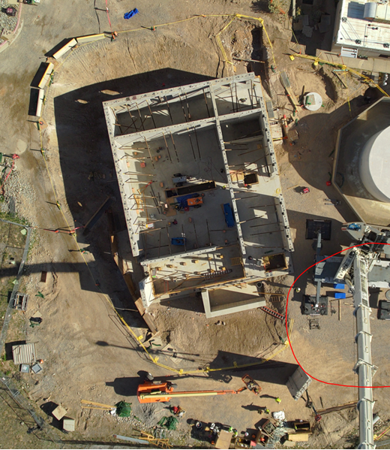

Bottom Line Up-Front
Increased Capacity Required to Meet Current & Future Mission
Unique Opportunity - Leverage DOE’s Enhanced Mission Delivery Initiative (EMDI) to Accelerate Streamlining Initiatives
Evaluation of Project Life-Cycle & Organizational Influence/Interface – Identifies a Plethora of Improvement Opportunities
Streamlining Initiatives for Non-Nuclear/Low Complexity Commercial-Like Capital Projects & Innovative Acquisition Strategies
General Project Initiatives to Streamline & Increase Subcontractor Capacity
  Engineering Improvement Initiatives
  ALDPI Specific Initiatives

Slide 3
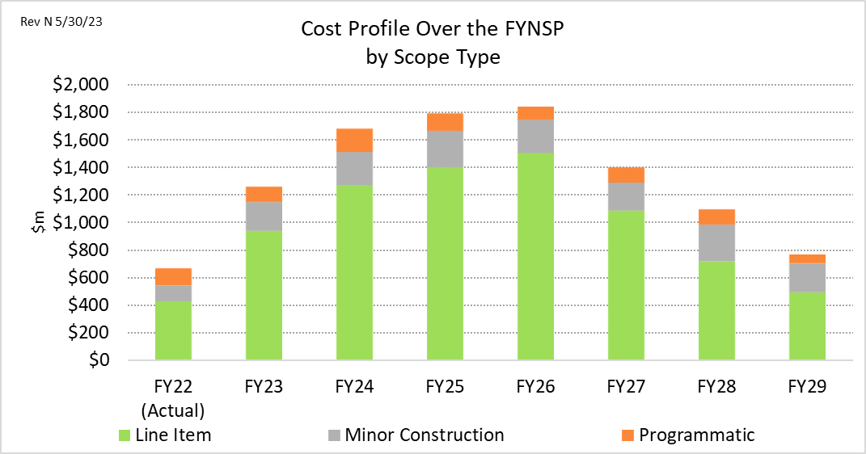
Facility Investments Underpin LANL’s Ability to Meet Current and Future Mission
Los Alamos National Laboratory is currently managing rapid growth in its construction portfolio to support the Pit Production mission.
Estimated Portfolio Project Cost
>$1B/year over the next ~5 years
Primary focus is modernizing the Plutonium Capability
along the Pajarito Corridor
  Equipment Refresh in PF4
  Enhanced security infrastructure for higher throughput
  Transuranic Liquid Waste Facility
  Office Complex
  Proforce Facility
  Supporting Utility Infrastructure
We are also simultaneously modernizing and balancing needs of broader capabilities across the site
    Electrical Capacity, Weapons Engineering, High Explosives, DARHT, LANSCE, & IGPPs (office buildings, warehouses)
Assessing our current capacity, particularly in the area of construction, is central to meeting our commitments and ensuring success of the NNSA mission
Notes:
This preliminary analysis is targeted at understanding the challenges and gaps associated with the capacity of the Laboratory.

Slide 4
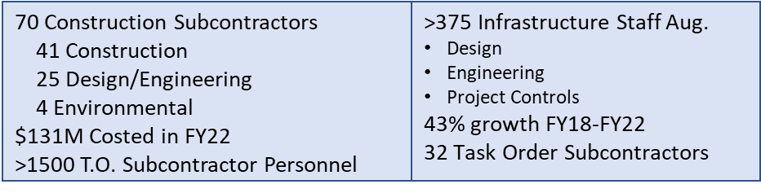
Capacity & Output Has Grown Under Triad
Growing the Workforce
    Project headcount has grown by ~43% since 2018 (e.g., Project Management/Support, Craft)
    Growing the craft workforce (working with Unions to build regional pipelines, expanding subcontractor base, load leveling >1250 LANL craft)
    Managing space constraints - moving as much work offsite as possible (design/engineering, procurement, modular/prefab construction methods)
Leveraging Subcontractors
Building regional subcontractor supply chains reliant on scaling both acquisition and contract management functions
Streamlined LANL process, accelerate adoption of commercial construction approaches
Challenges Remain
Regional competition for sub-tier craft labor suppliers
Housing and transportation (LANL and subcontractor) leading to hiring and retention challenges
# of Projects
Building Our Subcontractor Base

Slide 5
Leverage EMDI - Streamline Project Management at LANL
NNSA’s EMDI report conveys the license and urgency to think differently about how DOE/NNSA Sites operate. A couple of converging factors are driving the need at LANL to disrupt our current project management model, including:
  NNSA’s scrutiny of our capacity to execute construction work – due to unprecedented project cost growth and inability to meet baseline schedules
  LANL’s Pu mission is evermore important in this challenging geopolitical environment – “To Secure America -We Must Deliver.”
  To achieve LANL’s infrastructure milestones and goals, and improve cost and schedule performance, we must resolve to:
    Streamline the Project Management Process – starting with what’s in LANL’s control
    Embrace innovative acquisition and execution methods that resonate with and deemed beneficial by our subcontractors – thus ensuring sustained capacity
    Inventively tailor our overall project management processes based on project complexity and risk, to include 413.3B compliance and oversight, seeking variances for commercial-like construction (e.g., 10CFR851)
    Challenge overly conservative DOE/NNSA interpretations and direction, e.g., EVMS, that have added layers of ‘nonvalue added requirements’ that stifle our project management systems and add cost/schedule
Notes:
Highlight EMDI and the leverage and opportunity it provides to push-back on non-value added requirements and streamline project management processes, e.g., tailoring of low complexity/non-nuclear Line Items.
Blue shade – sentiment from NNSA and the reality that LANL is the near-term/mid-term provider of Pits – critically important due to current geopolitical circumstances.
The flesh tone/shade – LANL specific challenges.

Slide 6
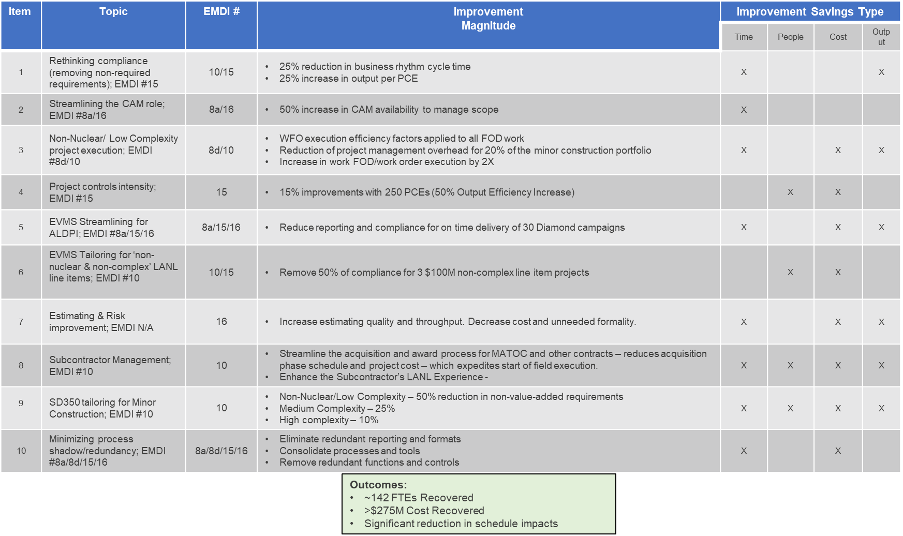
Examples of LANL Streamlining Initiatives
Notes:
Recommendation 8a – Review major processes and procedures to reduce complexity and standardize implementation of requirements across sites.
Recommendation 8d – Implement improvements in how new or changed directives/requirement sets are accepted by NNSA, such that process improvements focus on the need for more formal justifications, cost and mission impact determinations prior to their promulgation.
Recommendation 10 – NNSA should use the existing exemption process to waive low risk commercial-like construction (e.g., office buildings, light manufacturing facilities) from DOE Order 413.3B requirements. Their construction should follow commercial building codes, and wherever possible, adopt approved OSHA and state safety standards, e.g., Cal/OSHA.
Recommendation 15 – Use a standard set of schedule and execution data that sites automatically generate and minimize specialized data calls requiring manual manipulation. In addition, the number of “Federal only” meetings should be held to a minimum and the M&O technical leads should be incorporated, where possible, to brief directly to internal and external groups, including the DOD, Congress, etc.
Recommendation 16 – NNSA’s Office of Defense Program review and reduce process and program controls through a joint HQ, field, and M&O group with the goal of holding the sites accountable for technical execution of the program and incentivize cross-site teamwork while providing transparency and keeping federal managers informed of emergent issues with major cost and schedule impacts

Slide 7
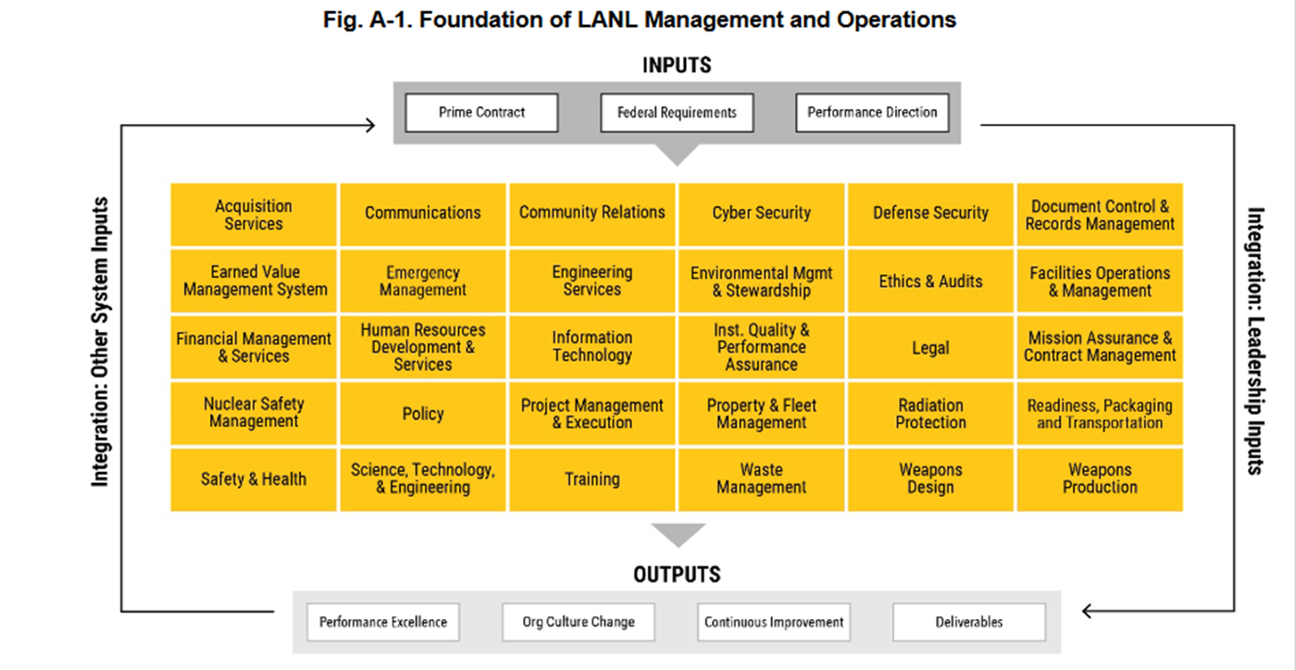
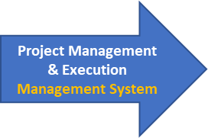
Standard Project Phases
Up to 14 Management Systems Crosscut/Interface Project Phases
Others
Others
Others
Others
Others
“Subcontract Task Force” Formed to Drive a Sense Of Urgency to Streamline Processes and Ensure Effective & Efficient Project Execution/Delivery
Notes:
Key points – Highlights the Magnitude or Potential Areas to Improve Processes – Across the Management Systems:
With up to 14 difference Management Systems interfacing and crosscutting throughout the Project Phases – each system can impose requirements on Triad and/or Subcontractors. Not graphically displayed but this includes Legal, Facilities & Operational Management (e.g., FODs), EVMS for line item, etc.
The obvious are ASM, Engineering, Quality, ES&H, Waste Management and Records Management
Working with and managing these interfaces as they pertain to Capital Projects is essential – to ensure management system processes are streamlined and non-value, non-directive/contractual steps/processes do not creep into the overall project life-cycle. “Shared Fate across all Management Services.”
Takeaway provides the segue way to the next slide – Subcontractor Task Force – and highlights of what’s been accomplished to date.

Slide 8
“Subcontract Task Force” - All-Inclusive Management System Stakeholder with Authority to Streamline Project Execution - Recent Highlights
MATOC Execution – Challenge/Actions
    Streamline MATOC RFPs
        Limited solicitations to Price/Schedule competition only for prequalified MATOC Subcontractors
    Streamline MATOC Acquisition
        April 2023, 54 Projects (FY23 to FY25 execution), submitted to MATOC Subcontractors - solicit input on aligning like/similar projects into ~12 to15 Master Agreements (with multiple Task Orders)
        May 2023, receive MATOC input and interest
        FY23 4th QTR award Master Agreements
Simplify RFPs – Challenge/Actions
    Streamline RFPs - Exhibits and Attachments
      April 2023, FITL & DARHT Vessel pilot – reduced RFP by 25% and enhanced comprehensibility
      May 2023, based on FITL/DARHT Vessel LL - complete review of all Exhibits – to eliminate redundant and nonvalue added language/requirements
Enhance Subcontractor’s LANL Experience – Challenge/Actions
    Voice of Subcontractors - “LANL is a difficult site to execute projects”
      January 2023, approved establishing Subcontractor Mentors/Advocates, to support Mentor Protégés, new/less experienced LANL subcontractors, and subcontractors experiencing safety or performance issues.
        May 2023, initial 3 Subcontractor Mentors/Advocates deployed – Focused on Mentor Protégés and TA-55 Subcontractors
      May 2023, enhance the Mentor Protégé Program/Process – to include Subcontract Mentors/Advocates and R2A2s for Project Management Resources
Steady Determination to Streamline and Enhance Project Execution & Delivery
Notes:
Takeaway intended to stress the sense of urgency.

Slide 9
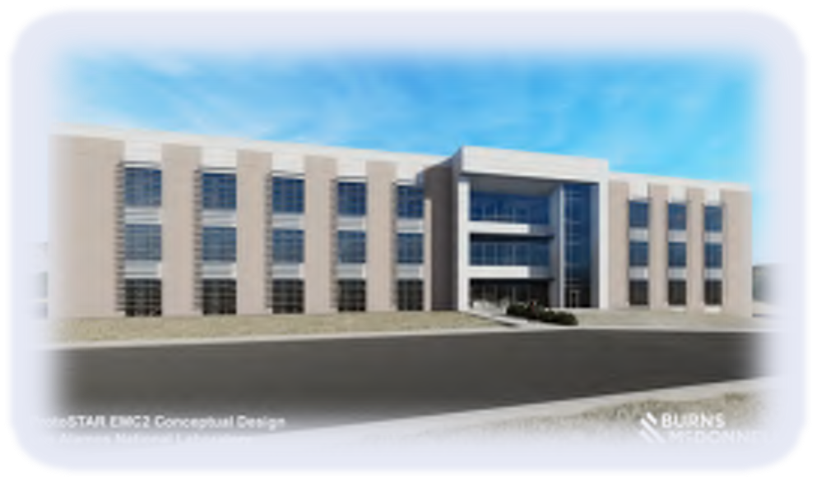
LANL Streamlining Non-Nuclear/Low Complexity Commercial-Like Capital Projects & Innovative Acquisition Strategies
Commercial Execution Practices
  Seeking variances to 10 CFR 851 (use OSHA) & DOE O 420.1C/DOE STD 1066 (use IBC and consensus standards)
  Progressing towards non-complex commercial design methods – Tailored ESM, ProtoSTAR
  Implementing the DOE ProtoSTAR non-complex commercial design standard
    TA-15 office building achieved 100% design on December 13, 2022
    Pajarito Corridor Office Complex (PCOC) facilities
Acquisition Strategies
Single Award Task Order Contracts (SATOCs)
  Master Agreements with Multiple Task Order Releases. Subsequent task order releases are price and schedule only - requiring limited level of effort/resources. A key benefit – provides certainty of work over an extended period of time to subcontractors, which ensures retained subcontractor capacity.
  This acquisition strategy is being used to award:
    Pajarito Corridor Office Complex (PCOC) Projects – five (5) $50M commercial-like office complexes (managed via the EMC² requirements/methods – similar to Minor Construction projects)
    “Prequalified MATOC Subcontractors” Projects - ~54 discrete minor construction projects are being grouped into ~12 to 15 separate master agreements. Contract awards in FY23 and FY24, with execution through FY28.
Construction Manager/General Contractor (GM/GC) (aka CMAR)
  Project delivery is an integrated approach to planning, design, and construction. LANL, designer/AE, and contractors work collaboratively to develop the project scope, optimize the design, improve quality, manage costs and share risks.
  This acquisition strategy is being deployed for the minor construction Weapons Archive Records Facility (WARF) project, initiated in FY23

Slide 10

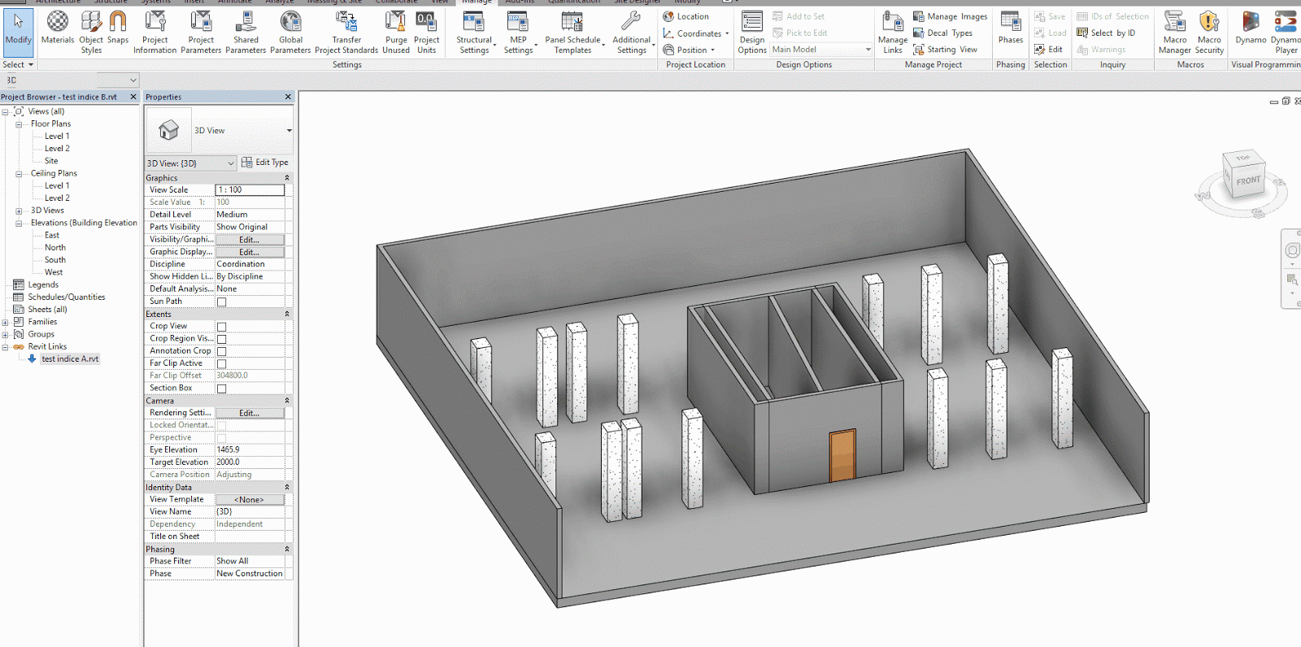
Engineering Streamlining Project Execution
Recent Accomplishments:
Graded Seismic Design Criteria: Allows contractors to use a lower seismic design criteria for qualified projects. Significantly reduces project design and construction cost when used.
Tailored Standards Manual (TSM): Abbreviated/simplified LANL Engineering Standards for commercial-like projects.
Reduced Construction Submittals: Eliminated un-necessary construction submittals in our specifications, resulting in a total 33% reduction of submittals.
Revised Test and Inspection Plan: A simplified template of all Tests and Inspections required for construction project, rather than the subcontractor having to identify/locate from the contract documents.
Where We’re Headed:
Virtual Built Environment (VBE): Collect and utilize Building Information Modeling (BIM) for planning, design, construction, operations, and maintenance.
OLD
NEW
Notes:
Reduced Construction Submittals
How did we reduce our submittals?
1. Engineering leadership and SMEs reviewed every LANL specification over the course of a year to ensure the following:
a. Our submittals are aligned with industry standards.
b. Our specifications match our submittal lists.
c. We extend trust to our subcontractor EORs by eliminating concurrent LANL reviews where appropriate.
Examples of eliminated submittals:
LANL Specification Paragraph Submittal
03 3001 - Reinforced Concrete A-45 Technical data and samples of finish for architectural concrete
07 7600 - Roof Pavers 1.2.A.2 Installation instructions for roof pavers
09 3013 - Ceramic Tiling 1.2.A.3 Manufacturer’s installation instructions for ceramic tiling
Revised Test and Inspection Plan (TIP):
Provides a consolidated listing of the required tests and inspections. Previously the sub had to work through the full set of contractual documents to ensure all tests and inspections were identified/completed. This provides a better understanding to subs to propose and plan their work.

Slide 11
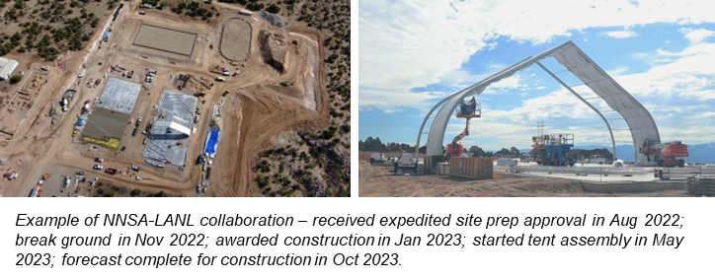
Pu Infrastructure Projects - Streamlining & Increase Subcontractor Capacity
Utilize integrated procurement team to improve consistency and efficiency for contract management.
Utilize integrated Material Assignment Schedule (MAS) for multiple projects – demand forecast and bulk purchase (if possible) to mitigate supply chain challenges.
Improve receipt and inspection, invoice and payment processes.
Bundle service needs (e.g., sitewide helium leak testing) into IDIQ contracts for providing demand forecast and obtaining the required resources.
Establish rapid response teams (for glovebox fabrication; and construction) to address design change, clarification, and issue resolution for keeping the work going.
Improve training implementation and tracking (for enabling qualified workers to perform work)
Same number of signature required to reject and approve Supplier Deviation Disposition Report (SDDR)

