Slide 1
Waste Management Working Group FY2023 EFCOG Annual Meeting
Renee Echols Firewater Associates, LLC
Working Group Chair
June 21, 2023

Slide 2
Waste Management Working Group
WMWG Leadership:
Renee Echols, Chair, Firewater
Tammy Monday, Vice Chair, AvanTech
Jeff England, Secretary, NAC International
DOE Liaisons
Betsy Forinash, EM 4.2, Deputy Asst Security Waste and Materials Management
Doug Tonkay, EM 4.22, Office of Waste Disposal
Justin Marble, EM 4.21, National TRU Program
Julia Schenk, EM 4.24, Packaging & Transportation
Ahmad Al-Daouk, NNSA NA-ESH, Associate Administrator
EFCOG Sponsoring Director
Billy Morrison, Veolia

Slide 3
WMWG Subgroups
Subgroups:
Challenging Waste
Tammy Monday, Chair, AvanTech
Decontamination & Decommissioning
Brant Hancock, Chair, Lawrence Livermore National Lab (new)
Packaging & Transportation
Paul Jones, Chair, Perma-Fix
Transuranic Waste
Dan Pancake, Chair, Argonne National Lab

Slide 4
WMWG Strategic Initiatives
Provide technical expertise for challenging waste streams – specific focus on reactive metals and Poly-fluorinated Alkyl Substances (PFAS).
Develop lessons-learned/best practicesprocess improvement for TRU Waste generation to effectively utilize WIPP.
Improve best practice sharing between D&D and WM organizations to ensure waste generated complies with O 435.1 and is managed efficiently (avoid reinventing processes).

Slide 5
WMWG Strategic Initiatives
Provide technical comment to the latest DOE Order 435.1 revision.
Provide technical support for Packaging & Transportation to improve process consistency and share risk mitigation strategies.
Maintain forum for NNSS disposal requirements and issues.

Slide 6
FY23 Key Achievements
Challenging Waste Subgroup
Created a forum for information sharing for reactive metals (e.g., sodium) challenges and disposition strategies.
At WM23 - annual WMWG meeting -BEA-Idaho, UCOR-Oak Ridge, and CPCo – Hanford shared progress on sodium disposition strategies and inventories. Subgroup has aided BEA-Idaho to make significant progress (next slide).
At Radwaste Summit (June) - workshop - sites discussed challenges, updates on PFAS, and technology providers shared latest innovations for treatment.

Slide 7
FY23 Key Achievements

Slide 8
FY23 Key Achievements
Challenging Waste Subgroup
Provide DOE EM and EHSS with technical expertise and support related to PFAS roadmap initiatives.
Provide information sharing on rapidly changing characterization methodologies/laboratory analyses/regulatory limits for PFAS chemicals.
Provide a forum for DOE sites to maintain updated information on existing and new industry capabilities.

Slide 9
FY23 Key Achievements
TRU Waste Subgroup
Developed Waste Minimization resource library to capture best practices/lessons learned/process improvements:
Life cycle planning for TRU generation (e.g., filter changes, media use).
Volume reduction (size reduction and compaction) to improve waste loading
Shielded Container Assemblies (SCAs) to take advantage of CH TRU disposal.
Appropriate characterization/hazardous waste designation.
Remote size reduction.

Slide 10
FY23 Key Achievements
TRU Waste Subgroup
Developed Process Improvement for Remote Size Reduction:
Evaluated/recommended proper tooling (electro-hydraulic cutting) for use in hot cells to maximize waste loading, minimize airborne contamination, and reduce filter changes.
To be published in WMWG library and Subgroup Site this FY.
Collaborating with CCP and CBFO on Point-of-Generation characterization policies and processes (e.g., cellulose rags and nitric acid). Goal is to help avoid non-compliances.
Support CBFO on procurement process for SCAs for restart of RH TRU acceptance.

Slide 11
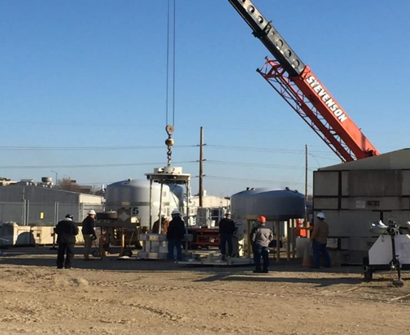
FY23 Key Achievements
TRU Waste Subgroup
Hosted SCA loading event in April at ANL (included CCP/DOE).
Review of SCA loading operations.
Used to reduce RH TRU at ANL by 40%.

Slide 12
FY23 Key Achievements
Packaging & Transportation Subgroup
Working with EM4.24 on evaluating blocking/bracing for RAM packages due to new truck auto braking:
Newer auto braking systems has resulted in shifting of loads with standard blocking/bracing (including shipments to NNSS).
Some sites are going beyond standard load securement requirements to address this issue (future best practice).

Slide 13
FY23 Key Achievements
Packaging & Transportation Subgroup
Working with NNSS on DOT vs DOE fixed survey requirements for exclusive shipments.
WMWG has previously worked this issue and issued a white paper, but inconsistent requirements persist.
Work with MCEP carriers to communicate EPA PCB registration requirements.
EPA has identified carriers from 2 regions hauling PCB wastes without being registered.

Slide 14
FY23 Key Achievements
Decontamination & Decommissioning Subgroup
Develop best practices/lessons learned:
Mentoring opportunities/knowledge capture
Characterization processes
Federal and local constraints
Execution and delivery models
Site challenges
Resource loading / staffing / supply chain

Slide 15
FY23 Key Achievements
Decontamination & Decommissioning Subgroup
Increase coordination between D&D and waste management organizations on:
High concentration mercury & beryllium waste removal, packaging & disposal
Other complex waste streams (PFAS, Hg/PCB/Rad combined, high activity wastes)
White paper being developed on end state D&D considerations for facility design. Includes information sharing with UK NDA (LLNL).

Slide 16
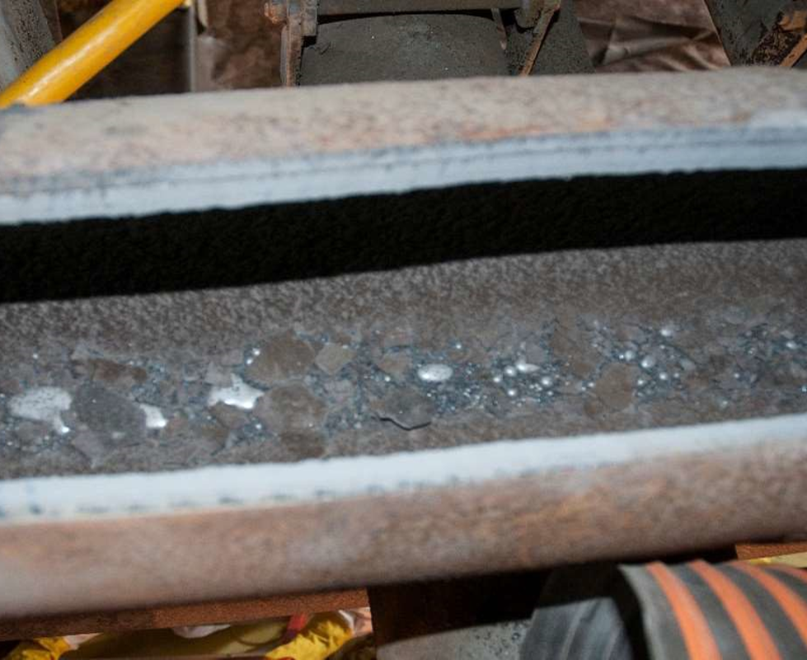
FY23 Key Achievements
Decontamination & Decommissioning Subgroup
Capture and share D&D lessons learned and technology applications by UCOR for Y-12 cleanup.

Slide 17
FY 2024 Upcoming Focus Areas and Planned Achievements
Continue support to EM and NNSA specifically on challenging and TRU waste streams, 435.1 training and LFRG.
Collaborate on standardized Hazardous Commodity Order Checklist (transportation order checklist) with MCEP carriers.
Begin participation in NNSA’s Waste Management Community of Practice for consistency and information sharing.
Complete report and recommended solutions on DOE vs DOT transportation limits.

Slide 18
FY 2024 Upcoming Focus Areas and Planned Achievements
Issue additional TRU waste minimization process improvements/lessons learned.
Continue CBFO support on procurement process for SCAs for restart of RH TRU acceptance.
Issue white paper that considers end state D&D as part of facility design.
Issue a Best Practice on need for increased blocking and bracing to prevent load shifts.
Support EM’s efforts on disposition for surface contaminated nickel.

Slide 19
Issues
High demand for waste containers and limited manufacturers may facilitate work with other WGs (Project Delivery, Safety[QA], or Supply Chain Task Team).
Hanford and Los Alamos are working together on ways to expedite the commercial Grade Dedication Process.
Difficult to get NNSA HQ involvement in WG meetings on consistent basis. For field offices, intermittent EM field office staff attendance but none from NNSA.

