Slide 1
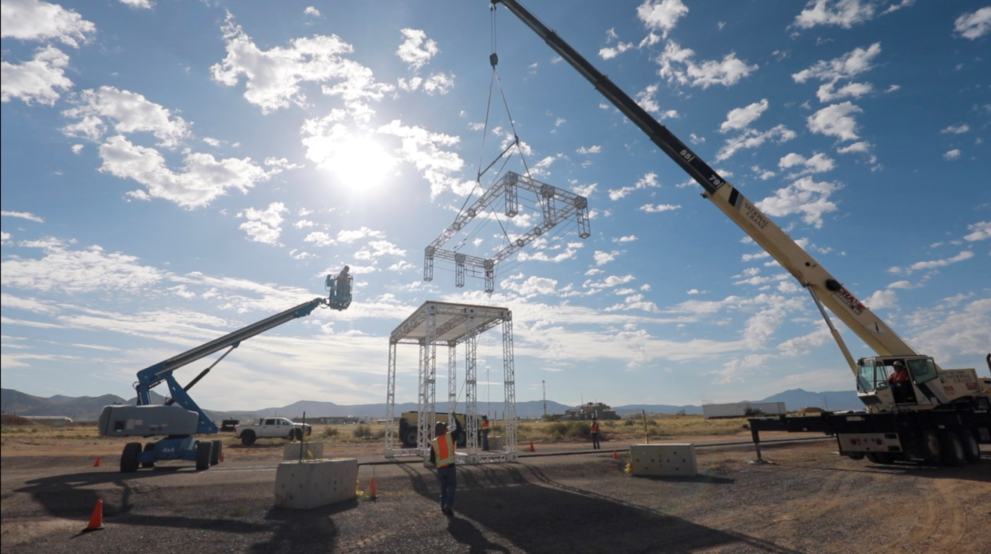
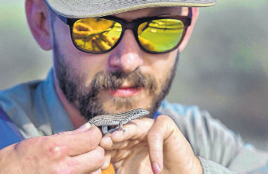
2021 EFCOG Nuclear & Facility Safety Workshop Welcome
Rafael A. Gonzalez
Senior Manager, Performance Assurance and Engineered Safety
Sandia National Laboratories

Slide 2
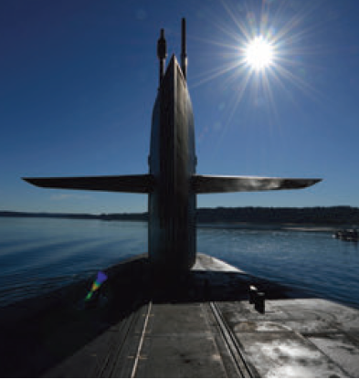
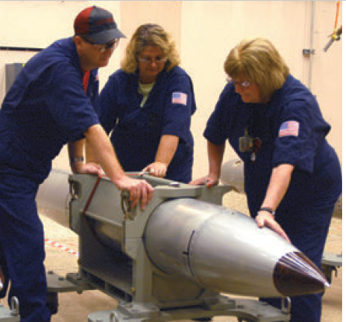
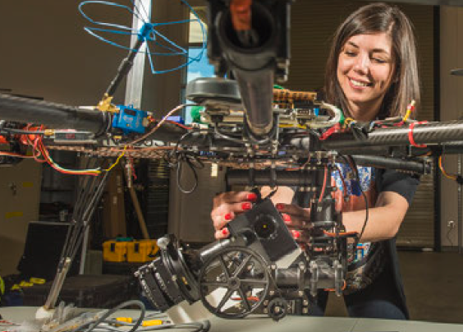
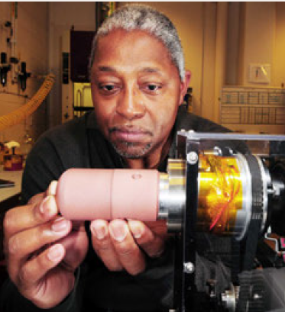
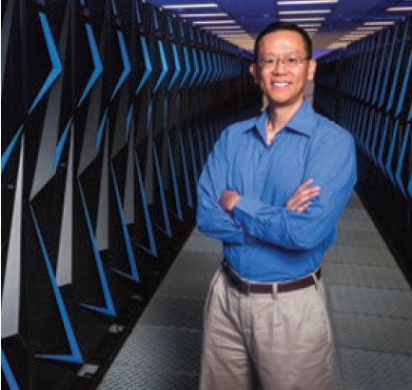
Why are we here?
Maximize Department of Energy (DOE) and National Nuclear Security Administration (NNSA) mission success:
Sharing best practices for operational excellence
Ensuring safety, security and quality
Unparalleled community of practice reach
Efficiency and Cost Savings
Rapid response complex-wide network
Integrated complex partnership to deliver
Empower and synergize with industry leaders and DOE contractors for world-class solutions
Bottomline: We are all here to win together for the Nation!
One Team, One Mission!
Integration, collaboration, synergy and innovation as one enterprise to ensure mission success:
Strengthening our Nation through Nuclear Security
Develop advanced technologies to ensure global peace
To solve National Security challenges through scientific excellence
Change the world energy future and secure our infrastructure
World-class research and development capabilities
Integrate the enterprise, invest in people and revitalize the infrastructure
Bringing science solutions to the World with cutting edge facilities
One Team, One Mission!

Slide 3
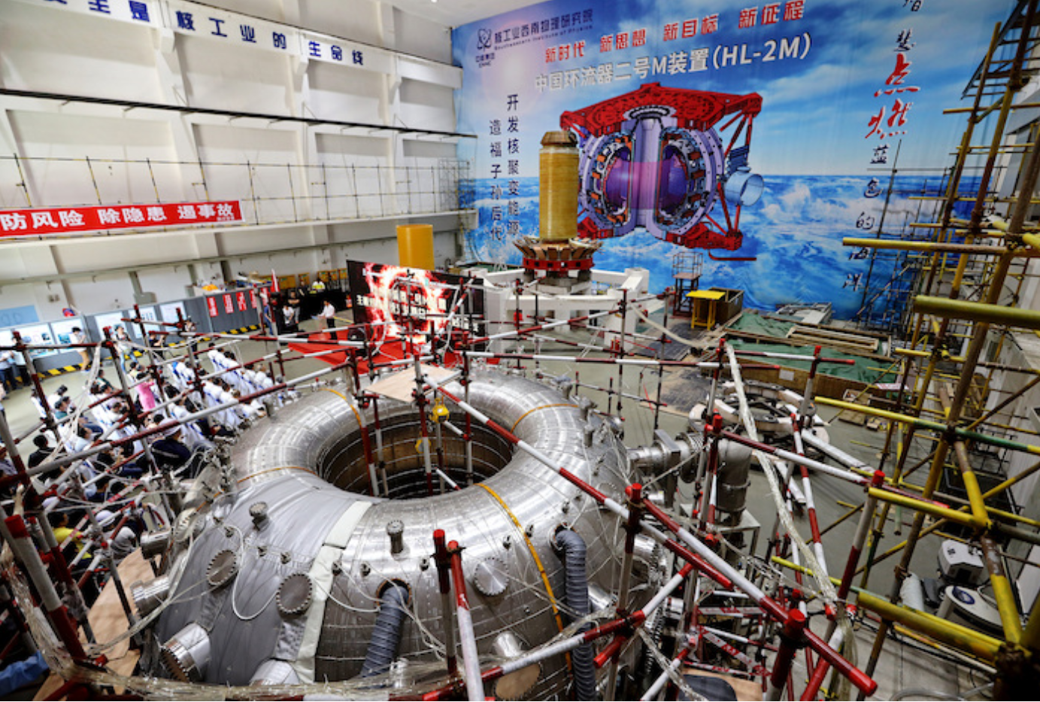
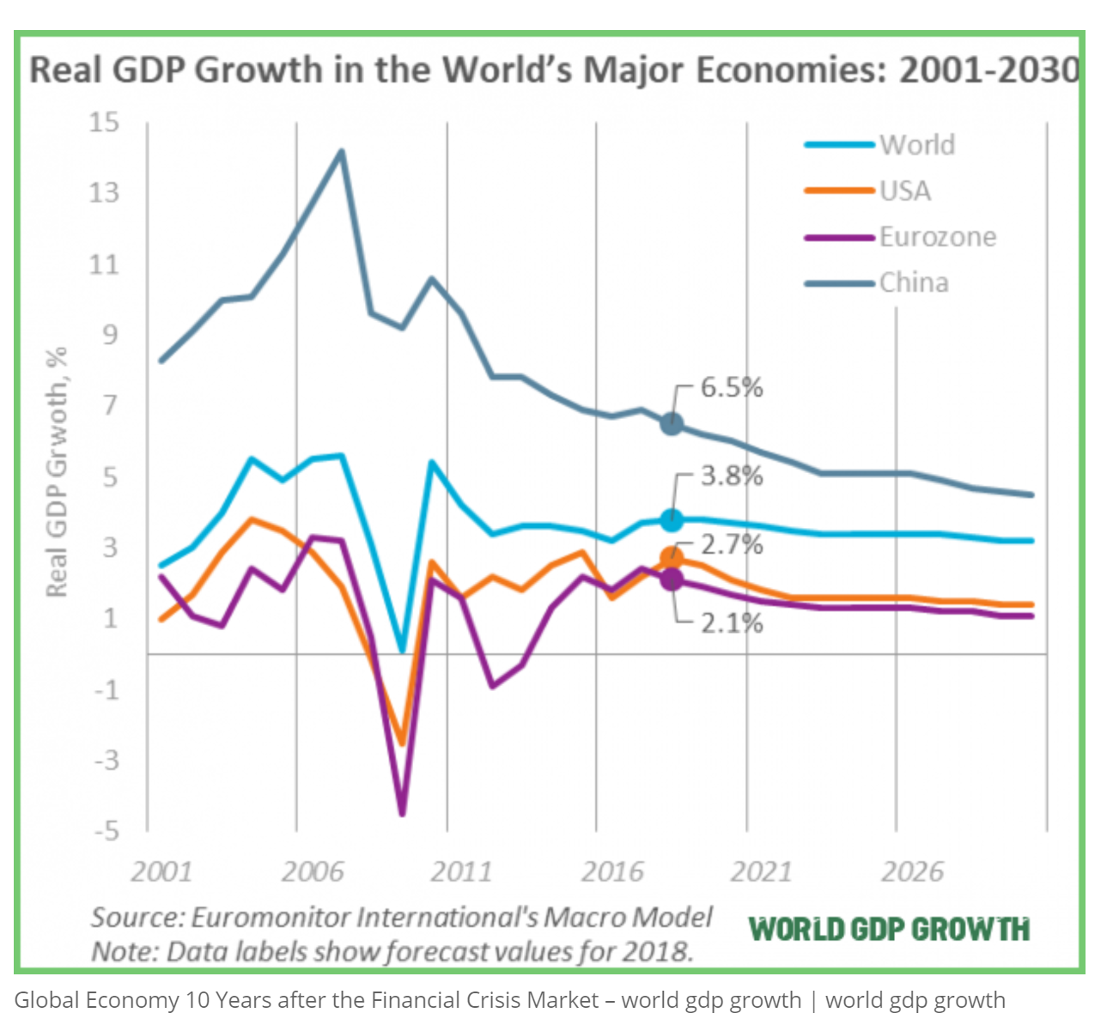
We are at an inflection point
We are in an innovation race to maintain technical superiority
We need to be able to win and compete in multiple domains
Our infrastructure is going through big modernization efforts
Geo-economics trends have changed the world landscape
We need to recruit, develop and retain our next generation workforce
Cost effectiveness is paramount to meet all challenges
We need to learn to do things differently at a much faster pace
History is on our side, we have always risen to the challenge!

Slide 4
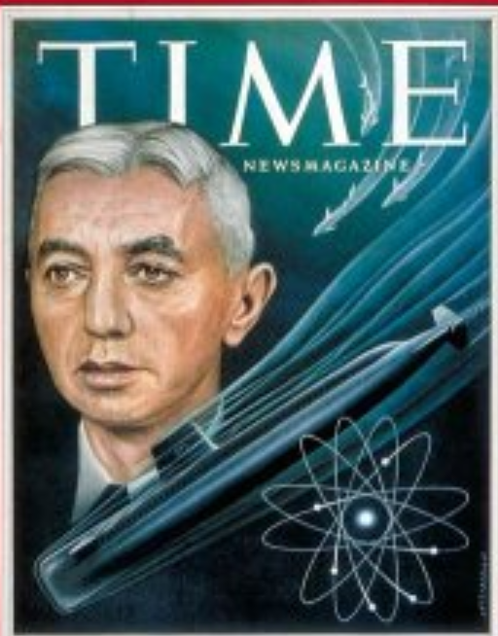
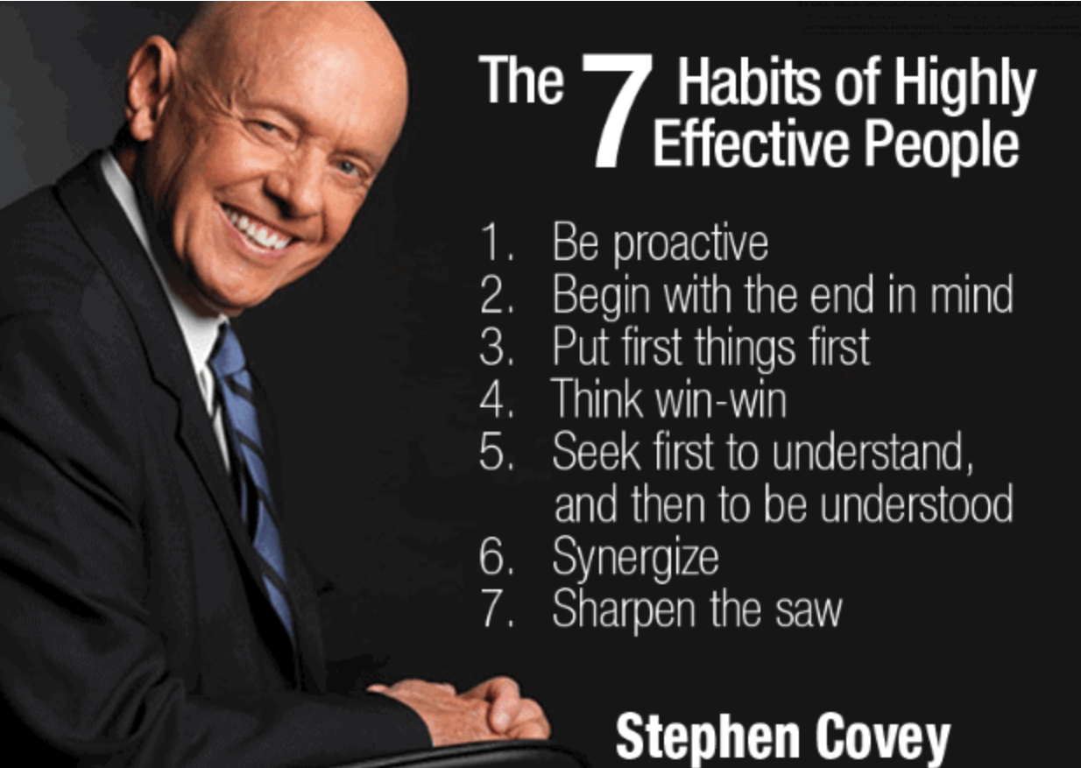
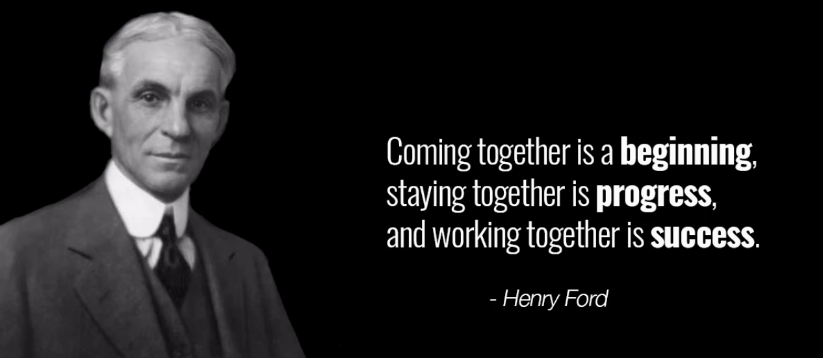
How we will succeed?
Unleash the power of the EFCOG community
Fully integrate best practices and lessons learned
Collaborate and synergize for win-win results
Mentor to empower our next generation and provide them world-class tools and systems
Improve cost effectiveness through operational excellence
Tip the scale from reactive to proactive with continuous improvement and a learning culture
Collectively innovate to meet future challenges and threats
Mission success, operational excellence and ES&H/Security are mutually inclusive results
Industry and complex collaborations for national security and economic prosperity
One Team, One Mission!

Slide 5
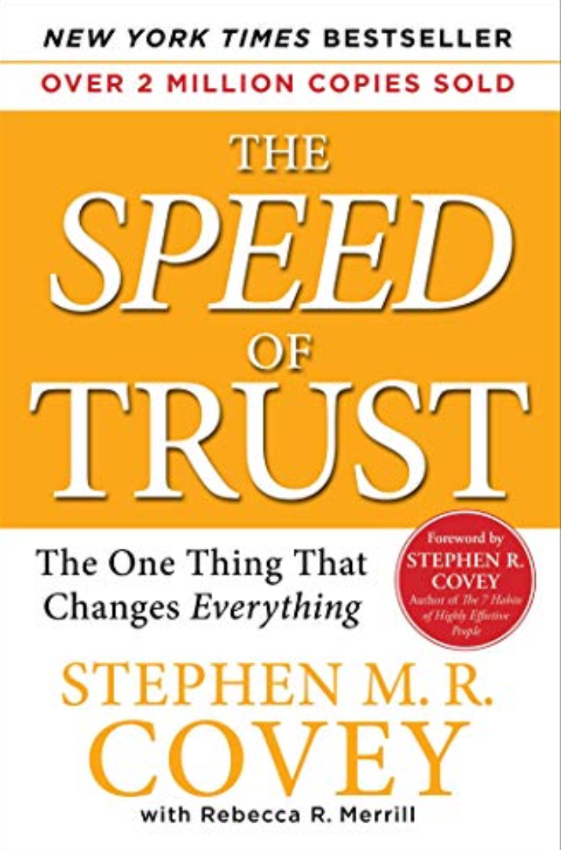
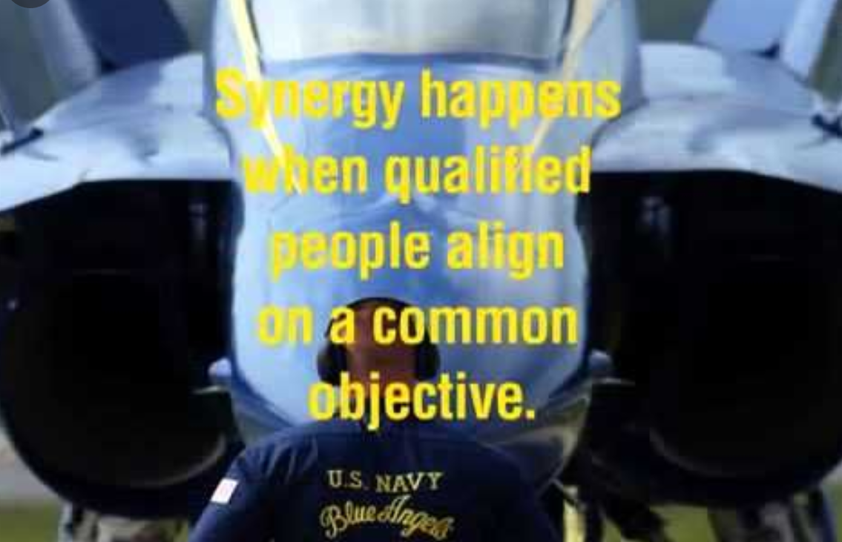
Closing thoughts
Get to know each other, develop trust-based networks
Be bold to have crucial conversations to elevate our performance and results with synergy
Be open to diverse perspectives and out of the box ideas that drive innovation
Integrated Mission Success, and Operational Excellence and ES&H/security
Empower all DOE contractors across the complex
Have fun as you enjoy the company of the best and brightest in the complex and the Nation!
We welcome you and appreciate the EFCOG community taking the time to get together!
One Mission, One Team!

