Slide 1
NS
Office of
Nuclear Safety
Office of Nuclear Safety
Brian DiNunno
EFCOG Nuclear & Facility Safety Workshop
February 2021

Slide 2
Top Line
AU-31 Key Initiatives
Roll out of Rule Changes
Support for Community of Practice development
Internal Review of Standards and Handbooks
AU-31 Directives Revisions
USQ Guide
Order 420
Guides for Design, DSA’s
AU-31 Standards and Handbooks Revisions
Updates on actions for 2021

Slide 3
Roll Out of Rule Changes
DOE currently developing a modest revision to DOE-STD-1104
Change is to implement changes in the process for annual update.
Also keep in mind that program office direction is still essential as their expectations for implementation can vary
Changes to 1104 have to be implemented via update to DOE O 420
Revision of USQ Guide will incorporate updates to “margin of safety” revision in Rule

Slide 4
Community of Practice
DOE-AU is supporting development of Organizational Excellence page as part of a healthy community of practice
https://orgex.energy.gov/frontpage
Accounts can be obtained, contractors supported

Slide 5
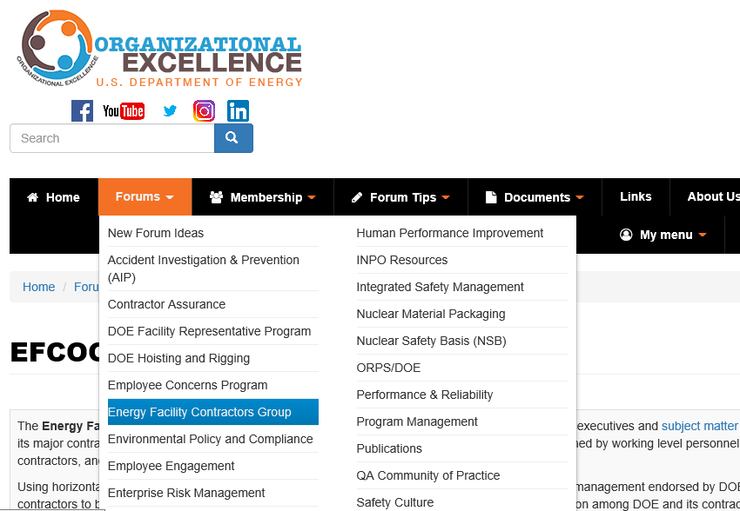
Community of Practice

Slide 6
Review of Standards and Handbooks
Overall review of the full suite of Standards and Handbooks in AU-31.
Emphasis on delivering needed, usable, clear documents
Feedback from user community is essential to our decision making process
Actively looking for your perspectives on our documents and opportunities to improve, gaps, or documents that have outlived their usefulness

Slide 7
Directives
USQ Guide is in final concurrence in the Department
Includes change to implement 10 CFR 830 rulemaking
More specifics to follow in discussions immediately after the next break
DOE Order 420
Immediate short-term effort to revise DOE O 420 to include an updated version of DOE-STD-1104 that implements Rule Change – NARROW FAST CHANGE
Followed by effort to consolidate proposed concepts, clarifications, implementation concerns – BROADER SLOWER CHANGE

Slide 8
Directives
DSA Guide is being assessed to determine its value
Design Guide is being assessed to determine options for consolidation with new and revised Air Cleaning standard/handbook

Slide 9
Revisions to Standards and Handbooks
DOE-STD-1020-2016, Natural Phenomena Hazards Analysis and Design Criteria for DOE Facilities – Revision to start in mid 2021
DOE-STD-1027-2018, Hazard Categorization and Accident Analysis Techniques – Department assessing need
DOE-STD-1066-2016, Fire Protection – Department is initiating revision
DOE-STD-1104-2016, Review and Approval of Nuclear Facility Safety Basis and Safety- Design Basis Documents – Revision to be submitted to RevCom pending departmental concurrence
DOE-HDBK-1169-2003, Nuclear Air Cleaning Handbook – In RevCom comment resolution
DOE-STD-1195-2011, Design of Safety Significant Safety Instrumented Systems used at DOE Nonreactor Nuclear Facilities – Resolving writing team comments
DOE-HDBK-1220-2017, Natural Phenomena Hazards Analysis and Design Criteria for DOE Facilities (Supplemental Guidance) - Revision developed in accordance with changes to DOE-STD-1020

Slide 10
Revisions to Standards and Handbooks
DOE-HDBK-1224-2018, Accident Analysis Handbook – Currently in RevCom, comment period ends in mid-March
DOE-HDBK-3010-1994 (R 2013), Airborne Release Fractions/Rates and Respirable Fractions For Nonreactor Nuclear Facilities – Draft developed, submitting to RevCom in next month
DOE-EH-0545, Seismic Evaluation Procedure for Equipment in U. S. DOE Facilities, March 1997 – Revision in development, submitted to RevCom in mid-2021.
DOE-STD-1237, Preparation of Documented Safety Analysis for DOE Reactors – In Departmental concurrence (about to be issued)

