Slide 1
DOE-HDBK-1163-2020
Integration of Hazard Analyses
Panel Discussion
February 16, 2021
EFCOG Nuclear and Facility Safety Workshop

Slide 2
DOE-HDBK-1163
Panel Discussion
Steve Singal (DOE/AU-10)
David Compton (PEC/AU-30)
Ron Beaulieu (NV/NSSS)
Rob Vrooman (NNSA/NA-512)
Jeff Woody (Link/EM-OR)
Kelsey Forde (Parvati)
Notes:
Provide DOE and all stakeholders with the highest quality data on laboratory performance.

Slide 3
DOE-HDBK-1163
Revision
DOE-HDBK-1163-2003 issued in 2003
Numerous regulatory drivers have changed since 2003
Chemical safety addressed in both 10 CFR 851 and 10 CFR 830
Hazard analysis requirements for non-nuclear facilities have been reduced since 10 CFR 830 (leaving gaps)
General need for an update requested from the field
DOE-HDBK-1163-2020 was issued in October 2020
Notes:
Provide DOE and all stakeholders with the highest quality data on laboratory performance.

Slide 4
Writing Team
Steve Singal (DOE/AU-10)
David Compton (AU-30/PEC)
Roberta Jordan (ID)
Andrew Vincent (SR)
Brad Evans (SC/PNNL)
Ron Beaulieu (NV)
Mary Flora (SRS)
John Hill (SRS)
Dina Siegel (LANL)
Duke Moscon (ICP)
Kelsey Forde (Parvati)
Steve Jahn (SRS)
Caroline Garzon (DOE/AU-31)
Jeff Woody (EM/OR-EM)
Rob Vrooman (NNSA/NA-512)
Karen Kubiak (ID)
Tim Stirrup (Parvati)
Jeffrey Hieb (Bechtel/WTP)
Max Betram (SC/ORNL)
Fitz Trumble (AECOM)
Karen Balo (OR/ETTP)
Rick Moore (SC/ANL)
Patricia Allen (SRS)
Notes:
Provide DOE and all stakeholders with the highest quality data on laboratory performance.

Slide 5
Review Team
Jim Dillard (DOE/AU-10)
Anthony Pierpoint (DOE/AU-10)
Robin Keeler (DOE/AU-10)
David Nester (NNSA)
Joanna Serra (SC)
Brenda Hawks (EM)
Charlie Maggart (NE)
Jeff Buczek (RL/EFCOG)
Ingle Paik (LLNL)
Notes:
Provide DOE and all stakeholders with the highest quality data on laboratory performance.

Slide 6
DOE-HDBK-1163-2020
Contents
1. Introduction
2. Hazard Analysis Process
3. Integrated Safety Management
4. Hazard Types (Hazards, Regulatory Drivers, Integration)
5. Lessons Learned
6. Maintaining Hazard Analyses
7. References
Appendices
Notes:
Provide DOE and all stakeholders with the highest quality data on laboratory performance.

Slide 7
Objectives & Expectations
HA activities are identified and integrated.
HA efforts share resources, data, and results.
ISMS coordinates HA efforts.
Facility managers are knowledgeable of facility hazards, hazard controls, and available HA resources.
Facility-level HAs are documented and updated periodically.
[DOE-HDBK-1163-2020, Section 1.3]
Notes:
Provide DOE and all stakeholders with the highest quality data on laboratory performance.

Slide 8
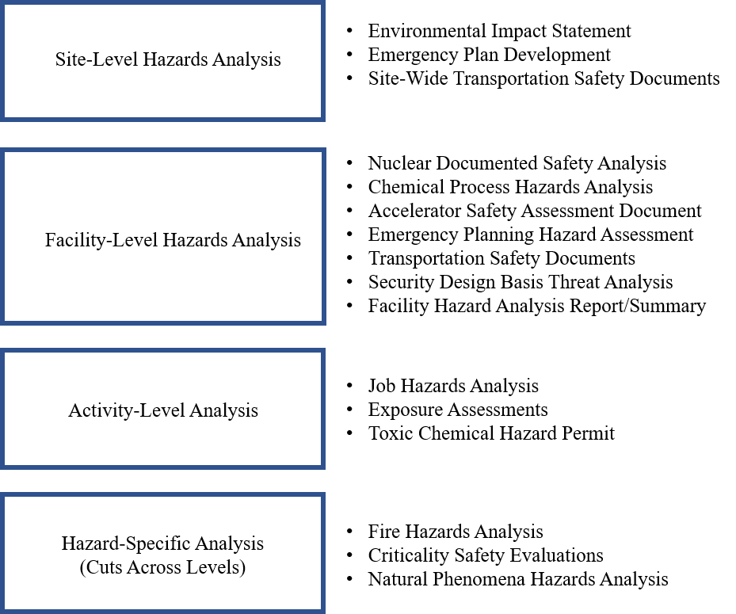
Figure 3
Hazard Analysis Levels and Examples
Notes:
Provide DOE and all stakeholders with the highest quality data on laboratory performance.

Slide 9
Attributes of Adequate Descriptions of Chemical Safety SMPs
Process for identification of hazardous chemical materials,
Process for identification of controls for hazardous chemical materials,
Industry standards used to identify and control hazardous chemical materials,
How the hazardous inventories are maintained accurate and up-to-date, and
How the integrity of hazardous material controls are assured.
[ DOE-HDBK-1163-2020, Section 4.3.3]
Notes:
Provide DOE and all stakeholders with the highest quality data on laboratory performance.

Slide 10
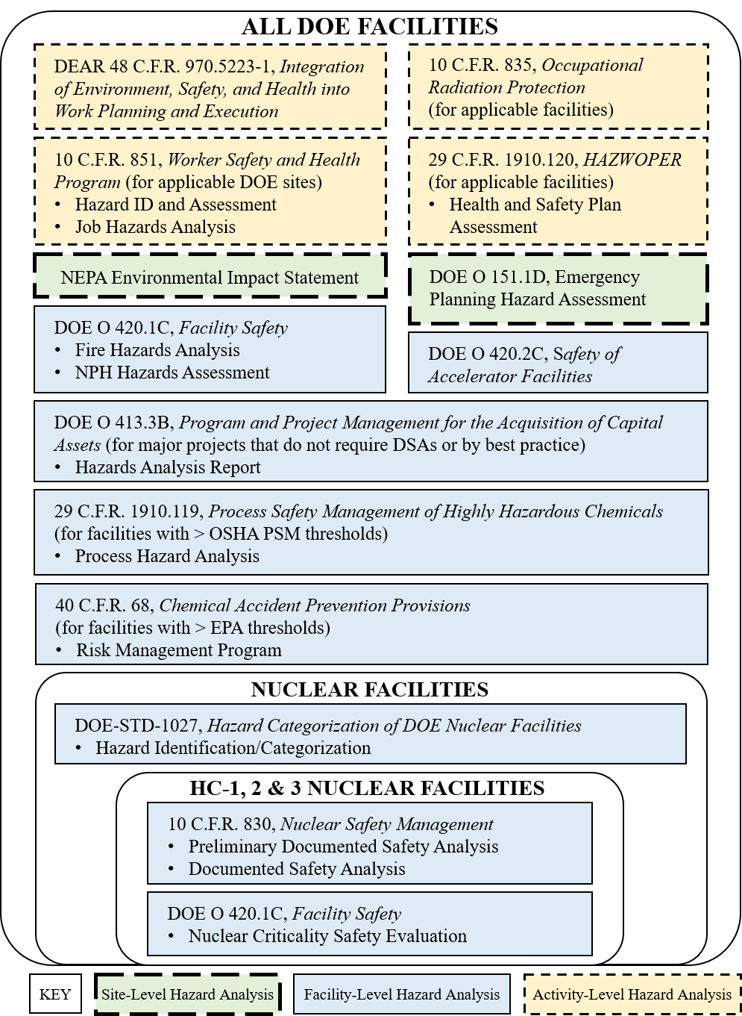
Figure 7, Summary of Regulatory Drivers by Facility Types
Notes:
Provide DOE and all stakeholders with the highest quality data on laboratory performance.

Slide 11
Table 4, Facility Categories for Graded Approach Application
Table 4. Facility Categories for Graded Approach Application
Facility Category | Threshold
HC-1, 2, and 3 Nuclear Facilities | See DOE-STD-1027
Accelerator Facilities | See DOE O 420.2A
High Hazard Chemical Facilities | Facilities that exceed the PSM or RMP thresholds and other facilities designated as containing high hazard chemicals
Below HC-3 Nuclear Facilities | Nuclear facilities with nuclear hazards less then HC-3 per DOE-STD-1027
Chemical Facilities | All remaining facilities that do not fit into one of the above categories but do contain significant chemical hazards
Industrial Facilities | All remaining facilities that do not fit into one of the above categories
Notes:
Provide DOE and all stakeholders with the highest quality data on laboratory performance.

Slide 12
Key Take-Aways
Below HC-3 Nuclear Facilities (hazard inventories & HARs) need to be actively managed
Chemical Safety SMPs should be relied upon for Nuclear Facilities
Various HAs need to be identified and integrated
HA Documentation on a graded approach
HAs need to be maintained
Facility managers need to be knowledgeable
Notes:
Provide DOE and all stakeholders with the highest quality data on laboratory performance.

Slide 13
Table 3, Hazard Analysis Report Contents for Below HC-3 Nuc. Facs.
Facility Description Physical description of the facility Scope of work at the facility Operational boundaries, including hazardous material limits, fissionable material limits Hazard Identification Identification of hazards Hazardous material inventories (and comparison to HC-3 threshold levels in DOE-STD-1027) (3) Hazard Evaluation Analysis of the hazards and the impact to the workers, public, and the environment Identification of controls to prevent or mitigate the identified hazards
Notes:
Provide DOE and all stakeholders with the highest quality data on laboratory performance.

Slide 14
Chemical Hazards in DSAs
  DOE-STD-3009-2014 has criteria for designating Safety Significant controls for chemical hazards, but it also indicates a screening process to only analyze “chemicals of concern”
  Q: “Why do I need to do more for a chemical in a nuclear facility than I do for the same chemical in a non-nuclear facility?”
  A: You don’t, unless your chemical hazards are substantial, or if they affect nuclear safety.
  HDBK-1163 provides a two-step screening process in which most chemical hazards can screen out to an acceptable Safety Management Program during hazard identification
  AU-30 plans to revise DOE-STD-3009-2014 discussion to clarify chemical hazard evaluation and controls
Notes:
Provide DOE and all stakeholders with the highest quality data on laboratory performance.

Slide 15
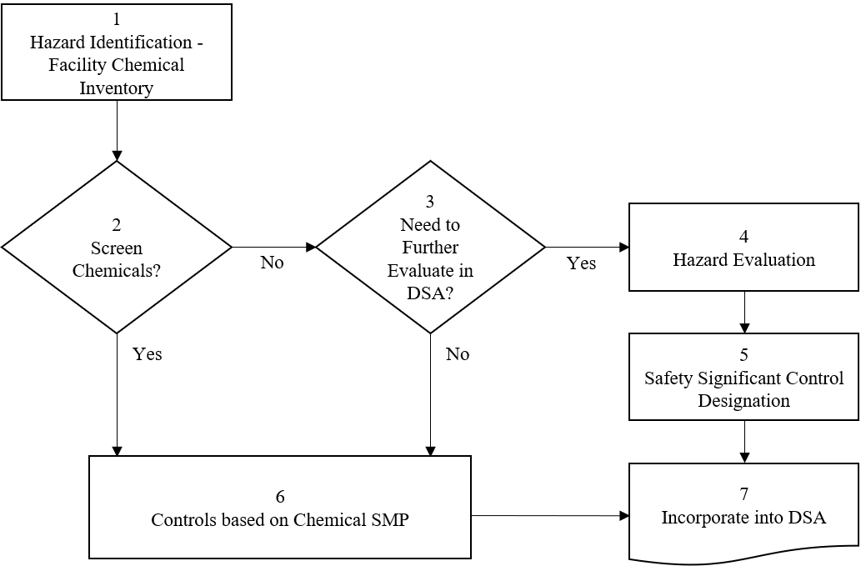
Table F-1, Chemical Hazard Evaluation and Control Strategy
Notes:
Provide DOE and all stakeholders with the highest quality data on laboratory performance.

Slide 16
Table F-1, Chemical Hazard Evaluation and Control Strategy
Box 2: Screen Chemicals? Criteria for screening chemicals (see DOE-STD-3009-2014, Appendix A.2 for more complete description of the bullets below on toxic chemical hazards; see DOE-STD-3009-2014 Appendix A.1 for more complete description of screening of standard industrial hazards):
Chemicals with no known or suspected toxic properties;
Materials that have a health rating of 0 or 1 based on NFPA-704;
Materials that are commonly available and used in the general public;
Small-scale use of quantities of chemicals, such as in laboratories; and
Chemicals that can be safely handled by implementation of a hazardous material protection program (chemical SMP) described in the DSA.
“Yes” answer goes to Box 6.
Notes:
Provide DOE and all stakeholders with the highest quality data on laboratory performance.

Slide 17
Table F-1, Chemical Hazard Evaluation and Control Strategy
Box 3: Need to Further Evaluate in DSA? Criteria for need to Further Evaluate in the DSA (to meet DOE-STD-3009-2014)
Chemical hazards with the potential for significant off-site consequences to the public (for example, greater than or equal to PAC-2);
Chemical hazards that initiate or worsen a significant radiological release;
Chemical hazards that adversely affect a credited nuclear safety function (for example, incapacitating a worker relied upon to perform a SAC);
Extraordinary chemical hazards (that have a high acute toxicity and high dispersibility (for example, having a PAC-3 of about 3 ppm or less, and highly dispersible such as compressed gases);
Uncontrolled chemical releases with potential for significant on-site consequences to co-located workers (for example, greater than or equal to PAC-3); and
Any additional chemical hazards that are not adequately identified and controlled by an adequate Chemical SMP and could cause significant harm to facility workers or co-located workers.
“Yes” answer goes to Box 4.
Notes:
Provide DOE and all stakeholders with the highest quality data on laboratory performance.

Slide 18
Integration
Lessons Learned
Identification of all HA efforts
Integrated Hazard Analysis Teams
Collection/Integration of Hazard Information
Standardization of HA Tools and Techniques
Facility Categorization – For Graded Approach
Graded Approach to Documentation & Integration
Knowledgeable Facility Managers
Hazard Analyses Maintained and Updates Coordinated
Notes:
Provide DOE and all stakeholders with the highest quality data on laboratory performance.

Slide 19
HDBK-1163
Implementation Tools
Example SIH Screening Criteria (Figure A-1)
Example Hazard Identification Checklist (Figure A-2)
Hazard Evaluation Technique Comparison (Appendix B)
Example Risk Assessment Methodology (Appendix C)
Example Qualitative Consequences Matrix (Figure C-1)
Example Qualitative Likelihood Matrix (Figure C-2)
Example Qualitative Risk Matrix (Figure C-3)
Notes:
Provide DOE and all stakeholders with the highest quality data on laboratory performance.

Slide 20
Figure A-1: Example SIH Screening Criteria

Slide 21
Figure A-2: Example Hazard Identification Checklist

Slide 22
Table B-1: Hazard Evaluation Technique Comparison

Slide 23
Figure C-1: Example Qualitative Consequence Matrix

Slide 24
Figure C-2: Example Qualitative Likelihood Matrix

Slide 25
Figure C-3: Example Qualitative Risk Matrix

