Slide 1
NSR&D Project - Incorporation of a Dense Gas Capability into the EPIcode Chemical Atmospheric Dispersion Model
Project Summary
Fernando Aluzzi, EPIcode Project Lead
Steve Homann – Lead Scientist, EPIcode Originator
February 22, 2021

Slide 2
Project Activities Overview Year 1 – Methods and implementation Year 2 – Validation
Task 1 Develop dense-gas capabilities in EPIcode (1st Year Effort)
1.1 – Determine plume-density criterion based on literature review
1.2 – Implement software identification for the dense-gas conditions
1.3 – Implement software calculations for the dense-gas concentrations
1.4 – Implement software for transition from dense-gas to neutrally-buoyant conditions
Task 2 Validation (2nd Year Effort)
2.1 – Collect data from field study experiments
2.2 – Evaluate usefulness of collected data
2.3 – Compare modeled dense gas results with field data
2.4 – Write final report and update EPIcode User’s Guide with description of dense gas capability
Notes:
Add Task 2 bulets

Slide 3
Overview of Atmospheric Dense Gas Dispersion Task 1 Activities (1st Year Effort)
1.1 – Criterion:
Will atmospheric release behave as a dense gas?
1.2 – Criterion Implementation
1.3 – Calculate Dense Gas Concentrations
1.4 – Transition from Dense Gas to neutrally-buoyant conditions
Notes:
Use graphics to identify T1, T2, T3, T4.
Add statement to summary box?

Slide 4
Release Richardson Number Equation
$$Release Richardson Number (Ric) =\frac{g\left(ρg−ρa\right)}{ρa}\frac{Q}{{u\text{∗}}^{2}u D}$$
g | - acceleration of gravity | 9.81 m/s²
$$ρg$$ | - density of released gas/aerosol | kg/m3
$$ρa$$ | - density of ambient atmosphere | kg/m3
Q | - volumetric release rate | m³/s
$u$* | - friction velocity | m/s
$$u$$ | - ambient wind velocity | m/s
$$D$$ | - source diameter | m
Notes:
Show the Ric equation. Ask SH for Britter reference
Show examples of parameters:
Show a table with factors increasing Ri hence increasing buoyancy: g, effluent density that is naturally greater than the ambient air density, large H,
and low u* versus high u*

Slide 5
Dense Gas (Negative Buoyancy) Criteria Based on Release Richardson Number
Release Richardson Number Criteria - Ri_{c}
Ri_{c} Range | Buoyancy Regime
Ri_{c} >= 30 | Negative buoyancy dominant
1 < Ri_{c} < 30 | Stably stratified shear flow
Ri_{c} <= 1 | Passive dispersion
Ri_{c} - Ratio of the vertical plume buoyancy term to the horizontal wind shear term
Notes:
The Ri criteria table.
SH to discuss the jump from water tunnel experiments to atmospheric situations
Return to the image 1 but now use Ri to identify the different regimes

Slide 6
Dense Gas (Negative Buoyancy) Criteria Based on Release Richardson Number
$$Ric≤1$$
$$1<Ric<30$$
$$Ric≥30$$
Notes:
The Ri criteria table.
SH to discuss the jump from water tunnel experiments to atmospheric situations
Return to the image 1 but now use Ri to identify the different regimes

Slide 7
Release Richardson Number Equation
$$Release Richardson Number (Ric) =\frac{g\left(ρg−ρa\right)}{ρa}\frac{Q}{{u\text{∗}}^{2}u D}$$
Two Methods for determining gas density - $ρg$
1) Molecular Weight Method
2) Liquid Aerosol Approach
Studies show flash vaporization of pressurized containers results in a majority of chemical becoming airborne liquid droplets
EPIcode will assume 100% is saturated liquid aerosol
Notes:
Show the Ric equation. Ask SH for Britter reference
Show examples of parameters:
Show a table with factors increasing Ri hence increasing buoyancy: g, effluent density that is naturally greater than the ambient air density, large H,
and low u* versus high u*

Slide 8
Criterion Test Case Suite
Material | Scenario Description | Richardson # | Molecular Weight Method
Cl₂ | Total Release: 100 kg over 100 min Wind speed @ 2 m height: 5. m/s | 0.55 Passive Phase | MW
Cl₂ | Total Release: 100 kg over 10 min Wind speed @ 2 m height: 5. m/s | 5.5 Transition Phase | MW
Cl₂ | Total Release: 100 kg over 1 min Wind speed @ 2 m height: 5. m/s | 55 Dense Phase | MW
HF | Total Release: 20 kg over 100 min Wind speed @ 2 m height: 5. m/s | 0.32 Passive Phase | Pressure/aerosol
HF | Total Release: 20 kg over 10 min Wind speed @ 2 m height: 5. m/s | 3.2 Transition Phase | Pressure/aerosol
HF | Total Release: 20 kg over 1 min Wind speed @ 2 m height: 5. m/s | 32 Dense Phase | Pressure/aerosol
Notes:
Steves test table. Need good column header (Col 4).
SH to redo description column
Emphasis:
WIP

Slide 9
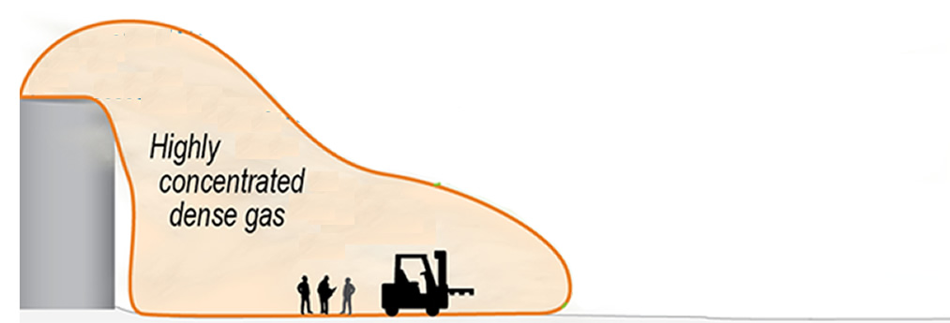
1.3: Calculate Dense Gas Concentrations Zone of Established Flow (S) – The Extent
(Havens et al, 1989)
S = Downwind extent of Zone of Established Flow
ρ_{g} = Density of the released gas/aerosol
ρ_{a} = Density of the ambient air
µ = Ambient wind speed
D = Source Diameter (From 1.2, Criterion)
Q =Volumetric Release Rate (From 1.2, Criterion)
V = Vertical jet velocity = Q/π(D/2)²
S
Notes:
SH to elaborate on what other methods are used.

Slide 10
1.3: Calculate Dense Gas Concentrations Depth & Concentration
$$d=\frac{SQ}{\text{µ}A}$$
Assuming 100% Concentration
d - Depth of the 100% concentration cloud
S = Downwind extent of the Zone of Establishment
Q = Volumetric release rate (Task 1.2, Criterion …)
µ = Ambient wind speed
A = Area of the dense gas zone
d
Notes:
SH to elaborate on what other methods are used.

Slide 11
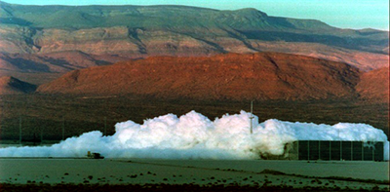
1.3: Calculate Dense Gas Concentrations Depth & Concentration – Real World Example from NTS
$$d=\frac{SQ}{\text{µ}A}$$
Assuming 100% Concentration
Constant depth cloud along S
A dense gas release at the Nevada Spill Test facility.

Slide 12
1.3: Calculate Dense Gas Concentrations Plume Radius (r)
Plume Radius at distances less than S – Britter (1989)
r
Notes:
SH to elaborate on what other methods are used.

Slide 13
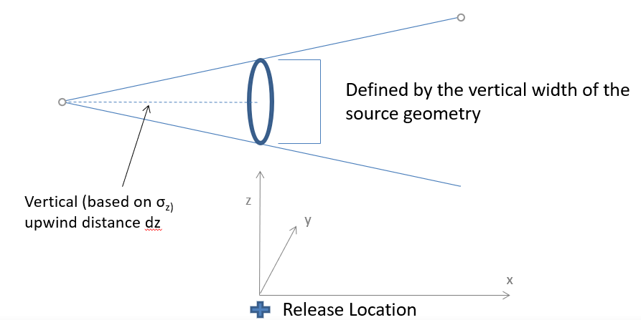
1.4: Transition from Dense to neutrally-buoyant Virtual Source Terms link Gaussian Dispersion to Dense Gas
Virtual source terms used to effect smooth transition from stably stratified shear flow regime to passive dispersion regime
S

Slide 14
Comparisons with Other Dense Gas Models
Compared methodologies of two established dense gas models and incorporated select concepts into EPIcode
DEGADIS
EPA dense gas model (Havens et al, 1989)
SLAB
LLNL dense gas model (D. L. Ermak, 1990)
AEOLUS
(NARAC, LLNL. A. Gowardhan)
CFD Urban Dispersion Model currently developing a dense gas capability

Slide 15
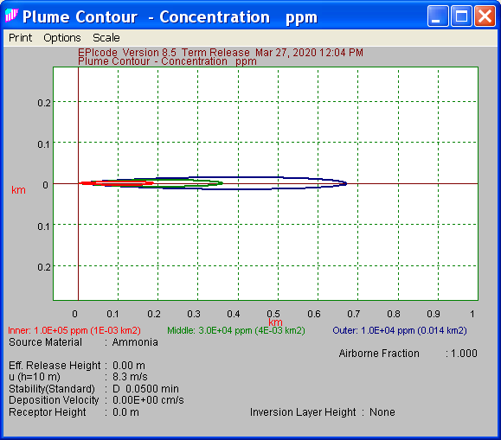
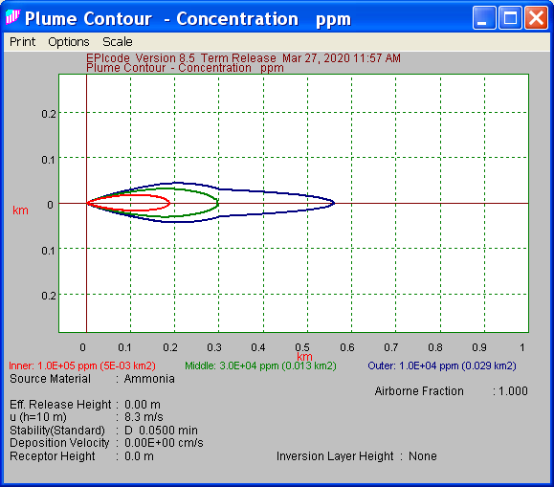
1.4 – Implement software for transition from dense gas to neutrally-buoyant conditions
Transition from dense gas to neutral – 100,000 ppm, 30,000 ppm, 10,000 ppm)
1 km
1 km
Current EPIcode EPIcode with Dense Gas Option
Notes:
If we extend the outermost contour, we will see the dense gas transition into the neutrally buoyant phase? Ie. If we go far enough downwind will the two plumes (EPI w dense gas, EPI w/o dense gas) match?

Slide 16
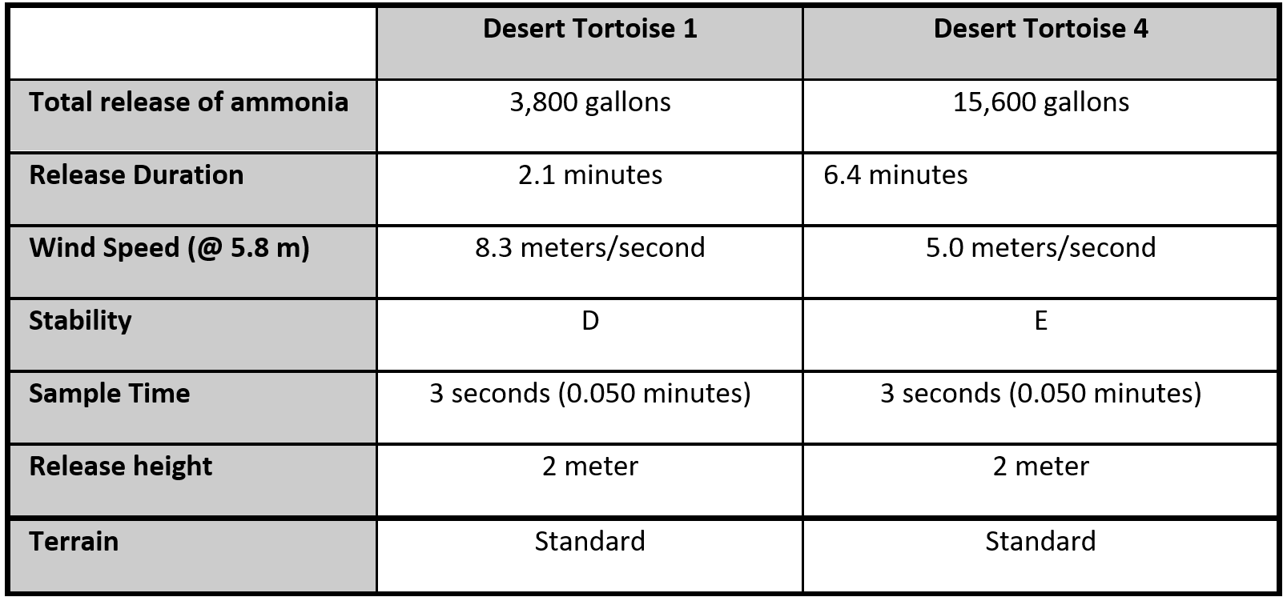
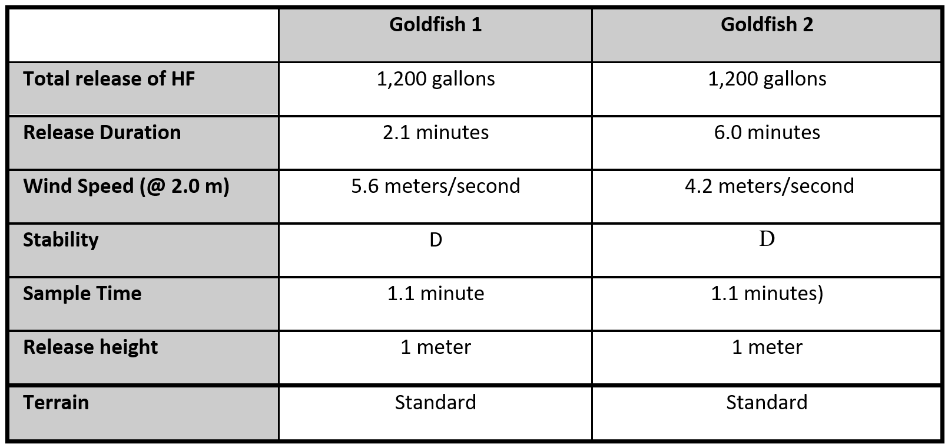
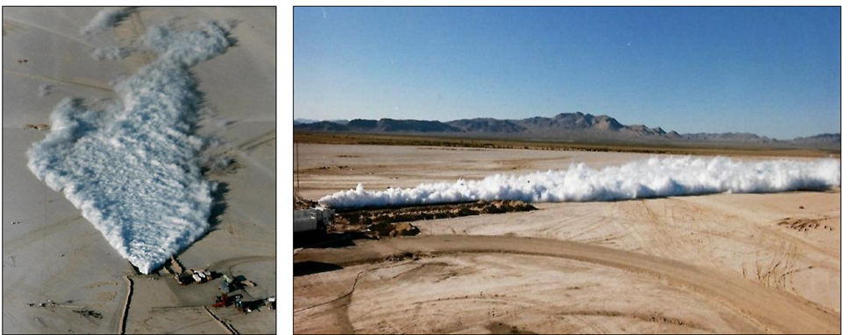
Field Studies used in V&V
Desert Tortoise
NTS
> 3k gallons of NH₃
Goldfish
NTS, LLNL and Amoco.
500 to 1,000 gallons of HF
Measurements of release parameters and downwind concentrations and plume dimensions
Validation based on difference between EPIcode and measured values

Slide 17
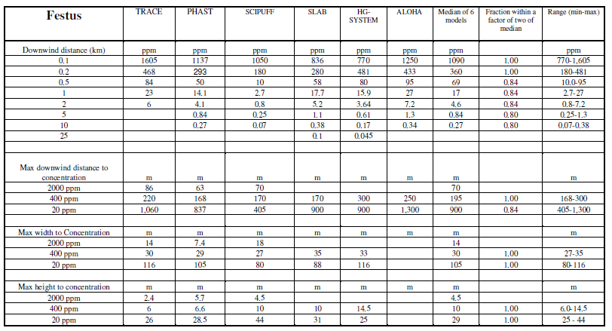
Real World Cases Comparisons with other Dense Gas Models
2008 Publication (Hanna et al, 2008) Compares Six Widely Used Dense Gas Models for Actual Chlorine Accidents

Slide 18
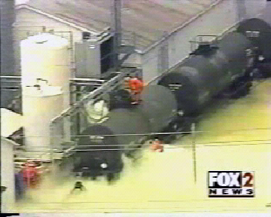
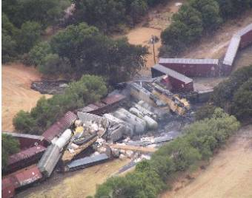
Real World Cases Comparisons with other Dense Gas Models
Festus, Missouri - August 2002
Macdona, Texas - June 2004
Known parameters – release quantities and atmospheric conditions
Hanna et. al 2008 provides results from six models to estimate downwind results
Validation based on difference between EPIcode and median values of the other dispersion models
Chlorine – 4000 gal
Chlorine – 9700 gal
Notes:
Festus Image source - https://www.csb.gov/dpc-enterprises-festus-chlorine-release/ …/assets/1/17/DPC.jpg
Macdona https://www.aristatek.com/newsletter/0708August/TechSpeak.aspx …../newsletter/0708August/TechSpeak_files/image002.jpg

Slide 19
Desert Tortoise Comparisons Centerline Concentrations
Modeled Centerline Concentrations at Specific Downwind Locations
 |  | Centerline Concentrations (ppm)
 | Distance (km) | EPIcode | DEGADIS | SLAB | Measured
DT1 | 0.1 | 76,000 | 310,000 | 20,000 | 40,000
 | 0.8 | 2,200 | 9,000 | 3,200 | 9,000
Notes:
EPI higher but not as high as DEGADIS. Over at 100 m, under at 800 m

Slide 20
Desert Tortoise Comparisons Centerline Concentrations
Modeled Centerline Concentrations at Specific Downwind Locations
 |  | Centerline Concentrations (ppm)
 | Distance (km) | EPIcode | DEGADIS | SLAB | Measured
DT1 | 0.1 | 76,000 | 310,000 | 20,000 | 40,000
 | 0.8 | 2,200 | 9,000 | 3,200 | 9,000
DT2 | 0.1 | 120,000 | 580,000 | 22,000 | 77,000
 | 0.8 | 3,700 | 12,000 | 4,000 | 10,000
DT4 | 0.1 | 210,000 | 600,000 | 23,000 | 60,000
 | 0.8 | 14,000 | 14,000 | 4,300 | 14,000
EPIcode within a factor of 2 -3 of both the measured concentration
Centerline concentration defined as maximum centerline
Notes:
EPI higher but not as high as DEGADIS. Over at 100 m, under at 800 m

Slide 21
Desert Tortoise Comparisons Plume Width Estimates
Modeled maximum plume width at select concentration values
 | Averaged Plume Widths¹ from DT1, DT2, and DT4 (m)
Distance (km) | EPIcode | DEGADIS | SLAB | Measured
0.1 | 64 | 59 | 13 | 22
0.8 | 330 | 250 | 94 | 120
1 - Plume width at 50% centerline concentration
EPIcode within a factor of 2 -3 of the measured width
Notes:
Too high close,

Slide 22
Field Experiment Comparisons Overview of Data Sets – Festus, Missouri (chlorine)
Modeled Centerline Concentrations at Specific Downwind Locations
Distance (km) | EPIcode | TRACE | PHAST | SCIPUFF | SLAB | HG-SYSTEM | ALOHA | MEDIAN
 | Concentration (ppm)
0.1 | 1,200 | 1,605 | 1,137 | 1,050 | 836 | 770 | 1,250 | 1,090
0.2 | 390 | 468 | 293 | 180 | 280 | 481 | 433 | 360
0.5 | 90 | 84 | 50 | 10 | 58 | 80 | 95 | 69
1 | 30 | 23 | 14 | 2.70 | 17.7 | 15.9 | 27 | 17
2 | 10 | 6.0 | 4.10 | 0.80 | 5.20 | 3.64 | 7.20 | 4.60
5 | 2.8 | - | 0.84 | 0.25 | 1.10 | 0.61 | 1.30 | 0.84
10 | 1.1 | - | 0.27 | 0.07 | 0.38 | 0.17 | 0.34 | 0.27
25 | 0.37 | - | - | - | 0.10 | 0.045 | - | -
EPIcode well within a factor of 2 of the median closer to source (100 to 200 m)
Factor of 2 up to ≈ 2 km, increasing beyond 2 km up to a factor of 4

Slide 23
Field Experiment Comparisons Overview of Data Sets – Festus, Missouri (chlorine)
Modeled maximum plume width at select concentration values
Concentration | EPIcode | TRACE | PHAST | SCIPUFF | SLAB | HG-SYSTEM | ALOHA | MEDIAN
(ppm) | Plume Width (m)
2,000 | 22 | 14 | 7.4 | 18 | - | - | - | 14
400 | 50 | 30 | 29 | 27 | 35 | 33 | - | 30
20 | 180 | 116 | 105 | 80 | 88 | 116 | - | 105
 | Plume Height (m)
2,000 | 2.1 | 2.4 | 5.7 | 4.5 | - | - | 4.5 | -
400 | 7 | 6 | 6.6 | 10 | 10 | 14.5 | - | 10
20 | 40 | 26 | 29 | 44 | 31 | 25 | - | 29
EPIcode within a Factor of 2 of the median of the 6 models for both plume width and height

Slide 24
Continuing Documentation Efforts
Updating user’s manual prior to eventual release
Create SQA V&V test case(s)

Slide 25
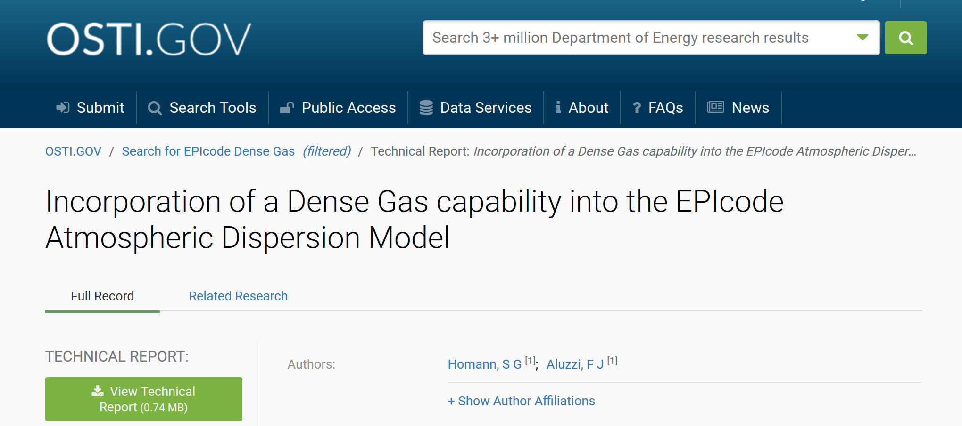
Final Project Report on OSTI.GOV
https://www.osti.gov/biblio/1763931-incorporation-dense-gas-capability-epicode-atmospheric-dispersion-model

Slide 26
Special Thanks
Patrick Frias, Project Sponsor, AU-31, NSR&D Program
Mark Mitchell, LLNL, Safety Analysis Group

