Slide 1

Entrainment from Contaminant Accident Scenarios Involving Fire
February 8, 2021
For the EFCOG Meeting, February 22, 2021
Dr. Alexander L. Brown; albrown@sandia.gov; (505)844-1008
Dr. Flint Pierce, and Ethan Zepper
Fire Science and Technology Department
SAND2021-1724 C

Slide 2
Overview
This talk will give an overview of the Sandia NSRD project on simulating contaminant entrainment from fires
  Year 1 focused on sources of contaminants from liquids
  Year 2 is in progress, focused on contaminated solids
This work differentiated from prior work because we are looking for mechanistic behavior, and validation of surrogacy assumptions common to most datasets
  Historically, Airborne Release Fraction (ARF) was the main objective
  ARF from limited datasets might not apply to other/all scenarios, propose using simulation capabilities to help augment coverage, validate surrogacy
    If we understand the mechanisms, then we can make models for the phenomena
  We aim to contribute to the safety and efficiency through an improved ability to assess hazards
  SIERRA/Fuego is the fire simulation tool for the NW program
    We would like to develop models appropriate to safety scenarios to enable physical modeling of scenarios to improve upon the largely empirical safety practice of ARF look-up

Slide 3
Historical Study Review-liquid sources
A review of liquid fire contaminant experimental work was conducted
Limited (surprisingly few) historical studies exist on entrainment of contaminants from liquids during a fire:
Study | Liquids | Contaminants
MS-1968 | Water nitrate | Pu(NO₃)n
MS-1973 | TBP/Kerosene | U, Ce, Cs, Zr, I
MS-1973 | Gasoline, water | UO₂, U(NO₃)n
Sutter et al., 1974 | TBP/Kerosene | Sr
Malet et al., 1983 | TBP/Kerosene | Ce, Th
Seehars and Hochrainer, 1983 | Kerosene | Ce and Pu oxides
Jordan and Lindner, 1983, 1985* | TBP/Kerosene, nitrate | U
Halverson et al., 1987 | TBP/Kerosene, nitrate | U
Nishio and Hasimoto, 1989 | TBP/Kerosene | Cs, UO₂, Ce, Zr
Lahaye et al. 1996 | Hexadecane | Ce
Ono et al., 2017 | TBP/Dodecane | Ru, Eu
Hubbard et al., 2020 | TBP/kerosene, nitrate | Lu, Yb, U

Slide 4
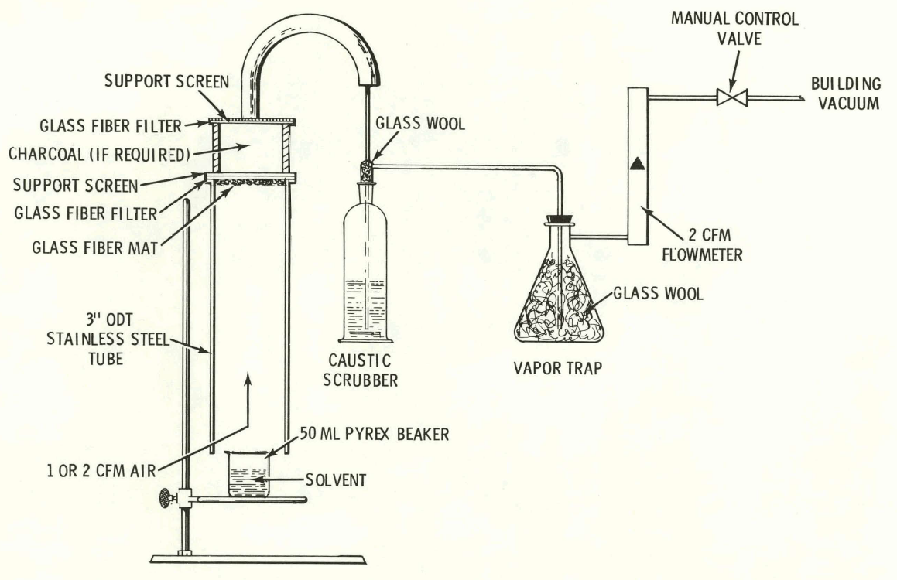
Contaminants from Liquids
PUREX process accidents, solvents, cleaning, fuel spills, etc.
We previously simulated historical (MS-1973) scenarios with SIERRA/Fuego
  Found ARF highly sensitive to parameters not varied in tests
    Liquid height
    Ignition method
Four entrainment mechanisms proposed (detailed on next slide)
New tests were recently performed (Hubbard et al., 2020)
NSRD project aimed to better characterize the emissions from the least studied mechanism, evaporation induced entrainment

Slide 5
Entrainment Mechanisms
Four natural mechanisms were identified
  Evaporation Induced Entrainment
    Contaminants ejected from pool by evaporating fluid
  Surface Agitation by Wind
    Strong winds create waves which suspend particles upon breaking
  Surface Agitation by Boiling
    Droplets become suspended as the gases rupture the liquid surface
  Residue Entrainment (Resuspension)
    After liquid has been consumed, remaining solid particles can erode by persisting flow conditions
An external mechanism also exists
  Impact Entrainment
    Droplets (i.e. rain, water from suppression devices) can impact and disturb the fuel surface
    Other such disturbance of the substrate (walking, collapsing structure, thermal stresses, etc.)
During Fire
After Fire
Notes:
Identified from the literature
Distribution of particles – spread “evenly” on the surface by hand, then fuel added via nozzle

Slide 6
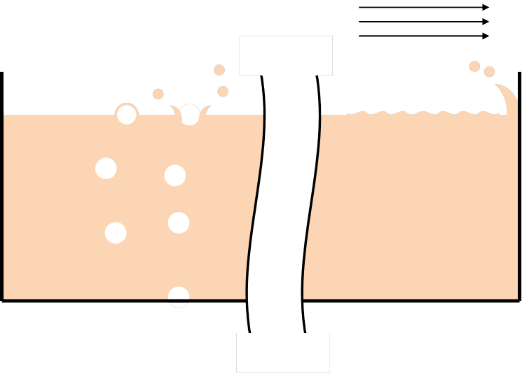
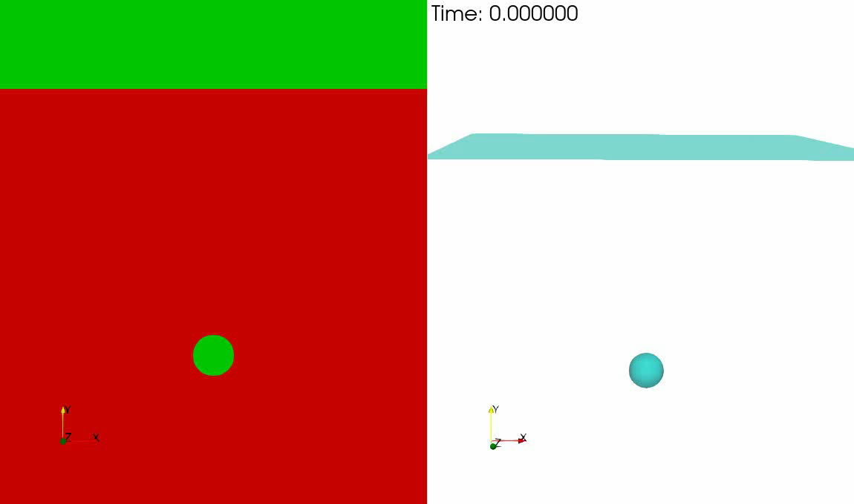

An Illustration of Two Entrainment Mechanisms
SIERRA/Aria Level-set simulation bubble burst video:
Surface Agitation by Boiling Surface Agitation by Wind
Involves pinch and rupture of bubbles Involves waves created by flow
Wind also induces ‘white crest’ behavior forming drops at wave summits
Multimodal:
Small drops from sheet thinning
Large drops pinched from collapsing bubble jet

Slide 7
What is Evaporation Induced Entrainment (EIE)?
EIE requires no surface agitation
Particles entrained are well below their evaporation temperatures
Previous experiments have found that contaminants can release ‘sympathetically’ with an evaporating liquid well below the evaporation temperature of the contaminant
The schematic on the right represents our rough conceptual idea of the mechanism leading to EIE
Gray particles represent contaminants
White particles represent evaporating liquid

Slide 8
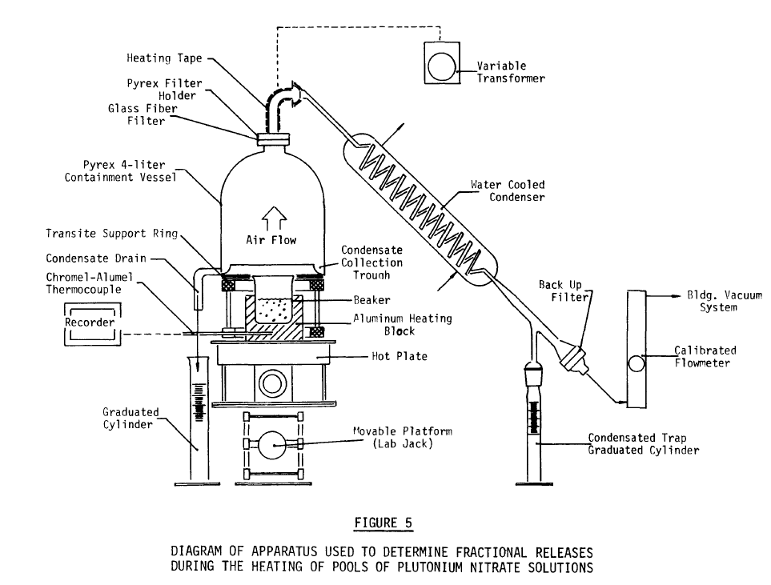
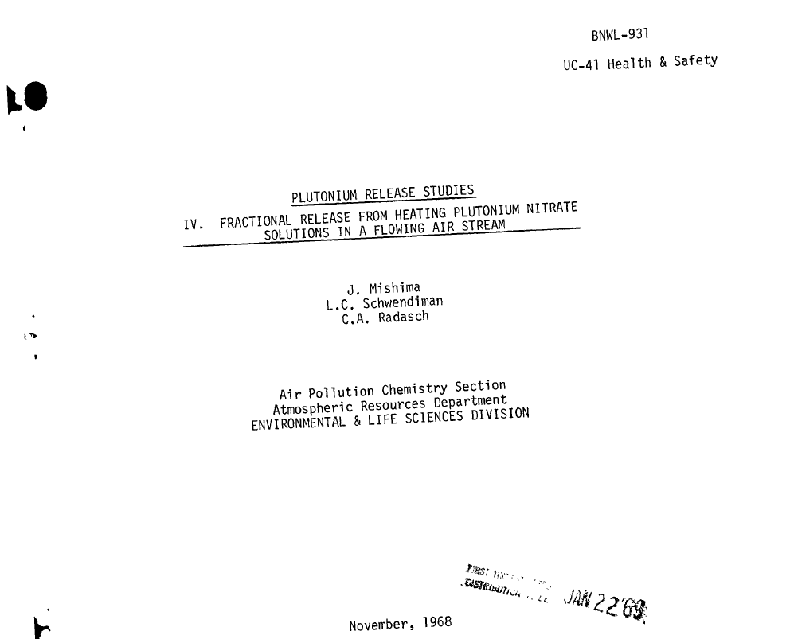
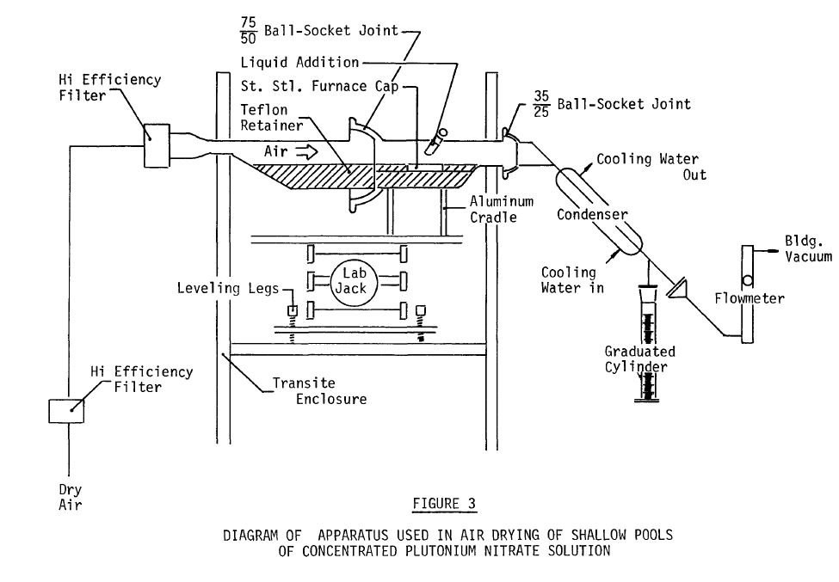
What indications do we have of EIE?
This is not a well studied field. It is a mix of colloquial evidence and testing that primarily goes back to a single report by Mishima et al. (1968)
  Using plutonium nitrate under air drying and forced drying (heated)
  Rates is generally low (non-zero) until surface agitates

Slide 9
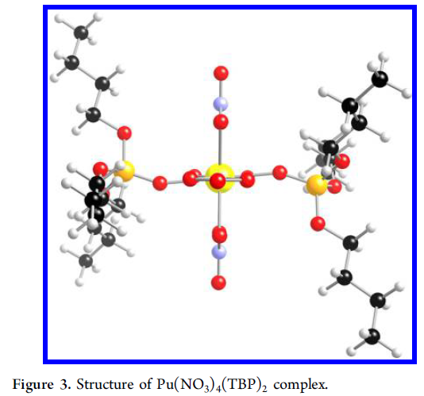
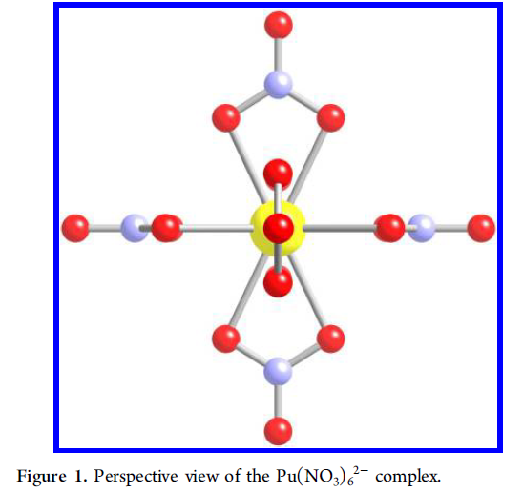
What is the liquid fuel source?
In historical work relating to the Plutonium Uranium Redox EXtraction (PUREX) process, we have TBP/Kerosene with nitrate and water
In Mishima et al. (1968) they used Pu(NO₃)₆ in dilute nitric acid
These are ‘coordination complexes,’ which are weakly or covalent bound liquid molecules
  Evaporation mechanics taught in school generally do not deal with such anomalies
  Bond strength depends on atomic number
How these behave in evaporating conditions is not clear, but key to understanding historical EIE
Šulka, M., Cantrel, L. and Vallet, V., 2014. Theoretical study of plutonium (IV) complexes formed within the PUREX process: A proposal of a plutonium surrogate in fire conditions. The Journal of Physical Chemistry A, 118(43), pp.10073-10080.

Slide 10
MD for Quantitative Model Parameters
We present here the basis for some new modeling capabilities
  Molecular dynamics (MD) using the LAMMPS package developed at SNL allows for a discrete, atomistic- scale method for interrogating the process of sub-boiling evaporation of a liquid solvent resulting in the release of molecules into the gas phase above the liquid vapor interface (LVI).
  By constructing an appropriate and equilibrated sample of solvent with dissolved contaminant species, we can evolve the sample in time and investigate the appearance of contaminant in the gas phase above the LVI. While below the boiling point of the solvent, this process is referred to as EIE (as previously) described.
  We have performed LAMMPS simulations of this type for two different solvents over a range of temperatures below the boiling point for each solvent. The first scenario involves the dilute HNO₃ solutions used by Mishima et al. (1968), while the second is Purex, a common separation medium for radio-nuclides, each with appropriate Pu-based contaminants.
  LAMMPS allows for a full description of inter- and intra-molecular forcefields including electrostatic, bonded, angle, dihedral/improper angles, and non-bonded (van der Waals) types. Many of the terms have been informed by the OPLS-AA parameterization developed by Jorgensen, with additional necessary terms for the specific species in this study found in the literature.

Slide 11
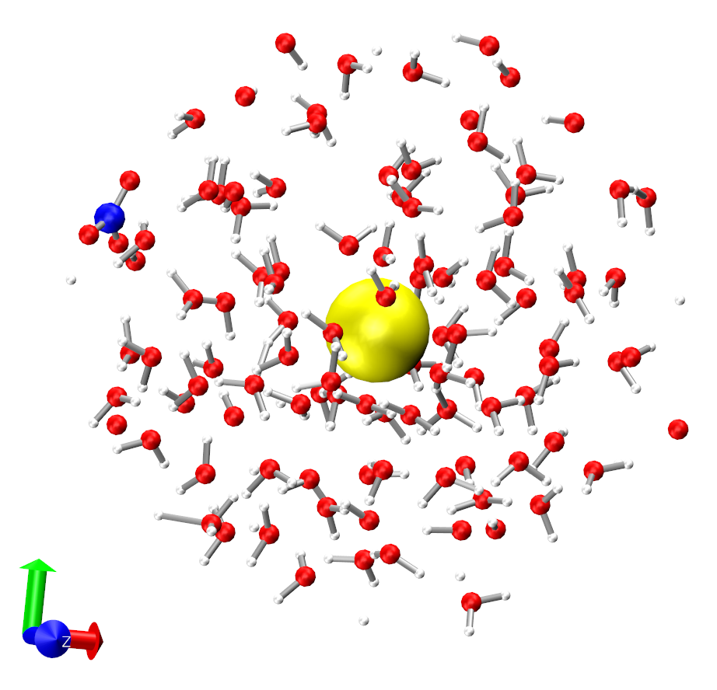
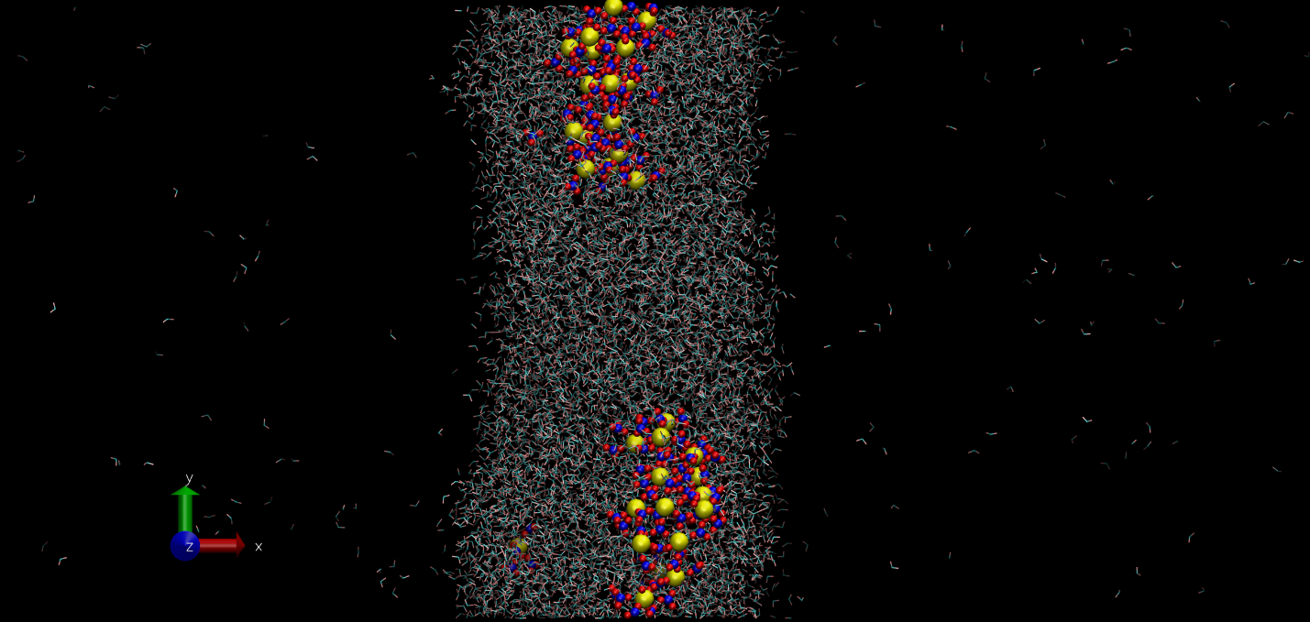
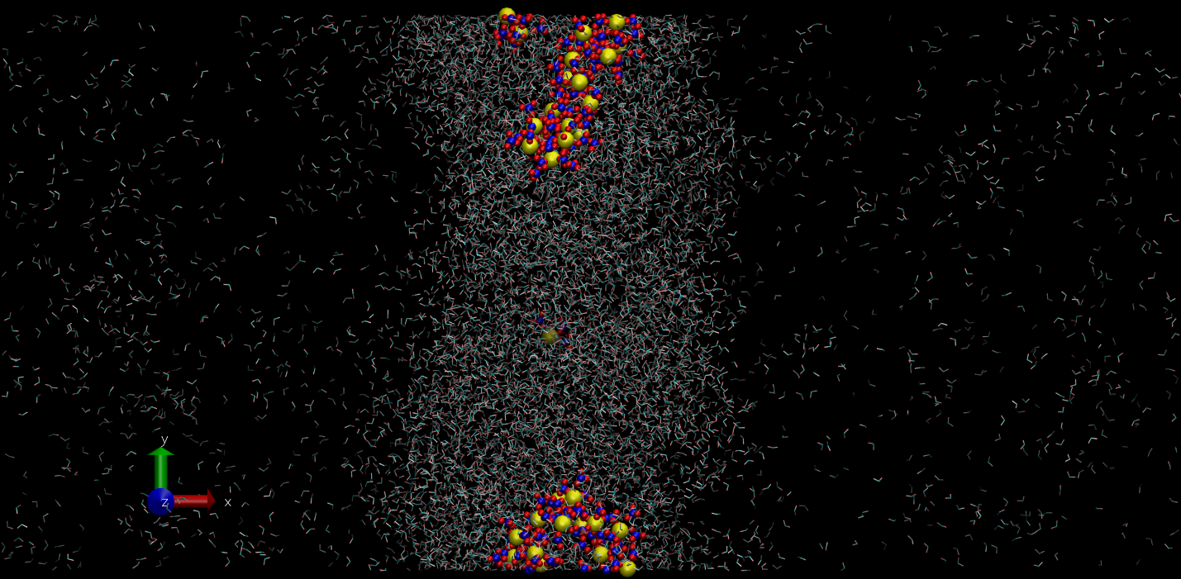
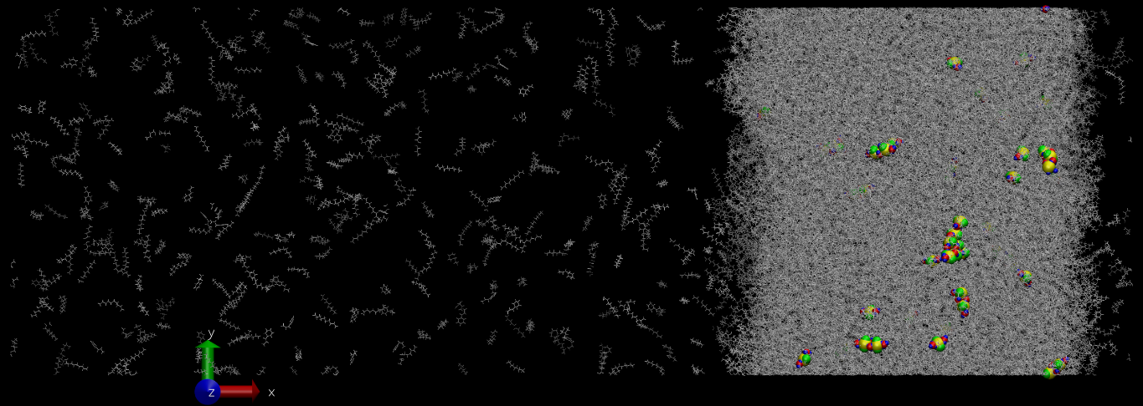
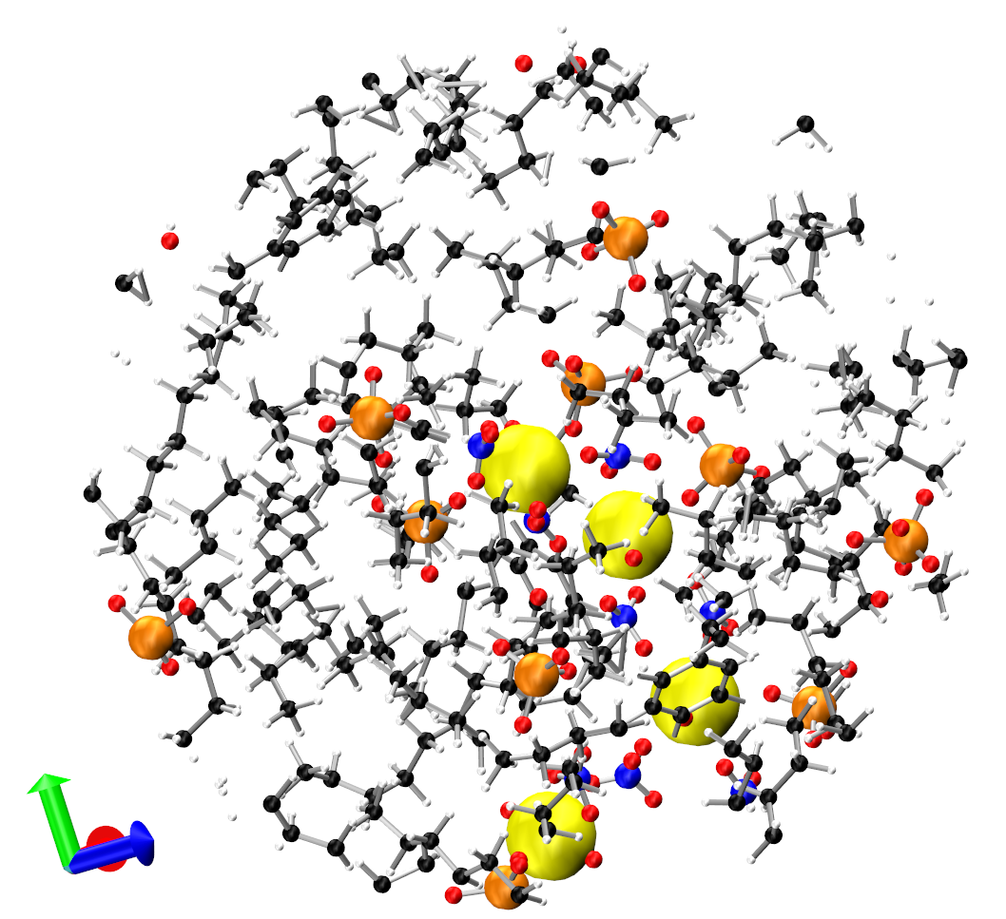
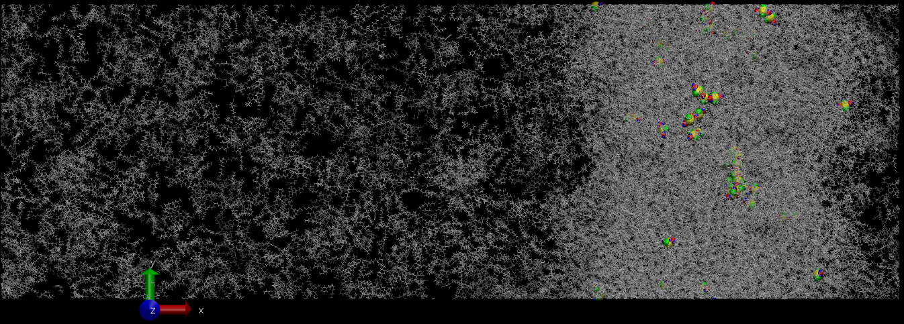
MD Transient Simulations – Water/Purex Scenarios
400K
550K
Water (MS-1968) Scenario:
H₂O/NO₃⁻ shown on left w/ CPK coloring (H – white, O – red, N – blue) and Pu⁴⁺ in yellow for clarity. Image is from transient simulation of H₂O with NO₃- and Pu⁴⁺ contaminant taken from the bulk of the solvent at 300K.
Right images are from transient states of the LVI for these samples at 400K and 550K.
315K
PUREX Scenario:
Kerosene, TBP shown on left with CPK coloring (C – black, H – white, O – red, N – blue, P - orange) and Pu⁴⁺ in yellow for clarity. Image is from transient simulation of Purex with Plutanyl Nitrate contaminant taken from the bulk of the solvent at 415K.
Upper and lower images are from transient states of the LVI for these samples at 315K and 450K.
450K

Slide 12
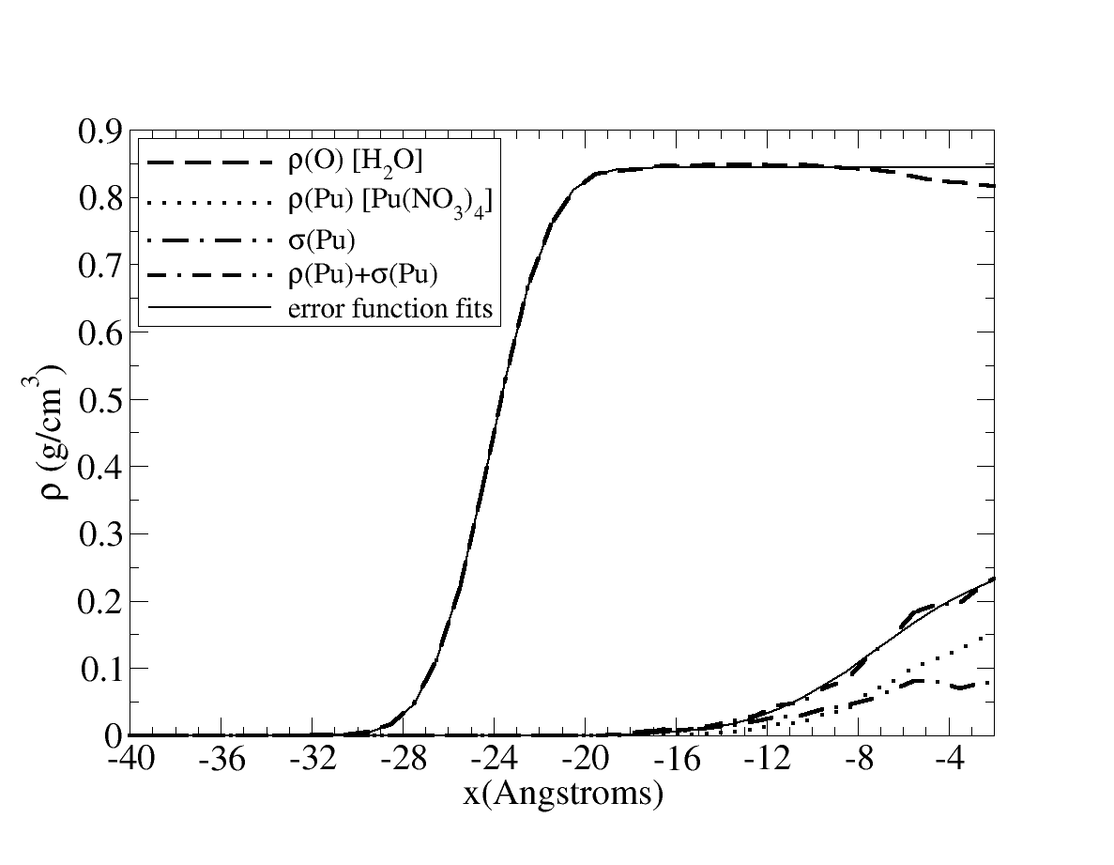
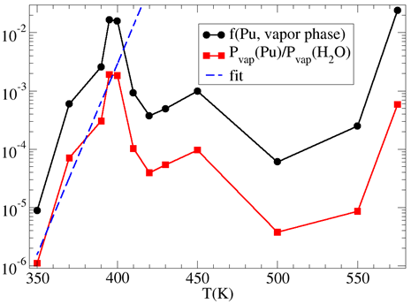
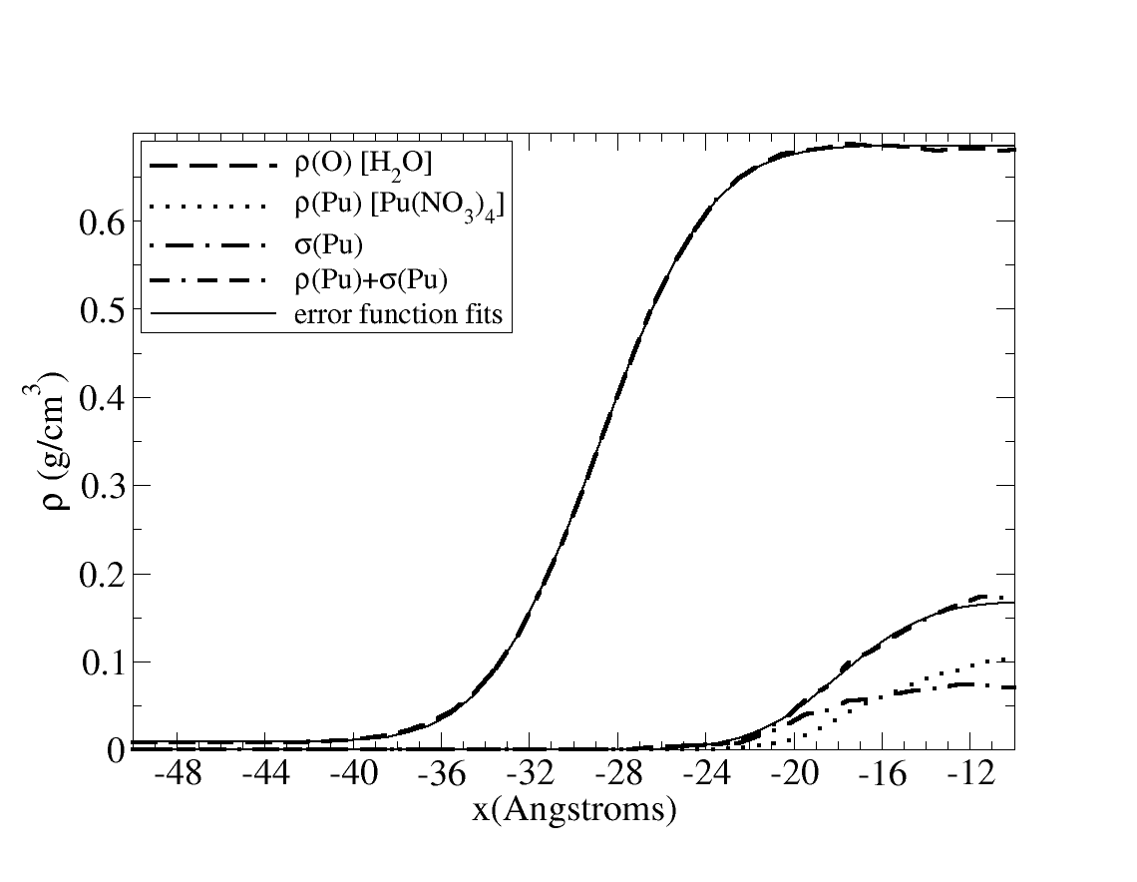
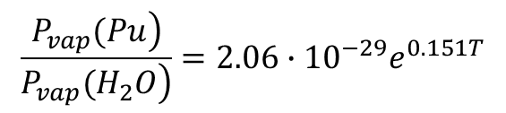
Mishima et al. – calculation of EIE/Pu vapor pressure
Left: atomic/molecular mass density profiles for solvent and Pu contaminant at 350K (top) and 500K (bottom) including standard deviations. Extension of Pu density profile past LVI for solvent allows metric of Pu vapor pressure at the specific temperature.
Right: fraction of Pu in the vapor phase and relative vapor pressure of Pu to H2O solvent as a function of temperature as determined by density profiles. Exponential fit to data below boiling point of solvent is shown. These data have been used to compare to Mishima et al. experimental results for EIE.
$$\frac{\left.P_{vap}(Pu\right)}{\left.P_{vap}(H_{2}O\right)}=2.06∙{10}^{−29}e^{0.151T}$$

Slide 13
MD predictions of Pu compared to data
Comparison of partial pressure model to ARF not 1:1, but instructive (should be correlated)
  Partial Pressure model relatively consistent with historical EIE data from MS-1968:

Slide 14

MD Results to Quantitative CFD Model
  Molecular dynamics simulations using the LAMMPS package have been used to determine EIE source terms for the Mishima et al. (1968) case (Pu contaminant in dilute HNO₃)
  Purex case requires significantly longer simulation times to derive precise source terms.
  SIERRA/Fuego has been enhanced to allow EIE source term of particles (of any size distribution) into CFD domain – tunable to the specific source term determined via MD results.
    Particle entrainment relates to the partial pressure model through a simple relation where ‘P’ is determined from the ratio of the partial pressures determined from MD
  The only prior model of this nature is suggested by the combined journal paper from researchers on 3 continents, and suggests contaminant release is proportional to soot formation
    This doesn’t make sense from a mechanistic standpoint, and is not further pursued here
$$\dot{m_{P}^{"}}=P×{RR}_{f}ρ_{f}$$

Slide 15
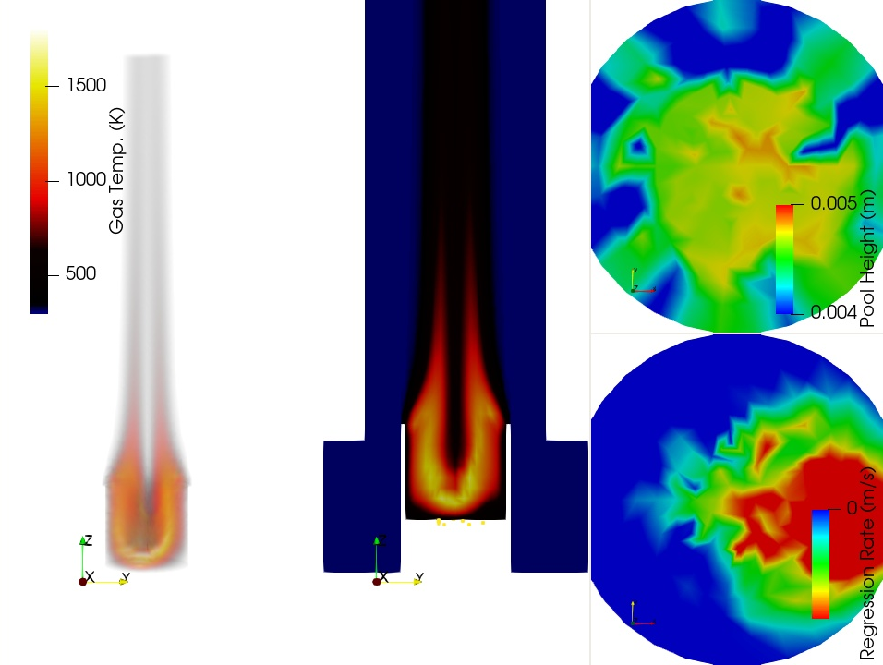
CFD simulations
  Using Sandia’s SIERRA/Fuego, a pool regression model predicts the evaporation rate based on thermal feedback from the fire
  Particle injections are proportional to the evaporation rate in the model
Snapshot of pool behavior during oscillating phase of burn
Start-up
Periodic oscillating flame

Slide 16
Historical Study Review-solid sources
Limited (fewer than with liquids), highly variable, historical studies exist on entrainment of contaminants from solids during a fire:
Study | Solids | Contaminants | Sizes Pre-test
MS-1973; BNWL-1730 | 4-5 kg of mixed Cardboard, paper, plastic, rubber, rags, oil, tape | UO2, Uranium nitrate liquid, air dried uranium nitrate | 0.2-30 mm
MS-1973; BNWL-1732 | Sandy soil, vegetation, stainless steel, | UO2, Uranium nitrate liquid, air dried uranium nitrate | 0.2-30 mm
Halverson et al., 1987 | Polychloroprene, polystyrene, PMMA, cellulose | UO2, uranyl nitrate hexahydrate (UNH) solution, and UNH salt | MMD of 1 micron, aqueous, and crystal
Bhanti et al., 1988 | Styrene divinyl benzene co-polymer | Th in the resin | N/A
Buijs et al. (1988-1992), Pickering et al. (1987-1989) | Primarily PMMA with other materials | Ce, Eu oxides in large-scale tests U, Pu ,and Am oxides in small-scale tests | MMD of 10.5 micron with sieve below 40
Fernandez and Burghoffer (1995) | PMMA | CeO2 | 1.75-7.5 micron MMD
Mendoza et al. (2020) | Cheesecloth, plastic bag, PMMA, rubber, cellulose | CeO2
Hubbard et al., 2021 | Cellulose | Lu, Yb, U, nitrates and mesoparticles of salts | N/A

Slide 17
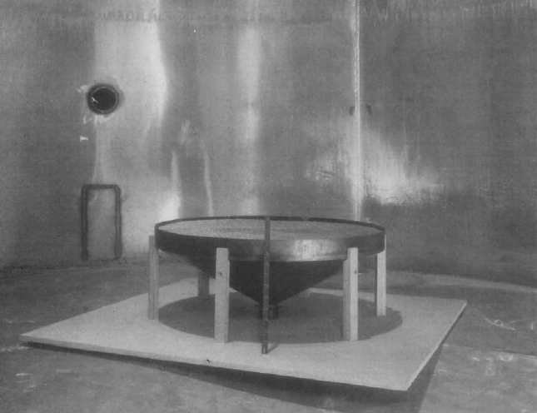
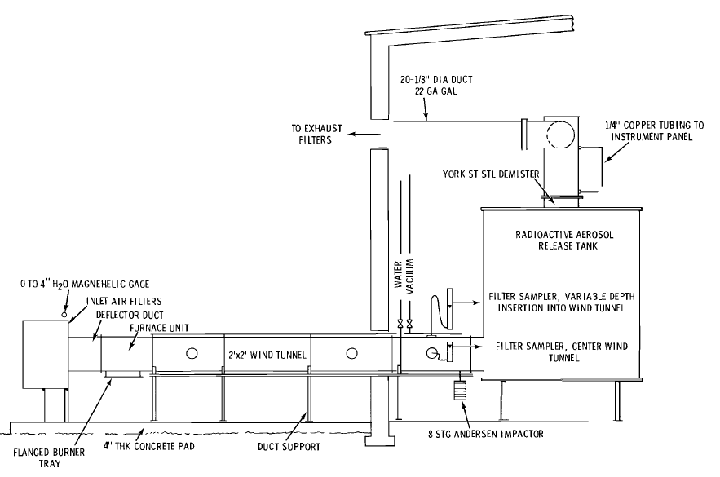
Mishima and Schwendiman (MS)-1973
Various scales of testing, wide variety of solids and other substrates
Limited observations, but wide breadth of data

Slide 18
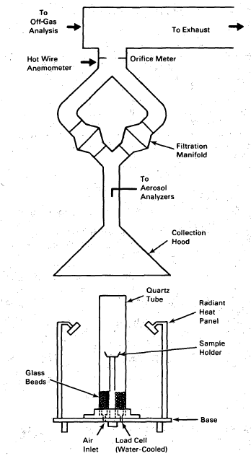
Halverson et al., 1987
Small-scale testing of liquid and solid contaminants
  Various forms of U contamination
  Temporal data on evolution
  Relatively poor characterization of the irradiance
  Limited variation of the flow conditions

Slide 19
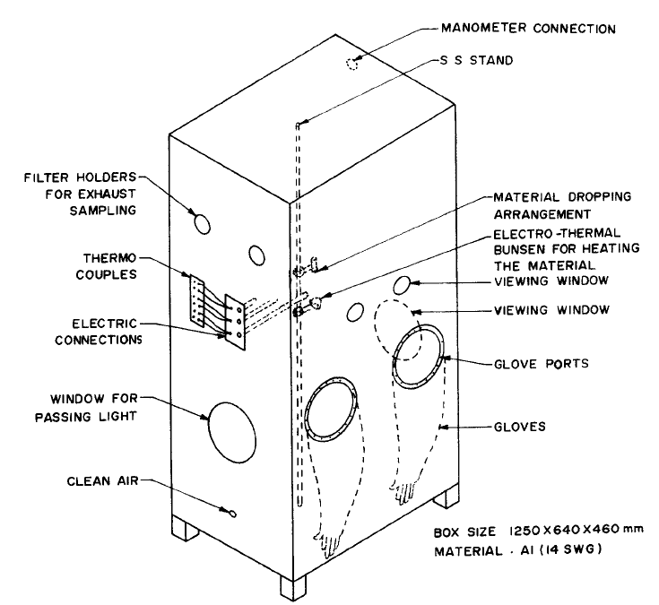
Bhanti et al., 1988
Burning ion exchange resins
  Dropped into a hot crucible
Looked at a variety of scales from small to large
Noted a relationship between ARF and the scale of the experiments

Slide 20
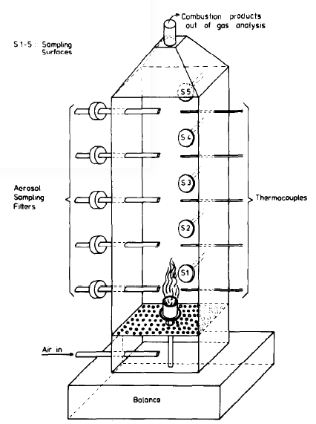
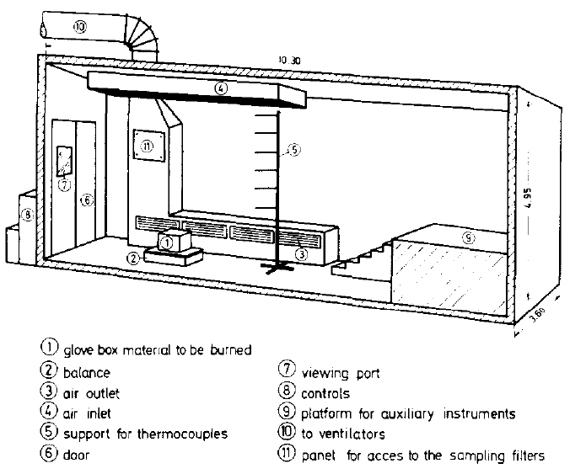
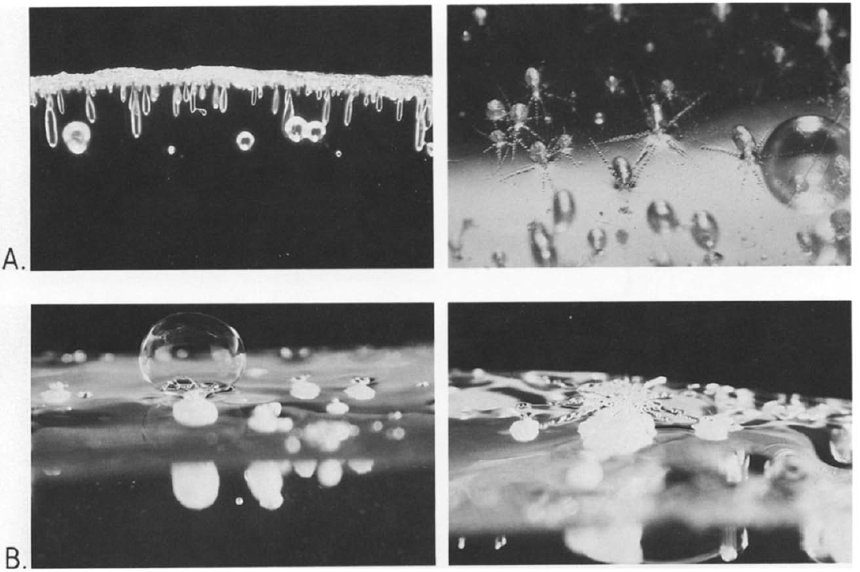
Buijs et al. (1987), Pickering (1989)
Multiple scales of testing, with various contaminants (Eu, Ce, U, Pu, Am), fuels (plastics, organics), configurations
Solids arranged more for testing convenience, less for being representative of a fire scenario
Images highlight multi-phase challenges with PMMA

Slide 21
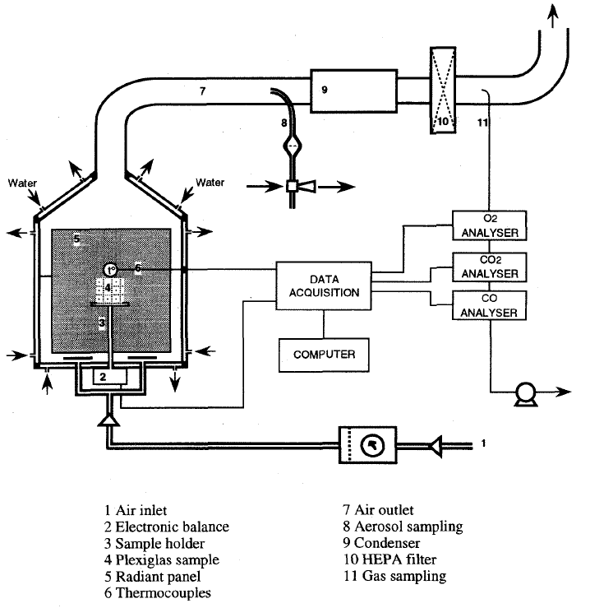
Fernandez and Burghoffer (1995)
Radiant panel exposure of a contaminated PMMA slab
Used design of experiments methods
  Two air flows
  Two radiant panel temperatures
  Two CeO2 mass loadings
  Two MMD particle diameters
Found that initially superficial particles migrated into the solid during the burn
  Mechanistically challenging
Describe a non-linear relation between mass loss rate and contaminant release

Slide 22
Fernandez and Burghoffer (1995)
PMMA perhaps the most studied solid for contaminant release
  Gloveboxes are primarily constructed from PMMA
Test results imply complex behavior of contaminants on PMMA surfaces
  Migration not likely due to gravity due to vertical orientation of samples
  Other forces possibly affecting behavior include surface effects (tension), diffusion, and thermophoresis
    Model will be different depending on chosen mechanism
A)
B)
C)
Heat

Slide 23
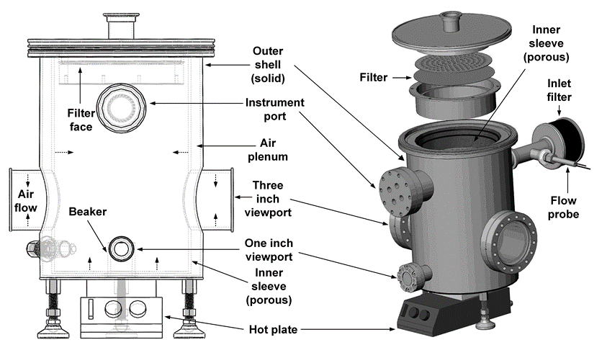
Hubbard et al. (2021)
Presented at last EFCOG meeting
Cellulose strips contaminated with one of three metals having one of two chemical forms
ARF depended significantly on the chemical form, nitrate versus mesoparticle

Slide 24
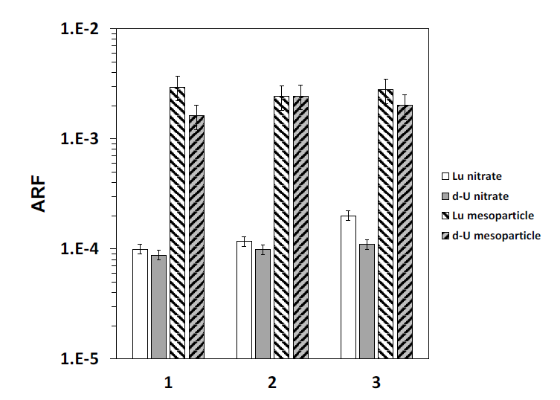
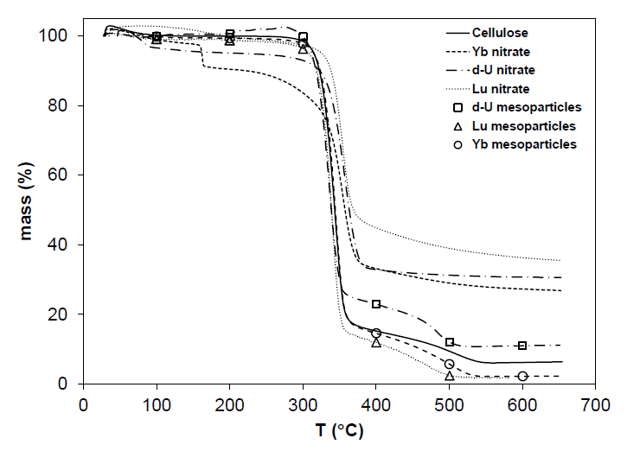
Hubbard et al. (2021)
Form of the metal contaminant has a marked effect on the ARF yields (right)
TGA decomposition data (left image) suggest enhancement of char yield (fixed carbon) depending on metal form
  This relation is also a complexity desirable to capture in the models

Slide 25
Phases of Burning Solids and Release Prospects for Contaminants
Burning Phases Release Prospects
1. Initial heating and initial pyrolysis
  Solid bonds begin to break, liberating gases from the surfaces, possibly evolving particles as well
  2. Charring and flaming combustion
  Some materials yield char, which creates a carbon solid that can envelop the contaminant
  3. Char oxidation
  The char can be slowly oxidized, liberating enveloped particles
  4. Residual Ash
  Remaining material is typically inorganic, not very cohesive, and easy to disperse
1. Initial heating and initial pyrolysis
  Thermal stress and jetting can entrain contaminants
  2. Charring and flaming combustion
  Flow induced by flames may augment entrainment, char formation may enhance retention of particles
  3. Char oxidation
  Carbon burning away from around the particles can provide a new opportunity for entrainment
  4. Residual Ash
  Without an organic substrate, the contaminants may be easy to liberate and disperse in this phase

Slide 26
Plastics versus natural organics
There are a variety of plastics and plastic behaviors during fires
1. Initial heating and initial pyrolysis
  Some plastics melt and flow before they burn
  2. Charring and flaming combustion
  Plastics may or may not char
  3. Char oxidation
  Instead of char oxidizing, a melting polymer will boil, which looks more like a liquid fire
  4. Residual Ash
  Many plastics will yield some ash, and it is postulated that contaminants will contribute thereto

Slide 27
PMMA Fire
The International Association of Fire Safety Science (IAFSS) is conducting a workshop in late April 2021 focusing on PMMA decomposition
  Dozens of institutions testing and modeling identical samples
  We are participating in this activity
  Expected to result in improved understanding of reaction rates
PMMA is one of the more widely contaminated solid combustibles studied in the historical literature
  This is one of our target materials for model development
  We have a model that assumes the rate of pyrolysis is proportional to the particle evolution
    Perhaps true for a very small contaminant uniformly dispersed through the solid
    Literature review suggests some additional complexity to the real problem
  Never tested, probably more likely a fire on the outside, particles on the inside
    This case possibly more likely because glovebox atmospheres are typically inert (N₂) on the inside

Slide 28
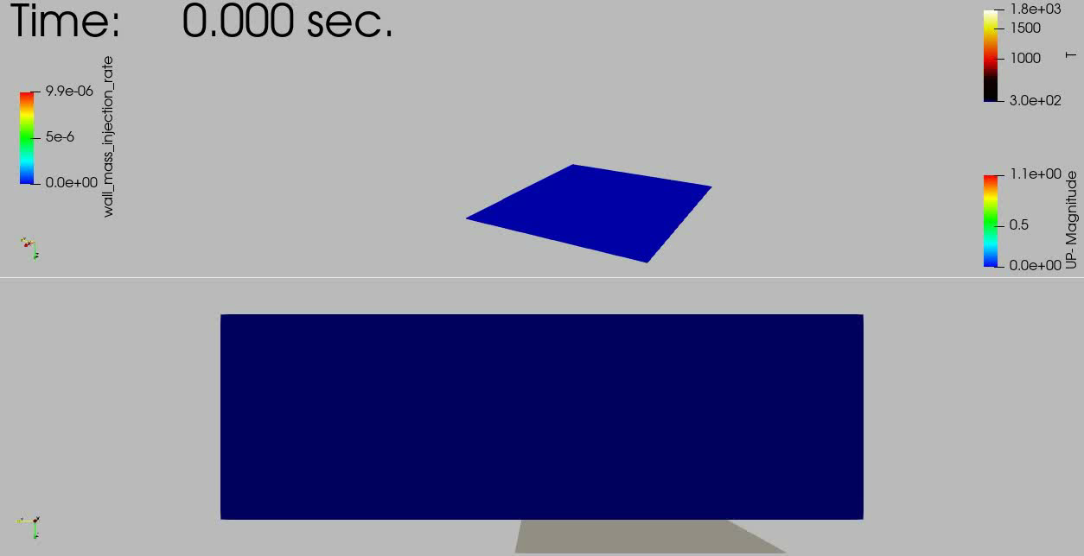
PMMA Fire Video
Particle entrainment model development in progress; PMMA burn illustrated below with particle entrainment functional with pyrolysis rate

Slide 29
Project Outlook
We have identified some complexities associated with contaminant emission from solid materials
  Variable propensity to form and be subsumed in the char during pyrolysis/burning of cellulose depending on contaminant form
  Particles migrating inward on a decomposing/burning PMMA sample
We are addressing these by developing generalized models that can simulate this behavior
  Models being implemented in SIERRA/Fuego, the DOE fire code for the NW complex
  General models can be adapted to fit a variety of scenario results
Uncertainties exist in the nature of the observations
  Modeling work depends on future data shedding additional light on behavior and appropriate model parameters

Slide 30
Summary
A review of experiments on contaminant entrainment from fires has been completed for solid and liquid combustibles
Evaporation Induced Entrainment is described quantitatively based on MD simulations
  The model is adaptable to permit predictive evolution using a CFD code
Solid emissions are potentially sensitive to:
  The propensity for the char to accumulate around the particles
  Transit of particles into liquid polymers
We are pursuing mechanistic models for predicting airborne release
  Using SIERRA/Fuego as a platform for model development
  Data are lacking to sufficiently characterize the test behaviors

Slide 31
Extras

Slide 32
Experimental
We have designed a test enclosure to provide heating to a sample that off-gases or burns
Heating from below or ignition through a side port
Porous sleeve prevents wall deposition
Particulates are collected for lab processing

Slide 33
Experimental Results
Lutetium (Lu) and Ytterbium (Yb) were prepared as PUREX related samples
Most tests involved burning
  A few tests from heated evaporation only
  All images shown here from burning tests
SEM/TEM of collected samples from burn tests suggests:
  200 nm particles or aggregates
  Variable carbon content in particles
  Phosphorus, oxygen found with metals

Slide 34
Experimental Results-Boiling
Energy-dispersive X-ray spectroscopy provides speciation
TEM imagery suggests the 200 nm particles are predominantly the contaminant as well as phosphorus and oxygen.
  Suggests the P and the metal contaminant stay together, although the carbon from the ligands seems to be driven off
  TBP is (CH₃CH₂CH₂CH₂O)₃PO

