Slide 1
MELCOR Code Validation for LPF Applications
David L.Y. Louie, Ph.D.
Email: dllouie@sandia.gov
Sandia National Laboratories
EFCOG Nuclear Facility Workshop 2021
NSR&D Subgroup Session
February 22, 2021
SAND2021-1838 C

Slide 2
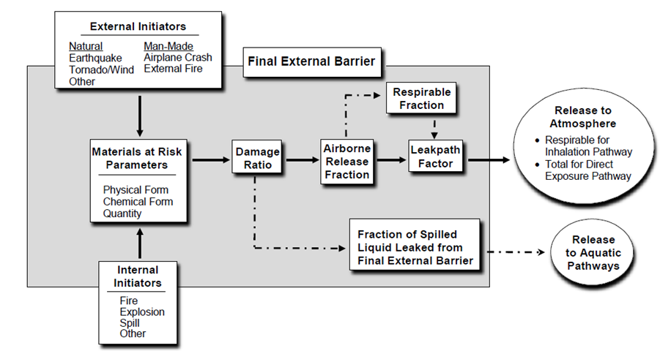
What is Leak Path Factor?
[DOE-HDBK-1224-2018]
Five Factor Formula
$ST=MAR∙DR∙ARF∙RF∙LPF$
MAR - material at risk
DR – damage ratio
ARF – airborne release fraction
RF – respirable fraction
LPF – leak path factor
ARF & RF from DOE-HDBK-3010
Source Term (ST) [DOE-HDBK-1224-2018]
$IST −Initial ST defines as MAR ∙DR∙ARF$
BST- Building ST defines as IST∙LPF
Respirable: IST_{RF}= IST∙RF, BST_{RF} = BST∙RF
LPF
$Analytical approach −a lot of assumptions and limited in scope.$
Computer code, such as MELCOR – more flexible
Needs IST from the scenario, and building information, etc.

Slide 3
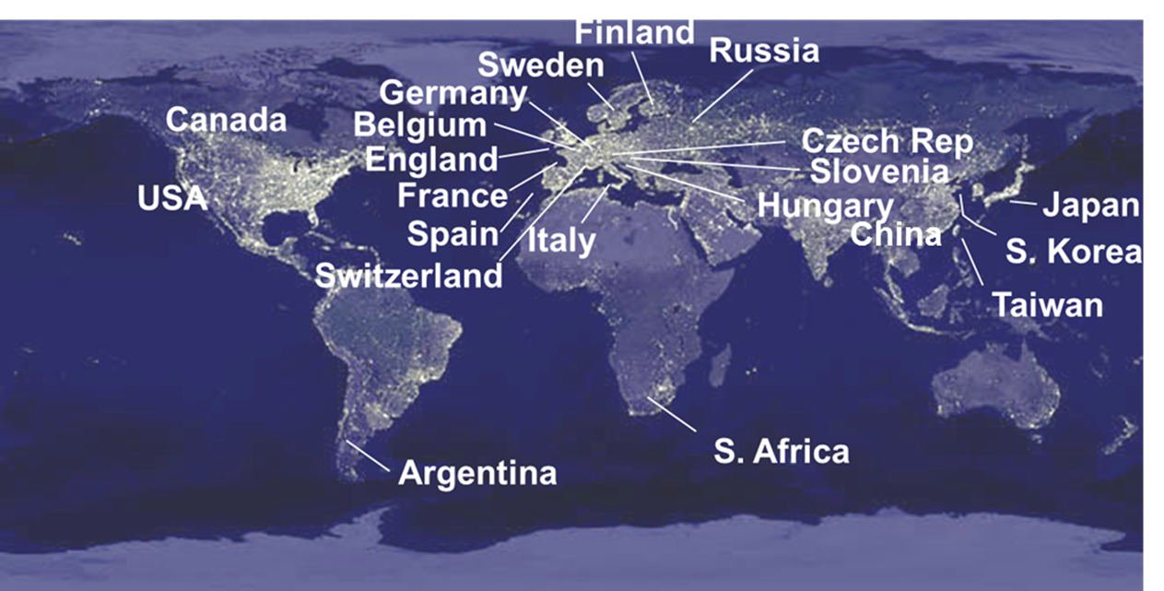
MELCOR Code
MELCOR is developed by Sandia National Laboratories
US Nuclear Regulatory Commission (NRC)
Developed initially for severe accident analysis of Light Water Reactors
Since early 1980s
MELCOR Development
US NRC Cooperative Severe Accident Research Program (CSARP)
Over 900+ licensed MELCOR users worldwide
Light water reactor (LWR) research
Advanced reactor development
Nuclear fusion development
MELCOR Application
NRC licensing support
Existing LWRs
Advanced reactors
Non-reactor support
Nuclear fusion research
Spent fuel reprocessing accident analysis
DOE facility support
MELCOR is designated as a Toolbox code for LPF analysis

Slide 4
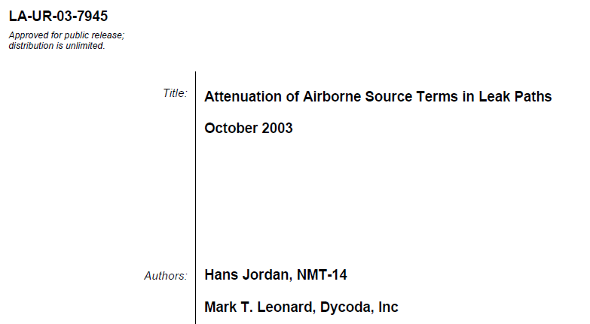
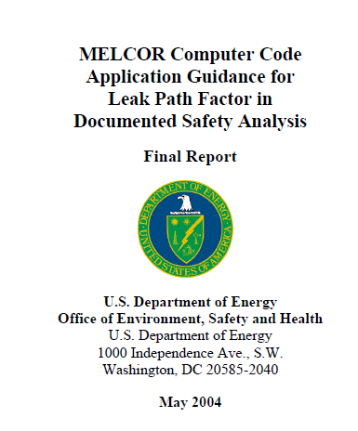
History of MELCOR uses in SBs
MELCOR is a DOE Toolbox code
MELCOR 1.8.5 LPF guidance and gap analysis reports (2004)
MELCOR 1.8.5 and 1.8.6 have been used for LPF analyses (2000+)
To support the facility DSA at:
LANL – PF4(TA-55), WCRRF, DVRSF, CMRR, BTF
LLNL – Plutonium facility (331)
NNSS– Device Assembly Facility, Area G Tunnel
Pantex
SRNL – K Area Spent Fuel Storage Facility
MELCOR 2.0 or later version (today)
LANL PF4

Slide 5
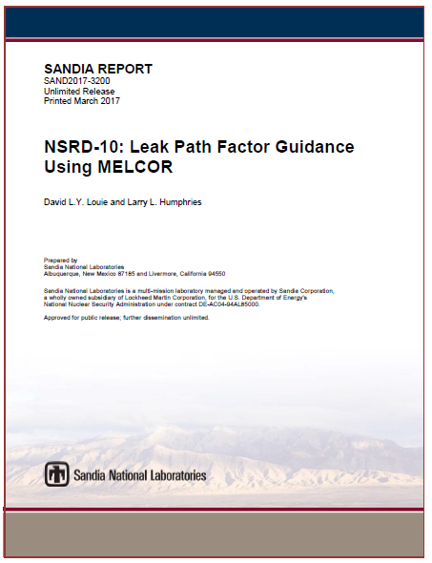
MELCOR V&V
DOE NSR&D Program
NSRD-10 project was done to supplement the 2004 MELCOR 1.8.5 guidance report
Use latest MELCOR version (2.1)
Validation tests
Reactor and non-reactor experiments, particularly for aerosol physics
Analytical tests
Verification tests
Version-to-version comparison – MELCOR 1.8.5, 1.8.6 and 2.1
Additional verification beyond those in MELCOR 1.8.5 guidance report
Best practices for common accident scenarios at DOE facilities

Slide 6
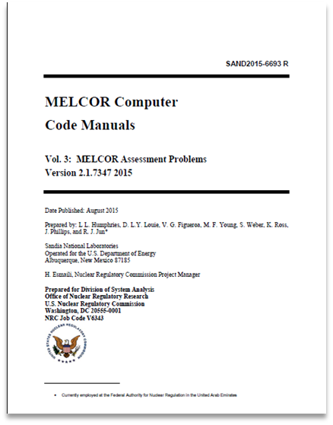
NSRD-10 V&V Test
In addition to those identified from MELCOR Assessment Report
Fire test –LLNL Enclosure Fire – from Validation document of CFAST
Aerosol resuspension test – STORM SR-11 Test
Additional experiments from DOE-HDBK-3010-94
Wind Tunnel Gasoline pool fire tests conducted at the RART facility
Spills and Pressurized Release Tests conducted in RART
Verification
Sample problems in MELCOR 1.8.5 guidance report
Version-to-version comparison: MELCOR 1.8.5, 1.8.6 and 2.1

Slide 7
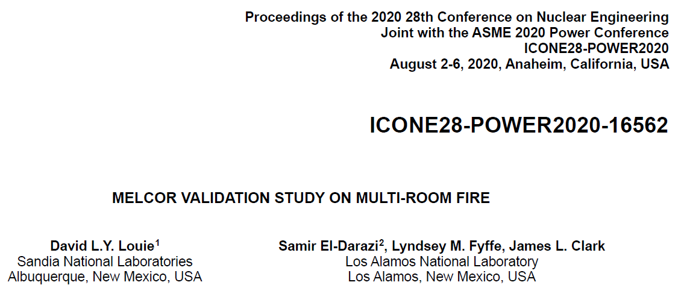
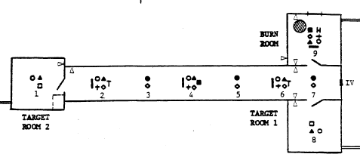
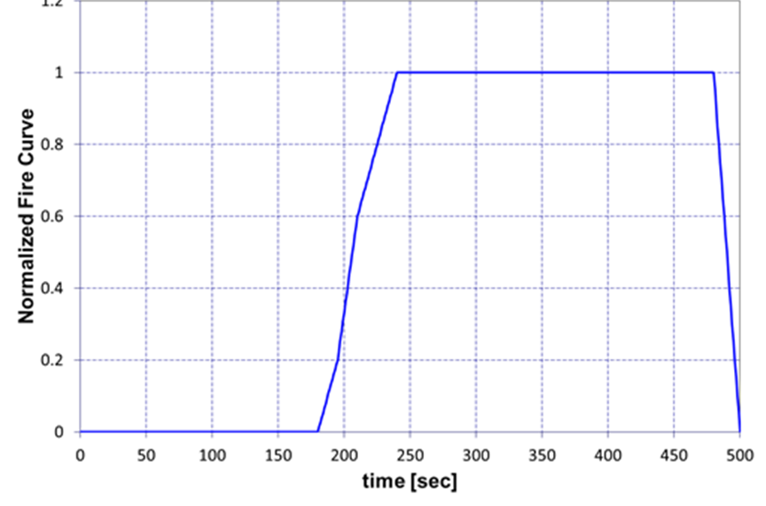
Multi-Room Fire Validation Study
Funded by LANL SB group
Assess MELCOR thermal-hydraulic response in multi-room fire
Assess smoke/contaminant aerosol transport
Light smoke particle (hydrocarbon)
Heavy contaminant particle (i.e., PuO₂)
Use NIST NBS-GCR-502 FM21 Test to validate MELCOR
Part of CFAST validation suite
Thermal hydraulic validation
CCF model:
Aerosol transport of smoke/contaminants
Heat Release Rate from Propylene Combustion
$$2 C_{3}H_{6}+9 O_{2}→6 CO_{2}+6 H_{2}O$$

Slide 8
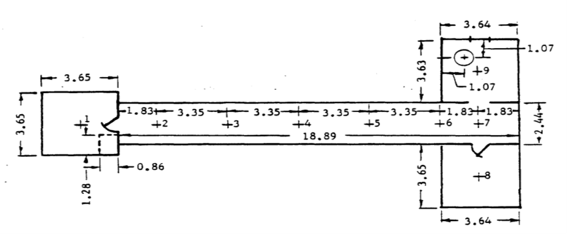
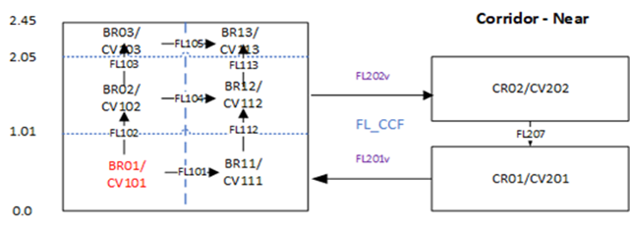
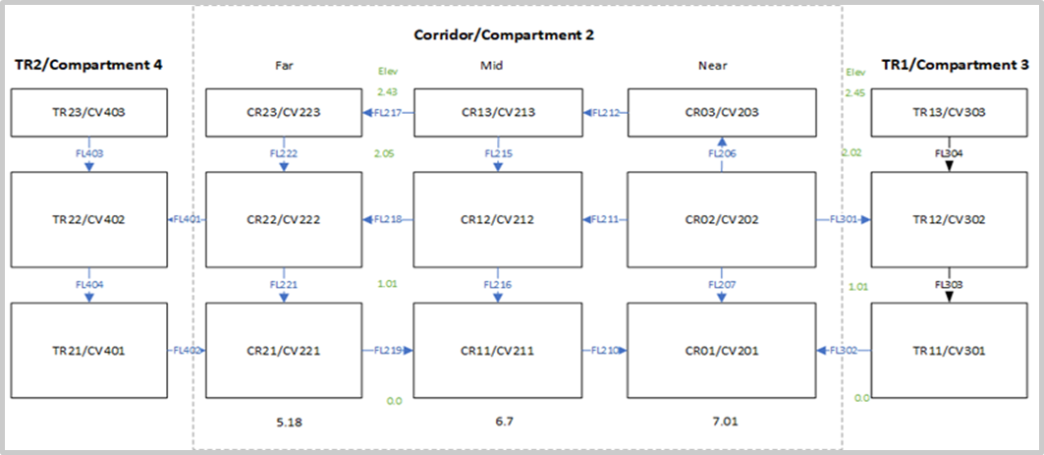
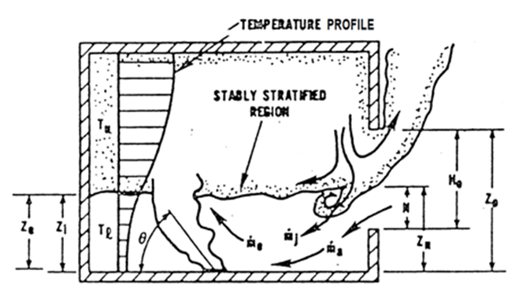
FM21Test – MELCOR Model
Control Volume setup to support:
Counter-current flow through door
Circulatory flow within room
Control Volume setup to support stratified aerosol transport
[Tan 1992]

Slide 9
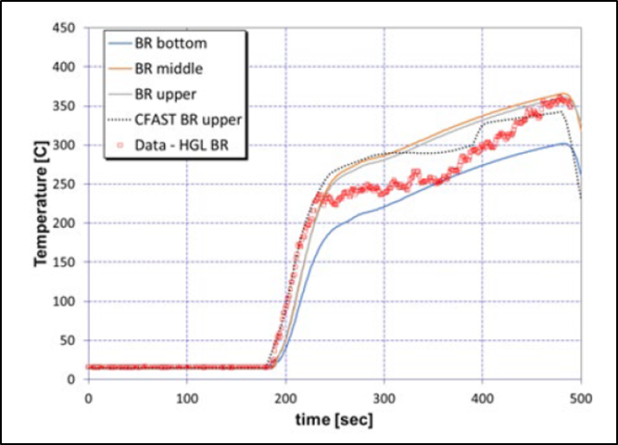
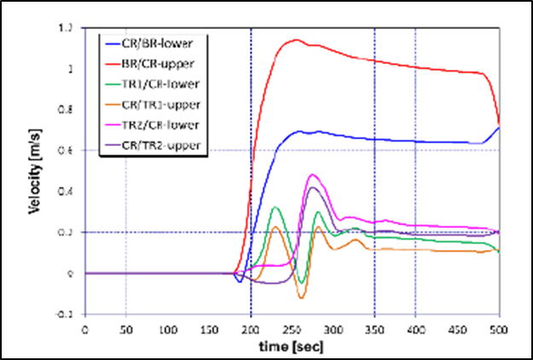
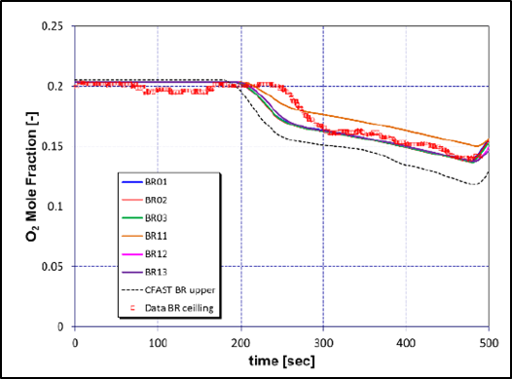
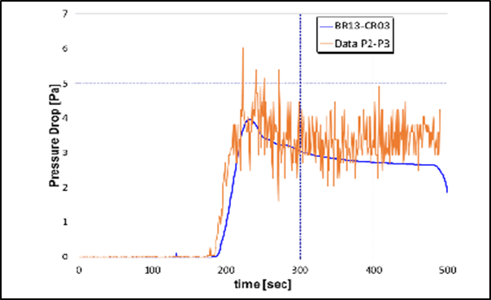
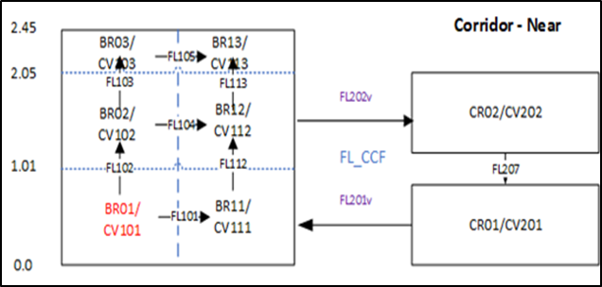
THERMAL-HYDRAULIC RESULTS (FM21 STUDY)
Hot Gas Layer Temperature Comparison
Experimental and predicted trends (Case 0) agree
Door counter-current flow not measured in experiment
Predicted counter-current flow agrees with expected flow behavior
Oxygen
composition
in Burn Room
Counter Current Flow
∆P between BR and Adjacent Corridor

Slide 10
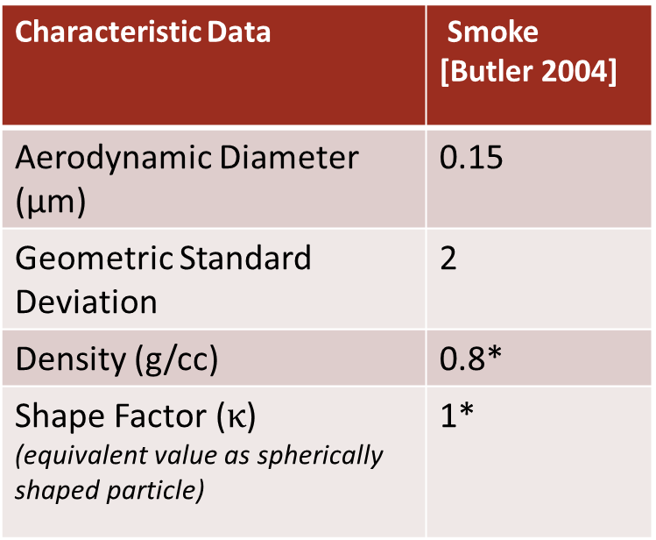
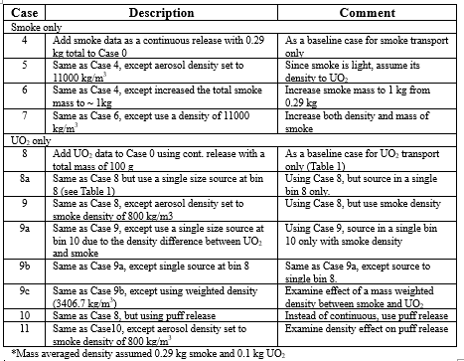
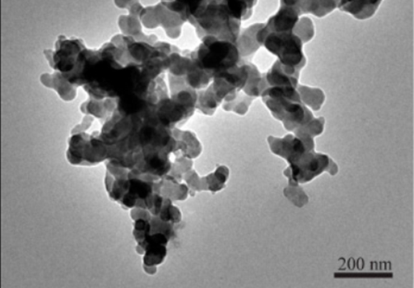
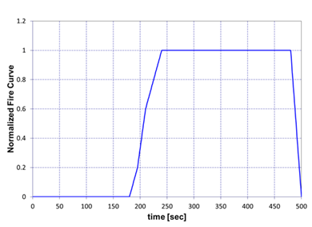
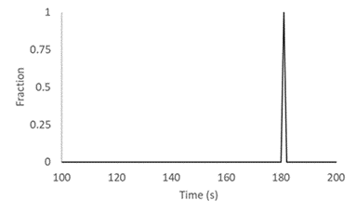
SMOKE & CONTAMINANT INPUTS (FM21 STUDY)
We did small sets of sensitivity studies on smoke only, UO₂ and combination
*Assumed. Smoke is typically irregular shaped+ and ranges between 1 to 2 g/cc.
Production rate of 0.095 smoke mass per mass of fuel (g/g-fuel) [Butler 2004]
Irregular shaped soot particles [Xu 2017]
Assumed UO₂ release rate options
Cont.
Puff

Slide 11
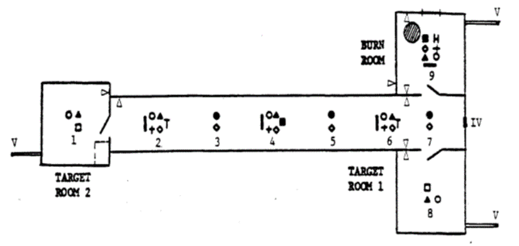
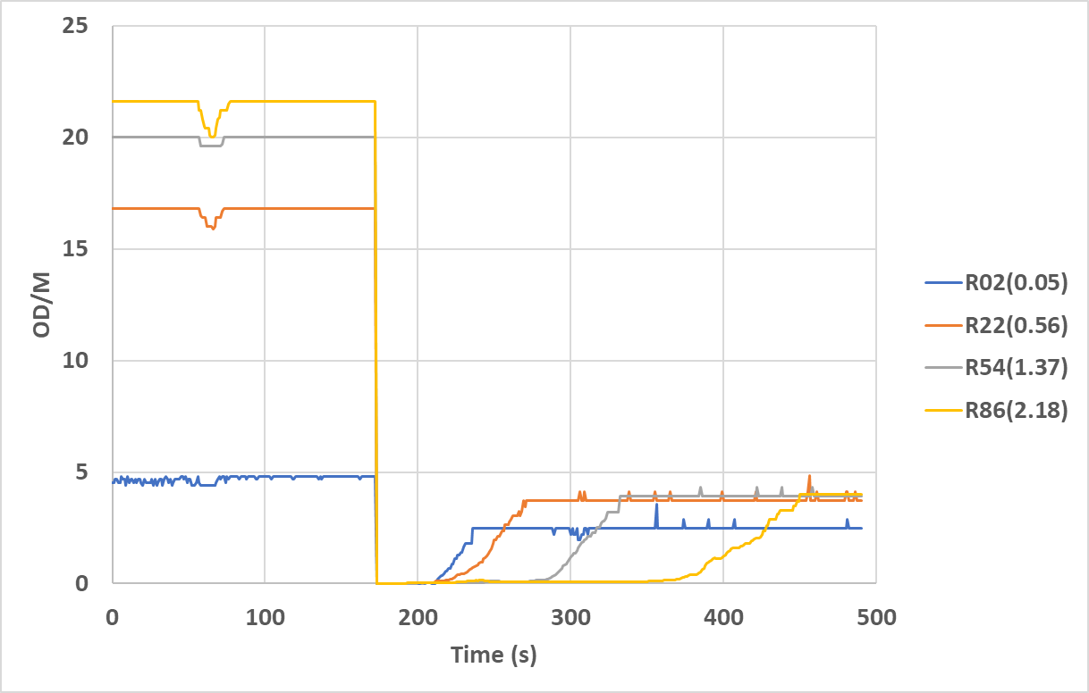
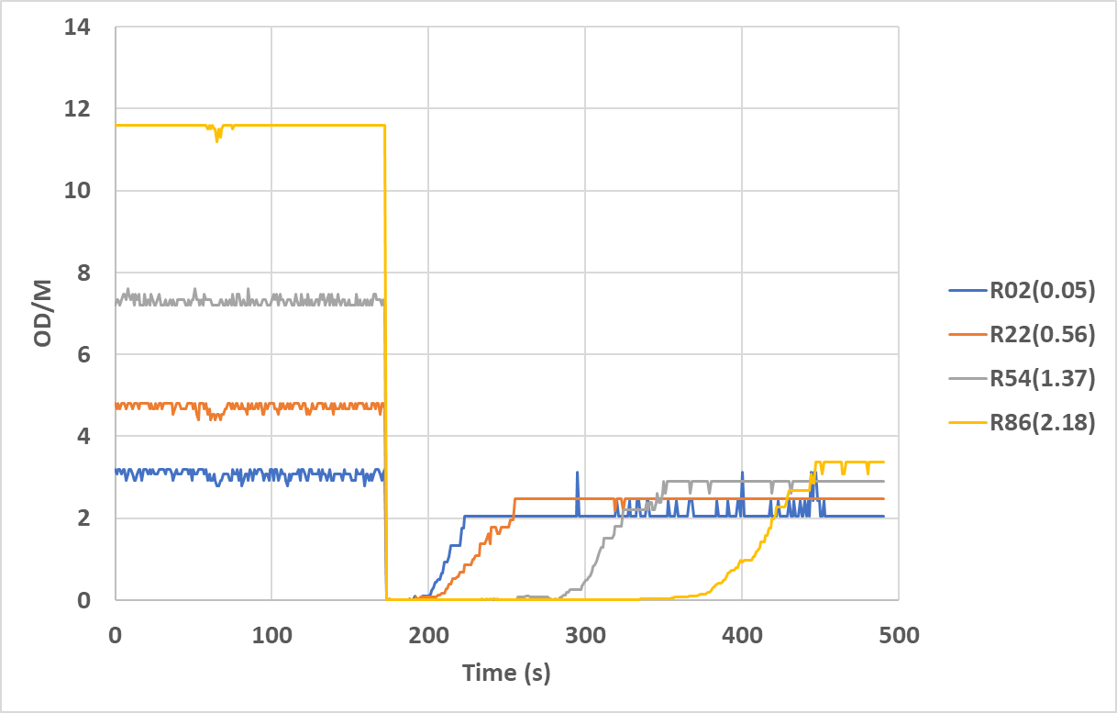
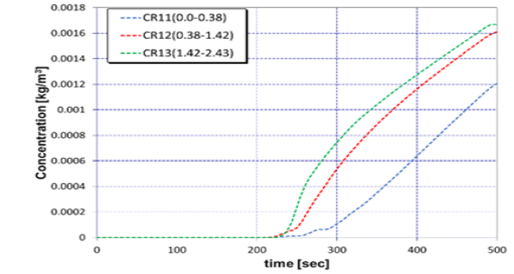
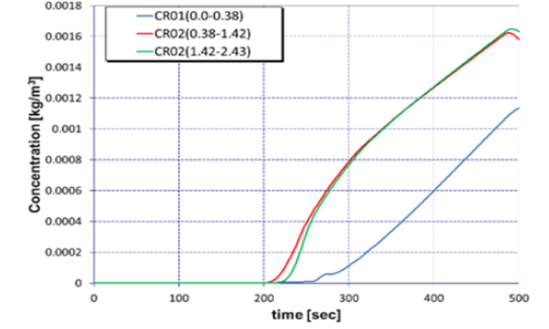
SMOKE TRANSPORT RESULTS (FM21 STUDY)
General trend agreement (with exceptions) between experimental opacity and MELCOR smoke concentration (Case 4)
Notes:
We assume a density of 0.8 g/cc for smoke in MELCOR calculation, and shape factor of 1.

Slide 12
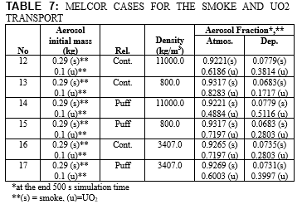
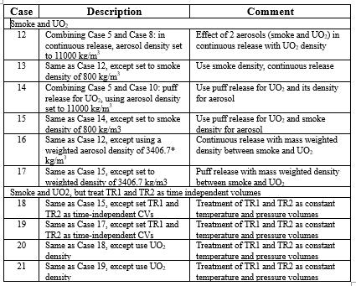
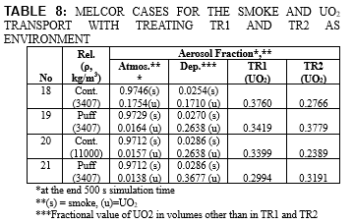
AEROSOL RESULTS (FM21 STUDY)
TR2
TR1

Slide 13
SUMMARY AND CONCLUSIONS (FM21 STUDY)
Thermal hydraulic response
MELCOR can model fire scenario, even through it does not contain a dynamic hot gas layer by using stratified control volumes
Combustible burn can be modeled to allow better treatment of oxygen condition
Counter-current flow model enables fire-room door counter-current flow
Smoke transport response
MELCOR agrees well with FM21 smoke data
Irregularly shaped particulate can be modeled by adjusting density and shape factor
Modeling insights associated with smoke, UO₂ deposition and environmental release
Higher density increases deposition
Particulate size is a major contributor to gravitational settling
MELCOR single aerosol density limitation can be overcome by use of particle size smear density adjustment method
Instantaneous sourcing yields a lower environmental release

Slide 14
FUTURE MELCOR NUCLEAR FACILITY SAFETY IDEAS
Sandia commits to expand MELCOR for active support to DOE facility safety
Hope to engage more safety analysts at DOE to utilize MELCOR for LPF applications and update old MELCOR calculations in the current DSAs, if any
Engage with DOE-AU32 to ensure that the latest version of MELCOR is in the DOE Central Registry
Conduct MELCOR training on LPF applications to EFCOG members
Successfully conducted 2 a week-long in-person MELCOR workshops at LANL
Will notify community of similar MELCOR workshops once in-person activity is allowed
Continue to support LANL SB group on MELCOR model review activity
Like to propose to form a MELCOR user group (FMUG, Facility safety MELCOR User Group) for facility safeties in EFCOG
Other applications for MELCOR
Support facility upgrade and new facility design

Slide 15
What MELCOR stands for?
Although the name “MELCOR” is occasionally and incorrectly said to be an acronym for “Methods for Estimation of Leakages and Consequence of Releases,” it is actually a portmanteau derived from “MELting CORe.”
THANK YOU!!!
Notes:
DOE-HDBK-1224-2018 is referred MELCOR as Methods for Estimation of Leakages and Consequences of Release.

