Slide 1
Transport and Fate of Tritium Oxide in Forests
Brian Viner, Martine Duff, Ashlee Swindle, Wendy Kuhne SRNL
David Fuehne, Jeff Whicker LLNL
EFCOG
February 22, 2021

Slide 2
Acknowledgments
This work has been supported since 2015 through a combination of funding sources:
PDRD & NNSA NSR&D (current: modeling and field trials)
SRNL LDRD (initial model development)

Slide 3
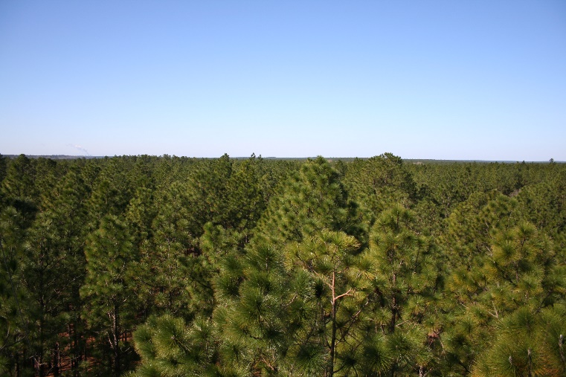
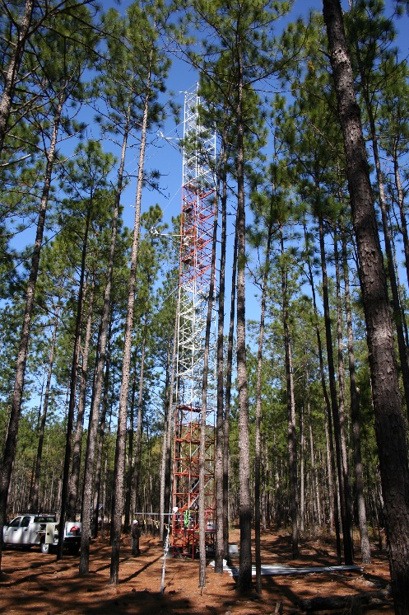
Making improvements to Safety Basis Modeling
The goal of the project is to identify a non-zero deposition velocity for HTO
We know that HTO interacts with surface vegetation/soil
These interactions can occur on a relatively short time period
Under the basis of an ‘ideal surface’ and a ‘straight-line plume’, there is a basis for assuming that deposition processes can be ignored
Forested environments are far from ‘ideal’
Turbulent mixing at canopy top pulls HTO into canopy.
HTO is then or mixed below the canopy or absorbed within the canopy.
Wind conditions within a forest canopy can be markedly different than above the canopy
Mixing HTO out of the forest will not necessarily occur in the same location as the original plume.

Slide 4
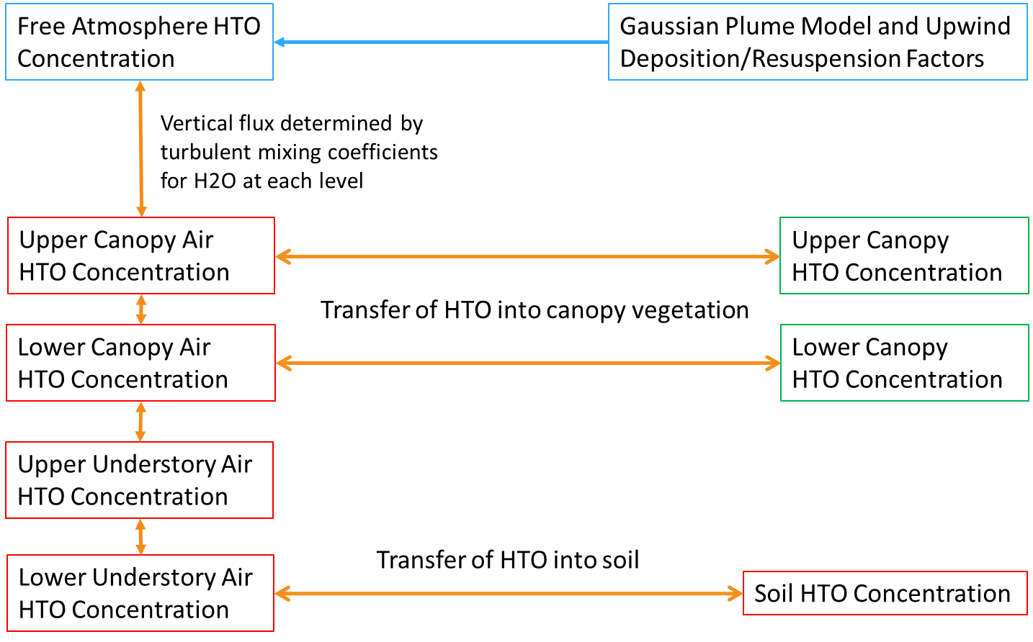
Earlier Work (Presented Previously in 2019)
A numerical model was developed to theoretically assess the movement of tritium oxide in a forested environment.

Slide 5
Model Simulations
Modeling work suggested that deposition velocities of 0.75 cm/s were plausible
Model details are published in Viner and Goodlove (2000): “Using a coupled dispersion model to estimate depletion of a tritium oxide plume by a forest.” in the Journal of Environmental Radioactivity
28 m
25 m
18 m
12 m
Distance (km)
(Oriented perpendicular to the wind direction above the canopy)
Distance (km)
(Oriented according to the wind direction above the canopy)

Slide 6
Surface releases in 2019/2020 – Can we detect D2O? How quickly does it mix vertically?
Sampling (water bottle and vegetation) were taken at 10m intervals at the surface and at 5 m intervals vertically at the sampling tower.
25
20
15
10
5
2
Meters above ground
10 20 30 40 50 60 70 80 90 100
Meters Downwind of the release

Slide 7
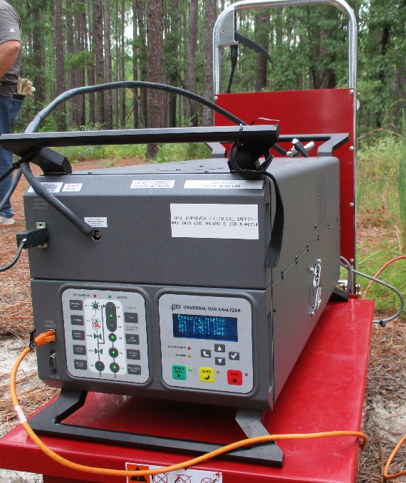
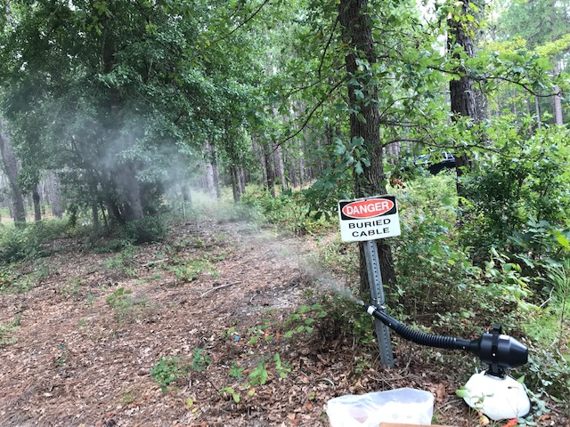
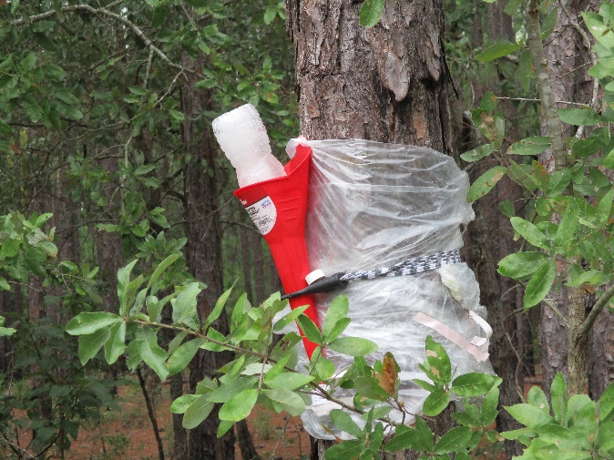
Field Measurements for Validation
Surface D2O release
5 L of D2O released over 19 minutes (~ 1 L per 4 minutes)
Atomist discharged D2O as ~20 micron droplets which rapidly evaporated
Measurements were taken of D2O prior to, during and post-release:
Air: Instantaneous Air Samples
Continuous Real-Time Monitoring (Mass Spectrometer)
Average Air Concentration
Biota: Leaf samples of surface vegetation
Mass Spectrometer
Condensation Collector
Atomist Aerosolizer
7

Slide 8
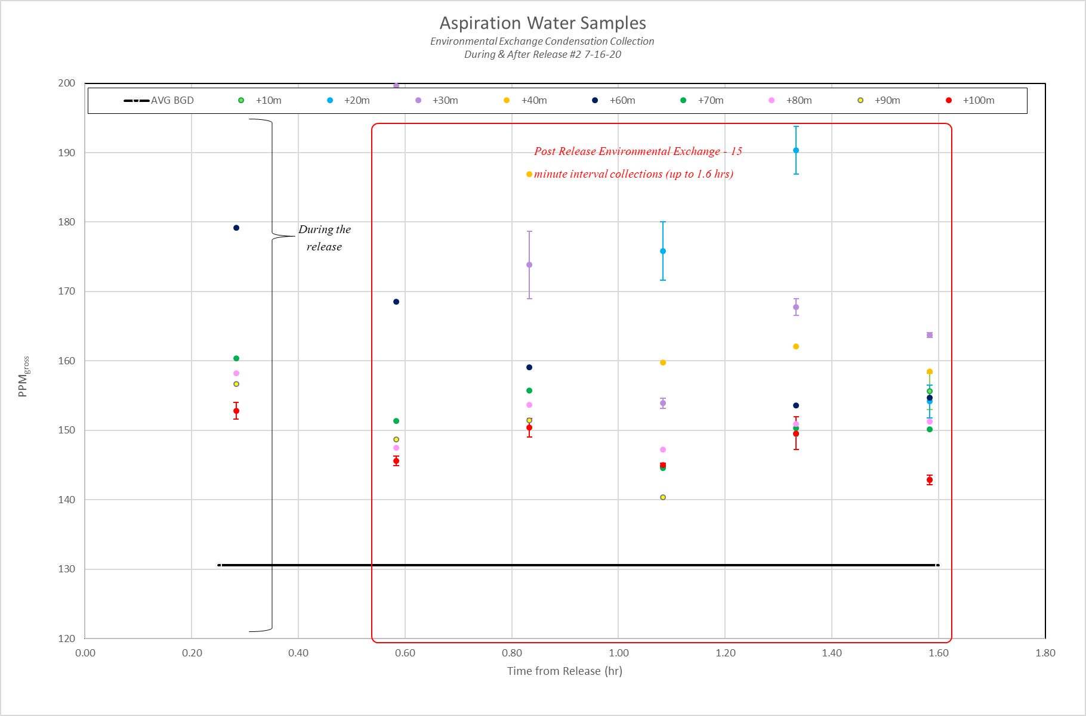
Surface Water Collections – Jul 16, 2020

Slide 9
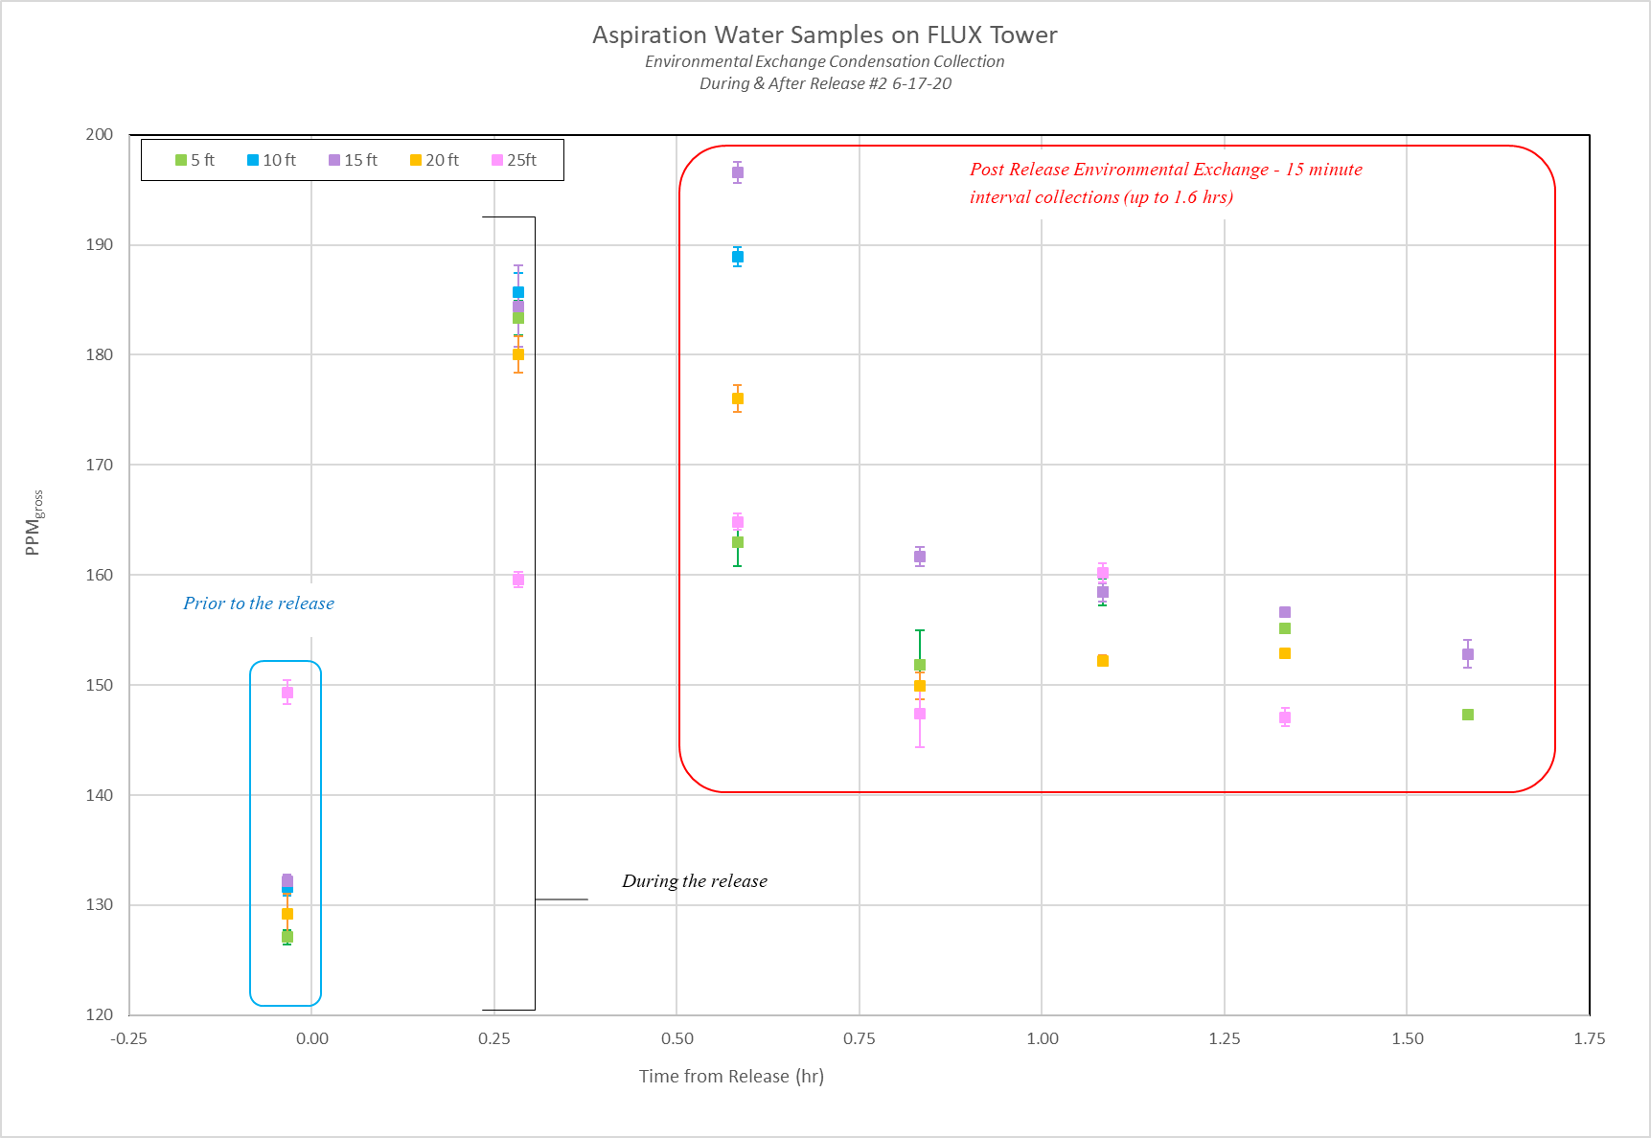
Elevated Water Collections – July 16, 2020

Slide 10
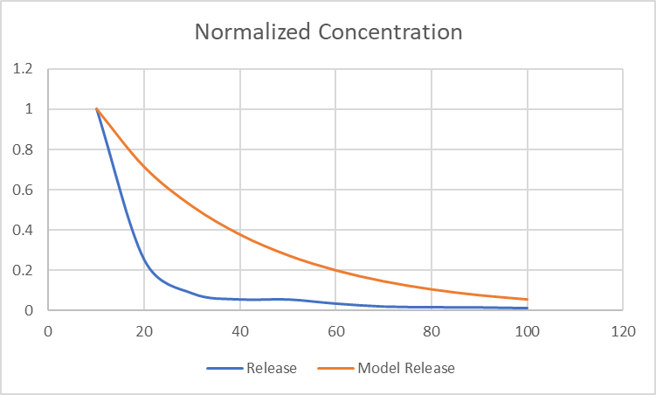
Modeling of the July 16, 2020 Release
Average Normalized Concentration During Release

Slide 11
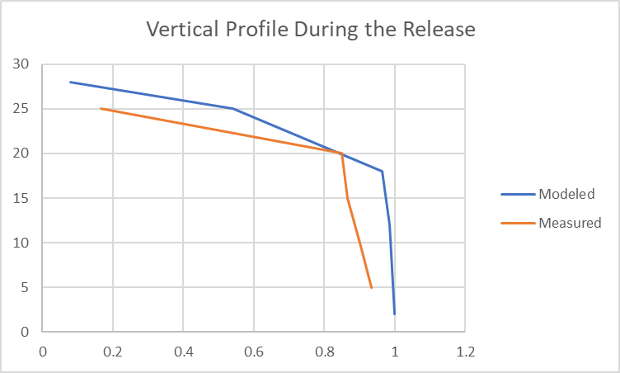
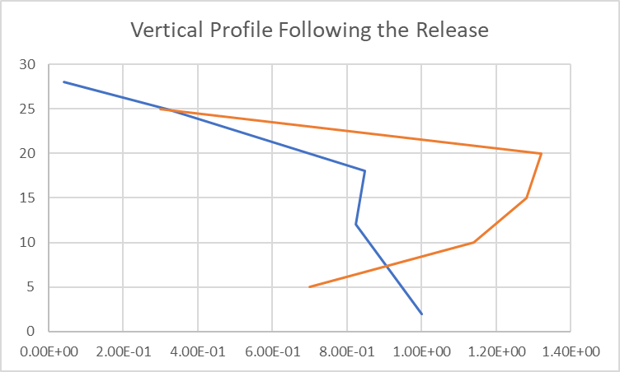
Modeling of the July 16, 2020 Release
Concentration values are normalized by the surface concentration at the vertical profile site.

Slide 12
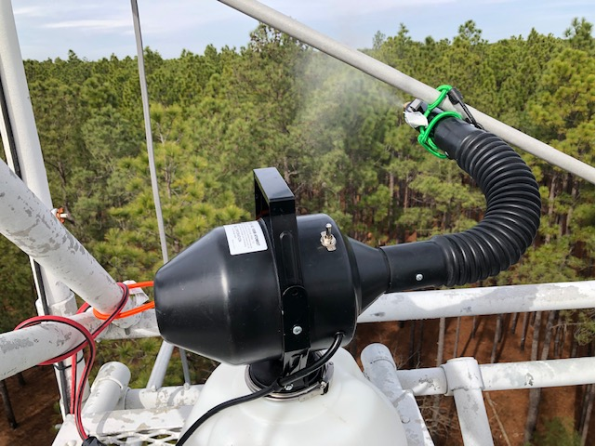
Elevated Release – How quickly can a plume mix into the forest?
10 L of D₂O were released over a 45 minute period on February 4, 2021
The D₂O was released at a height of approximately 27 m, just above the forest canopy top

Slide 13
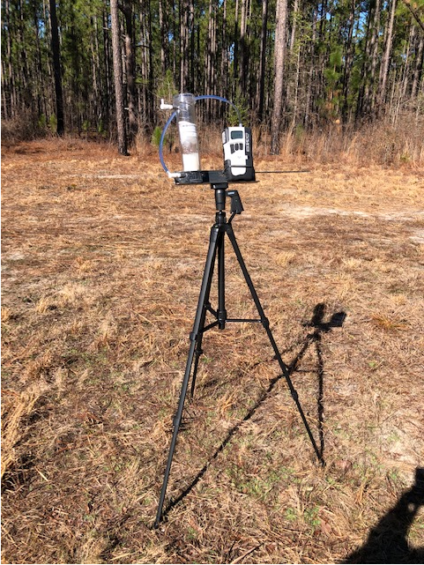
Air Sampling
We used air pumps which drew air through a silica-gel medium which captured ambient water.
After the field project, the silica gel was returned to the lab where the deuterium content of the captured water was analyzed.
Only surface measurements were taken for this release

Slide 14
Measurements from the Elevated Release
Pre-Release
Concentration 154-160 ppm

Slide 15
Measurements from the Elevated Release
Samplers collected about 11g of water during this time
Release Average Concentration ~172-179 ppm
Pre-Release
Concentration 154-160 ppm

Slide 16
Measurements from the Elevated Release
Samplers collected about 11g of water during this time
Release Average Concentration ~172-179 ppm
Pre-Release
Concentration 154-160 ppm
Post-Release Average Concentration 158-164 ppm

Slide 17
Measurements from the Elevated Release
Calculated average D₂O concentrations ranged from ~ 5.32e-6 to 1.06e-5 g/m3
Measured air concentrations of D2O during the release generally decreased with distance from the source.
The exception is the 350m site which was located near a gravel roadway and may have allowed for some extra downward mixing to occur.

Slide 18
Simulation of the Elevated Release
Surface Measurements
Concentration (g/m3)
Surface Predictions
Distance (m)
The modeled average concentrations at the sampling sites underpredicted the measured average concentrations.
The model calculated deposition velocity was 1.2 cm/s for the plume, and still underpredicted

Slide 19
Planned Large-Scale Sampling Campaigns
Additional releases from the tower are planned in 2021.
Additional field sampling over longer distances is planned at both SRNL and LANL in 2021
These campaigns will target planned releases as part of standard operations.
SRNL – 2-3 small releases
LANL – 1 large release (Planned for 2020, but has been delayed until 2021)
Measurements from these campaigns will further validate the numerical model as well as provide additional deposition velocity estimates.
Surface and elevated measurements are planned.

