Slide 1
Nonlinear Soil-Structure Interaction: V&V and Integration into Risk Assessment
Chandu Bolisetti
Lead, Facility Risk Group, INL
EFCOG, 22nd Feb 2021

Slide 2


Acknowledgments
INL team
  Kyung Tae Kim, Efe Kurt, and Will Hoffman
University at Buffalo
  Anthony Tessari, Marzieh Shahraki, and Andrew Whittaker
NC State University
  Saran Bodda, Pragya Vaishnav, and Abhinav Gupta
Simpson, Gumpertz and Heger
  Mohamed Talaat
NNSA
  Sharon Steele

Slide 3
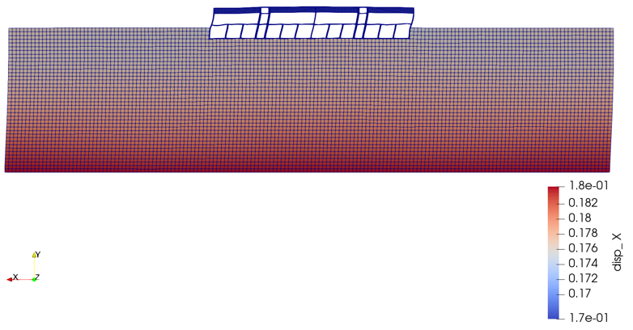
Outline
Motivation
V&V studies at INL and University at Buffalo
SPRA integration and demonstration for a representative NNSA facility
Future work

Slide 4

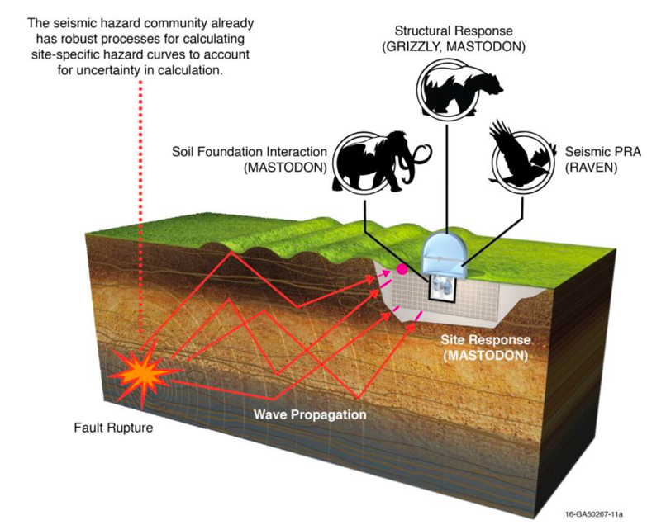
MOOSE-based open-source code: Structural mechanics and dynamics, fluid-structure interaction, structural material aging, uncertainty quantification, seismic PRA, design optimization
Sample applications
  Advanced seismic M&S (nonlinear soil-structure interaction, fluid-structure interaction, seismic isolation)
  Seismic PRA integrated with M&S
  Design optimization
Software quality assurance
  Towards NQA-1 compliance (manuals, V&V docs, requirements, etc.)
Focus of this study
https://mooseframework.org/mastodon

Slide 5


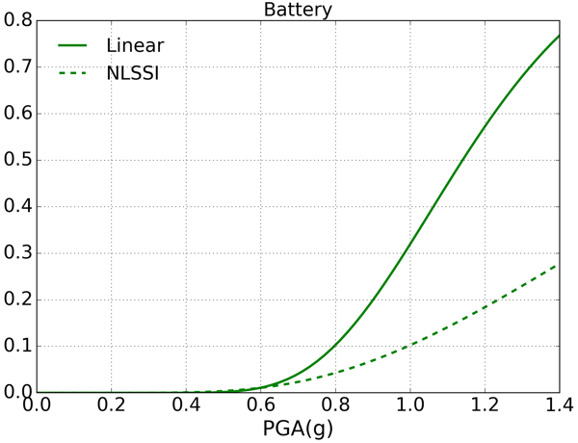
Motivation
What is nonlinear soil-structure interaction?
  Seismic analysis that includes all energy dissipation mechanisms, maximizes accuracy, and minimizes conservatisms
  Typically, including NLSSI reduces seismic demands and probabilities of failure
  Nonlinear response is closer to reality, especially beyond design basis
Seismic hazard has been increasing at many sites as new faults are discovered
Need accurate quantification of seismic loads and margins to ensure safety AND economics
Component probability of failure
Challenges
→ Lack of expertise and guidelines
→ Lack of experimental data to validate the numerical tools

Slide 6
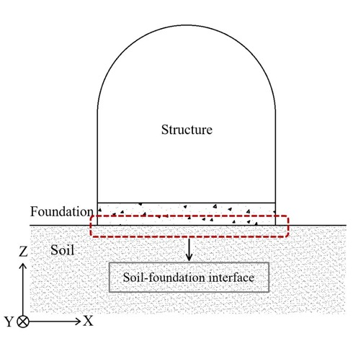
Experiments at INL
Purpose
  Validation of soil-foundation interface models to predict gapping, sliding and uplift at the foundation
Why important?
  Gapping and sliding can significantly affect structural response
  Currently available numerical models were developed for other applications and not for soil-concrete interfaces
  Most importantly, no experimental data is available to validate/improve existing models or develop new models
Structural Dynamics Laboratory
  Concrete sliding on F55 Ottawa Sand
  Vertical forces up to 10,000 lb
  Frequencies up to 10Hz
Testing setup at INL Structural Dynamics Laboratory: model placed on dry sand deposited on rigid soil container (4 ft x 4 ft x 4 ft)

Slide 7
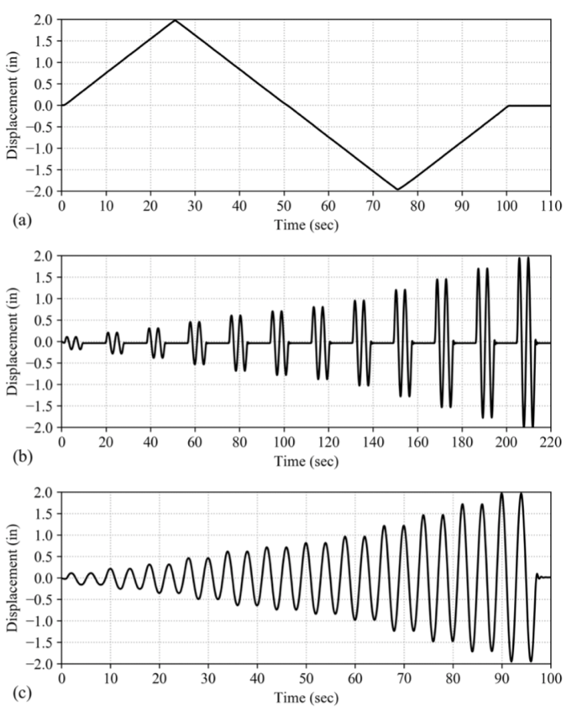
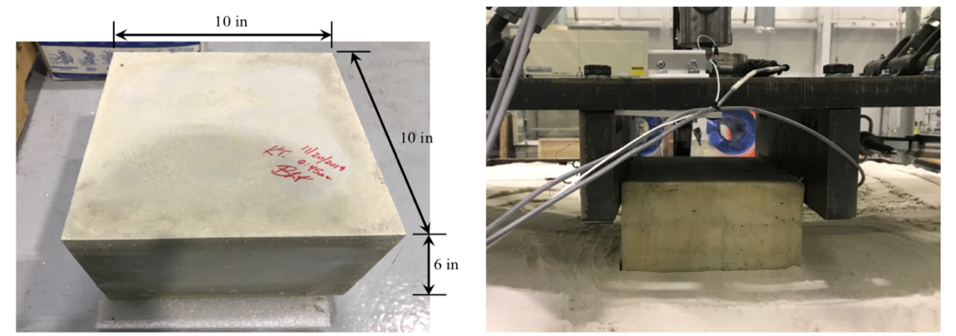
Experiments at INL – Set up
Loading protocol
Test 1: Testing Specimen with dimensions of 10” x 10” x 6”
  Nominal vertical pressure of 0.45 psi
  3 embedment levels: 0%, 25%, and 50% of the structure height
  3 loading conditions: monotonic and cyclic
Structural model (Weight of structural model = 45 lbf)

Slide 8
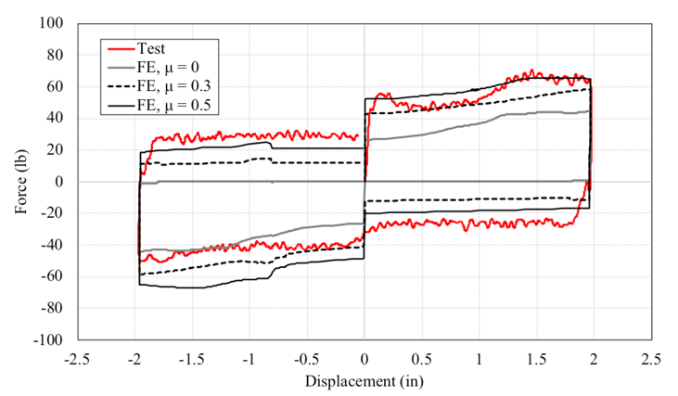
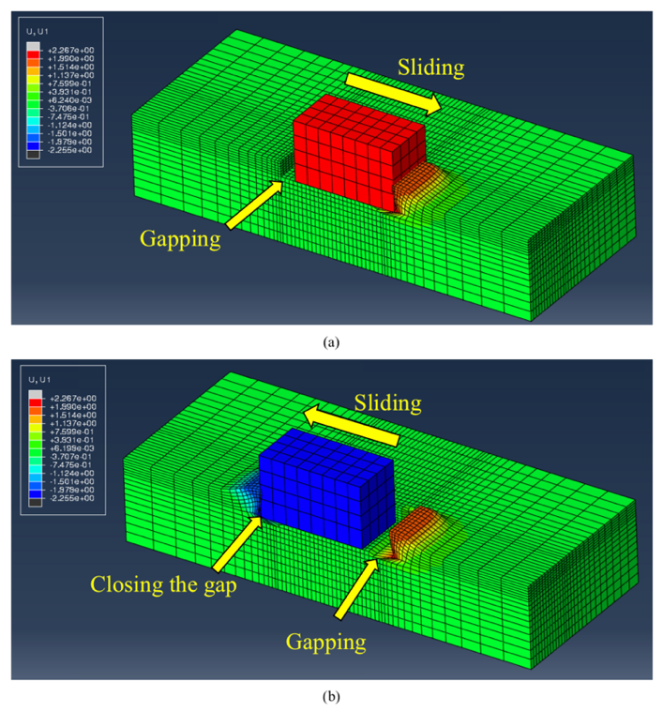
Experiments at INL
Corresponding numerical models in ABAQUS
Force-displacement response at 1.5” embedment
Concrete-soil interface at 2” displacement

Slide 9
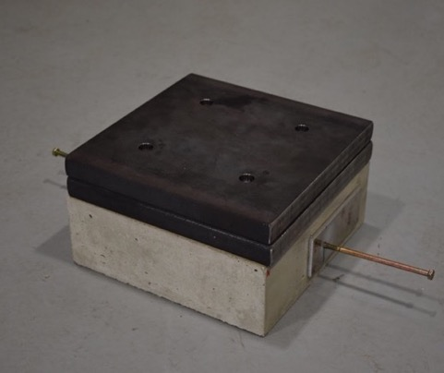
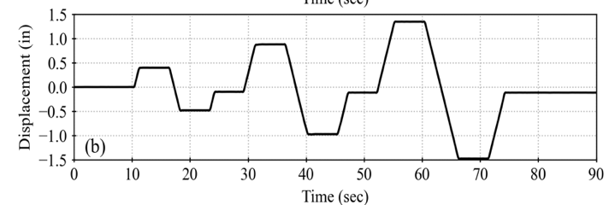
Experiments at INL – Set up
Instrumentation
Test 2: Testing Specimen with dimensions of 10” x 10” x 4”
  5 vertical pressures of 0.28 psi, 0.56 psi, 0.83 psi, 1.06 psi, and 1.33 psi
  3 embedment levels: 0%, 40% of the structure height
  1 loading condition: pseudo-static
Loading protocol
Structural model (Weight of structural model =28 lbf)
Steel plates placed on the testing model to increase vertical pressure

Slide 10
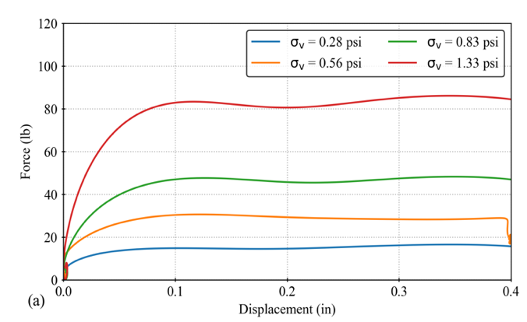
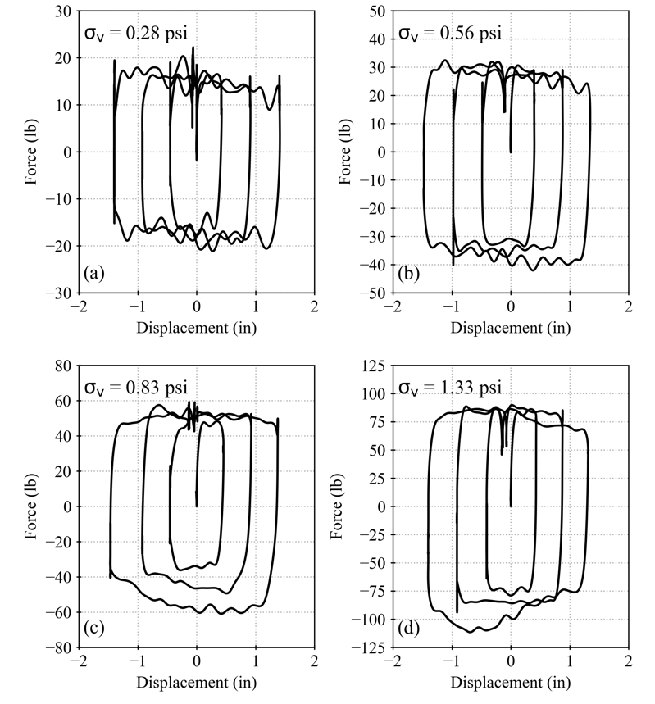
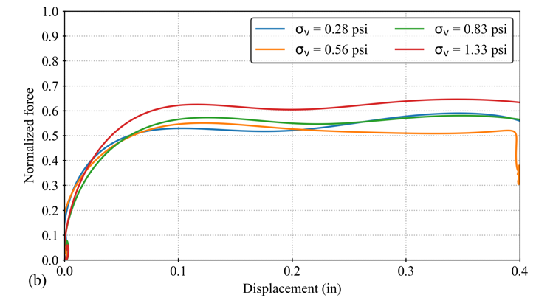
Experiments at INL – Sample results
0” embedment
Force-
displacement
Coulomb friction?
No.
Normalized force-
displacement
Friction coefficient, 𝜇 = 0.5 – 0.65

Slide 11







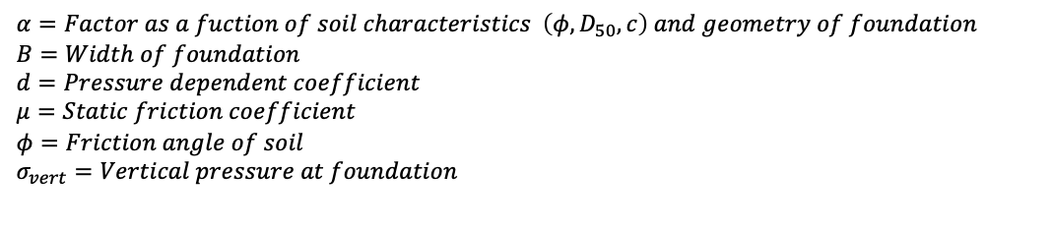

Experiments at INL – Numerical modeling
$$τ$$
$$G_{init}=αB^{d}∙σ_{vert}∙tan⁡(φ)$$
$$τ_{ult}$$
$$=μσ_{vert}$$
Backbone curve of interface element
$$τ=\frac{G_{init}∙γ}{1+\frac{γ}{γ_{1}}}$$
$$γ_{1}$$
$$γ_{2}$$
$$γ$$
Num-exp
comparison
$$α=Factor as a fuction of soil characteristics \left(φ, D_{50},c\right) and geometry of foundation$$
$$B=Width of foundation$$
$$d=Pressure dependent coefficient$$
$$μ=Static friction coefficient$$
$$φ=Friction angle of soil$$
$$σ_{vert}=Vertical pressure at foundation$$

Slide 12
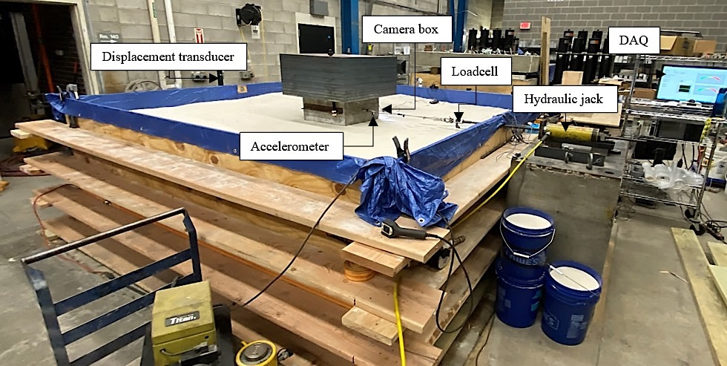
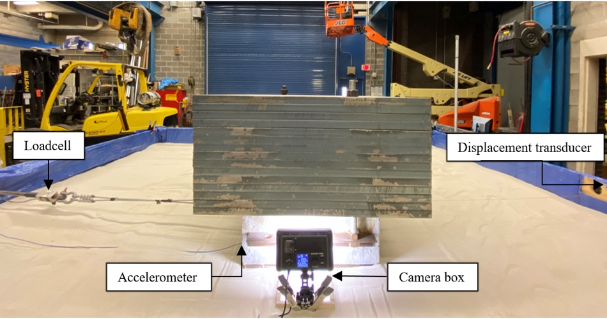
Experiments at UB – Set up
Objectives
Investigate the interface behavior under various conditions: normal pressure, surface roughness (smooth and rough), materials (Ottawa sand, crushed gravel, waterproof membrane, moisture (dry and saturated), and shearing rates varying from 0.05 in/s – 1.5 in/s
Characterize the interface behavior captured through digital images and pressure sensors
Testing setup at UB
Structural model (20” x 20” x 10”) and instruments

Slide 13
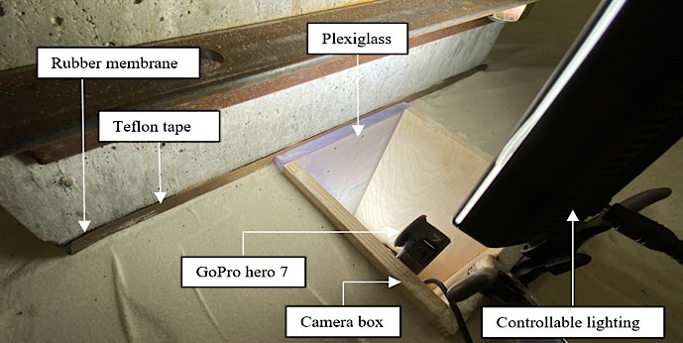
Experiments at UB
PIV results for the rough surface in contact with dry sand under normal contact pressure of 8 psi
Microscopic shear behavior resulted from digital image cross-correlation techniques
Camera setup for digital image analysis
Displacement vectors
Strain contour
Preliminary observations
Interface shear zone characteristics depend on surface roughness, normal stress, particle hardness, and angularity.
Relative roughness (ratio of average surface roughness to the particle mean size) influences shear zone formation and failure mode at the interface.
interlocking of the grains and domination of particles’ rolling rather than sliding.

Slide 14
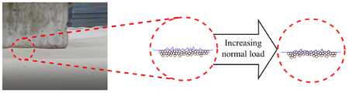
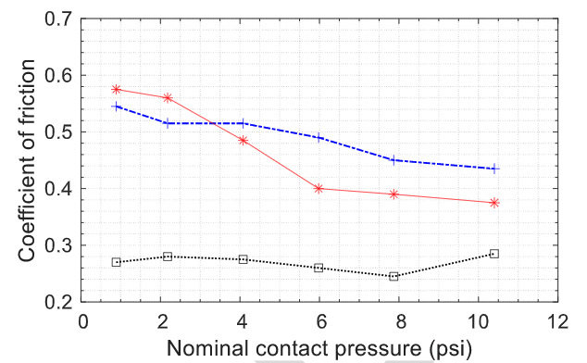
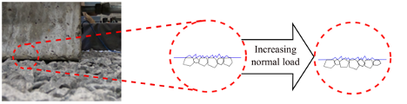
Experiments at UB – Sample observations
Illustration of contact area for two interface materials
Coefficient of friction variation for different contact surface conditions
< Dry Sand >
Dry Sand
< Crushed Gravel >
μ decreases with increasing normal pressure on Ottawa sand and remains constant on crushed gravel
μ is independent of normal load subjected to monotonic loading.

Slide 15

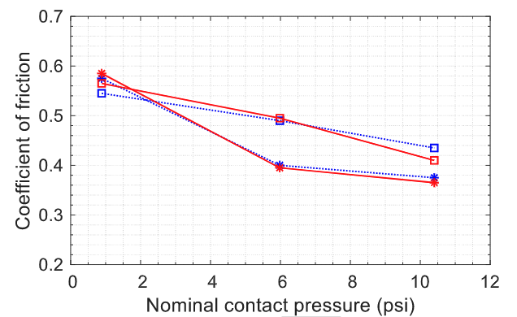
Experiments at UB - Sample observations
Effect of moisture
Saturated sand showed a lower shear strength than dry sand due to the lubrication layer formation between sand particles.
Effect of Shearing Rate
The coefficient of friction is approximately independent of the velocity of relative movement, in this studied range of 0.05-1.5 in/s
Smooth surface
Dry Sand

Slide 16
SPRA process in MASTODON
Probabilistic sampling of the input model
LHC, Monte Carlo, Sobol, etc.
Automatically parallelized
Preprocessing
Running simulations
Simulation
FEA
Currently available
Calculating fragilities
Enhanced fragility calculation from demand and capacity distributions
Postprocessing and risk assessment
FTA and ETA
Minimal cutsets, importance measures, system fragility, and risk
Currently available in Python and C++. Will fully integrate into MASTODON in FY21

Slide 17
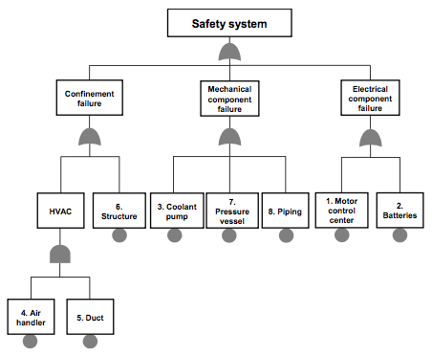
Fault-tree analysis in MASTODON
Top event
Currently a Python module but will soon be integrated into and will use MASTODON input files
Uses the MOCUS algorithm used by SAPHIRE and outputs
  Minimal cutsets: most ‘minimal’ combination of basic events that leads to the top event
  Top event fragility: Exact quantification, rare event approximation, and upper bound approximation
  Importance measures: Ratio importance (e.g., Fussell-Vesely) and interval importance (e.g., Birnbaum importance)
  System risk after convolution with seismic hazard
Benchmarked with SAPHIRE
OR gate
AND gate
Basic events
Sample fault tree
Notes:
Describe what basic event and top events are

Slide 18
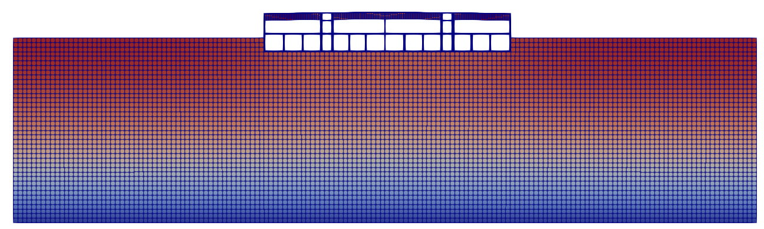
Demonstration for a representative facility
Input motion
Modeling details
2D plane strain
Fixed-base horizontal modes: 4Hz and 12Hz
Fixed-base vertical modes: 15Hz and 40Hz
Accounting for nonlinear soil-structure interaction
Soil properties
200 ft deep, Vs = 1800 ft/sec
Density = 1730 kg/m³
Stress-strain backbone curve

Slide 19
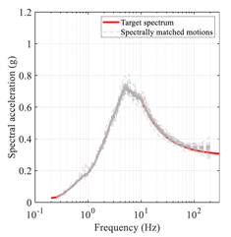
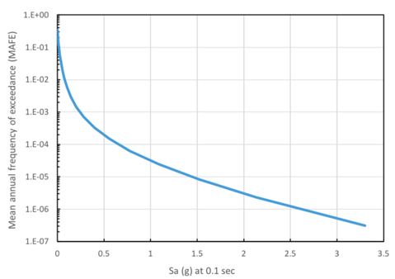
Enhanced fragility calculation in MASTODON
30 GMs x 6 bins = 180 simulations
15 hours in 720 procs

Slide 20
Enhanced fragility calculation in MASTODON
Am = 1.59
β = 1.06
Enhanced fragility
Am = 0.41
β = 1.3

Slide 21
Future work
Finalize development of numerical models for gapping and sliding
Use the integrated SPRA tool to investigate the effect of various modeling assumptions on seismic risk:
  Nonlinear soil-structure interaction
  Gapping and sliding (using V&V’ed numerical models)
  Topography effects
  Risk assessment procedures
    Multiple-stripes-type approach
    Conditional scenario spectrum (CSS) approach

Slide 22






Contacts:
chandrakanth.bolisetti@inl.gov
WWW.INL.GOV

