Slide 1
DOE-STD-1239-DRAFT
Chemical Safety Management
Steve Singal (AU-10)
and
David Compton (PEC/AU-30)
February 23, 2021
EFCOG Nuclear & Facility Safety Workshop

Slide 2
DOE-STD-1239 DRAFT Development
DOE-HDBK-1163-2020 revision completed in October 2020
Development of DOE-HDBK-1163-2020 revision shed light on need for DOE-wide chemical safety management program
Chemical safety addressed in both 10 CFR 851 and 10 CFR 830, but implementation varies across sites and facilities
Opportunity to improve chemical safety throughout the DOE complex
Opportunity to develop robust safety management program (SMP) that is acceptable for use in documented safety analyses for HC-1, HC-2, and HC-3 nuclear facilities
Notes:
Provide DOE and all stakeholders with the highest quality data on laboratory performance.

Slide 3
Writing Team
Steve Singal (DOE/AU-10)
David Compton (AU-30/PEC)
Rob Vrooman (NNSA/NA-512)
Ron Beaulieu (NV)
Jeffrey Hieb (Bechtel/WTP)
Steve Jahn (SRS)
Lisa Pansoy-Hjelvik (LANL)
Brian Petersen (ID/ICP)
Eric Turnquest (SC/ANL)
Caroline Garzon (DOE/AU-31)
Jessica Kratchman (DOE/AU-31)
Jeff Woody (EM/OR-EM)
Karen Kubiak (ID)
Jennifer Hidden (Bechtel/WTP)
Kevin Usher (SRS)
Kelsey Forde (Parvati)
Iryna Gilbert (PEC)
Notes:
Provide DOE and all stakeholders with the highest quality data on laboratory performance.

Slide 4
Review Team
Jim Dillard (DOE/AU-10)
Brian Dinunno (DOE/AU-30)
Kelli Markham (NNSA)
Joanna Serra (SC)
Brenda Hawks (EM)
Charlie Maggart (NE)
Tom Temple (SR)
Jeff Buczek (EFCOG/RL)
Ingle Paik (EFCOG/LLNL)
Chip Lagdon (Bechtel)
Anthony Pierpoint (DOE/AU-10)
Notes:
Provide DOE and all stakeholders with the highest quality data on laboratory performance.

Slide 5
Schedule
Project Justification Statement (PJS) received full concurrence – October 2020
First draft released to review team – February 11, 2021
Review Team comments requested by March 1, 2021
Submit for full DOE-wide RevCom review – April 2021 Target
RevCom comments due – June 2021
Comment Resolution – August 2021
Concurrence Review – September 2021
Approval and Issuance – October 2021
Roll-out after Approval
Notes:
Provide DOE and all stakeholders with the highest quality data on laboratory performance.

Slide 6
DOE-STD-1239-2021 Guiding Principles
• Chemical hazard controls should be proportional to the risks.
• Chemical hazard controls should be similar for HC-1, -2, and -3 nuclear facilities, below HC-3 nuclear facilities, and non-nuclear facilities with similar chemical hazards (assuming no significant interactions with nuclear materials).
• DOE standards on chemical safety should be compliant with or exceed existing industry standards and regulations on chemical safety.
• DOE standards on chemical safety should be similar to those used by high-performing chemical industry peers (characterized as safety and performance driven), not minimally performing chemical industry peers (characterized as compliance-driven).
• DOE standards on chemical safety should not drive sites/facilities to make significantly more expensive or inferior technical solutions for chemical management just to achieve compliance.
Notes:
Provide DOE and all stakeholders with the highest quality data on laboratory performance.

Slide 7
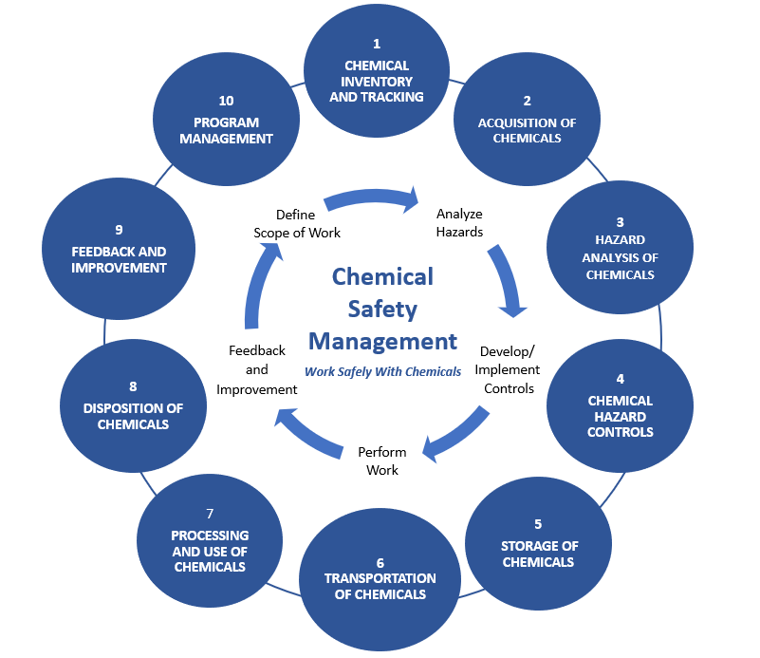
Chemical Safety Management Program
Notes:
Provide DOE and all stakeholders with the highest quality data on laboratory performance.

Slide 8
DOE-STD-1239-2021 DRAFT Contents
Title Page
Foreword
Table of Contents
Introduction: Purpose, Scope, Background, Benefits
Terminology: Acronyms, Definitions, Shall/Should/May
Program Requirements
References
Appendix: Historical Chemical Accidents
Notes:
Provide DOE and all stakeholders with the highest quality data on laboratory performance.

Slide 9
Path Forward
This Standard will provide clear expectations for chemical safety management programs
This Standard is intended to provide an acceptable method for implementing a chemical safety management program and meeting associated requirements in 10 CFR 851 and 830.
This Standard is not being invoked as a requirement, but can be adopted or invoked in a contract or implementing document
Nothing in this Standard can change a DSA safe harbor method. A revision to DOE-STD-3009-2014 (and others) is anticipated to clarify handling of chemical hazards and possible use of this Standard, after this Standard is finalized
Notes:
Provide DOE and all stakeholders with the highest quality data on laboratory performance.

Slide 10
Thank-you!
Steve Singal
DOE Office of Health and Safety (AU-10)
(w) 301-903-9047
steve.singal@hq.doe.gov
David Compton
PEC Principal Consultant
Supporting DOE Office of Nuclear Safety (AU-30)
(c) 571/289-4599
david.compton@hq.doe.gov

