Slide 1
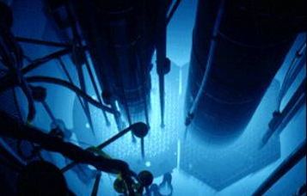
EFCOG Nuclear and Facility Safety Workshop Reactor Facility Updates Annular Core Research Reactor (ACRRF) and Sandia Pulsed Reactor Facility (SPRF)
PRESENTED BY:
Jeff Marr
SAND2021-2000 PE

Slide 2
ACRRF and SPRF Integrated DSA
SPRF
ACRRF
Revise HA
Complete
Revise HA
In Review
Consolidate SARs, add HA, update AA/TSRs*
Complete
Update AA
In Process
Begin Integrated DSA
DOE-STD-3009-2014 updates, SMP updates

Slide 3
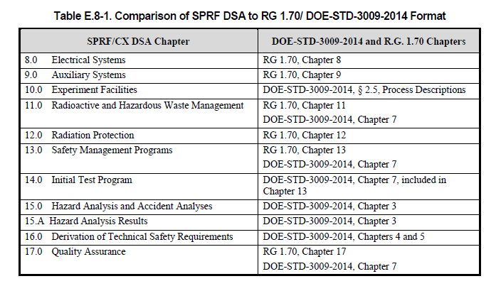
SPRF Update for the Integrated DSA
Combined SPRF SAR and SPRF/CX Addendum into a single DSA
Upgraded HA/AA to DOE-STD-3009-2014.
Derive and implement TSR controls consistent with DOE-STD-3009-2014.
Format: Combination of DOE-STD-3009-2014 and RG 1.70*.
SER received December 2018.
Three Annual updates completed with minimal impact
* Not performed under an alternate methodology

Slide 4
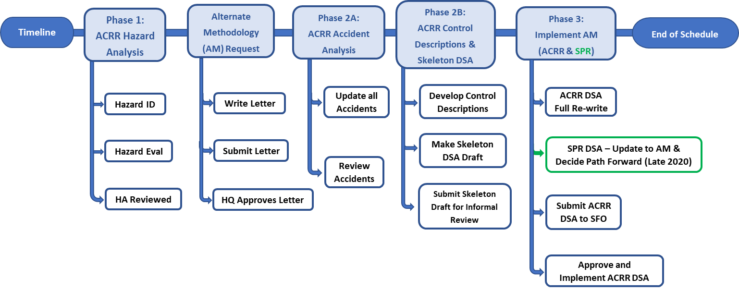
ACRRF Update for the Integrated DSA*
* Updated analysis performed concurrent with maintenance of current DSA/TSRs.

Slide 5
Alternate Methodology (Approved 03/2020)
Implementation of DOE-STD-3009-2014 hazard analysis and evaluation methodology, hazard control classification and DSA format and content considering RG 1.70, NUREG-1537, and ANSI/ANS-15.21 to comply with safe harbor;
Implementation of operating and provisional facility limits for facility MAR, reactor operation, and experimental activities to address over conservatisms in the analysis.
Implementation of an automatic reactor protection system to prevent or mitigate damage to the reactor fuel and its fission product barrier(s);
Implementation of reactivity limits to prevent damage to the reactor fuel and its fission product barrier(s);
Addition of a hazard control classification category of “Reactor Protection” and applied to hazard controls which contribute significantly to the prevention of damage to the reactor fuel and its fission product barrier(s); and
The DSA content will be expanded to accommodate descriptions of the reactor, its coolant system, its instrumentation and control systems, and its experiment irradiation features, and the Reactor Protection control classification.

Slide 6
Path Forward
Complete HA/AA*;
Derive/develop controls*;
Draft skeleton DSA & submit for informal review*;
Perform full re-write of ACRRF DSA*;
Update SPRF DSA as needed;
Submit for approval; and
Implement (ECD: 2023)
* Coordination with the maintenance of the current DSA/TSRs will be necessary.

Slide 7
ACRRF Fuel Health Program – Program Elements
Initial inspection and acceptance of fuel and control rods (including spare fuel) In-Service fuel cladding inspection
- Near-term approach with a focus on common techniques (Go/No-Go, Visual, etc.)
- Long-term Approach with advanced techniques
In-Service fuel pellet inspection (neutron radiography)
Disposition of fuel failing in-service inspections
- Advanced inspection techniques or disposal
Fuel leak detection and cleanup
- Advanced techniques to detect leaks at incipient stages (e.g., continuous water sampling)
Mitigation/Fix of cladding risks and issues
- Recladding and/or new fuel development

Slide 8
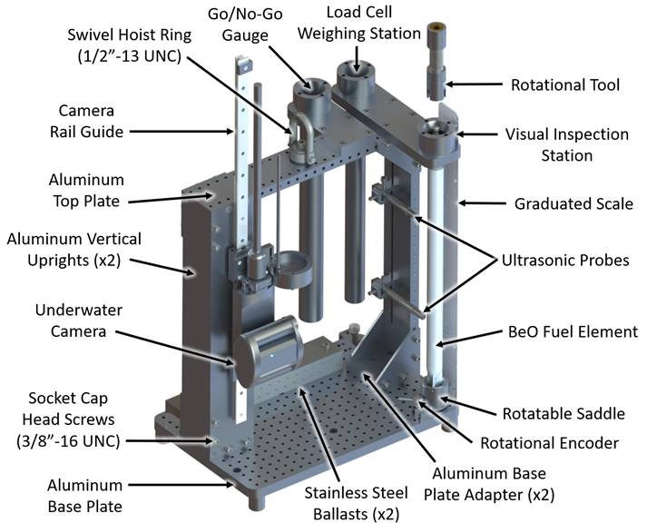
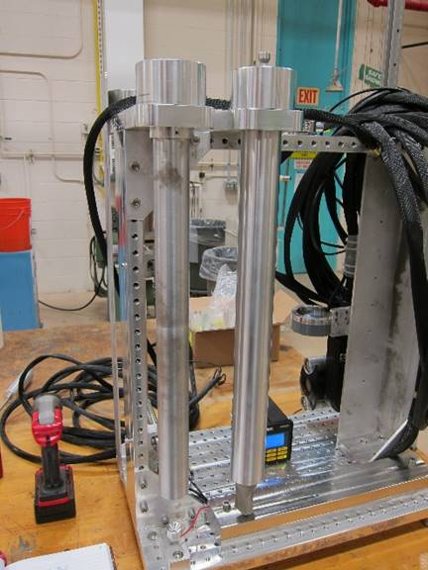
ACRRF Fuel Health Program – Fuel Element Inspection Jig (FEIJ)

Slide 9
ACRRF Fuel Health Program – Fuel Inspection Techniques
Technique | Brief Description
Bubble Test/Hermiticity | Visual check to observe for bubbles emanating from the cladding
Go/No-Go Gauge | Check for swelling, elongation, and bowing
Visual Inspection | Viewing surface of fuel element with an underwater camera to inspect for defects
Mass | Tracking for mass differences
Ultrasonic | Evaluate the difference in material properties between cladding and internal structures; looking for water intrusion

Slide 10
Path Forward
Complete FRA for fuel inspection activity;
Implement corrective actions from readiness activities;
Finalize procedures as needed;
Inspection process;
Sampling approach;
Update ACRRF DSA/TSRs as needed*;
* May require leveraging the USQ process until the next annual update.

