Slide 1
Department Of Energy
Natural Phenomena Hazards Program
Sharon Jasim-Hanif, Ph.D.
Office of Nuclear Safety Basis & Facility Design (AU-31)
February 2021

Slide 2
Agenda
Program Overview
Policy
DOE Order 420.1C
DOE Standard 1020-2016
DOE Handbook 1220-2017
DOE Handbook XXXX-YR
Schedule
Questions
Notes:
Provide DOE and all stakeholders with the highest quality data on laboratory performance.

Slide 3
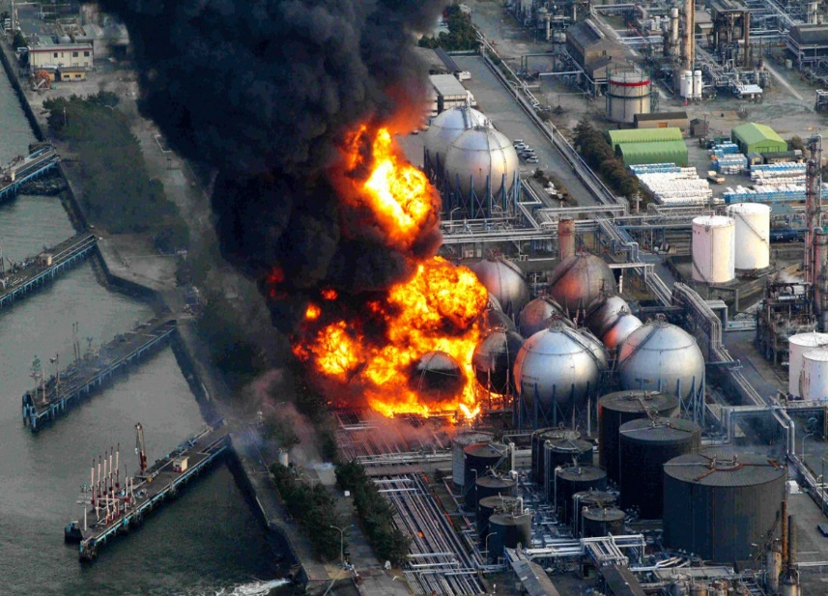
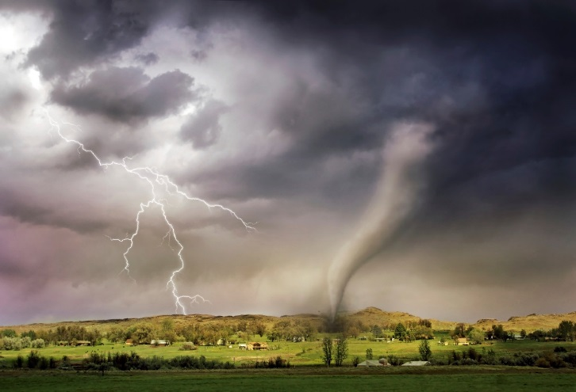
NPH Program Overview
DOE Office: Office of Nuclear Safety (AU-30)
Mission: Develop & maintain requirements, standards and guidance for DOE facilities exposed to NPHs
Driver: Established through DOE Order (O) 420.1C, Facility Safety
Direction & Guidance: Seismic, extreme wind, tornado, precipitation, flood, volcanic & lightning hazards
How: Provides assistance, training, communications & support to facilitate effective implementation of DOE’s NPH Standards to assure public & worker health & safety
Notes:
Provide DOE and all stakeholders with the highest quality data on laboratory performance.

Slide 4
DOE-O-420.1C, Facility Safety
Chapter 4: NPH Mitigation
Establish facility design, construction and operations requirements for NPH events
Applies to:
Government-owned and leased nuclear and nonnuclear facilities and sites
New construction
Existing facilities
Major modifications to existing facilities
Requirements:
General
NPH Design Criteria: DOE-STD-1020-2016
NPH Accident Analysis
Periodic Review
Seismic Detection
Post-NPH Event Procedures
Notes:
Provide DOE and all stakeholders with the highest quality data on laboratory performance.

Slide 5
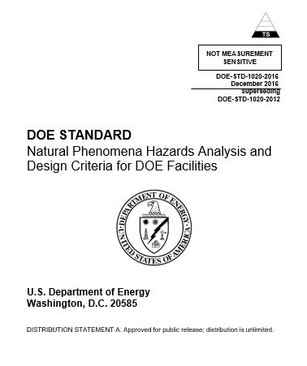
DOE-STD-1020-2016
Purpose:
Provides criteria and guidance in NPH analysis and design of structures, systems, and components (SSCs) for:
Implementing requirements of DOE O 420.1C, Facility Safety, and to ensure SSCs perform safely under NPH events.
Use of industry building codes and voluntary consensus standards encouraged by 1995 National Technology Transfer & Advancement Act
Notes:
Provide DOE and all stakeholders with the highest quality data on laboratory performance.

Slide 6
DOE-STD-1020-2016 Evolution
Background documents supporting implementation of the NPH requirements:
Year | DOE Standards | Background Documents
1989 |  | UCRL-15910
1994 | DOE STD-1020-94
1996 | DOE STD-1020 Change Notice #1
2002 | DOE STD-1020-2002
2005 |  | ASCE 43
2008 |  | DOE STD-1189-2008
2012 | DOE STD-1020-2012 | DOE STD-1189, ANS 2.26, ASCE 43
2016 | DOE STD-1020-2016 | DOE STD-3009-2014

Slide 7
DOE-STD-1020-2016 Revision Scope
Summary of Technical Changes:
Corrected errors & omissions in DOE-STD-1020-2012 (Table 2-1)
Aligned with updated DOE-STD-3009-2014, DOE-STD-1189-2016, and DOE O 420.1C, Chg. 1 (Table A-1)
Implemented results from 10 Year NPH Assessment Review Report
Aligned with updated industry standards and voluntary consensus codes
Invoked updated Executive Order (EO) requirements
Summary of General Changes:
Consolidated ‘shall’ statements from 400 to 140 requirements
Minimized rephrasing of requirements from industry standards
Improved clarity significantly
Overall length reduced from 90 to 55 pages
Reorganized sections to better emphasize DOE NPH requirements
Notes:
Provide DOE and all stakeholders with the highest quality data on laboratory performance.

Slide 8
DOE-STD-1020-2016 Structure of Standard
Organization - NO change:
Section 1. Introduction
Section 2. General Criteria for NPH Design
Section 3. Seismic Design
Section 4. Wind, Tornado, and Hurricane Design
Section 5. Flood, Seiche, and Tsunami Design
Section 6. Lightning Design
Section 7. Precipitation Design
Section 8. Volcanic Eruption Design
Section 9. Evaluation and Modification of SSCs in Existing Facilities
Section 10. Quality Assurance and Peer Review
Notes:
Provide DOE and all stakeholders with the highest quality data on laboratory performance.

Slide 9
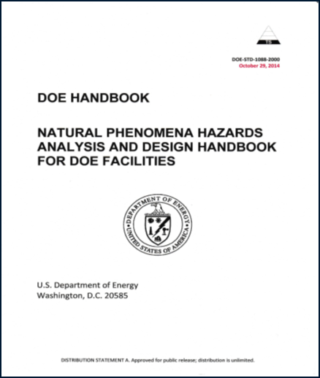
DOE-HDBK-1220-2017
Purpose:
Companion document to DOE-STD-1020-2016
Captures & updates useful and applicable technical information from DOE-STD-1020-2002, DOE-STD-1020-2012 & DOE Guide 420.1-2.
Good practices & implementation aid to meet the Standard’s requirements and guidance.
First issuance 2017
Applies to:
Same as DOE-STD-1020-2016
Format and organization is same as the Standard
Notes:
Provide DOE and all stakeholders with the highest quality data on laboratory performance.

Slide 10
Under Development
DOE Handbook (HDBK) XXXX-YR
Seismic Evaluation Procedure for Equipment in U.S. DOE Facilities.
Purpose:
Based on DOE Report, DOE/EH-0545, Seismic Evaluation Procedure for Equipment in U.S. Department of Energy Facilities, 1997.
Provide technical updates since its issuance in 1997 and convert the report into a Handbook to clearly identify criteria and guidance for enhancing the seismic safety of facilities.
Referenced in DOE-STD-1020-2016-Section 3.6 Building and Equipment Capacity Evaluation
Adapted from the Seismic Qualification Utility Group (SQUG) Generic Implementation Procedure (GIP) used by the nuclear power industry.
In the late 1970s, the U.S. Nuclear Regulatory Commission (NRC) expressed concern that nuclear equipment seismically qualified to standards preceding to IEEE-344-1975, Recommended Practices for Seismic Qualification of A Class 1E Equipment for Nuclear Power Generating Stations and newer more rigorous seismic design criteria might not provide sufficient assurance of seismic adequacy in older facilities.

Slide 11
Under Development
DOE Handbook (HDBK) XXXX-YR
Seismic Evaluation Procedure for Equipment in U.S. DOE Facilities
Background:
The DOE/EH-0545 procedure involves facility walkdowns and applying screening criteria to identify deficiencies. Evaluates the seismic adequacy of equipment greater than or equal to the seismic demand imposed on it.
DOE-EH/0545 adopts many of the GIP 20 classes, and amends those with DOE specific equipment.
DOE facilities are not structurally equivalent to nuclear power plants, which are typically stiff, with shear wall structures.
The approach in the SQUG GIP for comparing seismic capacity with seismic demand has been modified for DOE usage.
Revision Scope:
Based on revision 3A of SQUG GIP,
Consistency with current DOE policy orders, and standards (DOE-STD-1020-2016 seismic design categories and other terminology), and
Update references to relevant industry standards where additional SQUG guidance exists

Slide 12
Handbook Team
DOE Steering Group | DOE Writing Group | Technical peer review
Sharon Jasim-Hanif Brian Dinunno Steve McDuffie Brent Gutierrez | Sharon Jasim-Hanif Michael W. Salmon (c) Glenn Cox (v) Greg Mertz (c) George Antaki (c) Joe Vasquez (v) F. George Abatt (c) Steve Eder (c) Jim Johnson (c) Rick Cutsinger (c) | Senior managers Independent panel of industry experts familiar with SQUG GIP Users of DOE-EH/0545

Slide 13
Policy Revision Schedule
Policy Document | Revision Timeline
DOE Order 420.1C Chg3(LtdChg) | Complete Nov 14, 2019
DOE Standard 1020-2016 | Next 2021
DOE Handbook 1220-2017 | Next 2021
DOE Handbook XXXX-YR | Active 2020/21

Slide 14
Questions
Sharon Jasim-Hanif, DOE-STD-1020-2016 Lead Office of Nuclear Safety Basis and Facility Design (AU-31) Phone: (301)-903-4664; E-mail: sharon.jasim-hanif@hq.doe.gov
Brian Dinunno, Director, (AU-31) Office of Nuclear Safety Basis and Facility Design (AU-31) Phone: (301)-903-0926; E-mail: brian.dinunno@hq.doe.gov

