Slide 1
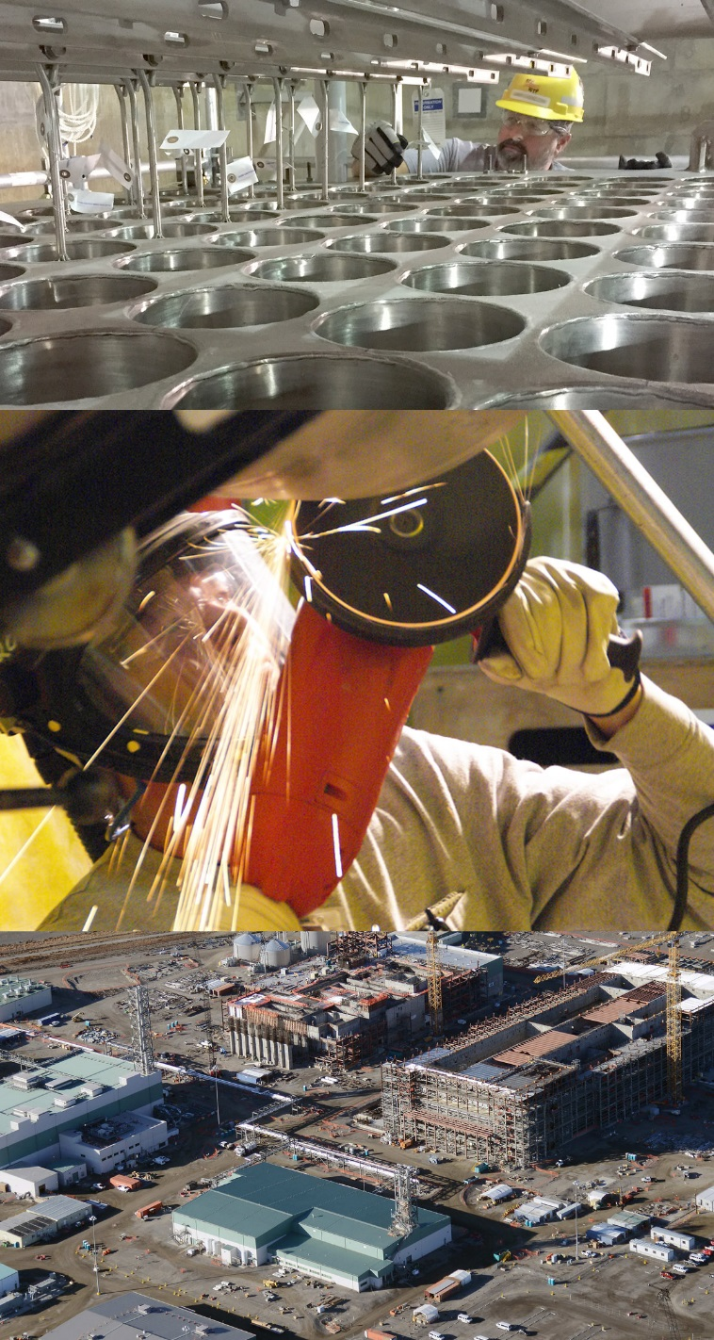
Waste Treatment Plant Project
DFLAW Nuclear Facility Safety and Chemical Safety Implementation
Michael Greutman
WTP Nuclear Safety Engineering Manager
Feb 16, 2022

Slide 2
DFLAW Implementation Topics
Facility Overview
Hazard Categorization
Primary Hazards/Material At Risk
DOE STD-1228 Implementation
Control Strategy
Implementation Status
Notes:
What remains from years of plutonium production is 56 million gallons of radioactive chemical waste
Sludge
Saltcake
Liquids
Including about 190 million curies of radioactivity
67 of Hanford’s 177 tanks are presumed to have leaked at least one million gallons of liquid radioactive waste into the soils.
The waste has reached the groundwater under the Hanford site, but not yet the Columbia River, which flows about 7 miles from the tanks.
Protecting the Columbia River is paramount to the public and environment, with the threat to several hundred thousand people living nearby and millions downstream and to the agriculture- and technology-based economies in the region.

Slide 3
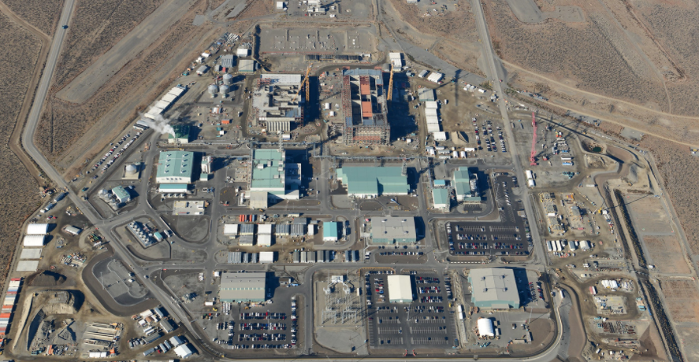
WTP Arial View – October 2021
Analytical Laboratory
Low-Activity Waste Facility
Notes:
The 65-acre WTP construction site is in the center of the DOE Hanford site in the “200 area central plateau.”

Slide 4
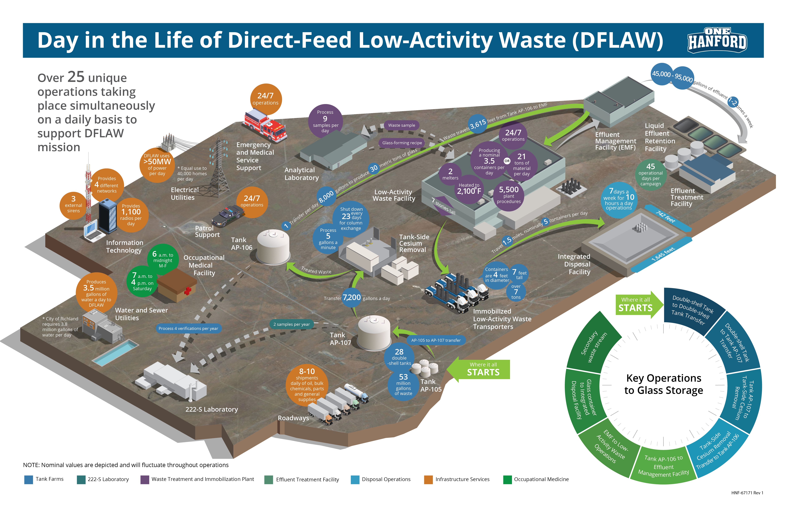
DFLAW Operational Overview

Slide 5
Primary LAW Hazards/Material At Risk
Principle hazards from operations are chemical hazards from:
Melter Offgas (primarily NO_{x}, co-mingled with Rad)
Process Waste (NaOH-like, co-mingled with Rad)
NaOH – (chemical reagent used in offgas treatment)
Ammonia – (chemical reagent used in offgas treatment, PSM quantities in BOF)
Mercury – (Separated from process waste in carbon bed, no Rad)
Rad – Consequences to all receptors (Public, CLW, FW) are “Low” and controlled through Safety Management Programs and DiD features.
All consequences of chemical hazards are limited to FW and CLW with the exception of mercury recovered from the offgas which could have a public consequence of concern if inventory not controlled.

Slide 6
Safety Documentation Overview
Current Safety Documentation:
Documented Safety Analysis for the Low-Activity Waste Facility, Rev. 4
Process Hazard Analysis in Support of the LAW DSA, Rev 11
Low-Activity Waste Facility Technical Safety Requirements, Rev 4
DFLAW Safety Evaluation Report (SER)
Chemical Safety Management Program Description, Rev 1
Process Hazard Analysis for Melter 2 Heatup during Cold Commissioning
Process Hazards Analysis for Balance of Facilities Ammonia Reagent System (note – outside of LAW Nuclear Facility Boundary)
Process Hazards Analysis for Environmental Performance Demonstration Test

Slide 7
DFLAW Hazard Categorization
DFLAW is categorized as a Hazard Category 3 Nuclear Facility by DOE-STD-1027-92, CN1
DFLAW Consists of 2 segments:
LAW Vitrification Facility Building 20
24590-LAW-Z0C-U10T-00001
0.93 HC-2 SOR
EMF Building 25
24590-LAW-Z0C-W14T-00022
0.46 HC-2 SOR
Isotopes of most significance: Sr-90, Cs-137, Pu-239, Pu-240, Am-241
Criticality precluded by nature of the process as documented in the facility’s criticality safety evaluation reports 24590-WTP-CSER-NS-16-0001 and 24590-LAW-CSER-NS-17-0001

Slide 8
DOE-STD-1228 Implementation
DOE-STD-1228 is Safe Harbor Methodology for the DFLAW DSA
Considered a successor document to DOE-STD-3009
Applicable to DOE Hazard Category 3 Nuclear Facilities
Provides more detail regarding Chemical Hazard Screening and Control
Original issuance of the DSA used the methodology from DOE-STD-3009-94, CN3
STD-1228 was implemented as part of Rev. 3 of the DSA

Slide 9
DOE STD-1228 Implementation
The regulatory approach is compliant with 10 CFR 830 and 10 CFR 851 for the following reasons:
DSA changes are made in accordance with a DOE-approved safe harbor methodology, DOE-STD-1228-2019, as supplemented by the DOE guidance memorandum (EM 2019).
The PrHA provides identification and analysis of hazards, as required under 10 CFR 830.202, “Safety basis,” and 10 CFR 851.21, “Hazard identification and assessment.”
Engineered controls remain physically and functionally intact as they transitioned from 10 CFR 830 to 10 CFR 851.
The CSMP that is added as a safety management program in DSA Chapter 18, satisfies the definition of a safety and health standard in 10 CFR 851.3. The CSMP also satisfies the requirement from DOE-STD-1228-2019, Sections 3.1.1.3 and 3.1.1.4, as supplemented by DOE guidance (EM 2019), that hazards screened from further analysis in the DSA are adequately analyzed in accordance with 10 CFR 851 and controlled by safety management programs.

Slide 10
DOE STD-1228 Implementation
Regulatory approach (continued):
An effective management of change (MOC) process is established that addresses potential chemical hazards while preserving DOE control over some changes. ORP approval authority is reserved for changes to engineered features involving: PPJ interlock safety functions, Safety Integrity Level (SIL), and chemical functional requirements; and melter offgas and C5V passive boundary safety functions and chemical functional requirements that were identified as safety significant.
A sound CSMP is established that includes, within its scope, implementation of 29 CFR 1910.119, “Process Safety Management of Highly Hazardous Materials,” and hazard controls with sufficient granularity to preserve the integrity of the controls transferred to the CSMP from Rev 2 of the DSA.

Slide 11
DOE STD-1228 Implementation

Slide 12
DOE-STD-1228 Implementation

Slide 13
DOE STD-1228 Implementation
Screening may be utilized to remove chemical hazards, including those that coexist with radioactive material, from further consideration in the DSA when such hazards meet all the following criteria provided by DOE-STD-1228-2019 :
Is adequately analyzed/evaluated through 10 CFR 851 and controlled by a safety management program such as the Chemical Safety Management Program;
Does not have the potential to initiate or worsen a radiological event;
Does not have the potential to compromise the ability of facility operators to respond to nuclear events (e.g., implementing a SAC); and
Does not have the potential for significant offsite consequences (i.e., exceed Public PAC-2).

Slide 14
DOE STD-1228 Implementation
Commitment and Overview Documented in Chapter 18 of the DSA
KE-18.1: A DOE-ORP approved Chemical Safety Management Program Description document
KE-18.2: A DOE-ORP approved Management of Change procedure
Chemical Safety Management Program
24590-WTP-PD-RAWS-SS-003, Chemical Safety Management Program Description
Chemical Safety Management Program Description originally approved by DOE on 01/23/2020.
Included all program requirements and list of Chemical Safety designated controls and safety functions
Uses existing LAW PrHA as the primary base hazard analysis
Additional Hazard Analyses developed for chemical hazards outside the scope of the DSA (i.e., BOF Anhydrous Ammonia) or for cold commissioning activities.
Was revised for consistency with Rev. 4 of the DSA and BOF AMR PHA.

Slide 15
CSMP Implementation
Issued Process Hazard Analysis for Chemical Safety and Process Safety Management Procedure
Issued Management of Change Procedure
Issued Pre-Startup Safety Review Process
Issued Chemical Safety Management Program Assessment Plan
Issued Chemical Safety Management Implementation Plan
Developed and Implemented Training
Developed Surveillance Requirements and Implementing Procedures for CS Controls
Developed procedures for Operability Determinations and Evaluations
Performing Phased Implementation Verification Reviews of CS Controls consistent with hazard introduction

Slide 16
Chemical Safety Management Program (CSMP) – Phased Implementation
Objective Evidence
CSMP Implementing Crosswalk showing relationship between KPs/EFs and implementing program level documents. Flow down of CSMP Hazard Controls and Key Attributes confirmed in DOORS.
Assessments with LOIs for each KP/EF to confirm interfacing programs are implemented and that the processes are being followed.
Assessments confirm that procedures, training, etc. have been implemented and verified for hazard controls prior to introduction of the associated hazards.
Continuous monitoring of the CSMP program.
Requirements
CSMP Hazard Controls Flowed Down
Program
CSMP Programmatic Attributes Implemented
Controls
Hazard Controls Implemented/Verified Prior to Hazard Introduction
CSMP
Continue to Execute the Program
CSMP Implementing Mechanisms Confirmed
Status of Program Established
Interfacing Programs Implemented
Prepared for ISMS Phase II Review
Prior to Melter #1 Heatup ORCL (for NaOH or all CSMP hazards)
Maintain Program
Prior to CCMA (NOx and remaining controls (i.e., carbon media))
Prior to PSSR (prior to receipt of ammonia on-site)
Monitor Program Health
Phase 1
Phase 2
Phase 3
Program
Execution
We are here

Slide 17
DFLAW Control Strategy
Controls for Safe Operations
Specific Administrative Controls (SACs)
Safety Management Program Key Elements
Chemical Safety Management Program Controls
Chemical Safety SSCs (Table A-1 of CSMPD)
Chemical Safety Administrative Controls (Table A-1 of CSMPD)
Chemical Safety Key Attributes of Interfacing Programs (Table A-2 of CSMPD)
Key Defense-In-Depth
Safety Management Programs
Defense-In-Depth

Slide 18
Specific Administrative Controls (SACs)
Two SACs have been established to protect the facility Hazard Categorization and consequence assumptions for release scenarios:
Waste Acceptance Criteria SAC – Ensures waste feed received at the facility is consistent with consequence calculations and hazard categorization.
Spent Carbon Media Disposal Requirements SAC – Ensures mercury loading in Spent Carbon media does not exceed consequence calculation assumptions.
There are no safety significant SSCs identified for the LAW facility, as radiological consequences are low to all receptors and all public chemical consequences are low.

Slide 19
CS Control Summary Example

Slide 20
Key Defense-In-Depth (DiD)
A risk-based approach was used to determine which DiD features would be designated as Key DiD.
LAW C5V Exhaust Flow
LAW C3V Exhaust Flow
LAW ISA Quality
LAW EMJ NOx and Ammonia Gas Detection and Alarm
ICN SSCs Preceeding PPJ Interlocks Including Differential CO Interlocks
LAW Building Structure
PPJ Interlocks (also CS designated)
Key DiD system functions are managed at a higher level of rigor than non-Key DiD features and will have specific operability requirements for ensuring their availability during operations.
Because of the importance to hazard control, elimination of any Key DiD requires approval of the Plant Management Review Board (PMRB).

Slide 21
SMP Interface and Implementation
Safety Management Programs are described in DSA Chapters 6 through 18 and the TSRs, and include:
SMP | SMP
Prevention of Inadvertent Criticality (DSA Chapter 6) | Radiation Protection (DSA Chapter 7)
Hazardous Material Protection (DSA Chapter 8) | Radioactive and Hazardous Waste Management (DSA Chapter 9)
Initial Testing, In Service Surveillance, and Maintenance (DSA Chapter 10) | Operational Safety (Conduct of Operations and Fire Protection) (DSA Chapter 11)
Procedures and Training (DSA Chapter 12) | Human Factors (DSA Chapter 13)
Quality Assurance (DSA Chapter 14) | Emergency Preparedness Program (DSA Chapter 15)
Provisions for Decontamination and Decommissioning (DSA Chapter 16) | Management, Organization, and Institutional Safety Provisions (DSA Chapter 17)
Chemical Safety Management Program (DSA Chapter 18)

Slide 22
USQ and MOC Process Implementation
Currently, Safety Evaluation (SE) Process is implemented as part of change management of the DSA
USQ Procedure, Guide are approved, and Out of Scope Documents and Facilities (OSDF) Document currently in DOE review. Current forecast to begin training in March 2022.
MOC Process is developed and implemented for change management affecting the Chemical Safety Management Programs and associated Safeguards
USQ and MOC processes are implemented in parallel

Slide 23
Implementation Review Timeline
Ammonia Pre-Startup Safety Review – Complete
Melter 1 Heat-up – Spring 2022
Cold Commissioning Management Assessment – Summer/Fall 2022
CSMP Fully Implemented
Implementation Verification Review (IVR) – Fall 2022
DSA, TSRs, and USQ Program Implemented
LAW MSA - 2023
LAW CORR - 2023
LAW DORR - 2023

Slide 24
Questions
?

