Slide 1
End States Contract Model (ESCM) – Step 2
May 2019

Slide 2
End States Contract Model (ESCM)
End State Contracting Model - Single award Indefinite Delivery/Indefinite Quantity (IDIQ) contract for each Acquisition with the ability to issue both Cost-Reimbursement (CR) and Firm-Fixed-Price (FFP) Task Orders (TO)
Subsequent Single Sourced TO(s) = Effective Task Order Negotiations by Partnering
Allows for Effective “Partnering”
Partnering - Open negotiations between the Contractor, Field, EM, Stakeholders, and Regulators to effectively negotiate Cost Plus Incentive Fee (CPIF) Task Order(s) for Site closure/defined End State(s) within the first 180-days

Slide 3
End States Contract Model (ESCM)
Partnering & Negotiation Objectives (Complete within 180 days)
Agree on scope, schedule and cost, inclusive of discussions with Regulators, as necessary
Identify ownership of risks and mitigations
Identify any required Government Furnished Services and Information
Develop completion criteria and incentive fee structure (ceiling for scope of work beyond sample task period to include flat portion of CPIF Cost Curve [+/- % of cost])
Encourage profit sharing with employees
If cannot agree on reasonable price, re-compete the contract as minimum guarantee has been satisfied

Slide 4
End States Contract Model (ESCM) – Current Acquisitions
ESCM Current Acquisitions
Central Plateau Cleanup Contract (CPCC)
Tank Closure Contract (TCC)
Nevada Environmental Program Services (NEPSC)
Oak Ridge Reservation Cleanup (ORRC)
Portsmouth Cleanup (PC)
Idaho Cleanup Project (ICP)

Slide 5
Steps 1 & 2 – Overview
Step 1 – Acquisition process through Contract Award for each Site, which may include issuance of Pre-Award Task Order(s)
“Pre-Award Task Order” – A Task Order where the Request for Task Order Proposal (RTP) was included in the Prime Contract Final RFP and evaluated prior to Award)
Step 2 – Transition of the new contractor through the issuance of Pre-Award Task Orders and all subsequent Post Award ESC Task Orders
Step 2a – Initial Contract Transition after Award of new Contract and issuance of remaining Year 1 Task Orders (i.e. Balance of Work (BOW) and Non-Fee bearing Task Orders (Pension, Government Furnished costs, Benefits, etc.))
Step 2b – After Initial Contract Transition through issuance of all Post Award ESC Task Orders of the new Contract Period of Performance (POP)

Slide 6
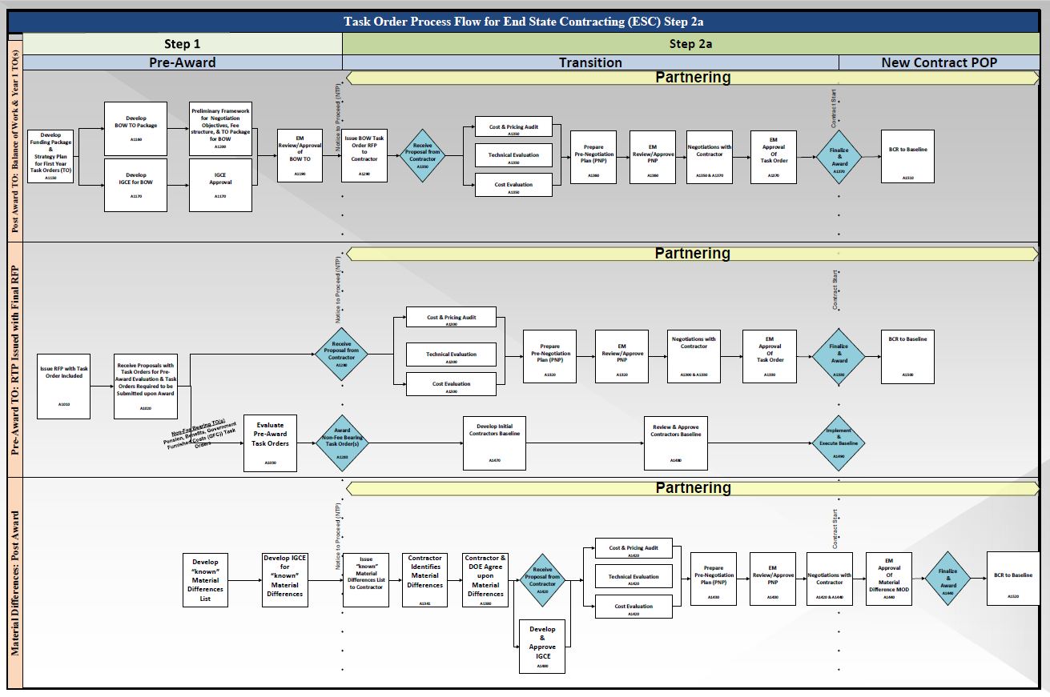
Step 2a – Task Order Process Flow

Slide 7
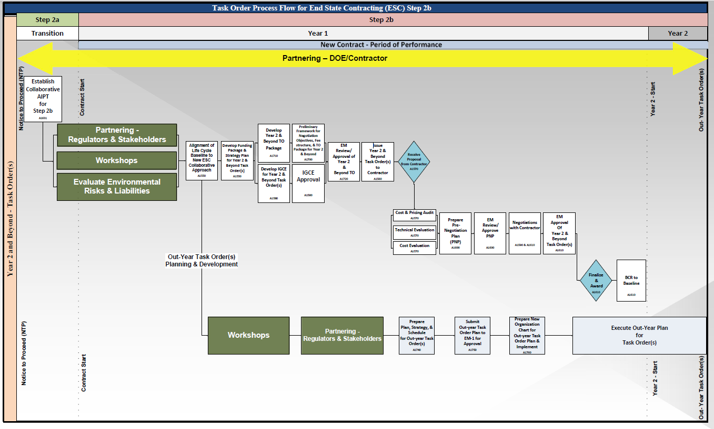
Step 2b – Task Order Process Flow

Slide 8
End States Contracting Teams
End State Contracting Team (ESCT) – A Site team comprised of Federal Staff and General Support Service Contractors (GSSC) tasked to develop, coordinate, report and support all Step 2 activities and deliverables. This team will add SMEs during Step 2b based on regulatory and technical challenges.
Site Initial Transition Team – A Site team to manage and oversee the Transition of the new and outgoing Contractor through the stated Transition period in the RFP.
Negotiation Team – A team with a mix of Site staff and Headquarters staff which provides technical support for negotiations.

Slide 9
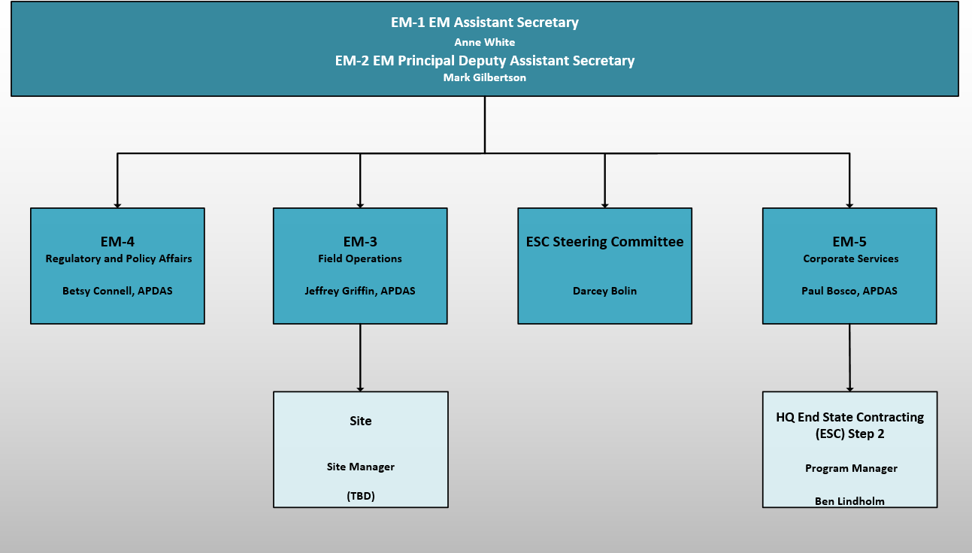
Step 2 HQ Organizational Structure

Slide 10
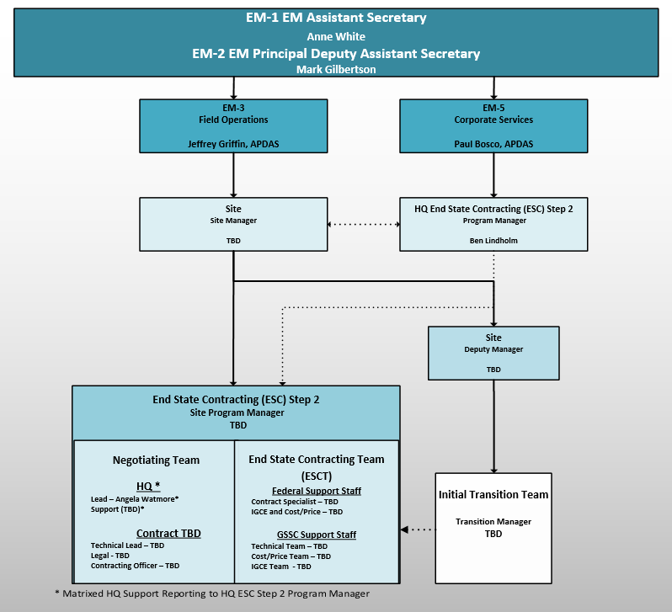
Step 2 Standard Site Organizational Structure

Slide 11
Step 1 & 2 Team Roles and Responsibilities
Step 1 – Acquisition through Contract Award and issuance of the Master IDIQ
Team consists of EM-3, EMCBC, Site SEB, SSA and Advisors
Responsibilities include:
Develop Acquisition Plan
Develop RFP
Perform Evaluation
Contract Award
Issue Single Award Master IDIQ

Slide 12
Step 1 & 2 Teams Roles and Responsibilities (cont.)
Step 2 – Post Award Negotiated Task Order(s)
Split into two separate distinct phases from Transition through the negotiation and issuance of all Post Award Task Orders for the New Contract Period of Performance
Step 2a – Initial Transition Notice-to-Proceed through Transition completion
Step 2b – After Initial Transition Phase through the end of the Contract Period of Performance

Slide 13
Step 1 & 2 Teams Roles and Responsibilities (cont.)
Step 2a
Ensure Site has completed workforce Transition and Year 1 work scope through issuance of Task Order(s), prior to completion of Contract Transition
Planning/Development and Issuance of all Follow-on Task Orders covering work scope commencing after Year 1
Issue ESC Task Orders included and evaluated in the Pre-Award phase (no more than 1 year of work)
Issue any Non-Fee Bearing Task Orders that are Government Furnished Costs (GFC) (i.e. Pensions and Benefits) awarded at NTP
Develop and issue Balance of Work (BOW) Task Orders that cover ongoing work that was not finished by the outgoing Contractor

Slide 14
Step 1 & 2 Teams Roles and Responsibilities (cont.)
Step 2b
Establish Collaborative Acquisition Integrated Project Team
Open Negotiations/Facilitate Partnering for Site closure/defined End State(s) the meet the following:
Reduce EM Liability and Risks
Have Regulatory Approval
Meet EM Mission for Closure
Issue all Post Award Negotiated Task Order(s) through the remainder of the Contract POP

Slide 15
Step 1 & 2 Teams Roles and Responsibilities (cont.)
End State Contracting Team (ESCT)
Develop all products for Step 2a and 2b and provide to Negotiation Team
Program Manager is responsible to develop all deliverables with support from Site and/or Headquarters resources
Work with Site Managers to align EM-1 Mission into Task Order(s)
Manage and maintain schedule, provide reporting to Headquarters, and support discussions with Contractor
Site Initial Transition Team
Coordinate with the ESCT on Step 2 activities and deliverables
Finish activities after deliverables required for Transition is completed by the New Contractor
Negotiation Team
Lead effort and negotiate all Post Award ESC Task Orders for Step 2a and 2b
Define End State Completion Criteria
Drive Policy and Regulatory decisions at the Site and Headquarters level
Approve Scope for Task Orders
Develop Contract and Fee structure on Task Orders

Slide 16
Step 2a Pre-Award Activities
Pre-Award Activities
ESCT members assigned/designated by Site and a kickoff meetings held
ESCT establishes weekly meetings and reporting requirements
ESCT develops a Partnering strategy (as associated with the Task Order process) and get comments from Headquarters and Site management
ESCT to develop a Task Order detail process, including a P6 schedule consistent with H-clause Requirements
Task Order process will be presented to New Contractor immediately upon award
Discussions with Contractor during kickoff meeting (Partnering) and team can negotiate the process with Contractor and both parties have an agreement to work towards
ESCT to determine all Non-Fee Bearing Task Order(s) Required; Government Furnished Costs (GFC) (i.e. Pension, Benefits, Legacy Pensions)
Develop and prepare Non-Fee bearing Task Order(s) Packages
Issue all Non-Fee Bearing Task Order(s) at Award

Slide 17
Step 2a Pre-Award Activities (cont.)
Pre-Award Activities
Develop IGCEs for Step 2a Post Award Task Orders
Post Award Task Orders
Proposals received from winning Offeror 5 days after NTP
Requires meeting with Site management, Projects and Technical SMEs to develop Scope, define Deliverables, and Assumptions
Task Orders are part of the current RFP
ESCT develops all New Task Orders that will be issued to Contractor after Award including IGCEs, Task Order package, and Schedule. All Task Orders need to be ready at time of award so that issuance of the Task Order packages can be delivered to the Contractor 5 days after NTP.

Slide 18
Initial Task Order Issuance after Contract Award
Partnering/Kickoff of Task Order(s) (see H clause for objectives in Partnering)
Provide Contractor Task Order templates and process to follow for Contractor review
Set up meeting with Contractor’s Task Order team
Hold meeting and complete the following
Review H clause on Task Ordering Procedure
Agree upon the Task Order Process and Templates
Develop with Contractor - list of roles, responsibilities, objectives and goals for the Task Order process
Agree upon Schedule for Task Order issuances provided by the Government
Issuance of Task Orders evaluated during Pre-Award Phase
ESCT debriefs Contractor on evaluated Task Orders
ESCT negotiates terms of issuance of Task Orders with Contractor
Task Orders issued to Contractor within 5 working days of NTP

Slide 19
Initial Task Order Issuance after Contract Award
Issuance of Task Orders for Non Fee Bearing work
ESCT negotiates terms of issuance of Task Orders with Contractor
Task Orders issued to Contractor within 5 working days of NTP
Issuance of Task Orders submitted by Contractor immediately after Award
ESCT debriefs Contractor on submitted Task Order
Contractor provides revised proposal, if required, 2 days after debrief
ESCT holds preliminary negotiating meeting with Contractor within
ESCT negotiates terms of issuance of Task Orders with Contractor
Task Orders issued to Contractor with NTP

Slide 20
Initial Task Order Issuance after Contract Award
Issuance of Follow-on Task Order(s) for New Work
ESCT holds a kickoff meeting with Contractor for Follow-on Task Order(s)
ESCT presents Task Order Package to Contractor, negotiates/explain Scope, Schedule and level of Detail Required in submission
Contractor presents Task Order Proposal back to Government
ESCT may need to hold other meetings for clarification or direction if required, but this does not justify an extension of the submittal of the Task Order Proposal
Government performs modified evaluation of Task Order(s)
ESCT negotiates Task Order with Contractor
Awards the Task Order prior to Transition Completion

Slide 21
Baseline Development
Contractor Baseline Development
ESCT holds a kickoff meeting with Contractor and reviews original Baseline submittal requirements and due dates for Task Orders evaluated during Pre-Award phase.
Contractor to submit a BCR with all new Task Orders issued Post Award.
DOE to review BCRs and provide comments, if any, back to Contractor prior to issuance of Task Order.
DOE to audit Contractors baseline 30 days after Contractor takes over the Contract from the current Contractor. Review by DOE, Step 2 Team will be completed within 30 days and all comments resolved by Contractor 10 days after comments issued.

Slide 22
Step 2b Objectives
Step 2b Objectives
Set up a collaborative team with established partnering agreements made up of the following:
New Site Contractor
EM-1 and EM-2
Site Manager
DOE EM Regulatory SME’s
State and Local Regulatory Agencies
Define each Sites vision/priorities and align with EM-1 for Contract Period of Performance
Define achievable End States and completion criteria that reduces Liability and Risk to EM
Work with Regulators so EM can issue Task Order for these End states with achievable completion criteria to Site Contractor
Develop out-year planning packages with schedules, list of issues to resolve with regulators, and cost estimates that will be issued in future Task Orders as required at the Site

Slide 23
Step 2b Deliverables
Deliverables
ESC Integrated Project Team (IPT) Established and Chartered
Integrated Priority List for the POP within 6 months of Contract Award
Partnering agreement
Regulatory and Policy Assessment for future Task Orders
Suggested End State and Completion Criteria Report for POP
P6 Schedule showing issuance of all Task Orders for POP
ESCT development of Task Order packages
Updated PMB by Site Contractor approved by DOE
Out-year planning packages with schedules, list of issues to resolve with regulators, and cost estimates

