Slide 1
Snippet 1-3:
EVMS Certification
U.S. Dept. of Energy
Office of Project Management (PM)
Notes:
This Earned Value Management System, commonly referred to as EVMS, Training Snippet, is sponsored by the United States Department of Energy’s Office of Project Management. This Snippet discusses the intent, roles and responsibilities, and processes involved in conducting a Certification of a contractor’s EVMS.

Slide 2
Intent of EVMS Certification Reviews
4
Provide a documented and defensible record for both DOE and the contractor
3
Assess maintenance and continued implementation
2
Ensure implementation in a compliant manner to plan, monitor, and manage cost, schedule, and technical performance
1
Ensures deployment of an EVMS compliant with EIA-748 across applicable DOE Order 413.3B capital asset projects
Notes:
Fourth, documentation is a necessity to ensure a defensible record is kept for not only DOE and the contractor, but also should either be subject to an outside government audit. Another reason for maintaining a record is to support acceptance of the contractor’s system by another Federal Agency under other contractual circumstances.
Certification is not intended to verify how well projects or programs are performing, but to assess the capability of the system for use in planning, to provide an objective measure of progress, and the effective use of the system for making management decisions. Project data are simply means of demonstrating EVMS compliance. Elements of the EVMS (that is, the design as reflected by policies, procedures, and processes; and the implementation as reflected by reports and other documents) are evaluated individually and as a whole to ensure that they meet the intent of EIA‑748.

Slide 3
EVMS Certification Thresholds
Certifying Authority is the Office of Project Management (PM)
TPC of $100M or greater, PM conducts certification review process and certify the contractor’s EVMS compliance with EIA-748
On an exception basis, or at the request of the PMSO. PM may conduct compliance reviews that have a TPC between $50M and $100M.
Total Project Cost (TPC) between $50M and $100M, the contractor shall maintain an EVMS compliant with EIA-748.
Compliance requirements for contractors with an applicable project:
Notes:
The Certifying authority for EVMS compliance reviews is the Office of Project Management, referred to as PM. PM is responsible for establishing, maintaining, and executing the EVMS certification and surveillance review processes in accordance with established levels to ensure full compliance with applicable Federal acquisition regulations and Office of Management and Budget requirements. Compliance requirements and thresholds defined in DOE Order 413.3B include:
For contractors where there are applicable projects having a total project cost or TPC of $100 million dollars or greater, PM conducts the certification review process and certifies the contractor’s EVMS compliance with EIA-748, or as required by the contract.
On an exception basis, or at the request of the Program Office’s Project Management Support Office or PMSO, PM may conduct compliance reviews of contractors with applicable projects that have a TPC between $50M and $100M.
For contractors where there are applicable projects with a TPC between $50 Million and $100 Million dollars, the contractor is required to maintain an EVMS compliant with EIA-748. Does this mean that the contractor self-certifies? No, it does not. It means that the contractor is contractually bound to maintain and be able to demonstrate an EVMS compliant with EIA-748.

Slide 4
Review Team Roles and Responsibilities
Review Director
A PM-30 senior representative responsible for approval of EVMS findings and reports
Assigns the Review Chief and approves the selection of the Review Deputy and Review Assistant
Responsible for all decisions of EVMS noncompliance
Review Chief
Member of PM-30 staff responsible for overall conduct of assessment and review
Responsible for leading the review team in the execution of its duties and responsibilities before, during, and after the compliance review
Nominates the Review Deputy, Review Assistant, and the Review Team
Ensures team members sign non-disclosure agreements prior to receiving access
Review Deputy
Supports the Review Chief; typically filled by an EVMS SME on the PM-30 Staff
Responsible for operation of the Review Team and process
Review Assistant
Assists the Review Chief in handling all administrative details and document control
Typically filled by an EVMS SME on PM-30 staff or obtained via contract support
Maintains the CAR/DR/CIO log and track all phases of CAR/DR/CIO development
Notes:
PM-30 organizes, plans, and leads EVMS Certification assessments. The key positions, roles and responsibilities of EVMS Certification reviews are as follows:
The Review Director is a PM-30 senior representative responsible for ultimate approval of EVMS findings and reports. The PM-30 Director typically fills this position unless otherwise delegated. The Review Director assigns the Review Chief and approves the selection of the Review Deputy and Review Assistant. The Review Director is responsible for all decisions of EVMS noncompliance.
The Review Chief is responsible for the overall conduct of the assessment and review and for leading the review team in the execution of its duties and responsibilities before, during, and after the compliance review. A member of the PM-30 staff typically fills this position. The Review Chief identifies and nominates the Review Deputy, Review Assistant, and the Review Team to the Review Director for his or her approval. The Review Chief is responsible for ensuring team members sign non-disclosure agreements prior to receiving access to contractor data.
The Review Deputy supports the Review Chief and is responsible for the operation of the Review Team and the EVMS compliance review process. This position is typically filled by an EVMS subject matter expert on the PM-30 staff or obtained through contract support.
The Review Assistant assists the Review Chief in handling all administrative details of the review including particularly document control. This position is typically filled by an EVMS subject matter expert on PM-30 staff or obtained through contract support. One of the most critical tasks for the Review Assistant is to maintain the Review log and serve as the go between for all phases of Corrective action requests, discrepancy reports, and continuous improvement opportunities development.

Slide 5
Review Team Roles and Responsibilities continued
Process or Area Team Lead
Responsible for assessment and documentation of one or more of the six areas of the EIA-748
Conduct a process capability assessment
Interview Team Lead
Federal employees, EFCOG EVMS / PCA members, or contracted resources
Responsible for planning, scheduling, performance, and accurate reporting of the interviews
Review Team Members
Federal employees, EFCOG EVMS / PCA members, or contracted resources
Experienced in EVMS compliance assessment
Typically serve cross-functional roles as both Process or Area and Interview Team members
Assigns team members early in the data analysis step to ensure the team is involved
Complete analysis results of concerns, the Guideline Summary, and the CARs, DRs, and CIOs
Provide final determination of EVMS compliance for a process capability
Notes:
The Process or Area Team Lead is assigned by the Review Chief and is responsible for assessment and documentation of one or more of the six areas of the EIA-748 EVMS Guidelines.
The Process or Area Team Lead considers the adequacy of the ten core management processes associated with an integrated project management approach, that is organizing, planning and scheduling, budgeting and work authorization, material management, subcontract management, analysis and managerial reporting, change control, accounting considerations, indirect cost management, and risk management. This will be accomplished by conducting a process capability assessment to test the ability of a core management process and practice to meet prescribed EIA-748 compliance criteria.
The final determination of EVMS compliance for a process capability is accomplished by looking over a specified period time to determine how well a process meets a set of specification limits. The Process or Area Team Lead’s tasks begin at the data analysis step and continues through post review and closeout step.
Output documents include but are not limited to providing analysis results of concerns to the respective Interview Team Leads, the Guideline Summary for area of responsibility, and the associated CARs, DRs, and CIOs.
The Process or Area Team Lead assigns team members early in the data analysis step to ensure the team is involved, prepared, and diligently executes their duties associated with the EVMS compliance process.
The Interview Team Leads may be Federal employees, Energy Facility Contractor’s Group members, [abbreviated as EFCOG (pronounced as ‘eff cog)] EVMS or Project Controls Analysts, or contracted resources.
The Interview Team Leads are responsible for planning, scheduling, performance, and accurate reporting of the interviews and discussions held with Control Account Managers and other contractor personnel including various managers and project management personnel as determined by the Review Director and Review Chief.
Review Team Members are Federal employees, ‘eff cog’ EVMS or Project Controls Analysts, and contracted resources with EVMS compliance assessment experience. Review Team Members are responsible for performing detailed evaluations of a contractor's EVMS within their assigned Area. Review Team members typically serve cross-functional roles as both Process or Area and Interview Team members supporting a Process or Area analysis as well as conducting and documenting the interviews.

Slide 6
PM Certification Process Phases
Initial Visit
Data Analysis
Readiness Assessment
On-Site Prep and Review
Post Review and Closeout
Notes:
The phases for a certification review include the Initial Visit, Data Analysis, Readiness Assessment, On-Site Preparation and Review, and Post-Review and Closeout. We will discuss each phase on the following slides.

Slide 7
PM Certification Process
On-site Meeting
“Level-set” expectations
Identify any potential concerns
Initial Visit
Data Analysis
Readiness Assessment
On-Site Prep and Review
Post Review and Closeout
Notes:
The Certification Process starts with an Initial Visit at the contractor’s offices. This is usually a 1 to 2 day visit by the Review Director and Review Chief with the contractor’s team. The Review Director explains the Certification Review (CR) process, sets review expectations among the stakeholders, and identifies potential concerns with the contractor’s EVMS processes and procedures and areas of non-compliance already observed. The contractor’s team can take advantage of this visit to ask questions about areas of compliance they are struggling with or are unclear about, and to clear up any misunderstandings of the Certification process flow.

Slide 8
PM Certification Process
Initial Visit
Team analyzes data, procedures, independent assessments
Results are documented noting any concerns
Determination is made whether to proceed to next Phase
Data Analysis
CAM and Managerial Interviews
Conduct Data Traces
Readiness Assessment
Review CAP Evidence Submittal
Assess CAP Implementation
On-Site Review
On-Site Prep and Review
Post Review and Closeout
Notes:
During the Data Analysis, the Review Team sends a notification to the contractor requesting data and artifacts, contractor independent assessments, their EVM system description and supporting procedures with the EVMS Cross-Reference Checklist. The letter may also request a Webinar for the contractor to provide a demonstration of their system.
Upon receipt of the information request, the team then begins their analysis. Much of the data analysis is automated using software; however, the results are based on thresholds which are flagged if missed. The analysts review the flagged results against data artifacts to determine compliance or need for follow up interview questions.
The contractor’s independent assessment and past internal surveillances are reviewed by the Process or Area Team Leads to assess completeness and compare with the results of the data analysis.
The Review Chief and Process or Area Leads review the contractor’s EVM System Description and supporting procedures for EIA-748 compliance using the EVMS Cross-Reference Checklist from Appendix A of the ECRSOP. The reviewer provides specific rationale for identified non-compliant text in the contractor’s EVM System Description but does not recommend revised language to the contractor as this could interfere with the contractor’s business practices.
The Process or Area Leads will document the results of their review and identify any concerns that need further assessment. This documentation will be provided to the Review Chief as soon as practicable. The Review Chief will then coordinate with the Review Director for use in a determination to proceed to the next step. Should non-compliance and material data validity issues be found, it may be necessary for the Process or Area Leads to issue preliminary Corrective action requests and or Discrepancy Reports prior to the Readiness Assessment Phase. If so, the contractor must make appropriate corrections and resubmit new data and artifacts for the Review Team to analyze.

Slide 9
PM Certification Process
Initial Visit
Data Analysis
Assess contractor readiness
Conduct Readiness Assist Visit if necessary
Document and advise Contracting Officer of results
Readiness Assessment
On-Site Prep and Review
Post Review and Closeout
Notes:
The purpose of the Readiness Assessment is for a final determination to be made whether the contractor is ready for the formal review, or if the contractor needs additional time to correct findings resulting from the prior Data Analysis Phase. The Readiness Assessment phase also allows for a Readiness Assist Visit to aid the contractor by explaining the current issues and to further assess the contractor’s state of readiness for the formal EVMS review. Readiness Assist Visits are conducted on an ‘as needed’ basis as determined by the Review Director based on the indication of the contractor’s readiness to date.
If it is it determined that the contractor is not ready, the Review Director or Review Chief will notify the Contracting Officer and contractor of the decision, and the subsequent cancelling or postponement of the pending EVMS Certification Review. The Review Chief will update the review schedule based on the follow-on actions required, if any. If the Data Analysis phase identifies significant data anomalies and core management process issues that require corrective action before proceeding further, the Review Chief will prepare Corrective action reports and discrepancy reports, and will develop an Readiness Assessment report for the Review Director’s approval and subsequent submittal to the Contracting Officer.

Slide 10
PM Certification Process
Initial Visit
Pre-visit preparation
Notification to Contractor
Complete final data analysis, artifact traces, and EVM System Description review.
Tailored Interview Findings Forms completed
Interview selections made; Agenda finalized
Pre-visit security information completed
On-Site Review
Review Director brief
Contractor brief
Interview teams conduct interviews
Draft CARs, DRs, and CIOs
Daily Review Director brief to Contractor
Exit brief to Contractor on last day
Data Analysis
Readiness Assessment
On-Site Prep and Review
Post Review and Closeout
Notes:
The first step in this Phase is to notify the contractor of the team composition, team meeting room requirements, draft agenda, interview room requirements, and any additional artifacts that are needed prior to the team’s visit.
The team completes their final analysis and identifies interview questions to populate the Interview Findings Form. The EVM System Description review is completed.
At this point, the Review Director can advise the contractor who will be interviewed based on results of analysis and the Agenda can be finalized. Besides Control Account Managers and Project Controls, other key people to be interviewed may include contractor’s senior executives, project manager, business manager, functional managers, major subcontractor manager, indirect manager, master scheduler/planner, accounting manager, and risk manager.
The Review Chief submits the necessary pre-visit security information for team members.
The On-Site Review begins with a briefing by the Review Director. The contractor normally provides a briefing that has been discussed with the Review Chief in advance to ensure items of interest for the team are covered.
The team members then can begin conducting interviews which is the most important piece of the On-Site Review. The Review Director and Review Chief lead interviews of management personnel. The Interview Teams conduct interviews of the Control Account Managers and Project Controls staff. Interviews are conducted using a tailored Interview Findings Form for each person interviewed based on areas of concern identified during the data analysis and artifact traces. After each interview, the team will draft any corrective action requests, discrepancy reports, or continuous process opportunities.
At the end of each day, the Review Director briefs the Contractor.
On the last day of the review, the Review Director conducts an Exit Brief to the contractor, covering any potential findings at a high level. Findings are completed in the next Phase.

Slide 11
PM Certification Process
Initial Visit
Data Analysis
Post Review
Finalize CARs, DRs, and CIOs
Draft Final Report
Conduct Factual Accuracy Review
Issue Report including findings
Contractor prepares Corrective Action Management Plan (CAMP) with comments by Review Director and Review Chief
Monitor CAMP progress
CAMP Closeout
Review evidence package
Close CARs and DRs as verified
Issue Certification memo to Contracting Officer
Post the Review documentation to PARS central repository
Readiness Assessment
On-Site Prep and Preview
Post Review and Closeout
Notes:
During this phase of the review process, the Process or Area Teams and Interview Teams complete the documenting of findings on either a CAR or DR format. These are then reviewed by the Review Chief and Review Director. The Review Chief will begin drafting the EVMS Review Report. Once the Review Director and Review Chief have finalized the Corrective Action Requests and Discrepancy Reports, they will submit them to the contractor for the purposes of a factual accuracy review. The contractor may provide comments relating to the accuracy of the facts and exhibits stated in the Corrective Action Request and Discrepancy Report that led to the determination; however, the intent is not to debate the overall conclusion of non-compliance.
After the completion of the factual accuracy review, the contractor’s comments are reviewed by the Review Director and Review Chief, and changes to the draft report are made, if needed. The Review Chief will complete the report and will provide it to the Review Director for concurrence and issuance by the PM Office Director. The letter of transmittal will identify the contractor’s next steps and will identify the timeframe for submittal of a Corrective Action Management Plan or CAMP.
The preparation of the CAMP is an iterative process, led by the contractor but monitored by the Review Director and Review Chief. Routine meetings are held between the Review Director and Review Chief throughout the CAMP process to monitor progress. understand the results of root cause analysis, and determine the Corrective Action Requests and Discrepancy Reports closeout process.
The Review Chief in consultation with the Review Director will plan, schedule, and approve all verification follow-up actions and closure of Corrective Action Requests and Discrepancy Reports . This may be done on site or remotely depending on the nature of each EVMS issue.
The contractor will provide the evidence package for closeout and the Review Chief and Review Director will conduct the closeout review either remotely or on-site. Once all Corrective Action Requests and Discrepancy Reports have been closed, the Review Director will inform the Director of the Office of Project Management who will approve and issue the Closeout report with memorandum of certification to the Contracting Officer.
Lastly, the Review Chief ensures that all documentation relative to the review process and final determination is submitted into the PARS document management system.

Slide 12
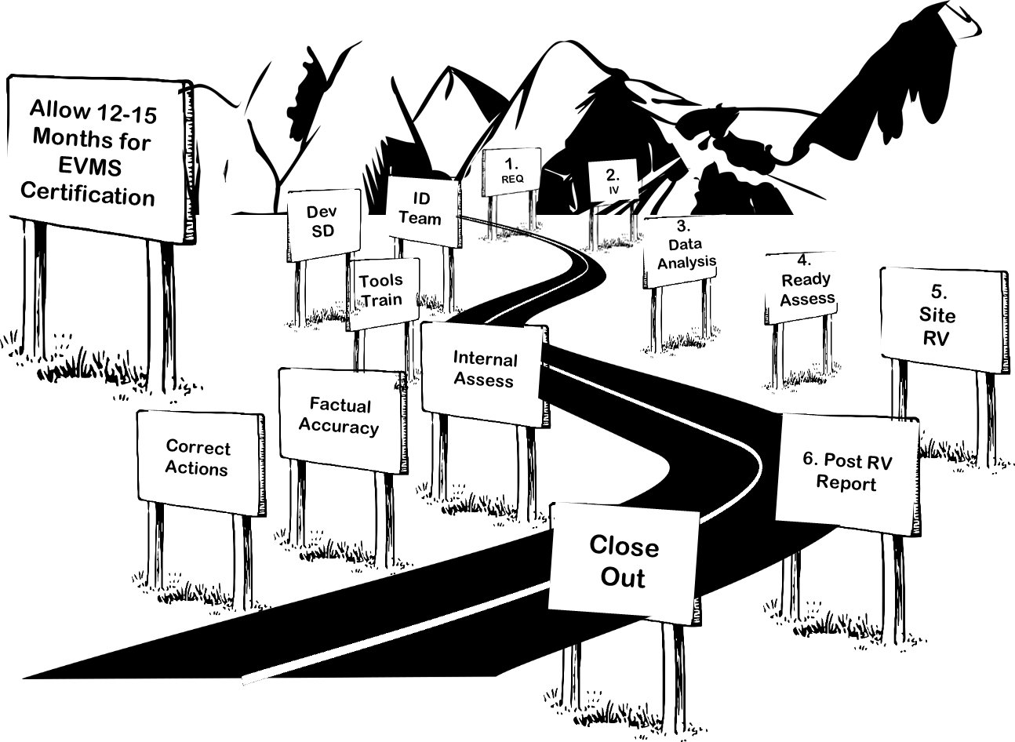
Length of process depends on contractor readiness and willingness to address identified issues
One to two-day Initial Visit
Pre-Review Assessment includes contractor self-assessment, PM data analysis, and procedural review
Two weeks on-site review
Corrective action phase – depends on # of findings
One week on-site for follow up to verify implementation of corrective actions
Review Process Timeline
Notes:
The length of the process is dependent on the contractor readiness and willingness to promptly and properly address issues identified during the various stages. While there is a possibility it could be done in less time, it may take up to 15 months or longer to proceed through the phases. This timeline includes a one to two day Initial Visit, a data analysis phase, may include an on-site Readiness Assessment visit, a one or two week on site compliance review, the contractor component of developing and completing the Corrective Action Management Plan, followed by the follow-up review phase to close Corrective Action Requests and Discrepancy Reports by verifying implementation of corrective actions.
The duration of each phase and step of an EVMS compliance review will vary depending on several factors to include, but not limited to the size of the project and the maturity of the contractor’s EVMS, etc. A notional timeline for an EVMS certification is between 12 and 15 months.

Slide 13
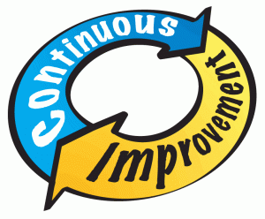
EVMS Changes After Certification
Contractor-proposed EVMS changes require DOE approval prior to implementation
DOE PM as the Certifying Authority reviews the proposed changes against EIA-748 to determine compliance and makes recommendations to the CO generally within 30 days.
If approved, the changes are recommended for approval to the CO
The implementation verification would be annotated as a possible area of risk, and confirmed based on surveillance activities
If the proposed EVMS changes deemed non-compliant, PM works with the Contractor to reach agreement. If no agreement reached, Contracting Officer sends a letter of non-consent
Notes:
Changes to policies and procedures are expected and encouraged as a matter of continuous improvement. The contractor must notify the DOE certifying authority when making any changes to its system description and supporting procedures per DOE Order 413.3B, FAR 52.234-4(e), and DOE-H-2024. This requirement is designed to protect both parties in the event a change may unintentionally cause non-compliance.
The Contractor submits the notification of all proposed changes to the EVMS procedures and the impact of those changes to the Contracting Officer. Any changes to a PM certified EVMS proposed by the contractor require approval of DOE PM prior to implementation. PM will advise the contractor of the acceptability of such changes as soon as practicable (generally within 30 calendar days) after receipt of the contractor's notice of proposed changes.
If the change causes non-compliance which cannot be resolved, the Contracting Officer should send a letter of non-consent based on the findings of the Certifying Authority. The contractor is encouraged to submit the proposed process changes electronically, to both the CO and Certifying Authority simultaneously, to avoid delays in approval.

Slide 14
Corporate Certification
Allows a contractor to adopt their existing certified EVMS for application under a new contract at another location
Contractor will be considered certified upon acceptance of prior certification documentation
DOE conducts implementation typically prior to CD-3
Other Certification Issues Handled on Case Basis
One or more EVMS certified contractors form LLC and adopt an existing certified EVMS
New contractor adopts incumbent contractor’s certified EVMS
DOE will conduct either Certification or Implementation review before granting certification of compliance
Notes:
Sometimes there are special cases when determining Certification. The first case involves a Corporate Certification. DOE Order 413.3B allows a contractor to adopt its existing DOE-certified EVMS for application under a new contract at another location. For a pre-existing certified EVMS to be considered, the contractor must provide the prior certification documentation to the responsible DOE certifying organization. The Certifying Authority must conduct an implementation review typically prior to CD-3.
Other certification issues will be handled on a case by case basis such as one or more EVMS certified contractors form a Limited Liability Corporation (LLC) and adopt an existing certified EVMS, or a new contractor adopts the incumbent contractor’s certified EVMS. DOE will conduct either a certification or an implementation review before granting a certification of compliance.

Slide 15
Summary
PM-conducted EVMS Certification Review phases include:
Initial Visit
Data Analysis
Readiness Assessment
On-Site Preparation and Review
Post-Review and Closeout
Duration of the Review averages between 12 and 15 months
Contractor changes to a certified EVMS are expected
Prior notification is given to the Contracting Officer and PM
PM reviews changes for compliance and annotates need for review of implementation during surveillance
Special circumstances apply when:
A contractor who has been previously certified but is now working from another location
One or more EVMS certified contractors form LLC and adopt an existing certified EVMS
New contractor adopts incumbent contractor’s certified EVMS
Notes:
The phases for a certification review include the Initial Visit, Data Analysis, Readiness Assessment, On-Site Preparation and Review, and Post-Review and Closeout. The duration of each phase and step of an EVMS compliance review will vary depending on several factors to include, but not limited to the size of the project and the maturity of the contractor’s EVMS, etc. A notional timeline for an EVMS certification is between 12 and 15 months.
Changes to policies and procedures are expected and encouraged as a matter of continuous improvement. The contractor must notify the DOE certifying authority when making any changes to its system description and supporting. This requirement is designed to protect both parties in the event a change may unintentionally cause non-compliance.
Special circumstances apply when a contractor has been previously certified and moves to a new location, when a certified contractor forms an LLC with other contractors, and when a new contractor adopts an incumbent contractor’s EVMS.

Slide 16
For additional information, please browse our library at the following Project Management Earned Value Management websites.
External:
https://www.energy.gov/projectmanagement/services-0/earned-value-management
Internal:
https://community.max.gov/display/DOEExternal/PM+EVM+Guidance
Notes:
For additional information on EVMS Certification Reviews, please refer to the EVMS Compliance Review Standard Operating Procedure, available along with other EVMS procedures, templates, helpful references, training materials, and other Snippets, on the DOE PM’s external EVM Home page or the internal Max.Gov PM Library listed on the slide. Check back periodically for updated or new information.
Thank You for using the Snippet Library.

