Slide 1
Snippet 1-5B: How to Implement an Over Target Baseline (OTB) and/or an Over Target Schedule (OTS)
Dept. Of Energy
Office of Project Management (PM)
Notes:
This Training Snippet, sponsored by the Department of Energy’s Office of Project Management, discusses the process for implementation of an Over Target Baseline or OTB and or an Over Target Schedule or OTS. The purpose is to provide a common understanding within DOE and among DOE contractors, and to provide consistency when the baseline is no longer deemed executable. Snippet 1-5A provides information on why an OTB and or OTS may be implemented.

Slide 2
Primary References
Department of Defense (DoD) Over Target Baseline (OTB) and Over Target Schedule (OTS) Guide, 12/05/2012
https://www.acq.osd.mil/evm/#/policy-guidance/guides-references
Department of Energy (DOE) 413.3-20 Change Control Management Guide, Washington, DC, 0729/2-11 (Chg 1 10/22/2015)
https://www.directives.doe.gov/guidance#b_start=0

Slide 3
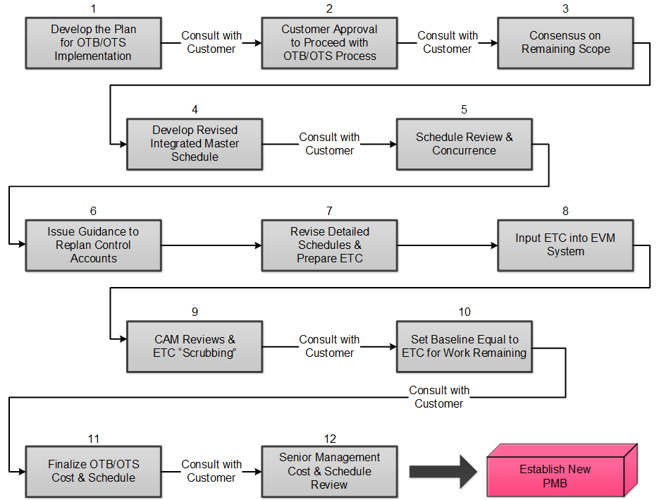
OTB Process Flow
3
Notes:
The process flow on this graphic is from the OTB and OTS Guide referenced on the prior slide. We will follow this flow as we examine the Guide’s recommended 12 steps to execution of the new PMB. The flow chart steps refer to contractor actions and identifies when customer interaction is essential. Note that early involvement and frequent interaction with DOE is critical.

Slide 4
Steps 1 through 5
Develop the plan
Receive DOE approval to proceed
Consensus on remaining scope
Develop a revised IMS
Schedule review and concurrence
Notes:
Implementing an Over Target Baseline is as involved as the project’s initial baselining process, if not more so.
During Step 1, the contractor develops an implementation plan and schedule. The plan identifies ground rules and assumptions, scope, impact, plans to adjust variances, potential reporting changes, documentation recommendations, and planned dates for implementation. The DOE Federal Project Director documents expectations, such as special reporting or coordination requirements from senior management.
In Step 2, the contractor submits the formal request for approval to initiate the OTB to the DOE Contracting Officer. The request includes a top-level projection of potential cost and/or schedule growth, recommendation of whether or not performance variances will be retained, and an implementation schedule.
Upon approval from the Contracting Officer, the contractor and DOE will proceed to Step 3. This step is where the parties reach consensus on the scope of the remaining effort as supported by the ground rules and assumptions for the comprehensive estimate to complete. This validation should not result in a scope change to the contract. The level of scope review should be done at the work package/planning package level. Any changes to the scope of the contract identified during the validation requires a bilateral modification by the Contracting Officer and should be tracked separately from the OTB process for contract budget base reconciliation purposes.
During Step 4, the contractor should base all revised planning on a complete, integrated, and realistic IMS. Logic, durations, and completeness of the new schedule should be validated whether an Over Target Schedule is required or not. If contractual completion dates are affected, then an OTS is required. The new dates in the OTS are for performance measurement purposes only and do not represent an agreement to modify the contract fee, schedule, terms or conditions. The Contracting Officer will only issue a modification for the cost overrun. The new schedule should be integrated not only with related key events, but also with the key vendors, suppliers, and subcontractors as well. This scheduling process, just as it was done at the original contract planning, is very time consuming and requires a strong, experienced scheduling support team.
Step 5 is the Schedule review and concurrence. This is where contractor and DOE project teams assess the logical sequencing of schedule, validate the activities and durations, and verify horizontal and vertical schedule integration and traceability. Upon approval of the IMS, the contractor proceeds to Step 6.

Slide 5
Step 6
Page 5
Issue guidance to re-plan control accounts
Issue project directive to CAMs: revised schedule, comprehensive ETC, variance adjustments, etc.
Adjust Variances
Eliminate all variances; set BCWS and BCWP = ACWP (least preferred)
Eliminate the schedule variances only; set BCWS = BCWP
Eliminate the cost variance only (rare); set BCWP = ACWP
Eliminate selected variances
Retain all variances
Never change ACWP
Variance elimination actions are always made in the current period; never change history
Notes:
Step 6 is the point where the contractor issues a project directive to Control Account Managers (CAMs) defining remaining scope of work to be estimated, revised schedules, variances to be adjusted, and an overall schedule for completing the comprehensive estimate to complete. This document should be provided to the DOE Federal Project Director and DOE Contracting Officer to ensure awareness of the impact to the proposed final cost.
It involves the entire project team, including the CAMs. The CAMs are the managers who must take ownership of the new schedule and budget. The comprehensive ETC, also known as the complete bottom-up estimate to complete, across the entire project, now should be accomplished. This step should already be clearly described in the contractor’s EVM System Description Document--and be initiated preferably by a Project Manager Guidance Directive. There should also be a kick-off meeting. The adjustment of cost and schedule variances, or which OTB will be used, is involved at this point; any adjustment requires a contract modification issued by the Contracting Officer.
A key consideration in implementing an OTB is to determine what to do with the variances against the pre-OTB baseline. A Single Point Adjustment (or SPA) refers to eliminating cumulative performance variances, replanning the remaining work, and reallocating the remaining budget to establish a new PMB. Either cost or schedule variances, or both, can be set to zero during an SPA depending on the Government’s requirements to retain certain historical variances for visibility. It is expected that an OTB has some form of SPA; however, it is possible to implement an OTB without adjusting past cost variances. An SPA can be implemented for the total project or selected sub-elements.
There should be a cost/benefit analysis to support a decision to remove cost variances. The perceived benefit of starting over is offset with the cost of implementation and the distortion of common EVM metrics. If implemented, metrics will need to be recalculated from the point of OTB implementation forward.
There are five different approaches for adjusting the variances. The first is to eliminate both cost and schedule variances. The BCWS and BCWP are set equal to ACWP. Although this has been used in the past in DOE, it is the least preferred and is discouraged because it does not accurately reflect the work performed at closeout and invalidates the use of the Cost Performance Index (CPI) which is used in evaluating revised estimates at completion.
A better approach is the option which only eliminates the schedule variance. The BCWS is set equal to the BCWP, or said another way, the budget is set equal to the performance earned. The remaining BCWS is then available for replanning into future periods as part of the replanning exercise. This is a logical approach as the budget which corresponds to the revised scope of work, provides a valid basis for measuring performance on the revised work, and historical records of actual costs associated with work performed have not been lost.
Another option is where only the cost variances are eliminated. This is rare but is done when the PM and FPD believe the schedule information is valid and want to preserve it.
The next approach is to eliminate selected variances. This would be appropriate when only certain WBS elements are causing the need for an OTB. An example may be that a single subcontractor is out of line with the baseline.
Please note that even if any variances are eliminated, there is still visibility of the pre OTB variances in the IPMR.
Another approach is to retain all variances when the contractor has been performing fairly well to the baseline plan to date with no significant variances; however, the contractor needs additional budget to complete the remaining effort. Any of the approaches recommended by the contractor would be subject to approval by the CO.
Note that in none of these examples is the ACWP adjusted. The ACWP should always be reconcilable to the actual accounting records. Also all adjustments are made in the current period. Changes to previously reported periods are not authorized.

Slide 6
Steps 7 - 12
Page 6
Revise detailed schedules and prepare estimate to complete
Input ETC into the EVM System
CAM reviews and ETC ‘scrubbing’
Set Baseline equal to ETC for the work remaining
Finalize OTB/OTS cost and schedule
Senior management cost and schedule review
Notes:
In step 7 the control account managers now must revise those detailed schedules, as applicable, from Step 4 and simultaneously prepare detailed estimates of all the resources required to complete the remaining contract work.
These new Estimates to Complete should be broken down into the staffing, the material, other direct costs (ODC), purchased services, and any other elements of cost. The remaining risk, its potential cost and/or schedule impact, probability of occurrence, and mitigation plans should all be considered in the detailed Estimate to Complete or ETC.
The detailed comprehensive ETC obviously must include any applicable subcontractor’s OTB, which includes its detailed ETC.
The new amount of management reserve is based on several factors including consideration of the percentage of the project remaining, robustness of risk management processes and ability to identify risk, technical evaluation of future risks, and the amount of MR consumed to date compared to the percentage of cumulative BCWP.
The next step is number 8. Once the ETC has been prepared, reviewed, and approved, it can be input into the contractor’s system as the new performance measurement baseline. It is not unusual for this process to take two accounting periods; one to input the information, and another period to perform error correction on the output from the system.
Step 9 is where each CAM reviews the new baseline to ensure no mistakes were made. Then the contractor PM conducts a review of the new baseline, ETC, and detailed schedules with each CAM. The DOE Federal Project Director may be included in these discussions to ensure full understanding and communication. The resulting EAC is reviewed and accepted by the Federal Project Director.
At step 10, the ETC becomes the basis for the baseline plan for those control accounts involved in the OTB.
Step 11 is the point where any last changes are incorporated and the OTB and/or OTS is finalized.
The last step, number 12, is the senior management review and approval by both the contractor and DOE. This is also the opportunity for the parties to affirm their commitment to complete the effort within the cost and schedule plan. At this point the parties determine the timing for conducting the Integrated Baseline Review.
In summary, this process ensures that the PMB is equal to the latest forecast of completion so therefore, it is reasonable for assessment of performance.

Slide 7
OTB/OTS Example
Using Single Point Adjustment (SPA)
Notes:
Let’s take a look at an example using the Single Point Adjustment method of eliminating variances and examine the before and after graphs.

Slide 8
OTB/OTS Example Using Single Point Adjustment
Page 8
Eliminate Both Cost and Schedule Variances
Least preferred method
May require retroactive changes to in-process and completed work
Ensure they are done in the period when the OTB is taking place, i.e. no changes to historical data
May require a simultaneous Over Target Schedule (OTS) implementation; time intensive.
Notes:
The following example will show before and after using the Single Point Adjustment method, where both Cost and Schedule Variances are eliminated. It is the least preferred method, as both BCWS and BCWP are set equal to ACWP.
This Formal Reprogramming Method involves considerable effort, as adjustments are made to all work completed as well as to all work in process. Because of the many budget changes involved, retroactive changes to BCWS and BCWP will probably have to be undertaken.
And, finally, if there is to be an Over Target Schedule implementation in concert with the OTB, there’s considerable time and effort involved. Implementing an OTB and OTS with the Single Point Adjustment takes at least as much time and effort as it did to plan the original project baseline effort.

Slide 9
Project Baseline And Status Before Reprogramming
$M
Legend ($M)
CTC:
BCWS:
BCWP:
ACWP:
BAC:
EAC:
Completed
$165
$100
$ 80
$105
$165
$200
49%
280
260
Time Now
October
240
220
BCWS:
BCWP:
ACWP:
ETC
EAC = $200M
200
180
ETC
CBB/PBB = CTC = $165M
160
140
PMB
BAC = $165M
ACWP = $105M
120
100
BCWS = $100M
80
BCWP = $80M
60
Contract Completion Date
20XX/09/30
40
20
0
Time
Notes:
In this scenario, before reprogramming, the current overruns are not significant; however, notice that the estimate to complete the remaining effort is significantly more than the performance measurement baseline. This indicates that the baseline may not include all the tasks required to complete the effort.
Recall we previously stated that the primary purpose for implementing an Over Target Baseline is to improve managerial control over the remaining project. The remaining original baseline is no longer realistic and managers will cease to recognize it as an achievable goal. The performance measurement information from an unrealistic baseline is not valid so should not be used for decision making. All attention is directed toward the ever-increasing Estimate at Completion with little interest or sensitivity to the schedule or newly developing, potentially correctible cost and schedule problems. Therefore, in this scenario, the contractor and DOE decide to go to an OTB.

Slide 10
Project Baseline And Status After Reprogramming
$M
Legend ($M)
CTC:
BCWS:
BCWP:
ACWP:
BAC:
EAC:
Completed
$165
$105
$105
$105
$200
$200
53%
280
260
Time Now October
240
220
BCWS:
BCWP:
ACWP:
ETC
EAC = $200M
200
}
BAC = $200M
ETC
OTB = $35M
180
PMB
CBB/PBB = CTC = $165M
160
140
120
ACWP = $105M
100
BCWS = BCWP = $105M
80
60
Contract Completion Date
20XX/09/30
40
20
0
Time
Notes:
The baseline graph, After Reprogramming, illustrates the adjustments to BCWS and BCWP to now co-align with the ACWP at Time Now. In other words, a single point adjustment was done setting BCWS and BCWP equal to ACWP. The resultant PMB and ETC curves are identical as is the BAC and EAC. In this example, there was no change to the completion date; therefore, an Over Target Schedule or OTS was not necessary.

Slide 11
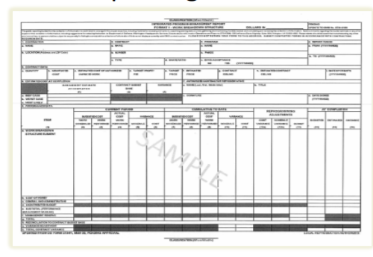
Reporting the OTB in the IPMR
Special reporting for an OTB
Blocks are included in the Integrated Program Management Report (IPMR) Format 1
Increased budget values are identified
Retains visibility of schedule and variance adjustments
Refer to DOE’s IPMR data item description
Notes:
Special reporting is required for an OTB project via the Contract Performance Report or Integrated Program Management Report, whichever is on contract. Format 1 is used to reconcile the increased budget values to the CBB. Any pertinent details on the reporting of the OTB will be included in Format 5.
As we discussed previously in step 6 of the OTB process, there are several ways to adjust the variances. Although the variances may have been re-set in the OTB process, visibility of the variance adjustments is retained in the CPR or IPMR. If the contractor uses a portion of the additional budget to adjust or eliminate variances applicable to completed work, the adjustments made to the cost and schedule variances are also shown in Format 1.
For more information on reporting an OTB, refer to DOE’s Data Item Description for the IPMR.

Slide 12
Post OTB Expectations
Executable and achievable baseline plan
Management Reserve budget pool
Renewed “Buy-In”
Meaningful Performance Indicators
Restored Confidence
Notes:
The OTB and or OTS route is a significant amount of work, so it should be carefully considered. What is the goal versus what is the cost? The ultimate goal of the process is improved project management control. The contractor should once again have an executable and achievable integrated scope, schedule, and resource baseline plan to work with and from which to measure performance.
The contractor PM will re-establish an adequate pool of MR budget that is based on a thorough analysis of the risk in the remaining work. An adequate amount of MR is essential in order to maintain the integrity of the PMB as any risks in the remaining work are encountered.
An OTB and/or OTS should result in a common understanding between all stakeholders of the remaining effort and resources required to complete the work. The CAMs, IPT leaders and members, PM, corporate leadership, and DOE will have a renewed buy-in to the OTB project baseline plan.
As work is accomplished according to the new baseline plan, a more credible schedule, along with more accurate estimates, will provide the basis for more reliable performance indicators as measured against the OTB project plan.
Ultimately, all parties should have renewed confidence in the baseline that is established for the remainder of the effort. This confidence should extend to the resulting analysis as the post-OTB indicators begin to establish new and reliable performance variance trends. Although the cost and schedule projections may be outside the bounds of the negotiated contract envelope, they represent a more credible basis for predicting the funds required for continuing the project.

Slide 13
For additional information, please browse our library at the following Project Management Earned Value Management websites.
External:
https://www.energy.gov/projectmanagement/services-0/earned-value-management
Internal:
https://community.max.gov/display/DOEExternal/PM+EVM+Guidance
13
Notes:
For additional information relative to EVMS procedures, templates, helpful references, more Snippets, and training materials, please refer to DOE PM’s external EVM Home page or the internal Max.Gov PM Library. Check back periodically for updated or new information.
Thank You for using the Snippet Library.

