Slide 1

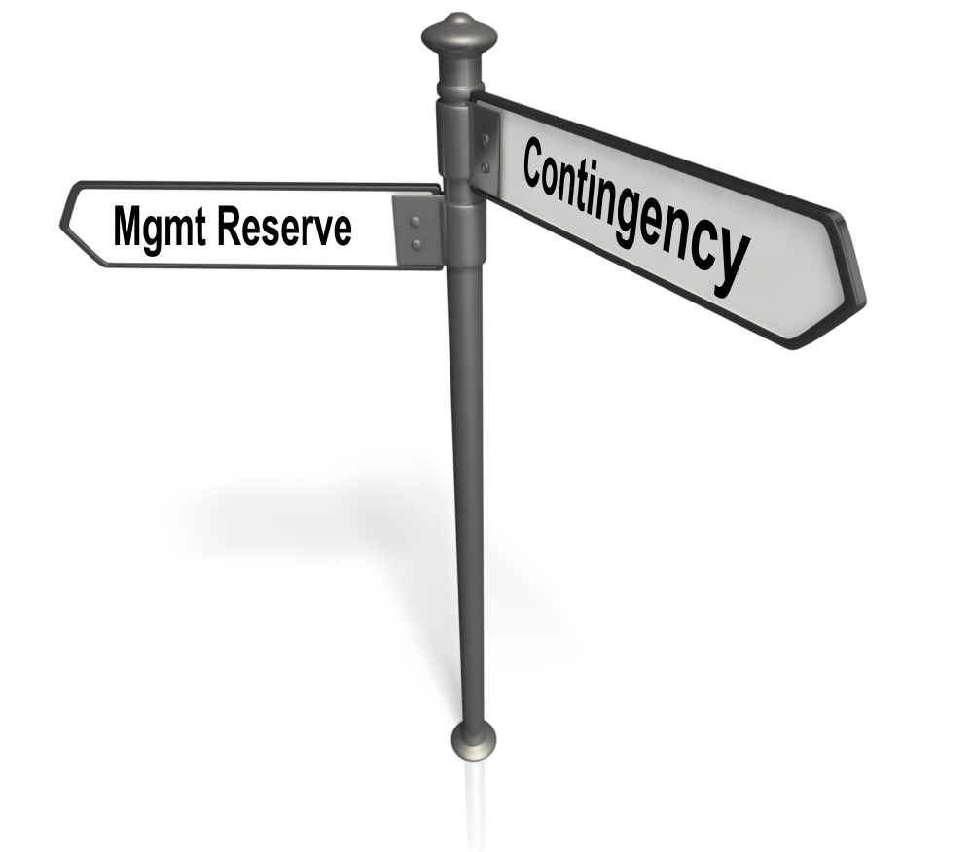
Snippet 6-3A:
Concepts of Management Reserve vs. Contingency
U.S. Department of Energy
Office of Project Management (PM)
Notes:
This EVMS Training Snippet, sponsored by the Department of Energy’s Office of Project Management is the first of two Snippets regarding Management Reserve or MR versus Contingency. The purpose is to provide a common understanding within DOE and among DOE contractors, and to provide consistency.
Snippet 6-3A is a discussion of Management Reserve and Contingency concepts, purposes, and uses. Snippet 6-3B provides detailed scenarios of how normal project changes impact the performance measurement baseline, management reserve, projected variances at completion, and DOE contingency.

Slide 2

Notes:
The difference between Management Reserve and DOE-Held Contingency can be confusing. They are not the same, nor do they equal each other. This Snippet will explain their similarities and their distinctly different purposes.

Slide 3
Management Reserve and Contingency
Both Management Reserve and Contingency are used to allow for adjustment in the Resources used in the execution of a Project.
While they may be similar at a high level, they differ significantly on a few important points:
Classification: Budget vs. Funding
Use: Adjusting Scope vs. Covering Costs
Limit: Total Allocated Budget vs. Total Project Cost
This Snippet will expand on the differences between these two resources, and the uses of each.
Control: Contractor vs. DOE
Notes:
Management Reserve, or MR, and Contingency are both tools used on DOE contracts to adjust the resources used in the execution of a project.
However, these tools have some significant differences. MR is controlled by the contractor while Contingency by DOE. MR is considered an element of the contractor’s budget, while Contingency a source for funding by DOE.
MR is primarily used to adjust scope at the control account level within a contract without any change in the contract level scope, while Contingency is used by the DOE to cover project cost overruns and fund contractual changes within the Performance Baseline, or PB, scope, schedule, and cost. The amount of MR budget held by a contractor is limited by the contract’s Total Allocated Budget, while the amount of Contingency funding is limited by the DOE Total Project Cost.
This Snippet will expand on the differences between these tools and the uses of each.

Slide 4
Basic Definitions
Management Reserve is the Contractor’s Budget for Management Control purposes
Part of the Contract Budget Base or Project Budget Base¹ and traces to the Performance Measurement Baseline when applied
Contingency is a DOE Funding Source for changes within the project’s PB scope, schedule, and cost
Can be applied to FUND contractual changes
Can be applied as FUNDS to pay the bill, i.e. cost reimbursement type overruns
¹ Refer to Snippet 1-11 Varying Project and Contract Structures or the DOE EVMS Gold Card for information relative to the relation of the Contract Budget Base (CBB) and Project Budget Base (PBB).
Notes:
Before we dive into the details of these concepts, we will provide some top-level definitions of each.
Management Reserve is the Contractor’s Budget for Management Control Purposes. This budget is a part of the Contract Budget Base or Project Budget Base and is applied to the Performance Measurement Baseline when authorized internal changes are made. Refer to Snippet 1-11 entitled Varying Project and Contract Structures or the DOE EVMS Gold Card for information relative to the relation of the Contract Budget Base (CBB) and the Project Budget Base (PBB).
Contingency is the DOE’s funding source for unforeseeable costs within a project. It may be applied to fund contractual changes within the project’s Performance Baseline scope, schedule, and cost, and it may be applied to pay the bill for overruns on Cost Reimbursement type contracts. DOE is responsible to reimburse the contractor for all allowable costs up to the cost and funding limits established in the contract in accordance with FAR Clause 52.232-18, Limitations of Cost, for any fully funded cost-reimbursement contracts and 52.232-22 Limitations of Funds clause, as applicable for incrementally funded cost reimbursement contract.

Slide 5
Performance Baseline Components
Performance Baseline (PB)
[Total Project Cost (TPC)]
Color Key
DOE
Contractor
Contract Price
(CP)
DOE Other Direct
Project Costs
Contingency
Notes:
The graphic on this chart will provide a context in which to understand the components of the Performance Baseline, or PB. Those elements in light blue are controlled by the DOE and the elements in grey by the contractor. Starting at the top, the Performance Baseline represents the Total Project Cost for DOE. This is broken down to three elements: DOE-held Contingency, the Contract Price issued to the contractor, and DOE-held reserves for Other Direct Project Costs.

Slide 6

Performance Baseline Components
Performance Baseline (PB)
[Total Project Cost (TPC)]
Contract Price
(CP)
DOE Other Direct
Project Costs
Contingency
Color Key
DOE
Contractor
Total Allocated Budget (TAB) =
Contract Budget Base (CBB) or Project Budget Base (PBB) + Over Target Baseline (OTB)
Management Reserve (MR)
Performance Measurement Baseline (PMB)
Notes:
The Contract Price, issued to the Contractor, is comprised of two different components; the Profit or Fee, and the Total Allocated Budget, or TAB. The TAB equals the Contract Budget Base unless an Over Target Baseline has been declared and approved. The contractor then takes the TAB (or CBB or PBB when no OTB exists) and breaks it down into Management Reserve, or MR, and the Performance Measurement Baseline, or PMB.

Slide 7
Performance Baseline Components
Performance Baseline (PB)
[Total Project Cost (TPC)]
Contract Price
(CP)
DOE Other Direct
Project Costs
Contingency
Total Allocated Budget (TAB =
Contract Budget Base (CBB) or Project Budget Base (PBB) + Over Target Baseline (OTB)
Color Key
DOE
Contractor
Management Reserve (MR)
Performance Measurement Baseline (PMB)
Summary Level Planning Packages (SLPPs)
Control Accounts
(Distributed Budget)
Undistributed Budget (UB)
Work Packages (WPs)
Planning Packages (PPs)
Notes:
This Snippet does not focus on the components of the PMB, rather here we focus on the TAB which is the level at which budget is managed by the contractor.

Slide 8

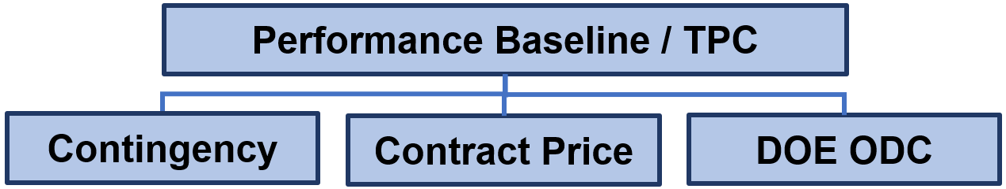
DOE Contingency
  Owned by DOE
  Held outside the project scope, schedule and budget negotiated values, i.e. the Total Allocated Budget
  Used to:
    Ensure that adequate funds are available to pay for all project work
      Tracks to the Estimate at Completion
      Authorized overruns beyond the Contract Target Cost
      Incremental FY funding
    Pay for contract Scope Changes, i.e. additions to the statement of work, authorized via contract modifications which are within the PB scope
      Funding as part of the Contract Target Cost
      Converted by the contractor to budget when added to the CBB or PBB
Notes:
We will start with an explanation of Contingency, which is a cost reserve owned by the customer, in this case the DOE. It is held outside the project scope, schedule, and budget that have already been provided to the contractor. On the performance baseline components chart recall that Contingency was shown above the Total Allocated Budget.
The contingency is the source for additional funding. DOE must ensure adequate funds are available to pay for all completed contractual work scope. It tracks to the estimate at completion, which represents the best estimate for the final cost of the project, plus profit, fees, and Other Direct Costs. Contingency funds are used to pay for overruns. DOE can also use the contingency as funding to increase the Contract Target Cost with budget and within-scope modifications to the current project statement of work. In this case, after receipt of the contract modification, the contractor adds the budget for the change to the Contract Budget Base or Project Budget Base.

Slide 9
DOE Contingency
Pay the bill
  Project scope requirements
    Original Statement of Work (SOW)
    Changes and/or additions to the SOW
  Contractor overruns
    SOW did not change; it just costs more than the contractor’s estimate
Notes:
Remember that the government has to have funding to pay the bill for the project scope requirements. The government also has to ensure that any changes or additional project scope have sufficient funding available. Should the contractor incur cost overruns, the contingency is available as funding to cover those allowable, actual costs.

Slide 10
DOE Contingency
M&O (Management and Operating) vs. Non-M&O Contracts
  Under a non-M&O contract, contingency is held by DOE outside the contract, thus requiring specific contract action to place and use on contract
  Under an M&O contract arrangement, all available funds, including contingency, may be available on contract, thus NOT requiring specific contract action to place on contract…However DOE approval is required for contingency use
    Contingency must be held above the project level CBB or PBB
    Specific controls must be established between DOE and the contractor to prevent use of contingency until authorized by DOE
    MR belongs to, and is managed and approved for use, by the Contractor PM
Notes:
The requirements of MR, contingency, budget, and funds must be consistently established and followed. The process is very similar whether the project is executed under either an M&O or non-M&O contract, even though significant differences may exist in contract funding mechanisms between M&O and non-M&O contracts.
For example, while under a non-M&O contract, contingency is held by DOE outside the contract and specific contract action must be taken to place and use contingency on contract, under an M&O contract arrangement, all available funds, including contingency, may be available on contract, thus NOT requiring specific contract action to place on contract. Nonetheless, specific, written DOE approval must still be obtained for any contingency use. Specifically, contingency must be held by the M&O above the project level CBB or PBB, and explicit controls must be established between DOE, the M&O contractor management, and the project-level PM for use of any contingency.
The contract Project Managers are responsible for establishing and managing the MR. Approval for MR use outside the contractor PM is not required.

Slide 11
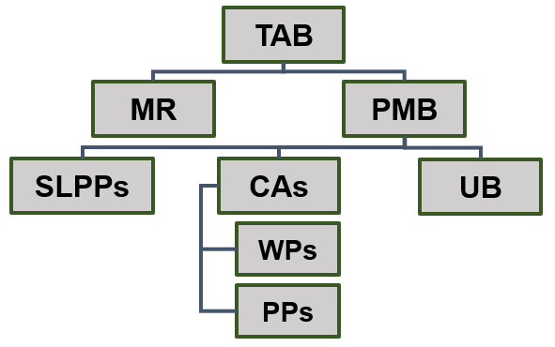

Management Reserve (MR)
Definition
  An amount of the total contract or project budget set aside for management control purposes by the contractor
Purpose
  Owned by the Contractor for unexpected growth within the currently authorized work scope, rate changes, risk and opportunity handling, and other project unknowns
  Applied for future needs
  Cannot be used to offset accumulated variances (overruns or under runs)
  Cannot be eliminated from prices during subsequent negotiations or used to absorb the cost of contract scope changes
Notes:
Let’s switch to management reserve, or MR. It is an amount of the total budget set aside by the contractor from the TAB for management control purposes.
The purpose of management reserve is to have budget that can be applied due to unexpected growth within the currently authorized work scope, rate changes, risk handling, and other project unknowns. It is used to budget future internal needs but it may not be used to ‘pad the future’ to offset previously accumulated overruns or under runs. When the prime contractor is negotiating with the government customer, MR is typically not separately identified, and once it is identified, it cannot be eliminated from pricing during subsequent negotiations or used to absorb the cost of project level scope changes.

Slide 12
Establishing MR
The value of the MR budget is at the discretion of the contractor’s project management.
The MR establishment process should be supported by the identification of project risks during the initial baselining process.
It is anticipated that projects with greater risks and unknowns will start with a larger value of MR.
The substantiation of risks for the establishment of MR should not be confused with the intent to expend MR for that purpose.
MR is a budget without specific scope associations. All identified contractually authorized scope must be budgeted in the Performance Measurement Baseline.
Notes:
The MR budget is initially established during the early baselining period after contract authorization. While the value of the MR budget is at the discretion of the contractor’s project management team, the process should be tied to the identification of project risks, and overall risk levels, identified. It is anticipated that projects with greater risk and unknowns will have a larger reserve budget.
However, there is no requirement that the application of the MR will be limited to the identified risks. In fact, if a contractor does this it may be an indication that well-defined and probable scope has been left out of the baseline. MR is a budget without specific scope assumptions. All contractually authorized scope must be held in the Performance Measurement Baseline and distributed to Control Account Managers in a timely manner.

Slide 13
Allowed Uses of MR
  Previously unrecognized tasks or realized risks consistent with the general scope of work of the contract
  Change in execution strategy (e.g., make/buy decisions)
  Unexpected future internal scope growth within the currently authorized scope of the project
  Direct and indirect rate changes and currency fluctuations
  Risk and opportunity handling (not for cost or schedule variance- based risks)
  Activity that needs to be reworked (not the result of inaccurately reported progress)
  Changes to the future budget of work not yet started (e.g., subcontractor activities that are negotiated post project award)
Notes:
Generally, MR can be used by the contractor’s PM to plan or replan future effort not yet started for one or more of the following reasons:
It may be used for previously unrecognized tasks and identified risks that are consistent within the scope of work of the contract. All risks, unrealized and realized, are usually identified, quantified, and tracked through a risk register.
MR may be used for changes in execution strategy. An example would be a make or buy decision that is changed from the original baseline plan. This is an example of an assumption change that would be included in the approval documentation.
MR may be used for unexpected future internal scope growth within the currently authorized scope of the project,
MR may be used for changes in direct or indirect rates. Also included would be currency fluctuations.
MR may be used for risk and opportunity handling. However, allocating MR for Cost or Schedule Variance based risks is inappropriate.
MR may be used for work that needs to be repeated. However, it is not appropriate to be added as budget when the progress has been inaccurately reported.
MR may be used to change future budget for work not yet started. For example, the baseline may have been estimated prior to final negotiations of subcontractor work. MR may be used to increase the budget associated with final negotiations; however, not if the effort has begun.

Slide 14
Allowed Uses of MR
  Previously unrecognized tasks or realized risks consistent with the general scope of work of the contract
  Change in execution strategy (e.g., make/buy decisions)
  Unexpected future internal scope growth within the currently authorized scope of the project
  Direct and indirect rate changes and currency fluctuations
  Risk and opportunity handling (not for cost or schedule variance-based risks)
  Activity that needs to be reworked (not the result of inaccurately reported progress)
  Changes to the future budget of work not yet started (e.g., subcontractor activities that are negotiated post project award)
Except for Rate Changes, MR Transactions must be related to Control Account Scope Changes
Notes:
As a good rule of thumb, MR transactions must be related to the change in work scope at the Control Account Level. The only exception is for rate changes. MR can never be used to eliminate a performance driven variance.

Slide 15
MR Usage Guidance
For new work not yet planned and future needs not yet started, meaning performance has not been taken nor actual costs incurred.
Burden of proof is on the contractor to demonstrate it is an authorized use, and
  Applied beyond the freeze period, generally more than one month in the future; current period scope changes should be minimized, and urgency of need must be documented
  Not related to a current trend or cost variance
  Changes to existing, open, work packages is not preferred.
  Allocation of new scope to existing work packages should be executed by closing the current work package(s) and planning a new work package(s) with the added scope
Notes:
There are some guidelines for applying MR budget. It should be for new work which has not yet been planned or begun; meaning performance has not been taken and actual costs not incurred.
The burden of proof is on the contractor to demonstrate that MR use is legitimate and meets the requirements of internal procedures.
MR should be applied beyond the planning freeze period identified in the contractor’s system description; this is generally more than one month in the future. Current period scope changes should be minimized and any urgency of need must be documented.
If the MR budget allocation impacts an active existing work package or set of work packages, it is preferred that those affected work packages are closed, and replanned with the additional scope and budget in new work packages.

Slide 16
Harvesting MR
Example 1:
  Work Package Complete: BCWP = 100; ACWP = 90; Cost Variance = +10
  Cost Underrun
Example 2:
  Work Package Complete: BCWP = 100; ACWP = 110; Cost Variance = -10
  Cost Overrun
Harvesting: Term to describe transferring of positive cost variances on completed WPs to MR which is NOT ALLOWED
MR cannot be created by “Harvesting” underruns.
Notes:
We discussed earlier that MR cannot be used to offset accumulated variances (overruns or underruns). In the first example we see a completed work package with a cost variance of +10 which is a positive variance meaning that the WP had a cost underrun. Should a work package complete with a negative cost variance like the second example, then it is reported as a cost overrun.
EVMS does not allow transferring positive variances to completed work packages to MR for any use. That is referred to as Harvesting.
Cost metrics are reported as is. This is important to understand because it is from the variances that management can help predict and manage future performance. Therefore, the performance results, both favorable and unfavorable, must be retained throughout the life of the project to reflect how the budgeted scope for each work package was actually completed in terms of earned value and cost. This information aids management in predicting future performance.

Slide 17
Management and Control of MR
Management Reserve is the contractor’s budget
Contractor is responsible for management of MR throughout the life of the project
Contractor PM may or may not allocate MR based on the assessment of CAM impact and availability of MR remaining balance
Applications must be documented and traceable
Contingency cannot be used to replenish MR
MR balance cannot be negative
Notes:
MR is the contractor’s budget and it is the contractor’s responsibility to manage MR wisely for the risks over the life of the project. The contractor PM must ensure that MR will be used prudently during the life of the project. Depleting MR while there are significant project risks greatly increases the chances of a contract overrun, and is an early warning sign for a probable Over Target Baseline.
It is important to note that MR is never required to be allocated. MR allocation is subject to the PM’s approval based on the CAM’s definition of the requirement for new scope and any project impact, and whether any MR remains that is available for allocation.
It is important that MR be carefully controlled and monitored in formal records such as the MR and CBB or PBB Logs. These logs must be directly traceable to the CPR or IPMR with narrative explanations of MR use included in Format 5.
DOE Contingency cannot be used to replenish MR. MR cannot be allocated beyond what exists; in other words, the balance cannot be negative.

Slide 18
SUMMARY
Both Management Reserve and Contingency are tools used on DOE contracts to adjust the resources required for successful execution.
Management Reserve is the DOE Contractor’s tool, and is a budget used to make scope adjustments which change the budget of a control account without a corresponding change in Contract scope.
Contingency is DOE’s tool and is a funding source for both project cost performance, or overrun, and the addition of contractual scope within the Performance Baseline (PB).
Notes:
In summary, both MR and Contingency are tools used to adjust the resources as the project proceeds based on new information. They are required for successful execution of the Performance Baseline.
MR is considered the Contractor’s tool in that it is a budget reserve set aside for contractor management use. The MR can be applied due to unexpected growth within the currently authorized work scope, rate changes, risk handling, and other project unknowns. No contractual change is required for MR use.
Contingency is DOE’s tool and is a funding source for both project cost performance and for the addition of contractual scope within the project’s Performance Baseline.

Slide 19

For additional information, please browse our library at the following Project Management Earned Value Management websites.
External:
https://www.energy.gov/projectmanagement/services-0/earned-value-management
Internal:
https://community.max.gov/display/DOEExternal/PM+EVM+Guidance
19
Notes:
Please refer to Snippet 6-3B for information relative to MR and Contingency Scenarios. For additional information relative to EVMS procedures, templates, helpful references, more Snippets, and training materials, please refer to DOE PM’s external EVM Home page or the internal Max.Gov PM Library. Check back periodically for updated or new information.
Thank You for using the Snippet Library.

