Slide 1
PARS CPP Upload Document and DIDs
Current Versions:
  CPP Upload Requirements Version 3 – October 25, 2018
  IPMR DID – Version 2018 – October 25, 2018
  CFSR DID – Version 2018 – October 25, 2018
Under revision / update into one document
CPP Upload Requirements tied to DOE Order 413.3B
IPMR DID – reports due end of each month – tie to CPP Upload
CFSR DID – reports due with PARS uploads – when contractually required

Slide 2
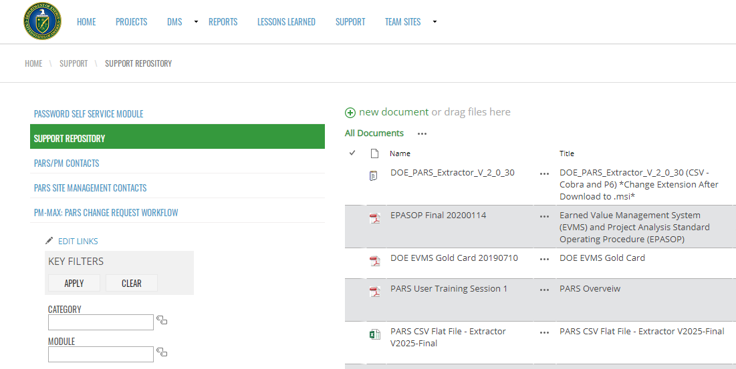

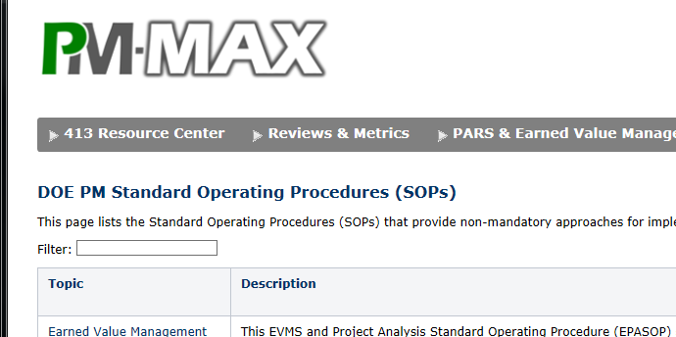
PARS CPP Upload Document and DIDs
Locations:
  PARS Support Library under Support Repository
  PM-MAX
    PARS and Earned Value Management
      About EVM
        Guidance

Slide 3
PARS CPP Upload Document and DIDs
Why Update!
  Add DOE Comma Separate Value - CSV format to the document (Flat file submissions)
  Consolidate three documents that are related into one
  Better describe how to load these documents into PARS
  Update requirements for IPMR Format 6 (native Schedule files)
  Make sure the relationship of IPMR Format 7 and PARS Upload is clearly understood
  Better delineate what is contractor and what is FPD upload requirements for project management life cycle (CD-0 to CD-4 and Closeout)
  Move to table format which may be easier to read

Slide 4
PARS CPP Upload Document and DIDs
When EVM requirements of DOE O 413.3 are applicable, formats 1-7 are required.
What to submit and to where:
IPMR Format 1-5 to PARS Document Management System (DMS) each month for the Project (not contract)
IPMR Format 6 – as required (program may require monthly)
IPMR Format 7 – PARS CSV / MDB data upload each month into PARS
CFSR to PARS DMS as required by contract
Future Goals:
  Move Format 5 to be part of IPMR Format 7
  Include data to support Format 3 and 4 as part of IPMR Format 7
Optional Additional Flat Files

Slide 5
PARS CPP Upload Document and DIDs
2.4.3 Flat Files in CSV Format
The following is the list of CSV flat files:
FF01 WBS - required
FF02 OBS - required
FF03 cost - required
FF04 schedule - required
FF05 schedule_logic - required
FF06 schedule_resource - required
FF07 IPMR_header - required
FF08 IPMR_F1 - required
FF09 IPMR_F2 - required
FF10 IPMR_F3 - reserved for future use and may be requested for EVMS reviews
FF11 CC_log - reserved for future use and may be requested for EVMS reviews
FF12 CC_log_detail - reserved for future use and may be requested for EVMS reviews
FF13 WAD – under development now for testing
FF14 CAM_VAR - reserved for future use and may be requested for EVMS reviews
FF15 VAR_CA_log - reserved for future use and may be requested for EVMS reviews
FF16 subKor_perf - reserved for future use and may be requested for EVMS reviews
FF17 IPMR_F4 - reserved for future use and may be requested for EVMS reviews
FF18 IPMR_F5 - reserved for future use and may be requested for EVMS reviews
FF19 risk_log - reserved for future use and may be requested for EVMS reviews
FF20 rates - reserved for future use and may be requested for EVMS reviews
FF21 forward_pricing - reserved for future use and may be requested for EVMS reviews
FF22 WBS_dictionary - reserved for future use and may be requested for EVMS reviews
FF23 HDV-CI - reserved for future use and may be requested for EVMS reviews

Slide 6
PARS CPP Upload Document and DIDs
2.4.6 Contractor System Descriptions (SD)
Contractor will provide a copy of the SD to DOE, placing a copy in PARS DMS. As updates are made, an updated version of the SD will be uploaded to the DMS. The SD, crosswalk, and process instructions will be placed in the contractor section of the DMS and if there are project specific items, in the project folder of DMS. In addition to the SD, the following supporting document shall be provided in the project file:
Flat file-to-source-crosswalk spreadsheet: Excel file with crosswalks of FF fields to the source fields.
Process instructions on how flat files are generated
Significant changes: Word file identifying notable data changes from prior submit, e.g., data structure, tools, multiple uploads, etc.

Slide 7
PARS CPP Upload Document and DIDs
2.4.8 EVMS Metrics
The FFs are the critical to generating the EVMS audit metric results. Metric definition are stored in ECRSOP appendix A. Automated tests in PARS report on these metrics or support manual and automated/manual operations.
• EVMS metrics may not address the metric intent completely; thus, all generated EVMS metric results need further review by user. Flags are a discussion point, not automatically a failure.
• Y determines the data set based on the count or sum of the stated primary field, and may not be applicable to all metrics.
• X is a subset of Y. Generate Y then X then threshold comparison values, i.e., work metric specification section 14 from "top-to-bottom."
• If the metric threshold is a percentage, X is the numerator and Y is the denominator.
Each EVMS metric is based on one of the following methods:
• automated = software tool generated
• automated/manual verification = automated requiring manual verification
• automated/manual = manually generated with software tool generated Y data set/listing
• manual = manually generated

Slide 8
PARS CPP Upload Document and DIDs
Technical Specifications
  3.1 – CSV File Submission
  3.2 – IPMR DID
  3.3 – CFSR DID
  3.4 – MDB File Submission (no update from 2017)

Slide 9
PARS CPP Upload Document and DIDs
Technical Specifications
  3.1 – CSV File Submission

Slide 10
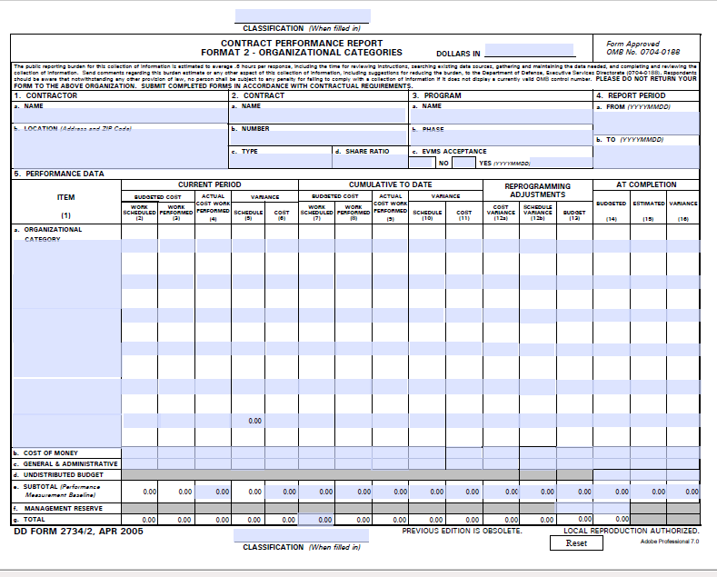
PARS CPP Upload Document and DIDs
Technical Specifications
  3.2 – IPMR DID
  Standard DOD forms with locally generated options possible
Instructions

Slide 11
PARS CPP Upload Document and DIDs
Technical Specifications
  3.3 – CFSR DID
  Standard DOD forms with locally generated options possible
Instructions

Slide 12
PARS CPP Upload Document and DIDs
Technical Specifications
  3.4 – MDB Upload Format
  Same as current CPP Upload Document – v3 October 25, 2018
  The Access file template is based on 2003 technology and will be phased out when operating systems can no longer can work with the technology or security requirements mandate. Projects currently reporting with the Access file format should consider the following,
    If finishing up in less than a year – remain in Access format, but recommend checking with DOE PM as to current stability and status.
    If more than a year remains – work to migrate to newer format.
    If approaching CD-2, start reporting using the CSV format.

Slide 13
PARS CPP Upload Document and DIDs
DOE Extractor
DOE CSV extractor – v 30 in PARS Support
  Supports EOC roll up to reporting level
  Fixes issues identified in use
  Adds option for Cost Files to be generated out side of extractor

Slide 14
PARS CPP Upload Document and DIDs
Time Line:
22 to 24 April 2020 - Internal review next week
27 April - Provide next week to EFCOG (via Lisa) for review and comment
Updated documents target release in May 2020

