Slide 1
EFCOG Project Controls Working Group Annual Meeting
Arizona State University (ASU) Joint EVMS Research Study Update
Mel Frank – Director
PM-30 Project Controls Division
September 20, 2021

Slide 2
EVMS Research – Initial (2019) Study Aims and Objectives
Elevate the worth and utility of the EVMS through unbiased scientific research encompassing survey questionnaires and the statistical analysis of contractors' performance data
Develop a tailorable EVMS Maturity Model inclusive of EIA-748 compliance requirements that can accommodate the unique missions, program and project types of the DOE, DoD, NRO, NASA, and other CFAs, as well as commercial ventures requiring disciplined scope, schedule, and cost management
EVMS is a powerful project management method that is implemented in aerospace, engineering and construction, telecommunications projects where participants have adopted EVM principles in different ways
An effective EVMS can position a project for success by meeting its technical and quality objectives on budget and on schedule
Develop a weighted EVMS Maturity Score that provides insights into implementation risks and opportunities
As FICO® scores are calculated from many different pieces of credit data in an individual’s credit report, an EVMS Maturity Score can reflect the importance of a management process or attribute, individually or collectively during the planning and execution of a project

Slide 3
EVMS Research – Initial (2019) Study Problem Statement
A major obstacle to obtaining full benefit from the EVMS is the lack of a common definition for its application across diverse work scopes and consideration of environmental factors in its implementation
A major obstacle for genuinely implementing the EVMS is the stigma that it is more of a regulatory burden where costs outweigh benefits rather than a necessity for managing dynamic work scopes

Slide 4
What are the most challenging aspects of managing a project/program using the Earned Value Management System (EVMS) (top three ranked)
Notes:
updated

Slide 5
EVMS Research – Correlative Study (FEED MATRS)
EVMS Research Study will result in a method to assess the maturity of management processes and attributes which comprise the EVMS and the environment factors in which the EVMS operates
Define the attributes of an effective EVMS at various maturity stages
Define the key enablers and barriers to the effectiveness of the EVMS
EVMS Research Study will leverage the Construction Industry Institute’s (CII) Front End Engineering Design (FEED) Maturity and Accuracy Total Rating (MATRS) methodology as a guide for its work
CII PDRI consists of 46 engineering design elements and 27 accuracy factors that generates two separate scores: a maturity score and an accuracy score
The FEED MATRS methodology lays the foundation for predictable and efficient project delivery through better Front End Planning (FEP), and has been a CII Best Practice for over 24 years resulting in project cost savings and project schedule reductions

Slide 6
EVMS Research – CII’s FEED MATRS
(Best)
6% ABOVE
BUDGET
2 %
BELOW
BUDGET
24%
22% ABOVE
BUDGET
(Best)

Slide 7
RESEARCH TEAM MEETING August 17, 2021
Integrated Project/Program Management (IP2M) Maturity and Environment Total Risk Rating (METRR) using EVMS, formerly known as EVMS Maturity and Environment Total Rating (EVMS METR)

Slide 8
Joint Government and Industry Team
Team Member | Organization
Vartenie Aramali | Arizona State University
Elizabeth Betsy Ballard | Tecolote Research
Amy Basche | Mission Support Alliance
Ivan Bembers | National Reconnaissance Office
Danielle A. Bemis | U.S. Department of Defense - DCMA
Caitlin O'Grady | U.S. Department of Defense
Thomas P. Carney | Lockheed Martin
Mounir El Asmar, PI | Arizona State University
Jon Fleming | National Aeronautics and Space Administration
Mark Frampton | National Reconnaissance Office
Melvin Frank | U.S. Department of Energy
G. Edward Gibson, PI | Arizona State University
Jonathan de Guzman | Booz Allen Hamilton
Wayne A. Harris | Tech Source
Craig T. Hewitt | Washington River Protection Solutions
David Kester | U.S. Department of Energy
Kristen Kehrer | National Aeronautics and Space Administration
Team Member | Organization
Jeffrey King | Northrup Grumman
Derek D. Lehman | Washington River Protection Solutions
Doug Marbourg | Los Alamos National Laboratory
Ben Pina | U.S. Department of Energy - NNSA
John C. Post | Jacobs
Garrett Richardson | U.S. Department of Energy
Russel W. Rodewald | Raytheon Corp
Hala Sanboskani | Arizona State University
Paul J. Sample | CACI International Inc.
Vaughn M. Schlegel | Lockheed Martin
Anthony W. Spillman | Washington River Protection Solutions
Robert Sudermann | FLUOR
David Tervonen | U.S. Department of Defense
Tristan Walters | Sandia National Laboratories
William G. Weisler | U.S. Department of Defense - DCMA
Mathew Z. (Zac) West | U.S. Department of Energy
DCMA: Defense Contract Management Agency
NNSA: National Nuclear Security Administration

Slide 9
The tool name changed
Tool was originally called EVMS Maturity and Environment Total Rating (EVMS METR), pronounced “EVMS meter”
Changed the tool name to “Integrated Project/Program Management (IP2M) Maturity and Environment Total Risk Rating (METRR) using EVMS”, pronounced “IPM meter”
Reasoning:
More representative of the already existing integrated management framework of EVMS for projects and programs (e.g., integration of systems and processes, risk management, subcontract management, etc.)
More broadly acceptable to project/program managers that simplifies and democratizes EVMS.

Slide 10
Progress to Date
05/08/19 Team kick-off
12/31/19 Completed literature review; conducted and analyzed survey of 294 experts
06/30/20 Developed Maturity and Environment draft assessments
Jul-Sep 2020 EVMS Environment Workshops #1,2,3,4
Jul-Nov 2020 EVMS Maturity Workshops #1,2,3,4
Aug-Nov 2020 Addressed Environment comments and developed factor weights
12/08/20 Finalized the EVMS Environment Assessment
01/21/21 Software taskforce kickoff
Dec 2020-Feb 2021 Addressed Maturity comments and developed attribute weights
Apr-Aug 2021 Data collection performance workshops 1, 2, 3, 4 and in-progress workshops
Aug 2021-Jan 2022 Software development
09/15/21 Finalize performance analysis
10/31/21 Finalize publications
11/01/21 Start training
01/31/22 Software testing completion
12/31/22 NCE project completion

Slide 11
Overview of IP2M METRR Workshops
Date: | 9-Jul 2020 | 5-Aug 2020 | 5-Nov 2020 | 17-Nov 2020 | Total:
Workshop: | Maturity 1 | Maturity 2 | Maturity 3 | Maturity 4
# of Participants* | 12 | 13 | 13 | 18 | 56
Average years of EVM experience: | 19.5
Date: | 16-Jul 2020 | 12-Aug 2020 | 10-Sep 2020 | 15-Sep 2020 | Total
Workshop: | Environment 1 | Environment 2 | Environment 3 | Environment 4
# of Participants* | 9 | 11 | 13 | 14 | 47
Average years of EVM experience | 19.1
Date: | 8 April 2021 | 19 May 2021 | 2 June 2021 | 10 Aug 2021 | Total
Workshop: | Performance 1 | Performance 2 | Performance 3 | Performance 4
# of Participants (# of projects)* | 14 (11) | 6 (5) | 15 (11) | 21 (6) | 56 (33)
Average years of EVM experience | 19.9
* + 5 (ASU team and Mel Frank)
A total of 12 workshops
A total of 136 data sets collected
Adjudicated over 1500 comments

Slide 12
Participants in the 12 Workshops (unique)
Early Results, use with caution
Respondents’ avg. years of EVM experience | 19.9

Slide 13
Core processes typically make up an Earned Value Management (EVM) system. The top three ranked in terms of its impact on EVMS effectiveness.
N=276
Notes:
updated

Slide 14
Maturity Attributes and Weightings
www.energy.gov/projectmanagement/articles/ip2m-metrr-asu-evms-study
PM EVMS IP2M METR - Dept of Energy-External - MAX Federal Community

Slide 15
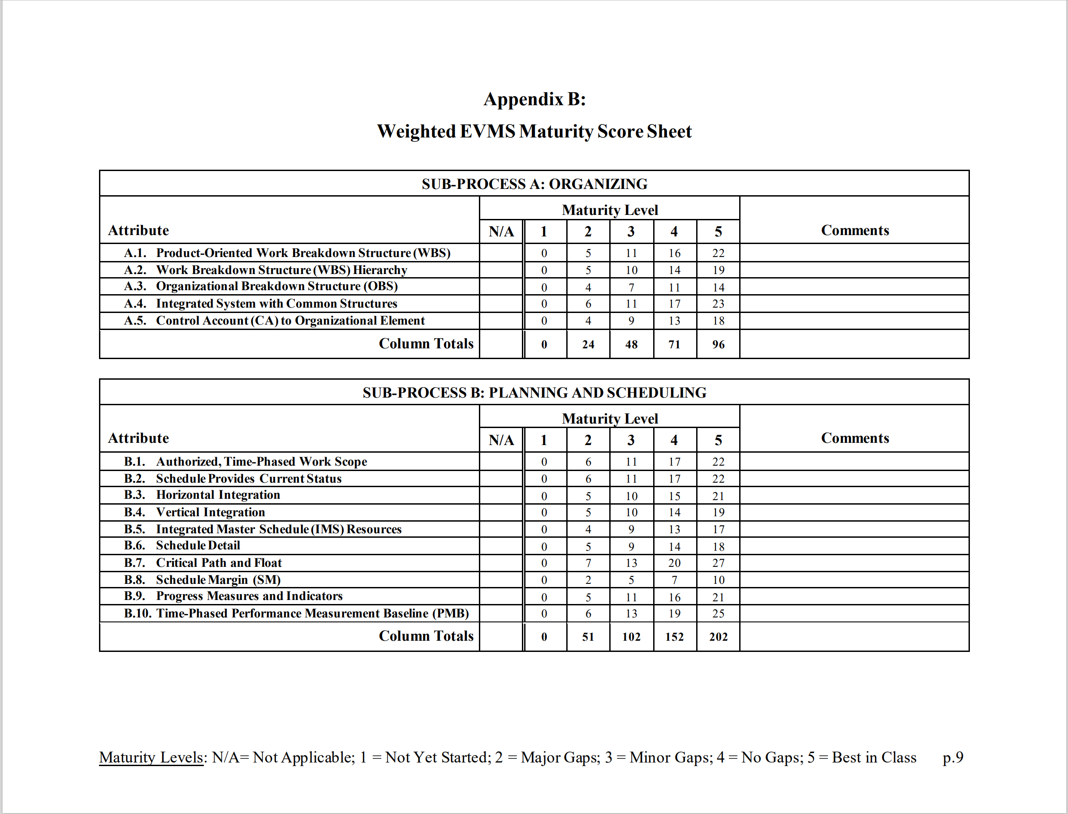
Maturity Attributes and Weightings (Cont.)

Slide 16
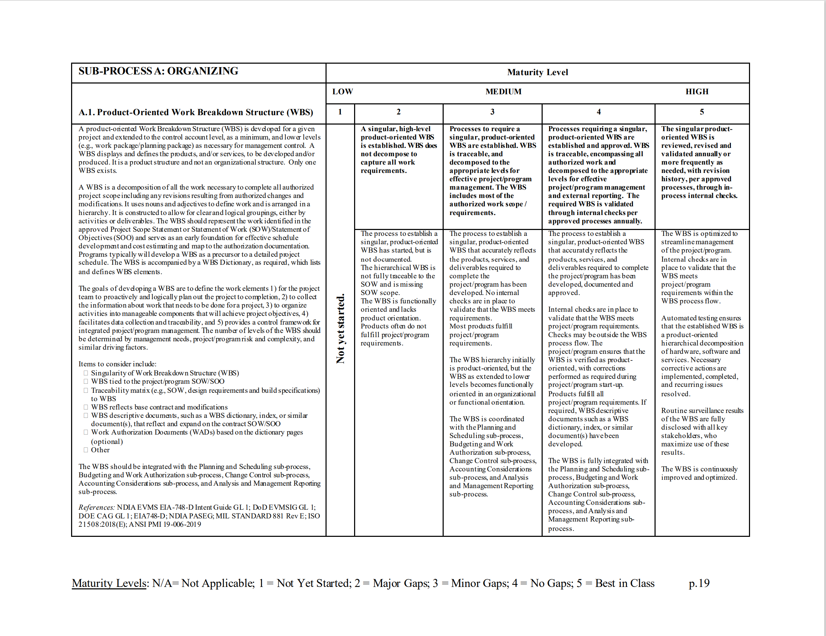
Maturity Attributes and Weightings (Cont.)

Slide 17
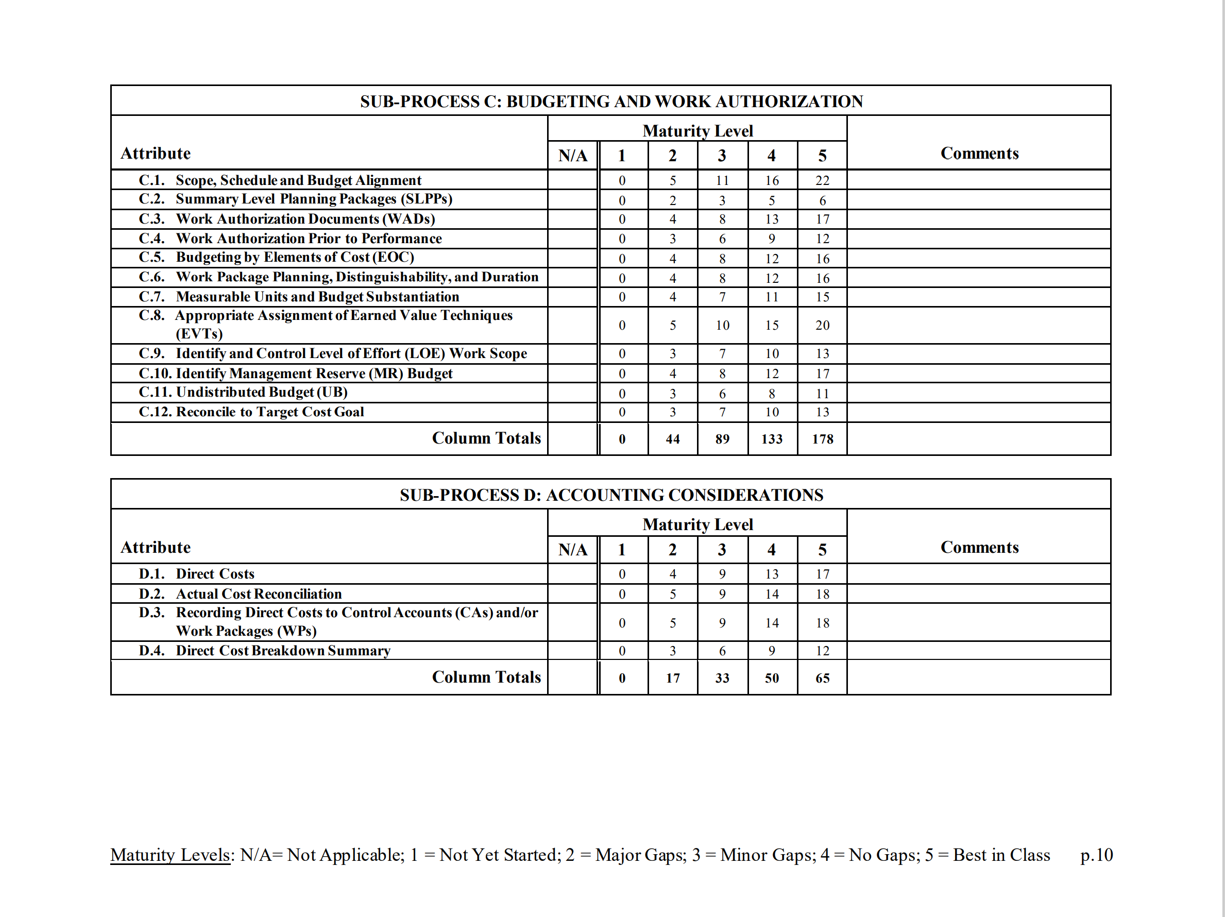
Maturity Attributes and Weightings (Cont.)

Slide 18
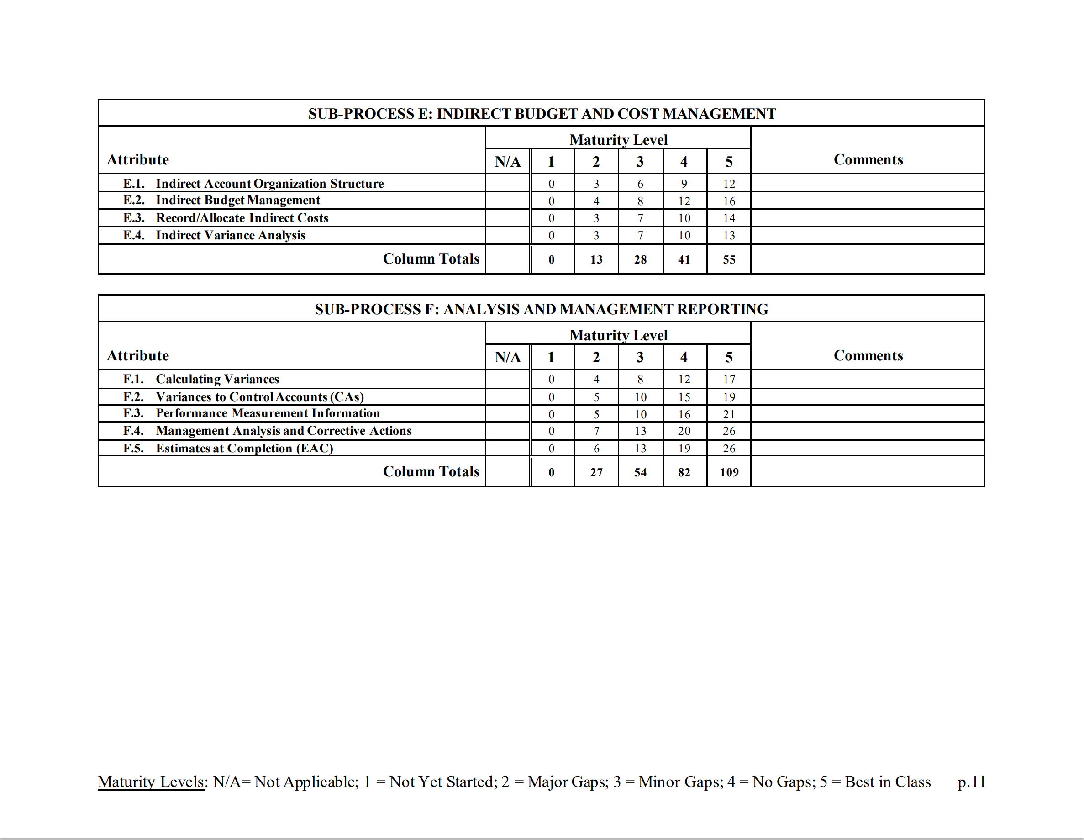
Maturity Attributes and Weightings (Cont.)

Slide 19
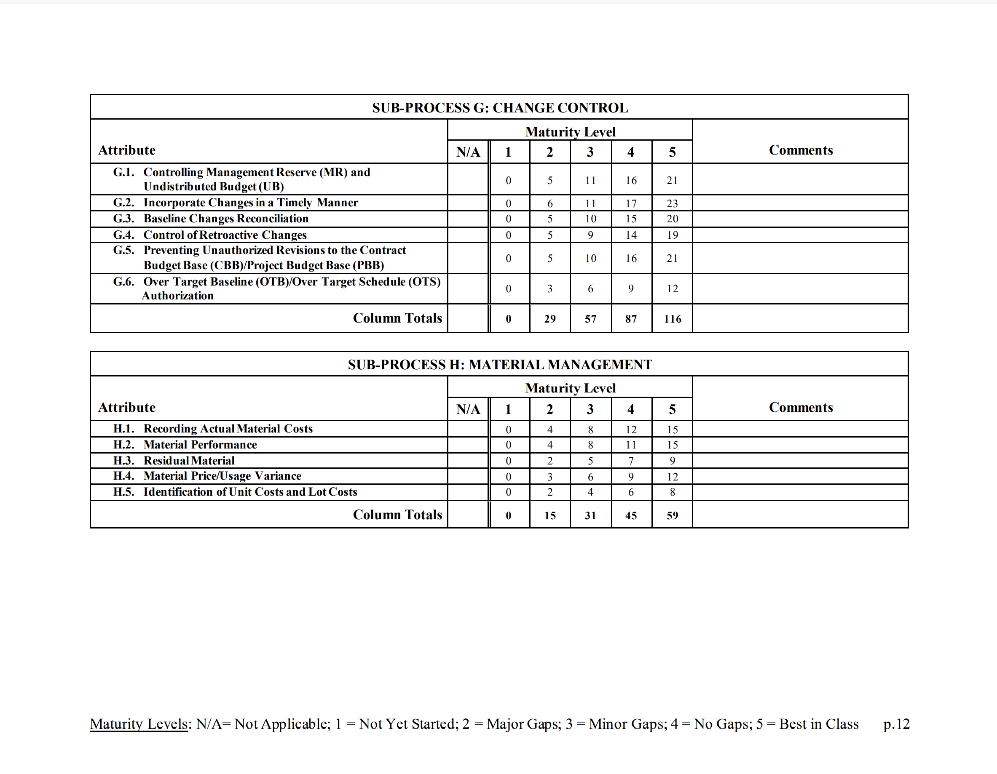
Maturity Attributes and Weightings (Cont.)

Slide 20
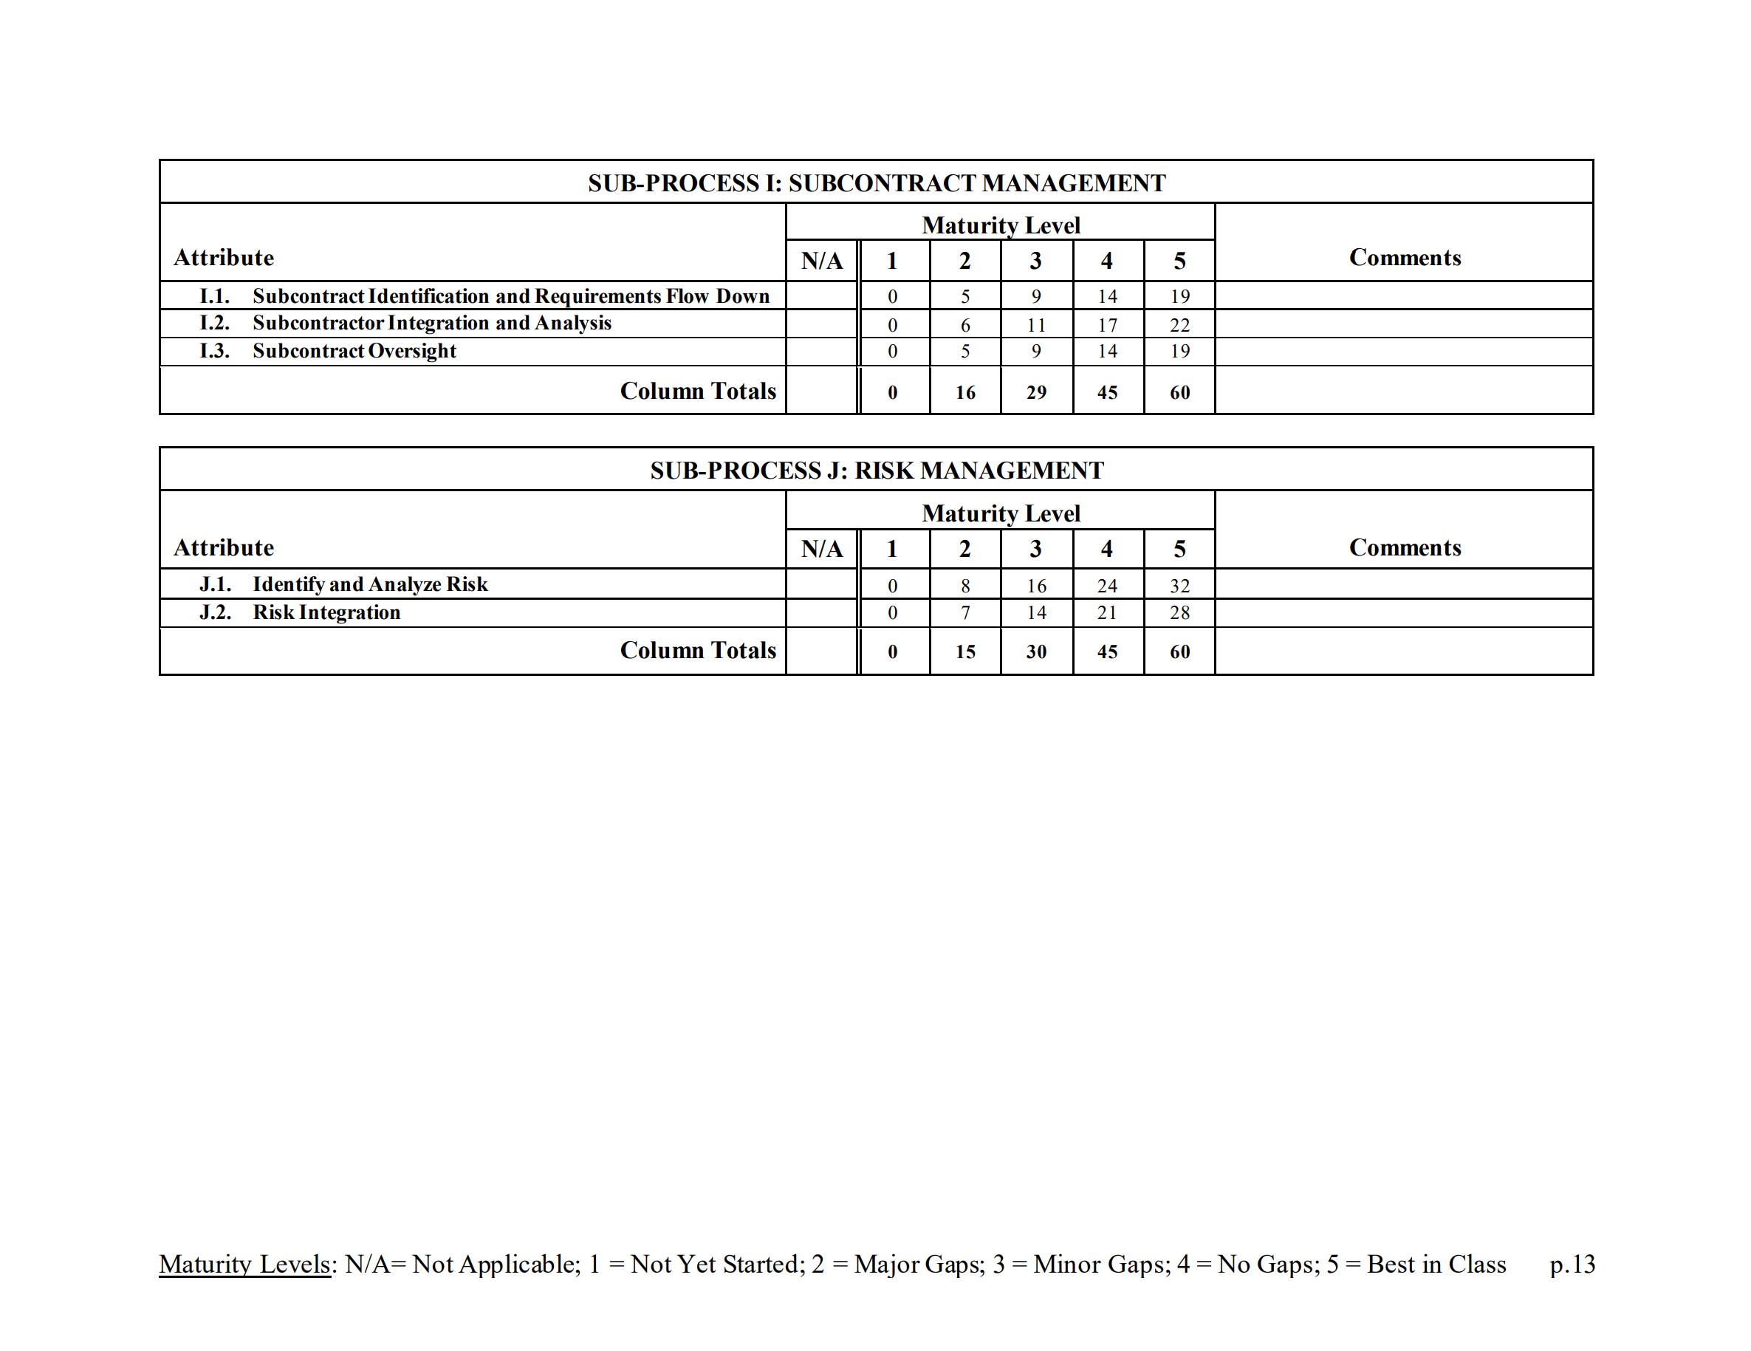
Maturity Attributes and Weightings (Cont.)

Slide 21
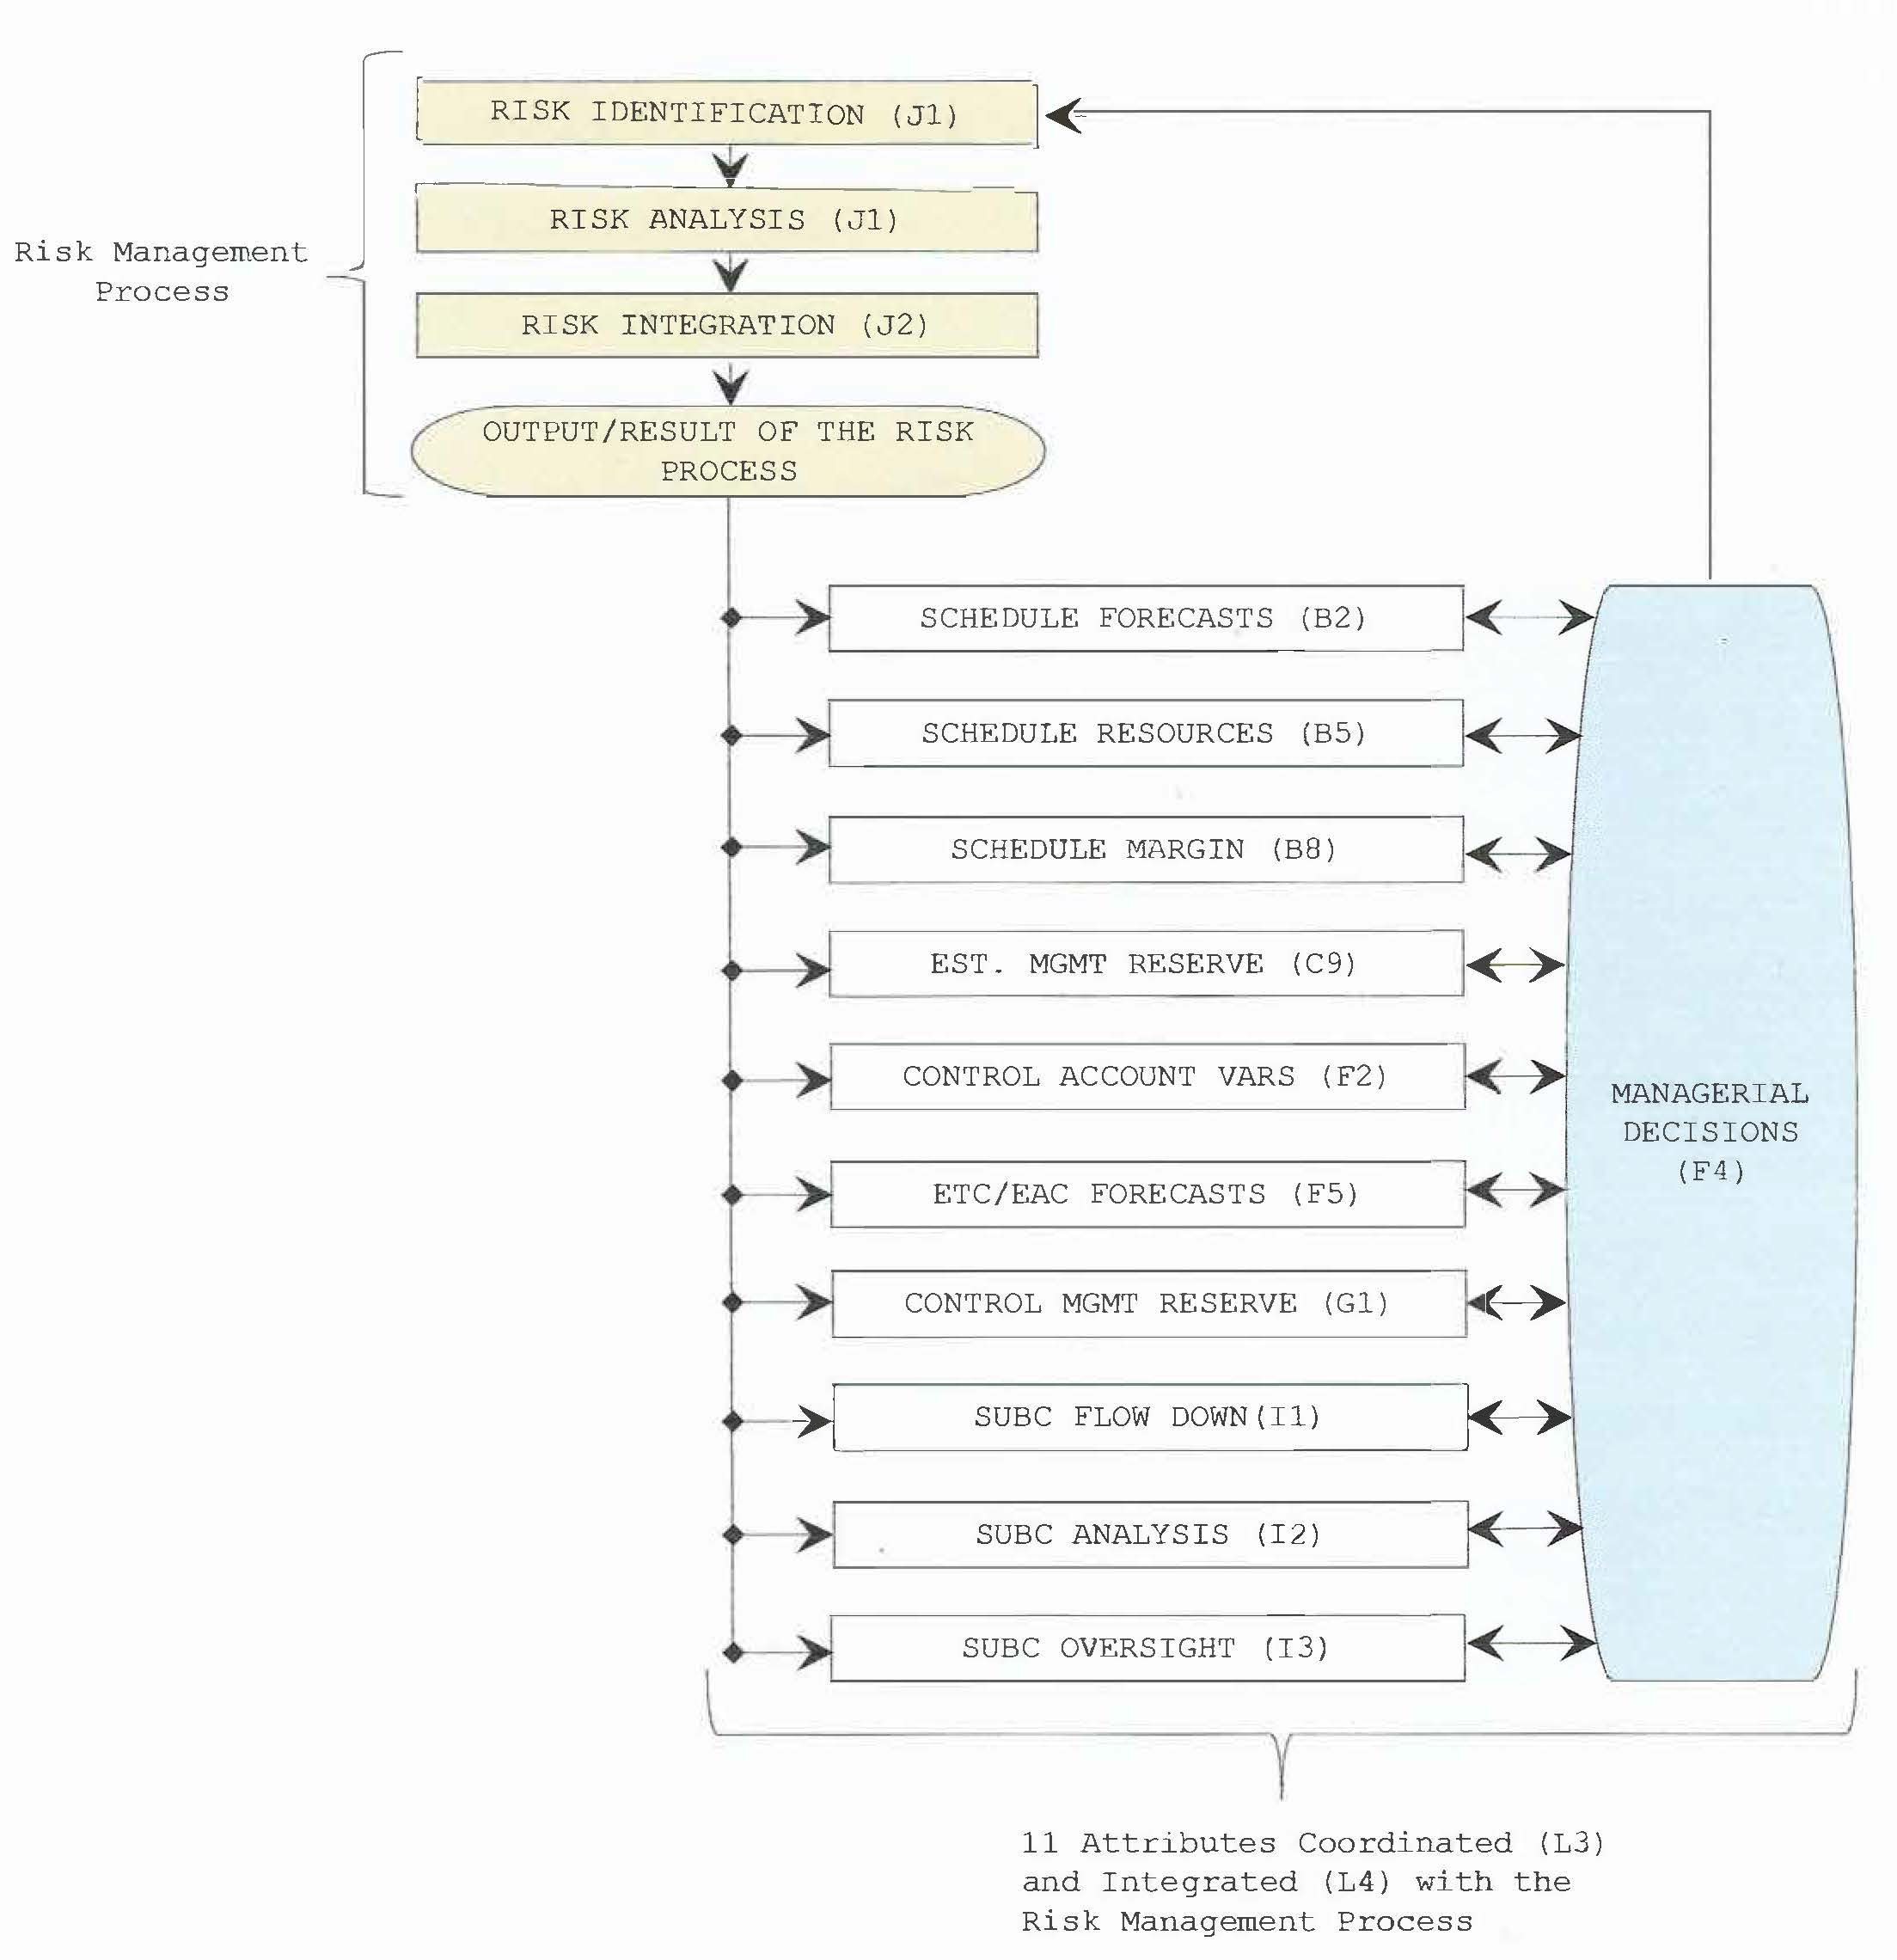
Risk Management

Slide 22
EVMS Environment Factors, the second dimension
Factors that influence the degree of confidence in the outputs of the EVM system, associated processes, and deliverables that serve as a basis for effective program/project management and decision making.

Slide 23
Factors impacting the Environment of Earned Value Management (EVM) systems
Notes:
updated

Slide 24
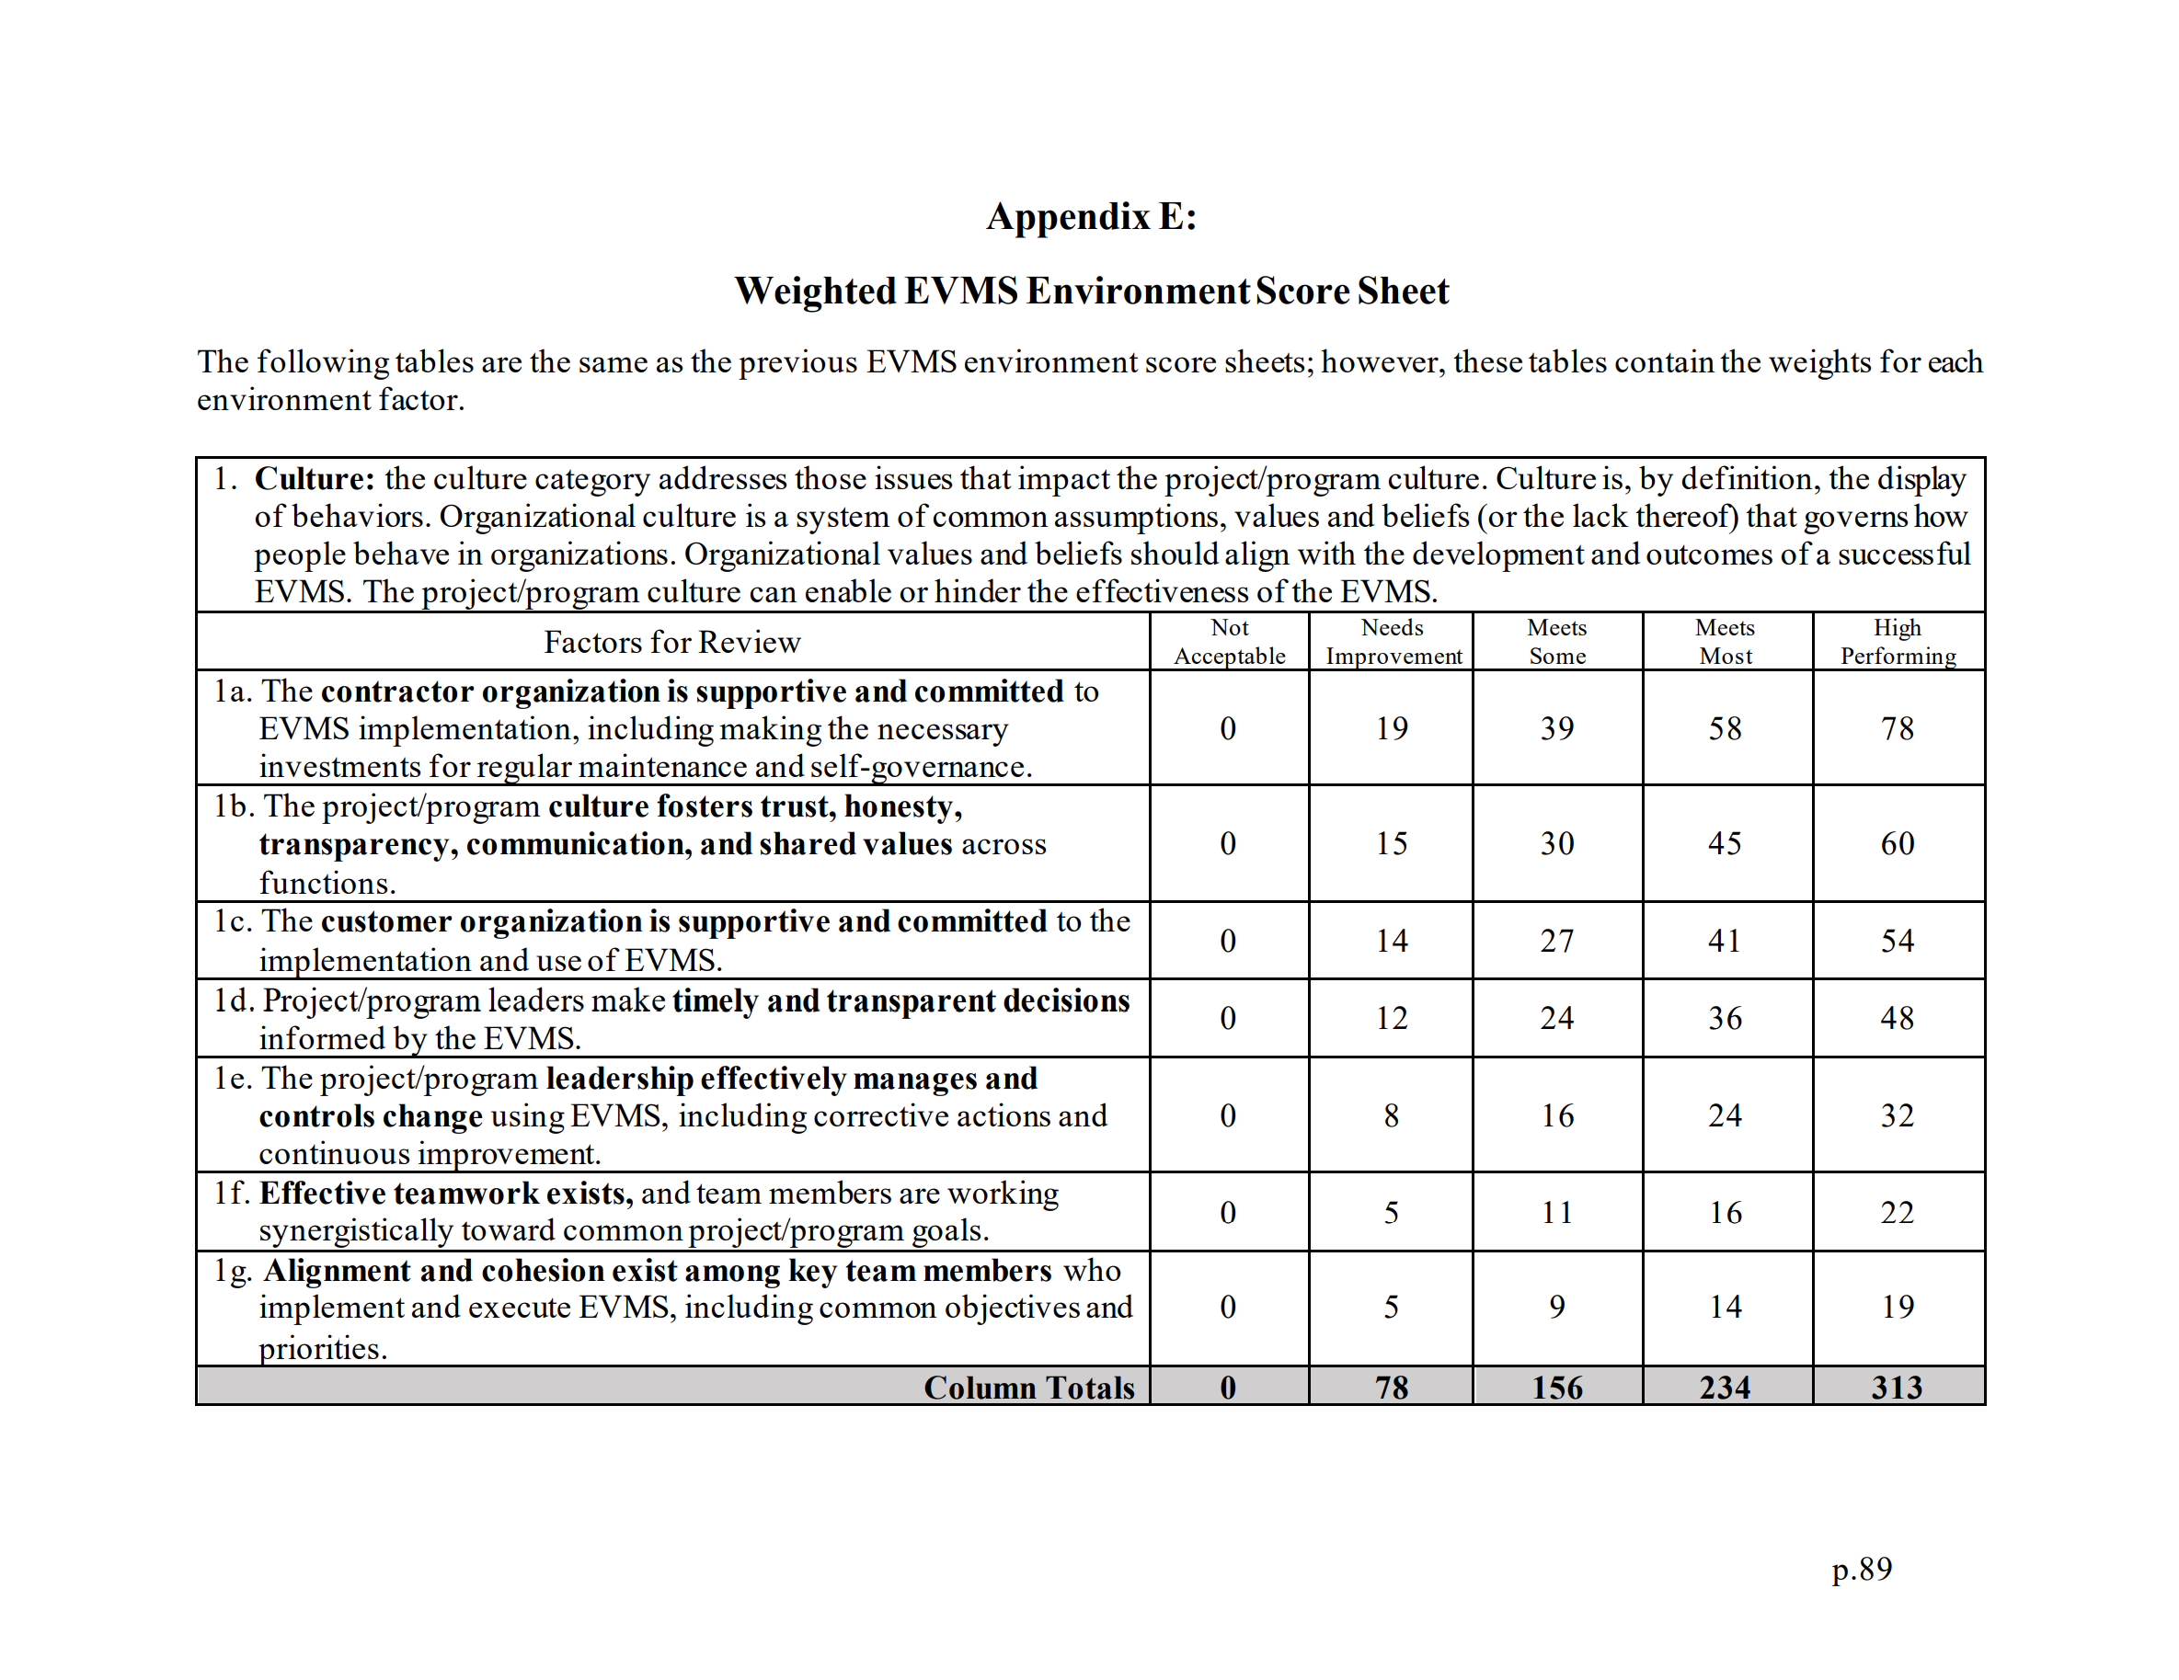
Environment Factors and Weightings

Slide 25
Environment Factors and Weightings (Cont.)

Slide 26
Environment Factors and Weightings (Cont.)

Slide 27
Environment Factors and Weightings (Cont.)

Slide 28
Environment Factors and Weightings (Cont.)

Slide 29
Environment Factors and Weightings (Cont.)

Slide 30
Performance Workshops Overview
Performance Workshop # | 1 | 2 | 3 | 4
Date (2021) | 8 April | 19 May | 2 June | 10 August
# of Participants* | 14 | 6 | 15 | 21
Duration | 5 hours
Agenda | Sample shown below
# of Projects | 11 | 5 | 11 | 6
Total | 33
* + 5 (Mounir, Edd, Vartenie, Hala, Mel)
SAMPLE PERFORMANCE WORKSHOP AGENDA
8:00 – 8:30 am Introductions and Workshop Objectives
8:30 – 8:45 am Project/program Characteristics and Performance
8:45 – 9:30 am Maturity Assessment
9:30 – 9:45 am 15-Minute Break
9:45 – 11:00 am Maturity Assessment (cont’d)
11:00 – 11:25 am 25-Minute Break
11:25 – 12:45 pm Environment Assessment
12:45 – 1:00 pm Conclusions & Wrap-Up
Note: All times are in Pacific Daylight Time (PDT)

Slide 31
Performance Workshop Participants
Early Results, use with caution
Respondents’ avg. years of EVM experience | 19.9
*3 respondents provided two projects each

Slide 32
Results (so far): 33 sample projects/programs
The collected data came from 27 projects and 6 programs, with
~$20 Billion USD in installed cost
Located in 17 U.S. states and territories:
Alabama
California
Florida
Idaho
Illinois
Indiana
Louisiana
Missouri
New Mexico
New York
Pennsylvania
South Carolina
Tennessee
Texas
Virginia
Washington
Washington DC
Early Results, use with caution
The types of projects/programs they represent, and the maturity and environment scores are shown in next slides.

Slide 33
Large and Complex Projects/Programs (N=33)
Type of projects/programs | # of project/programs
Clean-up | 7
Construction | 6
Defense | 6
Software | 4
Aerospace | 3
Manufacturing | 3
Other (science, unspecified) | 4
Early Results, use with caution

Slide 34
Sample Maturity and Environment Scores
 | N | Mean | Median | Min | Max | Std. Dev.
Raw Maturity Score (out of 1,000) | 33 | 611 | 626 | 57 | 887 | 180
Adjusted Maturity Score (out of 1,000) | 33 | 652 | 684 | 78 | 898 | 187
Environment Score (out of 1,000) | 33 | 650 | 684 | 200 | 897 | 160
Early Results, use with caution

Slide 35
Result: Rating Plot (draft)
Early Results, use with caution
Note: Maturity scores are adjusted scores.

Slide 36
Performance Data Collected
Inputs – at the point in time at 20% project completion (CUMULATIVE BCWP/PMB BAC, where BCWP is Budgeted Cost for Work Performed, PMB is Performance Measurement Baseline, and BAC is Budget at Completion)
Maturity and Environment scores
Initial Performance Measurement Baseline (PMB) Budget ($M)
Initial Baseline Project/Program Duration (Months)
Budgeted owner contingency above PMB, if known ($M)
Compliance with EIA-748 (Y/N) or NA
Demographics, including: Are you the government owner or the executor/contractor?
Outputs – at project completion
Final Project/Program Cost ($M) OR Cost Change (%)
Final Project/Program Duration (Months) OR Schedule Change (%)
Final CPI
Absolute value of change orders (in $M or % of PMB)
Please explain any changes that impacted the initial baseline cost or schedule by more than 5%
Please explain anything unusual about the project/program if any
The project/program met its objectives and business drivers (1–5 scale)*
Customer satisfaction (1–5 scale)*
The EVMS helped to proactively manage the project/program (1–5 scale)*
*Note: Scale 1 to 5, with 1 meaning “very unsuccessful” and 5 “very successful”.

Slide 37
Data Characteristics
 | N | Mean | Median | Min | Max | Std. Dev.
Initial Performance Measurement Baseline (PMB) Budget (in $M) | 31 | 480.8 | 112.0 | 3.1 | 3,981.0 | 1,005.4
Final Project or Program Cost (in $M) | 31 | 664.7 | 150.0 | 4.8 | 7,500.0 | 1,533.2
Final CPI | 33 | 0.95 | 0.98 | 0.60 | 1.10 | 0.10
Budgeted owner contingency above PMB, including Management Reserve (MR) (in $M) | 25 | 172.3 | 12.9 | 0.0 | 3,200.0 | 635.9
Absolute value of change orders (in $M) | 26 | 35.8 | 10.0 | 0.0 | 266.0 | 62.2
Initial Baseline Project/Program Duration (in months) | 30 | 50.7 | 48.0 | 8.0 | 96.0 | 21.2
Final Project or Program Duration (in months) | 30 | 56.9 | 48.5 | 20.0 | 132.0 | 26.4
Early Results, use with caution

Slide 38
Calculations
$Schedule Growth (\%) =\frac{ Final Project Duration − Initial Baseline Duration}{Initial Baseline Duration}$ $×$ 100
$Cost Growth (\%) =\frac{ Final Project Cost − Initial PMB Budget}{Initial PMB Budget}$ $×$ 100
$Change Absolute Value (\%) =\frac{ Absolute Value of Change Orders}{Initial PMB Budget}$ $×$ 100
$Contingency \left(\%\right)=\frac{ Budgeted Owner Contingency}{Initial PMB Budget}$ $×$ 100

Slide 39
Calculated Performance Data Characteristics
 | N | Mean | Median | Min | Max | Std. Dev.
Cost Growth (in %) | 32 | +56.9 | +13.0 | -13.8 | +537.9 | 124.9
Schedule Growth (in %) | 32 | +19.1 | +4.2 | -20.0 | +250.0 | 47.8
Change Absolute Value (in %) | 28 | 55.9 | 12.2 | 0.0 | 537.9 | 126.3
Contingency (% of PMB) | 28 | 35.1 | 9.3 | 0.0 | 572.7 | 107.5
Early Results, use with caution

Slide 40
Calculation of Thresholds
To determine what a “high” maturity and “good” environment score should be (where “high” means exceeding a maturity score threshold, and “good” means exceeding an environment score threshold), a step-wise analysis was conducted as shown in the next two slides.

Slide 41
Maturity Score Threshold
573
The lowest p-value of 0.0014 corresponds to a maturity score between 570 and 573.
Median is 680.
Early Results, use with caution

Slide 42
Environment Score Threshold
794
The lowest p-value of 0.004 corresponds to an environment score between 794 and 800.
Median is 685.
Early Results, use with caution
Therefore, the thresholds for maturity and environment are: 573 and 794, respectively.

Slide 43
Result: Cost & Schedule Performance (draft)
HMGE (N=7):
Avg. 0.7% cost growth
Avg. 1.7% schedule underrun
794
LMPE (N=10):
Avg. 111.1% cost growth
Avg. 22.4% schedule overrun
Early Results, use with caution
HMPE (N=15):
Avg. 46.9% cost growth
Avg. 26.6% schedule overrun
573
Note: The sample is reduced by removing one project with no performance information.
The split is based on thresholds (blue lines).

Slide 44
Result: Cost & Schedule Performance (draft)
HMGE (N=12):
Avg. 45.3% cost growth
Avg. 5.2% schedule overrun
LMGE (N=4):
Avg. 44.8% cost growth
Avg. 20.5% schedule overrun
685
LMPE (N=12):
Avg. 86.6% cost growth
Avg. 18.3% schedule overrun
Early Results, use with caution
HMPE (N=4):
Avg. 14.2% cost growth
Avg. 61.8% schedule overrun
USING MEDIANS IN THIS ANALYSIS SHOWED NO STATISTICAL SIGNIFICANCE.
680
Note: The sample is reduced by removing one project with no performance information.
This split is based on medians (blue lines).

Slide 45
Result: Compliance (draft)
HMGE (N=7):
100% compliant projects/programs
0% non-compliant projects/programs
0% compliance not applicable
794
Early Results, use with caution
HMPE (N=16):
69% compliant projects/programs
19% non-compliant projects/programs
12% compliance not applicable
LMPE (N=10):
40% compliant projects/programs
50% non-compliant projects/programs
10% compliance not applicable
573
Note: Compliance with NDIA EIA-748 at the point in time at 20% project completion.
The split is based on thresholds (blue lines).

Slide 46
Result: Business Objectives (draft)
HMGE (N=7):
86% very successful
0% successful
14% somewhat successful
0% unsuccessful
0% very unsuccessful
794
Early Results, use with caution
HMPE (N=16):
49% very successful
38% successful
13% somewhat successful
0% unsuccessful
0% very unsuccessful
LMPE (N=10):
20% very successful
40% successful
10% somewhat successful
20% unsuccessful
10% very unsuccessful
573
Note: The project/program met its objectives and business drivers.
The split is based on thresholds (blue lines).

Slide 47
Result: Customer Satisfaction (draft)
HMGE (N=7):
86% very successful
0% successful
14% somewhat successful
0% unsuccessful
0% very unsuccessful
794
Early Results, use with caution
HMPE (N=16):
50% very successful
37% successful
13% somewhat successful
0% unsuccessful
0% very unsuccessful
LMPE (N=10):
20% very successful
50% successful
0% somewhat successful
10% unsuccessful
20% very unsuccessful
573
Note: Customers were satisfied with the results of the project/program.
The split is based on thresholds (blue lines).

Slide 48
Result: EVMS Helped Proactively Manage (draft)
HMGE (N=7):
29% very successful
43% successful
28% somewhat successful
0% unsuccessful
0% very unsuccessful
794
Early Results, use with caution
HMPE (N=16):
12% very successful
44% successful
44% somewhat successful
0% unsuccessful
0% very unsuccessful
LMPE (N=10):
0% very successful
30% successful
40% somewhat successful
20% unsuccessful
10% very unsuccessful
573
Note: The EVMS helped to proactively manage the project/program.
The split is based on thresholds (blue lines).

Slide 49
Statistical Significance
Performance Metric | M&E Quadrants | P-value
Cost Growth | HMGE < HMPE < LMPE | 0.002; 0.01; 0.084
Schedule Growth | HMGE < LMPE | 0.044
Compliance | HMGE > LMPE | 0.021
Business Objectives | HMGE > HMPE > LMPE | 0.019; 0.05
Customer Satisfaction | HMGE > HMPE > LMPE | 0.021; 0.079
EVMS helped manage | HMGE > HMPE > LMPE | 0.036; 0.051
Note:
“HMGE” means High Maturity Good Environment
“HMPE” means High Maturity Poor Environment
“LMPE” means Low Maturity Poor Environment
Early Results, use with caution

Slide 50
Conclusions
IP2M METRR works.
The thresholds for maturity and environment are: 573 and 794, respectively.
There are statistically significant differences:
Cost performance
Schedule performance
Compliance
Meeting project objectives and business drivers
Customer satisfaction
EVM help proactively manage the project/program
No statistically significant differences were found for change order and contingency in this sample.
The causal connection is not clearly understood.
We feel that this tool can be used as a means of benchmarking current and completed projects in a wide variety of industry sectors.
More data will be useful.

Slide 51
In-progress projects
In addition, six on-going projects were assessed using IP2M METRR at their current project status. Four by DOE (IP1-IP4) and two by the ASU team (IP5-IP6).
Project | IP1 | IP2 | IP3 | IP4 | IP5 | IP6
# of workshops or interviews | 16 interviews | 13 interviews | 18 interviews | 20 interviews | 1 workshop | 2 workshops
Assessment components | Maturity and Environment | Maturity and Environment | Maturity and Environment | Maturity and Environment | Environment | Maturity and Environment
Assessment dates | October 19 – 23, 2020 | February 22 – March 4, 2021 | Jan 25 – March 4, 2021 | May 17 – 26, 2021 | June 10, 2021 | June 15 and 17, 2021, respectively
Duration of assessment | 1.5 Weeks | 1.5 weeks | 2 weeks total | 1.5 weeks | 3 hours | 3.5 hours and 3 hours, respectively
# of participants | 15 and 4 (see assessment method) | 8 and 4 (see assessment method) | 9 and 4 (see assessment method) | 17 and 4 (see assessment method) | 7* | 13 and 7, respectively*
Participants’ role | Customer and Contractor | Customer and Contractor | Customer and Contractor | Customer and Contractor | Contractor | Contractor
* + 4 (Mounir, Edd, Vartenie, Hala)

Slide 52
In-progress projects (cont.)
Project | IP1 | IP2 | IP3 | IP4 | IP5 | IP6
Participants’ employment role | KTR: Project manager, control account managers (CAMs), project controls personnel, EVMS SME, Contracting officer, functional managers, and CEO along other senior leaders Gov’t Customer: Federal project director (FPD), contracting officer, EVMS SME, and mid-level managers and senior leaders | KTR: PM, CAMS, Project controls, EVMS process leads, Senior leadership Gov’t Customer: Site leadership, Federal project director, Budget analyst | KTR: PM, CAMS, Project controls, EVMS process leads, senior leadership Gov’t Customer: Site leadership, Federal project director, Budget analyst | KTR: Project manager, Control Account Managers (CAMs), Project Controls Personnel, EVMS SME, contracting officer, functional managers, and CEO along other Senior Leaders Gov’t Customer: Federal Project Director (FPD), contracting officer, EVMS SME, and mid-level managers and senior leaders | Project/program management, project controls management, financial analyst, scheduler, executive or senior management, consulting, subcontract manager | Executive or senior management, compliance management, project/program management, president, corporate supervisor
Assessment method | Individual assessment of maturity attributes and environment factors conducted by 15 government review team members (first week). Individual assessment for the environment factors conducted by select (4) government personnel (second week). Individual assessment of maturity component were combined since each attribute was assessed by the specialty personnel. Results of first week environment factors were averaged and combined with second week results where all were averaged for a final score. | Maturity component assessment started with individual assessments, then the team reached consensus for the scores. Environment component was a team overall assessment. | Individual assessment of maturity for the 56 EVMS attributes and 27 environment factors conducted by 9 government review team members (first week). Individual assessment for the 27 environment factors conducted by select (4) government personnel (second week). Results of first week environment factors were averaged and combined with second week results where all were averaged for a final score. | Individual assessment of maturity for the 56 EVMS attributes and 27 environment factors conducted by 17 government review team members (first week). Individual assessment for the 27 environment factors conducted by select (4) government personnel (second week). Results of first week environment factors were averaged and combined with second week results where all were averaged for a final score. | Individual assessment for environment component where the scores were averaged. | Consensus reached for maturity component and individual assessment for environment component where the scores were averaged.
For IP1, IP3, and IP4: Each week’s interviews to assess environment factors were held with different contractor and government personnel.
The score results for these in-progress projects along with the completed projects are plotted and shown in next slide.

Slide 53
Plot with in-progress projects
794
Early Results, use with caution
573
Note: Maturity scores are adjusted scores.
Completed project
In-progress project

Slide 54
Validation of IP2M METRR (ongoing)
Testing in-progress project/program (6 total) – Completed
WRPS TSCR (review)
Battelle Energy Alliance at INL SPL (review)
MSTS UCEP (review)
FFPO SPR (review)
MSTS UCEP (facilitated assessment for Environment)
McMurdo Antarctica with Leidos/NSF AIMS (facilitated assessment)
Testing in-progress project/program (original target: 6 to 12 total)
NASA considering to test/use it this year
Research Team member volunteers (Doug, John Post, Paul internally, Bob, Jeffrey, others)
DOE planning to use it in more reviews this year
Other?
Different options exist
Interviews or Facilitated; Internal use; other
Different sizes and types of projects/programs

Slide 55
Software Update
Organizational meeting with taskforce (done)
Review software requirements with taskforce (done)
Meetings with developer and regular follow-ups (in-progress)
Proposal accepted by DOE (done)
ASU will develop a standalone and server-based application using ASU’s Decision Theater
Soft start already taking place, kick-off meeting within two weeks
Final deliverable in six months

Slide 56
Training Discussion
Two training sessions
Training materials will be provided
Delivery options: online (or in-person if appropriate)
Dates: Start in early 2022

Slide 57
Other Outreach
DOE Project Management Workshop (Spring 2022)
NDIA Workshop
College of Performance Management (CPM)’s “EVM World” workshop
EFCOG
Other?

Slide 58
Path Forward
Continue developing the User Guide
Continue software development
Collect more data from team members
Conduct more in-progress reviews using the tool
Develop training materials
Publicize the work
Position Federal Agencies for EVMS Compliance Reciprocity (OMB Requirement)

Slide 59
Next Steps
Rethink policies and procedures to promote and administer the IPPM METRR tool
Maturity and Environmental Factor Templates to become central for determination
Reimagine the EVMS review process
Begin with end in mind
More collaborative / ongoing dialogue / joint discovery
More automated (develop Turbo Check methodology to administer/collect Maturity and Environmental Factor scores)
Management focused
Continue to improve consistency
Lower cost / smaller footprint
Update policy and process in ECRSOP
Refine Metrics and CRC
Reformat CAR/DR templates

Slide 60
Turbo Check – Proof of Concept

Slide 61
Turbo Check – Proof of Concept (Cont.)

Slide 62
EFCOG Project Controls Working Group Annual Meeting
DOE 413.3B Guide and PM SOP Updates
Upcoming PM-30 Reviews
Mel Frank – Director
PM-30 Project Controls Division
September 20, 2021

Slide 63
DOE 413.3B Guide updates
DOE Planning and Scheduling – new guide currently in final review for approval
DOE Guide 413.3-10A, Earned Value Management System – rewrite and update of guide is currently in initial Department wide review
DOE Guide 413.3-21, Risk – Limited update incorporating Joint Confidence Levels. Guide is in final review period for approval, closes 9-23-2021.
DOE Guide 413.3-20, Change Control Management Guide – Update October 2021 incorporating root cause analysis, Over Target Baseline (OTB) and Over Target Schedule (OTS)

Slide 64
PM Standard Operating Procedure Updates
EVMS Compliance Review Standard Operating Procedure (ECRSOP) – Update underway, revised release expected January 2022.
EVMS Compliance Review Standard Operating Procedure (ECRSOP), Appendix A Compliance Assessment Guidance (CAG) – Update underway, initial draft being reviewed. Secondary draft due October 2021, release expected by January 2022.
EVMS Compliance Review Standard Operating Procedure (ECRSOP), Appendix A PM EVMS Compliance Review Checklist (CRC) - Update underway, release expected by February 2022.

Slide 65
Upcoming PM-30 EVMS Reviews . . . . Or
TRIAD – Implementation Review
Y-12 – Certification/Implementation Review (new contract)
Y-12 – Certification/Implementation Review (UPF breakout)
Pantex – Certification Extension/Implementation Review (new contract)
SRS – Certification Review (SRNS or new contractor)
WIPP – Certification/Implementation Review (new contract)
PORTS – Implementation Review
Others?

Slide 66
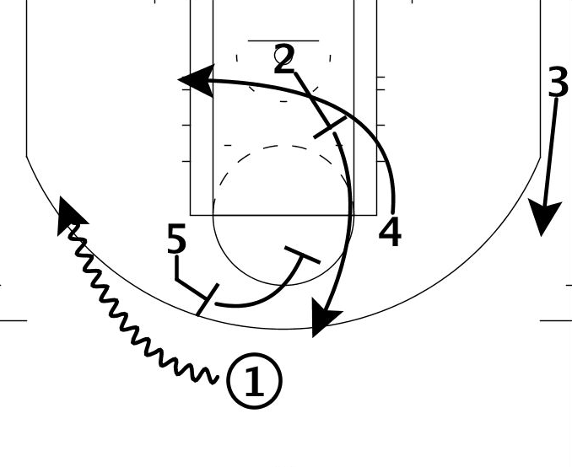
Reinstitute a Series of RSAVs to Introduce ASU EVMS Study Methods and Techniques with the Primary Goal of Building a Better and Sustainable DOE EVMS Mission
“Never mistake activity for achievement.”
- Coach John Wooden

