Slide 1
SNL’s Approach for Indirect Scope Incorporation
5/12/2022
Presented By:
Tristan Walters, Manager, Sandia EVMS Office

Slide 2
SNL’s Direct/Indirect Breakout Solution
Cobra calculations for direct and indirect rates by element of cost (EOC)
All indirect scope is captured in PMB through rates allocated by direct resources
Additional modeling of indirect scope with high schedule impacts is done through ZBAs (see slide 5)
$35
$65
$100
1
1
“Cost incurred to perform the assigned scope of work on projects funded by DOE/NNSA and Strategic Partnership Projects sponsors”
Indirect Amount (sum of all indirects from the Disclosure Statement as a single EOC)
PM
Burden Cost
Total cost (direct cost plus indirect cost)
ALD
Direct Amount (Raw Amount)
SPP Safeguards & Security
G&A
Mgt Fee
LDRD
Operational Overhead
Unit
Employee labor hours
Travel expense reports
Subcontract PO Value/Invoices
Unit
Employee labor hours
Travel expense reports
Subcontract PO Value/Invoices
Notes:
Cost pools tie to CAS disclosure statement
Wrap Rate

Slide 3
Flow of Data For Unit Escalation
Primavera P6
Oracle
Deltek Cobra
Direct units planned/estimated
Direct Resource Analysis for variance reporting
Actual Cost and Estimated Actuals
Raw (direct) and burden (per the CAS)
Breakout by EOC (Labor, Travel, Purchases, Chargebacks)
Indirect Analysis (aggregated as a single value) for variance reporting

Slide 4
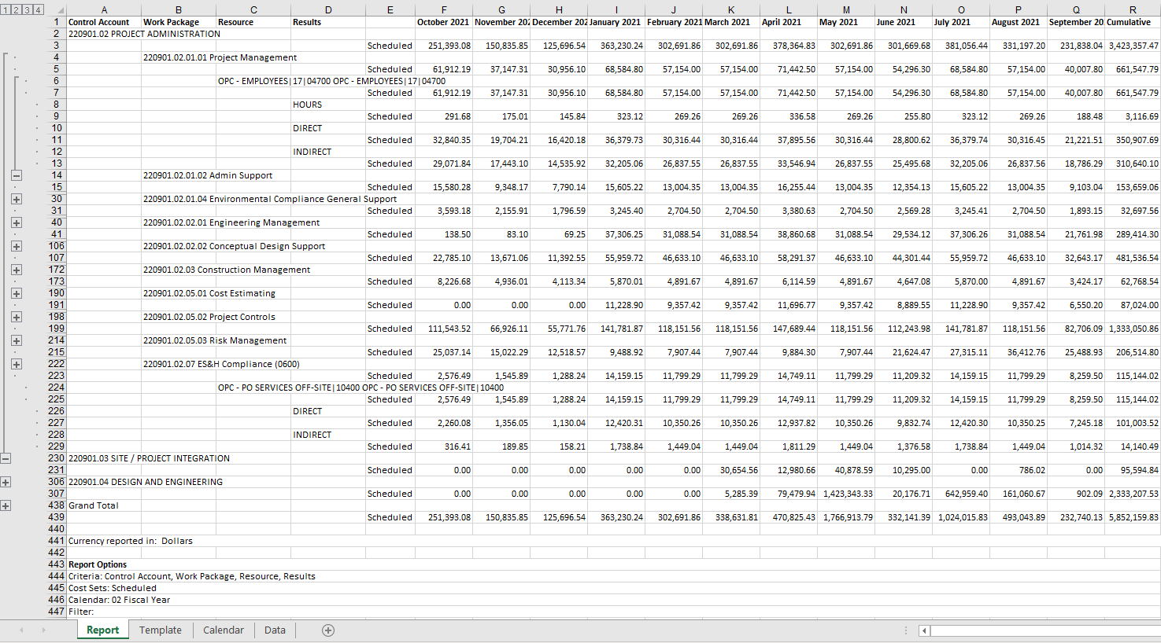
Example Time Phased Report From Cobra
Resource from the Resource Dictionary
Units planned in P6 imported into Cobra
Direct = Hours multiplied by the Standard Labor Rate
Indirect = Hours multiplied by the sum of the indirect elements of costs in the Disclosure Statement

Slide 5
Zero Budget Activities
For high schedule indirect scope impacts, Sandia utilizes ZBAs
Representative time is modeled in schedule as a ZBA, i.e. procurement time
No resource loading on ZBAs as resources are indirect
Indirect charges are allocated in the accounting system based on direct elements of cost charged to program and in accordance with Sandias CAS disclosure statement

