Slide 1
Indirect Policy, Process and Implementation Analysis
Tony Spillman
Project Management Programs/EVMS Reporting
June 14, 2022

Slide 2
Problem Statement
Our approach the PMB management with regards to Indirect Costs needs to address our Approach (Policy), Process (tools) and Implementation (CAM exposure and Reporting visibility).
The subsequent slides attempt to demonstrate compliance to the DOE Compliance Requirements (CAG and CRC) for:
E. INDIRECT BUDGET AND COST MANAGEMENT
Process Area
Attribute
Objective

Slide 3
Focus Areas for Discussion
Terminology
DOE CRC - Indirect Budgets are included in the PMB ... as specified in the Contractors EVMSD
DOE IPMR DID (3.2.4.5, 3.2.4.7, 3.3.1.5) “… sum of costs and budgets for direct, indirect, COM, and G&A.”
DOE CRC – Indirect Budgets (i.e., overhead, burden, cost of money and G&A expense)
PM CAG, G/L 20- Accounting system must segregate costs by EOC (labor, materials, odc, and indirect costs)
PM CAG - The term indirect includes all project burdens on direct work. Examples include overhead, General and Administrative (G&A), Cost of Money, and types of supervision that allocate their time.
DOE IPMR DID (3.6.10.1.2 ) - Cost Variance … Overhead rate changes … applicable to base or allocation.
Examples
WRPS Integrated EVM System and Monthly Performance Reporting Demonstration
Objectives
E.1 Indirect Account Org Structure – establish & control rates, resp./authority for budgets, costs, approvals
E.2 Indirect Budget Mgmt – appropriate org level, PMB using current rates, rate performance reviews conducted
E.3 Record Allocate Indirect Costs – cost allocated per procedure, rate adjustments, internal audits
E.4 Indirect Variance Analysis – cost analysis by those responsible, forecasting impacts to MEAC

Slide 4
PM CAG – Section 8 Indirect Considerations
Defined as costs not directly charged, must be allocated. Includes all burdens on direct work - overhead, General and Administrative (G&A), Cost of Money, and supervision that allocate time.
EV guidelines require indirect cost structure defined, and organization or function responsibility for control of indirect costs (G/L 4), budgeting (G/L 13), actuals accrued (G/L 19), and analysis performed (G/L 24).
Differences to traditional application of earned value:
Grouped into indirect pools, allocated against appropriate bases to yield planned indirect rates.
Annually based as planned rates, with adjustments at year end to actual rates.
Not managed with a project schedule or IMS.
Goal is stability of rates and control of costs. May include scope reduction
The CFO typically has overall responsibility for indirect management.
Not managed through EVMS CAs but those responsible for indirect services, for each pool or category.
Analysis performed by responsible indirect cost manager, considered by project’s CAMs during analysis.
Change control management to prevent retroactive changes and impacts to work remaining.
Contractor identifies pools and application bases in disclosure statement and indirect policy and documents responsibility for budgeting, charging, and analysis of major components

Slide 5
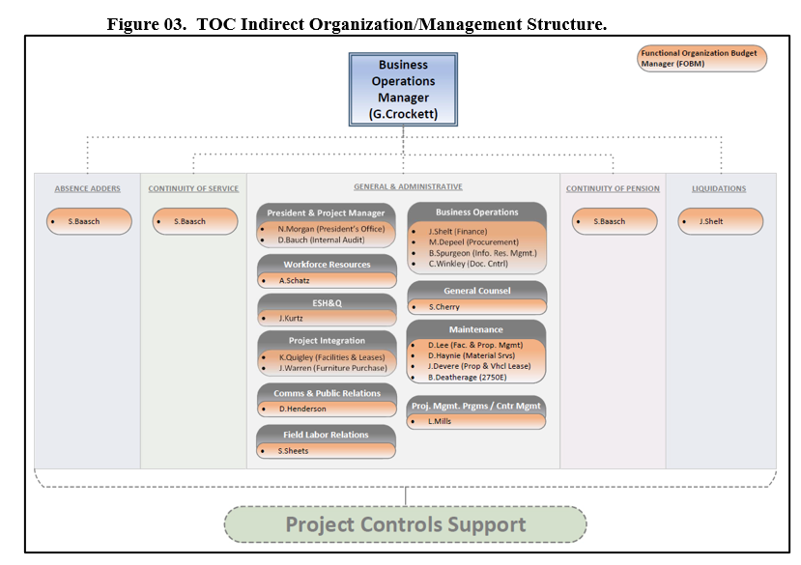
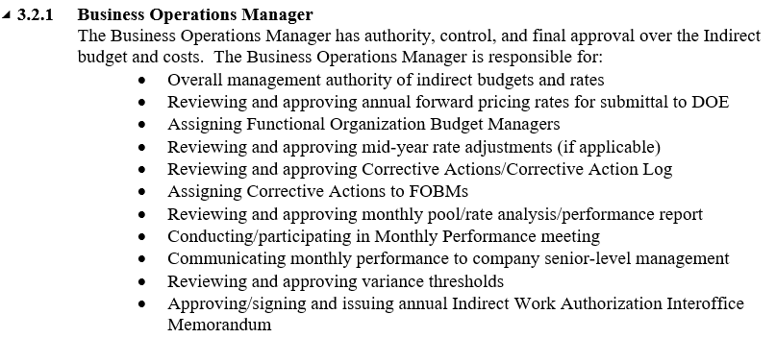
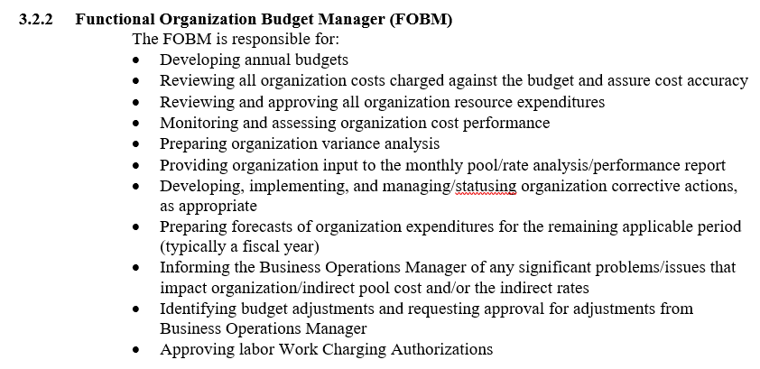
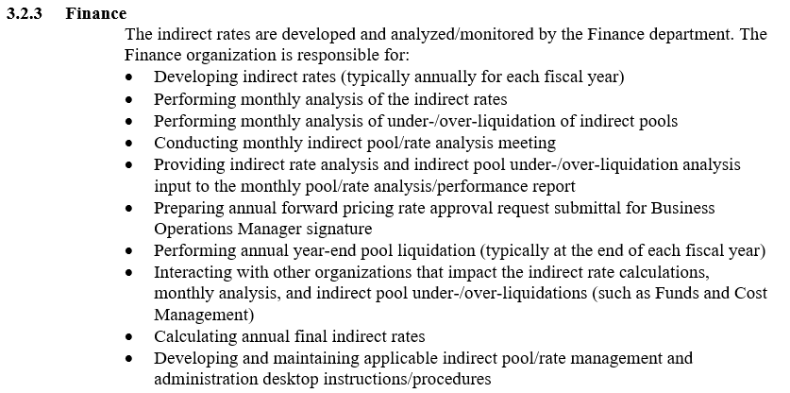
WRPS Examples – E.1 Indirect Account Org Structure
E.1 Indirect Account Org Structure – establishing and controlling rates, responsibility & authority for budgets, costs, approvals

Slide 6
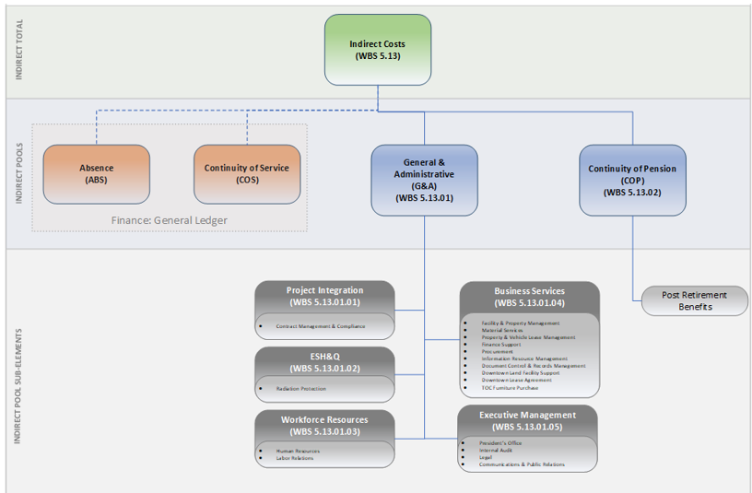
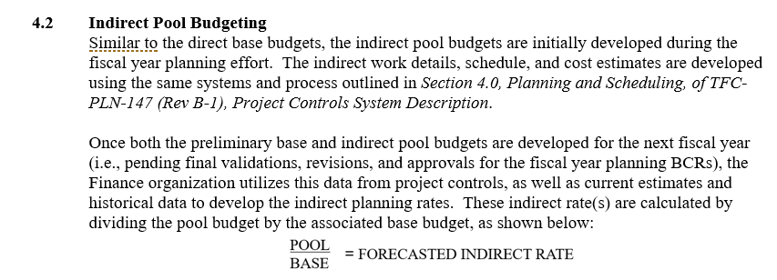
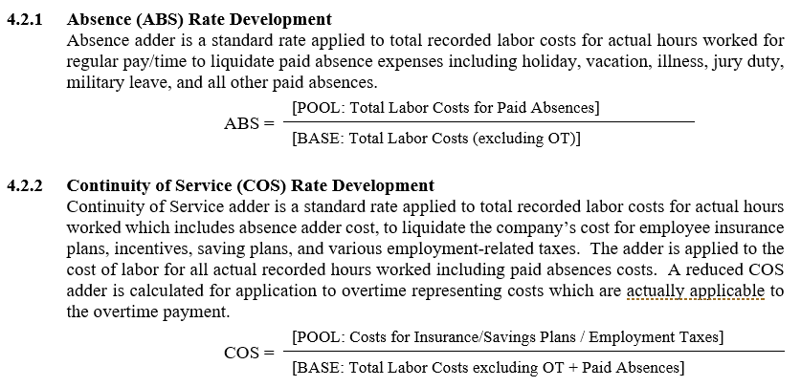
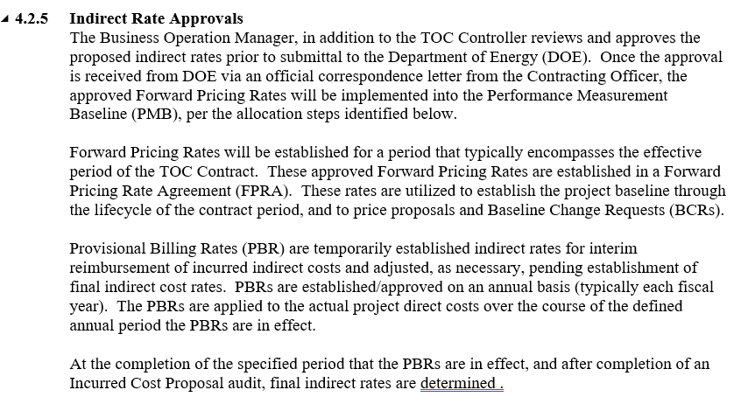
WRPS Examples – E.2 Indirect Budget Management
E.2 Indirect Budget Management – appropriate org level, PMB using current rates, rate performance reviews conducted

Slide 7
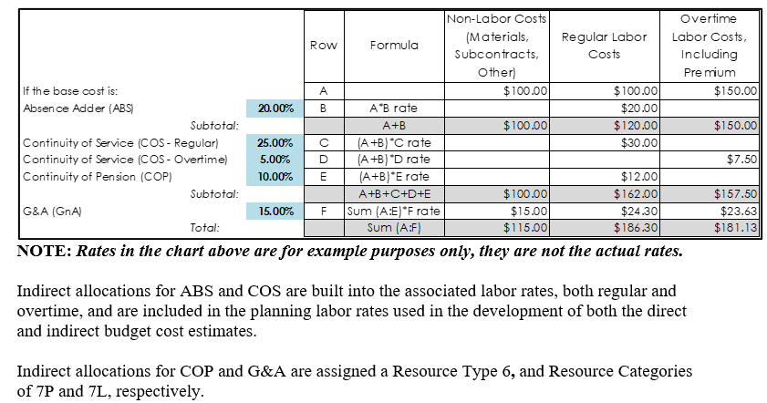
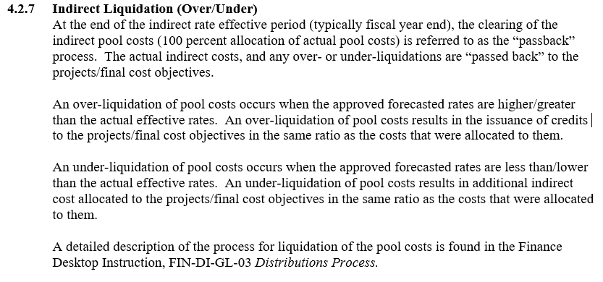
WRPS Examples – E.3 Record Allocate Indirect Costs
E.3 Record Allocate Indirect Costs – cost allocated per procedure, rate adjustments, internal audits

Slide 8
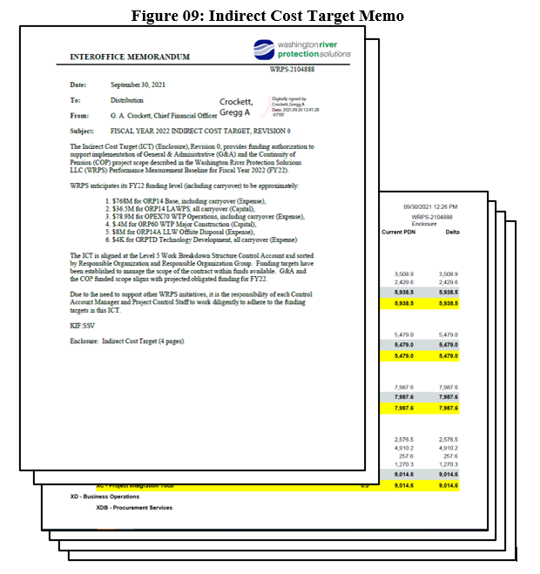
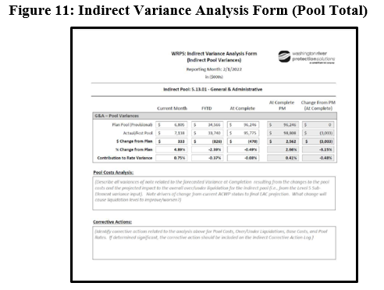
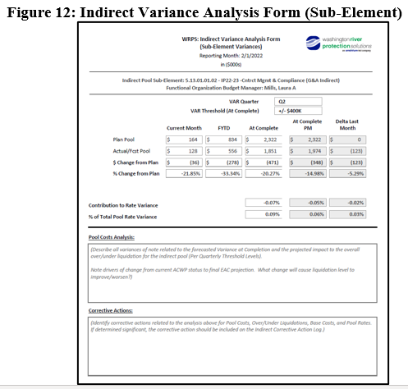
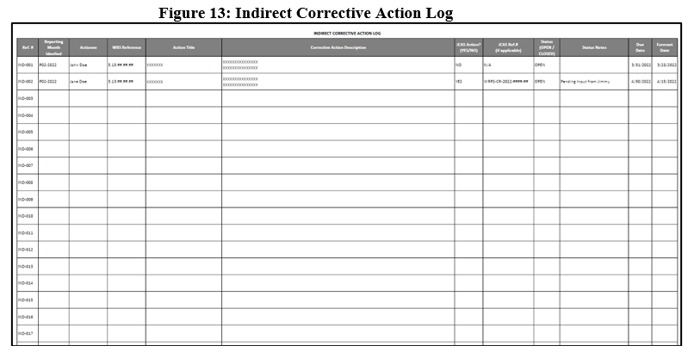
WRPS Examples – E.4 Indirect Variance Analysis
E.4 Indirect Variance Analysis

Slide 9
WRPS Demonstration
Walk Through of Systems Integration and Data Artifacts
Accounting (G/L, Pools, EOC)
Field Office Reports, Invoicing and Auditing
CAM EACs and VARs
Govt. Performance Reporting
3
4
1
2

Slide 10
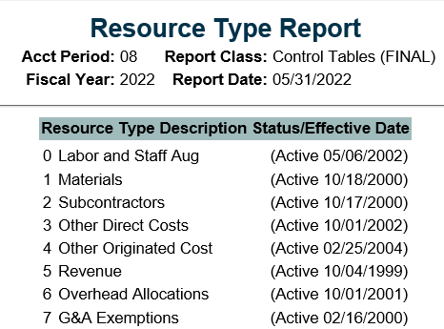
WRPS Demonstration – BMS Control Tables
Walk Through of Systems Integration and Data Artifacts
Accounting (G/L, Pools, EOC)
Field Office Reports, Invoicing and Auditing
CAM EACs and VARs
Govt. Performance Reporting
3
4
1
2

Slide 11
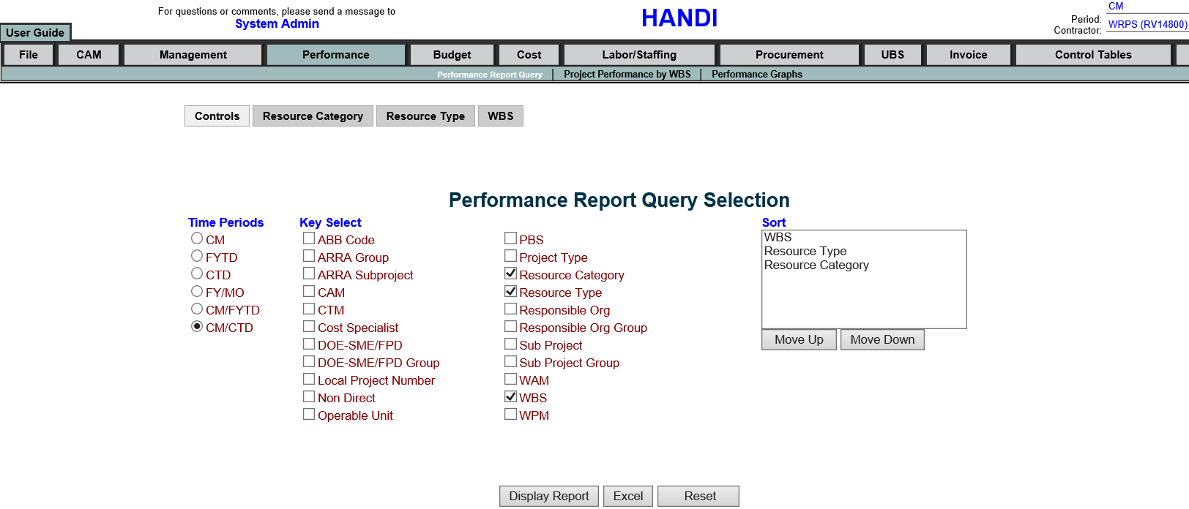
WRPS Demonstration – HANDI Detail Reports
Walk Through of Systems Integration and Data Artifacts
Accounting (G/L, Pools, EOC)
Field Office Reports, Invoicing and Auditing
CAM EACs and VARs
Govt. Performance Reporting
3
4
1
2

Slide 12
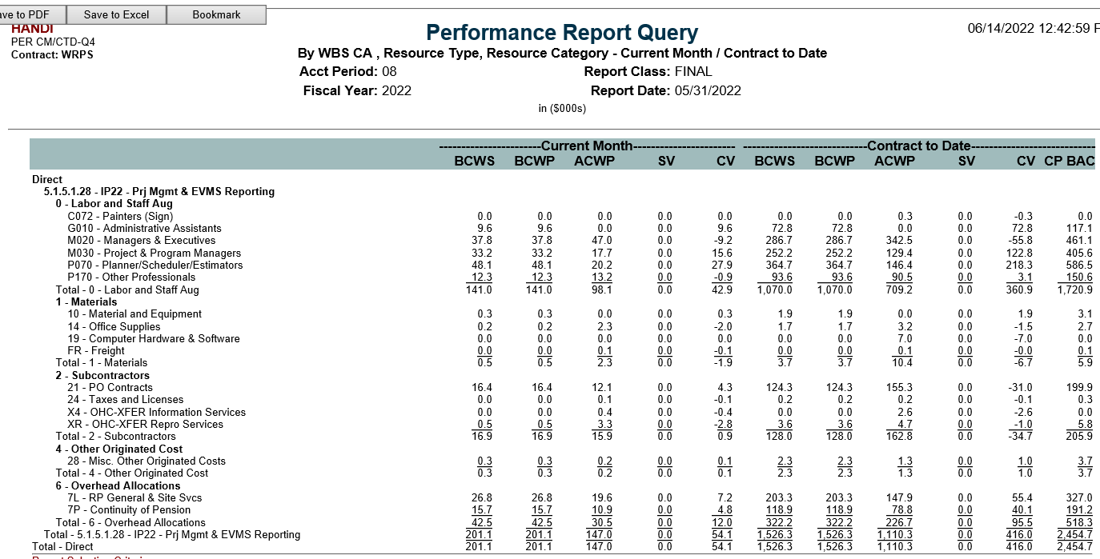
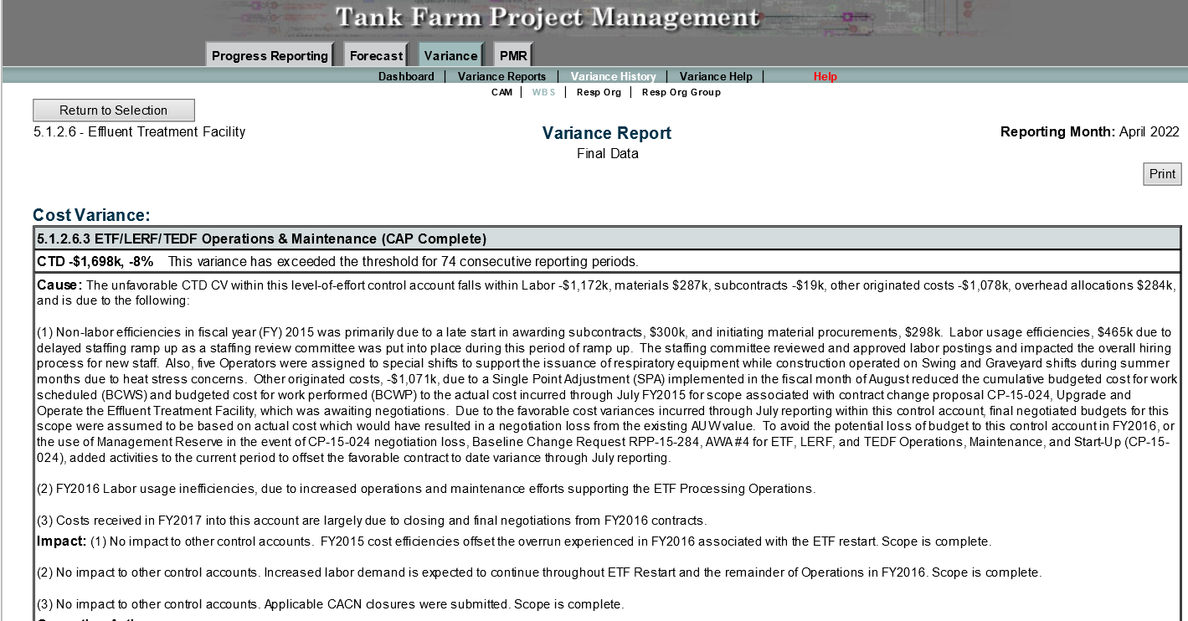
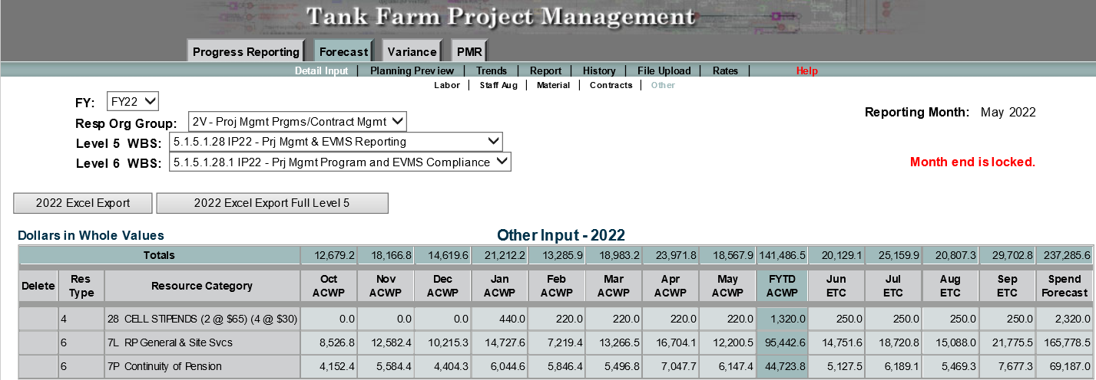
WRPS Demonstration – CAM EACs and VARs
Walk Through of Systems Integration and Data Artifacts
Accounting (G/L, Pools, EOC)
Field Office Reports, Invoicing and Auditing
CAM EACs and VARs
Govt. Performance Reporting
3
4
1
2

Slide 13
WRPS Demonstration – Performance Reporting (IPMR)
Walk Through of Systems Integration and Data Artifacts
Accounting (G/L, Pools, EOC)
Field Office Reports, Invoicing and Auditing
CAM EACs and VARs
Govt. Performance Reporting
3
4
1
2

Slide 14
Questions and Comments

