Slide 1
Schedule Margin and Schedule Risk Assessment (SRA) Forecasting
Doug Marbourg
Triad/LANL EVMS PO
April 10, 2023

Slide 2
Definitions:
“B.8. Schedule Margin (SM)
“Establishing SM in the schedule is an optional management technique that helps projects deliver on time, on target, and on cost (Table 17). SM is created by inserting activities to represent the time necessary to account for estimated schedule risks and uncertainties. SM is used to mitigate schedule risk and increase the accuracy of downstream forecasts. Although SM duration generally decreases over time as risks expire and uncertainties diminish, the duration can increase as additional risks and uncertainties are discovered. The customer’s schedule
contingency, if included in the schedule, is reflected consistently with SM.”*
“The amount of SM established directly relates to the estimation of schedule risk inherent in
accomplishing the project goals and deliverables. The relationship between SM and risk in the
schedule is documented and reviewable.”*
* ECRSOP CAG 2.0 - June, 2022 pg. 85

Slide 3
Definitions continued:
J.1.3. An SRA is used as an integral part of the overall risk process. The SRA validates the sufficiency of schedule margin duration and MR budget.
“…durations for schedule margin are updated
over time as risks are realized, risks are retired, and the risk register is updated, such that the
duration of schedule margin is commensurate with the amount of residual risk remaining on the
Project.”
*ECRSOP CAG 2.0 pg 236

Slide 4
Given:
Schedule Risk Assessment (SRA) is completed monthly as a function of robust risk management process. Value increase/decrease as residual risk is retired and/or new risks are identified.
Forecast schedule margin (SM) “articulates” monthly as a function of schedule variance (increases as schedule variance becomes positive/decreases as schedule variance becomes negative).
SRA values are typically not included in forecast SM as SM approaches zero.
Stakeholders reluctant to “report the bad news” as CBB moves into customer schedule contingency
CBB constraint not allowed, therefore customer schedule contingency must be reduced to maintain CD-4/TPC (will show negative float, or CD-4/TPC moves).
Current requirement is to tie LOE to CBB – Could result in LOE on critical path unless LOE is moved to TPC/CD-4.

Slide 5
Issues
Negative float is generally discouraged
SRA forecast for remaining work can exceed remaining forecast SM
Customer reluctance to “utilized” schedule contingency in forecast will require negative float to be present in monthly reporting

Slide 6
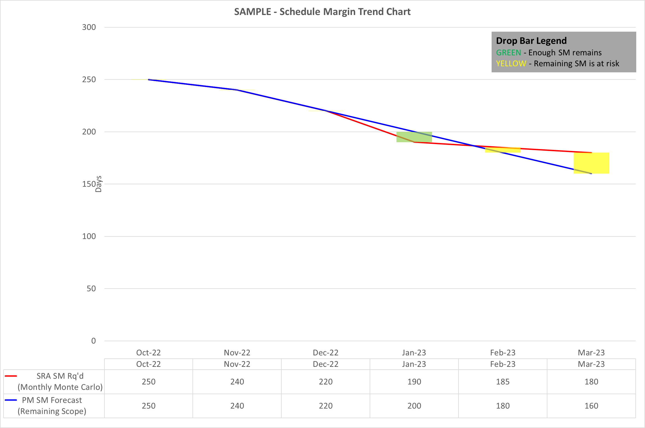
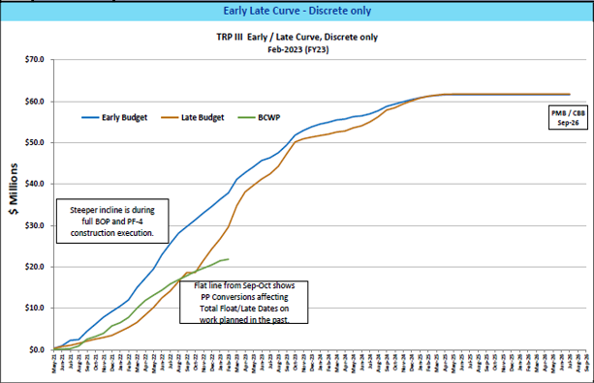

Slide 7
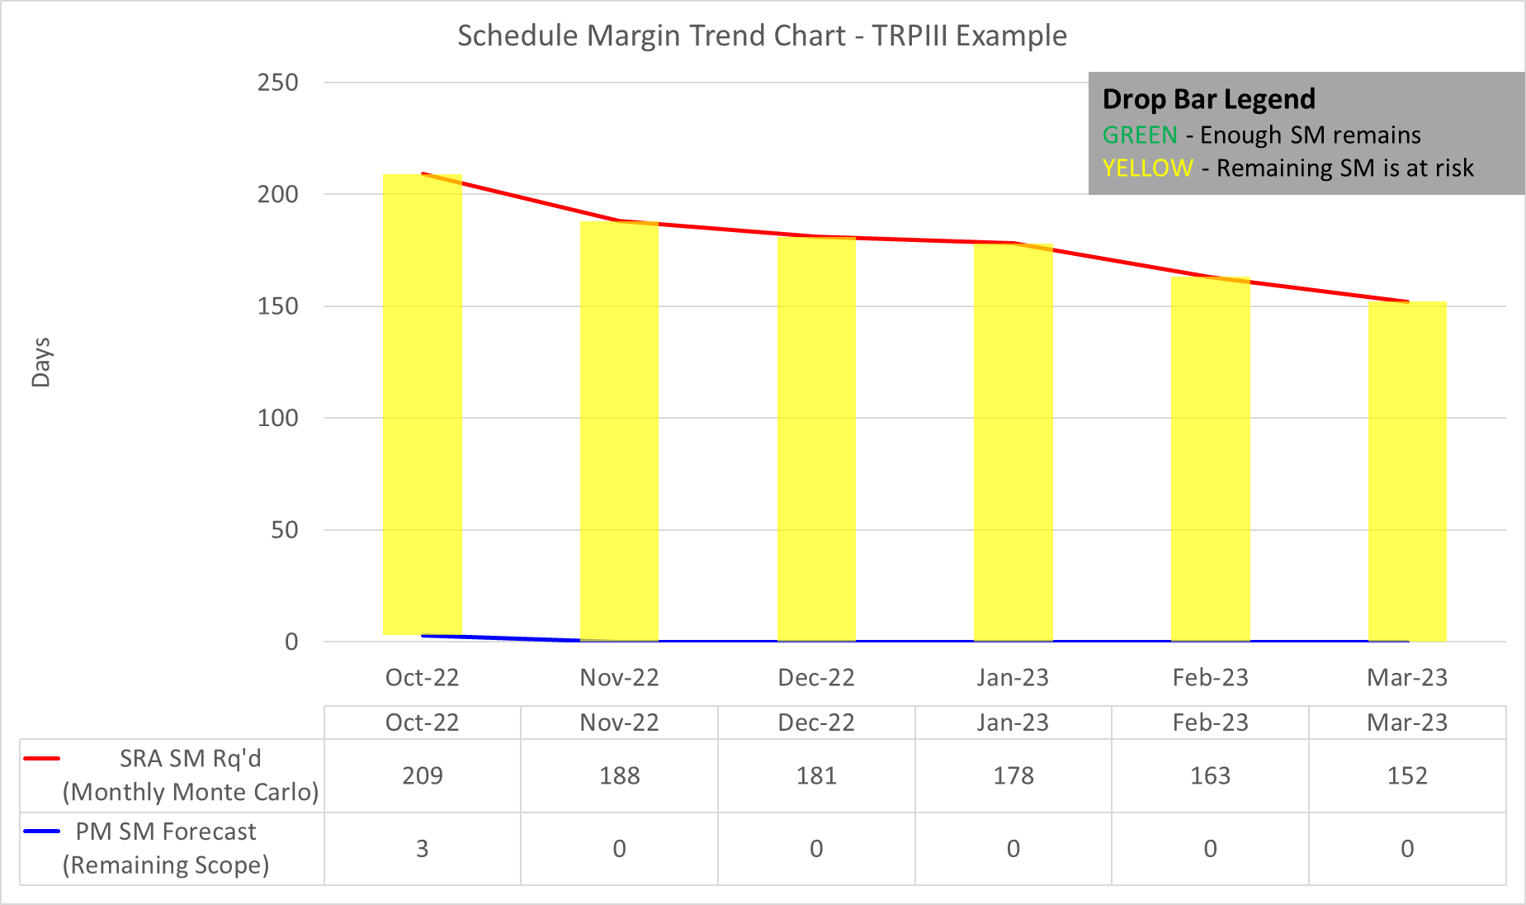

Slide 8
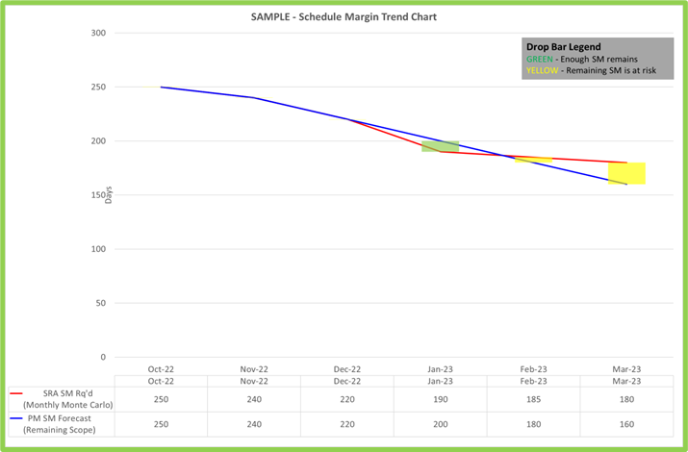
BACKUP

Slide 9
BACKUP

Slide 10
Conclusion:
Culture: Reporting “bad news” should be encouraged
Change “don’t tread on my margin” philosophy with stakeholders – Bad news does not improve with age!
Maturity: Tune-up requirements:
Ensure SRA forecast for remaining work can exceed remaining forecast SM
CBB moves into customer contingency OR Negative float is allowed – Justification needed and reported monthly

