Slide 1
EFCOG Working Group EVMS Tailoring & Scalability
Paul Tackett (CNS)
Kevin Carney (DOE PM-30)
April 10, 2023

Slide 2
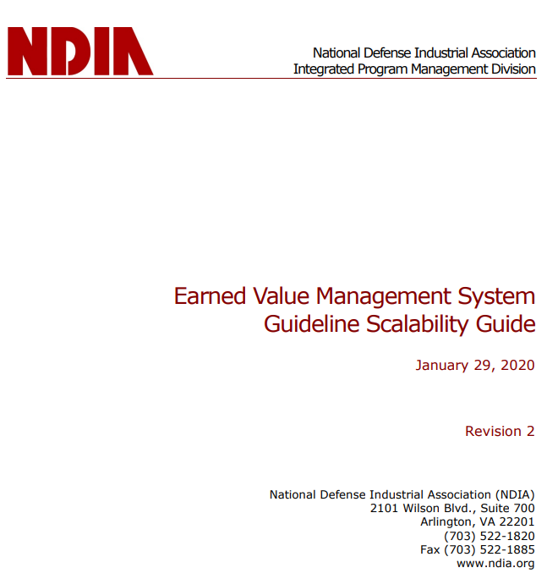
NDIA Activity
NDIA updating EVM Scalability Guide
Solid informational document on the merit of EVM principles
Limited guidance on tailoring
No mention of IP2M METRR
Voting member?
CNS influence on direction
Government input typically accepted
Type of update?
Minor “Evolutionary”
Major “Revolutionary”
Timeline?

Slide 3
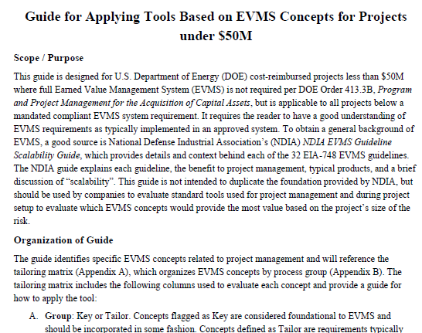
Prior EFCOG White Paper
EFCOG White Paper (Oct 2020)
Designed for DOE projects < $50M
Inventory of tools
Includes guide to tailoring
Considers project size and risk
Assumes reader is aware of EVMS tools and how they are used
Directs reader to NDIA for basic concepts
Prepared prior to IP2M METRR
Weighting of maturity attributes is not completely aligned
Add environment factor decision matrix;
Highlight foundational concepts

Slide 4
Options – Path Forward
Collaborate with NDIA to incorporate DOE objectives into existing NDIA scalability guide
Prepare stand alone DOE “issuance TBD”
Build on existing content (DOE guides and EFCOG White Paper)
Comprehensive
Longer development process
Large document
Hybrid approach
Smaller evolution from white paper
Point to other existing documents rather than incorporating content

