Slide 1
EVMS Self-Governance Implementation
Fluor BWXT Portsmouth
April 10, 2023

Slide 2
Implementation of Project Health Metric
EVMS Compliance Transition to Self-Governance
January 30, 2020 FBPORTS notified of successful demonstration of EVMS Compliance with 3 caveats
Implement an Estimated Actuals Process
Begin a Comprehensive EAC in 2Q FY20
Transition to the CSV PARS reporting format by June 30, 2020
Encourage continued partnership with PM in sharing lessons learned, continued development of consistent standards for EVMS compliance, and refinement of testing protocols and tools
Submit Surveillance reports to PM
Evolved and expanded our EV Checks, Project Health Checks and Schedule Metrics in support of PARS Audit Value responses

Slide 3
Implementation of Project Health Metric
Current Self-Governance Focus
Completion of PARS Audit Value Tests for 3 Capital Projects
PARSID 1047 OSWDF CAP-1
PARSID 1090 OSWDF CAP-2
PARSID 1163 X-326 Demolition
Currently evaluating against the 2020-02-10 Metrics
Continue evaluation of PARS Audit Values from October, November, and December
Complete loading of results from Automated, Hybrid, and Manual test results into an upload file

Slide 4
Transition to PARS Audit Value Guidelines Attributes and Tests
Transition of Automated Tests dependent upon availability of new metrics in PARS Audit value test outputs.
Automated tests drive numerator and denominator
Transition to new Metrics for Manual tests can begin in the next evaluation cycle
Building of FBP Internal Independent schedule/project checks continues and will evolve with the new metrics
Begin Environmental Assessment in conjunction with Process Area Maturity in the next evaluation cycle

Slide 5
Self-Governance
Develop Metric for completion of Self-Governance activities
Qualitative – Meeting, Surveillance visits with CAM / Control Team, Senior Management
Quantitative – Completion status for each Process Category Attribute metric
Test Complete
In-Progress
Test Incomplete
Frequency

Slide 6
Thoughts
Flat File CSV to JSON
Work with PM30 ongoing for JSON testing
Automatic Audit Vals
Schedule Health Metrics

Slide 7
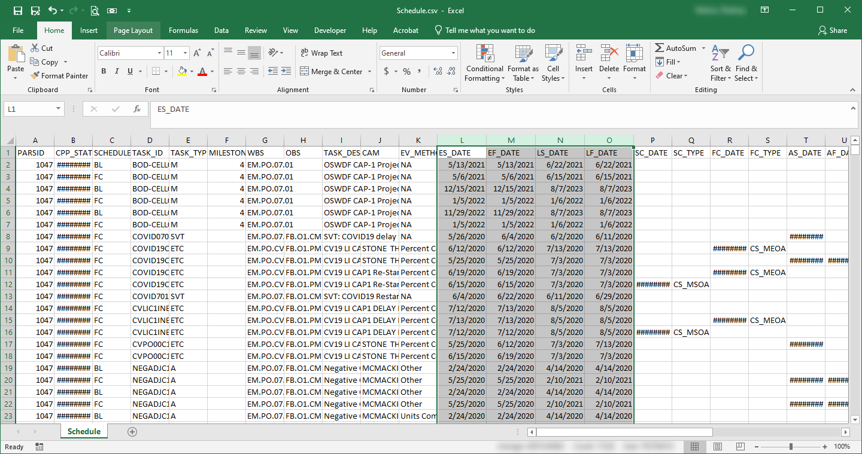
Thoughts
Flat File CSV to JSON
Started developing Flat File CSV uploads in late 2019

Slide 8
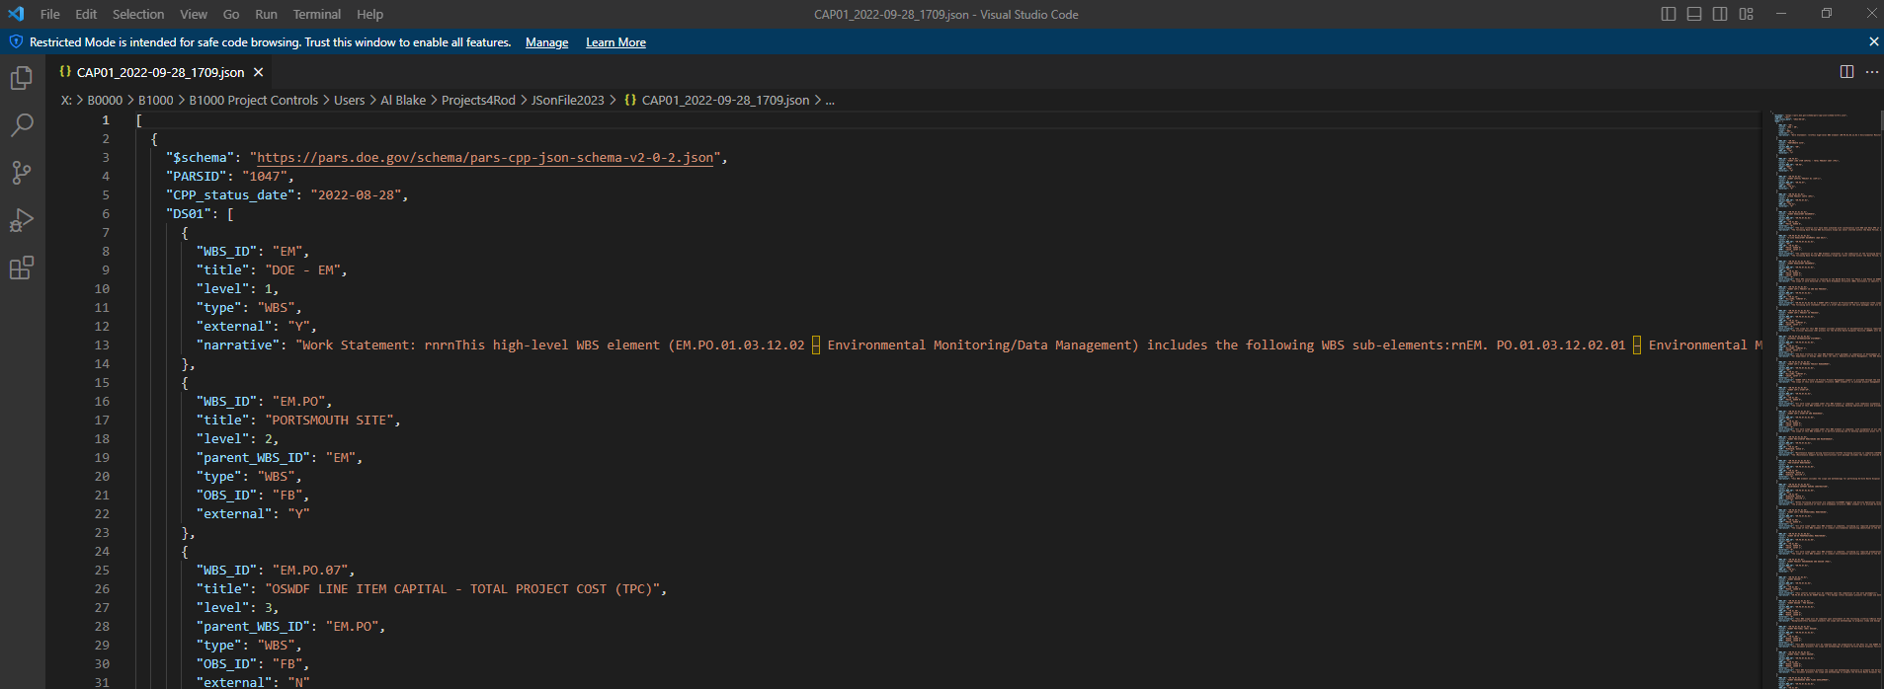
Thoughts
Flat File CSV to JSON
We have built the JSON within sql

Slide 9
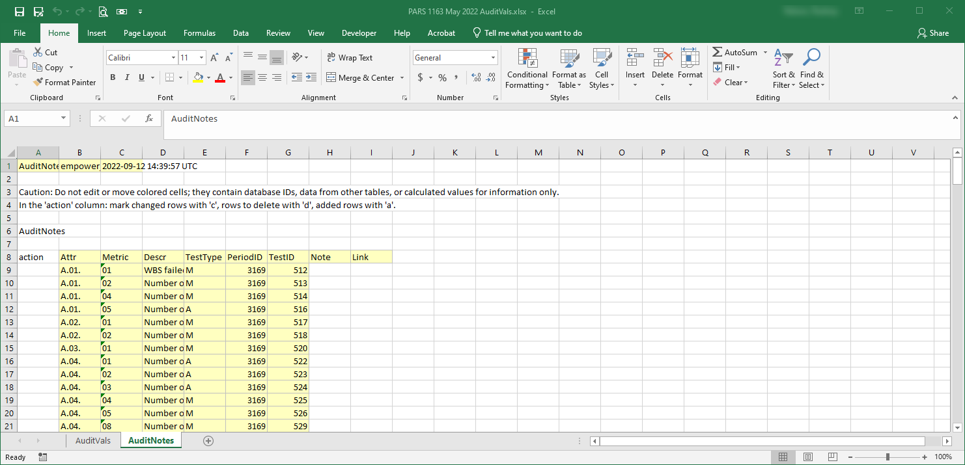
Thoughts
Automatic Audit Vals
Developed to pull into sql from PM30/PARS
Runs all automated tests on native data

Slide 10
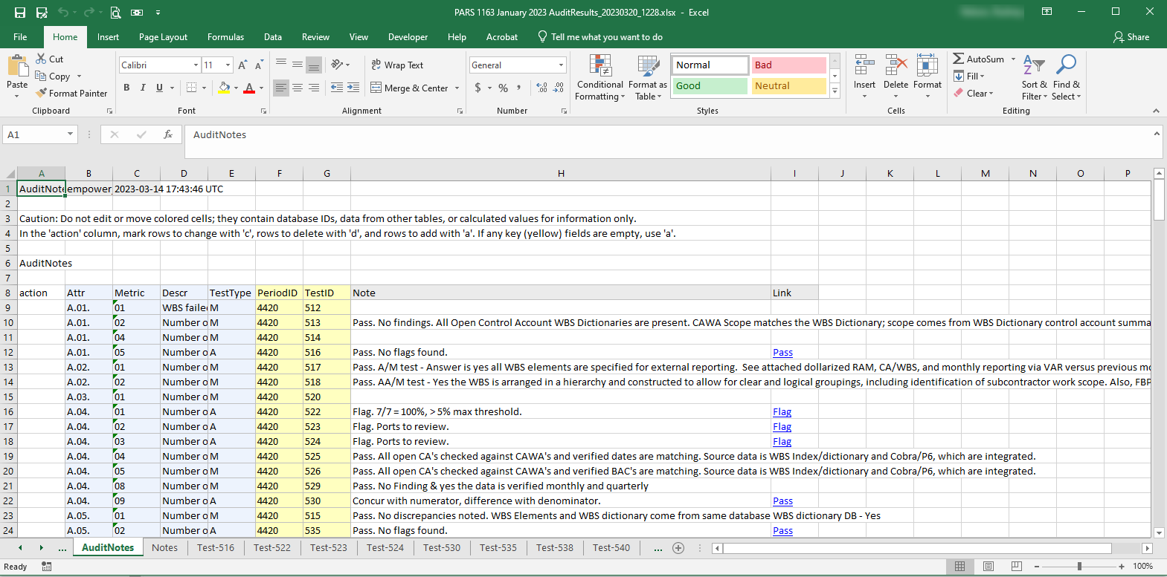
Thoughts
Automatic Audit Vals
Inserts Tabs into spreadsheet with comparisons between audit val results and native data results (X/Y)
Populates backup data in spreadsheets for reviewers so that data is readily available to formulate answers

Slide 11
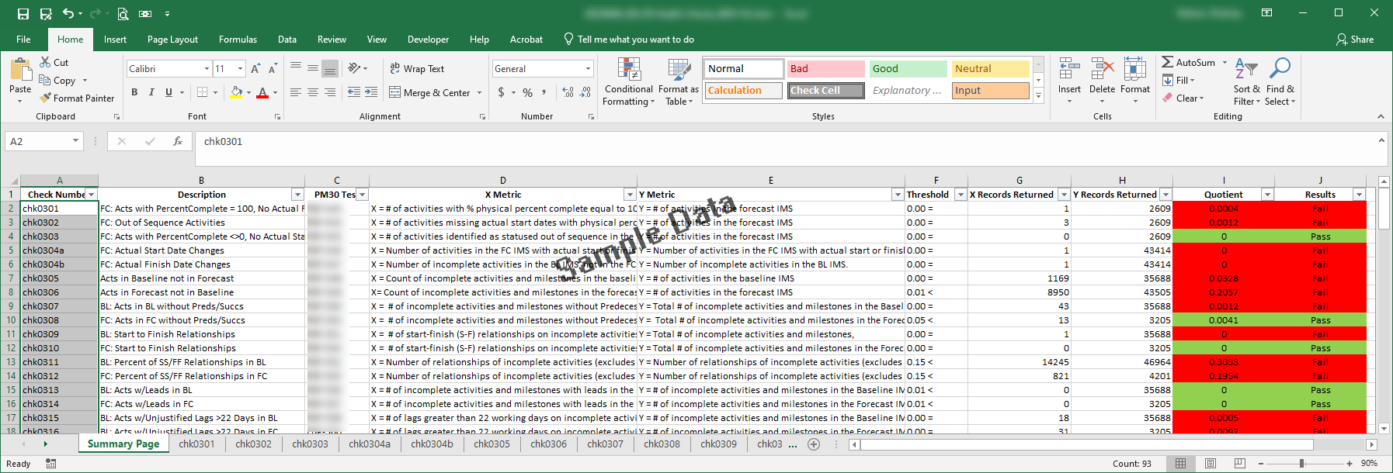
Thoughts
Schedule Health Metrics
Cobra to P6 Checks
P6 to P6 Checks
Cobra Health Checks
Overall Health Checks
EVMS Metric Spec Automated Tests

Slide 12
Thoughts
Schedule Health Metrics
Information and Tests are performed daily
Uploaded to EV NAV
Introducing automatic email notification

