Slide 1
TRIAD SELF GOVERNANCE
EVMS Executive Status Review
PMRC-EVMS-PO
June 20, 2023

Slide 2
Bottom Line Up Front
IP2M METRR Basis for Governance Model at Triad
EVMS Self Governance a point of stability that is bringing benefit to LANL
April’s EVMS Implementation Review (IR) for TLW a success
Excellent collaboration across line item executing orgs. leading to positive trends
Longer-term streamlining and improvement efforts underway
Supporting the delivery of successful line item projects the focus – challenges ahead

Slide 3
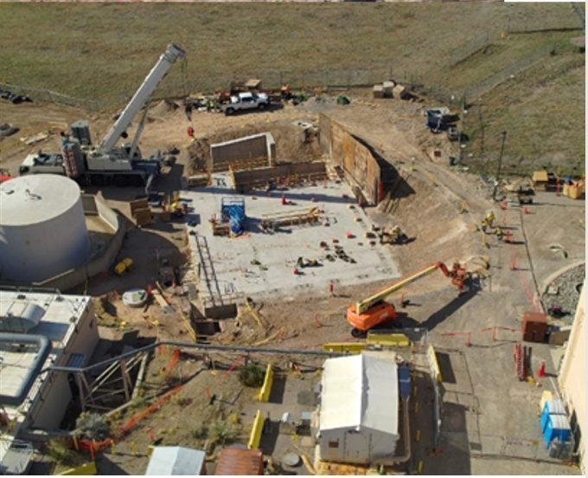
  TLW EVMS Active Surveillance – A Big Win for Triad
The April 15-18 EVMS Active Surveillance led by LANL’s EVMS-PO (not DOE!)
was a chance to demonstrate a complex first: DOE PM-30’s trust in the M&O contractor to
conduct its own implementation review.
    Three primary objectives:
    Assess overall EVMS compliance to the Triad certified system
    2) Enable TLW project to self-correct known/identified deficiencies
    3) Demonstrate to DOE-PM that Triad self-governance standard meets or exceeds expectations for internal surveillance, thus eliminating regular PM oversight.

Slide 4
TLW Project – Active Surveillance Results
Overall project meets expectations and is in general compliance with the LANL Certified EVM System
  8 Corrective Actions (CARs)
  3 Discrepancy Report (DRs)
Project has accepted all noted deficiencies through factual accuracy
Post review, PM-30 has communicated that their assessment of the Triad EVM Self-Governance is sufficient to warrant limited use formal IR’s moving forward. ASD will likely still require some PM participation (working to reduce this level)
DOE’s decision to allow all Triad line item projects to proceed under the approved EVMS self governance processes a major reduction in project effort and expenditure going forward.

Slide 5
Maturity Results
A. ORGANIZING | A.1 Product-Oriented Work Breakdown Structure (WBS) | A.2 Work Breakdown Structure (WBS) Hierarchy | A.3 Organizational Breakdown Structure (OBS) | A.4 Integrated System with Common Structures | A.5 Control Account (CA) to Organizational Element
B. PLANNING & SCHEDULING | B.1 Authorized, Time-Phased Work Scope | B.2 Schedule Provides Current Status | B.3 Horizontal Integration | B.4 Vertical Integration | B.5 Integrated Master Schedule (IMS) Resources
 | B.6 Schedule Detail | B.7 Critical Path and Float | B.8 Schedule Margin (SM) | B.9 Progress Measures and Indicators | B.10 Time-Phased Performance Measurement Baseline (PMB)
C. BUDGETING & WORK AUTHORIZATION | C.1 Scope, Schedule, and Budget Alignment | C.2 Summary Level Planning Packages (SLPPs) | C.3 Work Authorization Documents (WADs) | C.4 Work Authorization Prior to Performance | C.5 Budgeting by Elements of Cost (EOC) | C.6 Work Package Planning, Distinguishability and Duration
 | C.7 Measurable Units and Budget Substantiation | C.8 Appropriate Assignment of Earned Value Techniques (EVTs) | C.9 Identify and Control Level of Effort (LOE) Work Scope | C.10 Identify Management Reserve (MR) Budget | C.11 Undistributed Budget (UB) | C.12 Reconcile to Target Cost Goal
D. ACCOUNTING CONSIDERATIONS | D.1 Direct Costs | D.2 Actual Cost Reconciliation | D.3 Recording Direct Costs to Control Accounts and/or Work Packages | D.4 Direct Cost Breakdown Summary

Slide 6
Maturity Results – Cont’d
E. INDIRECT BUDGET & COST MANAGEMENT | E.1 Indirect Account Organization Structure | E.2 Indirect Budget Management | E.3. Record/Allocate Indirect Costs | E.4 Indirect Variance Analysis
F. ANALYSIS & MANAGEMENT REPORTING | F.1 Calculating Variances | F.2 Variances to Control Accounts (CAs) | F.3 Performance Measurement Information | F.4 Management Analysis and Corrective Actions | F.5 Estimates at Completion (EAC)
G. CHANGE CONTROL | G.1 Controlling Management Reserve and Undistributed Budget | G.2 Incorporate Changes in a Timely Manner | G.3 Baseline Changes Reconciliation | G.4 Control of Retroactive Changes | G.5 Preventing Unauthorized Revisions to the CBB/PBB | G.6 Over Target Baseline/Over Target Schedule Authorization
H. MATERIAL MANAGEMENT | H.1 Recording Actual Material Costs | H.2 Material Performance | H.3 Residual Material | H.4 Material Price/Usage Variance | H.5 Identification of Unit Costs and Lot Costs
I. SUBCONTRACT MANAGEMENT | I.1 Subcontract Identification and Requirements Flow Down | I.2 Subcontractor Integration and Analysis | I.3 Subcontract Oversight
J. RISK MANAGEMENT | J.1 Identify and Analyze Risk | J.2 Risk Integration

Slide 7
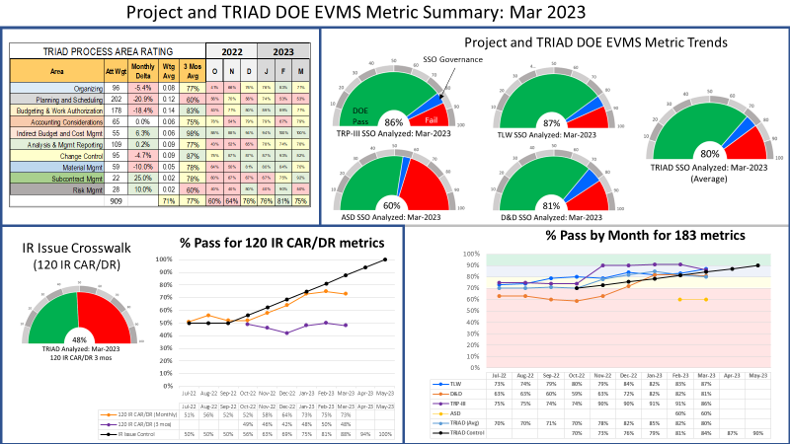
Triad’s Project Data can be Trusted: March ‘23 Data & Trends

Slide 8
Triad EV Environmental Factors Showing Improvement
90 Point Improvement
251 Point Improvement
121 Point Improvement
95 Point Improvement

Slide 9
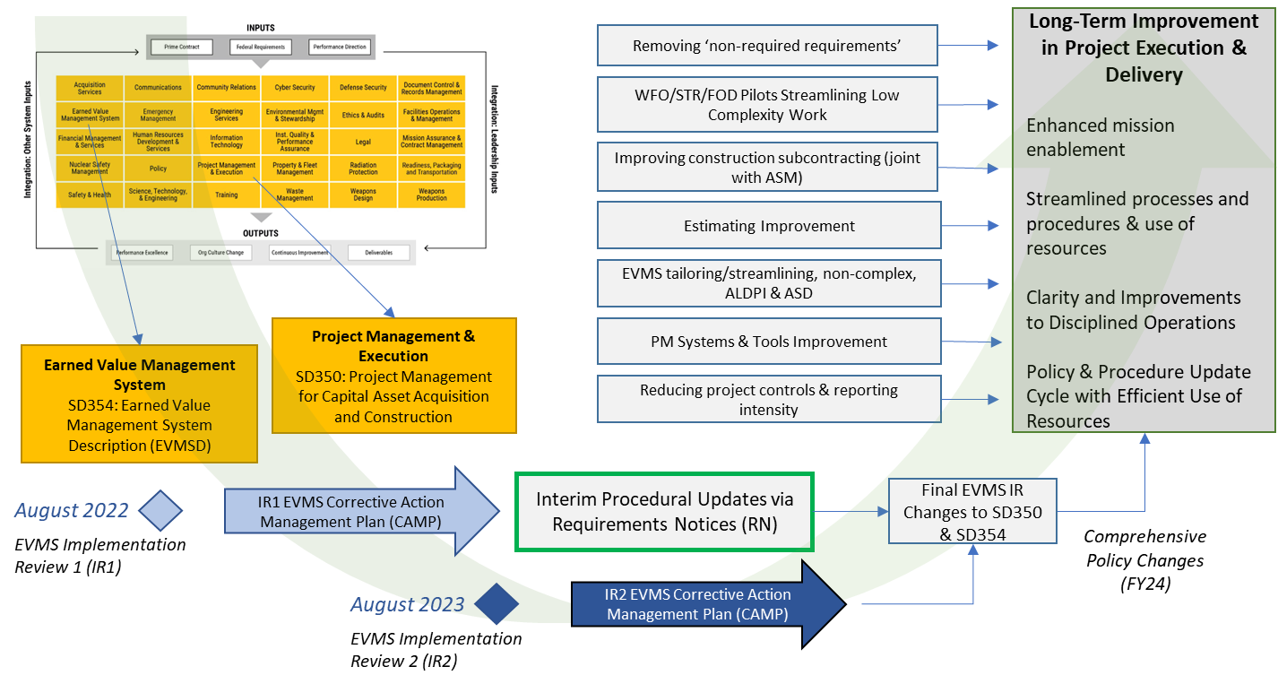
Longer-Term Improvements Underway

Slide 10
PARS Cost/Schedule Performance Summary: Apr 2023
Risk
Cost:
  3 & 6 month trends degrading across projects
Schedule:
  Cum. 3 & 6 month performance poor across projects (ASD outlier with improvement)
Risk (Management Reserve & Schedule Margin)

