Slide 1
Apportioned Earned Value Technique (Methodology) Best Practice White Paper
Mo Aboushousha / Doug Marbourg
September 12, 2023

Slide 2
Purpose
Demonstrate Apportioned EVT best practices and improve implementation guidelines
Promote the use of Apportioned EVT on DOE O 413.3B Capital Asset projects
Better planning and representation of the work
Apportioned EVT is a discrete deliverables with a start and finish
Better accuracy of measuring schedule and cost variances
Addresses appropriate use of Apportioned EVT vs. LOE EVT

Slide 3
Timeline
Apportioned focus group established in early June 2023
Development of White Paper requested by PM-30 with EFCOG participation in mid July
Participants included EFCOG members from several sites, Deltek, and PM-30
Draft White Paper sent to focus group in early August, with comment received and incorporated
Final Draft is ready

Slide 4
Definition
“Apportioned effort is effort that by itself is not readily divisible into short-span work packages but is related in direct proportion to an activity or activities with discrete measured effort. Apportioned effort work packages can be defined as discrete work packages, but apportioned effort tasks are unique because they are closely dependent on another discrete work package.” ⁽¹⁾
vs.
“Level of effort reflects earned value for activities that are merely related to the passage of time and have no physical products or defined deliverables…Level of effort should be used sparingly; programs that report a high amount of level of effort for measuring earned value are not providing objective data and the EVM system will not perform as expected. As a general rule, if more than 15 percent of a program’s budget is classified as level of effort, then the amount should be scrutinized. When level of effort is used excessively for measuring status, the program is not implementing EVM as intended and will fall short of the benefits EVM can offer.” ⁽²⁾
(1) 2015-12-22 GAO-16-89G Schedule Assessment Guide, (2) 2020-03-12 GAO-20-195G Cost Estimating and Assessment Guide

Slide 5
Background and Assumptions
For consistent reference of terminology:
Apportioned Work Package (WP) is referred to as “Target” WP
Discrete WP(s) that the Apportioned effort supports is referred to as “Base” WP(s)
There are various scenarios of target/base combination:
One Target to multiple Base (most common on DOE Capital Asset projects)
One Target to one Base, multiple Target to one Base, or multiple Target to multiple Base
According to DOE CPP DID V5-0-0, PARS* Upload Requirement, two defined Apportioned EVTs:
Apportioned (EVT J) is limited to target (one or more) to only one base combination
Calculated Apportionment (EVT M) is more robust to support any combination of target to base applications
Either EVTs can be used for Apportioned effort, depending on application
Baseline changes to the base discrete WPs will require changes to the target apportioned WPs.
* Contractor Project Performance Data Item Description / Project Assessment and Reporting System

Slide 6
EVMS Considerations (Key Points)
A capital asset project is in essence a discrete deliverable with a start and a finish; thus, the use of discrete EVT is a given
The use of LOE EVT can mask mask discrete performance
The use of apportioned EVT, and the increased use of discrete EVT, should improve project planning and execution
Apportioned WP must be assigned to discrete WP(s) within the same CA
This has the advantage to control Apportioned WP duration, easily trace the discrete-to-apportioned supported scope
Demonstrates consistent (like-for-like scope within the CA) and isolated variance and performance analysis at the CA level
Apportioned WP BCWS profile should be based on, but does not need to align with, the discrete WP BCWS profile(s)
Basis of Estimate documents Apportioned WP(s) assumptions, factoring and correlation to Discrete WPs
Like LOE, as support-type tasks, the apportioned tasks should not drive the critical path
Apportioned WP is considered special type of discrete, sound logic and schedule structure will apply
Apportioned task (target) predecessor is established to the discrete tasks (base) as SS & FF relationship
Apportioned effort BCWP is earned as technical work is accomplished in the discrete (base)
Following the discrete earned performance percent completion
Apportioned effort may have schedule variance, when compared to its planned BCWS

Slide 7
Apportioned Effort Development Phases
Step 1: Determine the discrete WP(s) (base) that Apportioned WP (target) will support
Step 2: Establish BOE for the Apportioned WP and its relationship to the discrete WP
Type and number of Apportioned resources needed to support the discrete WPs
The Apportioned WP’s BCWS profile may not align with the discrete WP’s BCWS profile, document assumptions
Establish the apportioned factoring (percent of planned and actual accomplishment earned by the base WPs)
Step 3: Plan the Apportioned effort in the schedule tool, then the cost tool
Scheduling will establish the Apportioned WP, develop tasks and their resources
Establish logic of the Apportioned effort tasks and their relationship to the discrete tasks SS & FF to discrete (base)
Cost tool planning includes setting up Apportioned WP and defining the rules for correlation to discrete (base) WPs
The rules include: 1) defining the relationships between discrete WPs and Apportioned WP, 2) determining percent (factoring) of the Apportioned WP in relation to the discrete WP, and 3) establishing BCWS time-phasing (profile).
Step 4: As discrete WP(s) progresses, Apportioned WP (target) will start earning performance
Apportioned WP performance is earned at the same rate
Cost tool calculates apportioned WP(s) earned performance as a weighted percent complete of the discrete WP(s)

Slide 8
Conclusion
“Apportioned EVT, as implemented appropriately including when LOE EVT is considered, will improve project planning and execution. Apportioned EVT will help the project team better analyze schedule and cost variances, so impacts are clearly identified, and appropriate corrective actions are established and implemented.
It is important to correlate like-to-like scope when establishing the discrete WP(s) (base) to the apportioned WP(s) (target) and within the same CA. The apportioned WP (target) budgeted cost of work scheduled (BCWS) profile(s) should be based on but does not need to align with the discrete WP (base) BCWS profile(s). The apportioned WP(s) (target) earned performance equals to the overall weighted incremental percent complete of the discrete WP(s) (base).
The use of apportioned EVT and the increased use of discrete EVT should improve project planning and execution on DOE O 413.3B capital asset projects.”

Slide 9
Apportioned Effort Systems Steps

Slide 10
Scenarios and Examples
Using Cobra as the cost tool, there are two Apportioned effort setups:
Apportioned (EVT J), which is simply used to collect the percent complete from the discrete (base) WP and distribute it to the Apportioned (target) WP(s). This option is limited to only one base supporting multiple target.
Calculated Apportionment (EVT M) is more robust across various WPs and allows more flexible set up to accommodate various apportioned to discrete applications and resources (i.e. multiple base to multiple target).
Calculated Apportionment (EVT M) is the recommended setup.
Using Calculated Apportionment (EVT M), two scenarios can be implemented in P6 and Cobra:
Scenario 1: establish and maintain Apportioned effort WP/activity budget and ETC, including BCWS and ETC time-phasing spread in P6. Cobra calculates BCWP.
Scenario 2: establish and maintain Apportioned effort WP budget and ETC, including BCWS and ETC time-phasing, in Cobra, and transfer this to P6. Cobra calculates BCWP. The corresponding performance percent complete is also transferred to P6.
Scenario 2 is a recommended option, if BCWS and ETC time-phasing profile of the Apportioned (target) WP follow and established as a factor of the discrete (base) WP(s) profile.

Slide 11
Scenario 1
Reference the attached example and process steps
Establish and maintain Apportioned effort WP/activity budget and ETC, including BCWS and ETC time-phasing spread in P6, transfer and integrate to Cobra. Cobra calculates BCWP for the Apportioned effort WP.
In general, the Apportioned effort WP (target) has one activity, discrete WPs (base) have multiple activities.
Using Calculated Apportionment method in Cobra (EVT M), as it supports one Apportioned effort WP (target) to many discrete WPs (base), the Apportioned effort WP BCWP (based on performance percent complete) is calculated, proportioned to the discrete WPs that it supports.
P6/Cobra integration and data flow (discrete, apportioned and LOE WPs) is from P6 to Cobra - normal integration process, with exception to BCWP (percent complete). Performance percent complete is calculated in Cobra, then entered/updated manually in P6. This is the same process for LOE WPs
This scenario requires some involved set-up in Cobra for calculating BCWP for the Apportioned effort WP. The set-up requires adding and defining specific unique apportioned resources in Cobra that map to MRD resources, establishing apportioned rate (factors) for the apportioned resources, and defining apportioned calculation rules.

Slide 12
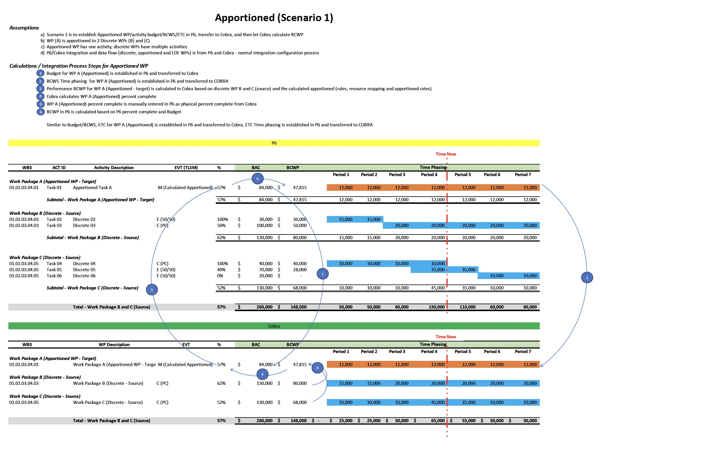

Slide 13
Scenario 2
Reference the attached example and process steps
Cobra establishes the Apportioned WP effort budget and ETC, including BCWS and ETC time-phasing, as a rate (factor) applied to the discrete WPs that the Apportioned effort WP supports. Cobra calculates BCWP for the apportioned WP.
In general, the Apportioned effort WP (target) has one activity, discrete WPs (base) have multiple activities.
As the Apportioned effort WP budget and ETC, including BCWS and ETC time-phasing, are established in Cobra, this scenario will require syncing/entering the budget and ETC in P6 for the Apportioned effort WP. As P6 spreads the resources evenly, the BCWS and ETC time-phasing between Cobra and P6 will not match, however, BCWP and performance percent complete will match.
Using Calculated Apportioned method in Cobra (EVT M), as it supports one Apportioned effort WP (target) to many discrete WPs (base), the Apportioned effort WP BCWP (based on performance percent complete) is calculated, proportioned to the discrete WPs that it supports. Performance percent complete is then entered/updated manually in P6. This is the same process for LOE WPs.
There is no automated integration from Cobra to P6 and Cobra, unlike the discrete WPs, where the data flow is from P6 and Cobra. Therefore, the data must be manually synced between Cobra and P6.
This scenario requires involved set-up in Cobra for calculating budgets, ETC, BCWS and ETC time-phasing, and BCWP for the Apportioned effort WP. The set-up requires adding and defining specific unique apportioned resources in Cobra that map to the planning resources, establishing apportioned rate (factors) for the apportioned resources, and defining apportioned calculation rules.

Slide 14
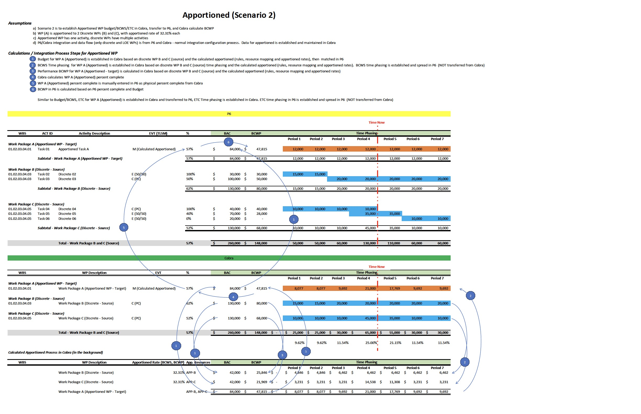

Slide 15
Other Information

Slide 16
Apportioned Effort Baseline Changes
As baseline changes implemented for discrete WPs (base), analyze impact on Apportioned WP (target)
BOE that are established at baseline implementation are reviewed and revised, as necessary
It is expected that correlated changes will occur for the Apportioned WP (base) budget and time-phasing
For work scope that has not started, discrete WPs (base) and Apportioned WP (target), if impacted, will reflect changes for budget at completion (BAC) and time-phasing BCWS in the requested baseline change proposal (BCP)
For work scope in-progress, discrete WPs (base) and Apportioned WP (target), if impacted, will reflect only changes for remaining budget and future time-phasing BCWS in the requested baseline change proposal (BCP).
In this case (in-progress Apportioned effort), historical budget and BCWS are not changed, and only changes are made to future remaining budget and BCWS.
Sites should follow their processes to maintain historical budgets/BCWS when re-planning the Apportioned WP (target) in the schedule and cost tools, which may require in some cases, to cleave in-progress tasks.
Sites EVMS system description and DOE EVMS guidelines are followed for baseline changes and freeze period.

Slide 17
Apportioned Effort Published Guidelines

Slide 18
References
2022-06-01 ECRSOP; app.A; CAG 2.0 (EVT J)
2022-04-08 DOE G 413.3-24 planning & scheduling (EVT J)
2020-03-12 GAO-20-195G (EVT J)
2015-12-22 GAO-16-89G (Apportioned Effort)
2022-09-12 NDIA PASEG (Apportioned Effort)
2012-01-01 H&A website (EVT J)
2016-10-24 PMI website (EVT J)
2020-08-13 AACEI; toc_79r-13 (EVT J)
2023-08-14 DOE CPP DID v05.00
2023-06-21 DOE O 413.3B Chg 7

