Slide 2
WebEVM CPP JSON Data Export
Four Sections to define settings

Slide 3
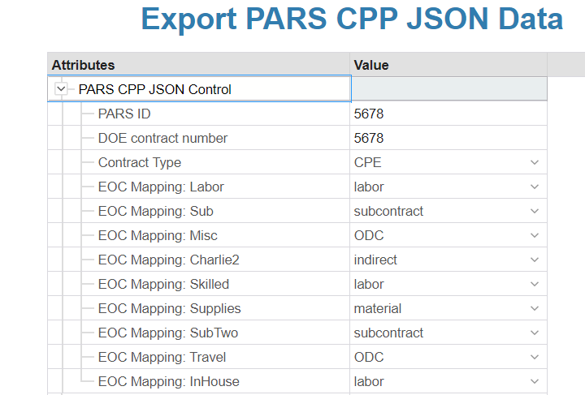
PARS CPP JSON Control Settings
Identifies PARS ID, contractual information and EOC Mapping

Slide 4
PARS CPP JSON Control Settings
All IPMR/CPR information will be exported. The tool requires Program Name, Contact Name/No. and completion date at a minimum.

Slide 5
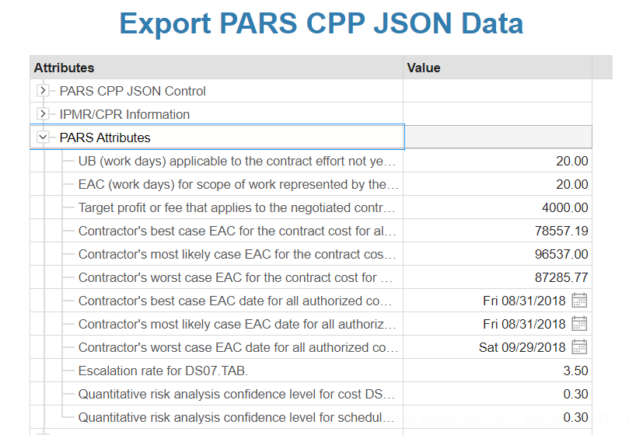
PARS Attributes
Identifies UB/EAC days, Best Case, Most likely, Worst Case Information, Escalation Rate and Quantitative Risk Confidence levels

Slide 6
PARS Thresholds
Identifies cumulative, incremental, VAC dollar and percentage threshold cost and schedule values

Slide 7
PARS Export
Zip file containing four json files

Slide 8
PARS JSON Validator Tool

