Slide 1
Classified Matter Channel (CMC)
Presented by CMPC - Maretta King
SAND2019-4056 PE

Slide 2
Objectives
Review federal policies for classified mail channels
Discuss classified mail channel challenges
Discuss how your sites manage these challenges

Slide 3
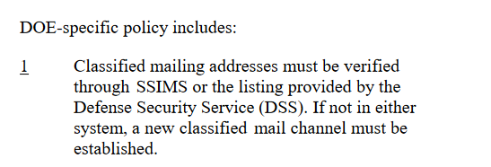
Federal Requirements
DOE O 471.6, Chg. 2, Information Security

Slide 4
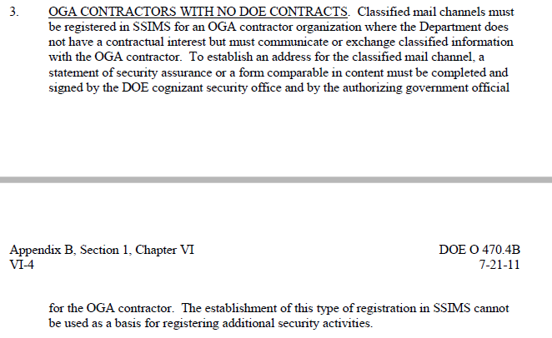
Federal Requirements
DOE O 470.4B, Chg. 2, Safeguards and Security
Appendix B

Slide 5
Facility Clearances
United States Department of Energy:
Safeguards & Security Information Management System
Facility Data and Approval Record (FDAR)
Statement of Security Assurance (SSA)
Defense Security Service (DSS) Portal:
National Industrial Security Program (NISP) Central Access Information Security System (NCAISS)
National Industrial Security System (NISS)
United States Department of Energy, National Nuclear Security Administration, Office of Secure Transportation
Certification Program Directory (CPD)

Slide 6
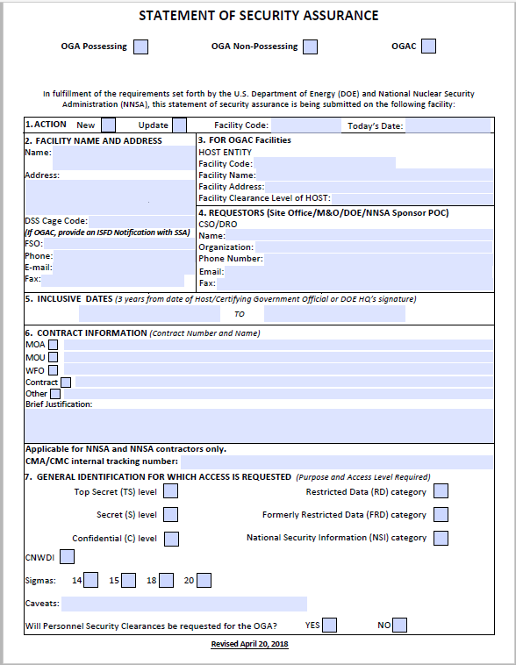
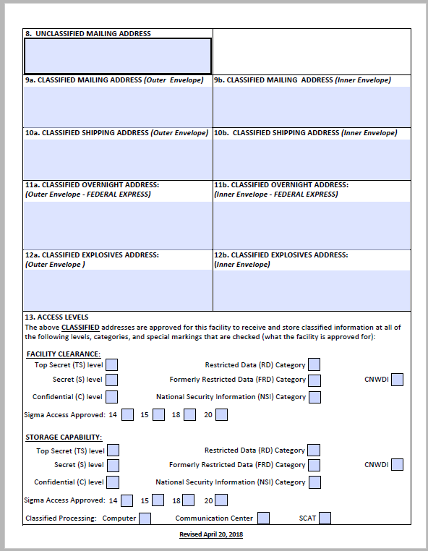
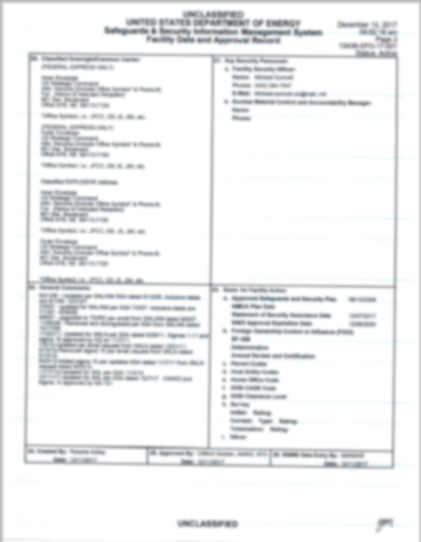
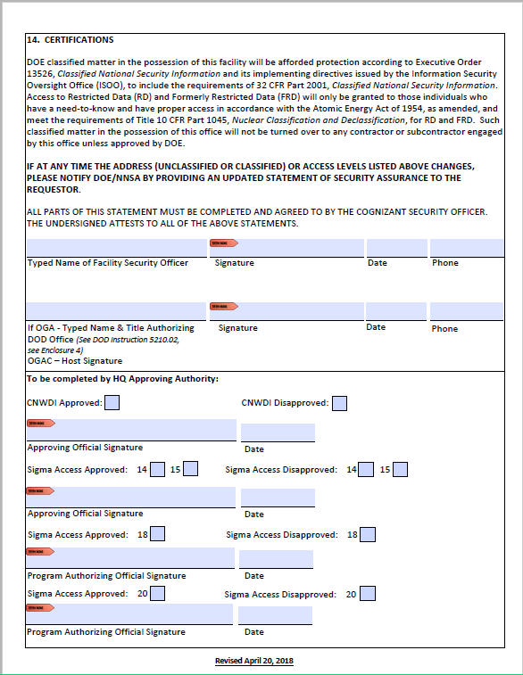
Safeguards & Security Information Management System (SSIMS)
Statement of Security Assurance (SSA)
Facility Data and Approval Record (FDAR)

Slide 7
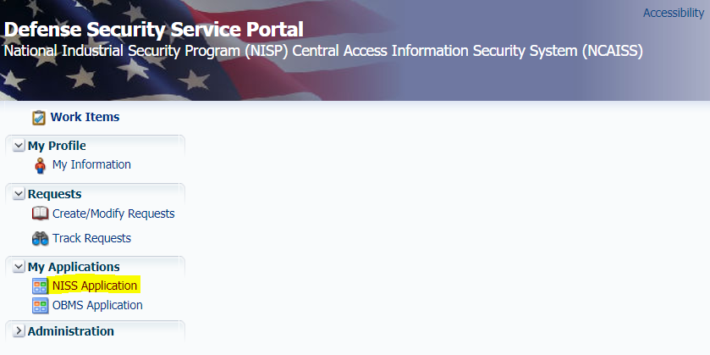
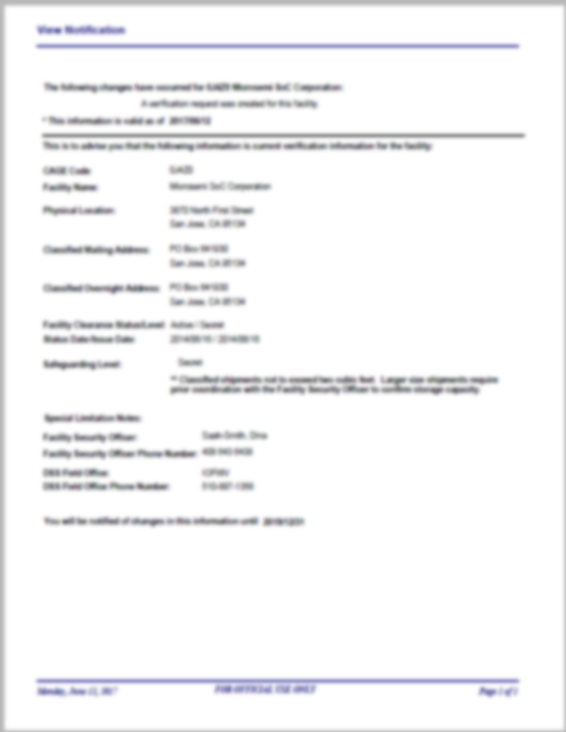
National Industrial Security System (NISS)
DSS/NISS Notification
SSA
When FedEx Address not on NISS Notification

Slide 8
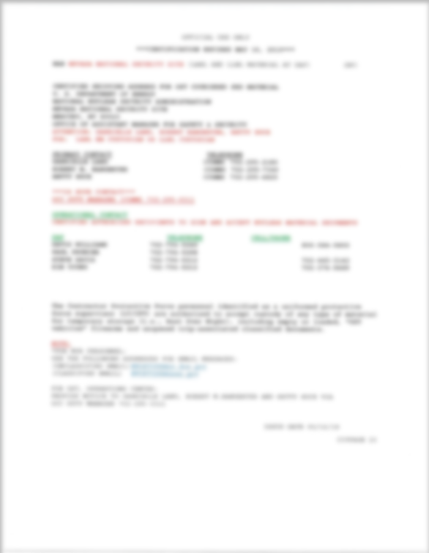
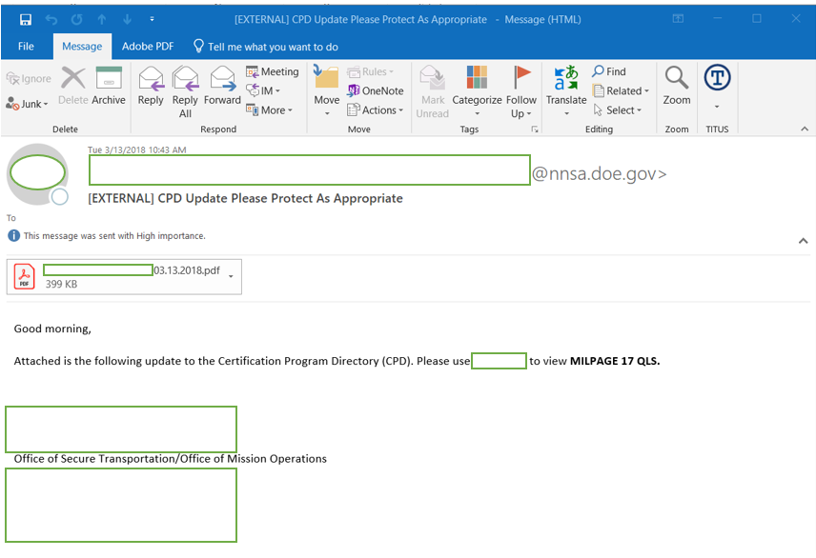
Certification Program Directory (CPD)
Email Notification
Certificate

Slide 9
Classified Mail Channel Challenges:
Lack of Training and Policy Guidance:
Who is our federal SME?
Training: other than SSIMS training, no other training offered on how to process requests.
When new staff at contractors sites are assigned, acquiring the knowledge, skills and abilities is significantly challenging due to lack of training.
Required form management (e.g., Statement of Security Assurance [SSA], Facility Data Approval Record [FDAR]):
Example #1- An SSA submittal by SNL was rejected by NA-10 because it was not on the new version of the form. Nobody communicated the update to the contractors.
Example #2- Who do contractors contact if they need assistance with interpreting fields on the FDAR (e.g., Storage vs. Processing in SSIMS; CNWDI vs. WD field)

Slide 10
Classified Mail Channel Challenges (cont’d):
SSIMS Database Challenges:
The FDAR and CSCS sections of SSIMS being hosted on an SRD classified network creates access challenges (e.g., data retrieved must always be reviewed by a DC).
DSS/NISS (DoD facility clearance database) is unclassified and more user friendly.
Process to verify data is manual in SSIMS (run reports to identify discrepancies). DSS/NISS provides email notifications (more time efficient).

Slide 11
Classified Mail Channel Challenges (cont’d):
Processing Challenges:
Many facility security officers (FSOs) are untrained and have no knowledge of the process and/or required forms.
In most federal audits of CMPC (EA-22), the assessment process is minimal. Auditors recognize the process and forms are complicated.
Approval times (may impact mission)
NA-10 requires 30 days notice for CNWDI and Sigmas
NA-70 requires 10 working days for FDAR entry into SSIMS

Slide 12
Classified Mail Channel Challenges (cont’d):
Logistics Challenges:
External entities not following information provided in SSIMS (e.g.., using incorrect addresses, not following approved special instructions).
Handling the above problems when the external entity is an OGA or OGAC.
External entities providing shipping information that is not captured in the federal approved system (e.g., SSIMS, DSS/NISS).
DoD and their contractors do not have access to SSIMS. Call NNSA/DOE contractors saying they can’t find us in their DSS/NISS (e.g., cage code).

Slide 13
Discussion
Questions for the group:
What are the biggest challenges at your site related to classified mail channels?
Does your site integrate procurement (e.g., work agreements/contracts) into your classified mail channel process?
How do you handle logistic issues from external entities (OGAs and OGACs)?

Slide 14
Questions & Answers

Slide 15
Work Agreements/Contracts
Not a Federal requirement, but a local requirement. Helps manage the movement of classified matter.
Manager certifies/approves via CMCD that the transmission of classified matter is required by the specific terms of the Work Agreement/Contract for the performance of official or contractual duties.
Types of Work Agreements/Contracts utilized at Sandia National Laboratories
NTESS Prime Contract No. DE-NA0003525
SNL’s subcontractors (suppliers)/Oracle
CRADA
Strategic Partnership Projects
Strategic Intelligence Partnership Program

Slide 16
Work Agreements in Detail
NTESS Prime Contract
When work does not fall under any of the other contracts, such as quarterly classified meetings to share information with contractors as directed by DOE or classified conferences.
SNL’s Subcontractors/Oracle Financial Contract
Oracle PO Contract any purchase order that is issued in the Oracle database and contracts that Sandia issues to its sub-contractors. If being used in conjunction with CMC, the facility must be a possessing site.
CRADA
Agreement between one or more laboratories and one or more non-federal entities (CRADA Participants), including industry, that facilities private-sector collaboration utilizing laboratories’ technologies, processes, R&D capabilities, or technical know-how.
Strategic Partnership Projects
SPP is designed to provide research, development, and technical assistance for non-DOE/NNSA sponsors that are not directly funded by DOE/NNSA. If a SPP project is classified, a Contract Security Classification Specification (CSCS) form (SF 7643-WFO) is required to document the exchange of classification and protection of information and record applicable classification guidance provided by the sponsor.
Strategic Intelligence Partnership Program
When the SPP involves Intelligence work

Slide 17
Approvals
SNL Management
DOE NNSA, Weapon Security and Control Division, NA-10
SRD/CNWDI/Sigma’s
FCL/FOCI, DOE NNSA, Facility and Personnel Clearance Processing Division, NA-70
SRD/CNWDI/Sigma’s, after NA-10 approval
SFRD and below w/SSA and not in DSS/NISS
Data Entry for SNL
CMC Coordinator
SFRD and below and in DSS/NISS

Slide 18
Time Frame
Expedited
~ 1 day to 3 days
Standard
~1 day to many months
Factors
Category, Level, and/or caveats
Contracts
Personnel
Approvals
Designated Responsible Office (DRO’s)

Slide 19
How are SNL Channels created?
Facility Clearance
Facility Information
Facility Name
Facility Security Officer Name
Contact Information (Phone Number and Email)
Channel Information
Delivery Types
Clearance Information (Category/Level/Caveats)
Work Agreements/Contracts
Contract Type
Approving Manager
Requester
Classification
Authorized Users/Orgs
Delivery Type
Approvals

Slide 20
CMCD and other Applications
Sandia Directory
Strategic Partnership Projects Application
Contract Security Management
Personnel Clearance Office Company Data
Web Shipper (SNL’s Shipping & Receiving)

Slide 21
2010 Flowchart – New CMC

Slide 22
2010 Flowchart - Renew

Slide 23
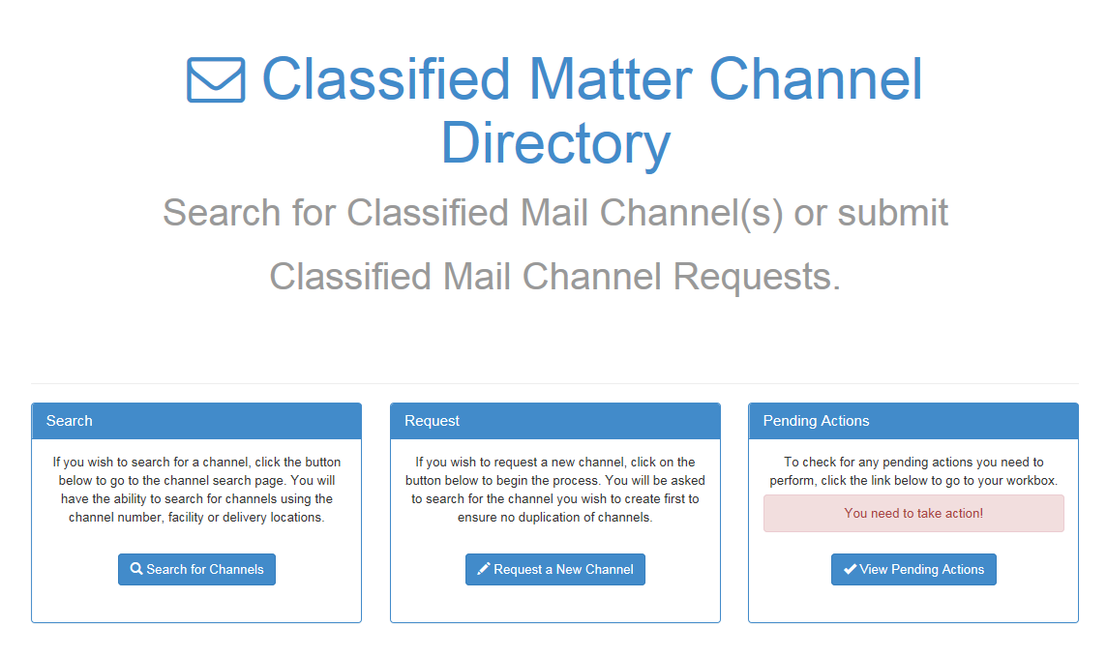
Classified Matter Channel Directory (CMCD)
FCL + Work Agreement/Contract = CMC

Slide 24
What is the CMC Directory (CMCD)?
Provides a directory of available facilities that are authorized to receive & store classified matter.
Used when sending classified matter externally (different facility code from SNL).
Provides mailing information: inner and outer addresses, special instructions, and including SNL’s return address utilizing the FDAR, ISFD, or CPD Facility Clearances (FCL).
Lists contracts authorized to use channel (including Level/Category/Caveat and authorized Orgs).

