Slide 1
Center for Security Technology, Analysis, Response, & Testing (CSTART)
April 20, 2022

Slide 2
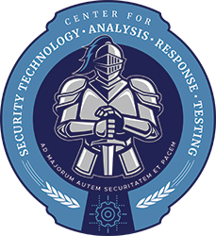
What is CSTART?
A virtual portal that brings together subject matter experts from NNSA and partner organizations
Goal: Enhance the physical security program across NNSA’s nuclear security enterprise
Key functions:
Provide expertise on security technologies, systems, analysis, testing, inspection support, training, and response forces
Collect, analyze, and distribute lessons learned
Support inspections and oversight activities
Promote professional development and training for security professionals
Advocate for continual improvement and security excellence

Slide 3
CSTART Centers of Excellence
Physical Security Center of Excellence
(PSCOE)
Security Operations Center of Excellence
(SOCOE)
Pacific Northwest National Laboratory
Richland, WA
Sandia National Laboratories
Albuquerque, NM
To contribute to the nuclear security operations and strategic initiatives, support a consistent and sustainable implementation of applicable programmatic regulations, and expand collaboration with all stakeholders, agencies, and partners
To develop and implement physical security solutions for our nation’s nuclear deterrence and critical assets against evolving threats

Slide 4
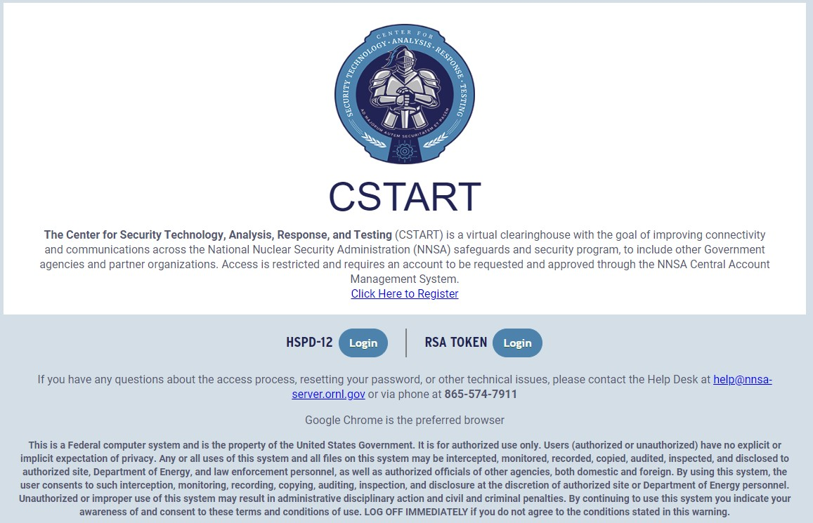
CSTART Portal Access
https://cstart-sec.nnsa.doe.gov

Slide 5
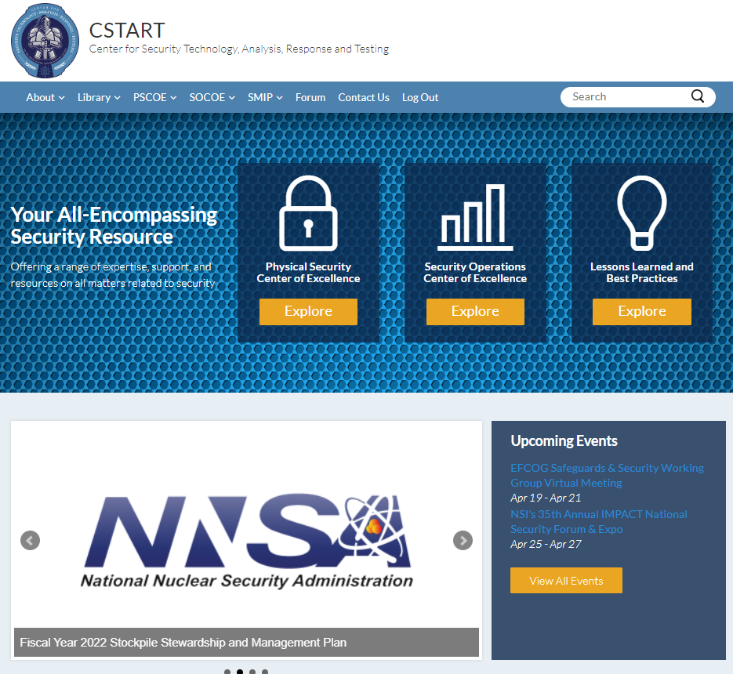
CSTART Main Page
New Look and Feel!

Slide 6
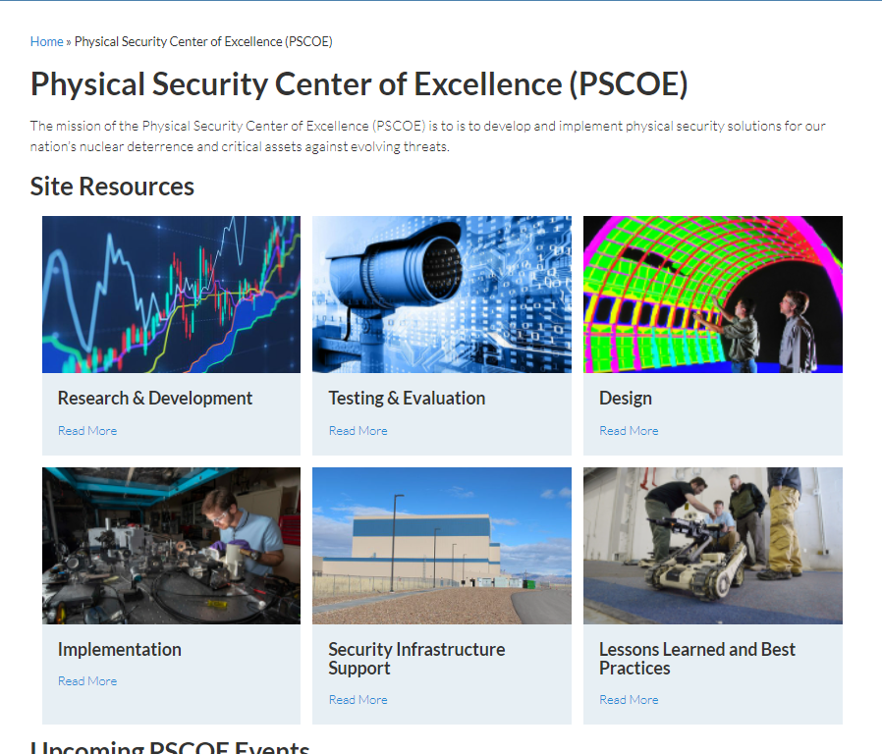
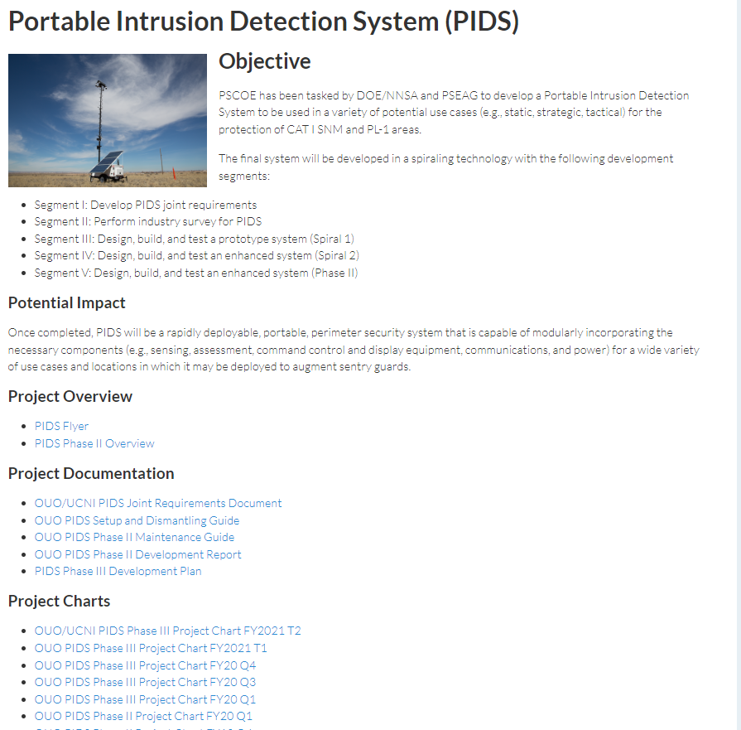
PSCOE Highlights

Slide 7
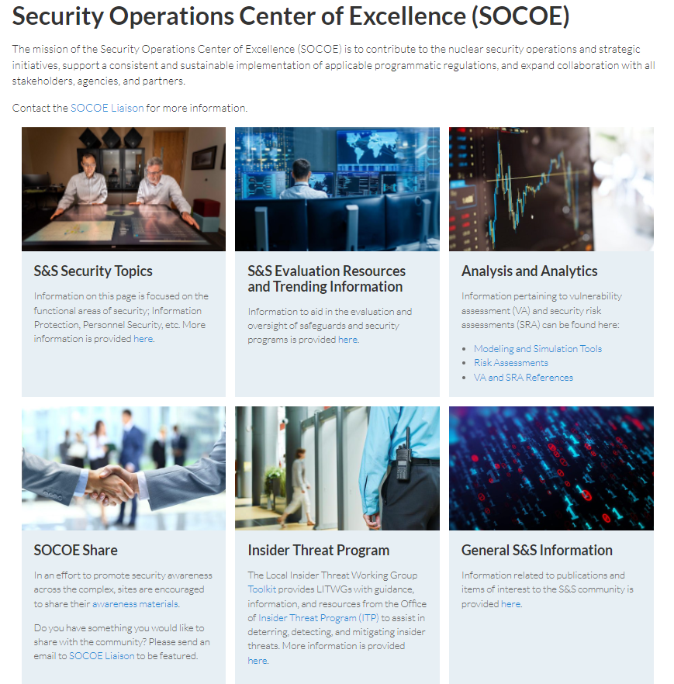
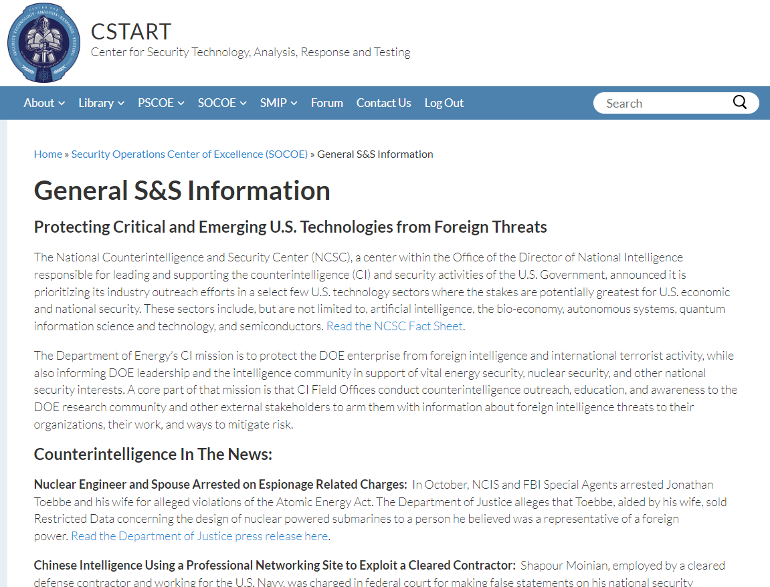
SOCOE Highlights

Slide 8
Forum
Welcome to the CSTART Forum!
Venue to engage with others and exchange ideas/ask questions
Discussions should remain unclassified
Ask questions, talk, share!
Talk about things that are important to your work as a security professional.

Slide 9
Lessons Learned & Best Practices
Lesson Learned: Knowledge gained from a good practice or an undesirable occurrence that is captured and shared.
Best Practice: a method or technique generally accepted as superior because it produces superior results than other means or because it has become a standard way of doing things.
Those who do not learn from history are condemned to repeat it.
George
Santayana

Slide 10
Benefits of Lessons Learned & Best Practices
Facilitate sharing of good practices
Prevent future adverse incidents
Highlight strengths that others can use to prevent a disaster
Identify areas that may need engagement or improvement
Improve the effectiveness of nuclear security operations
Support a continuously improving nuclear security program

Slide 11
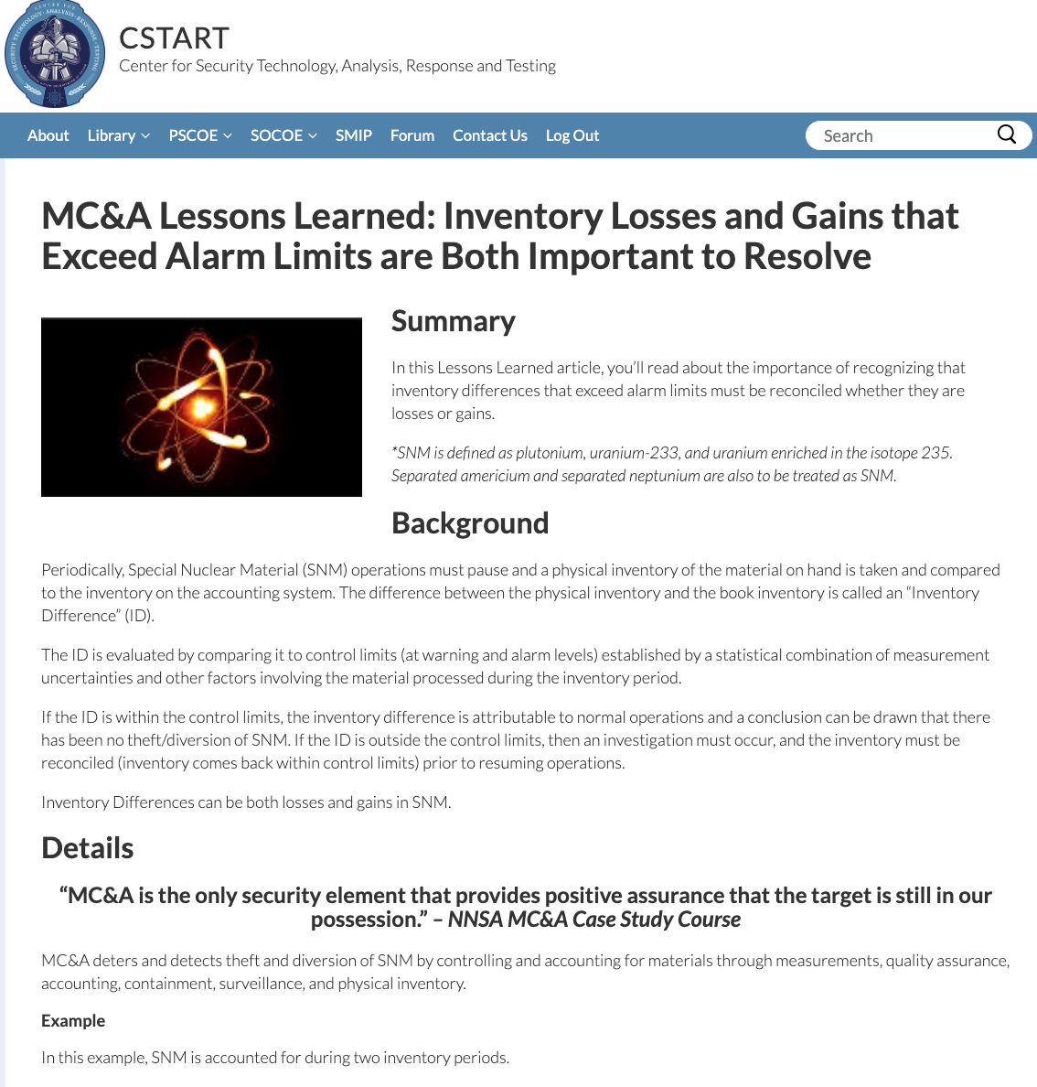
Partner with us!
Summary
Who, what, when, where, why, and how
Details
More information
Lessons learned
What went well?
What didn’t go well?
What would you change?
Can be ideas, drafts, or finished articles
Questions? Contact us!

Slide 12
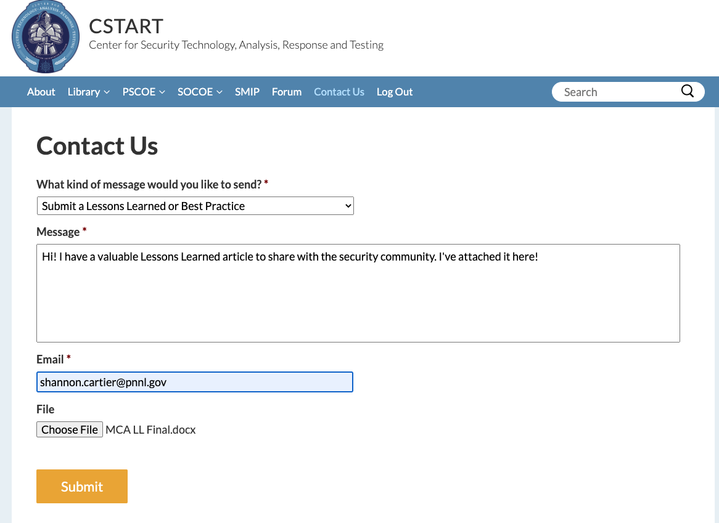
Submit a Lessons Learned or Best Practice

Slide 13
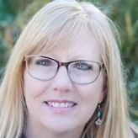
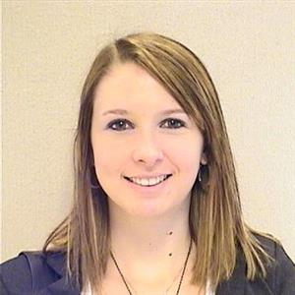
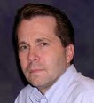
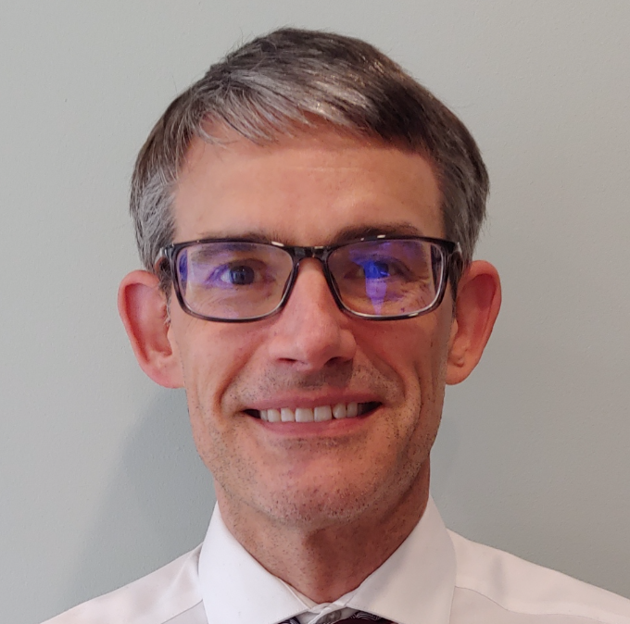
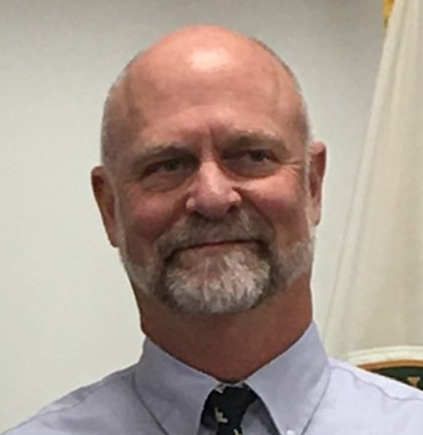
Points of Contact
SOCOE
PSCOE
Bette Higley
bette.higley@pnnl.gov
Jaclynn Stubbs
jstubbs@sandia.gov
Shannon Cartier
shannon.cartier@pnnl.gov
CSTART MANAGEMENT TEAM
Kevin Leifheit
kevin@trinitysecuritygroup.org
HEADQUARTERS LIAISON
Wes Gould
wes.gould@nnsa.doe.gov
JoAnn Archuleta
joann@trinitysecuritygroup.org
ACCESS REQUEST LIAISON
Steve Wanzer
Steve.wanzer@nnsa.doe.gov

Slide 14
Thank you!

