Slide 1
Controlled Unclassified Information (CUI) Program Briefing

Slide 2
CUI Timeline
Executive Order 13556 established the Controlled Unclassified Information Program
Released in Dec, 2009
The EO established an open and uniform federal program for managing CUI
Protects unclassified information that is considered sensitive
Required Executive Agencies to develop an internal CUI policy
DOE issued the DOE policy 471.7 on February 3, 2022
DOE established the CUI Program in February of 2022

Slide 3
What is CUI and why is protecting CUI important?
Controlled Unclassified Information is defined as:
Any unclassified information that requires safeguarding and dissemination controls in accordance with a law, regulation, or government-wide policy.
32 CFR §Part 2002 CONTROLLED UNCLASSIFIED INFORMATION (CUI)
Regulation that describes the requirements for the Executive Branch's Controlled Unclassified Information (CUI) Program and establishes policy for designating, handling, and decontrolling information that qualifies as CUI.
Why protect CUI?
CUI can be the path of least resistance for adversaries. Loss of aggregated CUI is one of the most significant risks to national security.

Slide 4
Roles and Responsibilities
Everyone is responsible for properly protecting and managing CUI
In accordance with DOE's CUI Policy, there are specific roles and responsibilities:
CUI Senior Agency Official – Directing and overseeing the DOE CUI Program and designating a CUI Program Manager. The CUISAO is Ann Dunkin
CUI Program Manager – Leading and managing the day-to-day operations of the DOE CUI Program. The Acting CUI PM is Tonya Crawford
Heads of Departmental Elements – Overseeing the implementation of the DOE CUI Program within their Departmental Elements.

Slide 5
Roles and Responsibilities
Departmental Element Designated CUI Official – Point of contact for their DOE Departmental element CUI activities. CUI Contact form
Authorized Holders – Individuals, agencies, organizations, or group of users permitted to designate or handle CUI, in accordance with 32 CFR Part 2002.
Contracting Officers – Including CUI security requirements in federal contracts.
DOE Employees and Contractors – Collecting, accessing, sharing, protecting, and safeguarding CUI in accordance with the applicable laws and policies, to include DOE's CUI policy and the Privacy Act, 5 U.S.C. 552a.

Slide 6
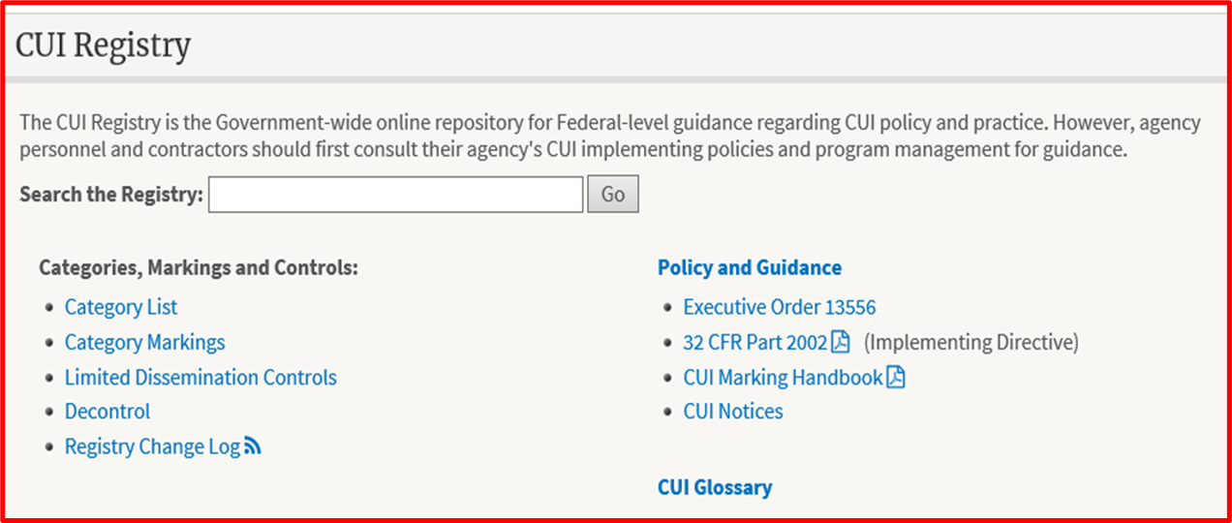
What is the CUI Registry?
The CUI Registry identifies all approved CUI categories and subcategories, provides general descriptions for each, identifies the basis for controls, establishes markings, and includes guidance on handling procedures.
The CUI Registry is located at www.archives.gov/cui.

Slide 7
CUI Categories
CUI categories are Basic or Specified. These categories are determined by law, regulation, or government-wide policy that covers any or particular category of CUI.
Examples of DOE information (e.g., emails and documents) requiring CUI Specified protection:
Basic
Specified
Sensitive Personal Identifiable Information
Inventions
Emergency Management
Critical Energy Infrastructure Information
Patent Applications
General Privacy
Budgeting
Unclassified Controlled Nuclear Information

Slide 8
How should I mark CUI?
For CUI Basic the only required banner marking is CUI in Capital letters (other departments and agencies may use the word Controlled instead) at the top of every page of the document.
For CUI Specified, the marking must also include the category or categories, in alphabetical order, separated by 1 slash.
Examples:
CUI
CUI//SP-BUDG SPECIFIED
CUI//INVENT BASIC
Either banner marking may also include limited dissemination information at the end of the marking. The CUI Registry has more information on markings.
CUI Coversheets may also be used to protect printed docs.

Slide 9
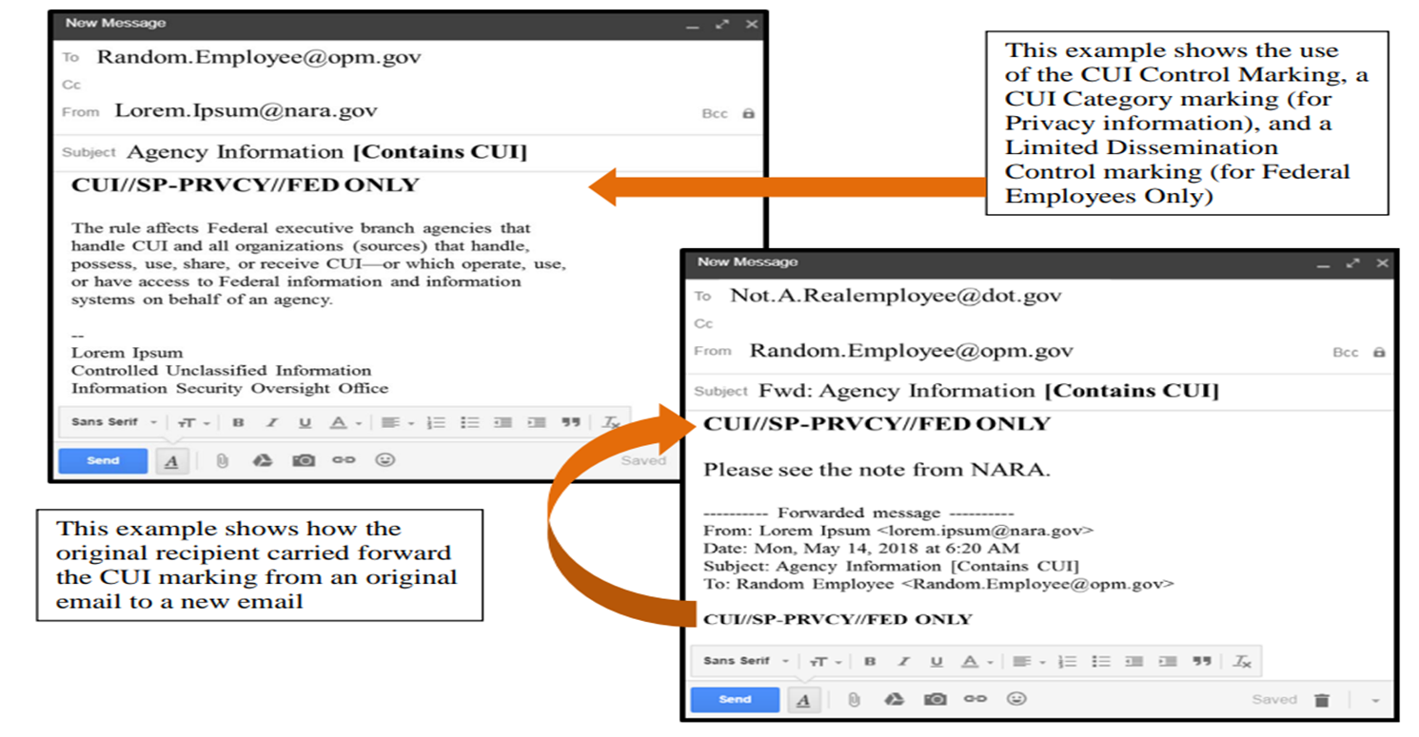
How do I mark emails containing CUI?

Slide 10
I have OUO information - Now what?
The OUO label is no longer a valid category for Controlled Unclassified Information (CUI).
For Information currently being used within DOE or shared outside of DOE the material must be re-marked using a current CUI category.
The CUI Program office and assist you with determining the current CUI category that applies to the category of OUO. DOECUI@hq.doe.gov
To determine the correct CUI category, review the CUI Registry for the current CUI categories, and review the Law, Regulation or government wide policy that allows for the use of the CUI category within DOE.
You may need to update existing contracts to ensure the new CUI categories are used.
Legacy information held by DOE that contains legacy markings has been waivered from the requirement to remark unless it is reused within DOE or sent outside of DOE.
https://www.energy.gov/cio/doe-cui-waivers

Slide 11
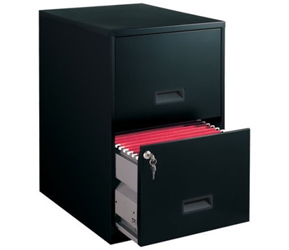
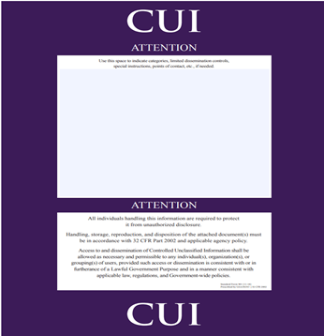
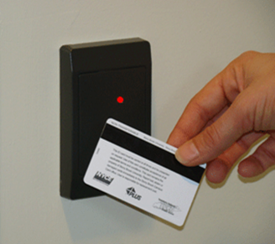
How do I protect CUI?
CUI must be protected in a controlled physical environment (e.g., lockable office, file room, or cabinet, etc.) When safeguarding physical CUI, you must use at least one locked physical barrier to protect CUI from unauthorized disclosure or access of the information. In an electronic environment (e.g., computer, intranet) must meet NIST 800.53 Rev 5 moderate level to prevent unauthorized disclosure or access of the information.
Locked file cabinet
Restricted access to electronic files
CUI cover sheet
Card key entry

Slide 12
How do I share CUI outside of DOE?
When sharing CUI outside of DOE, you should include:
Ensure you properly mark all CUI material with the proper category, (e.g., CUI//SP-CEII) on all DOE documents, emails, and magnetic media containing CUI
A CUI notice in the subject line of an email to ensure recipient is aware that the document or email and/or email attachments contain CUI
Your contact information should be included
If in paper format:
The Attach a CUI cover sheet SP -901 CUI Coversheets on top of the documents containing CUI and include guidance on how to protect and safeguard DOE CUI in accordance with the CUI Registry.

Slide 13
What should I do if I forget to mark CUI?
If you forget to mark documents and/or emails containing CUI when sharing the information with authorized recipients outside of DOE, you should:
Contact the recipient to provide notification of omission of CUI marking
Advise recipient that the information contains CUI
Provide an updated marked version as soon as possible

Slide 14
How do I send CUI in packages and mail?
CUI may be shipped through:
Authorized courier service
Commercial delivery service (e.g., Federal Express, United Parcel Service)
Interagency mail
United States Postal Service
When shipping CUI, you should NOT include a CUI control mark on the outside of packages (e.g., boxes, envelopes) containing CUI. You should include a CUI cover sheet, mark the document containing CUI, and ensure the package is addressed for delivery to the intended recipient (e.g., Delivery only to: John Doe). (Note: Automated tracking is a best practice.)

Slide 15
When should I decontrol CUI?
CUI should be decontrolled as soon as practical. CUI may be decontrolled when:
Laws, regulations, or government-wide policies no longer require its control as CUI. (Note: May still be subject to FOIA or Privacy Act.)
DOE, as the designating agency, decides to release the information to the public. (Note: CUI control markings must be removed prior to sharing the information with the public.)
The information is disclosed in accordance with an access statute (e.g., FOIA, Privacy Act, etc.).
A specific date or event has occurred.

Slide 16
Controlled Unclassified Information Disposal Requirements
CUI must be destroyed in accordance with a NARA-approved records disposition schedule. CUI should be destroyed or shredded in a manner that makes it:
Unreadable,
Indecipherable, and
Irrecoverable
A document containing CUI may be destroyed using a cross-cut shredder producing particles no larger than ¼ inch x 2 inches.
Do not place CUI in a recycle bin or trash can.

Slide 17
Resources
CUI: Executive Order 13556
CUI Implementing Regulation: 32 CFR part 2002
The CUI Registry: archives.gov/cui
NARA’s Training Videos: archives.gov/cui/training
NARA’s CUI Blog: isoo.blogs.archives.gov
NIST 800-171 Rev 2: Protecting CUI in Non-Federal systems
DOE CUI Policy: DOE O 471.7, Controlled Unclassified Information - DOE Directives, Guidance, and Delegations
CUI Mailbox: doecui@hq.doe.gov

