Slide 1
DOE O 473.2A Protective Force Operations
Mark Hojnacke
Office of Security Policy

Slide 2
Briefing Topics
Order Development
IPT Membership
Major Changes in Requirements
On-going PF Policy Activities
Questions

Slide 3
Order Development
Integrated Project Team established in accordance with DOE O 251.1D, Departmental Directives Program
Consisted of Federal and Contractor Subject Matter Experts from throughout the Department
Kick Off Meeting held in June 2019
IPT met virtually every other week for over two years

Slide 4
Order Development (continued)
The IPT received around 700 comments on the draft order
Comment resolution was conducted via 11 WebEx meetings and averaged 25 participants per session
Approximately 70% of comments were accepted; less than 20% were not accepted
Another 250 comments were received during the DRB review; 86% of those were accepted
Approved by the Deputy Secretary on August 30, 2021

Slide 5
Order Development (continued)
DOE O 473.2A
Protective Force Operations
DOE O 470.3C
Design Basis Threat
PPD-35 US Nuclear Command, Control, Safety and Security
10 CFR 1046
PF Standards
10 CFR 1047 Limited Arrest Authority/Use of Force
10 CFR 1049 Limited Arrest Authority/Use of Force (SPR)
DOE O 470.4B Safeguards and Security Planning
Atomic Energy Act of 1954
(As Amended)

Slide 6
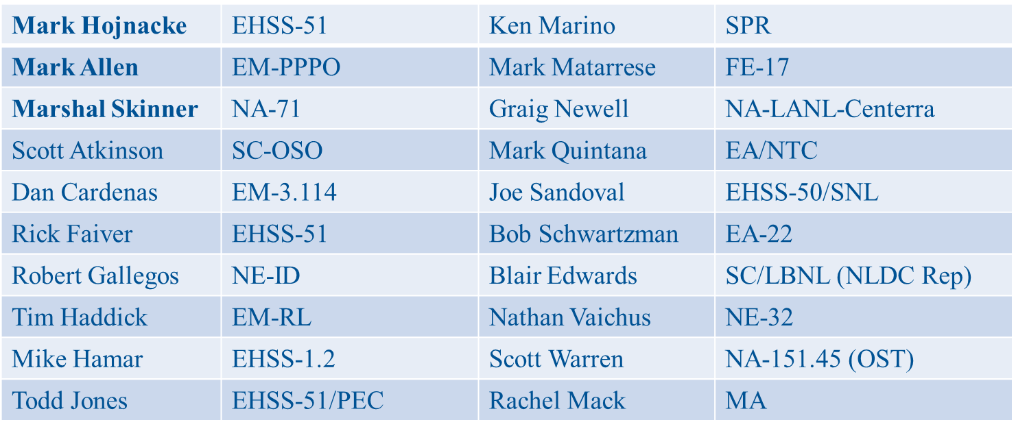
IPT Membership
Notes:
Steve Wanzer – NA-70
Dave Bradley – AU-50/PNNL longtime NNSS/NTS PF Management Official
David von Damm, Lawrence Berkely National Laboratory, National Laboratory Directors Council

Slide 7
Major Changes in Requirements

Slide 8
DOE Line Management Responsibilities
Approves fresh pursuit guidelines
Approves arrest procedures
Implements the DOE Tactical Doctrine (moved from DOE O 470.4b)
Approves requests for aviation and watercraft assistance
Notes:
Fresh pursuit guidelines include the use of vehicle ramming, pursuit intervention technique maneuvers, and tire deflation devices.
Approval of these procedures was moved from the Office of Security to DOE Line Management. Having the approval at the Office of Security level was a legacy requirements from the days of a centralized security office that oversaw all security activities within the Department, regardless of Program Office alignment.
The IPT thought having the Tactical Doctrine language in the PF order made more sense because it is so PF centric.

Slide 9
Agent/Officer Involved Shootings
Federal and Contractor PF programs must develop AIS/OIS response procedures:
Roles and responsibilities for pre-incident preparations
Incident scene procedures
Post incident procedures
Notes:
Pre-incident Preparations:
Investigatory jurisdiction
Crime scene responsibilities
Appointment of OIS response team members
Protocols for addressing the media
Incident Scene Procedures:
Officer involved responsibilities and legal rights/protections
Preservation of evidence
Incident Command responsibilities
Medical evaluation of all personnel directly involved in the incident
Provisions for officer legal consultation and representation
Post-Incident actions:
Notification of family members/significant others
Collections and examination of evidence, to include timelines for providing official statements
Officer involved mental health and wellness
Post incident leave policies
For cause testing, as specified in 10 CFR Part 707
Provisions for ongoing SPO legal consultation and representation

Slide 10
Explosive Breaching Programs
Approved by DOE Line Management
Breachers must be certified by a Nationally-recognized entity approved by the Program Secretarial Office
Breachers must maintain their certification in accordance with the original certifying entity’s requirements
Notes:
DOE, through AU-50 and its predecessor office, provided TEEC certification and recertification courses for the Department at the Harvey Point Defense Training Facility, NC, from 1995 until 2014. In 2014 the Department eliminated the AU-provided TEEC course, creating a training gap for the Department as the Order still requires site’s to use the AU-approved course if they employ an explosive breaching program.

Slide 11
PF Contingency Plan
Sites must have an approved work stoppage contingency in place, no less than six months prior to the end of the collective bargaining agreement
Notes:
Added at the request of Program Offices to address shortcomings in contingency planning. There was no driver to actually having a plan in place.

Slide 12
PF Training
TRF-100 replaces Basic Security Police Officer Training
Remedial Training Requirements
Three-time failures
Returning PF Officer Training Requirements
Notes:
IPT felt that TRF-100 better reflected the training necessary to address the threats we, as a Department, are now postulating…active shooter/assailant events as defined in the DBT. IF we identify a threat, we need to ensure our SPOs are trained to that threat.
NTC is updating their training courses to address this change. Maybe point to Q, if he’s in the audience.
CPF officers requiring remedial training for the same deficiency during three consecutive annual refresher training periods must be removed from the applicable CPF position without a fourth remedial training period. Aligns with weapons qual language in 10 CFR 1046.
IPT worked with NTC and GC to provide greater clarity to the returning SPO training requirements. Covers re-hired officers, former officers used in contingency force operations, former officers from another DOE facility, and officers returning from military service.

Slide 13
PF Training Instructors
Clarification on Firearms and Intermediate Force recertification timelines
Certification is good for 36 months
If not certified after 36 months, cannot perform those instructor duties
If not certified within 48 months, certification is lost and must attend the initial certification course

Slide 14
Firearms Training, Qualification and Operations
If supplemental sighting systems are used:
SPOs must be trained on sighting systems
One of the sighting systems must be designated as the primary sighting system
SPOs must qualify with the primary sighting system
Personnel handling firearms, ammunition, pyrotechnics, and explosives must be fit for duty
Loans of firearms and munitions to other organizations must be documented and approved by the ODFSA

Slide 15
Body Armor/Protective Masks
Body armor requirements changed from Type IIIA to Type III
Protective Masks
Required for sites with PL-1 – PL-4 assets
Optional for sites with PL-5 – PL-7 assets
Based on a site analysis of onsite chemical biological, or radiological assets
Sites operating environment
CPF response actions
In consultation with the site’s Respiratory Program personnel
Notes:
Aligns the protection afforded to officers to the threats outlined in the DBT. Language clarified on when body armor must be worn; interacting with the general public, ODFSA can make determination on other situations. When not worn, must be positioned so it can be donned without impacting response times. NAS Corpus Christi shooting at entrance gate, gate runner shot sailor manning the post, sailor took the round to the chest (plate worn), recovered and engaged the vehicle gate. Other responders eliminated the threat. Sailor fully recovered.

Slide 16
Performance Testing
Asset driven PT requirements
PL-1/PL-2 stays semiannually
PL-3/PL-4 becomes once a year
PL-5 – PL-7 stays once a year
ODFSA can grant an extension to account for weather/scheduling conflicts

Slide 17
Ongoing PF Policy Activities
New PF Topical Lead
10 CFR 1046 Update
PF Policy Panel
Firearms Qualification Technical Standard

Slide 18
EHSS-51 Protective Force Contacts
Kevin Webber, Topical Lead
Kevin.Webber@Hq.DOE.Gov 301-903-4291
Rick Faiver, Program Analyst
Richard.Faiver@Hq.DOE.Gov 301-903-4613
Todd Jones, Security Specialist Contractor
Todd.Jones@Hq.DOE.Gov 301-903-0948

Slide 19
Questions?

