Slide 1
Personnel Security
Information Briefing
Tracy L. Kindle, Personnel Security Policy Program Manager
Paul Du Fresne, Personnel Security Field Assistance Program Manager

Slide 2

Overview
    Integrated Project Team (IPT) Update
    Background
    IPT Membership
    Policy Changes
    Actions/Status
    Summary
    Questions

Slide 3
Background
  AUG 2019 Workshop:
  FEB 2020 DRB Approval
  MAR 2020 3 Day Virtual Workshop
  APR 2020 Focus on Sub working groups
  MAY 2020 – Present

Slide 4

IPT Membership
Member | Organization
Co-Chair Tracy Kindle | Office of Environment, Health, Safety and Security
Co-Chair Jeff Lascheid | National Nuclear Security Administration
Amanda Gerhardt | Headquarters Personnel Security Operations (AU)
Christina Pak | General Counsel
Kayla Lozano | Environmental Management
Solita Greene | Nuclear Energy
Kernan Longua | DOE-ID
Amy Bagley | Intelligence and Counterintelligence
Harold Sebastian | International Affairs
Jason Gordon | National Nuclear Security Administration
Katheranne Esquibel-Mead | National Nuclear Security Administration
Megan Bakkala | Naval Reactors Headquarters
Jill Fennell | Richland Operations Office

Slide 5
IPT Membership
Marcia Delmore | Savannah Rivers Operations Office
Angela Harvey | Science
Rachel Mack | Management
Darin A. Stockstad | Idaho National Laboratory (NLDC)
Joseph Thill | National Renewable Energy Laboratory (NLDC)
DeAnn Ingram | Oak Ridge National Laboratory (NLDC)
Alisa Haller | Pacific Northwest National Laboratory (NLDC)
Justin Martinez | Sandia National Laboratory (NLDC)
Jeffery Williams | Human Capital
Catherine Komljenovich | Human Capital

Slide 6
IPT Membership
Marcia Delmore | Savannah Rivers Operations Office
Angela Harvey | Science
Rachel Mack | Management
Darin A. Stockstad | Idaho National Laboratory (NLDC)
Joseph Thill | National Renewable Energy Laboratory (NLDC)
DeAnn Ingram | Oak Ridge National Laboratory (NLDC)
Alisa Haller | Pacific Northwest National Laboratory (NLDC)
Justin Martinez | Sandia National Laboratory (NLDC)
Jeffery Williams | Human Capital
Catherine Komljenovich | Human Capital

Slide 7
IPT Membership
IPT Subject Matter Experts
Kim Mandekich | Argonne National Laboratory
Jill A. Treacy | Kansas City National Security Campus
Kelly Karstens | Lawrence Livermore National Laboratory
Deborah (Deb) Martinez | Los Alamos National Laboratory
Paulette Solis | Sandia National Laboratories

Slide 8

IPT Meetings
  As needed
  Approach to updating Order
  IPT members comments and feedback
  Update Order to align with National policy
  Maintain Secretary’s Authority for Restricted Data

Slide 9
Policy Changes
    Continuous Vetting/Trusted Workforce
    Clearance Action Tracking System
    SEAD 7, Reciprocity*
    Reinstatements and Reapprovals
    Access by Former Presidential Appointees
    Other Government Agency Clearances
    SEAD 8, Temporary Eligibility*
    *Implemented by Secretarial Memorandum

Slide 10
Policy Changes
    Dual Citizenship
    Shared Access
    Processing Investigation Results
      Dual Citizen
      Personnel Security Consultations
      DOE F 472.1, Fair Credit Reporting Action Authorization
    SEAD 6, Continuous Evaluation
    Reinvestigations
    Intra-Agency Security Clearance Actions

Slide 11
Policy Changes
    Administrative Withdrawals of Clearances
    Personnel Security Files
    SEAD 3 Reporting Requirements
    Added Table of Contents
    Appendix – B Personnel Security Files
    Appendix – C Adjudicative Considerations related to Statutory Requirements and Departmental Requirements*
      Drug Certification Form

Slide 12
Policy Changes
    Appendix – D Other Government Agency Clearance
    Appendix – E Reciprocity of Background Investigations
    Appendix – F Access By Former Political Appointees
    Attachment 1 – Contractor Requirements Document
    Attachment 2 – Security Clearance Requestion/Justification and Access Authorizations

Slide 13
Policy Changes
      Attachment 3 – Limited Access for Non-U.S. Citizens
      Attachment 4 – Temporary Eligibility
      Attachment 5 – Reporting Requirements
      Attachment – 6 Personnel Security Quality and Training
      Attachment – 7 Definitions
      Attachment – 8 References

Slide 14

Actions/Status
  Actions Taken
    The IPT received over 1,000 comments during pre-RevCom review, the Directives Review Board (DRB) RevCom review, and two DRB coordination reviews.
    The IPT and the Office Primary Interest adjudicated all comments, and most comments were accepted or accepted with modifications.
  Status:
    IPT received DRB concurrence on April 11
    Currently pending approval from the Deputy Secretary

Slide 15
Summary
  Background
  IPT Membership
  Policy Changes
  Actions/Status
  Summary
  Questions

Slide 16
Trusted Workforce (TW) 2.0

Slide 17
Overview
  Background
  Phase 1
  Policy Issuances
  Trusted Workforce Working Group
  TW Transitional States
  Phase 2
  Summary
  Questions

Slide 18


Slide 19
Background
In March 2018, the Performance Accountability Council (PAC) convened Executive Branch, Congress, academia, and industry leaders for a two-day offsite.
Participants expressed a commitment to reform and agreed to fundamentally overhaul Federal personnel vetting. The resulting effort – Trusted Workforce (TW) 2.0 – chartered the boldest personnel vetting reforms in decades.
The group recommended TW 2.0 be organized into two phases. Phase One was to focus on preparing the enterprise for change by addressing the sizeable background investigation inventory and timeliness of investigations. Once these pressing issues were under control, Phase Two would focus on transforming personnel vetting from the ground up.
“NOTE: At this time, only the cleared population is being enrolled in TW. The remainder of the population will be enrolled as the vetting process moves to TW 2.0 – guidance pending with the Executive Agents

Slide 20
Background

Slide 21
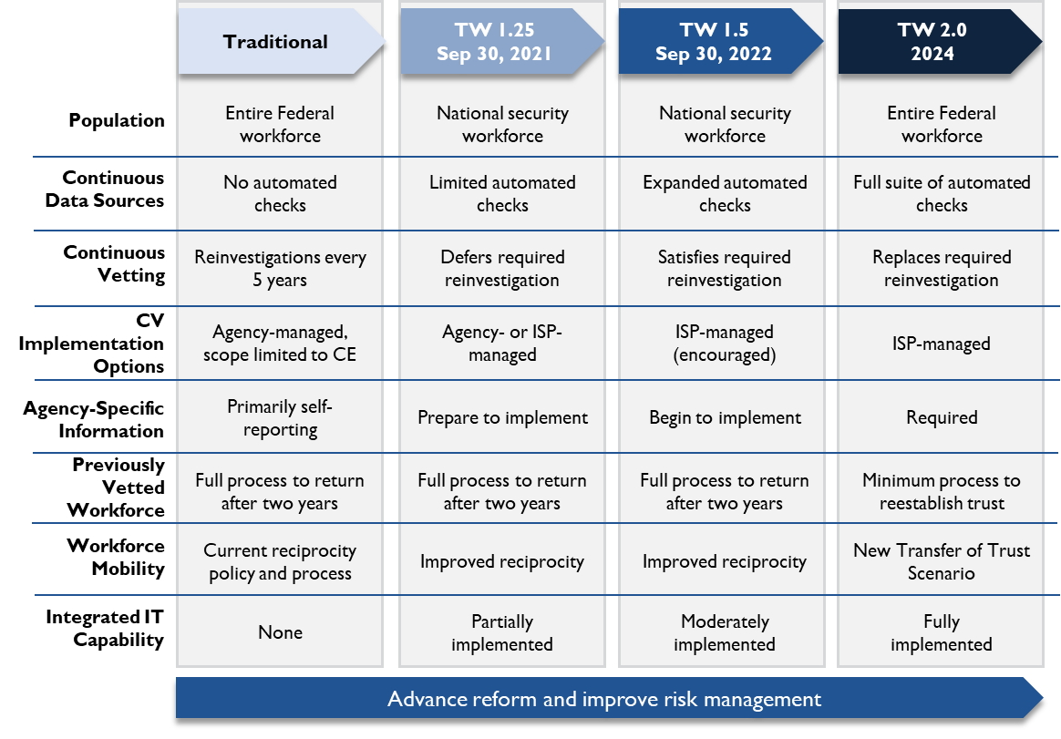
Background

Slide 22
Phase 1
In Phase One the Executive Agents issued Executive Correspondence with measures for reducing the inventory and improving timeliness. By March 2020, the inventory was stabilized at 200,000 cases and timeliness for investigations was significantly reduced - Top Secret from 411 to 79 days and Secret from 173 to 56 days. These improvements were made concurrently with efforts to transfer the National Background Investigation Bureau’s (NBIB) mission to the Department of Defense (DoD), that was completed in October 2019.

Slide 23
Policy Issuances
Federal Personnel Vetting Core Doctrine (February 2021)
  Establishes the philosophy for transforming the Federal Government’s personnel vetting process.
Executive Agents (DNI and OPM) Issued and Executive Correspondence January 2021
DOE Internal Policies
    DOE O 472.2A, Personnel Security
    TW 2.0 Secretarial Memorandum
TW Phase 2 Policies are under development

Slide 24
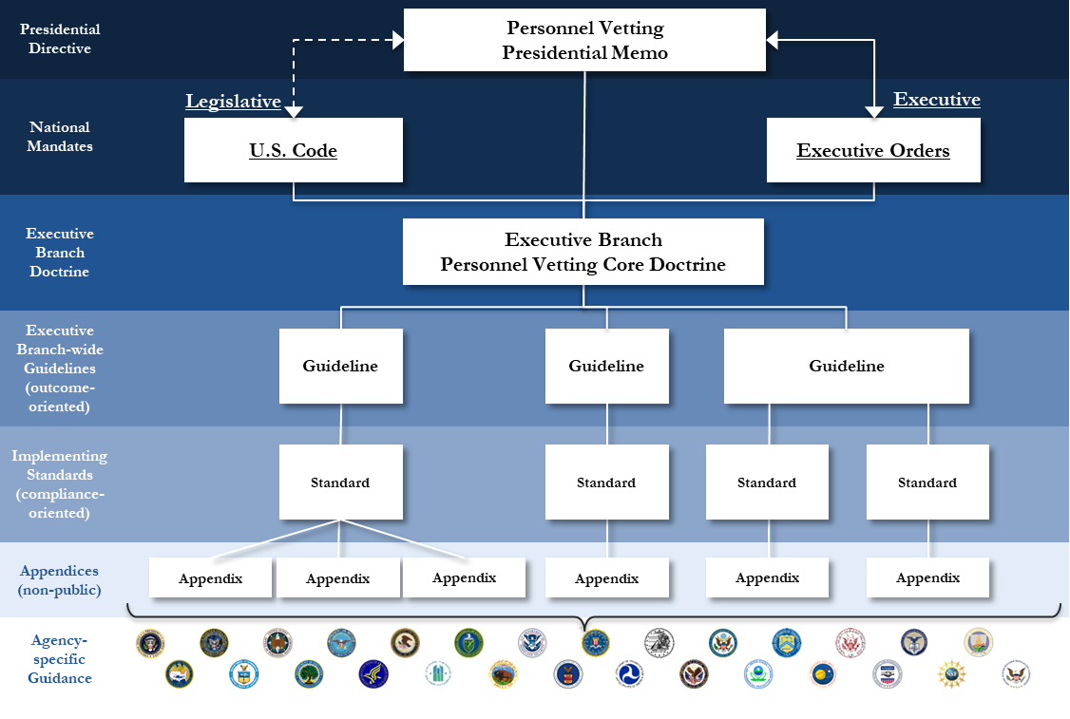
Policy Issuances

Slide 25
Policy Issuances
Executive Correspondence
National Milestones:
15 February 2021 is the deadline for agencies to establish an enrollment plan that meets the minimum requirement for their national security population.
31 March 2021: All Tier 3 and Tier 5 individuals whose periodic reinvestigations (PR) are currently deferred in accordance with previous Executive Agent guidance must be enrolled in a TW 1.25 or TW 1.5 capability.
  DOE is the process of deferring PRs
30 September 2021: All departments/agencies (D/As) must enroll their full national security population at a minimum in a TW 1.25 capability. This includes those individuals who are not yet due for a periodic reinvestigation under Reference F. D/As may choose to enroll some of that population in a TW 1.5 capability as well.
30 September 2022: All D/As must enroll their full national security population in the TW 1.5 capability. This includes those individuals who are not yet due for a periodic reinvestigation

Slide 26
DOE TW Working Group
Formed in March 2021 to address the numerous actions required to implement TW, our office formed a TW working group comprised of stakeholders from across the Complex
The creation of the TW Working Group (WG) allows for better prioritization of needs; provides greater overall transparency; and facilitates consistency as DOE moves forward to implementing TW
The work of this group will have a significant impact upon the future success of the Department of Energy Personnel Security Program

Slide 27
Transitional State 1.25
CUI
Enroll the full national security population in a TW 1.25 Capability
All cleared individuals are in a continuous vetting capability (Completed in November 2019). The Continuous Vetting checks include:
  Eligibility
  Terrorism
  Criminal Activity
  Agencies allowed to defer periodic reinvestigations (PR) and eliminate the traditional periodic reinvestigation
    DOE began deferring PRs in April 2022
Cleared individuals still required to complete a SF 86 every five years

Slide 28
Transitional State 1.5
CUI
Includes all the checks at TW 1.25 in addition to the following checks:
  Criminal Activity FBI Next Generation Identification Rap Back
  Foreign Travel
  Suspicious Financial Activity
  Credit Bureau Checks
  Public Record Checks
  Employment Conduct
  Subject Interviews
Agencies may cease periodic reinvestigations as we know them today –Note: Targeted investigations and PRs can be requested as needed
Cleared individuals still required to complete a SF 86 every five years

Slide 29
Phase 2
CUI
The Phase Two work of transforming personnel vetting from the ground up has been divided into three phases
Establishes a new personnel vetting framework approach (Complete)
  1 - One policy framework to align the personnel vetting domains—national security, suitability and fitness, and credentialing.
  3 - Three investigative tiers to speed up processing times, reduce duplication and complexity, and improve mobility.
  5 - Five personnel vetting scenarios to follow the lifecycle of an individual working for or on behalf of the Federal Government: initial vetting, continuous vetting, upgrades, transfer of trust, and re-establishment of trust.

Slide 30
Phase 2
CUI
Implements transitional states of continuous vetting to deliver early results while progress is made on finalizing policies and building new capabilities to support the TW 2.0 framework (Underway).
  In February 2020 and January 2021, the Executive Agents issued Executive Correspondences establishing minimum standards for transitional continuous vetting states, called TW 1.25 and TW 1.5. These transitional states advance reform and improve risk management as the new suite of TW 2.0 policies is being developed. The Executive Agents directed agencies to enroll their national security sensitive populations in a minimum of a TW 1.25-compliant capability by September 30, 2021 and a TW 1.5-compliant capability by September 30, 2022.
Focuses on the full implementation of the TW 2.0 future state (Underway).
  Implementing the new 1-3-5 approach, by finalizing the new TW 2.0 suite of policies to create the one aligned model; implementing the new three investigative tiers; and implementing the new five vetting scenarios. The effort required to put the new TW 2.0 future state in place will require changes across all aspects of the personnel vetting program from the ground up.

Slide 31
Summary
  Background
  Phase 1
  Policy Issuances
  Trusted Workforce Working Group
  TW Transitional States
  Phase 2
  Summary
  Questions

