Slide 1
Physical Protection Subgroup Chair – Mark Ames Vice Chair - Vacant
EFCOG SSWG
April 16 – 18, 2024

Slide 2
Day 1 Introductions
Mark Ames – Chair of the Physical Protection Group
Chair since August 2022
HMIS employee working for DOE/RL at the Hanford Site
Currently Hanford Physical Security Manager (March 2020)
Worked with Hanford Contractor Protective Force (January 2002)
Served in the USMC from August 97 to November 21
Reason to attend EFCOG –
Collaborate
Network
Find solutions to challenges we all face
Around the room

Slide 3
Day 1 UAS Reporting and Response Operational Approach
Develop Operational Approach document using DOE and FAA guidance on response to sUAS overflight over DOE property
NNSA vs EM sites
FAA guidelines for sUAS
Means of Detection
Confirmed overflight
Non-confirmed overflight
CPF response
sUAS and Pilot
Downed sUAS
Reporting guidelines
FAA
DOE
Better Practices
Expansion of no-fly boundary

Slide 4
Day 1 UAS Reporting and Response Operational Approach

Slide 5
Day 1 UAS Reporting and Response Operational Approach
NNSA Sites
Defined guidance through DOE orders and mandates at Cat-I holding facilities
Y-12, Pantex, Los Alamos, NNSS
Sandia (Kirtland AFB)
Savanah River (at NNSA locations)
Lawrence Livermore and Kansas City (non-Cat I sites)
EM Sites
The rest of us…
Should EM sites and non-Cat-I holding NNSA sites establish a CUAS program?

Slide 6
Day 1 UAS Reporting and Response Operational Approach
DOE O 473.1A
“Counter Unmanned Aircraft Systems. The ODFSA must approve the use of counter unmanned aircraft systems in accordance with the provisions of the 2017 National Defense Authorization Act [P.L. 114-328] and applicable delegation orders.”
2017 National Defense Authorization
50 USC 2661. ‘‘SEC. 4510. PROTECTION OF CERTAIN NUCLEAR FACILITIES AND ASSETS FROM UNMANNED AIRCRAFT.”
Detect, identify, monitor, and track
Warn system operator
Disrupt
Seize
Confiscate
Use of reasonable force
Forfeiture
Basically, its all dependent on your SRAs, VAs, and ODFSA approval

Slide 7
Day 1 UAS Reporting and Response Operational Approach
FAA guidelines
sUAS Drones are prohibited from flying over designated national security sensitive facilities, without prior authorization. Operations are prohibited from the ground up to 400 feet above ground level and apply to all types and purposes of UAS flight operations.
Other FAA guidelines
Pilots must always maintain line of sight
Must not interfere with manned aircraft
Flights must remain below a 400-foot ceiling
Register and externally mark the drone with the FAA

Slide 8
Day 1 UAS Reporting and Response Operational Approach
Means of Detection
Reporting
Confirmed vs Non-Confirmed
Confirmed sUAS overflight must be confirmed via a detection system (CUAS) or by a CPF officer who has visually located at a minimum part of the sUAS system (drone).
Non-confirmed sUAS overflights are;
Reported by non-CPF personnel without confirmation by site CPF or CUAS system detection.

Slide 9
Day 1 UAS Reporting and Response Operational Approach
CPF Response
sUAS
Track UAS to locate pilot if possible
Confiscate if possible
Pilot
Make contact, utilize additional units to back up contact officer
Ask for identification, registration paperwork, etc.
Collect data for Incident Report
Take into custody if feasible – 10 CFR 1047
Trespass, Photographing of DOE installations(?), and/or Conspiracy(?)
Report
Downed sUAS
Abandoned / Crashed
Suspicious Package response
Crash notifications

Slide 10
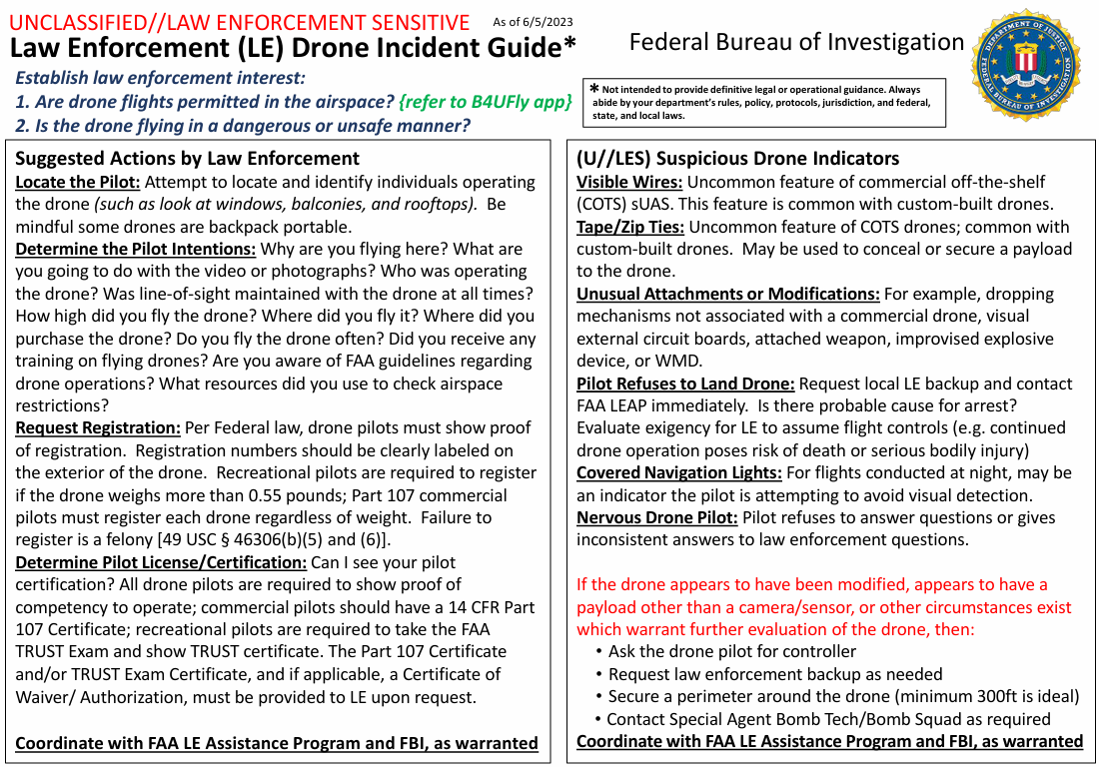
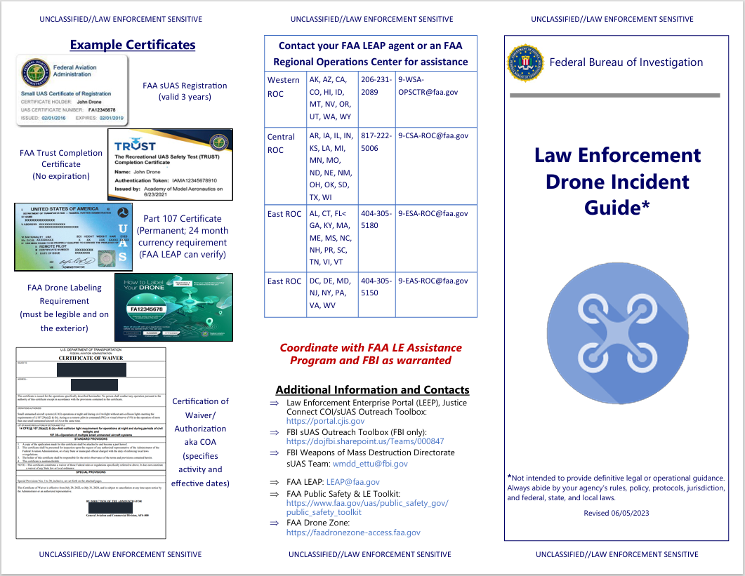
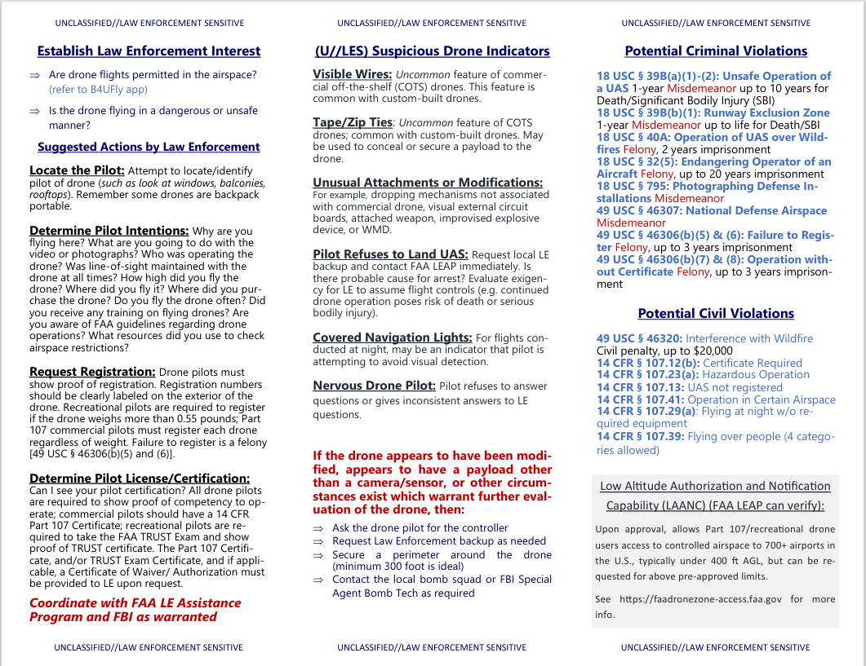
Day 1 UAS Reporting and Response Operational Approach

Slide 11
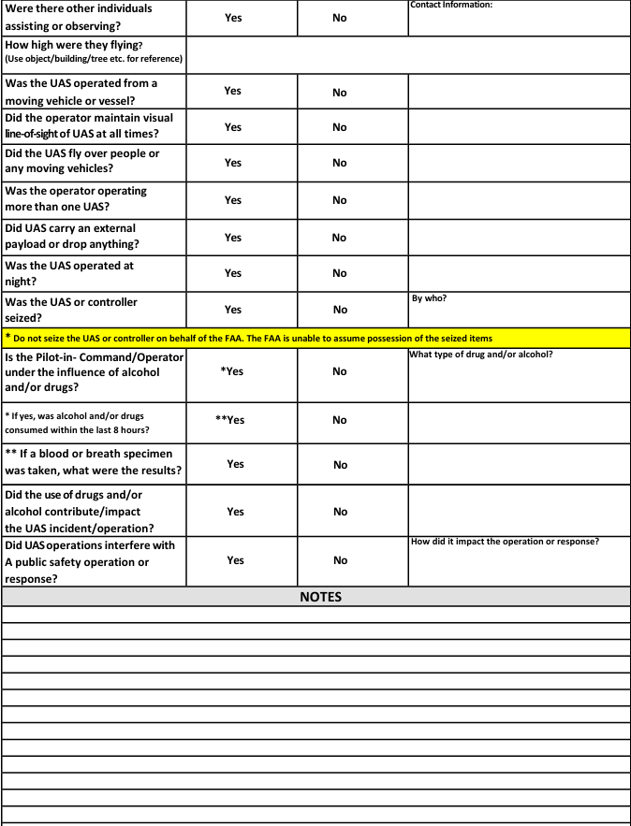
Day 1 UAS Reporting and Response Operational Approach

Slide 12
Day 1 UAS Reporting and Response Operational Approach

Slide 13
Day 1 UAS Reporting and Response Operational Approach
EM Memo
1. All employees must be made aware the use of UAS is prohibited, unless authorized by the ODFSA;
2. Employee training must ensure personnel know who to contact to report a UAS sighting;
3. Any unauthorized UAS reported that is flying over an EM site with an established no-drone-zone, must be reported within SSIMS as an Incident of Security Concern (IOSC), as Category A, drone sighting. The EM-3.114, Chief, Safeguards & Security Branch must also be notified within 2-hours;
4. Any unauthorized UAS reported flying over an EM site must be reported within SSIMS, as Category B, drone sighting

Slide 14
Day 1 UAS Reporting and Response Operational Approach
Reporting Requirements
3. Any unauthorized UAS reported that is flying over an EM site with an established no-drone-zone, must be reported within SSIMS as an Incident of Security Concern (IOSC), as Category A, drone sighting. The EM-3.114, Chief, Safeguards & Security Branch must also be notified within 2-hours;
This is why establishing what is a confirmed sighting is important
Establish who makes this notification and when your 2-hour timeline begins

Slide 15
Day 1 UAS Reporting and Response Operational Approach
Better Practices
Develop and implement a CUAS plan
Administrative plans are better than no plan at all
Should cover response and reporting practices
Post signage and educate site populace
Reinforce the security message with site populace
Establish signage at approved boundaries
4th amendment issues
Expand no-fly boundary through FAA
Provide arc.gis mapping of DOE controlled space
Work with federal counterparts
Expand CUAS detection capabilities
Technology to detect
Technology to counter
Partner with other entities if possible

Slide 16
Day 1 UAS Reporting and Response Operational Approach
Expand no-fly boundary through FAA
Feds (SES) communicated intent to the Program Office, EM 3.114
Program Office expressed support and put SES in contact with FAA SSI Application Approvers to facilitate a Q&A
FAA was able to provide specific requirements for submittal
SES communicated its intent to the site’s support services contractor (HMIS)
HMIS has in house geospatial information technology services, and was able to produce a geospatial dataset (shapefile) in arc.gis
After boundaries of the new SSI were agreed upon, the package (shapefile and associated data) underwent the public release approval process
After approved for public release, HMIS sent package to SES
SES sent package via email to the FAA
FAA completed reshape evaluation and made changes in UAS Data Delivery Service (UDDS)

Slide 17
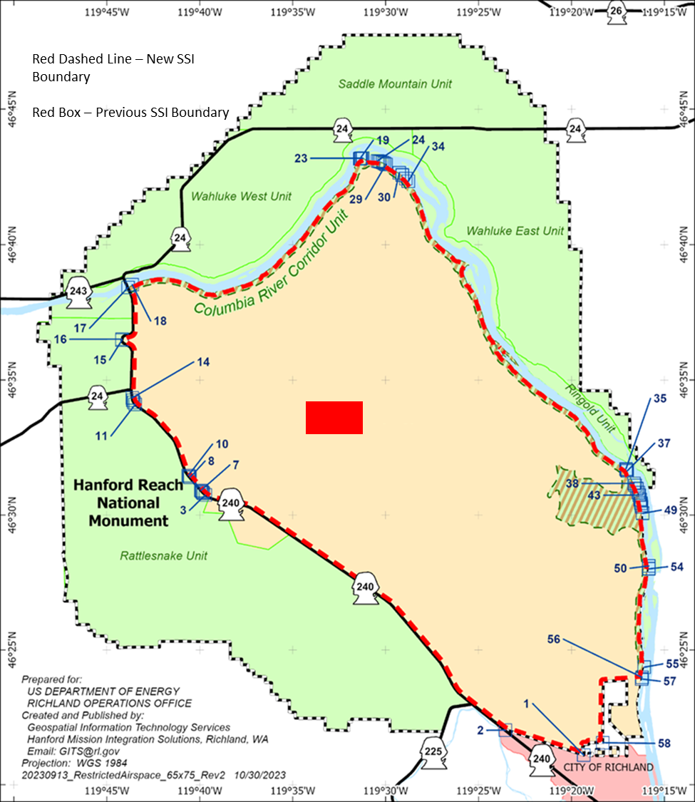
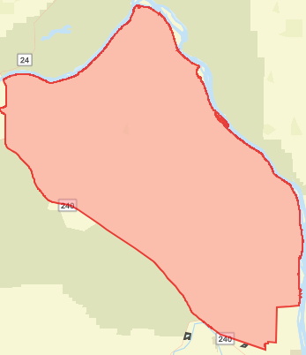
Day 1 UAS Reporting and Response Operational Approach
Link

Slide 18
Day 1 UAS Reporting and Response Operational Approach
This Photo by Unknown Author is licensed under CC BY-NC-ND

Slide 19
Day 1 UAS Reporting and Response Operational Approach
Day 2 discussion
Areas of Concern
Topical area(s) for EFCOG (next year)
Staffing/involvement of EFCOG membership

Slide 20
Day 2 Areas of concern & future planning for EFCOG
Areas of Concern
DOE Order implementation of 473.1A and/or 473.2A
FAR and/or NAR Issues
Reporting non-compliance
How to really calculate FAR
PL-5 & PL-6 Assets and Protection Measures
Shipment security plans
Analysis overload
4-Hour checks/IDS at SRD locations

Slide 21
Day 2 Areas of concern & future planning for EFCOG
Topical Area(s) for EFCOG
What would you all want to see going forward?
What topics should we be working on for next year?
What are the major problem areas where we can share our individual site experiences to help the community?
Volunteers?

Slide 22
Day 2 Areas of concern & future planning for EFCOG
Staffing for the Physical Protection Group
Vice Chair status?
Chair status?
Community involvement
Meetings, Emails, Communication?

