Slide 1
ESHQ Requirements Management at NREL
Brenden Spetzler

Slide 2
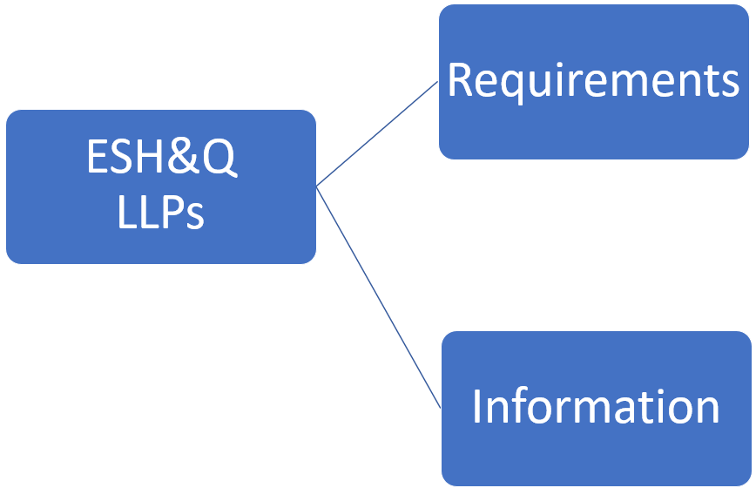
Sulfuric Acid Spill Corrective Action
DOE Requirements
Internal Requirements, Roles, DOE Requirements

Slide 3
2022 – Requirements Management System
DOE Prime Contract
LLP
NREL Established Roles
Requirement
Compliance Report
Role Requirement Report
Information
Regulation
Regulation
Requirement
Role
Code
Role
Requirement
Requirement
Role
Requirement
Standard
Role
Requirement
LLP
Requirement
DOE Order
Role
Requirement
Requirement
Role
Requirement
Requirement
Role
Requirement
Information

Slide 4
2023 – Business Management System
LLP
Responsible
Accountable
Consulted
Informed
Requirement
Information
Requirement
Role
Role
Role
Role
Requirement
Role
Role
Role
Role
LLP
Role
Role
Role
Role
Requirement
Role
Role
Role
Role
Role
Role
Role
Role
Requirement
Role
Role
Role
Role
Requirement
Information

Slide 5
DOORS Opportunities - Change Management
DOE Requirements
LLP
NREL Established Roles
Other Advantages
Search across all ESHQ LLPs
Role
Role
Requirement
Regulation
Role
Requirement
Regulation
Role
Requirement
Role
Regulation
Requirement
Role

Slide 6
DOORS Opportunities - Gap Analysis
DOE Requirements
Lab Level Procedure (LLP)
NREL Established Roles
Role
Requirement
Role
Regulation
Requirement
Role
Code
Role
Requirement
Standard
Role
Requirement
Role

Slide 7
DOORS Opportunities - Auditing
DOE Requirements
Lab Level Procedure (LLP)
NREL Established Roles
Role
Requirement
Role
Regulation
Requirement
Role
Code
Role
Requirement
Standard
Role
Requirement
Role

Slide 8
DOORS Opportunities - Configuration Management
Requirements across all LLPs
Requirements across all LLPs
Requirement
Requirement
Requirement
Requirement
Requirement
Requirement
Requirement
Requirement

Slide 9
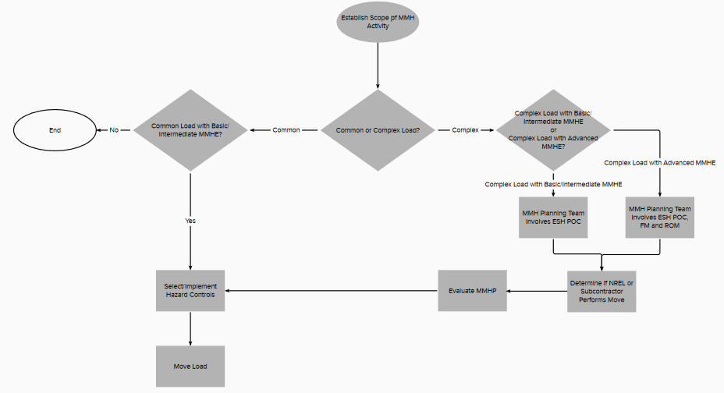
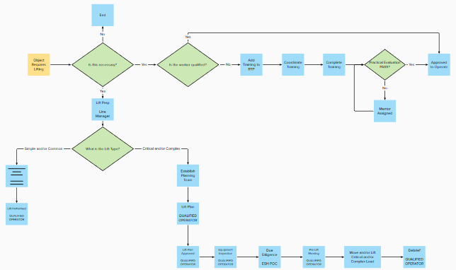
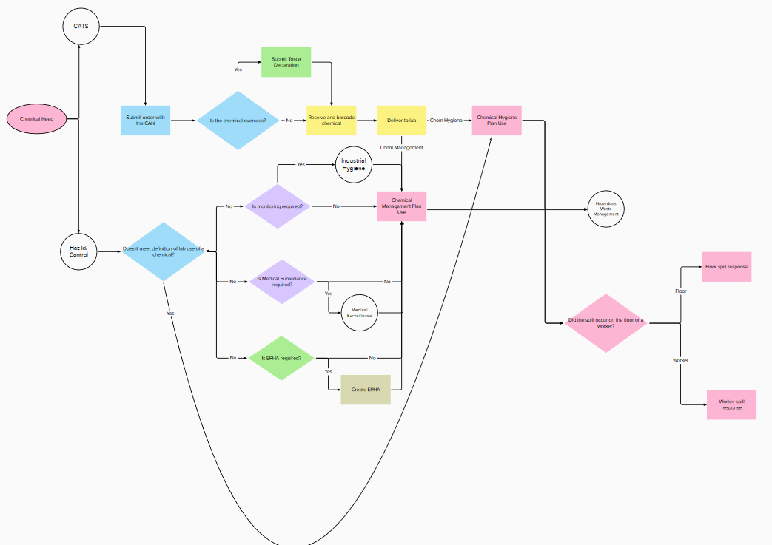
2023 – Business Management System
LLP
Requirement
Requirement
Requirement
Information
LLP
Requirement
Requirement
Requirement
Information

Slide 10
2024 – Business Management System
LLP
Requirement
Requirement
Requirement
Information
LLP
Requirement
Requirement
Requirement
Information

Slide 11
2024 – Business Management System
External Requirement
Requirement
Responsible
Accountable
Consulted
Informed
CFR
Requirement
Lift Operator
Line Manager
SME
ROM
Code
Trainer
ESH POC
Construction Manager
Requirement
Standard
Lift Master
Lift Owner
Information

