Slide 1
PNNL’s Enterprise Risk Management Journey
Christopher Larmey & Cahley Jaekel
Pacific Northwest National Laboratory

Slide 2
Value of Enterprise Risk Management (ERM)
Drives risk awareness across all levels of the Laboratory.
Creates sustainable risk-based culture.
Promotes risk-based decision-making and informs investment priorities.
Provides transparency and accountability for managing the impact of risk.
Reduces operational surprises, issues, and events.
Assures compliance with risk management expectations.
Helps the Lab achieve its mission

Slide 3
PNNL’s ERM Journey
FY12
FY13
FY14
FY16
FY19
FY20
FY21
FY22
FY23
FY24
PHASE 1
PHASE 2
PHASE 3
ERM Framework
Enterprise Risk
Register
Chief Risk Officer Role
Risk Assessment
ERM Maturity
Review & Improvements
Standard Risk Screening & M&O Risk Register
Directorate Risk Register
R2A2s, Recalibrate Risk Screening & Gartner ERM
Leadership Council
Integrated
Risk Dashboard
ERM Training, Predictive Risk Modeling & More Improvements

Slide 4
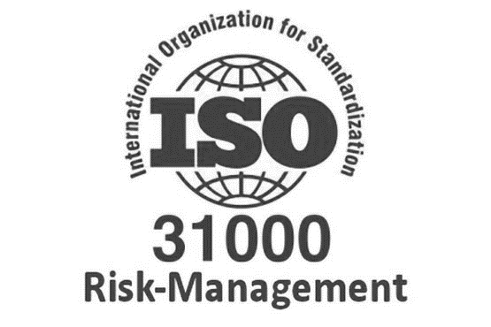
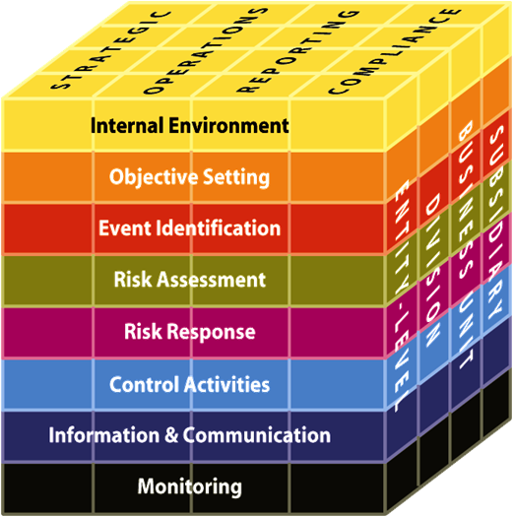
Established PNNL’s ERM Framework
ERM Phase 1
2012-2017
Influenced by ISO and COSO risk standards, PNNL developed a comprehensive and integrated framework to manage risks at various levels of the Laboratory.
The framework includes:
Standardized risk management terminology
Standardized process for managing and assessing risks
Standardized risk registers for documenting risks
PNNL’s ERM framework enables effective management of the combined impact of PNNL’s risks and provides contractor assurance in both the performance management and corporate governance functions.
COSO Internal Control- Integrated Framework

Slide 5
Implemented ERM Governance
ERM Phase 1
2012-2017
DOE Site Office: Understands and controls government resources and liabilities to enable mission execution and prioritizes DOE oversight based on risk.
Board & Committees: Focuses primarily on external and strategic risks and manages risk through four risk committees (Institutional Strategy, Science & Technology; Operations; Business & Audit; Human Resources & Compensation).
Laboratory Management: Focuses primarily on Lab-level, external, and strategic risks that could impact the success of PNNL.
Directorate: Focuses on risks that could impact the success of the Directorate.
Project: Focuses on risks that could impact the success of the Project.
M&O Program: Focuses on risks associated with the scope of the M&O Program that could impact the success of PNNL.
Headquarters & Site Office
Board & Committees
Laboratory Management
Directorate
Project
M&O Program
Activity & Space
Requirements

Slide 6
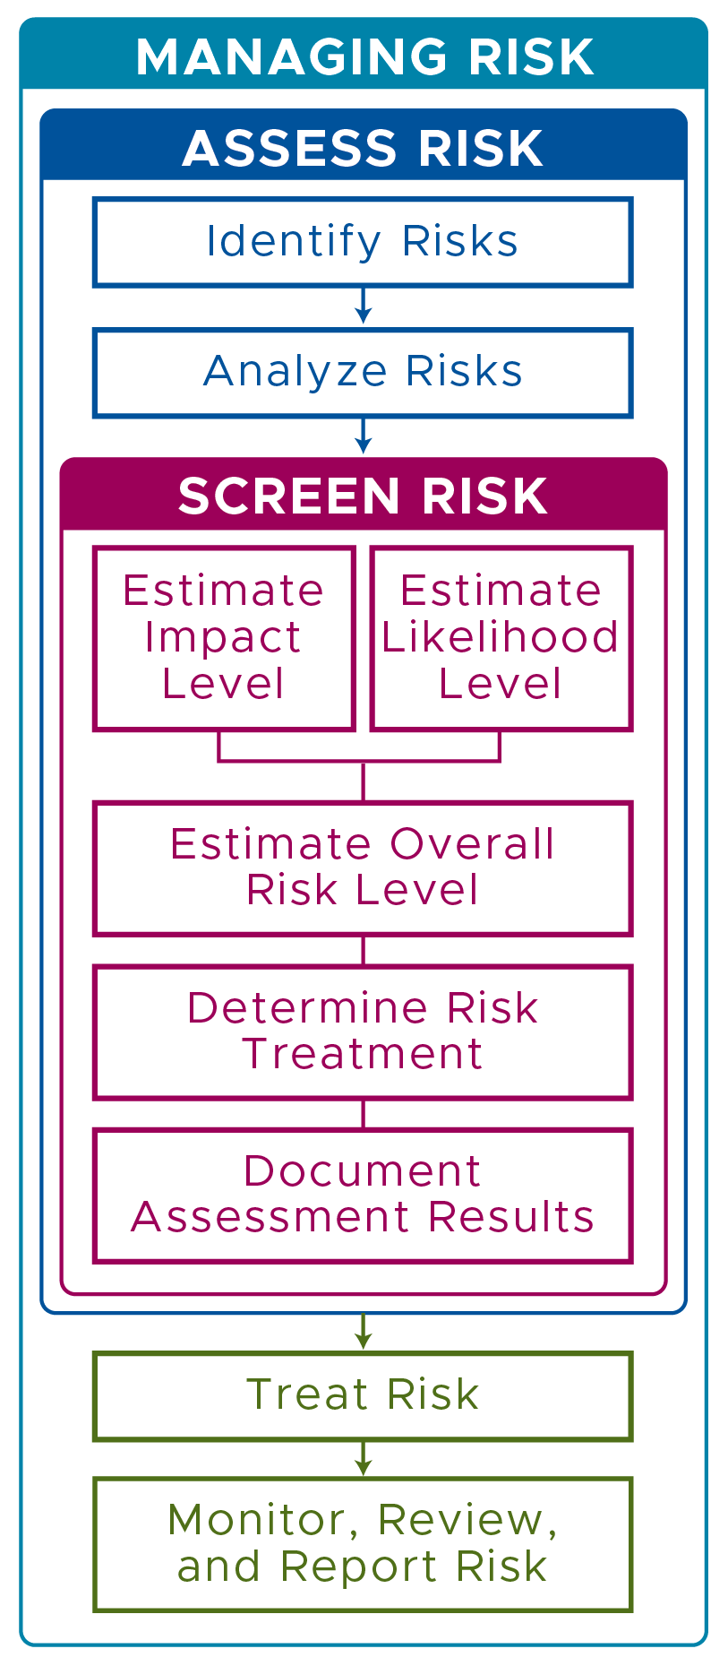
Standard Risk Evaluation
ERM Phase 1
2012-2017
ASSESS: Identify and analyze the risk.
SCREEN: Estimate risk level based on impact and likelihood and determine the appropriate treatment.
TREAT: Apply treatments to mitigate or manage risk.
MONITOR, REVIEW, & REPORT: Continue to monitor and review risk to determine if additional treatment or actions are needed. If a risk changes, report the changes within the appropriate risk register.

Slide 7
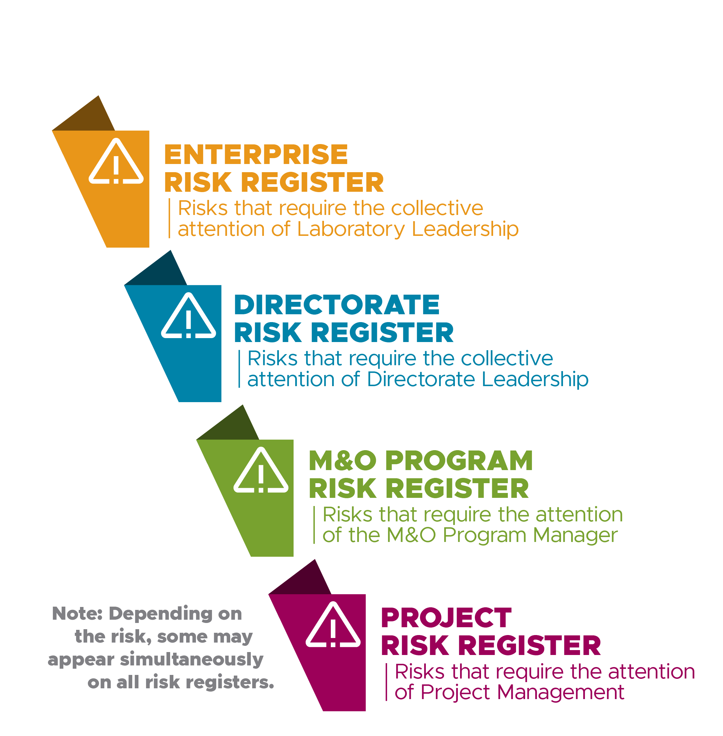
Standard Risk Assessment
ERM Phase 1
2012-2017
Risk Registers
Capture most important risks associated with a PNNL project, M&O Program, Directorate, or the Laboratory.
Include specific risk details such as risk source, mitigations, controls, likelihood and impact, key risk indicators, risk treatment, risk level, and risk owner.
Projects utilize a risk register within a work planning and controls system.
Enterprise, directorates, and programs use a standardized electronic risk register.

Slide 8
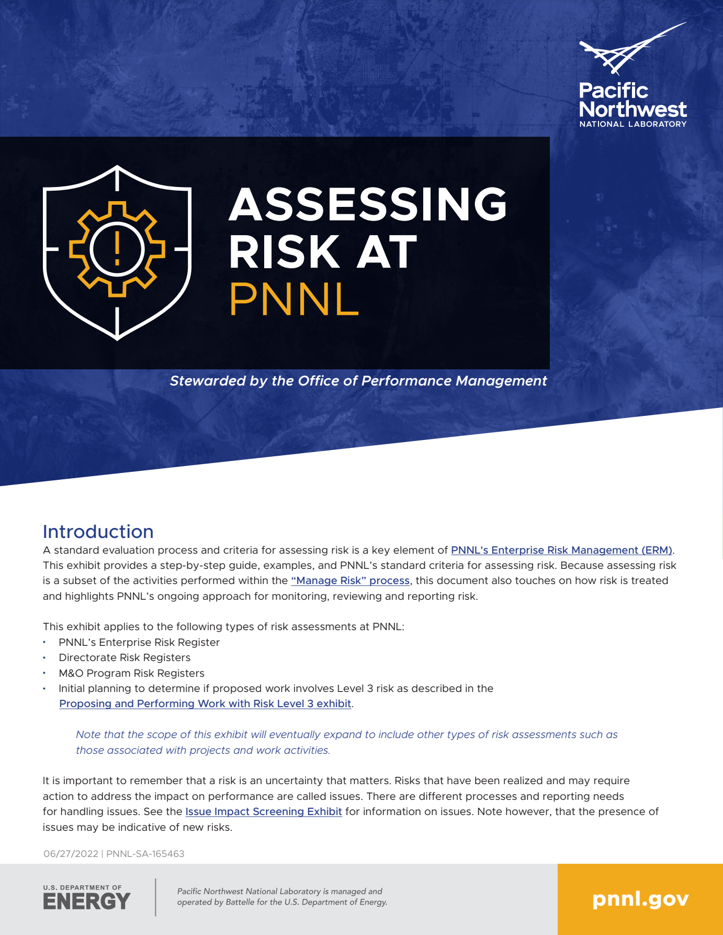
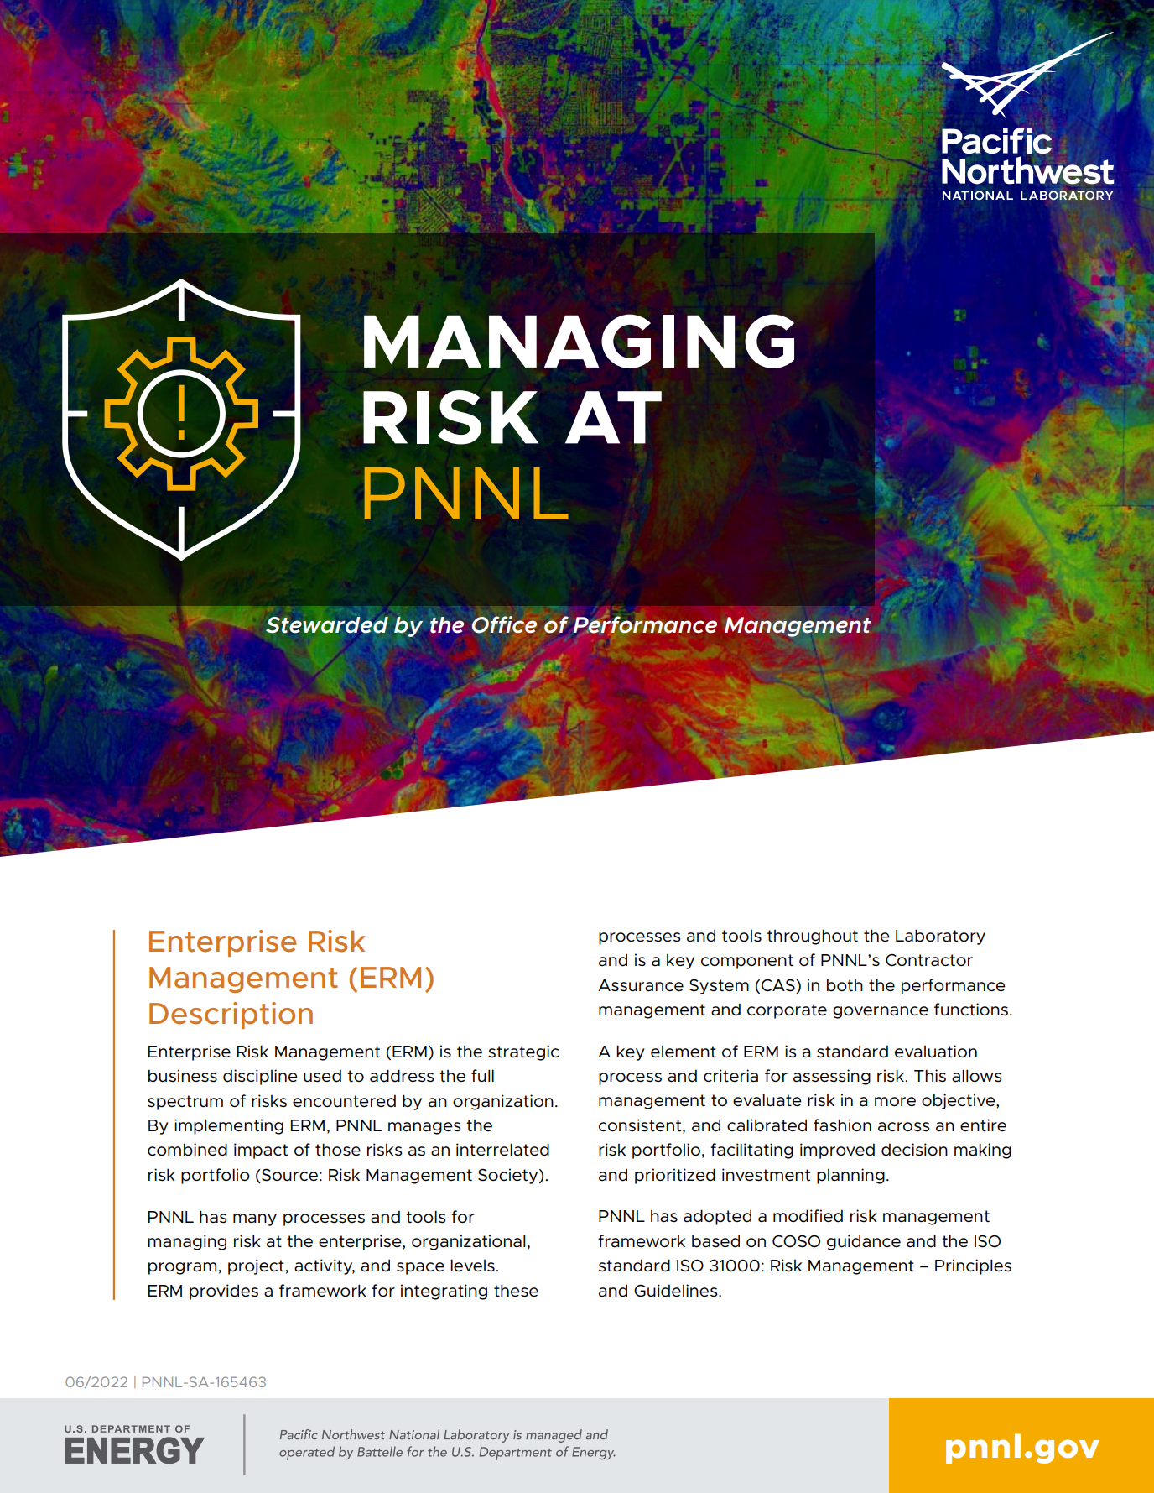
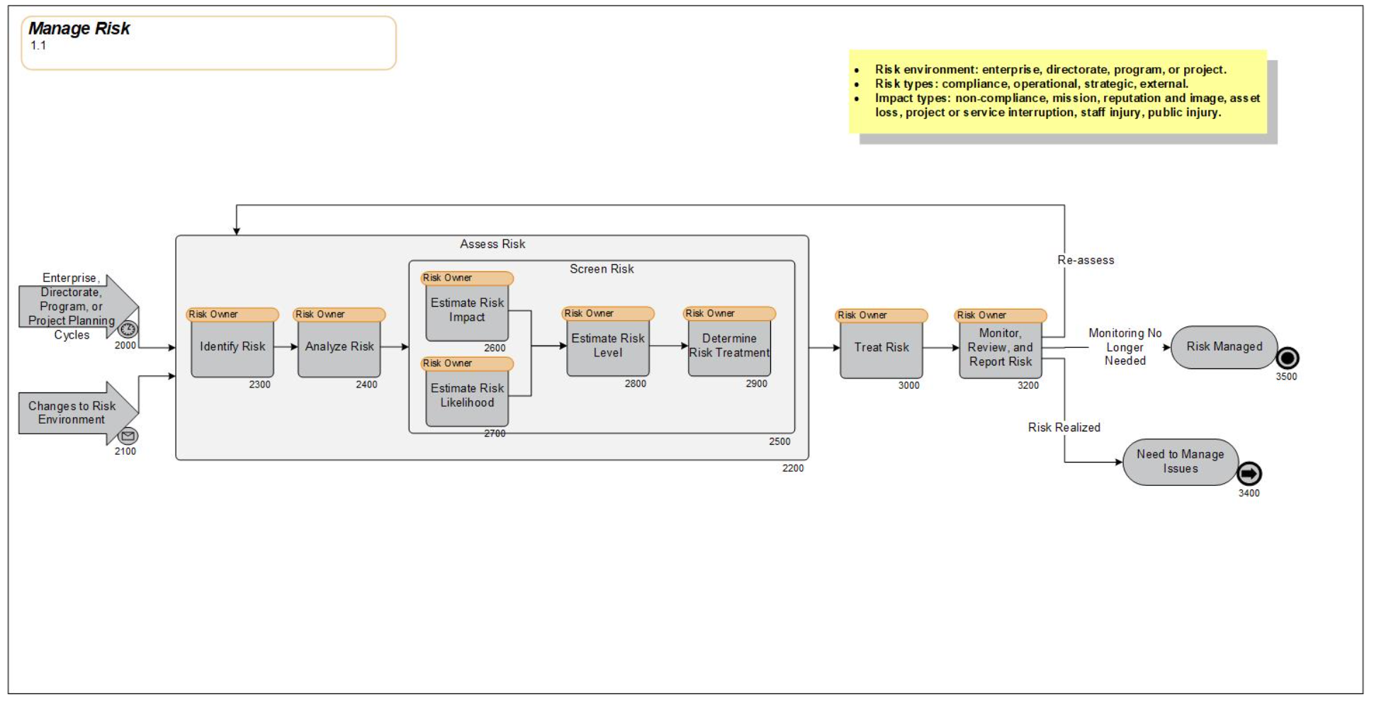
Evolving PNNL’s ERM Framework
ERM Phase 2
2017-2021
Simplified risk terminology and tools
Increased support of ERM from senior leader
Established Chief Risk Officer (CRO) role
Enhanced risk-related R2A2’s for key roles
Created more dynamic enterprise risk register
Integrated ERM into other Contractor Assurance
Past ERM documentation and training

Slide 9
Simplified Risk Terminology & Assessment
ERM Phase 2
2017-2021
Risk Terminology | Required Approval for Acceptance
Risk | An uncertainty that matters.
Issue | A realized risk.
Control | A risk treatment that maintains or mitigates risk and increases the likelihood established objectives will be achieved.
Critical Control | A control whose failure or degradation would result in a significant increase in risk.
Determining Risk Level by Impact and Likelihood | Risk Level Table
Likelihood Level | Impact Level
 | Level 1: | Level 2: | Level 3:
Level 3: | Risk Level 2 | Risk Level 3 | Risk Level 3
Level 2: | Risk Level 1 | Risk Level 2 | Risk Level 3
Level 1: | Risk Level 1 | Risk Level 1 | Risk Level 2
Required Approval for Acceptance | Required Approval for Acceptance
Risk Level 1: | None; accepted as-is by risk owner
Risk Level 2: | Directorate Chief Operating Officer, or Associate Laboratory Director if no Chief Operating Officer
Risk Level 3: | Delegated by Laboratory Director to the Deputy Director for Operations and Deputy Director for Science and Technology

Slide 10
Established Chief Risk Officer
ERM Phase 2
2017-2021
The Chief Risk Officer role was established by the Laboratory Director in 2020.
The purpose of the role is to help create a unified perspective of risk and coordinated approach to its management.
The Chief Risk Officer also:
helps prioritize risk across the enterprise and coordinates strategies for managing risk.
executes the strategic oversight of PNNL enterprise risk.
assists PNNL and Battelle senior management in executing key institutional risk management functions as the enterprise Subject Matter Expert
Dana Storms
Chief Risk Officer & Executive Director
Office of Performance Management

Slide 11
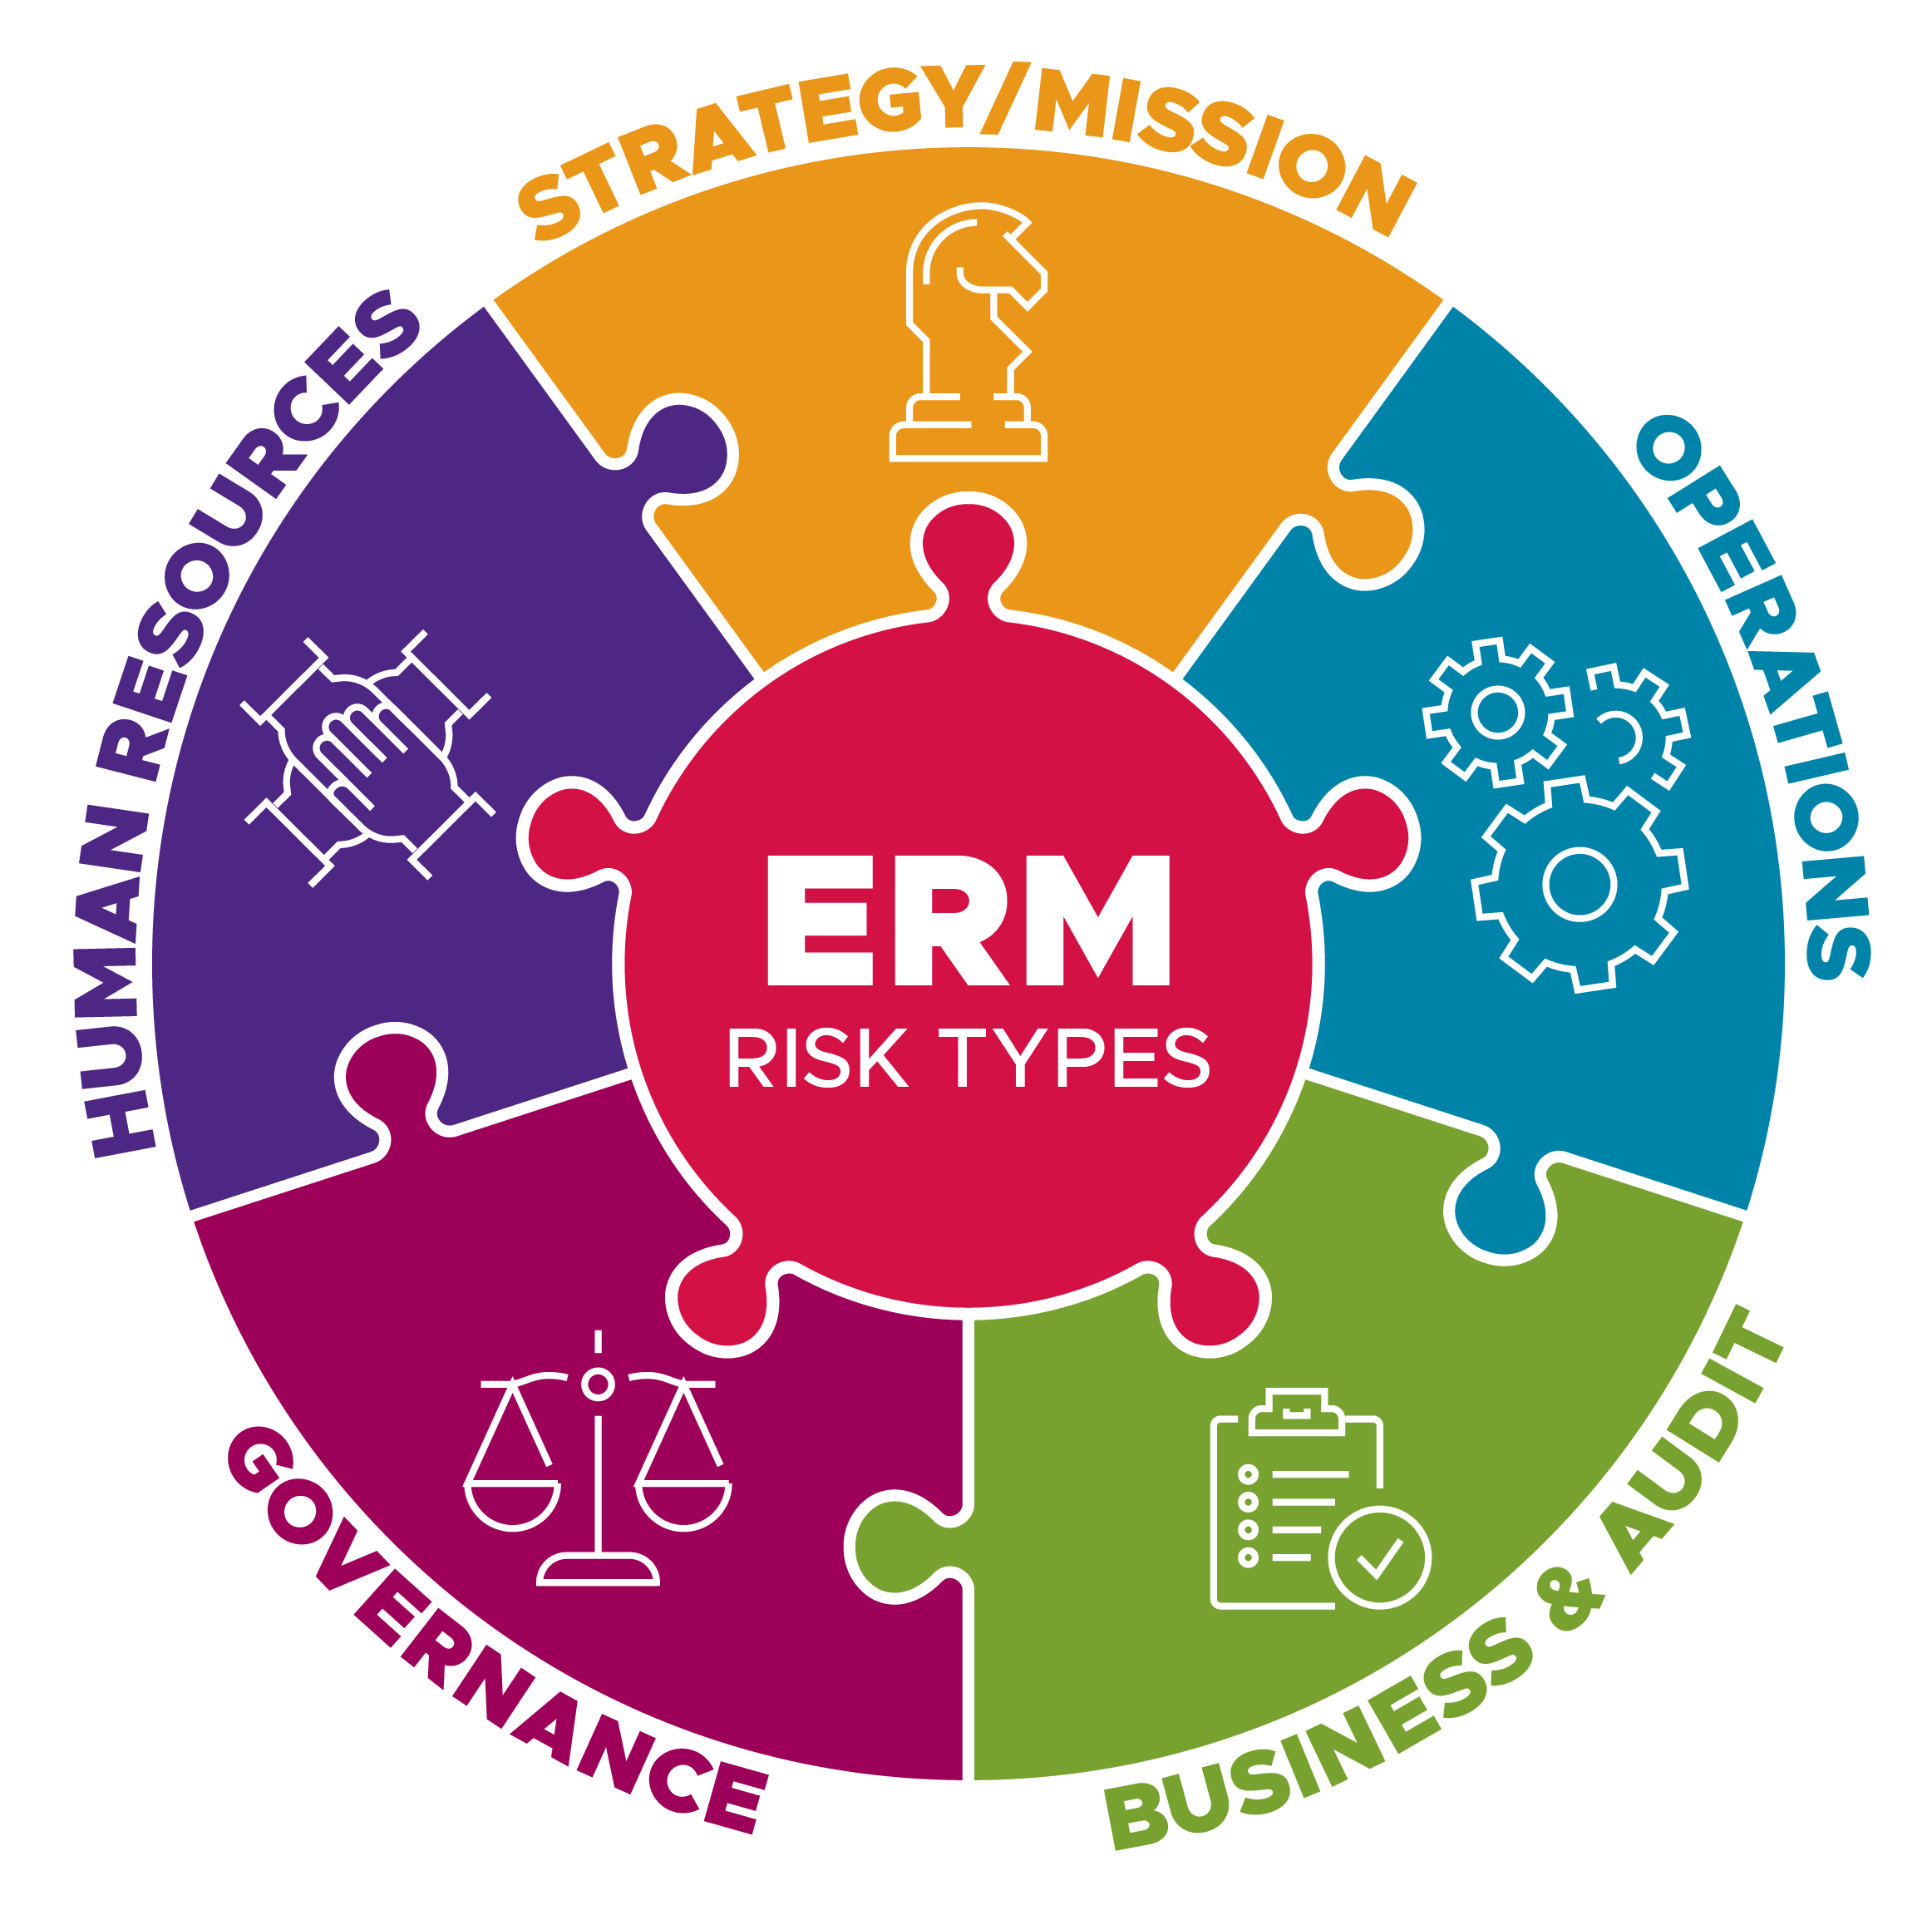
Improved Enterprise Risk Register
ERM Phase 2
2017-2021
Focused enterprise risk register on select subset of risks that the Lab Director and Lab Leadership Team must actively managed at the enterprise level.
Eliminated “forever” risks from the ERR
Eliminated “issues” from the ERR
Held regular “deep dive” meetings to facilitate meaningful discussion of risks and actively manage risks throughout year.
Used register in discussions with key stakeholders including DOE site office and Battelle board and risk committees.

Slide 12
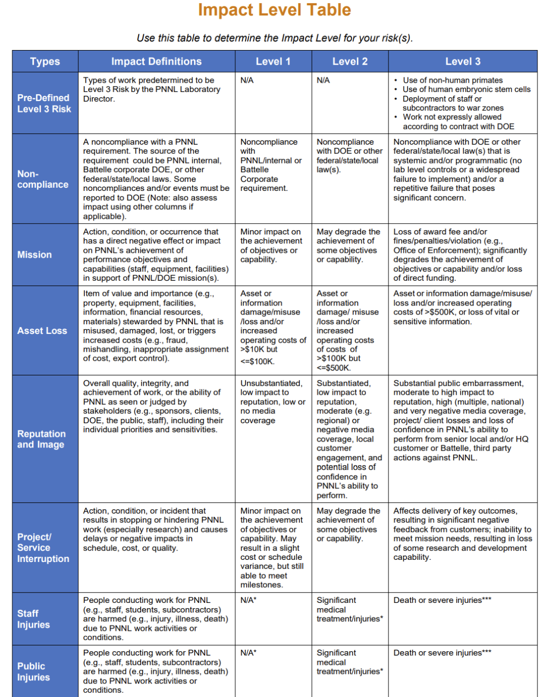
Integrated ERM with CAS
ERM Phase 2
2017-2021
Added risk register and risk terminology to planning on research proposals/projects
Added risk dimension to "decision rubric" for internal investment projects
Aligned impact tables for assessing risks and issues
Combined information on risks, requirements, controls, and measures/assessments in trimester performance reporting for M&O Programs

Slide 13
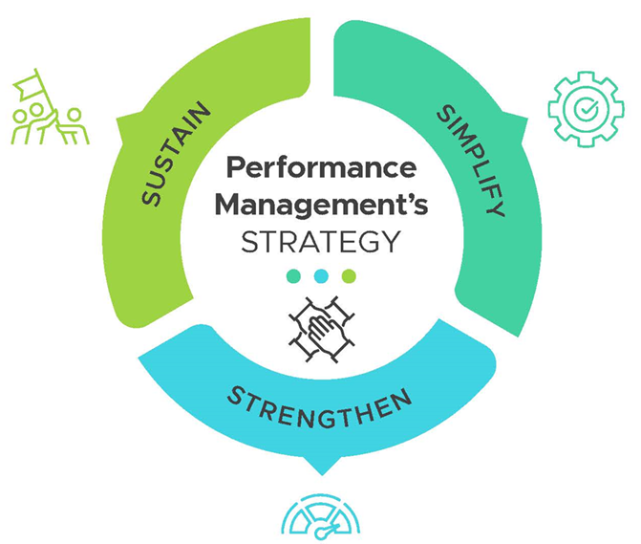
Modernizing PNNL’s ERM Framework
ERM Phase 3
2022-Present
Simplify, strengthen, and sustain:
Documentation
Training
Tools
Data analytics
Risk modeling
Stakeholder engagement
User experience

Slide 14
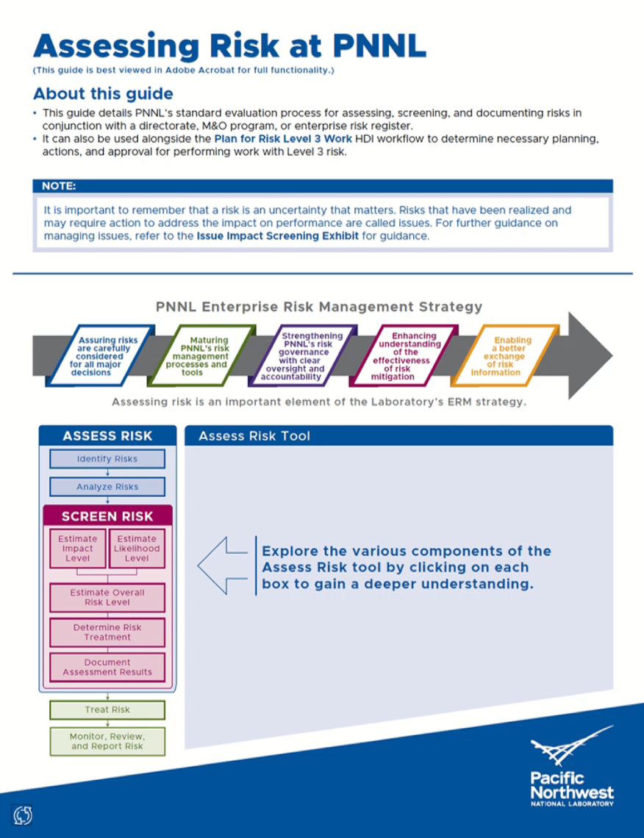
ERM Phase 3
2022-Present
Improved documentation and training
New ERM Online Training
New Interactive Assessing Risk Guide

Slide 15
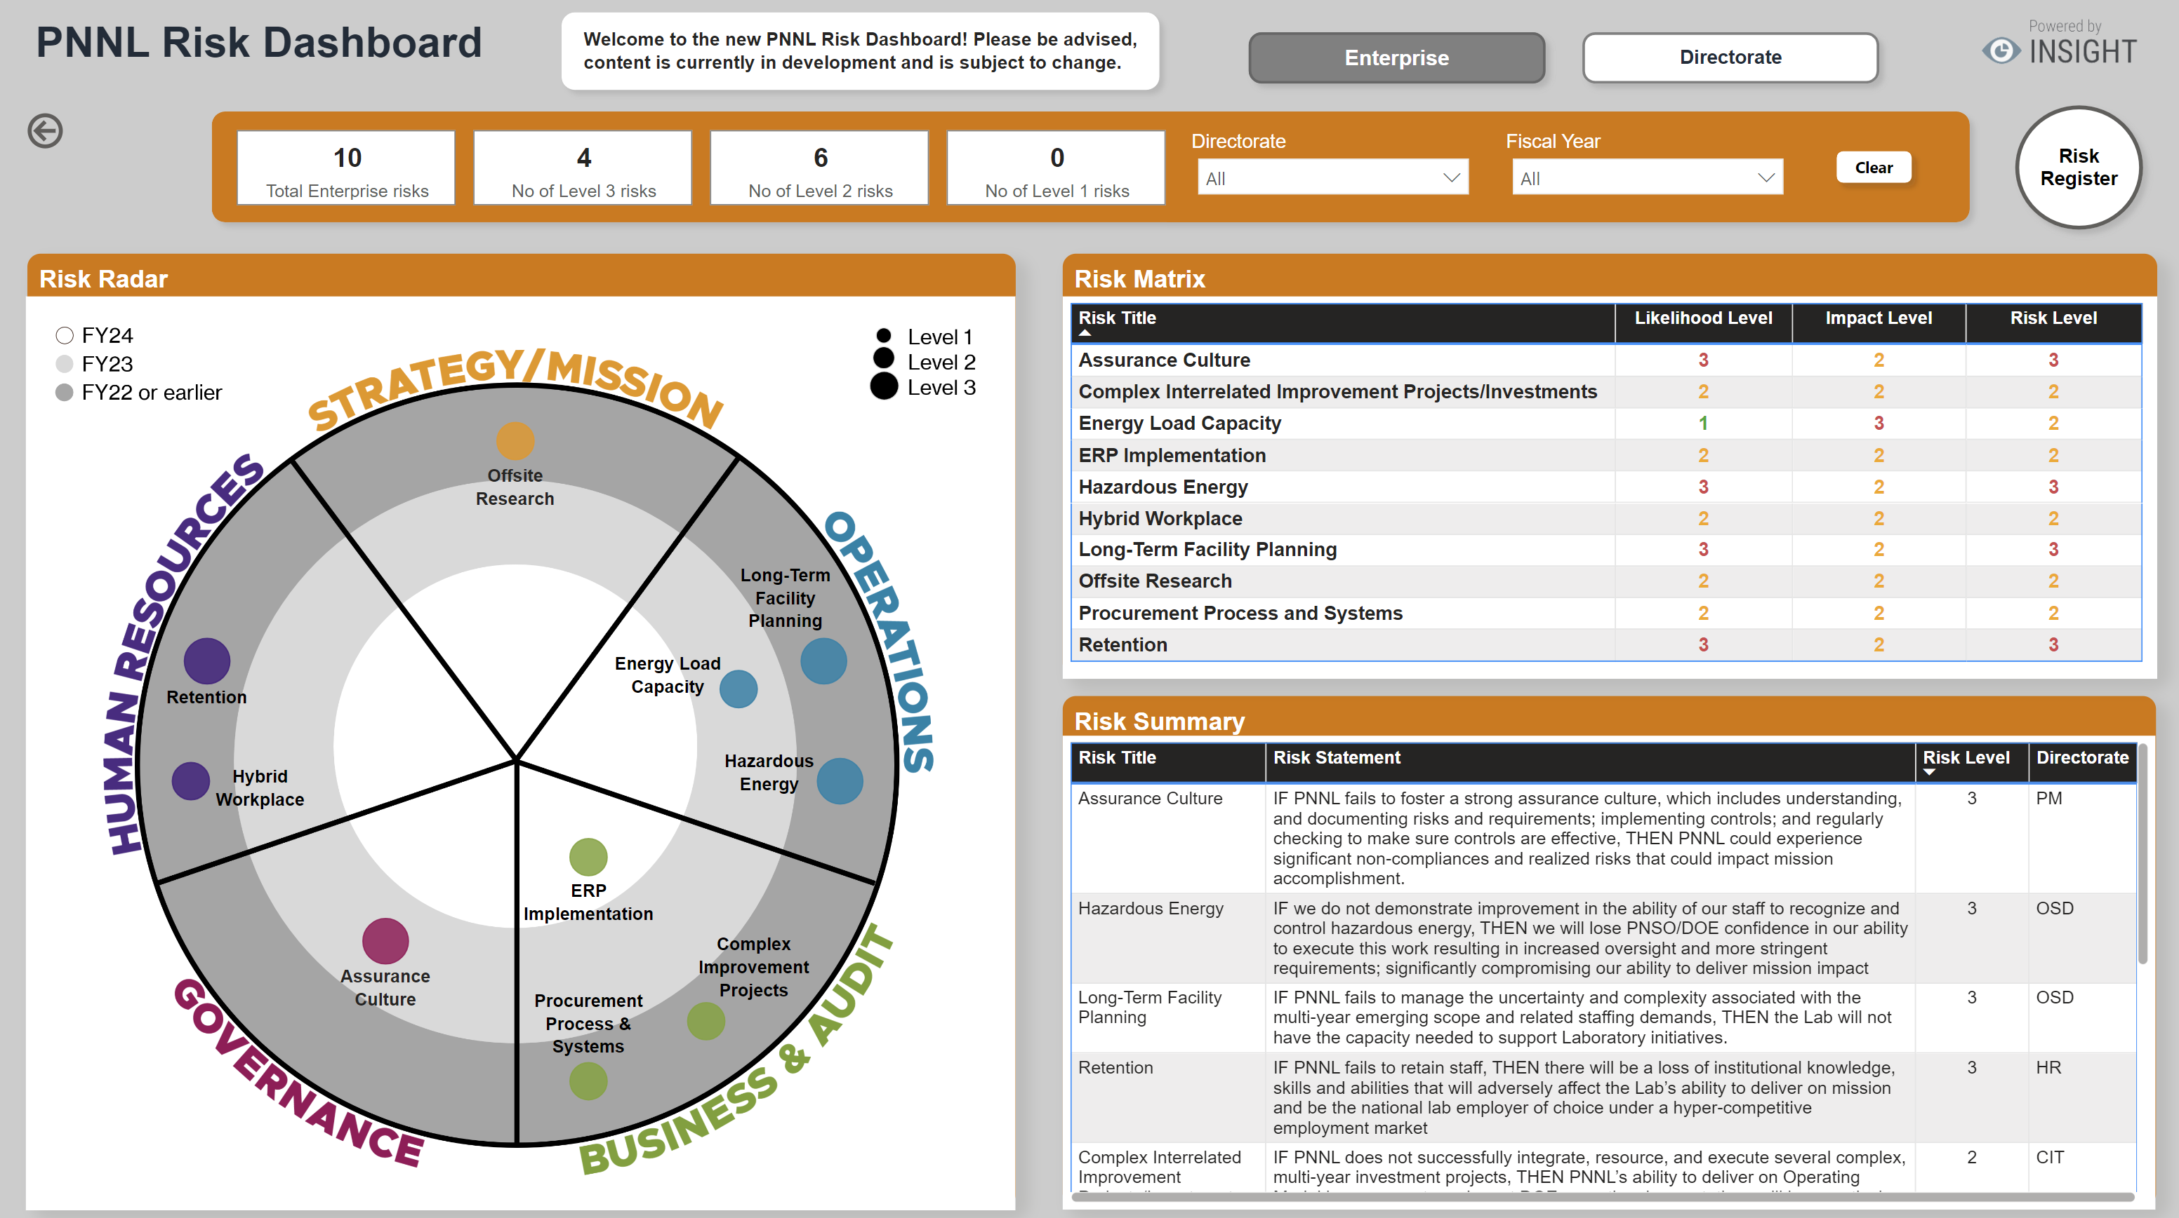
ERM Phase 3
2022-Present
Enhanced tools and data analytics
Refreshed Risk Dashboard
New ERM Webpage

Slide 16
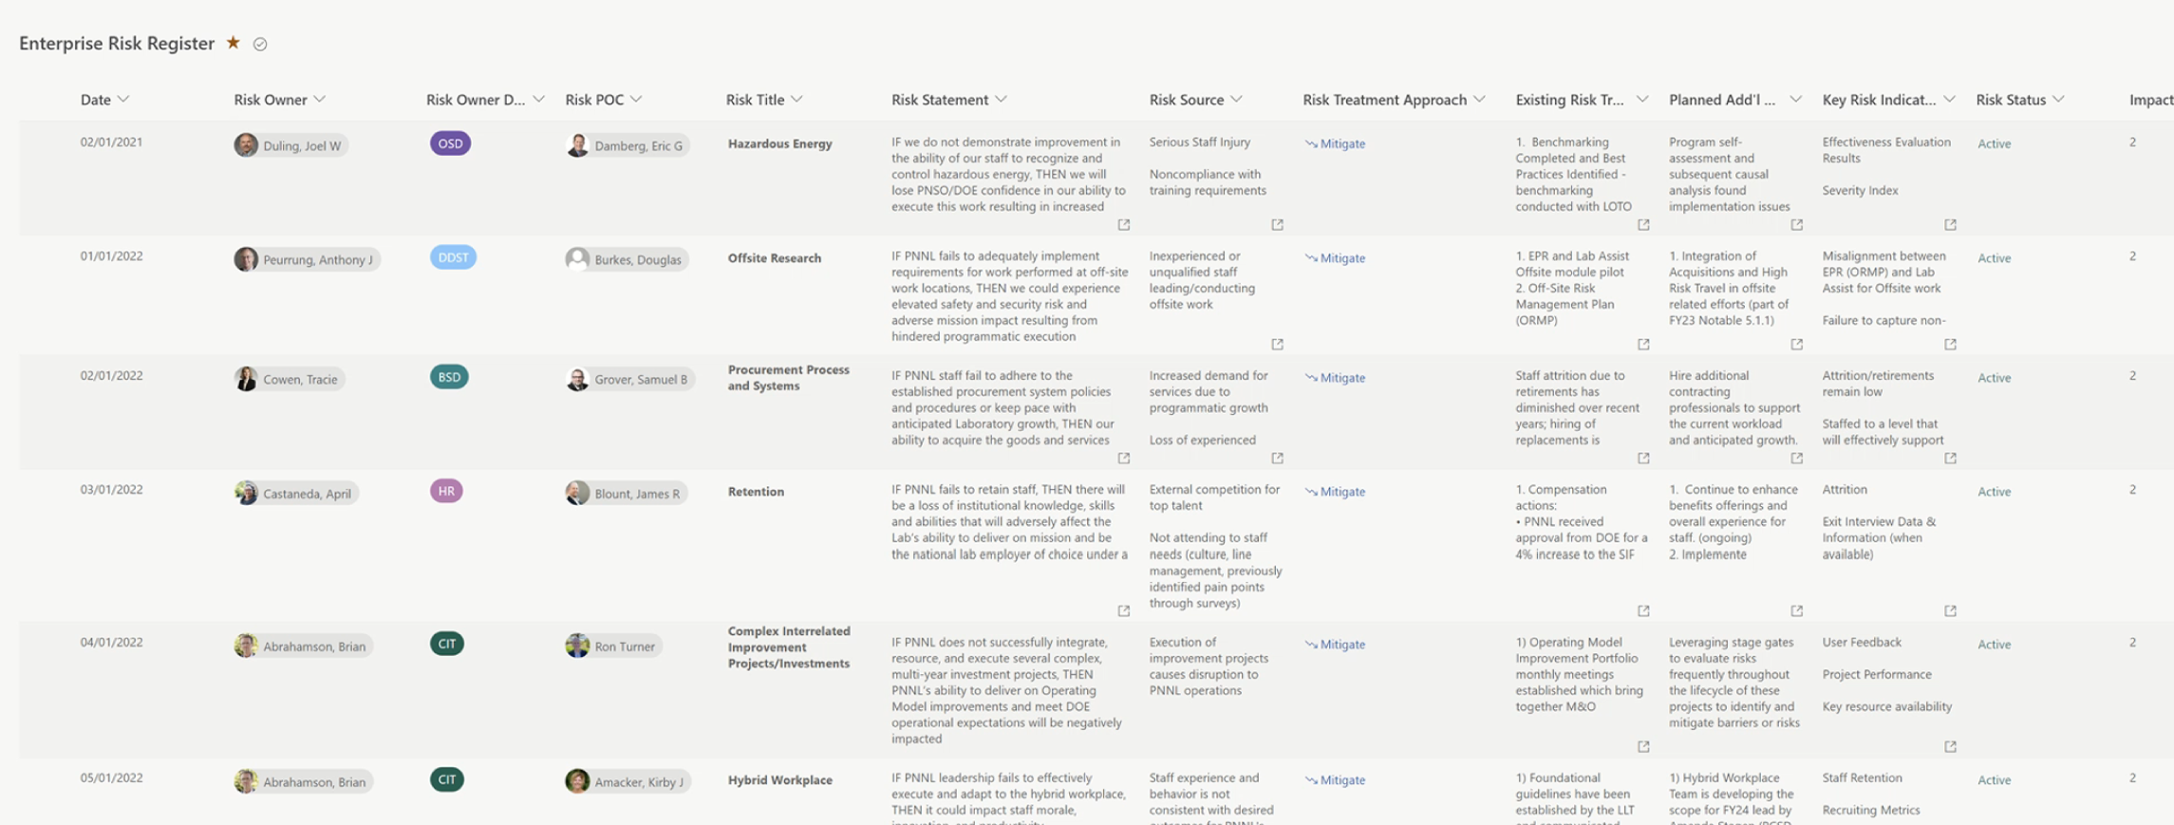
ERM Phase 3
2022-Present
Enhanced tools and data analytics
New Online Risk Register(s)

Slide 17
Enhanced tools and data analytics
ERM Phase 3
2022-Present
A Risk Model enables you to combine multiple data streams or key risk indicators (KRIs) in a meaningful way to proactively monitor risk and performance and alert the right people to take action BEFORE a risk is realized.
Primary Risk Sources
Risk Amplifiers
Risk
Exposure to High-Hazard KRI: # of exposures of team members to high hazards
Work Planning & Controls
Risk
Major Operational Incident Involving Team
Team Size (FTEs)
Team Size (LTEs)
Operational Culture
Index
FTE New Hires
Team Engagement
FTE Staff Leaving
17

Slide 18
PNNL’s ERM Journey
FY12
FY13
FY14
FY16
FY19
FY20
FY21
FY22
FY23
FY24
PHASE 1
PHASE 2
PHASE 3
ERM Framework
Enterprise Risk
Register
Chief Risk Officer Role
Risk Assessment
ERM Maturity
Review & Improvements
Standard Risk Screening & M&O Risk Register
Directorate Risk Register
R2A2s, Recalibrate Risk Screening & Gartner ERM
Leadership Council
Integrated
Risk Dashboard
ERM Training, Predictive Risk Modeling & More Improvements

Slide 19
Looking Ahead
ERM Phase 4
& Beyond
Future enhancements:
Further integrate risk management into other CAS processes, guidance, and workflows
Better operationalize PNNL’s risk appetite
Incorporate risk management into Lab-level strategic planning

Slide 20
Q&A

