Slide 1
An Assessment on Knowledge Transfer at PNNL
Pamela Hughes
May 7, 2024
PNNL-SA-195214

Slide 2
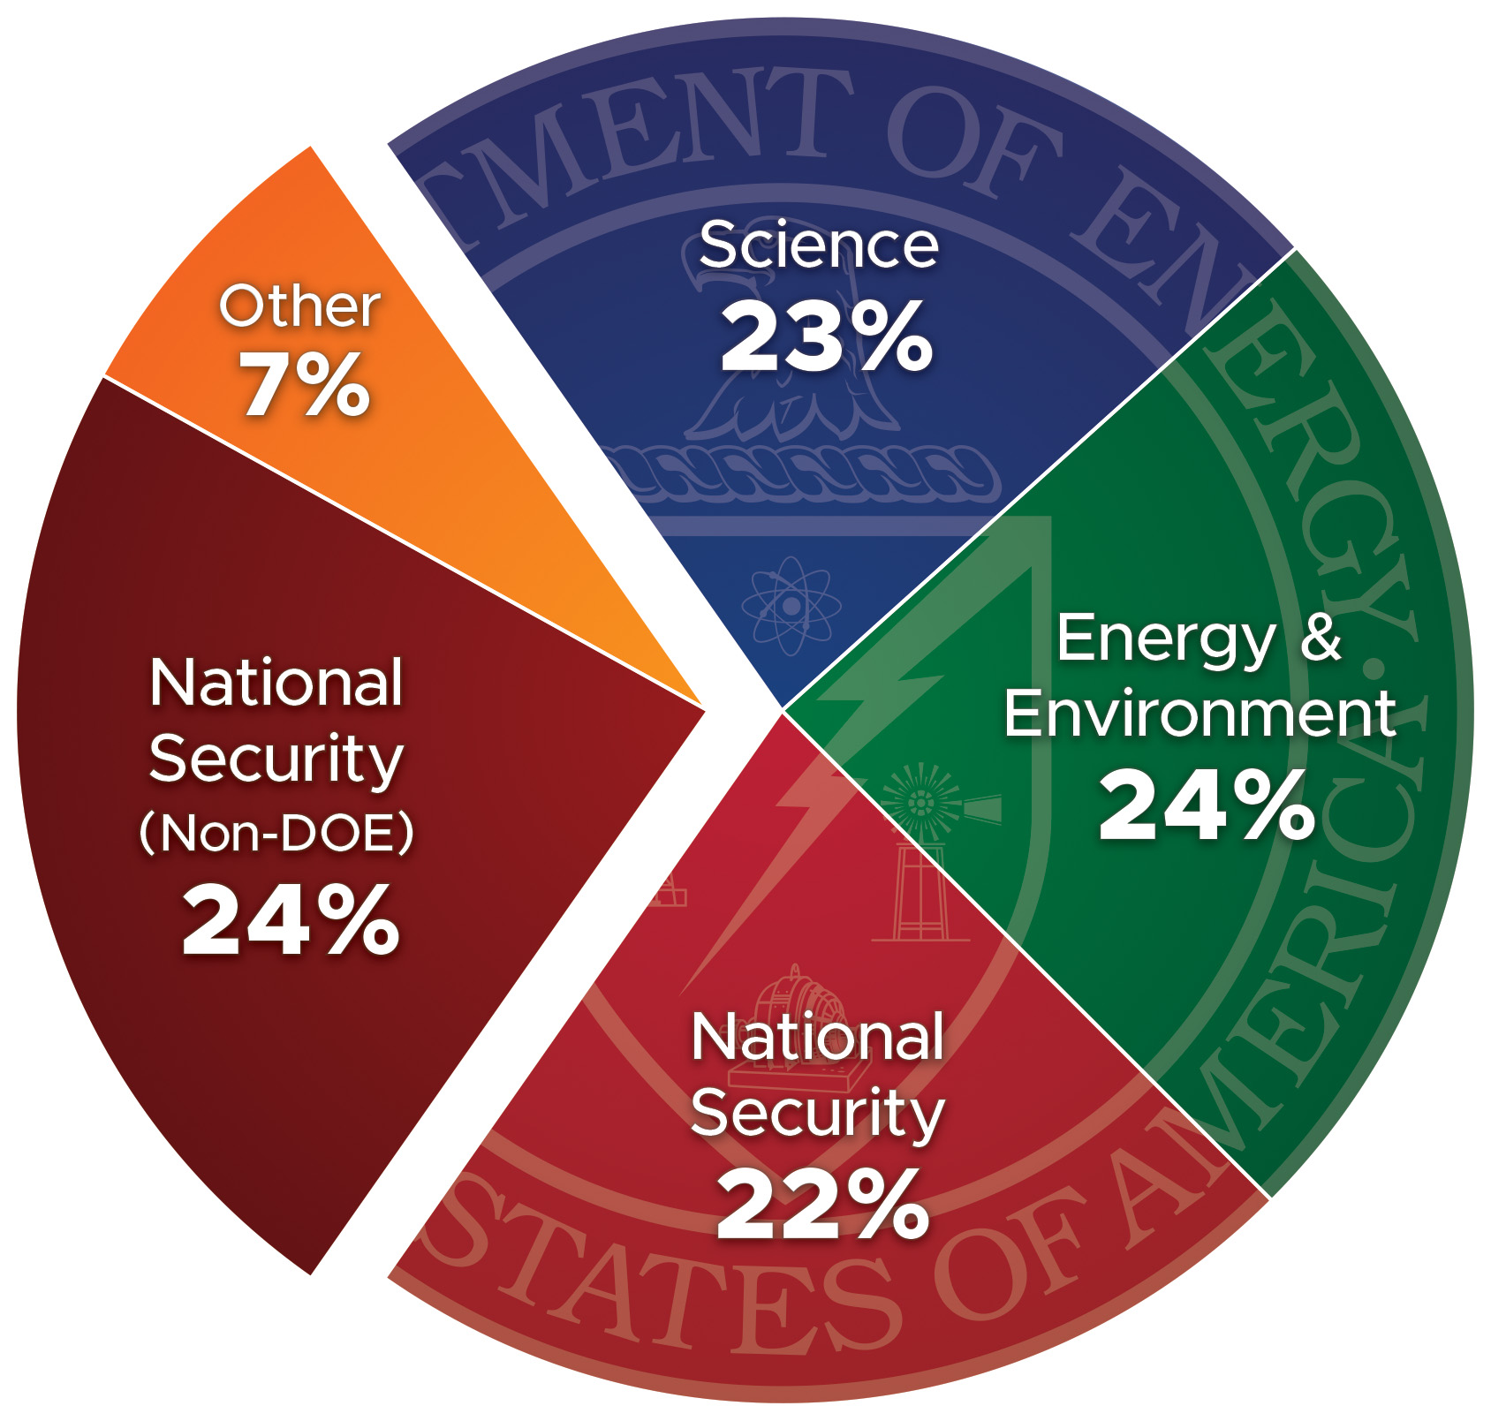
PNNL – A lot of staff in motion!
FY 2022 Spending
6,088 staff
~50% of staff have been at PNNL less than 5 years
Attrition rate = 7.1%
Average of ~20% staff changing jobs per year
October 2023
18% virtual; 42% hybrid

Slide 3
Charge to the assessment team Provide insights into knowledge transfer across PNNL
Identify where knowledge transfer practices are most important (through one’s career lifecycle)
Identify implementations to knowledge transfer methods and practices
Address knowledge transfer use cases that help staff build upon key career development competencies
Identify potential opportunities for improvement

Slide 4
Our assessment approach was conducted in two phases
Phase I
(September to October)
Conduct Interviews with senior leadership, staff, and the Pacific Northwest Site Office
Conduct analyses on staff transitions during the fiscal year
We conducted a study of the literature on knowledge transfer models
Draft preliminary observations and themes based on interviews and analyses
Phase II
(November through December)
Present preliminary results to our senior level forums
Finalize our report

Slide 5
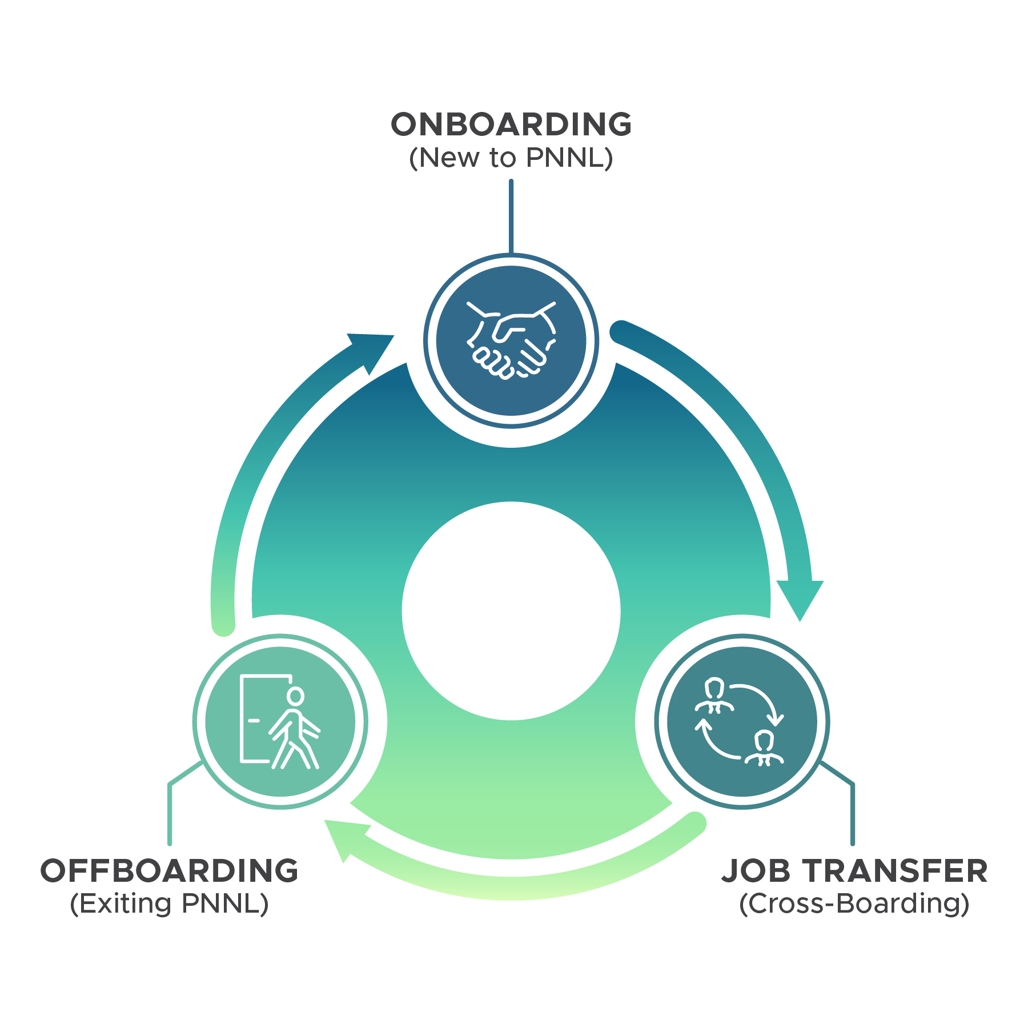
What is knowledge transfer
Knowledge transfer is the capturing and sharing essential information related to executing job functions (e.g., skills, abilities, competencies) to assure Laboratory operations and activities can be effectively sustained during periods of staff transition
Knowledge transfer happens along a continuum

Slide 6
Guiding principles
Intentional
Performed as a way of doing business
Strategic
Emphasizes areas of knowledge transfer essential to effective operation of PNNL
Holistic
Involves explicit and implicit knowledge across all jobs
Shared Responsibility
Requires intent and execution on the part of the line management, project management, and staff
Focused
Concentrates on knowledge essential to jobs, critical operations, and career progression
Continuous
Includes onboarding, cross-boarding, promotion, offboarding

Slide 7
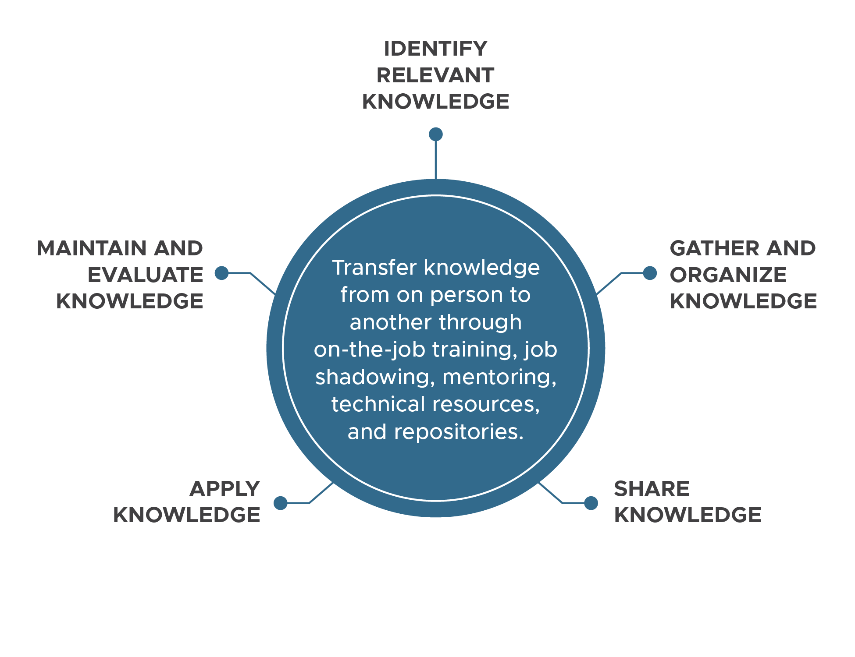
Knowledge transfer framework
Identify important knowledge that exists within the organization
Gather and organize knowledge and document in a way that makes it accessible and easy to find and use
Share knowledge with the staff and stakeholders through training programs, newsletters, and collaboration tools.

Slide 8
Knowledge transfer framework (continued)
Apply knowledge to improve organizational performance such as process improvements and S&T innovation.
Maintain and evaluate knowledge to assure its relevance and accuracy

Slide 9
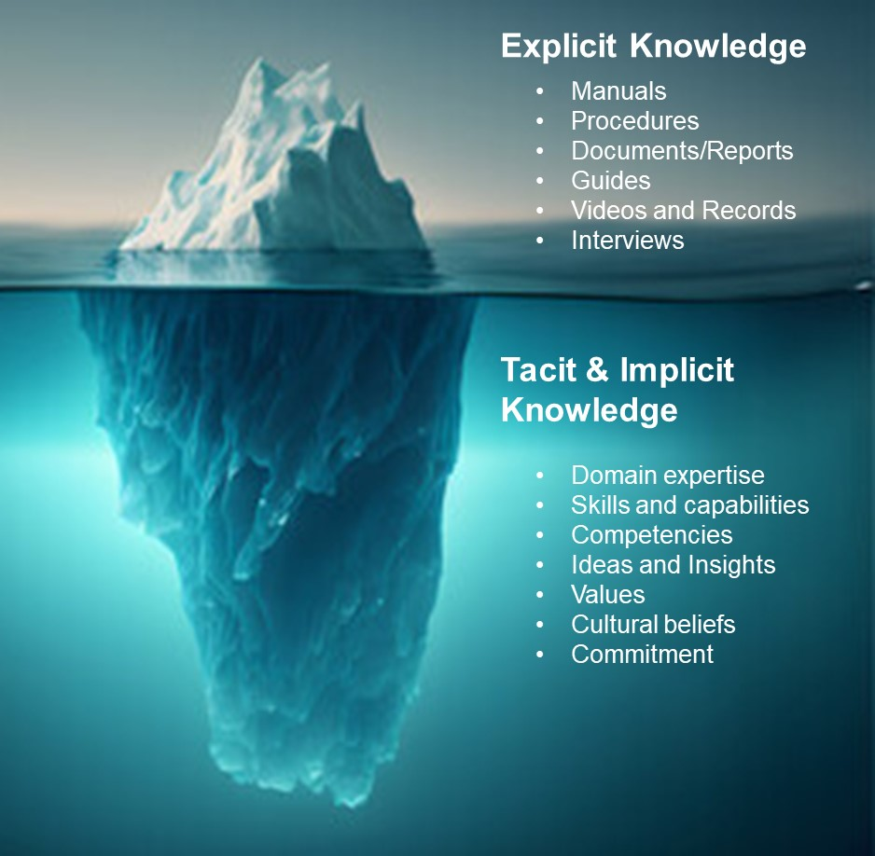
Questions that enabled the study team an analysis of knowledge transfer at PNNL
What types of knowledge are needed to be successful?
How is this knowledge captured, transferred, and shared?
How is this knowledge applied and used?
What are gaps if knowledge transfer is ineffective?
What can be done to mitigate risks?
What are some best practices to be shared?

Slide 10
Established four knowledge transfer “use cases”
Use Case | Definition
Day-to-day work | The explicit knowledge needed for staff to succeed in their day-to-day work tasks
Career development | Implicit and non-technical knowledge that goes beyond day-to-day work and is necessary to successfully interface with sponsors, influence outcomes, win proposals, and build networks
Executive leadership | Implicit knowledge necessary for successful transition to executive positions
Critical operations | Explicit knowledge needed to understand critical operations and manage operational risks

Slide 11
Day-to-Day Work
Large focus on explicit knowledge (especially for early career) and implicit knowledge for staff who are more mature in their career
Key success factors
Providing staff with a peer partner who is a reference point for domain knowledge, has access to legacy knowledge, and can share “tricks of the trade”
Creating templates and instructions for use in report development, assessments, causals, and other activities
Sending staff to trainings to help build skills-based competencies (that in turn, increase the capabilities of the group)
Introduction to key networks (internally and externally)
User groups, communities of practice, and technical forums that document Laboratory practices and help staff build knowledge, skills, and networks in their jobs

Slide 12
Career development
A sustained, multi-year process that requires staff to continuously acquire and apply new knowledge and skills to adapt to changing work environments and emerging assignments
Key success factors
Acquiring knowledge involves obtaining relevant information, skills, and expertise required for professional growth
Engaging in mentorship programs (throughout one’s career) and/or seeking guidance from experienced professionals was described as heightening one’s learning curve
Building relationships through networking provides staff with the opportunity to connect with sponsors, build professional relationships with staff at other institutions including through communities of practice across Battelle-affiliated laboratories
A commitment to ongoing professional development results in enhancing a staff member’s existing skills and facilitates the acquisition of new knowledge

Slide 13
Executive leadership
Hold unique positions that are instrumental in shaping the Laboratory’s organizational culture, determining its strategic direction, and setting performance expectations for staff
Knowledge transfer is largely unstructured
Key success factors for new executives
An introduction to the DOE laboratory system, its origins, and current purpose and impact
How a laboratory operates
Peer buddies (both from a research and mission support side)
Roadmap of people to contact and network with
Change management
Transition memo describing unwritten or tacit expectations (key sponsors, risks, and pitfalls)

Slide 14
Critical operations
Encompass a wide range of potential hazards that organizations face in their day-to-day operations
Key success factors
Robust documentation
Documented lessons learned
Job shadowing to observe operations and ask questions of those performing the work
Mentoring, peer partnering
Hiring proactively allows incoming staff to have adequate time with their predecessor
Rotating staff through multiple positions help to build bench strength

Slide 15
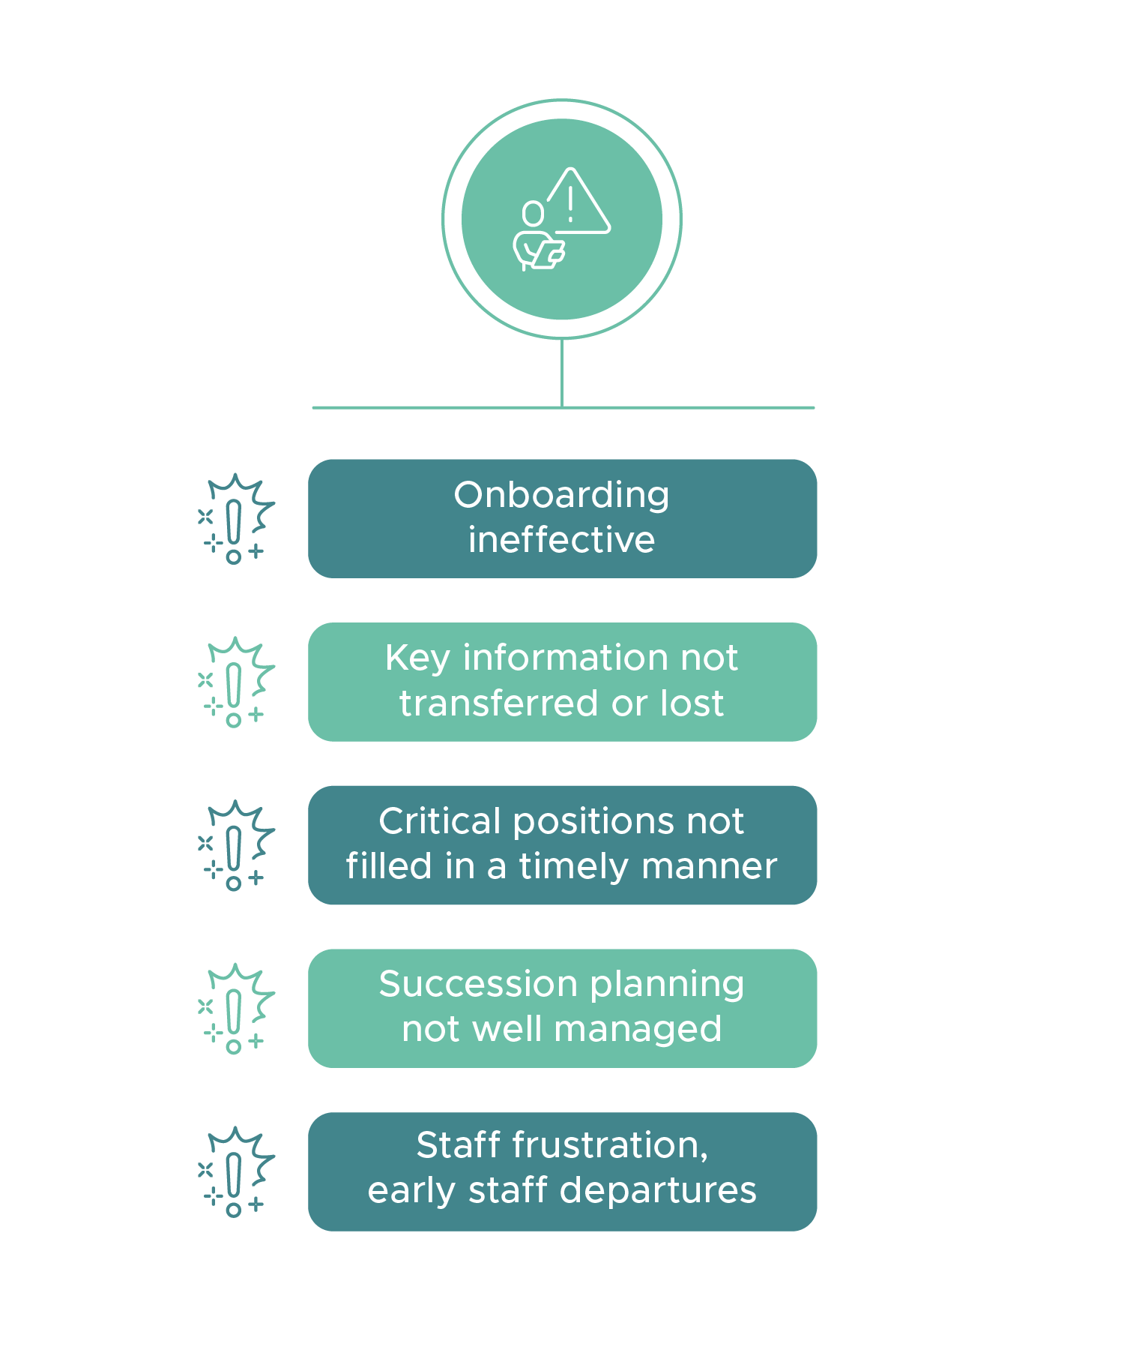
Organizational risks of not applying knowledge transfer
Organizational performance decreases
Weakens collaboration and inhibits effective decision-making
Results in poor coordination, miscommunication, and reduced overall performance
Productivity declines
Leads to reinventing the wheel
Creates duplicative work, errors, and unnecessary delays
Impacts meeting sponsor deadlines, milestones, and deliverables

Slide 16
Organizational risks of not applying knowledge transfer (continued)
Talent development limited
Unable to fully leverage the potential of the organization’s workforce
Confines knowledge to a few individuals creates knowledge gaps and limits opportunities for others
Can compromise safety, security, and compliance
Innovation impeded
Reduces creative problem-solving
Increases stagnation; staff unable to build upon existing knowledge
Hinders the organization’s ability to adapt to a changing environment

Slide 17
Key Considerations for a Path Forward
For knowledge transfer to be successful, it needs to be seen as a cultural expectation and a way of doing business
Primary responsibility with knowledge transfer lies with line management (for all staff), project management (for projects), and staff
There should be a graded approach that focuses initially on critical risks and opportunities

Slide 18
Key Considerations for a Path Forward (continued)
The HR organization has a critical role in supporting this process
Knowledge transfer should be incorporated into existing processes and initiatives (doesn’t need to be a new effort)
Ultimately, there needs to be “committed intent”

Slide 19
What’s next
We have several opportunities for improvement in front of our Leadership Team
We are building a roadmap
Continuing to learn and make adjustments as we go

Slide 20
Many thanks go to the IO assessment team, including Bob McCallum, Nico Branderhorst, Joe Burks, Ray Klann, Carolynn Novich, Parans Paranthaman, Reid Peterson,
Chris Ross, Peter Stromberg, and Katrina Walker; and to PNNL’s Chief Operations Officers, Division Director Forum, PMOD Forum, and M&OP Managers, and to PNSO for their contributions to the IO Assessment effort on Knowledge Transfer.

