Slide 1
DOE-STD-1197-2011 Revision Update EFCOG QA / ISM / CAS Spring 2024 Meeting
Andy Hobbs Consolidated Nuclear Security (CNS) Y-12 National Security Complex
Contractor Writing Team Member for Revision of DOE-STD-1197-2011
May 6-9, 2024

Slide 2
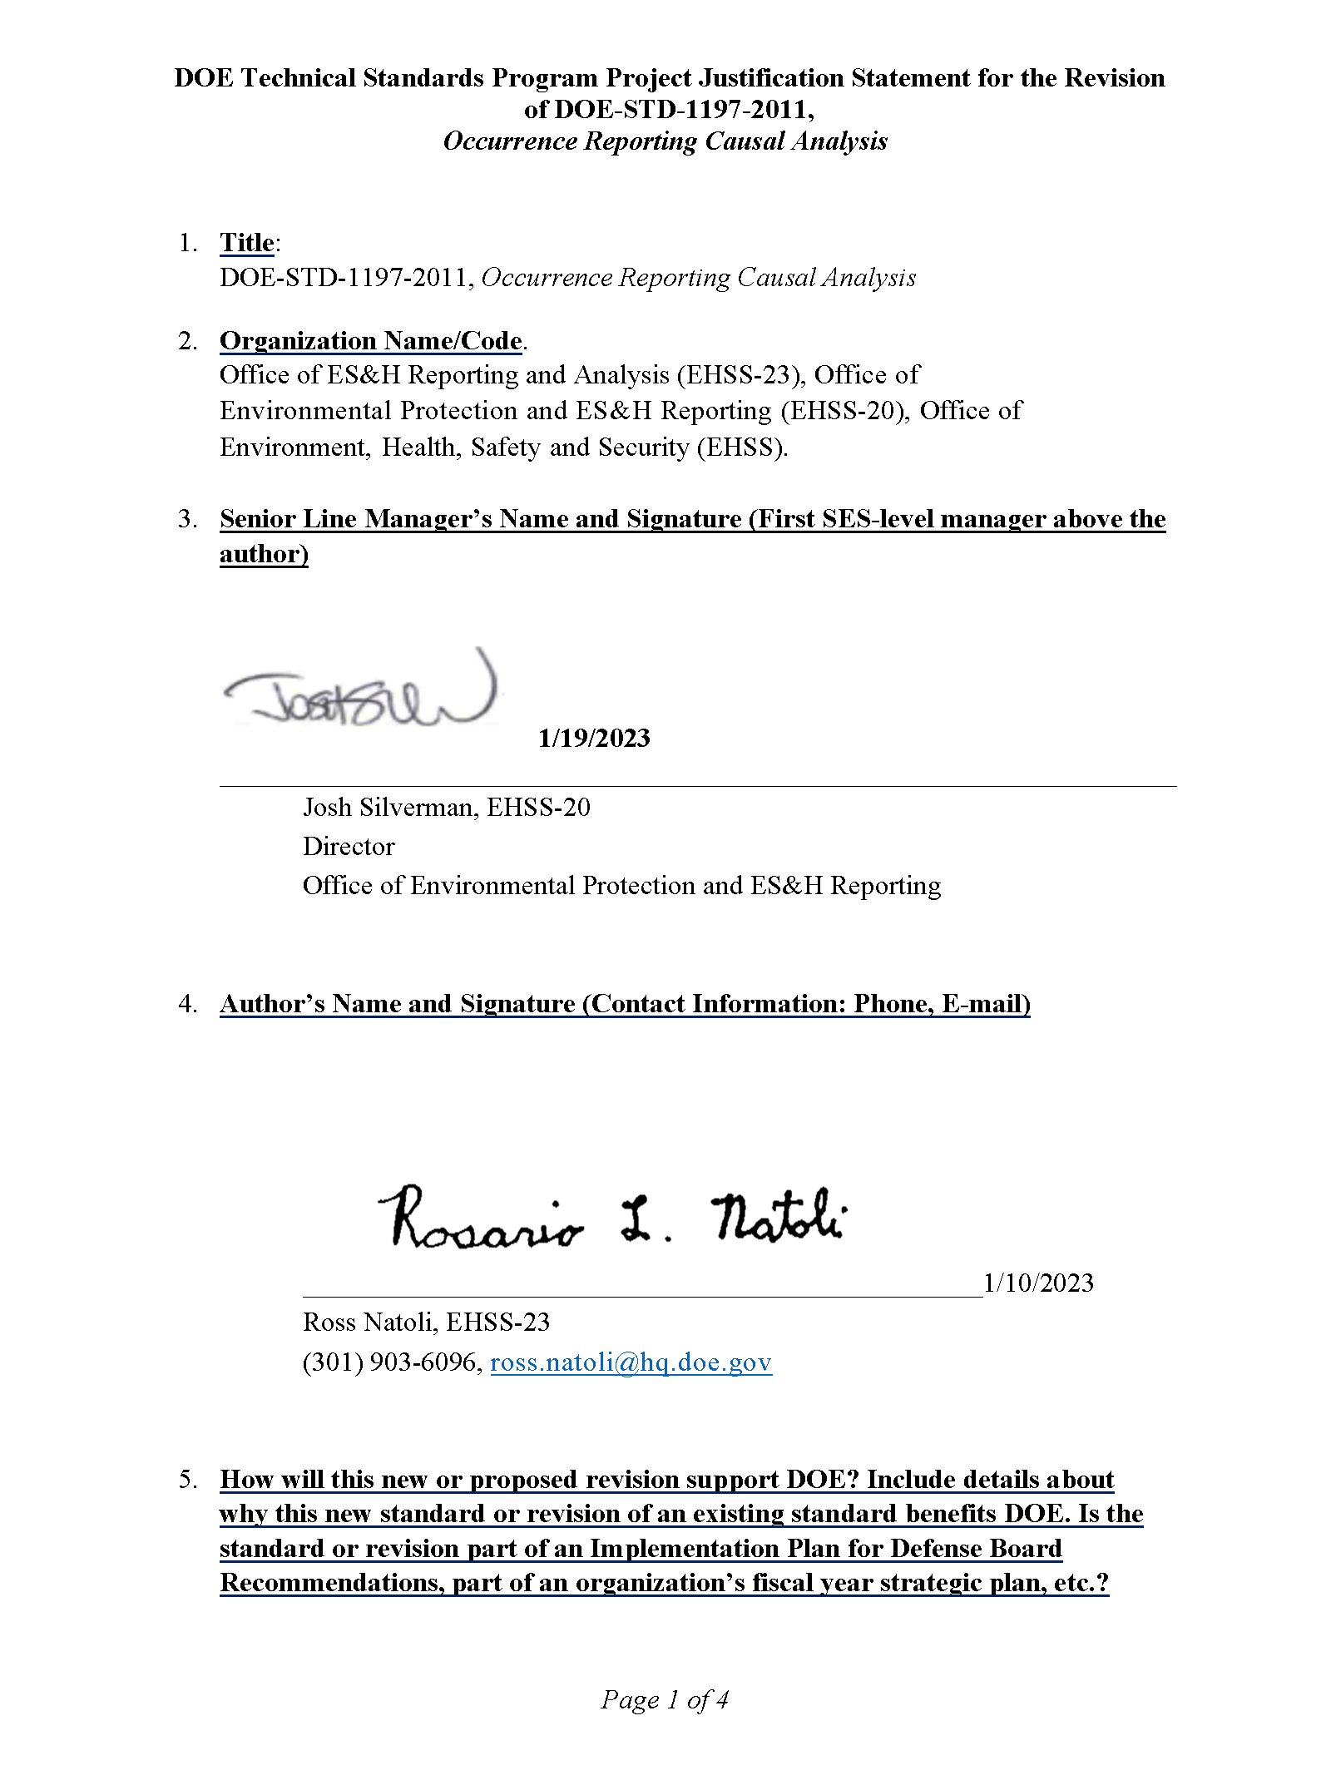
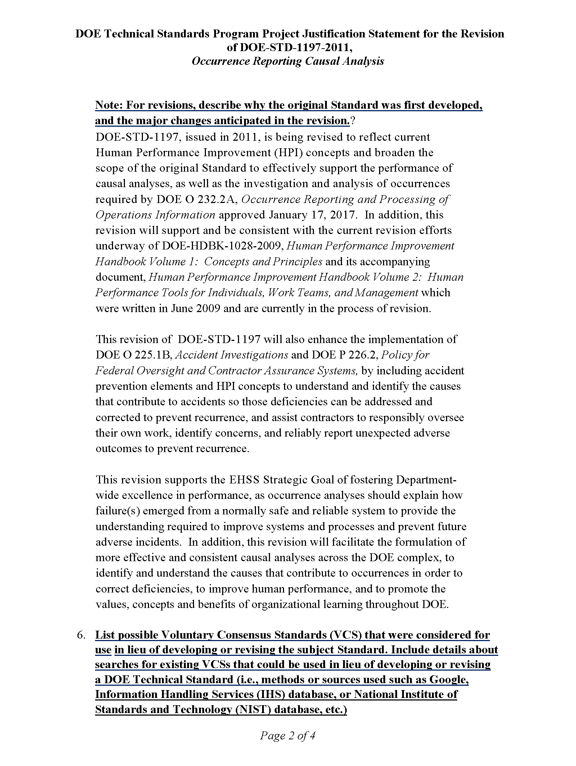
Project Justification (EHSS-23), Jan. 2023

Slide 3
Project Justification (EHSS-23), Jan. 2023
To reflect current Human Performance Improvement (HPI) concepts and broaden the scope of the original Standard to effectively support the performance of causal analyses, as well as the investigation and analysis of occurrences.
Will also enhance the implementation of DOE O 225.1B, Accident Investigations and DOE P 226.2, Policy for Federal Oversight and Contractor Assurance Systems, by including accident prevention elements and HPI concepts to understand and identify the causes that contribute to accidents so those deficiencies can be addressed and corrected to prevent recurrence.
Will facilitate the formulation of more effective and consistent causal analyses across the DOE complex,
to identify and understand the causes that contribute to occurrences in order to correct deficiencies,
to improve human performance, and
to promote the values, concepts and benefits of organizational learning throughout DOE.

Slide 4
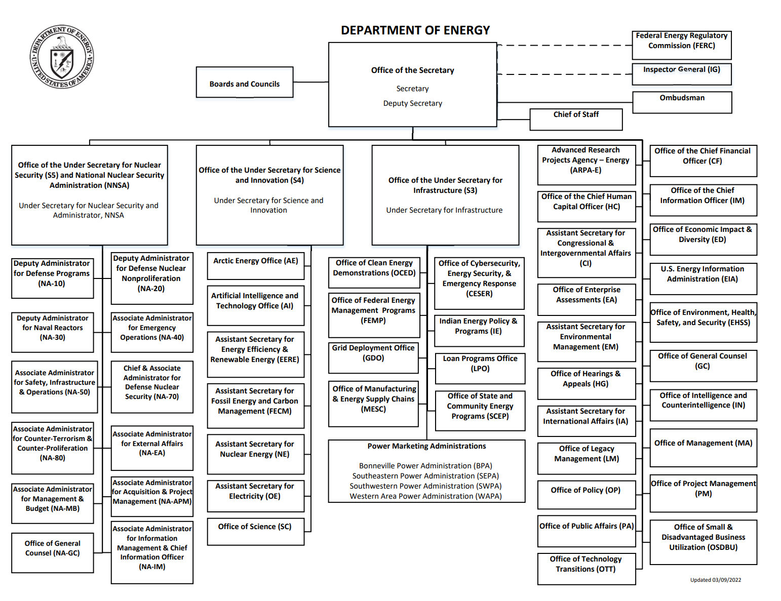
Revision (Writing Team) Sponsors & Leaders
Colette Broussard
Director, Office of ES&H Reporting and Analysis, EHSS-23
Under the Office of Environment, Health, Safety & Security (EHSS)
Ross Natoli
ORPS Program Manager
Office of Environmental Protection and ES&H Reporting
Office of ES&H Reporting & Analysis, EHSS-23
Project endorsed by:
Jeff Feit Technical Standards Program
Manager, EHSS-32
Josh Silverman,
Director, Office of Environmental Protection & ES&H Reporting,
EHSS-20
Special thanks to:
Rizwan Shah
Organizational Culture Advisor, EHSS

Slide 5
Objectives of Revision
To reflect current Human Performance Improvement (HPI) concepts and broaden the scope of the original Standard to effectively support the performance of causal analyses, as well as the investigation and analysis of occurrences required by DOE O 232.2A.
To support and be consistent with the current revision efforts underway of DOE-HDBK-1028-2009 Vols. 1 & 2.
To facilitate the formulation of more effective and consistent causal analyses across the DOE complex:
Identify and understand the causes that contribute to occurrences in order to correct deficiencies
Improve human performance
Promote the values, concepts and benefits of organizational learning throughout DOE

Slide 6
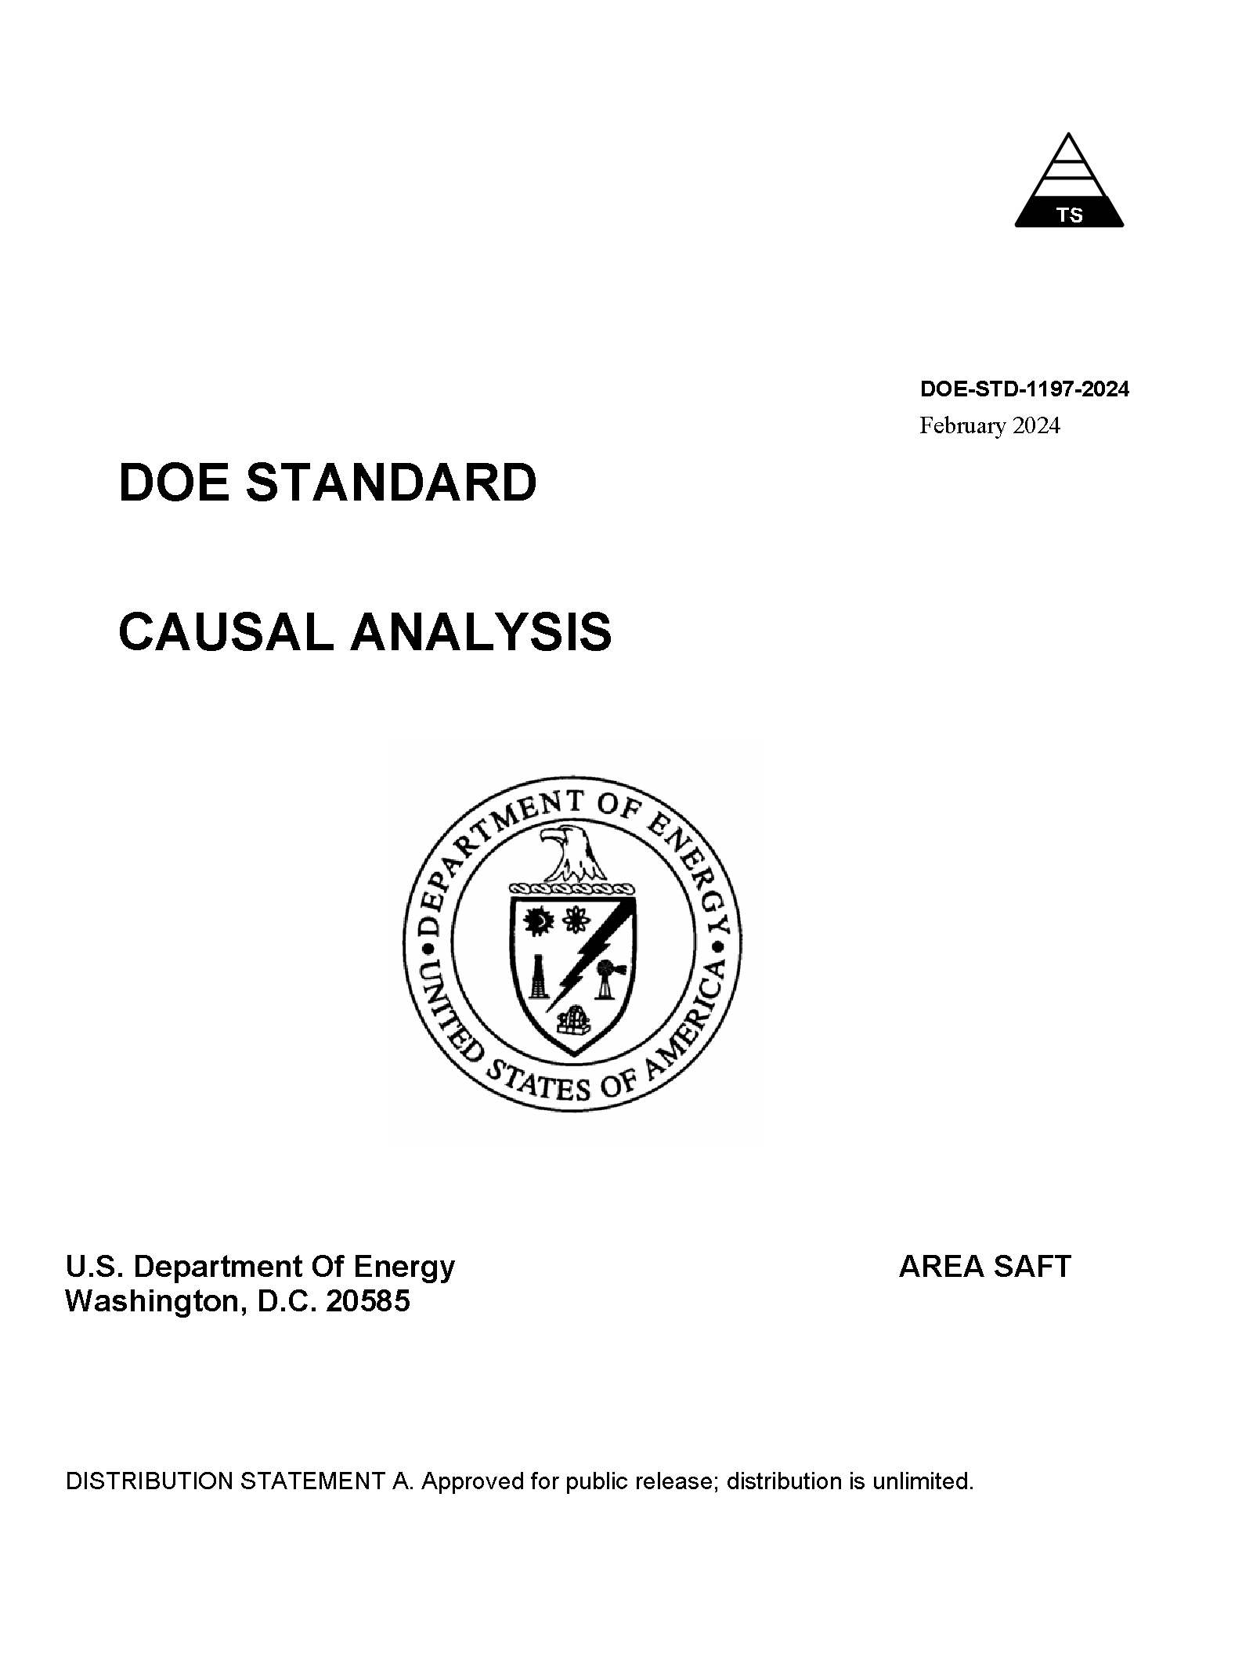
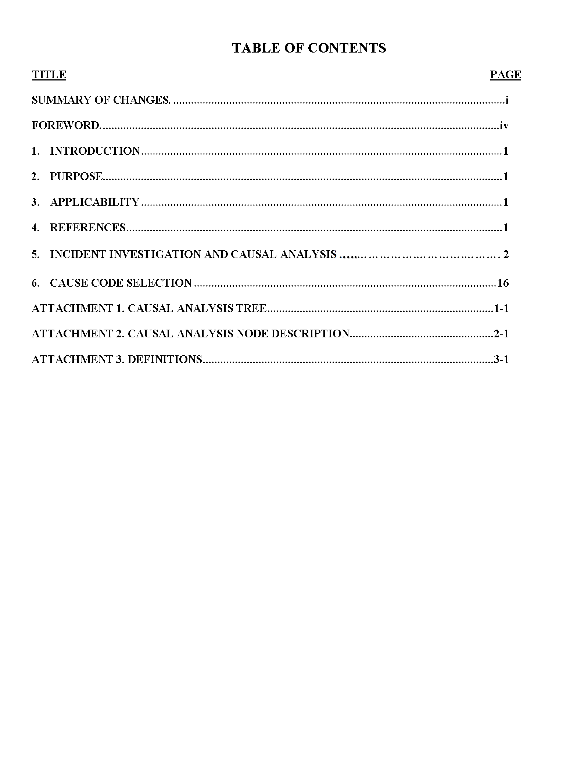
Draft DOE-STD-1197-2024 (June 2024)
DRAFT

Slide 7
Meeting the Objectives
By including accident prevention elements and HPI concepts:
to understand and identify the causes that contribute to accidents so those deficiencies can be addressed and corrected to prevent recurrence,
and assist contractors to responsibly oversee their own work
identify concerns, and
reliably report unexpected adverse outcomes to prevent recurrence.
Changes made throughout to:
Make links/connections between sections of the standard and branches of the CAT.
Provide enough explanation to enable analyst to understand cause codes so they will know when to select them.

Slide 8
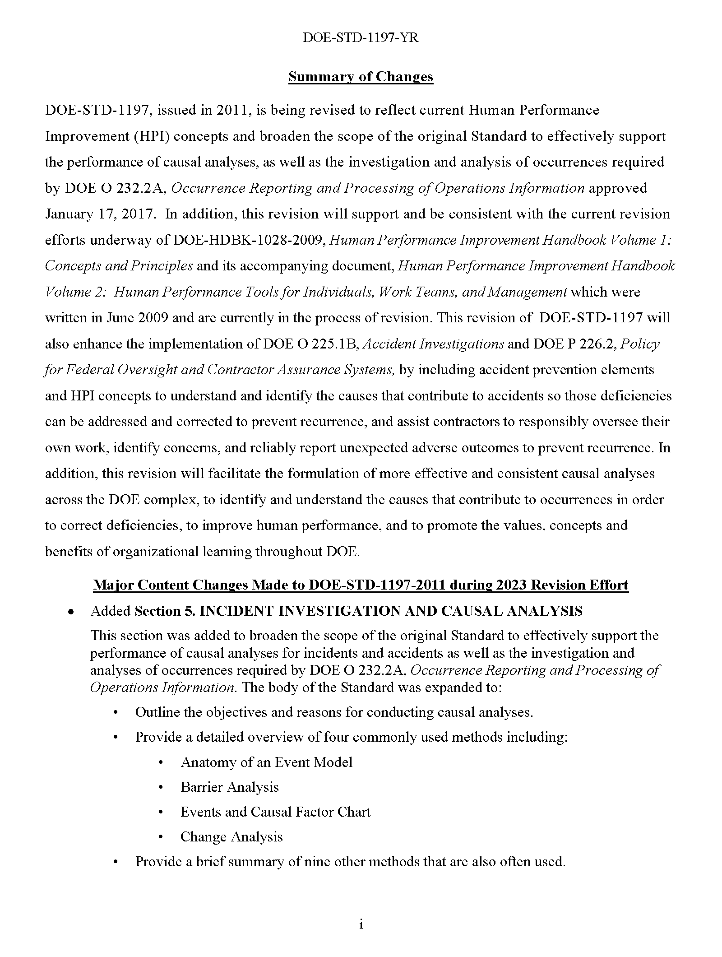
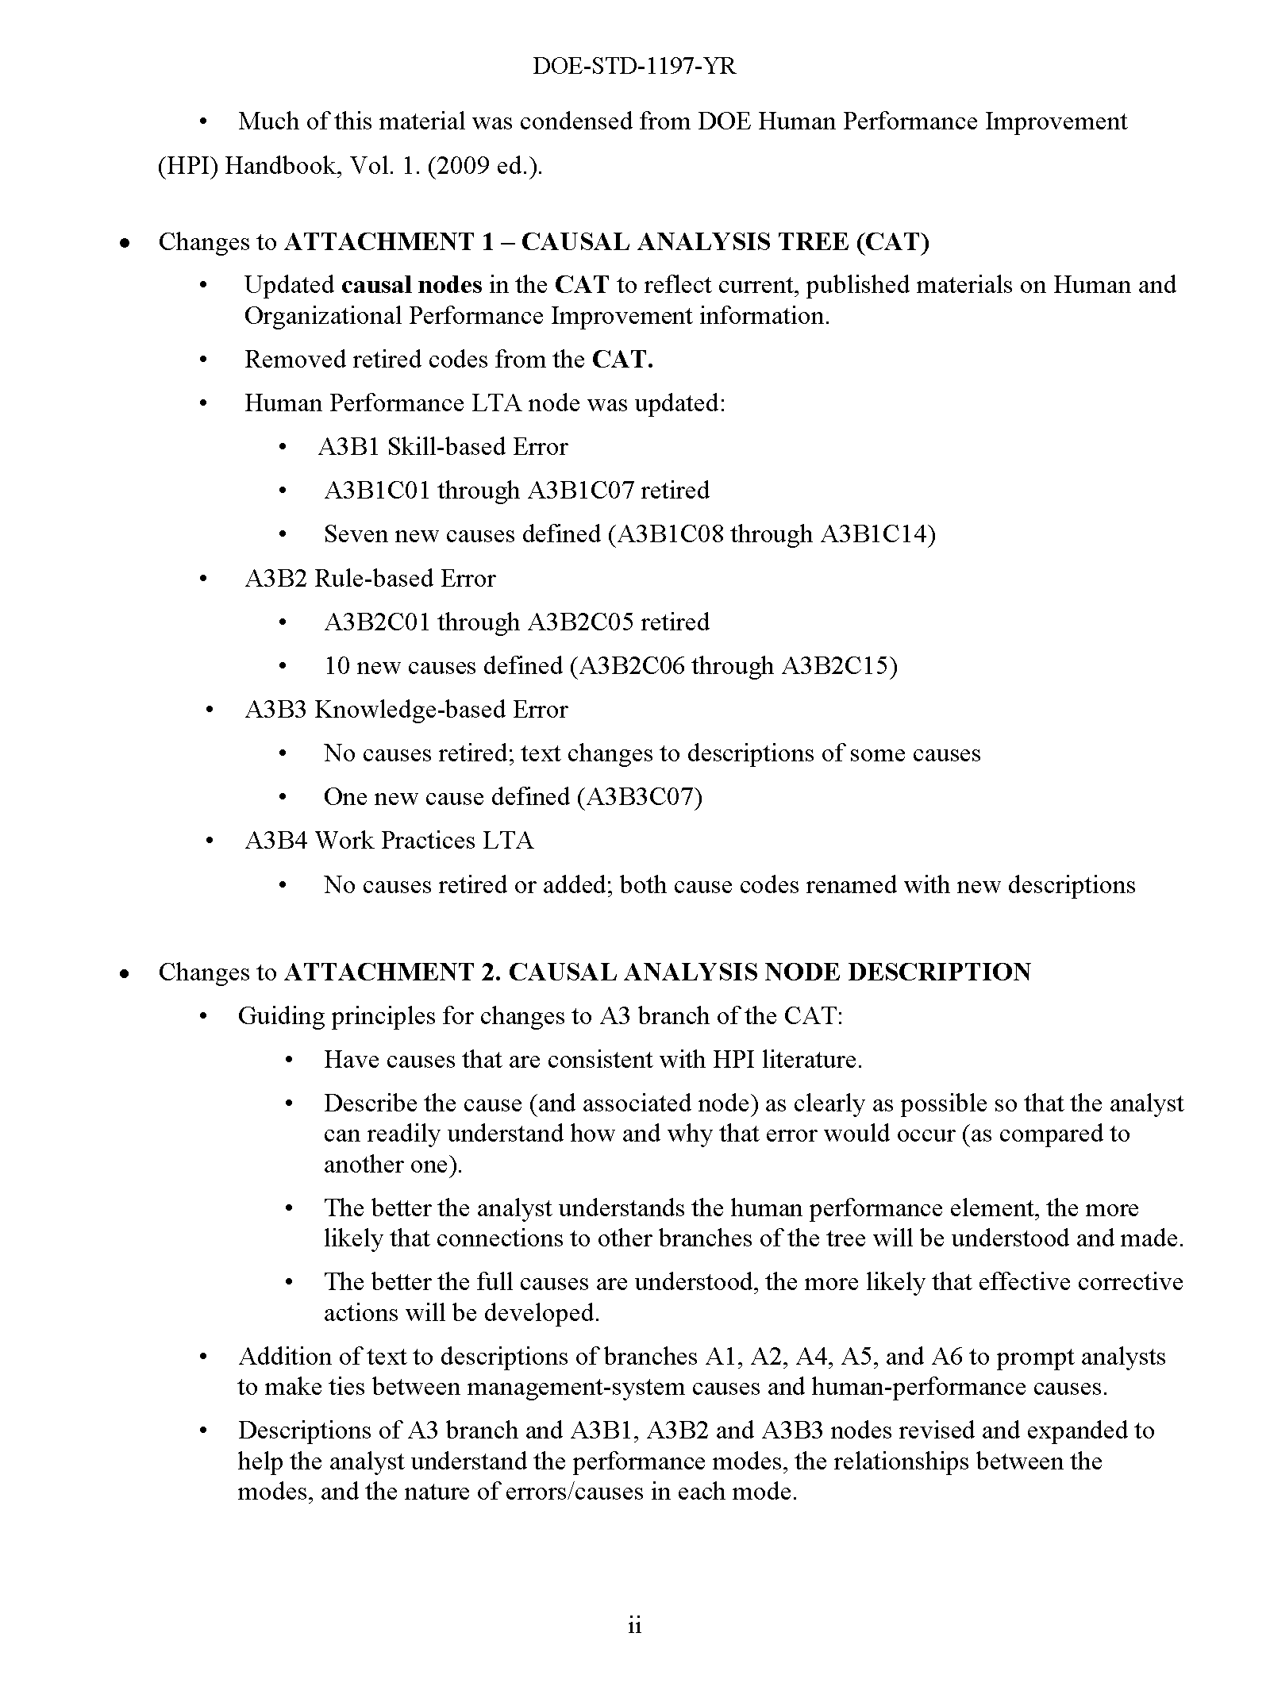
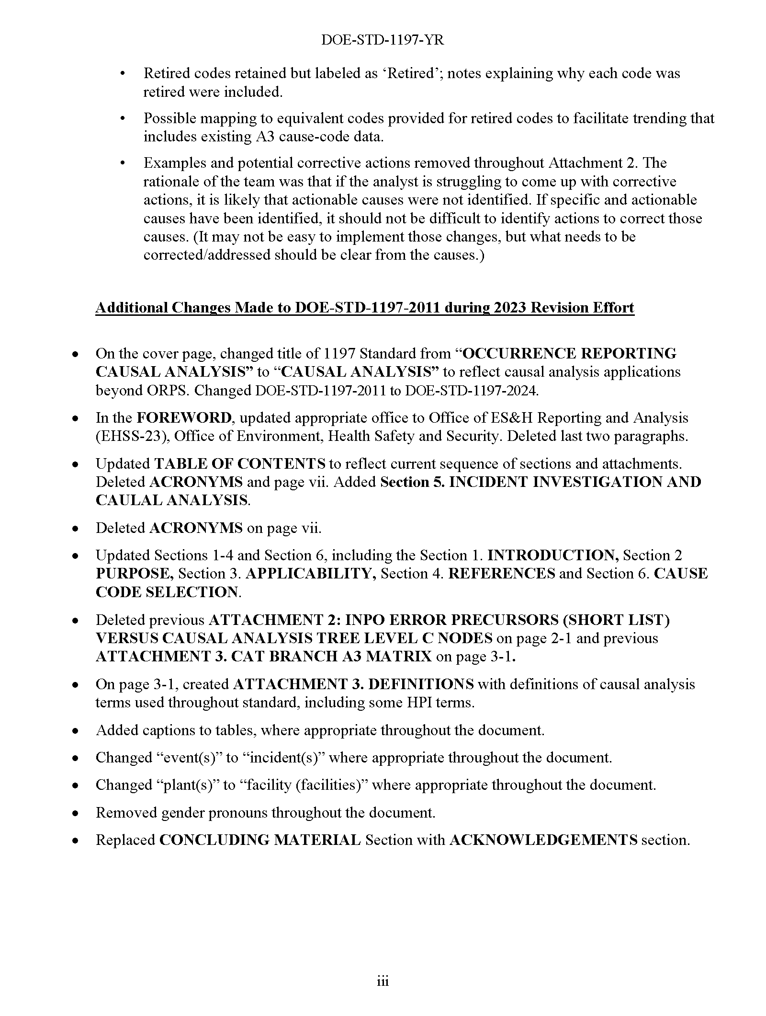
Summary of Changes

Slide 9
Changes and Additions
Expanded standard to include guidance on performing investigation and causal analysis, in addition to the structured list of standard cause codes (tree) to label causes identified during the analysis.
Overview of the goals for, approaches to, and need for a systematic approach in performing causal analysis.
Detailed guidance on four proven methods.
Anatomy of an Event Model
Barrier Analysis
Events & Causal Factors Chart
Change Analysis
Information on nine other frequently-used methods.

Slide 10
Changes and Additions (contd.)
Provided an expanded intro to the entire A3 Branch, to provide overview of human behavior, error, task performance modes, and instructions for relating people-based causes to causes in other parts of the system (coupling), so as to capture a complete “picture.”
Added overview of A3B1, A3B2 and A3B3 nodes to lay a foundation for understanding the general nature of codes in the three modes of performance that people experience when performing recurring tasks.
Added new and revised causes to provide for situations where conditions are different than imagined or planned

Slide 11
5. Incident Investigation & Causal Analysis
Excerpts:
Incident investigations and causal analyses are important learning opportunities that present themselves following an accident or incident. They allow for an exchange of information and provide management and staff the ability to promote collaborative decision making with the opportunity to determine the best path forward to reduce the risk of recurrence or to minimize the consequence of similar incidents in the future. The overarching aim of an incident investigation is to understand and identify the causes (both individual and organizational) that contributed to the accident so those deficiencies can be addressed and corrected.
The decisions and activities of managers and supervisors determine what is done, when it is done, and how well it is done, either contributing to the health of the system(s) or further weakening its resistance to error. Preventing incidents should include the identification and elimination of latent organizational weaknesses by using causal analysis that goes beyond the direct cause (initiating action). This is vital to organizational learning and to strengthening related processes and systems.

Slide 12
Attachment 2 – Changes to A3 Branch
Guiding principles:
Have causes that are consistent with HPI literature.
Describe the cause (and associated node) as clearly as possible so that the analyst can readily understand how and why that error would occur (as compared to another one).
The better the analyst understands the human performance element, the more likely that connections to other branches of the tree will be understood and made.
The better the full causes are understood, the more likely that effective corrective actions will be developed.
Examples and potential corrective actions removed throughout Attachment 2.
If the analyst is struggling to come up with corrective actions, it is likely that actionable causes were not identified.
If specific and actionable causes have been identified, it should not be difficult to identify actions to correct those causes.
It may not be easy to implement those changes, but what needs to be corrected/addressed should be clear from the causes.

Slide 13
Three Levels of Performance (When Learning)
Situations
Routine
Trained-for problems
Novel problems
Control Modes
Conscious Mixed Automatic
Skill-based
Rule-based
Knowledge- based
Skill-based – routine, highly-practiced task carried out automatically with occasional conscious checks on progress
Rule-based – switched to because of change in situation; applies rules on an if-then basis
Knowledge-based – resorted to when rule-based fails (no rule applies); trial and error
Notes:
[Source: Reason, p. 69; based on Jens Rasmussen, “Human errors: A taxonomy for describing human malfunction in industrial installations,” Journal of Occupational Accidents, 4, 1982, pp. 311-333.]
These performance levels are not mutually exclusive. All three can coexist at the same time. However, this view depicts the relationship between attention to task performance and familiarity with the task in the way that humans learn.
When a situation is new, we can only perform based on our knowledge.
As a person gains knowledge and experience, he learn rules that help him govern his behavior in a given situation.
Eventually, through practice and repetition, she can develop the ability to perform the task automatically, without consciously thinking about how to do what he wants to do. Habits and skills are interrelated, and are developed in the same way.
Training programs are usually a combination of classroom and practical training where a person gains the knowledge, skills and abilities needed to perform the tasks that pertain to a specific job. Eventually, a person becomes skilled and can perform tasks successfully without supervision.

Slide 14
Performance Modes (Task Mastery Achieved)
% Actual error
15%
60%
25%
Chance for error
1 : 2
1 : 1,000
1 : 10,000
High
Uncertainty
Knowledge-based
Patterns
Attention (to task)
Rule-based
Change
Inaccurate
Mental Picture
If - Then
Skill-based
Misinterpretation
Automatic
Low
Low
Familiarity (with task)
Inattention
High
Notes:
[Source: Reason, James. Human Error, 1990, p. 56; cited in Human Performance Fundamentals Course Reference, Institute of Nuclear Power Operations (INPO), Rev. 6 (December 2002), p. 28]
(This figure and related concepts are discussed in greater detail in Human Performance Improvement (HPI) Fundamentals training – Course #HPI Fund.)
Here is a brief review of the three performance modes:
Skill-based refers to the way humans carry out routine, highly-practiced tasks in a largely automatic fashion with occasional conscious checks on progress. This type of failure was not consciously made.
Rules in this context are simpler and include much more than just formal procedures, policies and other types of written requirements. Management expectations, supervisor preferences, and company/corporate culture etc. are examples of other types of rules that influence workers’ behavior. We will discuss rule-based behavior in more detail a little later.
Knowledge is gained in a number of ways. Though much of task-related knowledge is gained through formal means, workers also gain knowledge from on-the-job experience, co-workers and supervisors.
The graph in this slide is the same as depicted in the “Three Levels of Performance” graph we saw earlier, but the axes are inverted. This view shows how trained and qualified (i.e. skilled) workers normally perform their tasks. However, when a change occurs, the person switches to rule-based mode. If no rule applies, then the person switches to knowledge-based mode. Notice that the error rate (or chance of making an error) increases exponentially up the scale. As you can see, it is preferred that individuals be able to work in skill-based mode as much as possible, because the potential for errors is much lower.
When an error occurs that results in a negative consequence, it becomes important to try to determine in which performance mode the error occurred before determining causes, and subsequently, in determining corrective actions.

Slide 15
A3 Description (excerpt)
A3 Human Performance Less Than Adequate (LTA)
To be comprehensive, causal analysis must identify all elements of a situation that were causal to the incident or condition being analyzed, as well as to its consequences. Therefore, the analysis must evaluate both the behaviors of people involved, as well the latent weaknesses in the organization that contributed to the situation. The behaviors and actions of individuals in the incident sequence cannot be viewed in isolation, but must be considered in the context of the situation as it existed at the time, and as it was viewed and understood by those people in that situation as it unfolded. To be effective, causal analysts should keep the following principles in mind:
Focus on what could have prevented any errors and their consequences, rather than who caused the incident.
Build context by identifying for each individual what they were trying to accomplish (goals), what they were paying attention to (focus), and what each person knew at critical points in the sequence of events (knowledge).
Evaluate connections or relationships between the effects or consequences of any actions of people with the designs, materials, processes, instructions, training, and other elements of the overall management system that could have prevented those actions or mitigated their consequences.

Slide 16
A3B1 Description
A3B1 – Skill-based Error
Skill-based performance is behavior associated with highly-practiced actions in a familiar situation usually executed from memory without significant conscious thought and with only intermittent checks on progress by conscious attention. Skill-based errors are commonly referred to as slips or lapses. A slip is a physical action different than was intended. A lapse is an error due to a failure of memory or recall. Also included in this node are perceptual errors, which occur when a person misrecognizes some object or situation, in large part due to expectation and habit.
Performance of a task often involves a person doing several things simultaneously, such as with their hands, feet, eyes and ears when driving a car or playing a piano. Once the person has mastered the skill, physical movements are controlled subconsciously, and so conscious attention is focused on higher-level aspects of the task, such as finesse, smoothness of movements, timing and rhythm, as well as confirming expected conditions, and monitoring of changes in conditions in the environment that might impact execution. Events in the environment may automatically trigger (activate) an action, but internal thoughts (and memories) can also trigger an action or interrupt the flow of execution of actions.

Slide 17
A3B2 Description
A3B2 – Rule-based Error
People switch back and forth from skill-based to rule-based performance mode when they notice a need to modify their largely pre-programmed behavior, because they have to take into account some change in the situation; i.e., (if this, then do that). A rule-based error is one type of what is commonly called a mistake (e.g., not a lapse of memory).
Rule-based mistakes are errors that were committed because the intent of the act was incorrect for the work situation, typically defined by the condition of the physical work environment or an object in it that the work involves. The error is often misapplication of a “good” rule or application of a “bad” rule during the execution of work. Note that “rule” as used here is not limited to written instructions and procedures – rules are often learned as a result of personal experience, interaction with the facility or equipment, formal training, or by working with experienced workers, as well as from the local and general organizational culture. “Good” as used here merely means that, for the individual involved, the rule has been proven to be useful in a particular situation; “bad” in this context can range from the ‘just plain wrong’ to those that may simply result in clumsy, inelegant or inefficient, yet successful, performance.
Although the actual structure and hierarchy of a person’s rules framework is very specific to the individual, in general, multiple rules can be active (available for selection) at a given stage of task execution, along with, for each rule, associations to various situations, as well as exceptions to when the rule would apply ­– the variety and complexity of which are a function of retention and experience.

Slide 18
A3B3 Description
A3B3 – Knowledge-based Error
Knowledge-based errors are another type of mistake, and occur during response to what is, or has become, a totally unfamiliar situation – no skill, rule or pattern is recognizable to the individual. These errors occur during continued problem-solving that relies on personal understanding and knowledge of the system, the system’s present state, and the scientific principles and fundamental theory related to the perceived situation at hand. Knowledge-based errors can occur in situations where the individual realizes that none of their repertoire of rule-based solutions is adequate to cope with the problem; this is especially true in industrial settings when operators respond to abnormal situations and have realized that further analytical reasoning is needed.
The inability of the individual to pause or stop performance of a task contributes to the probability of a knowledge-based error occurring. For example, in continuous-control tasks, adverse incidents may continue to progress regardless of the actions of operators. On the other hand, with non-paced tasks such as maintenance, a person who encounters a novel situation which requires knowledge-based problem solving is in the position of being able to stop and think about it, or refer to a colleague for help.

Slide 19
Changes to A3 Branch (contd.)
A3 Human Performance LTA updated
A3B1 Skill-based Error
A3B1C01 through A3B1C07 retired
7 new causes defined (A3B1C08 through A3B1C14)
A3B2 Rule-based Error
A3B2C01 through A3B2C05 retired
10 new causes defined (A3B2C06 through A3B2C15)
A3B3 Knowledge-based Error
No causes retired; text changes to descriptions of some causes
1 new cause defined (A3B3C07)
A3B4 Work Practices LTA
No causes retired or added; both cause codes renamed with new descriptions

Slide 20
Changes to A3 Branch (contd.)
Retired codes removed from CAT, but retained in Attachment 2 labeled as ‘Retired’; note provided explaining why each code was retired.
List of codes that could be used as equivalent for trending/analysis if site dataset includes existing A3 cause-code data

Slide 21
Changes to A3 Branch (contd.)
New codes in A3B2 (Rule-based) and A3B3 (Knowledge-based) provide more codes to address a broader range of workplace situations
Limited latitude to fully revise A3B4 (Work Practices LTA) due to related enforcement reporting requirements (10 CFR 820.111)

Slide 22
Workplace Situations
No situation is exactly the same. While a task may be performed frequently, each time there will be some variation in the conditions that exist. The differences are often minor from one instance to another, but a situation may arise that interrupts the modes of performance and drives conscious decisions.
In a number of different scenarios (including troubleshooting, off-normal or emergent situations), a person may take a course of action because it was thought to be the best feasible option given the circumstances in which they found themselves.
It most often occurs that the situation drove the person to a decision point and they believed that the course of action chosen, though possibly different than prescribed, was the best thing to do in that circumstance.
Humans are logical creatures. In the pursuit of determining causal factors, it is vital to determine why people did what they did and why it made sense to them at the time.

Slide 23
Linking the CAT Branches
Guidance added to facilitate coupling of A3 cause codes with other codes from other branches (and vice versa), a complete “picture” of the cause may be captured. This provides for getting beyond apparent causes.
A1 Design / Engineering Problem
… Causal analysis should consider what A3 human performance codes may be coupled with the codes in this branch to more fully explain how the design deficiency resulted and/or was not detected during the review/verification steps of the design process.
A2 Equipment / Material Problem
… Causal analysis should consider what A3 human performance codes may be coupled with the codes in this branch to more fully explain how the deficiency or problem with the equipment/material occurred or was not detected previously in the processes for procurement, testing, inspection, acceptance, storage, maintenance, or periodic checks of the equipment/material.
A6 Training Deficiency
… Causal analysis should consider what A3 human performance codes may be coupled with the codes in this branch to more fully explain, for example, how the training deficiency resulted and/or was not detected during a stage of the training process, etc.

Slide 24
Linking the CAT Branches (contd.)
Some new A3 branch cause codes prompt the analyst to consider contributing factors that lie in other branches of the CAT.
A3B2C15 – Wrong rule selected during assessment of situation – … the wide range of factors that can influence the selection of such rules by an individual, including desire (or impetus) to complete the task (get the job done), prior training (formal) and/or coaching (informal), experience, management expectations, cultural norms within a trade, discipline, or organization, how recently “good” or “right” rules were reinforced, etc.
A3B3C07 – Nonconformance with requirements made when person believed it was best feasible option – … as specified in operational procedures, formal rules, standards, training, etc., …

Slide 25
Schedule for Issuance
Draft currently in RevCom, the online review, comment, and approval system for draft DOE Directives (including Technical Standards).
60-day comment period ended on April 29.
Draft currently in the 30 day comment resolution period ending May 29 (can be extended, if needed, upon request to Technical Standards Program Manager).
Planned finalization/issuance in June 2024

Slide 26
Objectives Met
Project goal was to include human performance concepts so as to understand and identify the causes that contribute to incidents so those deficiencies can be addressed and corrected to reduce risk of recurrence.
Expanded standard to include guidance on investigation, causal analysis, and analysis methods.
Revised standard should effectively support the performance of causal analyses, as well as the investigation and analysis of occurrences in the DOE complex, as well as by many other industries who also use this standard.

Slide 27
Supplemental Information

Slide 28
A3B1 Skill-based Error
All New!
C08 Description error – action performed on wrong object
C09 Automatic action caused by external trigger
C10 Intrusion of internal thoughts or associations
C11 Loss of cue that initiated action
C12 Action wrong due to different device mode
C13 Routine action took over unfamiliar activity
C14 Improper sequence of actions performed

Slide 29
A3B2 Rule-Based Error
All New!
C06 Strong rule misapplied during first encounter of exception to rule
C07 Indication of exception to rule not recognized or acknowledged
C08 Strong rule selected over weak rule during assessment of situation
C09 Common indicator chosen over uncommon indicator as basis for course of action
C10 Previously-successful solution selected despite limited number or variety of situations experienced
C11 Previously-successful solution favored over other available solutions
C12 Misapplication of rule during learning stage
C13 Misapplication of rule due to misunderstanding of underlying principles
C14 Application of rule without consideration of limitations or risks in dissimilar situations
C15 Wrong rule selected during assessment of situation

Slide 30
A3B3 Knowledge-based Error
C01 Attention was given to wrong issues
C02 LTA conclusion based on sequencing of facts
C03 Individual justified action by focusing on biased evidence
C04 LTA review based on assumption that process will not change
C05 Incorrect assumption that a correlation existed between two or more facts
C06 Individual underestimated the problem by using past events as basis
C07 Nonconformance with requirements made when person believed it was best feasible option
New!

Slide 31
A3B4 Work Practices LTA
C01 Erroneous performance due to limitations of an individual
C02 Intentional violation
A3B4C01 was revised to focus on the error(s) or lack of success in task performance, not on the individual
A3B4C02 was slightly renamed; focus is on misconduct that had an intended, possibly damaging or harmful outcome; provides for reporting of violations required by 10 CFR 820.11(b)
A3B3C07 added to A3B3 node provide for situations where nonconformance (“violation”) did not intend damaging or adverse consequences
Renamed!
Renamed!

Slide 32
Example of Retired Code
[Retired] A3B2C02 – Signs to stop were ignored and step performed incorrectly
Retirement Note: This cause has been retired because it can lead to using “hindsight bias” as a basis for evaluating the individual’s behavior. A sign or indicator that performance of the task “should” have been stopped would first need to be observed, and then recognized as such because a rule exists in the individual’s mental rules framework associating that indicator with that rule. Causal analysis would also need to ascertain if criteria have been established for the task with some level of formality that dictate when the task is to be stopped for such to be considered an error (or possibly a violation).
A3 Codes That Could Be Used as Equivalent for Data Analysis:
Common indicator chosen over uncommon indicator as basis for course of action
Previously-successful solution selected despite limited number or variety of situations experienced
Application of rule without consideration of limitations or risks in dissimilar situations

