Slide 1
Laying the Groundwork for discussing Incorporating Business Assurance into CAS
Presented by Paul Gubanc, AECOM N&E
N&E Performance Assurance Functional Area Coordination Team (PA FACT) Chair
May 2019

Slide 2
Outline of CAS Working Group Session #1 on Incorporating Business Assurance into CAS
Time | Topic | Speaker
0730 - 0745 | Introductions & Safety Share | Paul Gubanc, AECOM
0745 - 0815 | Laying the Groundwork Inventory of assessing orgs Comparison of drivers & standards Overlaps and opportunities | Paul Gubanc, AECOM
0815 - 0830 | Additional perspectives | Omar Cardona, SRNS
0830 - 0930 | Open discussion | All
0930 - 0945 | Distillation of key takeaways | Gubanc & Cardona
1300 - 1400 | Wrap up session (back in Room 304)

Slide 3
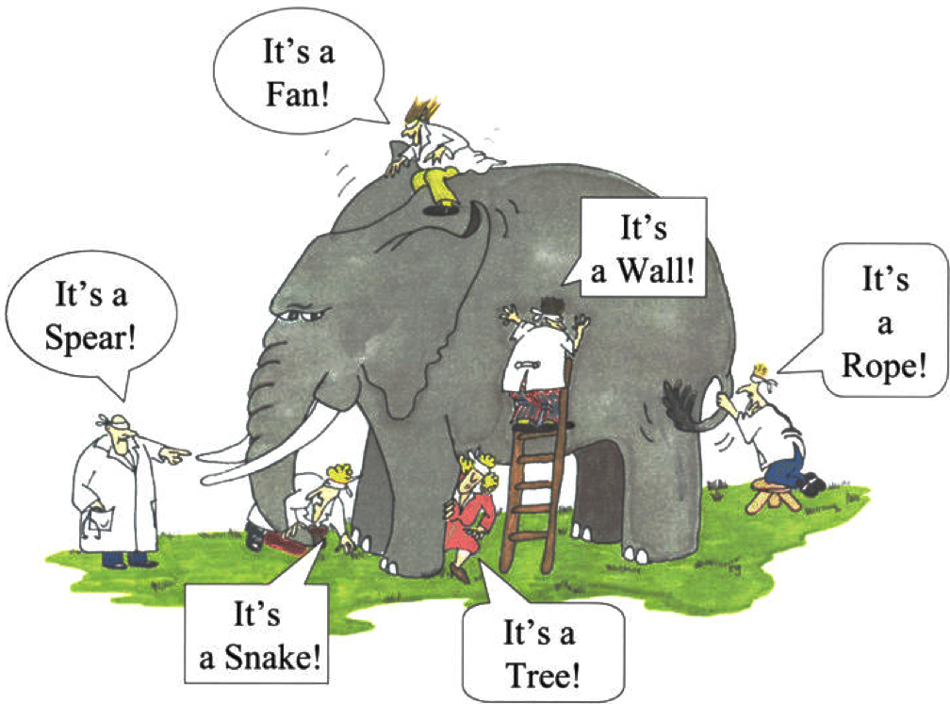
Introductions & Safety Share

Slide 4
The CAS & Business Assurance Nexus
DOE P 226.2, POLICY FOR FEDERAL OVERSIGHT AND CONTRACTOR ASSURANCE SYSTEMS, issued 9Aug2016, “expands the scope of CAS beyond the environment, safety, security, and health areas to include business and financial systems…”
DOE has not yet revised DOE O 226.1B, IMPLEMENTATION OF DEPARTMENT OF ENERGY OVERSIGHT POLICY, issued 25Apr2011 to align.
Blurring the demarcation between CAS and business assurance processes creates the potential for confusion, conflict and duplication.

Slide 5
Laying the Groundwork
In 2016, AECOM N&E established a holistic understanding and common framework for Business Assurance & CAS
Organizations who conduct assessments or play key roles:
Quality Assurance
Performance Assurance/Contractor Assurance
Project Management
Risk Management
Internal Controls
Internal Audit
Each has different drivers, standards, communities of practice, DOE DEAR clauses, Orders, and reporting req’ts

Slide 6
Quality Assurance
Initiator – Pressure vessel, construction & nuclear safety
COP – American Society of Mechanical Engineers (ASME) and American Society for Quality (ASQ)
Key Std – ASME NQA-1 and ISO 9000
Key Reg – 10CFR830 Subpart A (QA Rule, 10 criteria)
DOE – DOE O 414.1D, DEAR 970.0370, DEAR 970.5203-1
Stakeholders – LLC Mgmt and DOE EHSS

Slide 7
Performance Assurance/Contractor Assurance
Initiator – DOE ES&H and Integrated Safety Management
COP – Energy Facilities Contractors group (EFCOG)
Key Std – N/A
Key Reg – N/A
DOE – DOE O 226.1B, DEAR 970.5223-1
Stakeholders – LLC Mgmt and DOE EHSS

Slide 8
Project Management
Initiator – Construction project management
COP – Project Management Institute (PMI)
Key Std – PMI Project Mgmt Book of Knowledge (PMBOK)
Key Reg – N/A
DOE – DOE O 413.3B
Stakeholders – LLC Mgmt & Project Managers, and DOE Office of Project Management (and DOE Line PM offices)

Slide 9
Risk Management
Initiator – insurance industry, later public investor protection
COP – Casualty Actuarial Society (CAS)
Key Std – ISO 31000
Key Reg – Sarbanes-Oxley Act of 2002 (SOX)
DOE – DOE G 413.3-7A (Risk Mgmt Guide)
Stakeholders – LLC Mgmt & Project Managers, and DOE Office of Project Management (and DOE Line PM offices)

Slide 10
Internal Control
Initiator – Fraudulent financial reporting (1970/1980’s)
COP – Committee of Sponsoring Organizations (COSO) of the Treadway Commission (formed 1985, w/ reps from AICPA, AAA, FEI, IIA, and IMA)
Key Std – COSO Integrated Frameworks: Enterprise Risk Management (2004) and Internal Control (2013)
Key Reg – SOX, Federal Managers Financial Integrity Act (FMFIA), GAO Standards for Internal Control (Green Book), and OMB Circular A-123, Management’s Responsibility for ERM and Internal Control
DOE – DOE O 413.1B, DEAR 970.5232-7, DEAR 970.5232-8
Stakeholders – LLC Mgmt and DOE Chief Financial Officer

Slide 11
Internal Audit
Initiator – Expansion of corporate businesses in 1940’s
COP – Institute of Internal Auditors (IIA)
Key Std – IIA international Professional Practices Framework (IPPF) and IIA Common Body of Knowledge (CBOK)
Key Reg – FAR Part 42 and 48CFR52 §52.203-12
DOE – FAR 52.216-7, DEAR 970.5203-1, DOE Acquisition Guide
Stakeholders – LLC Board and DOE Office of Acquisition Management (MA-60)

Slide 12
Groundwork Takeaways
Recognize/acknowledge the differences
Initiating conditions, areas of emphasis, codes & standards, communities of practice, stakeholders, reporting requirements.
Nomenclature! Similar terms may hold different connotations.
Identify areas of common purpose and need
Risk-based, annual assessment planning & delivery, LLC health, integration & efficiency, effective reporting, demonstrating value
Coalesce around collaboration opportunities
Realize existing constructs don’t enable integration
Use a common ERM tool at each LLC
Sharing of assessment results and coordination of planning activities can offer full coverage while minimizing unproductive duplication

Slide 13
Additional Perspectives – Omar Cardona, SRNS
Integration of traditional CAS with Business Enterprise
Seek Improvement and opportunities via integration of methodologies and unified mindset
Already sharing key attributes:
Self Critical
Open to Internal/External Assessments, Risk Based
Continuous Improvement
Governance
Performance Metrics
But Integration Needs to Expand and Is Moving Towards Further Integration

Slide 14
Additional Perspectives – Omar Cardona, SRNS

Slide 15
Open Discussion
Has anyone defined/inventoried their LLC’s “business assurance” processes, who manages them and how they currently intersect with your CAS processes?
Local or corporate drivers that are pushing for CAS & business assurance integration? Goals & benefits?
What would be helpful to you from an EFCOG perspective?

